Slide 1
Wh-island effects and d-linking effects across languages
Zheng Shen and Beth Chan
Singapore Summer Meeting 2024

Slide 2
Background: Wh-island effects in wh-movement
Moving a bare wh-element out of an embedded question is degraded.
*What_{i} did Mary wonder [ whether Sarah bought t_{i} ]?

Slide 3
D-linking effects in wh-movement
Moving a d-linked wh-element out of an embedded question is better.
?Which book_{i} did Mary wonder [ whether Sarah bought t_{i} ]?

Slide 4
Syntactic analysis: featural Relativized Minimality (fRM)
Complete feature overlap between the probe and the intervening wh => bad
3. a. C did the waiter wonder whether the chef burned what?
[+Q] [+Q] [+Q]
b. What C did the waiter wonder whether the chef burned t?
[+Q] [+Q] [+Q]
Partial overlap/inclusion => better
4. a. C did the waiter wonder whether the chef burned which dish?
[+Q, +N] [+Q] [+Q, +N]
b. which dish C did the waiter wonder whether the chef burned t?
[+Q, +N] [+Q, +N] [+Q]

Slide 5
Processing analysis for d-linking effect
The amelioration effects of d-linked wh-element come from its complexity.
What do you think he read?
Which book do you think he read?
What do you wonder whether he read?
Which book do you wonder whether he read?
Hofmeister and Sag 2010: Sentences with d-linked elements are easier to process because the lexical information facilitate filler retrieval at the gap.
Or if you speak Ainese: people predict the verbs like ‘read’ because of ‘which book’
It would predict that the acceptability of both (6) and (8) improves.

Slide 6
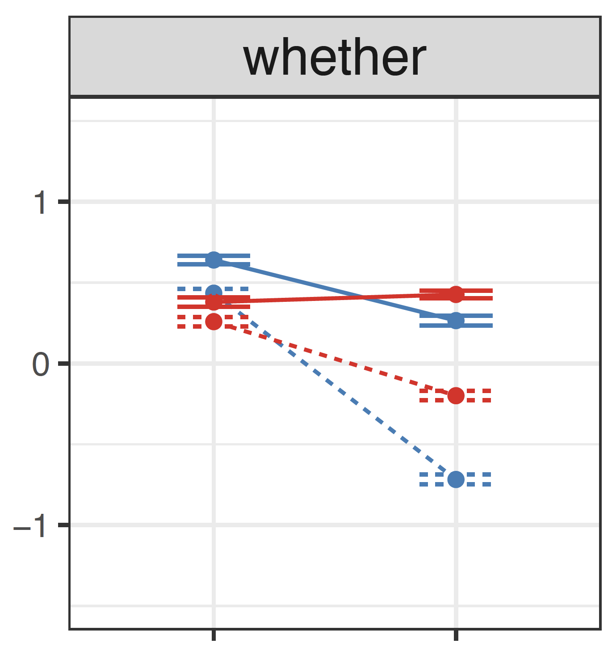
Previous experiments in wh-movement in American English
Villata and Sprouse 2023: (see also Villata, Franck, Rizzi 2016) dependency length*island*wh-type
9. Bare wh
a. Who thought that the chef burned the dish? (bare | no-island | short)
b. Who wondered whether the chef burned the dish? (bare | island | short)
c. What did the waiter think that the chef burned? (bare | no-island | long)
d. What did the waiter wonder whether the chef burned? (bare | island | long)
10. d-linked wh
a. Which waiter thought that the chef burned the dish? (d-linked | no-island | short)
b. Which waiter wondered whether the chef burned the dish? (d-linked | island | short)
c. Which dish did the waiter think that the chef burned? (d-linked | no-island | long)
d. Which dish did the waiter wonder whether the chef burned? (d-linked | island | long)
Partial amelioration: still wh-island effects but also a d-linking effect
Surprising for the processing approach: the d-linking effect is bigger in island conditions
short
long

Slide 7
Research questions
Cross-linguistic variation of wh-island effects and d-linking effects?
Wh-movement in Colloquial Singapore English (Singlish)
These two effects in wh-in situ?
Wh-in situ in Singlish and data in Chinese (from Chen 2024)

Slide 8
Exp 1: wh-movement in American English (n = 41)
Replicate Villata & Sprouse’s results
7. a. Who said that Liam organised the event? (bare-noisl-short)
b. Who wondered whether Liam organised the event? (bare-isl-short)
c. What did the director say that Liam organised? (bare-noisl-long)
d. What did the director wonder whether Liam organised? (bare-isl-long)
e. Which director said that Liam organised the event? (dlink-noisl-short)
f. Which director wondered whether Liam organised the event? (dlink-isl-short)
g. Which event did the director say that Liam organised? (dlink-noisl-long)
h. Which event did the director wonder whether Liam organised? (dlink-isl-long)

Slide 9
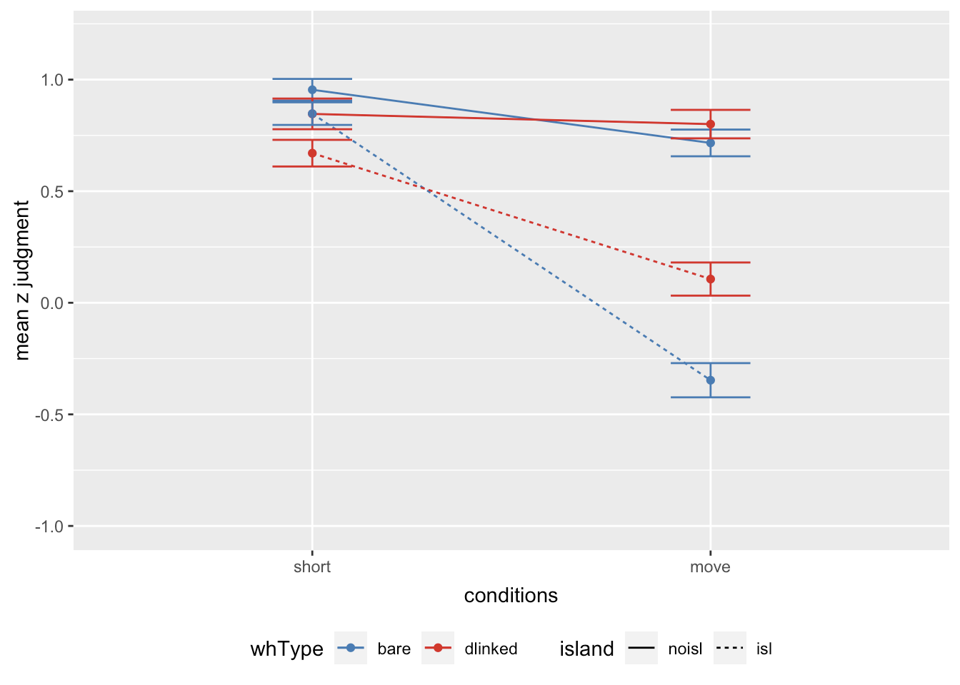
Exp 1: wh-movement in American English
Three way interaction (t = -2.57, p = .01): d-linking effects
Dependency length * island ( t = -8.88, p < .0001): wh-island effects
Bare wh: t = - 7.447, p < .0001
D-linked wh: - 4.046, p < .001
The results are pretty much identical to Villata and Sprouse
short
long

Slide 10
Exp 2: wh-movement in Colloquial Singapore English (n = 81):
the same design in Singlish (but also with wh-in situ, reported later)
12. a. Who say that Sean organise the event ah? (bare-noisl-short)
b. Who want to know whether Sean organise the event ah? (bare-isl-short)
c. What the director say that Sean organise ah? (bare-noisl-long)
d. What the director want to know whether Sean organise ah? (bare-isl-long)
e. Which director say that Sean organise the event ah? (dlink-noisl-short)
f. Which director want to know whether Sean organise the event ah? (dlink-isl-short)
g. Which event the director say that Sean organise ah? (dlink-noisl-long)
h. Which event the director want to know whether Sean organise ah? (dlink-isl-short)

Slide 11
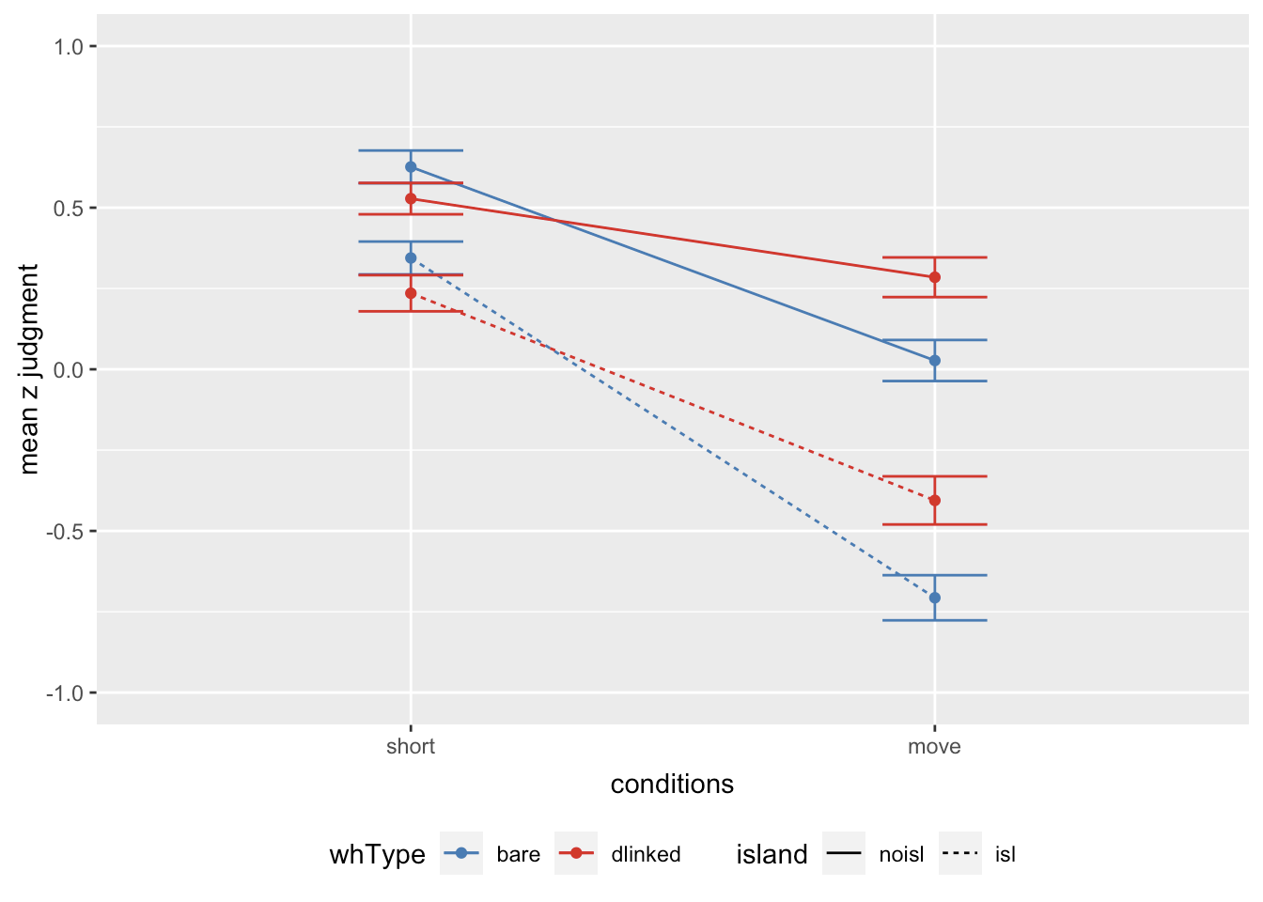
Exp 2: wh-movement in Colloquial Singapore English
No three way interaction (t = -0.32, p = 0.75): island effects did not reduce with d-linked wh
Dependency length * island (t = -3.93, p < .001): wh-island effects
Bare: t = -3.232, p < 0.01
D-linked: t = -3.179, p < 0.01
Wh type * dependency length : (t = 3.85, p < 0.001): d-linking improve long conditions regardless of embedded constructions
Singlish

Slide 12
Analysis: lack of partial amelioration in Singlish
Proposal: The attracting feature for d-linked wh-elements in CSE is [+Q], not [+Q, +N], thus no d-linking amelioration effects.
13. NAE: C the waiter wonder whether the chef burned which dish?
[+Q, +N] [+Q] [+Q, +N]
14. Singlish: C the waiter wonder whether the chef burn which dish ah?
[+Q] [+Q] [+Q, +N]
I don’t know where to look for independent evidence for such distinction.
Villata et al 2016 argued for d-linked elements involving [+Q, +N] because they can appear in different positions as bare wh-elements (in Italian dialects, European Portuguese, Norweigen dialects, Bavarian, Romanian). Maybe look for such differences in English and show that these differences don’t exist in Singlish.

Slide 13
Analysis: d-linked wh elements improve both long conditions
D-linking effects on long conditions result from the processing analysis for d-linked wh-elements (Hofmeister and Sag 2010, Goodall 2015, Villata et al 2016, among others)
Maybe such effect is universal but are masked in English by the partial amelioration effect.
Singlish does not have that syntactic effect, so the processing effect can be seen.
Villata and Sprouse p.c.: pseudo Ns in d-linked wh: Which glob do you think Sue read?
Prediction: the improvement in Singlish should basically disappear. OR: Which book do you think Sue burnt?
Singlish

Slide 14
Summary of d-linking effects in wh-movement
Two effects of d-linked wh in wh-movement:
D-linking amelioration on wh-movement is subject to cross-linguistic variation.
The fRM analysis: in some languages [+N] does not participate in wh-movement (e.g. Singlish).
D-linking effects on long conditions are present in Singlish (and possibly also English)
Hofmeister and Sag 2010: d-linked wh-elements are easier to process in wh-dependency
D-linking amelioration is a grammatical effect while d-linking effects on long distance dependency are processing-based.

Slide 15
Wh-island effects and d-linking effects in wh-in situ questions
Huang 1982: No wh-island effects in Chinese. (15a can be answered with either b or c).
15. a. ni xiang-zhidao [shei mai-le shenme]?
you want-know who buy-ASP what? “You wonder who bought what?”
b. Wo xiang-zhidao Lisi mai-le shenme.
I want-know Lisi buy-ASP what “I want to know what Lisi bought.”
c. Wo xiang-zhidao shei mai-le shu.
I want-know who buy-ASP book. “I want to know who bought books.”
Yang et al. et al. 2021: wh-island effects exist, but bare wh in (15a) can be interpreted as d-linked in Chinese.

Slide 16
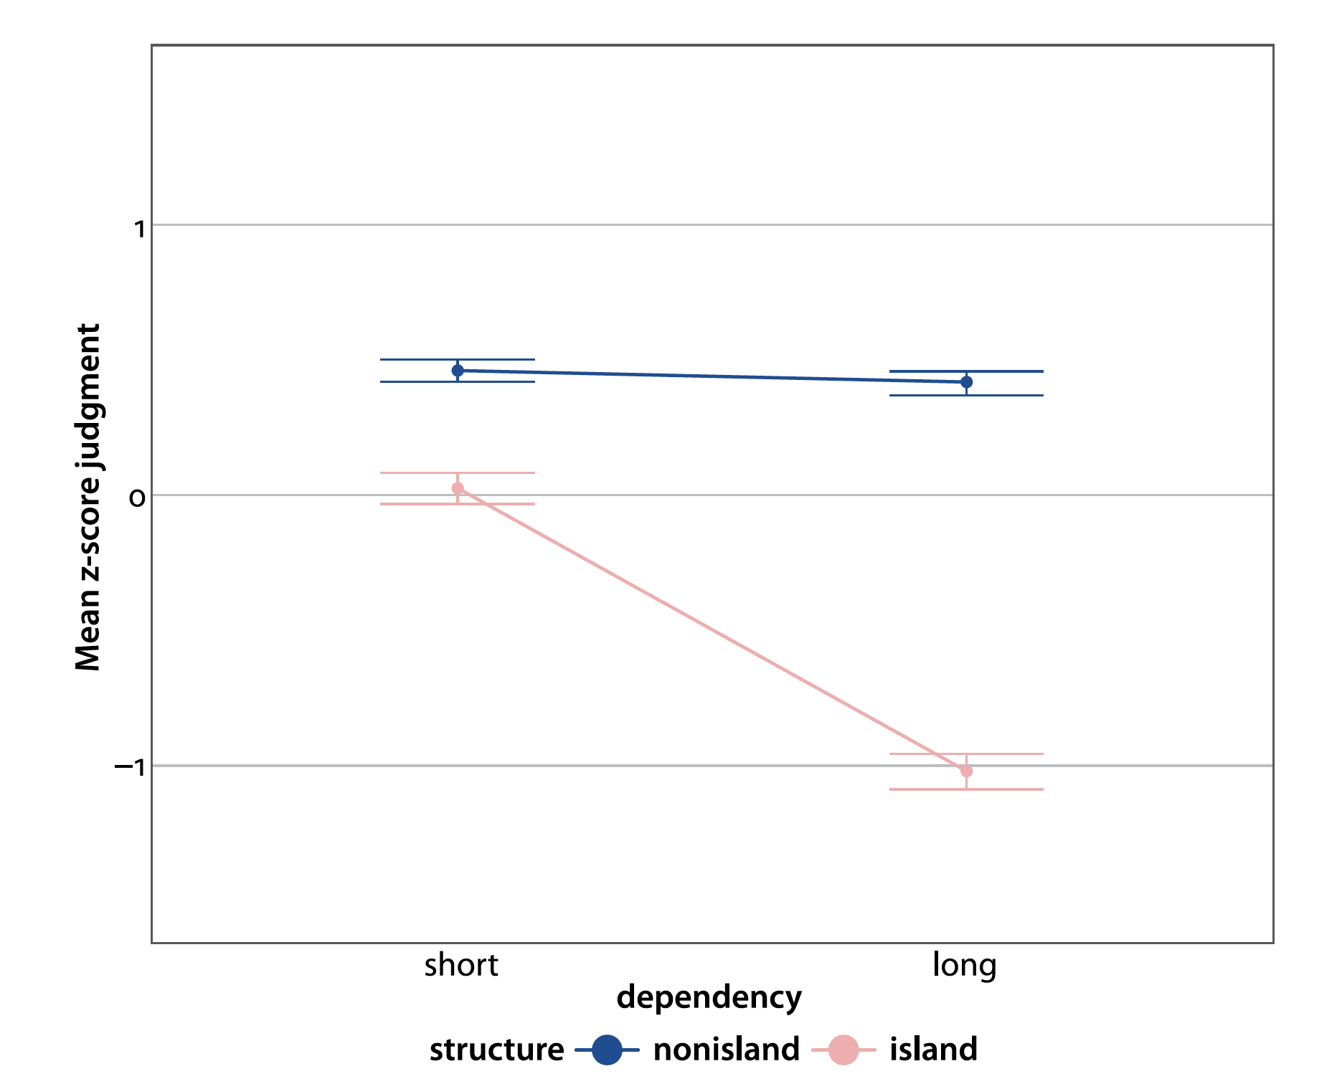
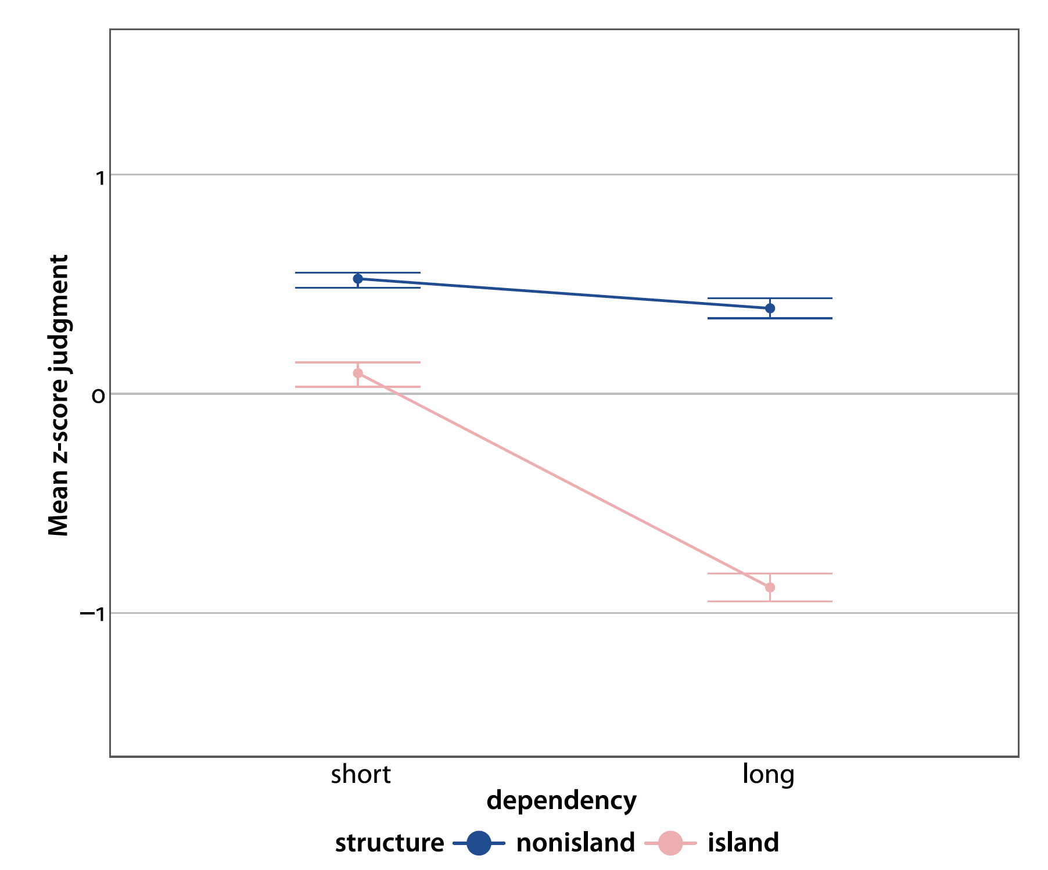
Wh-island effects and d-linking effects in wh-in situ questions
X. Chen 2024 used experiments to test wh-island effects with bare and d-linked wh
- Lili xiangzhidao shui maile shenme? Lili wonder who bought what? - Li laoshi. “Prof. Li.”
Wh-island effects exist in both bare and d-linked wh questions.
No d-linking effect on island size or on long conditions.
Chen proposes a LF movement approach and argues LF movement has the same locality constraints as overt movement.
Bare wh
D-linked wh

Slide 17
Puzzle for Chen’s conclusion
Wh-in situ and wh-movement behave differently in terms of d-linking:
D-linked wh in wh-movement in NAE shows partial amelioration.
D-linekd wh in wh-movement in Singlish shows improvement on long conditions.
D-linked wh in wh-in situ in Chinese brought no change what-so-ever.

Slide 18
Exp 2: wh-in-situ in Colloquial Singapore English (n = 81)
We don’t need to do question-answer pairs in Singlish and it’s more comparable with wh-movement.
17. a. Who say that Sean organise the event ah? (bare-noisl-short)
b. Who want to know whether Sean organise the event ah? (bare-isl-short)
c. The director say that Sean organise what ah? (bare-noisl-situ)
d. The director want to know whether Sean organise what ah? (bare-isl-situ)
e. Which director say that Sean organise the event ah? (dlink-noisl-short)
f. Which director want to know whether Sean organise the event ah?(dlink-isl-short)
g. The director say that Sean organise which event ah? (dlink-noisl-situ)
h. The director want to know whether Sean organise which event ah?(dlink-isl-situ)

Slide 19
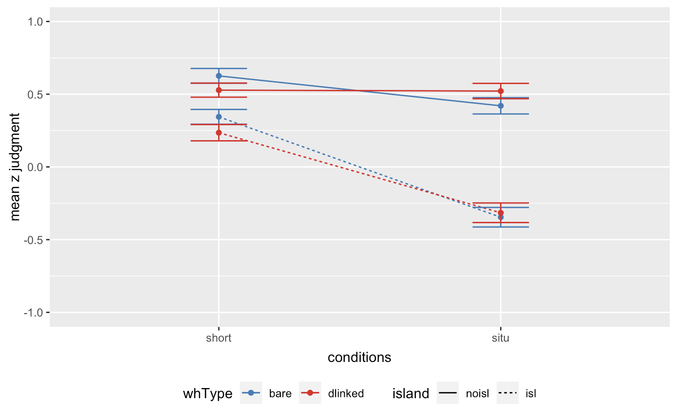
Exp 2: wh-in-situ in Colloquial Singapore English (n = 81)
No three way interaction (t = 0.44, p = .66): no d-linking amelioration
Dependency length*island (t = 4.631, p < .0001): wh-island effects
Bare: t = -3.11, p < 0.01
D-linked: t = -4.65, p < 0.0001
Dependency length*wh-type (t = 1.52, p = 0.14): d-linking did not make long conditions better
Wh-island effects are present in wh-in situ (Chen 2024, contra. Huang 1982)
no d-linking amelioration on island effects or d-linking effects on long conditions, similar to the Chinese data in Chen 2024
Bare wh
D-linked wh

Slide 20
Possible analysis 1
Chen: LF movement and overt movement share the same locality constraints
Can account for wh-island effects
For the lack of D-linking amelioration effect, we can assume that Chinese, like Singlish, only has C[+Q] even for d-linked wh
For the lack of D-linking improvement effect on long conditions, no long distance filler-gap dependency is involved so no ease of processing
Challenges:
- Cumulating experiment evidence show no island effects for argument wh-in-situ (Tian et al 2022 on CNPC in Mandarin, Shen and Huang on definite island in Chinese, Beth Chan’s MA thesis on CNPC and adjunct islands in Singlish, Shen on definite island in Singlish).

Slide 21
Possible analysis 2
Tsai 1994: Wh-in-situ questions are derived from unselective binding.
OP_{[+Q]i} Sean organize what_{i}?
Wh-island effects in wh-in situ questions is derived from a restriction on binding.
Operator A cannot bind variable B across an intervening operator C. *OPA_{i}…OPC…VariableB_{i} (Li 1992)
Wh-island effects are derived and no d-linking amelioration is predicted.
*OP_{i} the director want to know OP_{j} whether Sean organise what_{i/}which event_{i} ah?
Other operator binding relations are also blocked across embedded questions:
Ta yiwei OP_{ext} wo xiangzhidao OP_{[+Q]} shei xihuan shenme. (32 in Li 1992) He thought OP_{ext} I wonder OP_{[+Q]} who like what. No wh-indefinite reading: #He thought I wonder who like something.

Slide 22
Summary
Wh-island effects in wh-movement is driven by fRM
D-linking amerlioration is driven by C[+Q, +N]
Cross-linguistic variation is handled by some languages only having C[+Q]
D-linking improvement effects is due to processing facilitation
Wh-island effects in wh-in situ is driven by a constraint on binding
No d-linking amelioration as fRM is not violated
No d-linking improvement as no filler-gap dependency is involved
Puzzle for myself: what would a wh-in situ language with C[+Q, +N] look like?
Possible test case: Wh-ex situ in Mandarin

Slide 23
References
Chen, Xu. 2022. Wh-island effects in chinese: A formal experimental study. John Benjamins.
Huang, C.-T. James. 1982. Move WH in a Language without Wh-Movement. The Linguistic Review.
Li, Yen-Hui Audrey. 1992. Indefinite Wh in Mandarin Chinese. Journal of East Asian Linguistics.
Tsai, Wei-tien Dylan. 1994. On economizing the theory of A-bar dependencies: MIT dissertation.
Yang, Barry C.-Y., Ting ting Christina Hsu & Kazunori Kikushima. 2021. Rethinking wh-island effects in chinese. Studies in Chinese Linguistics 42(2). 161–182.
Villata, Sandra. & Jon Sprouse. 2023. The amelioration effect of which on strong/weak islands in English: An experimental study. GLOW talk.

