Slide 1


T-flapping in Singapore English: Evidence from perception and production
Wesley Mark Lincoln
ɾ
SingSum 2024 | 10 July 2024

Slide 2
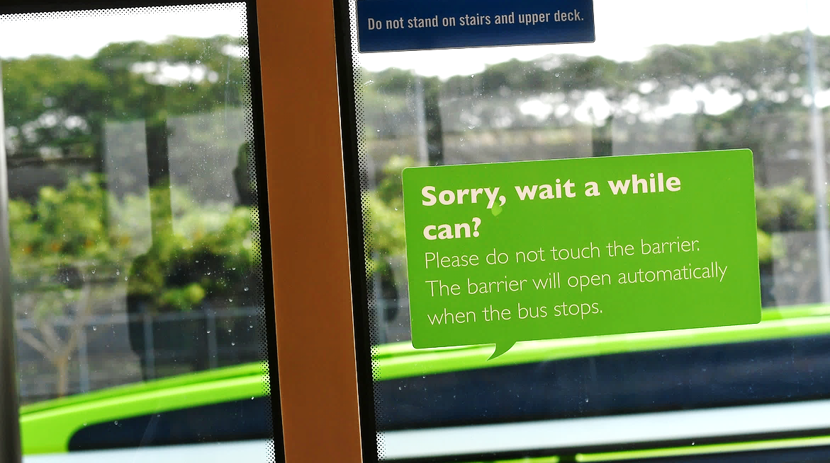
Endonormativity: Embrace of local norms for language use
Notes:
Endonormativity
Embrace of local language use → exemplified by embrace of CSE
Shift away from traditional BrE targets

Slide 3


Slide 4
Singapore English
Singlish
English
Contact variety
Modelled after
Standard Southern
British English (SSBE)
Substrate:
Hokkien, Baba Malay
Lexifier:
mainly English
Notes:
Phonology as pronunciation patterns – whether CSE or SSE
More American and less British (traditional norm)
American-like pronunciation (slang as locals may say)
Pronouncing r at the end of a syllable

Slide 5
Singapore English
Singlish
English
Shared phonological features
We need a
variationist
approach!
Non-rhoticity
Unaspirated /p t k/
Tense-lax vowel mergers
Syllable-timed rhythm
Starr (2019, 2021); Leimgruber (2012)
Notes:
Phonology as pronunciation patterns – whether CSE or SSE
More American and less British (traditional norm)
American-like pronunciation (slang as locals may say)
Pronouncing r at the end of a syllable

Slide 6
Trends in SgE
Rising endonormativity
Americanisation?
Away from SSBE
towards local norms
Rising rhoticity
Lexical choice
S. Tan (2016); Starr (2016 2021); Y. Tan (2012 2016)
Notes:
Phonology as pronunciation patterns – whether CSE or SSE
More American and less British (traditional norm)
American-like pronunciation (slang as locals may say)
Pronouncing r at the end of a syllable

Slide 7
Is Singapore English phonology becoming more American?
Notes:
Phonology as pronunciation patterns – whether CSE or SSE
More American and less British (traditional norm)
American-like pronunciation (slang as locals may say)
Pronouncing r at the end of a syllable

Slide 8
/t/-flapping: /t/ → [ɾ]
AmE
SSBE
SgE
Pervasive;
complex conditioning
Not traditionally
associated
Not traditionally
associated
Yes: city forty get it
No: latex fifty
Not observed in read speech
(Y. Tan 2016)
shut up
But…
whatever
forty-three

Slide 9
Is Singapore English phonology becoming more American?
Has T-flapping arisen in Singapore due to AmE influence?
Notes:
Phonology as pronunciation patterns – whether CSE or SSE
More American and less British (traditional norm)
American-like pronunciation (slang as locals may say)
Pronouncing r at the end of a syllable

Slide 10
Self-report data:
SgE speakers are well aware of AmE /t/-flapping
But do not claim to use it extensively
Tendency to report flaps for numbers
Accuracy (%)
Mean =
72.8%
n=105 participants
Lincoln & Starr (forthcoming)

Slide 11
Production Data
With Dr. Rebecca L. Starr
Q1: Do SgE speakers flap /t/?
Q2: Do their /t/-flapping patterns align with AmE norms?

Slide 12
Approach: collect read speech (n=30)
1
Mathematics Problems
2
Reading Passage
3
Wordlist
Notes:
Asked to read three types of materials
Then analysed the recordings: for every /t/ sound we noted whether it was flapped or not

Slide 13
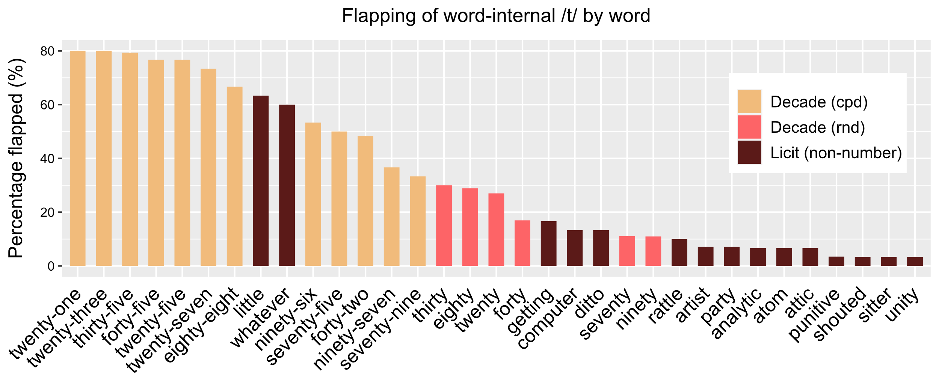
SgE /t/-flapping within words
Compound numbers
Round numbers
Non-numbers

Slide 14
SgE /t/-flapping by environment
Flapping
(%)
Compound
Numbers
e.g. 45
Round
Numbers
e.g. 40
Non-numbers
e.g. city
Between
words e.g.what if
Notes:
Different from American English
In American English /t/-flapping is used routinely in all of these situations

Slide 15
Predictors of odds of /t/-flapping
Term | Estimate | SE | z-value | Pr(>|z|)
Intercept | 0.585 | 0.408 | 1.433 | 0.152
Environment (vs. Compound number)
Round Number | -1.748 | 0.688 | -2.541 | 0.011 | *
Word Boundary | -1.237 | 0.775 | -1.596 | 0.111
Word-internal | -3.027 | 0.625 | -4.847 | 0.000 | ***
Genre
Reading Passage | -0.311 | 0.624 | -0.498 | 0.618
Wordlist | -1.941 | 0.371 | -5.227 | 0.000 | ***
Media Consumption
Daily or almost daily | -0.025 | 0.128 | -0.194 | 0.846
Interaction with AmE speakers
Every few days | 0.271 | 0.144 | 1.885 | 0.060
Every few months | -0.116 | 0.265 | -0.439 | 0.661
Never or almost never | 0.064 | 0.218 | 0.295 | 0.768
Notes:
/t/-flapping seems to cut across different segments of society – not one particular group

Slide 16
Discussion
SgE /t/-flapping not necessarily copied from AmE
Different distribution
Instead an independent development
True for New Zealand, Australian English (Meyerhoff & Niedzielski 2003; Horvath 2004)
Cross-linguistic tendency to lenite post-stress intervocalic stops (cf. BrE /t/-glottaling)

Slide 17
Perception Data
With Dr. Meredith J. Tamminga
Q3: Do SgE speakers evaluate flapped /t/ as an authentic local variant?

Slide 18
Approach: Social evaluation experiment
 | Non-number e.g. article | Number e.g. forty-five
Flap | [aɾikəl] | [fɔɾifaiv]
Stop | [atikəl] | [fɔtivaiv]

Slide 19
Audio stimulus manipulation
She told me that [fɔtinain] is the correct response.
She told me that [fɔɾinain] is the correct response.
She told me that [fɔtinain] is the correct response.

Slide 20

Audio stimulus manipulation
She told me that [fɔtinain] is the correct response.
She told me that [fɔɾinain] is the correct response.
She told me that [fɔtinain] is the correct response.

Slide 21
Audio stimulus manipulation
She told me that [fɔtinain] is the correct response.
She told me that [fɔɾinain] is the correct response.
She told me that [fɔtinain] is the correct response.

Slide 22
Audio stimulus manipulation
She told me that [fɔtinain] is the correct response.
She told me that [fɔɾinain] is the correct response.
digital splice
She told me that [fɔtinain] is the correct response.

Slide 23

Audio stimulus manipulation
She told me that [fɔtinain] is the correct response.
She told me that [fɔɾinain] is the correct response.

Slide 24
Lexical items
 | Non-number | Number
Items | article vertical watery lettering attitude literal | eighty-five forty-two thirty-six eighty-one forty-nine thirty-eight

Slide 26
Predictions
If SgE T-flapping is a local development limited to numbers:
Numbers
Non-numbers
Localness
flap
stop
flap
stop

Slide 27
Predictions
If SgE T-flapping is an AmE import with the same distribution:
Numbers
Non-numbers
Localness
flap
stop
flap
stop

Slide 28
Predictions
If SgE T-flapping is not considered a local feature:
Numbers
Non-numbers
Localness
flap
stop
flap
stop

Slide 29
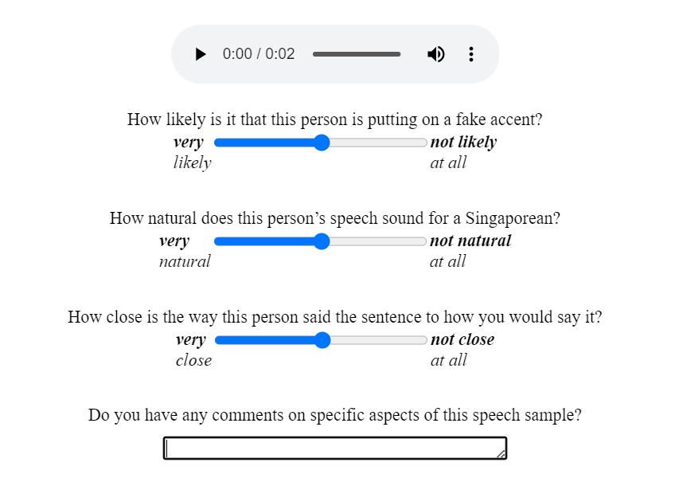
How do we measure localness?

Slide 30
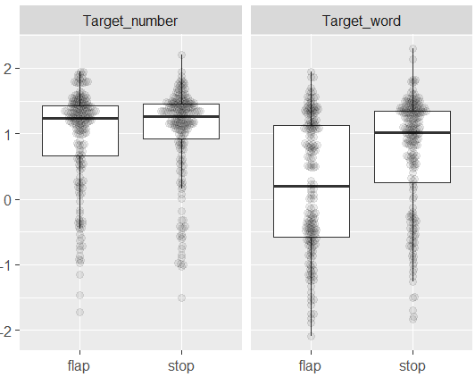
How likely is it that this person is putting on a fake accent? (n=68)
Number
Non-number
Less
likely fake
Fakeness
(Z-scored)
Bimodal?
More likely fake

Slide 31
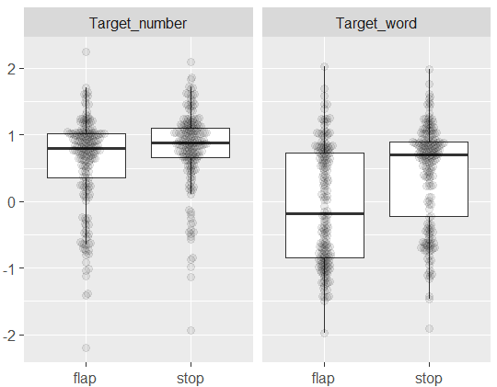
How natural does this person’s speech sound for a Singaporean? (n=68)
Number
Non-number
More natural
Naturalness
(Z-scored)
Less natural

Slide 32
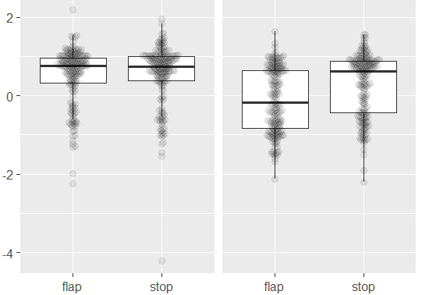
How close is the way this person said the sentence to how you would say it? (n=68)
Number
Non-number
Closer
Closeness
(Z-scored)
Further

Slide 33
Predictors of closeness
n = 68 participants
 | Estimate | SE | df | t-value | p-value
Intercept | 0.469 | 0.083 | 42.79 | 5.63 | 1.26e^{–06} | ***
Flap | –0.024 | 0.083 | 151.11 | –0.29 | 0.775
Non-number | –0.263 | 0.093 | 19.67 | –2.84 | 0.010 | *
Male | 0.157 | 0.079 | 61.90 | 1.99 | 0.051
Flap × Non-number | –0.378 | 0.103 | 622.28 | –3.67 | 0.0002 | ***
Note: ***: p<0.001; *: p<0.05

Slide 34
Discussion
SgE speakers rate flaps:
As local as stops in numbers
Less local than stops in non-numbers
Consistent with T-flapping as a local feature
No AmE exposure effects – not a matter of “copying”
No age or gender effects – perhaps a well-established feature
Notes:
/t/-flapping seems to cut across different segments of society – not one particular group

Slide 35
SgE /t/-flapping seems to be neither an AmE import nor an innovation – but likely an established local feature

Slide 36
Q: Is Singapore English phonology becoming more American? A: Based on T-flapping, no!
Notes:
Phonology as pronunciation patterns – whether CSE or SSE
More American and less British (traditional norm)
American-like pronunciation (slang as locals may say)
Pronouncing r at the end of a syllable

Slide 37
Q: Is Singapore English phonology becoming more American? A: Based on T-flapping, no!
But the prestige of AmE may influence the spread of T-flapping in SgE.
Notes:
Phonology as pronunciation patterns – whether CSE or SSE
More American and less British (traditional norm)
American-like pronunciation (slang as locals may say)
Pronouncing r at the end of a syllable

Slide 38
Current follow-up
 |  | Non-number
 |  | Flapping
 |  | [t] | [ɾ]
Rhoticity | [ɹ] | aɹtikəl | aɹɾikəl
 | ∅ | atikəl | aɾikəl
Number
Flapping
[t] | [ɾ]
fɔɹtinain | fɔɹɾinain
fɔtinain | fɔɾinain
Notes:
/t/-flapping seems to cut across different segments of society – not one particular group

Slide 39
Thank You!

Slide 40
Appendices

Slide 41
References
Alderton Roy. 2021. T-tapping in Standard Southern British English: An ‘elite’ sociolinguistic variant? Journal of Sociolinguistics 2021 1–12. doi.org/10.1111/josl.12541
Cowie Claire. 2021. Resolving Conflicting Evidence of Rhoticity in Indian English. [Paper presentation]. NUSS FASS Language and Linguistics Research Cluster talk.
de Jong Kenneth J. 1998. Stress-related variation in the articulation of coda alveolar stops: Flapping revisited. Journal of Phonetics 26. 283–310.
Deterding David. 2007. Singapore English. Edinburgh: Edinburgh University Press.
Eddington David and Dirk Elzinga. 2008. The phonetic context of American English flapping: Quantitative evidence. Language and Speech 51(3). 245–266.
Foo Amanda Limin and Tan Ying-Ying. 2019. Linguistic insecurity and the linguistic ownership of English among Singaporean Chinese. World Englishes 38(4). 606–629.
Hannisdal Bente. 2021. A corpus-based study of /t/ flapping in American English broadcast speech. The Corpus Phonology of English: Multifocal Analyses of Variation ed. by Anne Przewozny Cécile Viollain and Sylvain Navarro 256–276. Cambridge: Cambridge University Press.

Slide 42
References
Haugen Einar. 1938. Notes on voiced t in American English. Dialect Notes 6. 627–634.
Hickey Raymond. 2004. Irish English: Phonology. A Handbook of Varieties of English Volume 1: Phonology ed. by Edgar W. Schneider Kate Burridge Bernd Kortmann Rajend Mesthrie and Clive Upton 68–97. Berlin: De Gruyter.
Meyerhoff Miriam and Nancy Niedzielski. 2003. The globalisation of vernacular variation. Journal of sociolinguistics 7(4). 534–555.
Schneider Edgar W. Kate Burridge Bernd Kortmann Rajend Mesthrie and Clive Upton (eds.) 2004. A Handbook of Varieties of English Volume 1: Phonology. Berlin: De Gruyter.
Starr Rebecca L. 2019. Cross-dialectal awareness and use of the bath-trap distinction in Singapore: Investigating the effects of overseas travel and media consumption. Journal of English Linguistics 47(1). 55 – 88.
Starr Rebecca L. 2021. Changing language changing character types. Social Meaning and Linguistic Variation: Theorizing the Third Wave ed. by Lauren Hall-Lew Emma Moore and Robert J. Podesva 315–337. Cambridge: Cambridge University Press.

Slide 43
References
Stuart-Smith Jane. 2006. The influence of the media. The Routledge Companion to Sociolinguistics ed. by Carmen Llamas Louise Mullany and Peter Stockwell 140–148. First edition. London: Routledge.
Stuart-Smith Jane and Claire Timmins. 2014. Language and the influence of the media: A Scottish perspective. Sociolinguistics in Scotland ed. by Robert Lawson 177–196. Hampshire: Palgrave Macmillan.
Tan Ying-Ying. 2012. To r or not to r: Social correlates of /ɹ/ in Singapore English. International Journal of the Sociology of Language 218. 1–24.
Tan Ying-Ying. 2016. The Americanization of the phonology of Asian Englishes: Evidence from Singapore. Communicating with Asia: The Future of English as a Global Language ed. by Gerhard Leitner Azirah Hashim & Hans-Georg Wolf 120–134. Cambridge: Cambridge University Press.
Vaux Bert. 2000. Flapping in English. Paper presented at the annual meeting of the Linguistic Society of America paper Chicago.
Zue Wictor W. and Martha Laferriere. 1979. Acoustic study of medial /td/ in American English. The Journal of the Acoustical Society of America 66(4). 1039–1050.

Slide 44
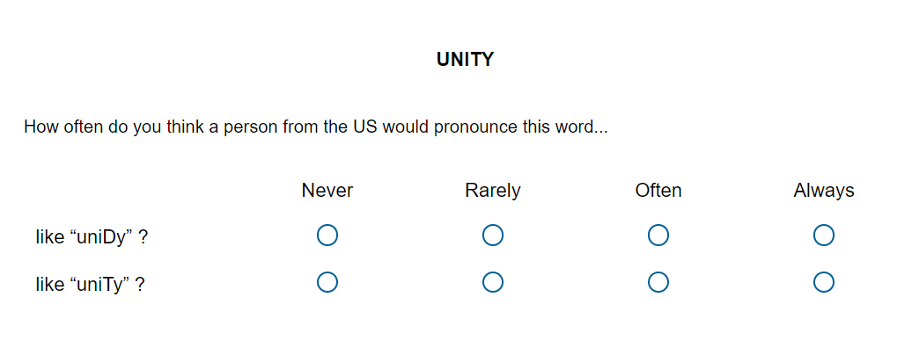
Appendix A: Sample survey question (AmE)

Slide 45
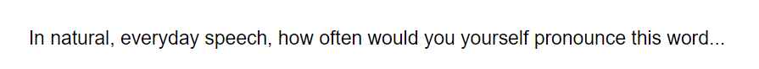
Appendix B: Sample survey question (SgE)

Slide 46
Appendix C: /t/-Flapping conditions in AmE
Applies in V₁_V₂ where V₂ is unstressed.
V₁ may have:
primary stress: bú[ɾ]er (obligatory)
secondary stress: ínnovà[ɾ]ive (obligatory)
no stress: imágina[ɾ]ive (optional)
Blocked if V₂ has stress: po[t]éntial
(Eddington & Elzinga 2008; Zue & Laferriere 1979; Haugen 1938)
Notes:
AmE varieties are more strongly associated with /t/-flapping whose phonological conditioning is complex (Vaux 2000)

Slide 47
Appendix C: /t/-Flapping conditions in AmE
Some sonorants may intervene between V₁ and /t/:
/n ɹ/ may intervene: hu[ɾ̃]er par[ɾ]y
/m l ŋ/ may not: symp[t]om fil[t]er Washing[t]on
(Hannisdal 2021; Vaux 2000; Zue & Laferriere 1979; Haugen 1938)
Morpheme-internally V₂ must be a reduced vowel:
Reduced: atom [ˈæɾəm]
Full: latex [ˈleɪtɛks]
(Eddington & Elzinga 2008; De Jong 1998)

Slide 48
Appendix C: /t/-Flapping conditions in AmE
Words with /nt/ clusters fall into two categories:
Most are realised with [ɾ̃]: twe[ɾ̃]y pai[ɾ̃]ing
Lexically arbitrary group realised with [nɾ]: carpe[nɾ]er seve[nɾ]y ni[nɾ]y
(Hannisdal 2021; Vaux 2000)

