Slide 1
Parasitic gaps and A'-movement in long and short Mandarin bei-passives
Jian Gang Ngui

Slide 2
Quick introduction to Mandarin bei-passives
Note: my focus today is on transitive bei-passives (and syntax)
Most of the literature (Feng 1997/2012; Huang 1999; Ting 1998; a.o.) has argued for or assumed that the short bei-passive involves A-movement while the long bei-passive involves A’-movement:
1) Short bei-passive (no overt initiator)
didi bei fa-zhan-le
younger.brother BEI punish-stand-PERF
Lit: ‘Younger brother was punished-stood.’
‘Younger brother was made to stand as a punishment.’
A-movement analysis:
[_{IP} zhangsan_{i} [_{VP} bei [_{VP} PRO_{i} sheng-zhi-le t_{i} ]]]
Short bei-passives, which do not have an overt initiator, have been argued to involve A-movement of PRO from the sister-to-V position of the logical object
2) Long bei-passive (overt initiator present)
didi bei mama fa-zhan-le
younger.brother BEI mother punish-stand-PERF
Lit: ‘Younger brother was punished-stood by mother.’
‘Younger brother was made to stand as a punishment by mother.’
A’-movement analysis:
[_{IP} zhangsan_{i} [_{VP} bei [_{IP} Op_{i} [_{IP} lisi sheng-zhi-le t_{i} ]]]
Long bei-passives, which have an overt initiator, have been argued to involve A’-movement of a null operator (NOP) from object position

Slide 3
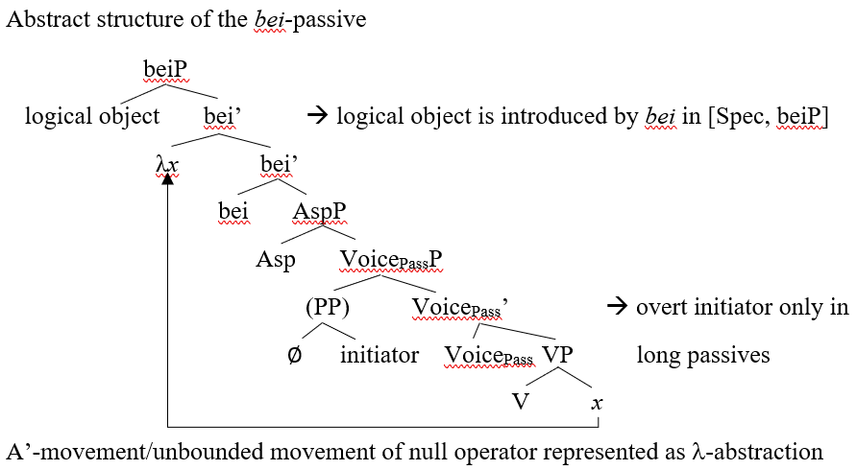
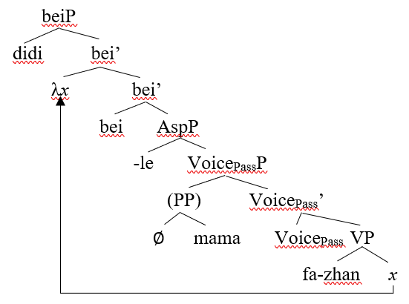
My overarching proposal
I claim that both long and short passives should uniformly involve A’-movement, and that a unified analysis is not only desirable but also empirically superior!
Note that my analysis assumes that both long and short passives involve A’-movement of the NOP (which the literature typically ascribe only to long passives)
As far as I know, only Her (2009) claims that long and short passives can be analysed uniformly

Slide 4
Why A’-movement of a NOP?
Feng (1997/2012) first noted that long passives could be analysed on a par with tough-constructions (specifically, of the “stubborn” type) in English
Relevantly, both exhibit long-distance dependencies, and both can host resumptive pronouns (RPs; we’ll come back to them soon):
3) John_{i} is too stubborn for Bill to ask Mary to talk to (him_{i}).
4) tongdao_{i} dou yijing bei (jiangjun) [pai bing [bashou x_{i}]]
passage all already BEI general send troop guard
Lit: ‘All passages have been “sent-troops-to-guard” (by the general).’
‘(Someone/the general) has sent troops to guard all passages. (Her 2009; 431, with modifications)

Slide 5
Evidence for A’-movement in both passives?
We have already seen the first piece of evidence, which is that both long and short passives exhibit long-distance dependencies
The second and third pieces of evidence pertain to the presence of RPs in two different syntactic environments – RPs have been argued to be part of A’-chains and therefore are indicative of A’-movement

Slide 6
RPs and adverbs
Huang (1999) and Ting (1998) propose that RPs are licenced in long bei-passives in the presence of adverbs such as ji-ci ‘few-instance’
Though they do not account for why such adverbs licence RPs, they point out that their presence indicates the involvement of A’-movement rather than A-movement
Her (2009) points out that data from Taiwanese online forums show that such RPs can also be found in short passives
5) Zhangsan_{i} bei (Lisi) henhende ma-le ta_{i} ji-ci
Zhangsan BEI Lisi viciously scold-PERF 3.SG few-instance
‘Zhangsan_{i} was viciously scolded him_{i} a few times (by Lisi).’

Slide 7
RPs and island extractions
As far as I know, the interaction of islands and bei-passives is a novel data point in my work
Typically, extraction from islands incurs island violations, but many scholars (Ross 1967; Aoun et al. 2001; McCloskey 2002; 2006; Asudeh 2007; 2011; Ting & Huang 2008; a.o.) have argued that RPs can obviate or ameliorate island violations, and I assume that Mandarin RPs can do so as well
6) kongzi_{i} bei [(baojun) she-fa [shao-diao [_{CNPI} zanmei*(ta_{i}) de shu ]]]
Confucius BEI tyrant come.up.with-idea burn-away praise 3.SG DE book
‘The burning of books that praised Confucius was planned (by a tyrant).’
Lit: ‘Confucius_{i} has been come-up-with-the-idea to burn away [_{CNPI} the books that praised him_{i}] (by a tyrant).’

Slide 8
Exploring parasitic gaps as another (potential) diagnostic for A’-movement
Parasitic gaps (PGs) have been proposed to be licenced by A’-movement (Culicover 2001; Engdahl 1983; Nissenbaum 2000; a.o.)
Specifically, their presence is contingent on the presence of another A-’chain in the derivation that does not c-command them, so with configurations involving PGs in adjuncts we can observe Mandarin PGs (Lai & Sun 2020; Lin 2005; Liu 2011; 2013; Ting & Huang 2008; Tsai 1997)
Since I argue that bei-passives uniformly involve A’-movement (of the NOP), we predict that we can get PGs in both long and short passives

Slide 9
PGs and long bei-passives
Liu (2011) observes that PGs can be licenced in long bei-passives (he also assumes that short passives involve A-movement, so he does not mention if they are available in those environments), and proposes that A’-movement of the NOP thus can licence PGs as well:
7) shei_{i} [_{PP} zai yuehan huijian pg_{i} zhiqian] jiu bei OP_{i} (dongshizhang) ma-le t_{i} ?
who at John meet before already BEI president scold-PERF
‘Who was scolded by the president (of the company) before John met him?’
(Liu 2011; 186, with modifications)
However, his example is slightly flawed as it involves 1) the presence of a WH-element and 2) an adjunct (the PP) that is outside of the complement of bei
As Ting & Huang (2008) correctly point out, an adjunct containing a PG that is outside of the complement of bei could be licenced by any other potential A’-movement in the higher clause, such as topicalization
Ideally, then, we would want the PG to be within the complement of bei so that we can be fairly certain that what licences said PG is the A’-movement of the NOP!

Slide 10
PGs and long bei-passives
They provide the following long passive example:
8) nage xiaotou bei [_{IP} Op [jingcha [zai jianchaguan zhenxun e hou] daibu-le t ]
that.CL thief BEI police at DA interrogate after arrest-ASP
‘That thief was arrested by the police after the DA interrogated him.’ (Ting & Huang 2008; 35)
Out of curiosity, how many of you find the short passive version of (8) to be acceptable?
They claim that the following short passive version is ungrammatical:
9) *nage xiaotou bei [_{VP} PRO turan [zai jianchaguan zhenxun e hou] daibu-le t]
that.CL thief BEI suddenly at DA interrogate after arrest-ASP
‘That thief was suddenly arrested after the DA interrogated him.’ (Ting & Huang 2008; 35)

Slide 11
PGs and bei-passives
Fortunately, we actually do have potential examples of PGs in the complement of bei that are licenced even in the short passive:
10) [nei-ge xiaotou]_{i} bei [_{AspP} OP_{i} (jingcha) toutou [_{PP} zai shichang genzong pg_{i} hou] daibu-le t_{i} ]
that-CL thief BEI police secretly at market follow after arrest-PERF
‘That thief was arrested (by the police_{i}) after being secretly tailed (by them_{i}) in the market.’
The grammaticality of (10) is completely ruled out under approaches that posit A-movement for short passives, but this is predicted by my unified account
The data from PGs thus further adds to the empirical coverage that my analysis has

Slide 12
Further consequences of my analysis
In fact, Ting and Huang (2008) are forced to claim that sentences like (10) or (11) below, which cannot involve the topicalization of the logical object, do not involve PGs but rather a True Empty Category (TEC; Li 2007; 2014)
11) henshao renzhi_{i} [zai jingcha qu jiu pg_{i} yiqian] hui bei (ren) shifang t_{i}
few hostage at police go rescue before will BEI person release
‘Few hostages will be released before the police went to rescue them.’
JG:’ ‘Few hostages get released (by someone) before the police go to rescue them.’
(Ting & Huang 2008; 36, with modifications)
The TEC is proposed to be a last resort strategy, so if we accept that (11) involves a TEC, it remains a mystery why examples like the ungrammatical (9) cannot also involve TECs rather than PGs (Lai & Sun 2020)
Under my analysis, we completely expect the presence of PGs in both the long and short passives since both involve A’-movement
We end up with a more parsimonious account for both bei-passives and empty categories in Mandarin!

Slide 13
Further consequences of my analysis
Example (12) below, which is suggested by Lai & Sun (2020) to be a grammatical variation of the ungrammatical (9), also falls out naturally from my analysis
12) [na-ge xiatou]_{i} [_{vP} zai jianchaguan zhenxun pg_{i} hou] bei [OP_{i} turan daibu-le t_{i} ]
that-CL thief at DA interrogate after BEI suddenly arrest-PERF
‘That thief was suddenly arrested by the police after the DA interrogated him.’
(Lai & Sun 2020; 197, with modifications)
Under my account, the difference in grammaticality between (9) and (12) would simply be due to the position of the vP adjunct (as seems to be suggested by Lai & Sun) as we would also expect to find PGs in short passives
Side note: if it turns out that people are ok with (9), that is also expected under my account!

Slide 14
References
Ackerman, Lauren, Michael Frazier & Masaya Yoshida. 2018. Resumptive Pronouns Can Ameliorate Illicit Island Extractions. Linguistic Inquiry 49. 547–859.
Aoun, Joseph, Lina Choueri & Norbert Hornstein. 2001. Resumption, Movement and Derivational Economy. Linguistic Inquiry 32. 371–403.
Asudeh, Ash. 2007. Three kinds of resumption. Paper presented at Resumptive Pronouns at the Interfaces. Online: http://www.sas.rochester.edu/lin/sites/asudeh/handouts/RP-2007-handout-corrected.pdf
Asudeh, Ash. 2011. Local grammaticality in syntactic production. In Emily Bender & Jennifer Arnold (eds.), Language from a cognitive perspective: Grammar, usage and processing. 51–79. Stanford, CA: CSLI Publications.
Bruening, Benjamin. 2013. By Phrases in Passives and Nominals. Syntax 16. 1–41.
Bruening, Benjamin and Thuan Tran. 2015. The nature of the passive, with an analysis of Vietnamese. Lingua 165. 133–172.
Chao, Wynn & Peter Sells. 1983. On the Interpretation of Resumptive Pronouns. North East Linguistics Society 13. 47–61.
Cheng, Lisa, C.-T. James Huang, Y.-H. Audrey Li & C.-C. Jane Tang. 1999. Hoo, hoo, hoo: Syntax of the causative, dative, and passive constructions in Taiwanese. In Pang-Hsin Ting (eds.), Journal of Chinese Linguistics Monograph Series No. 14. 146–203. Hong Kong, China: The Chinese University of Hong Kong Press.
Culicover, Peter. 2001. Parasitic Gaps: A History. In Peter Culicover & Paul Postal (eds.), Parasitic Gaps. 3–68. Cambridge, MA: The MIT Press.
Engdahl, Elisabet. 1983. Parasitic gaps. Linguistics and Philosophy 6. 5–34.
Engdahl, Elisabet. 1985. Parasitic gaps, resumptive pronouns and subject extractions. Linguistics 23. 3–44.
Erteshik-Shir, Nomi. 1992. Resumptive pronouns in islands. In Helen Goodluck & Michael Rochemont (eds.), Island Constraints. 89–108. Amsterdam, Netherlands: Kluwer Academic Publishers.
Feng, Shengli. 1998. Prosodically Motivated Passive Bei Constructions in Classical Chinese. SKY 1998 (The 1998 Yearbook of the Linguistic Association of Finland). 41–48.

Slide 15
References
Feng, Shengli. 2012. Empty Operator Movement in Chinese Passive Syntax. In Wang Lujiang (eds.), Festschrift for Professor Fang Li: 數理邏輯之美 —— 方立教授紀念文集. 117–136. Beijing: Beijing Language and Culture University Press.
Feng, Shengli. 2013. Short Passives in Modern and Classical Chinese. In Cao Guangshun, Hilary Chappell, Redouane Dijmouri & Thekia Wiebusch (eds.), Breaking down the barriers: Interdisciplinary studies in Chinese linguistics and beyond. 595–623. Taipei, Taiwan: Institute of Linguistics, Academia Sinica.
Ferreira, Fernanda & Benjamin Swets. 2005. The Production and Comprehension of Resumptive Pronouns in Relative Clause “Island” Contexts. In Anne Cutler (eds.), Twenty-First Century Psycholinguistics : Four Cornerstones. 263–278. England, UK: Routledge.
Heestand, Dustin, Ming Xiang & Maria Polinsky. 2011. Resumption Still Does Not Rescue Islands. Linguistic Inquiry 42. 138–152.
Her, One-Soon. 2009. Unifying the Long Passive and the Short Passive: On the Bei Construction in Taiwan Mandarin. Language and Linguistics 10. 421–470.
Huang, C.-T. James. 1999. Chinese Passives in Comparative Perspective. Tsing Hua Journal of Chinese Studies 29. 423–509.
Huang, C.-T. James. 2013. Variations in non-canonical passives. In Artemis Alexiadou & Florian Schäfer (eds.), Non-canonical Passives. 95–114. Amsterdam, Netherlands: John Benjamins Publishing Company.
Huang, C.-T. James, Y.-H. Audrey Li & Yafei Li. 2009. The Syntax of Chinese. Cambridge, UK: Cambridge University Press.
Kroch, Anthony. 1981. On the Role of Resumptive Pronouns in Amnestying Island Constraint Violations. Papers from the Regional Meeting, Chicago Linguistics Society 17. 125–135.
Lai, Jackie Yan-Ki & Yenan Sun. 2020. On Apparent Parasitic Gaps in Mandarin Chinese. Proceedings of the 22nd Seoul International Conference on Generative Grammar, Seoul, 195–199. Online: http://2020.sicogg.or.kr/wp-content/uploads/2020/08/SICOGG-22-Proceedings-final.pdf
Li, Y.-H. Audrey. 2007. Beyond empty categories. Bulletin of the Chinese Linguistic Society of Japan 254, 74–106.

Slide 16
References
Li, Y.-H. Audrey. 2014. Born empty. Lingua 151. 43-68.
Li, Charles N. & Sandra A. Thompson. 1981. Mandarin Chinese: A Functional Reference Grammar. Berkeley and Los Angeles, CA: University of California Press.
Lin, Jonah. 2005. Does wh-in-situ license parasitic gaps? Linguistic Inquiry 36. 298-302.
Liu, Chi-Ming Louis. 2011. Licensors for Parasitic Gaps in Mandarin Chinese. Online Proceedings of GLOW in Asia Workshop for Young Scholars, Tsu. 178–189. Online: https://faculty.human.mie-u.ac.jp/~glow_mie/Workshop_Proceedings/WorkshopProceedings_WholeBook.pdf
Liu, Chi-Ming Louis. 2013. Mandarin Parasitic Gaps. University of Pennsylvania Working Papers in Linguistics 19, 106–111. Online: https://repository.upenn.edu/pwpl/vol19/iss1/13/?utm_source=repository.upenn.edu%2Fpwpl%2Fvol19%2Fiss1%2F13&utm_medium=PDF&utm_campaign=PDFCoverPages
Liu, Na. 2012. The syntactic structures of the Chinese bei passive and the English be-passive. Proceedings of GLOW in Asia IX, Tsu, 125–139. Online: https://faculty.human.mie-u.ac.jp/~glow_mie/IX_Proceedings_Oral/GLOWIXProceedings_Final.pdf
Liu, Na. 2016. The Structures of Chinese Long and Short Bei Passives Revisited. Language and Linguistics 17. 857–889.
Liu, Na & C.-T. James Huang. 2013. The Syntax of Passives under the Smuggling Approach. Paper presented at the 31st annual meeting of the West Coast Conference on Formal Linguistics. Online: https://scholar.harvard.edu/files/ctjhuang/files/2013.02_wccfl_31_liuhuang_0429.pdf
Liu, Na and C.-T. James Huang. 2016. Control and raising passives, and why Mandarin does not smuggle. Journal of East Asian Linguistics 25. 385–404.
McCloskey, James. 2002. Resumption, Successive Cyclicity, and the Locality of Operations. In Samuel David Epstein & Daniel Seely (eds.), Derivation and Explanation in the Minimalist Program. 184–226. Oxford, UK: Blackwell Publishers.
McCloskey, James. 2006. Resumption. In Martin Everaert & Henk van Riemsdijk (eds.), The Blackwell Companion to Syntax. 94–117. Oxford, UK: Blackwell Publishers.
Morgan, Adam Milton & Matthew Wagers. 2018. English Resumptive Pronouns Are More Common Where Gaps Are Less Acceptable. Linguistic Inquiry 49. 861–876.

Slide 17
References
Nissenbaum, Jonathan. 2000. Covert Movement and Parasitic Gaps. Proceedings of the North East Linguistic Society 30. 541–555. Online: https://scholarworks.umass.edu/cgi/viewcontent.cgi?article=1455&context=nels
Pan, Victor Junnan. 2016. Resumptivity in Mandarin Chinese. Berlin, Germany: De Gruyter Mouton.
Ross, John Robert. 1967. Constraints on variables in syntax. Cambridge, MA: Massachusetts Institute of Technology dissertation.
Sag, Ivan. 1983. On Parasitic Gaps. Linguistics and Philosophy 6. 35–45.
Sichel, Ivy. 2014. Resumptive Pronouns and Competition. Linguistic Inquiry 45. 655–693.
Tang, Sze-Wing. 2001. A complementation approach to Chinese passives and its consequences. Linguistics 39. 257–295.
Ting, Jen. 1993. A’-binding and the Bei-construction in Mandarin Chinese. MIT working papers 20. 239–254.
Ting, Jen. 1995. A Non-Uniform Analysis of the Passive Construction in Mandarin Chinese. Rochester, NY: The University of Rochester dissertation.
Ting, Jen. 1998. Deriving the Bei-construction in Mandarin Chinese. Journal of East Asian Linguistics 7. 319–354.
Ting, Jen & Yu-Chi Huang. 2008. Some Remarks on Parasitic Gaps in Chinese. Concentric: Studies in Linguistics 34. 27–52.
Tsai, W.-T. Dylan. 1997. On the Absence of Island Effects. Tsing Hua Journal of Chinese Studies 27. 125–149.
Tucker, Matthew, Ali Idrissi, Jon Sprouse & Diogo Almeida. Resumption ameliorates different islands differentially: Acceptability data from Modern Standard Arabic. In Amel Khalfaoui & Matthew Tucker (eds.), Perspectives on Arabic Linguistics XXX. 159–194. Amsterdam, The Netherlands: John Benjamins Publishing Company.
Wang, Chyan-an Arthur. 2008. Sluicing and Resumption. NELS 37: Proceedings of the 37th Annual Meeting of the North East Linguistic Society: Volume 2. 239–252.
Yan, Le. 2017. The Processing of Parasitic Gaps in Mandarin Chinese. Gainesville, FL: The University of Florida dissertation.
冯, 胜利. 1997. “管约”理论与汉语的被动句 [Government and Binding Theory and the Passive Construction in Mandarin]. In 黄正德 (eds.), 中国语言学论丛（Studies in Chinese Linguistics）. 1 – 29. 北京, 中国：北京语言文化大学出版社.

