Slide 1
To see is to know, but what if we kan?
Exploring acquisition of factivity for polysemous belief verbs
Serene Siow, Rachel Dudley and Nick Huang

Slide 2
see (visual) and see that (belief)
I saw Jo arrive at the party. Small clause
Visual usage
Used to report an observed visual event, such as Jo walking in through the door.
I see that Jo has arrived at the party. Sentential complement
Belief / Inferential usage
Used to report a belief formed through inference
Compatible with both direct evidence such as seeing Jo walk in, and indirect evidence such as seeing Jo’s shoes by the door

Slide 3
visual-belief usages for 看 kan
Wo kan ta zou jing lai. Small clause I see she walk enter come Translation: I watched/saw her walk in.
Visual usage
Wo kan ta dao le. Sentential complement I think she arrive -complete Translation: I think she has arrived.
Belief / Inferential usage

Slide 4
Seeing and knowing
Visual usages of see are acquired earlier than belief usages of see
Learners may acquire the belief usage of see via meaning extension from the visual usage (Lakoff & Johnson, 1980; Sweetser, 1990; Johnson, 1999)
Intrinsic link between seeing and knowing / understanding / mental state – when you see something happened, you know that it happened
In this study, we further develop this hypothesis by focusing more specifically on the acquisition of factivity
We also investigate the applicability to visual perception verbs beyond see

Slide 5
Factivity
Belief usage of see is factive, like know
Ben knows/sees that Jo has arrived at the party.
Presupposes that the complement “Jo has arrived at the party” is true.
Incompatible with a continuation of “but Jo is still stuck in a traffic jam”
In contrast, think is non-factive.
Ben thinks that Jo has arrived at the party.
Does not have the presupposition – Jo could have arrived, or Ben might be mistaken.
Fine with a continuation of “but Jo is still stuck in a traffic jam”

Slide 6
Non-factive 看 kan
Belief usage of kan is non-factive.
Wo kan ta dao le. I think she arrive PERF Translation: I think she has arrived.
Previous discussions of the extension hypothesis focused specifically on see
Does the non-factive property of kan pose a problem for seeing = knowing extension route for learning the belief usages of perception verbs?

Slide 7
Another theory for learning Factivity
Pragmatic-syntactic bootstrapping (Dudley et al., 2019)
Factive know is associated with interrogative complements and indirect questions
Non-factive think is associated with declarative complements and indirect assertions
Corpus analysis (Siow & Huang, 2024): See and kan showed similar syntactic and speech act distributions, and did not show classic factive or non-factive patterns
See and kan are polysemous verbs with a dominant usage that is more concrete
So let’s delve more into the meaning extension route

Slide 8
Looking ≠ Knowing?
To see is to know but what if we kan?
Kan is more like "look" (often used by parent to direct a child's attention): "You kan Mommy's home" "You kan this is what"
See is an achievement verb, while look is exploration (Fisher et al., 1991)
A person can look but not see, but cannot see without looking

Slide 9
Dichotomy between English and Mandarin
 | Visual achievement |  | Visual exploration
 | verb | belief? | verb | belief?
English | see | Yes, factive | look | No
Mandarin | Kandao 看到 | No | Kan 看 | Yes, non-factive

Slide 10
Dichotomy between English and Mandarin
 | Visual achievement |  | Visual exploration
 | verb | belief? | verb | belief?
English | see | Yes, factive | look | Non-factive?
Mandarin | Kandao 看到 | Factive? | Kan 看 | Yes, non-factive

Slide 11
Experiments covered in this talk
Experiment 1
Testing (non-)factivity of look when coerced into a sentential complement frame
Experiment 2 (planned – feedback welcome)
Generalizability of see and look patterns to other see-like and look-like verbs in English

Slide 12
Experiment 1
Testing (non-)factivity of look when coerced into a sentential complement frame

Slide 13
Matrix negation as test of factivity
Meg doesn’t know that Sally like apples more than oranges.
Presupposed: Sally likes apples more than oranges. (factive)
Meg doesn’t see that Sally like apples more than oranges.
Presupposed: Sally likes apples more than oranges. (factive)
Meg doesn’t think that Sally like apples more than oranges.
Not presupposed (non-factive)
Typically interpreted as Sally doesn’t like apples more than oranges.
Meg doesn’t look that Sally like apples more than oranges.
?

Slide 14
Participants
Monolingual American English adult speakers recruited from Prolific
2AFC task – Which does Sally like more, apples or oranges?
Total 60 trials
4 matrix negation trials per verb (know, think, see, look, and a nonce word)
4 no-negation fillers and 4 embedded negation fillers per verb
Version A (N = 40)
Version B (N = 40)
Inverted version (N = 40)

Slide 15
Versions
Version A – minimal instructions
“You will read a sentence that will act as a clue for you to help you answer the question”
Version B – facilitate meaning extension
Instructions to emphasize that the sentences are from a “dialect” of English
to avoid participants dismissing the look-sentences as ungrammatical and answering randomly
Practice trials to emphasize that this dialect has unique meaning extensions that aren’t found in standard English
to encourage participants to actively interpret look-sentences

Slide 16
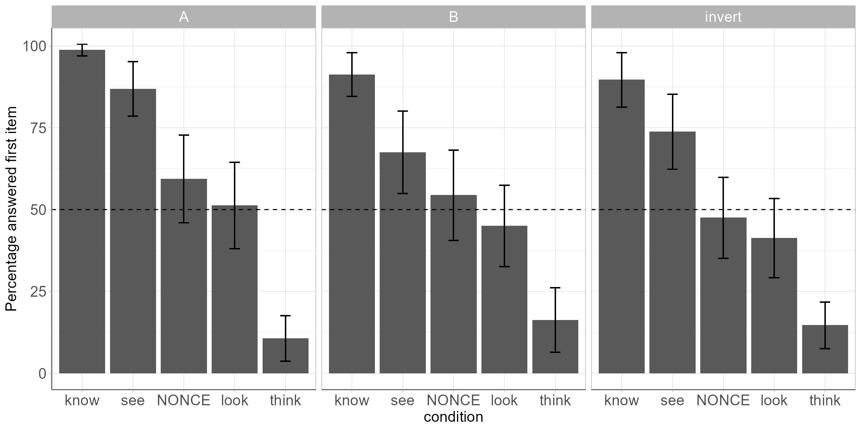

Slide 17
Order of blocks
A and B versions
Block 1: know + think
Block 2: look + (know + think)
Block 3: NONCE + see + (know + think)
Inverted version
Block 1: know + think
Block 2: NONCE + (know + think)
Block 3: look + (know + think)
Block 4: see + (know + think)

Slide 19
Exp 1 Summary
The pattern of results is stable across all versions
See shows a factive patterns of results, albeit with more variability than know
Look and nonce trials are not significantly different from chance, showing neither know-like nor think-like patterns
This suggests that look isn’t automatically grouped with see and assumed to be factive
But it also suggests that meaning extension may not be sufficient for learning the non-factive property of kan

Slide 20
Experiment 2 (planned)
Generalizability of see and look patterns to other see-like and look-like verbs in English

Slide 21
Synonyms of Look and See
Verbs of visual perception
Perceive, observe, glimpse, glance, peek, etc…
Are see-like verbs factive, and look-like verbs non-factive?
Is it categorical or gradient? (e.g., the more see-like a verb is, the more likely for it to show factive patterns?)
Feedback welcome on the proposed experiment design (pretest and main experiment)

Slide 22
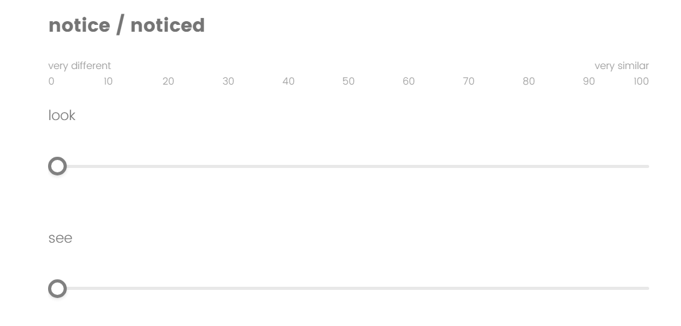
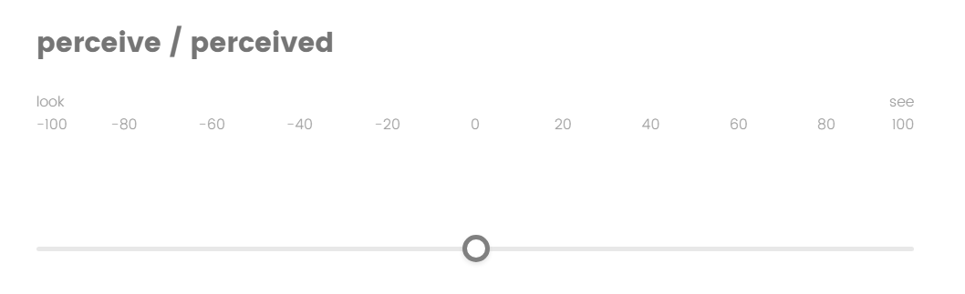
Pretest
How to obtain ratings of how see-like or look-like a verb is?
Option 1: Rating scale of semantic similarity

Slide 23
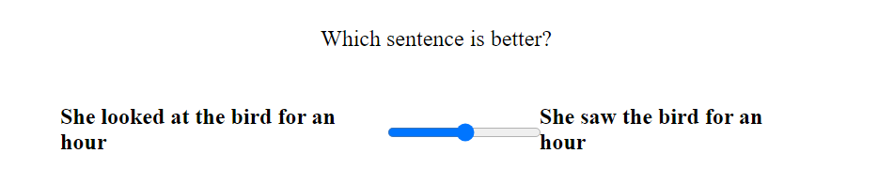
Diagnostics for achievement verbs
Option 2: Acceptability judgment using diagnostics of achievement verbs (Levin, 2009)
Duration: She saw the box for 10 minutes. / She looked at the box for 10 minutes.
Stop: She stopped seeing the box. / She stopped looking at the box.
Carefully: She carefully saw the box. / She carefully looked at the box.

Slide 24
Matrix negation task (Like exp 1)
Meg doesn’t perceive that Sally like apples more than oranges.
Meg doesn’t glimpse that Sally like apples more than oranges.
Meg doesn’t glance that Sally like apples more than oranges.
Meg doesn’t peek that Sally like apples more than oranges.

Slide 25
Further directions

Slide 26
Dichotomy between English and Mandarin
 | Visual achievement |  | Visual exploration
 | verb | belief? | verb | belief?
English | see | Yes, factive | look | Non-factive?
Mandarin | Kandao 看到 | Factive? | Kan 看 | Yes, non-factive

Slide 27
Is Kandao factive?
kandao can take a sentential complement like kan, despite not typically considered a belief verb
你 看 到 她 的 衣服 是 红 的 。(from CHILDES)
You see her poss. clothes be red -de
You saw that her clothes were red. / You see that her clothes are red.

Slide 28
Difficulties with this test in Mandarin
看 kan cannot be negated, so we cannot directly test its factivity
Another complication: Negation for states and actions are different
没 mei vs 不 bu
知道 zhidao (know) and 觉得 juede (think) are negated using 不 bu
看到 kandao is negated using 没 mei

Slide 29
SUmmary
Seeing = Knowing while Looking ≠ Knowing?
Coercion of look into a sentential complement frame shows patterns that are:
Different from see (learners do not automatically group all visual verbs together)
Neither clearly factive nor non-factive (meaning extension insufficient?)
Future studies aimed to more directly explore the seeing = knowing extension

Slide 30
Thank you!
Questions?

Slide 31
More discussion
Experiment design

Slide 32
Further discussion
It is still unclear how exactly a seeing = knowing metaphor may guide learners towards a factive interpretation
Visual see is ambiguous: Meg doesn’t see the book.
Context 1: The book is in the bookshelf, but Meg missed it.
Context 2: Meg searched the bookshelf, and the book isn’t there.
Belief see is factive: Meg doesn’t see that John can play the piano.
Interpretation: John can play the piano, but Meg has a mistaken belief about it.

Slide 33
Reasons for using comparatives
In pilot studies, frames where the embedded clause depicts a visual event elicited noisy data for see
For example, “Teddy doesn’t see that the ball is in the red box”
Having “like” as the embedded verb facilitates the inference reading of see, because liking something isn’t directly observable but instead must be inferred.
Additionally, comparatives allow us to design a two-alternative forced choice (2AFC) task instead of more metalinguistic alternatives. Compare:
Which does Sally like more? Apples oranges
Does Sally like apples? Yes no

Slide 34
Other sensory domains
We’ve only discussed visual perception so far, what about the other senses?
There may be room for investigating the auditory domain using listen and hear.
But English hear is polysemous:
Auditory perception, factive: “I heard him playing the piano”
Communicative, non-factive: “I heard (from someone) that he could play the piano”
Mandarin differentiates these two meanings, and also differentiates achievement and non-achievement usages
听 (non-achievement), 听到 (achievement), 听说 (communicative)

Slide 35
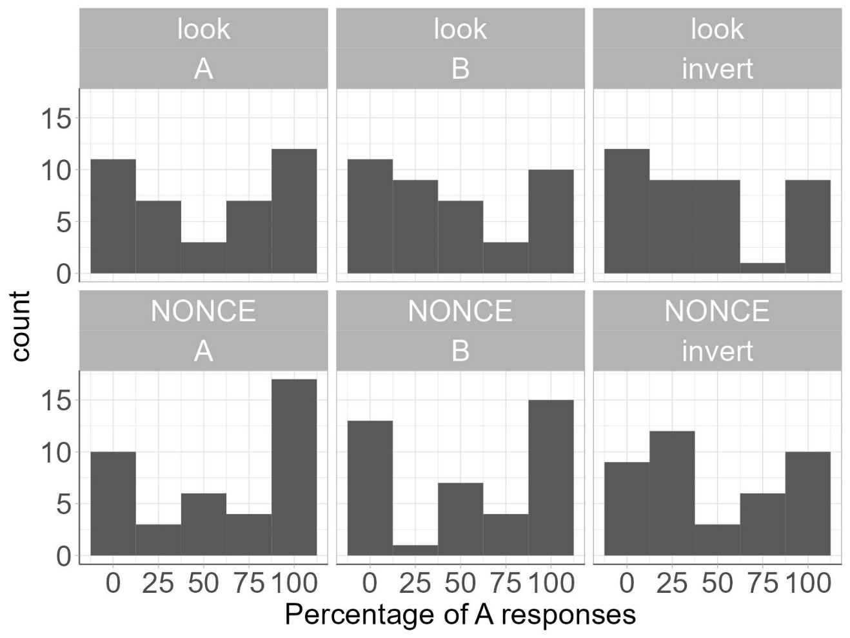
Distribution of answers
There is similar distribution of look and nonce trials
There is .61 correlation for A, .61 correlation for B, .46 correlation for inverted
Some suggestion of a bimodal distribution, but not very clear for look

Slide 36
More complication: ambiguity
我看小孩们在玩玻璃弹珠。
Wo kan xiaohaimen zai wan bolidanzu.
I KAN children PROG play marbles
Ambiguous:
I watch(ed) the kids play with marbles. Small clause Visual
I think the kids are playing with marbles. Sentential clause Belief

