Slide 1
REDUPLICATION IN NOMINAL ATTRIBUTIVE MODIFIERS (NAM) IN ÒGÈ
Priscilla Lọlá Adénúgà.
GK Colloquium, 16.01.2018

Slide 2
Structure of the talk
Introduction
NAM reduplication in Ògè
NAM reduplication in Standard Yoruba (SY)
Theory of labelling (Zeijlstra forthcoming)

Slide 3
1. Introduction, NAM in Ògè
(1) a. Ìkári áchọ hò. a’. Ìkari ópú sìn.
DET cloth white DET dog black
‘The cloth is white.’ ‘The dog is black.’
b. ìkári í-hò-hò áchọ b’. ìkári í-sìn-sìn ópú
DET NML-white-white cloth DET NML-black-black dog
‘the white cloth’ ‘the black dog’

Slide 4
Introduction, NAM in Standard Yoruba
(2) a. Asọ gbó. a’. Ilé ga.
cloth old house tall
‘cloth is old.’ ‘house is tall.’
b. asọ gbí-gbó b’. ilé gí-ga
cloth NML-old house NML-tall
‘an old cloth’ ‘a tall house’

Slide 5
2. The nature of NAM reduplication in Ògè
(3) Base Red Gloss
a. hò hò-hò ‘white’
b. sìn sìn-sìn ‘black’
c. chọ chọ-chọ ‘red’
d. gọ gọ-gọ ‘old’
e. yẹn yẹn-yẹn ‘sweet’
f. tun tun-tun ‘new’
g. gò gò-gò ‘dry’

Slide 6
3. Morphological Doubling Theory
Morphological Doubling Theory (MDT) (Inkelas and Zoll 2005)
the inputs to a morphological doubling construction are morpho-semantically identical
exactly two roots combine to form another category of word

Slide 7
Morphological doubling schema
category =Y
meaning =f (F)
(4)
category =X category = X
meaning = F meaning = F
Inkelas and Zoll (2005)

Slide 8
Morphological derivation of NAM in Ògè
(5) Category =Adjective
Meaning = ’white’
hò-hò
category = Pred category = Pred
meaning = ‘white’ meaning = ‘white’
hò hò

Slide 9
Ògè NAM in predicative construction
(6) a. Ìkári áchọ hò. c. Ìkári ópú sìn
DET cloth white DET dog black
‘The cloth is white.’ ‘The dog is black.’
b. *Ìkári áchọ hò-hò d. *Ìkári ópú sìn-sìn
DEM cloth white-white DEM dog black-black
Int. ̔ The cloth is white ‘ Int. ̔ The dog is black‘

Slide 10
Notes on NAM in Ògè
- NAM in Ògè is fully reduplicated
- The reduplicated form is derived through compounding
- the base form of the reduplicant occurs in predicative constructions
- in attributive position, the modifier has to be nominalized with a derivational prefix [í]

Slide 11
4. Nominalization in Ògè
(7) PFx Base Red Gloss
a. í- hò í-hòhò ‘white’
b. í- sìn í-sìnsìn ‘black’
c. í- chọ í-chọchọ ‘Red’
d. í- gọ í-gọgọ ‘old’
e. í- yẹn í-yẹnyẹn ‘sweet’
f. í- tun í-tuntun ‘new’
g. í- gò í-gògò ‘dry’

Slide 12
Nominalization in Ògè
(8) Ògè Gloss Ògè Gloss
a. pù ‘kill’ ínẹ- í- pù-ẹnẹ ‘murderer/killer’
person-NML-kill-person
b. chẹ ‘sweep’ ínẹ- í- chẹ-éshín ‘sweeper’
person-NML-sweep-floor/ground

Slide 13
Verbs are also prefixed with the high toned vowel [í] when they are in gerundive form;
(9) Ògè Gloss Ògè Gloss
a. gwuọ ‘drink’ í-gwuọ ‘drinking’
b. pu ‘kill’ í-pu ‘killing’
c. va ‘come’ í-va ‘coming’

Slide 14
Internal structure of Ògè NAM.
(10) N
NML Adj
í-
Pred Pred
hò- hò

Slide 15
Notes
verbs are prefixed with [í] when in gerundive form
NML is the head of the NAM
NAM is a noun in Ògè
NAM can occur in isolation in the DP without the noun it modifies

Slide 16
NAM IN ISOLATION
(11) a. Sade dà í-chọchọ. b. Bose ju í-yẹnyẹn.
Sade buy NML-red Bose eat NML-sweet/delicious
‘Sade bought the red one.’ ‘Bose ate the sweet one.’

Slide 17
5. Functional Properties of NAM in Ògè
(12) a. íkári í-hò-hò áchọ a’. ìkári í-sìn-sìn ópú
DET NML-white-white cloth DET NML-black-black dog
‘the white cloth’ ‘the black dog’
b. íkári í-chò-chò áchọ b’. ìkari í-gọ-gọ ópú
DET NML-red-red cloth DET NML-old-old dog
‘the red cloth’ ‘the old dog’

Slide 18
Functional Properties of NAM in Ògè
(13) a. *íkári hò áchọ a’.*ìkari sìn ópú
DET white cloth DET black dog
Int. ‘the white cloth’ Int. ‘the black dog’
b. *íkári í-hò áchọ b’.*ìkari í-sìn ópú
DET NML-white cloth DET NML-black dog
Int. ‘the white cloth’ Int. ‘the black dog’

Slide 19
Structure of NAM as a complex NP.
(14) DP
D’
D NP
ìkári NP DP
N‘
ìhòhò áchọ

Slide 20
Notes on functional properties of reduplicated form
the base form cannot be used attributively (13a&a’)
monosyllabic adjectival predicates are derived to attributive modifiers

Slide 21
Summary:
the two inputs to a morphological doubling (reduplication) are morpho-semantically identical. (Inkelas & Zoll 2005, Inkelas 2008)
no uniformity in the semantic function associated with the output of morphological doubling.
NAM in Ògè is restricted to the pre-nominal position.

Slide 22
NAM Reduplication in Standard Yorùbá (SY)
(15) a. asọ gbí-gbó a’. ilé gí-ga
cloth NML-old house NML-tall
‘an old cloth’ ‘a tall house’
b. ọnà fí-fẹ b’. gànga jí-jìn
street NML-wide well NML-deep
‘a wide street’ ‘a deep well’

Slide 23
6. Nature of NAM Reduplication in SY
(16) Base Red Gloss
gbó gbí-gbó ‘old,being old’
ga gí-ga ‘tall, being tall’
gbẹ gbí-gbẹ ‘dry, being dry’
fẹ fí-fẹ ‘large, being large’
jìn jí-jìn ‘deep, being large’
The reduplicated form is derived by the affix of a [Cí] prefix to the base.

Slide 24
Predicate cleft constructions in SY
(17) a. Pí-pa ni Sade pa ejò.
NML-kill FOC Sade kill snake
‘Sade [FOCUS killed] the snake.’
b. Gbí-gbó ti asọ gbó dùn mi.
NML-old REL cloth old hurt 1SG
‘The fact that the cloth is old hurt me.’
only nominal expressions can front

Slide 25
Base form of NAM in Predicate constructions in SY
(18) a. Asọ yẹn gbó. a’. Ilẹ mi fẹ.
cloth DEM old land 1SG large
‘That cloth is old.’ ‘My land is large.’
b. Ilé yìí ga. b‘. Ẹja naa gbẹ.
house DEM tall fish DET dry
̔ This house is tall.̕ ̔ The fish is dry.‘

Slide 26
Summary
NAM in SY are partially reduplicated (although, this is not exhaustive)
the reduplicated form is derived by the affix of a [Cí] prefix to the base, where the ‘C’ is a copy of the first consonant of the base form followed by the fixed high toned vowel [í] (Pulleyblank 2008)
the base form of NAM has a restricted distribution which is post-N position and in predicate constructions
NAM in SY are nominal expressions (Welmers 1973, Awobuluyi 1978, Ilori 2006).

Slide 27
Projection by selection approach
Rule 1: If α merges with β, and α carries a feature [uX] and β carries a matching independent feature [X], neither [uX] on α nor [X] on β percolates; all features that do not stand in such an [X]-[uX] sisterhood relation do percolate (Zeijlstra, forthcoming)
(19) a. {[F]} b. {[F],[uK]}
{[F],[uG]} {[G]} {[F],[uG]} {[G],[uK]}

Slide 28
Projection by selection approach
Rule 2: α merges with β iff at least one featural dependency is resolved as a result of this merger (Zeijlstra, forthcoming)

Slide 29
DP-internal selection in Dutch
(20) a. Het mooi-e huis/ Een mooi-Ø huis
The beautiful-DEF.SG.NEUT house/
A beautiful-INDEF.SG.NEUT house
̔A / the beautiful house.̕
b. Het / een huis is mooi*(-e)
The / a house is beautiful
̔ The / a house is beautiful’

Slide 30
DP-internal selection in NAM in SY
(21) {[D]}
{[N]} {[uN],[D]}
yẹn
{[N]} {[uN],[N]}
asọ
{[N],[uN],[uPred]} {[Pred]}
gbí- gbó

Slide 31
DP-internal selection in NAM in Ògè
{[D]}
(22) {[D],[uN} {[N]}
ìkári {[N],[uN]} {[N]}
{[N],[uN][uAttr]} {[Attr]} áchọ
í- hòhò

Slide 32
Syntactic assumptions
all features have been reduced to categorical features, percolation lines are nothing but percolations of interpretable (or independent) features

Slide 33
Syntactic assumptions
the prefix [í] is underlyingly feature set {[N],[uN],[uAttr]}
the prefix [gbí] is feature set {[N],[uN],[uPred]}
the base form of the reduplicated NAM in SY is feature set {[Pred]} while the base form of the reduplicated NAM in Òge is feature set {[Attr]}
the prefix [í] & [Cí] are the head of the reduplicated NAM whose feature must percolates up in the derivation

Slide 34
Summary and Conclusion
in both languages, NAM is derived from predicatively used adjectives
prefix [í] in Ògè derives fully reduplicated predicates into nominal modifiers

Slide 35
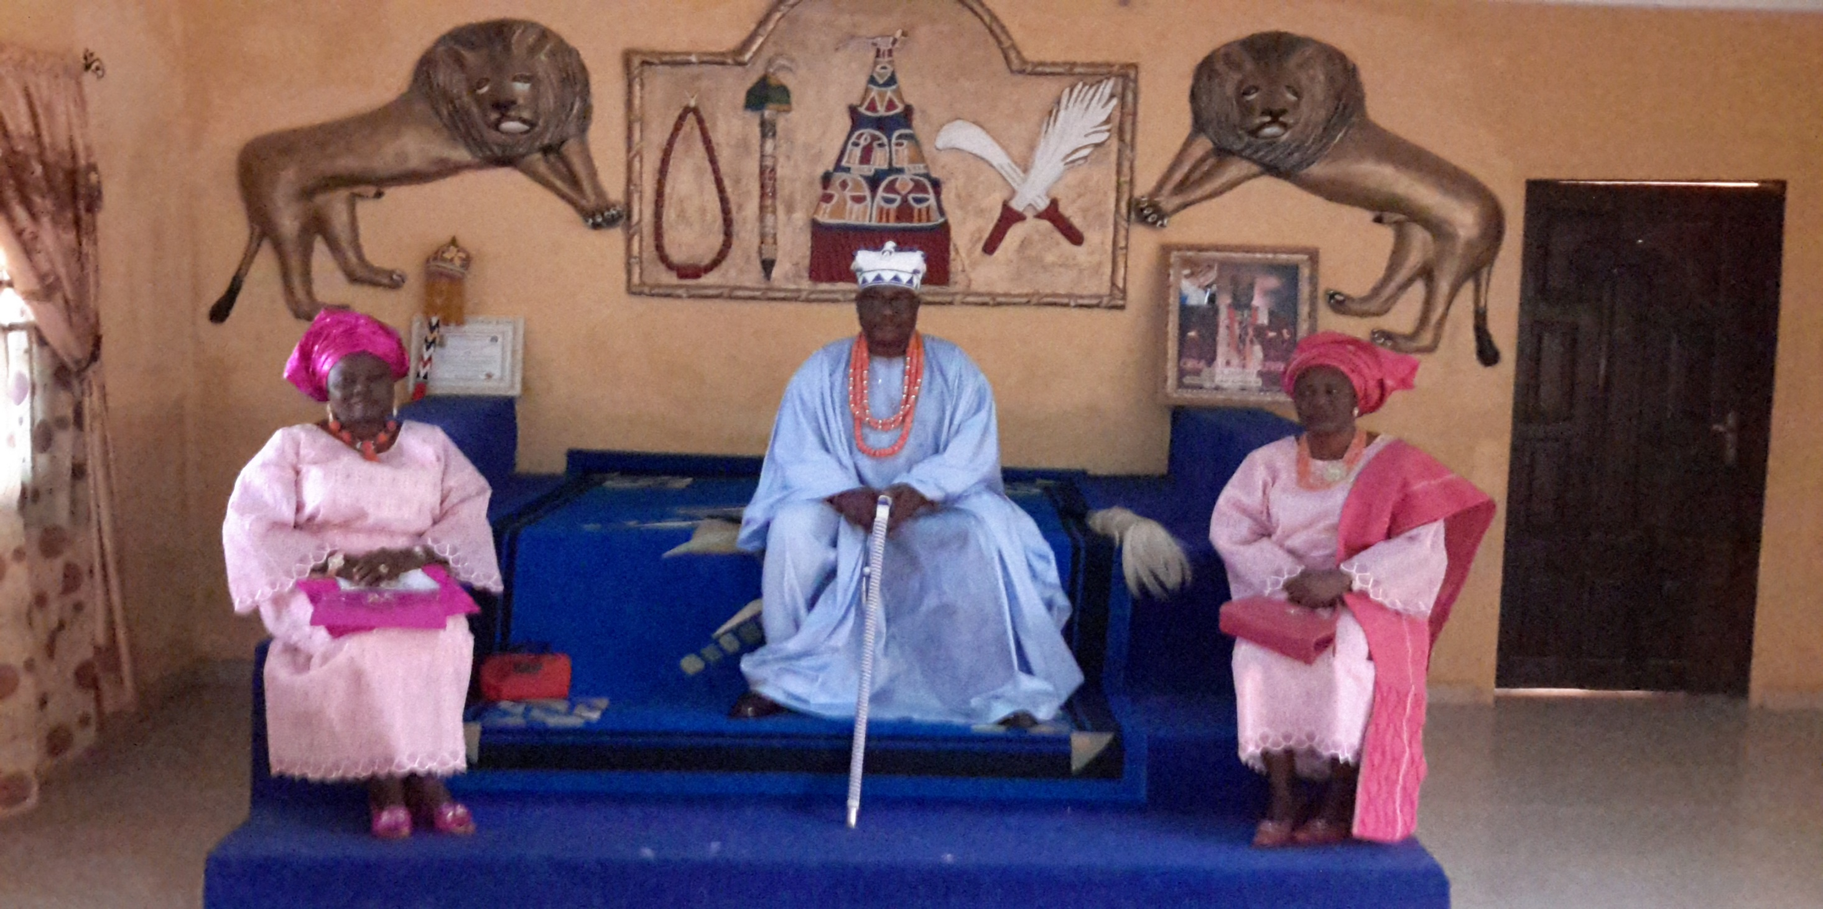
ÒGÈ KINGDOM

Slide 36
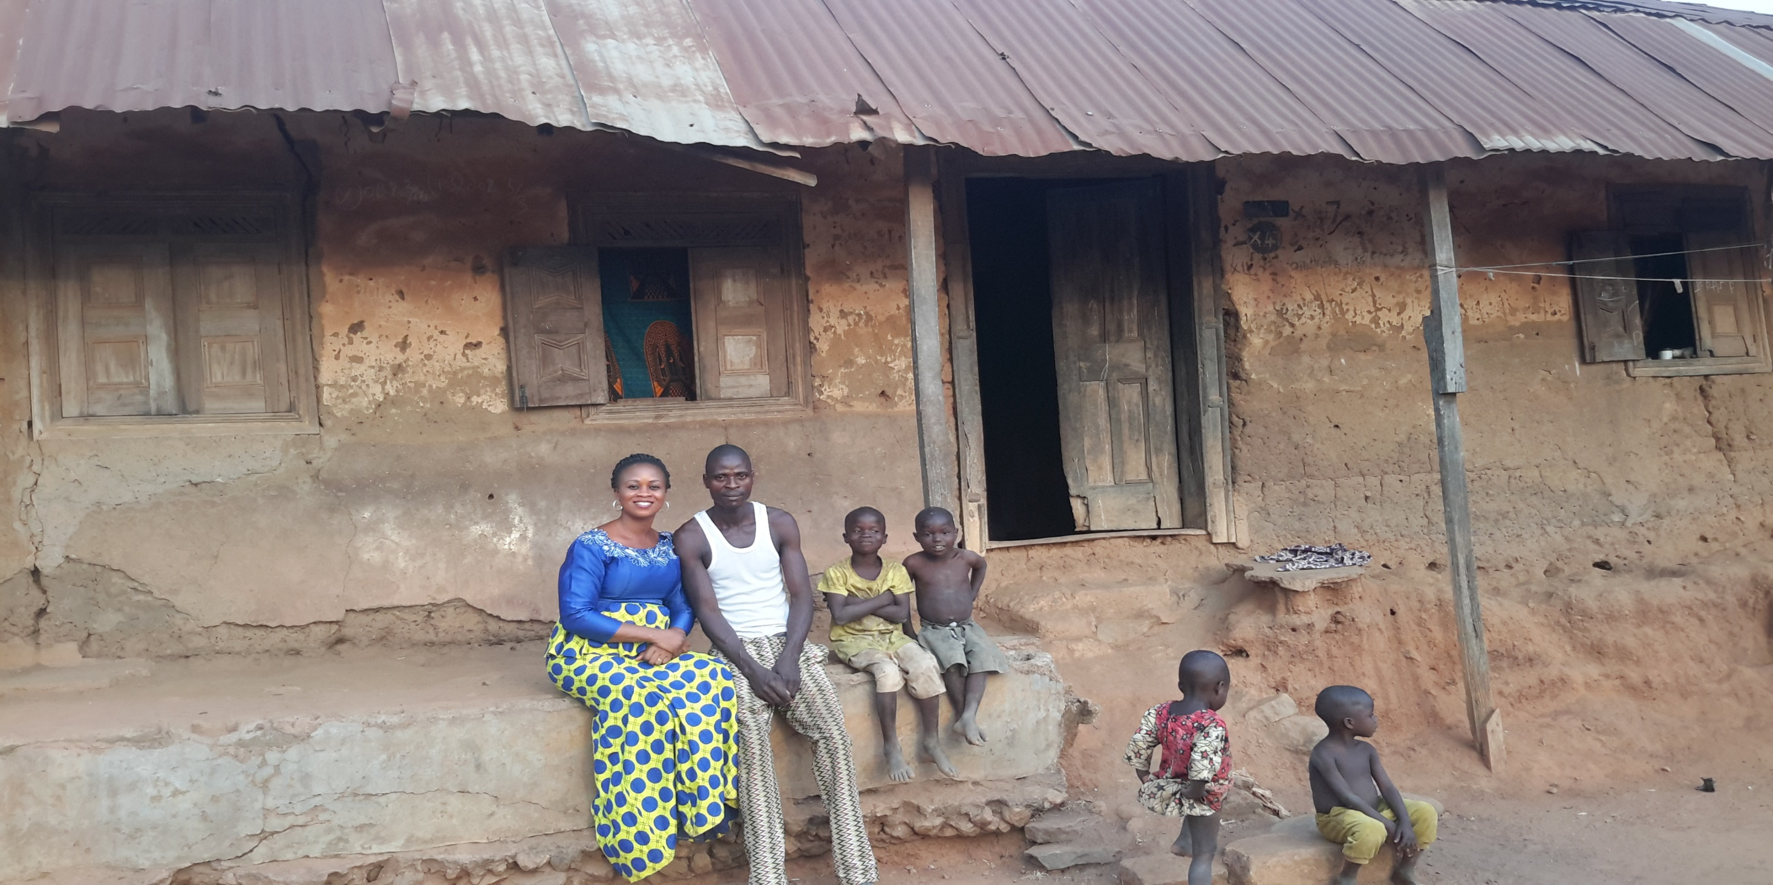
FIELD TRIP TO ÒGÈ

Slide 37
References
Awobuluyi, O. 1978. Essentials of Yorùbá grammar. Ibadan: Oxford University Press.
Ilori, J.F. 2016. ‘Categorial Status of Yoruba Attributives Modifiers’, Ihafa: A Journal of African Studies Volume 8 Number 2, 124-152.
Inkelas, S. & Zoll, C., 2005. Reduplication: doubling in morphology: Cambridge University Press.
Inkelas, S., 2005. Morphological Doubling Theory I: Evidence for morphological doubling in reduplication. In Bernhart Hurch (ed.) Studies in reduplication. Mouton.
Inkelas, Sharon & Cheryl Zoll. 2005. Reduplication: Doubling in Morphology. Cambridge University Press.
Zeijlstra, H., (forthcoming). Labelling, selection and feature checking. In Hartmann, Mursell and Smith (eds) Title tbd. Language Science Press
Welmers, W. 1973. African Language Structures. Berkeley: University of California Press

