Slide 1
Evaluating analyses of the Conjunct Constraint with its violations
Zheng Shen
National University of Singapore
2026.7.16 Singapore Summer Meeting

Slide 2
Coordinate Structure Constraint and Conjunct Constraint
Coordinate Structure Constraint (CSC):
Conjunct Constraint (CC): Conjuncts cannot be moved.
*What did Mary buy [ t and a book about linguistics ]?
Element Constraint (EC): No element contained in a conjunct can be moved out of that conjunct.
*What did Mary buy [ a photo of t ] and a book about linguistics?
Grosu 1973, Oda 2021: CC and EC are distinct constraints and should be analyzed separately.
We will focus on (two recent analyses of) the CC today.

Slide 3
The Category Transfer analysis (Zhang 2010)
CC is further split into CCe and CCi:
Assuming the structure: [ Ce [and Ci]]
CCi: ban on movement of the second/internal conjunct
*What did Mary buy [ a photo and ]?
Zhang: coordinators do not allow their complements to be moved or deleted.
There seems to be no exception to CCi.
CCe: ban on movement of the first/external conjunct
*What did Mary buy [ and a book]?
Zhang: Category Transfer analysis based on CCe-violating movement in Mandarin.

Slide 4
The Category Transfer analysis (Zhang 2010)
Assumption: Any moved element must have categorial features.
Coordinators like and in English can coordinate DPs, PPs, VPs, etc, indicating that they do not have categorial features.
In this case, the external/first conjunct transfers its feature to the coordinator and becomes immobile.
[C1_{[+N]} and[∅] C2 _{[+N]}] -> [C1 [∅] and _{[+N]} C2 _{[+N]}] –> C1 [∅] is immobile

Slide 5
The Category Transfer analysis (Zhang 2010)
Argument: he/gen in Mandarin Chinese can only conjoin nominals, thus have their own categorial feature [+N].
C1 retains its categorial feature thus can be moved.
In the sentences below, the first conjunct moves out of the conjunction.
Huoche hui [ t gen qiche] xiangzhuang ma? (Zhang 2010, ex. 85a) 火車 會 跟汽車 相撞 嗎？ train will [ t and car] collide Q ‘Will the train and the car collide?’
Akiu zai Riben [ t gen Baoyu] jian-le mian. (Zhang 2010, ex. 90b) 阿Q在日本 跟 寶玉 見了面 Akiu in Japan [t and Baoyu] meet-LE face ‘Akiu and Baoyu met up in Japan.’
Prediction: CC-violating movement of C1 is possible only for coordinators with categorial features.
Note that the categorial feature on the coordinator is a necessary but not a satisfactory condition for CC-violating movement.

Slide 6
The Parallelism Requirement
Fortuny 2024 (cf. Napoli 1993) proposes:
the Parallelism Requirement: Two syntactic constituents can be coordinated if and only if the categorial features are identical.
Fortuny proposes a generalized categorial feature system where [Foc], [Rel], and [Wh] (but not phi features) are categorial features
The Requirement can account for CCe as the conjuncts would have different wh-features:
*What did Mary buy [ t and a photo ]? did Mary buy [what_{[+wh]} and a photo_{[-wh]} ]?
Sidenote: one difficulty for parallelism requirement approach is ruling out ‘What did Mary buy [t and t]?
Fortuny 2024 proposes Prohibition against self coordination and the Integrity Condition on Coordinate Structures
But Zhang 2010’s treatment of CCi could do the job as well.

Slide 7
The Parallelism Requirement
Although Fortuny did not discuss CC-violating movement, the analysis predicts:
CC-violating movement cannot be a movement that target any features.
The Parallelism Requirement is also a necessary condition.

Slide 8
Predictions
The Category Transfer analysis predicts only coordinators without category restrictions can allow CC-violating movement.
The Parallelism Requirement analysis predicts only movement that does not target features can allow CC-violating movement.

Slide 9
CC-violating movement in BCMS
Bosnian-Croatian-Montenegrin-Serbian (thereinafter BCMS) allows CC-violating movement.
?Knjige je Marko [ t i filmove] kupio. Books is Marko [ t and movies] bought ‘Marko bought books and movies.’ (Boskovic 2009, ex 30, see also Stjepanović 2014, Oda 2021)

Slide 10
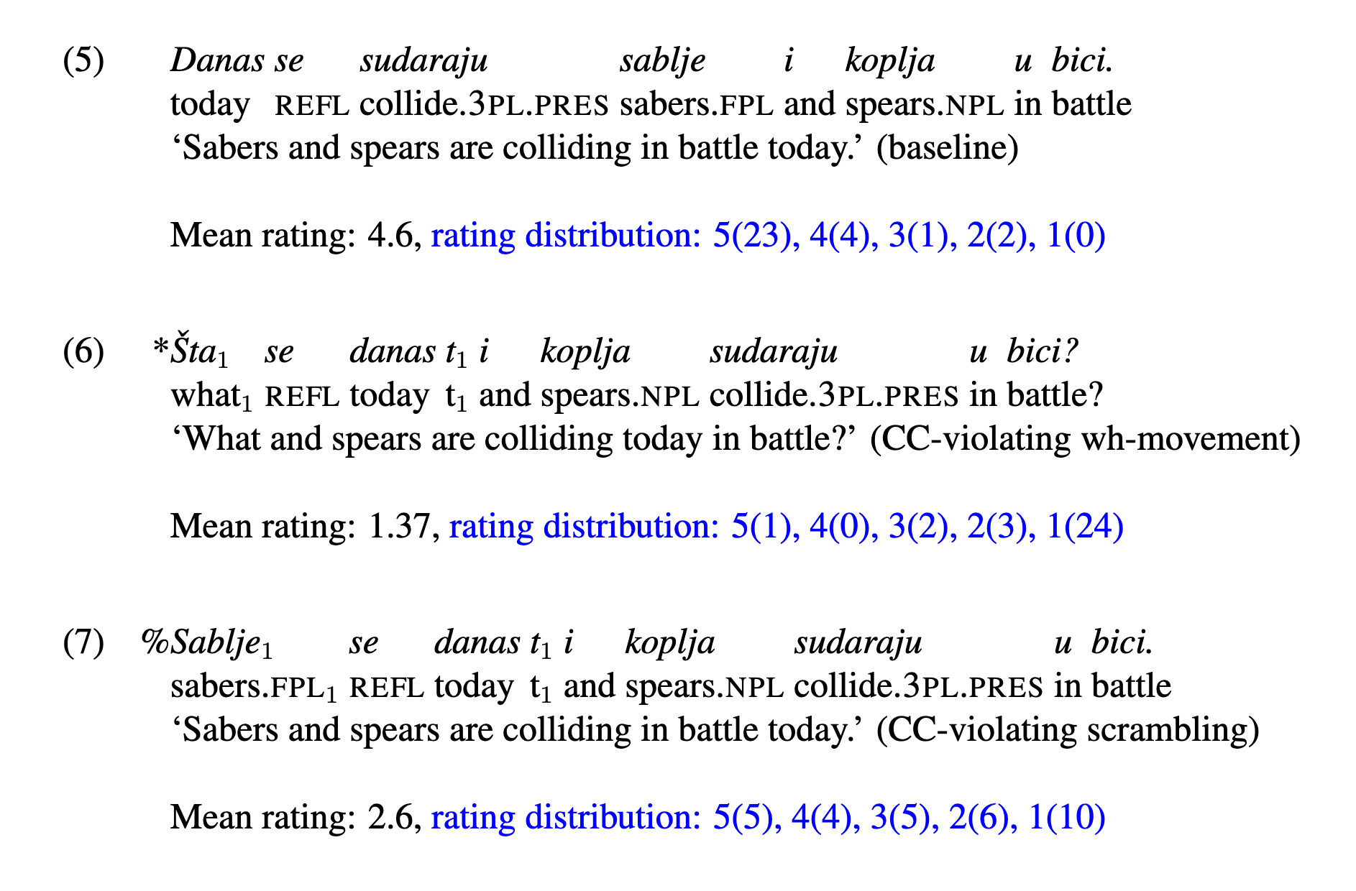
CC-violating movement in BCMS
Shen 2023 conducted a survey with 30 BCMS speakers
Observation 1: the coordinator is i
Observation 2: wh-movement cannot violate the CC while scrambling can (for some speakers)

Slide 11
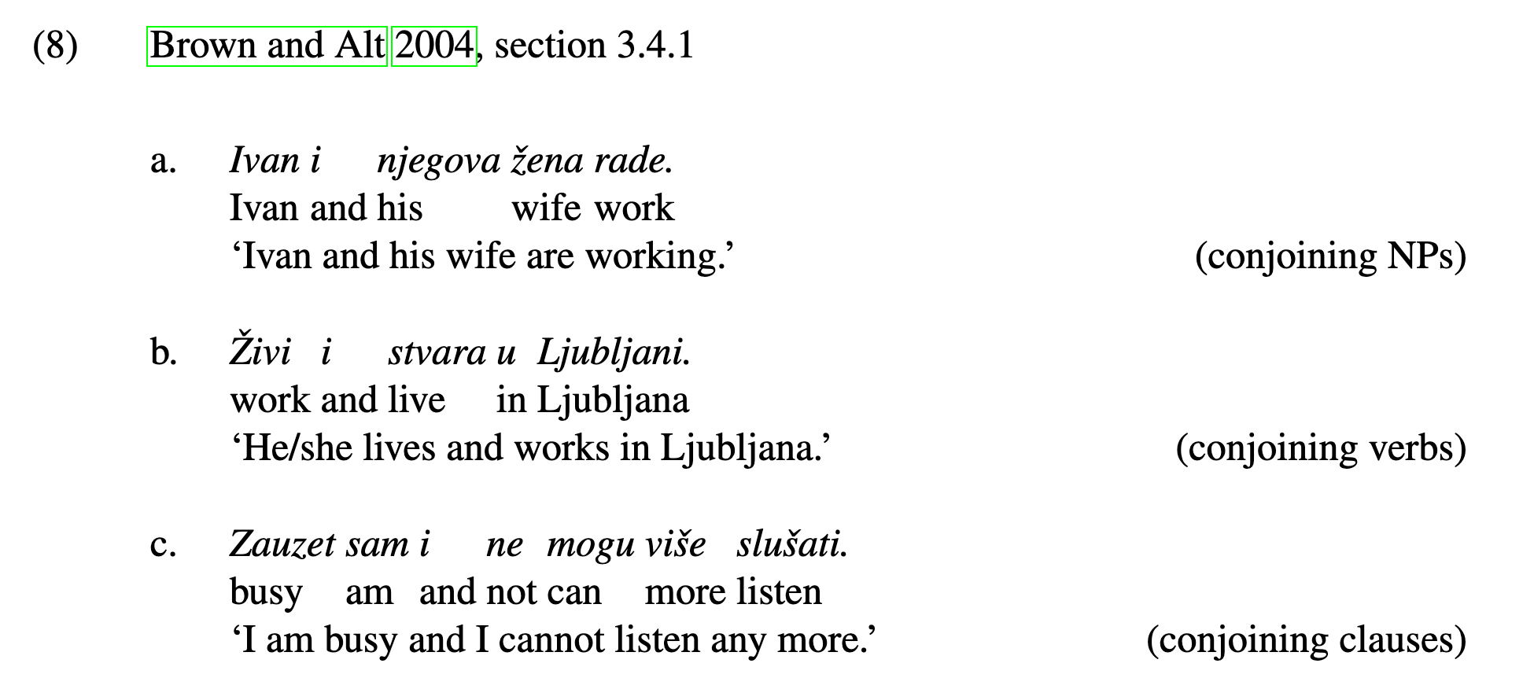
Implications for the Category Transfer analysis
The coordinator i in BCMS can coordinate different phrases:
Data from Oda 2021 suggests that the same CC-violating movement is available in Polish and Russian with the same coordinator i.

Slide 12
Implications for the Category Transfer analysis
CC-violating movement in BCMS thus challenges the cross-linguistic applicability of the Category Transfer analysis. (I think Zhang acknowledged this point in one of her papers, but I can’t recall which, please let me know if you know.)
It’s also unclear how this analysis would account for the contrast between wh-movement and scrambling.

Slide 13
Implications for the Parallelism Requirement analysis
The unavailability of CC-violating wh-movement is expected under the Parallelism analysis as one conjunct is [+wh] and the other is not.
The availability of CC-violating scrambling is also expected:
Bailyn 2001, 2004 argues that in Slavic languages, local scrambling is driven by EPP, following Miyagawa 2003.
Scrambling does not require the conjuncts to have different features, the Parallelism Requirement is thus not violated.

Slide 14
Further evidence for the wh/scrambling contrast
Data collected from 5 speakers confirms the wh vs. scrambling contrast:
*Koje sablje se danas i ta koplja sudaraju u bici? (1.8/5) What sabers aux today and those spears collided in battle ‘What sabers and those spears collided in battle today?’
Koje sablje se danas i koja koplja sudaraju u bici? (3.6) What sabers aux today and what spears collided in battle ‘What sabers and what spears collided in battle today?’
Moving a wh conjunct is OK as long as the other conjunct is also wh.

Slide 15
Back to CC-violating movement in Mandarin
Note that the CC-violating movement in Mandarin from Zhang 2010 also does not involve obvious feature checking.
Huoche hui [ t gen qiche] xiangzhuang ma? (Zhang 2010, ex. 85a) 火車 會 跟汽車 相撞 嗎？ train will [ and car] collide Q ‘Will the train and the car collide?’
Akiu zai Riben [ t gen Baoyu] jian-le mian. (Zhang 2010, ex. 90b) 阿Q在日本 跟 寶玉 見了面 Akiu in Japan [t and Baoyu] meet-LE face ‘Akiu and Baoyu met up in Japan.’

Slide 16
Back to CC-violating movement in Mandarin
Zhang 2008 provides an example of CC-violating relativization:
[t Gen Daiyu he-zu fangzi de ] xuesheng hen-qiong. 跟 黛玉 合租 房子 的 學生 很窮 [t and Daiyu co-rent house DE ] student very-poor ‘The student who rents a house with Daiyu is poor.’ (Zhang:2008 ex 57}
At the same time, Zhang 2008, 2010 argues that liang-ge-ren ‘two people’ ensure that the ‘A gen B’ string forms a constituent.
Adding liang-ge-ren（兩個人）to (9) makes the sentence degraded:
*Gen Daiyu liang-ge-ren he-zu fangzi de xuesheng hen-qiong. 跟 黛玉 兩個人 合租 房子 的 學生 很窮 and Daiyu two-CL-people co-rent house DE student very-poor Intended: `The student who rents a house together with Daiyu is poor.’
Gen Daiyu in (9) might not be part of conjunction, thus (9) is not CC-violating relativization.

Slide 17
Back to CC-violating movement in Mandarin
Adding liang-ge-ren to non feature probing CC-violating movement is OK:
Akiu zai Riben [ gen Baoyu] liang-ge-ren jian-le mian. 阿Q在日本 跟 寶玉 兩個人 見了面 Akiu in Japan [t and Baoyu] two-CL-people meet-LE face ‘Akiu and Baoyu two of them met up in Japan.’

Slide 18
Interim Summary
CC-violating movement in BCMS challenges the Category Transfer analysis for CCe.
The Parallelism Requirement analysis correctly predicts the wh-movement/scrambling contrast.

Slide 19
A problem for Fortuny’s Parallelism Requirement
Fortuny proposes a generalized categorial feature system where [Foc], [Rel], and [Wh] (but not phi features) are categorial features.
The ban on wh-movement out of conjunction is subsumed by the ban on coordinating phrases of difference categorial features.
However, recent discussion established that the ban on coordinating phrases of difference categorial features does not hold:
[[_{NP} That place] and [_{PP} behind these shops]] are where many families reside. (Patejuk and Przepiórkowski, 2023, ex. 20)
...[[_{NP} with respect] and [_{AdvP} humanly]] is not how all of us treat our animals! (Patejuk and Przepiórkowski, 2023, ex. 11’)
Note that the pseudocleft construction in (15-16) rules out the clausal ellipsis analysis of the sentences.

Slide 20
A modified Parallelism Requirement
I propose a modified Parallelism Requirement:
The Parallelism Requirement (modified): The conjuncts and the resulting coordinate structure are of the same A’ features e.g. [Rel], [Foc], [Wh].
Following van Urk 2015, A movement targets obligatory features while A’ movement targets optional features, thus (17) can be implemented as (18)
The Parallelism Requirement (modified): The conjuncts and the resulting coordinate structure are of the same optional features.
(18) predicts that CC-violating movement cannot be movement that probes A’/optional features.

Slide 21
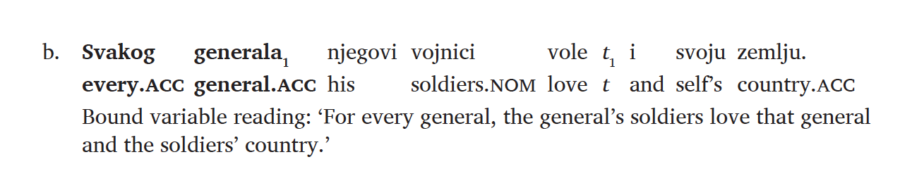
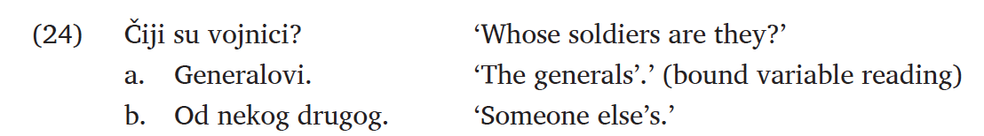
Evidence
Shen 2023: CC-violating movement in BCMS feeds quantifier binding, suggesting A movement.
5/30 chose the generals
25/30 chose the generals

Slide 22
Evidence
A reviewer suggest that (23b) could result from clausal ellipsis thus does not involve CC-violating movement:
[Every.acc general.acc his soliders love] and [self’s country <his soldiers love>]
Adding podjednako ‘equally’ rules out the clausal ellipsis parse and 4 out of 5 speakers I consulted chose the bound variable reading.
Svakog generala njegovi vojnici podjednako vole i svoju zemlju. Every general.acc his soldiers equally love and self’s country. ‘Every general₁ is such that his₁ soldiers equally love him and the soldier’s country.’

Slide 23
Challenges from cross-linguistic data?
So far the proposal is supported by the data from Mandarin and BCMS.
It would be ideal if the Requirement is universal.
Oda 2021 reported/summarized CC-violating movement from several other languages.
Almost all are scrambling-like movement, compatible with the proposal.
But there are examples of movement of wh-elements as well:

Slide 24
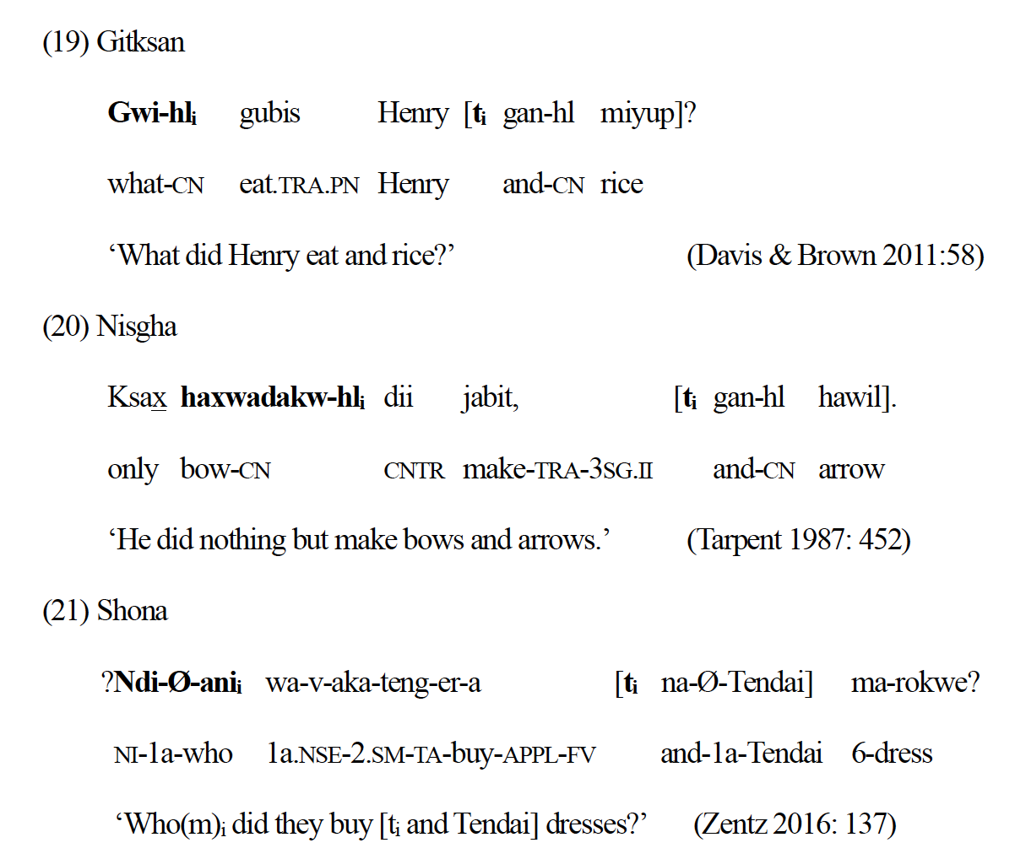
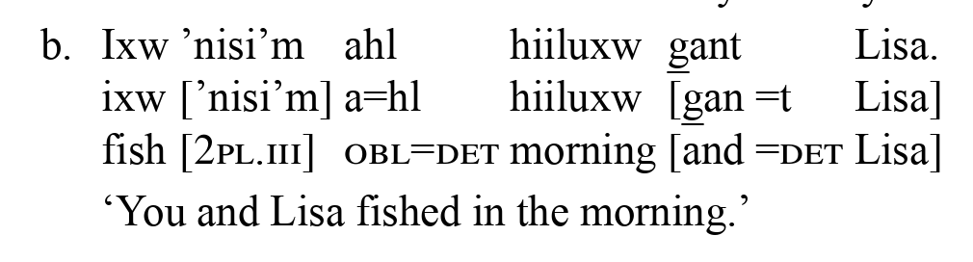
Challenges from cross-linguistic data?
Forbes 2014 notes that in Gitksan (19) and Nisgha (20), gan+DP2 can be extraposed to sentence final.
Forbes: that ‘gan+DP2’ adjoins to DP1 and can be extraposed.
Zentz 2016: na- involves a “comitative construction”, instead of coordination.

Slide 25
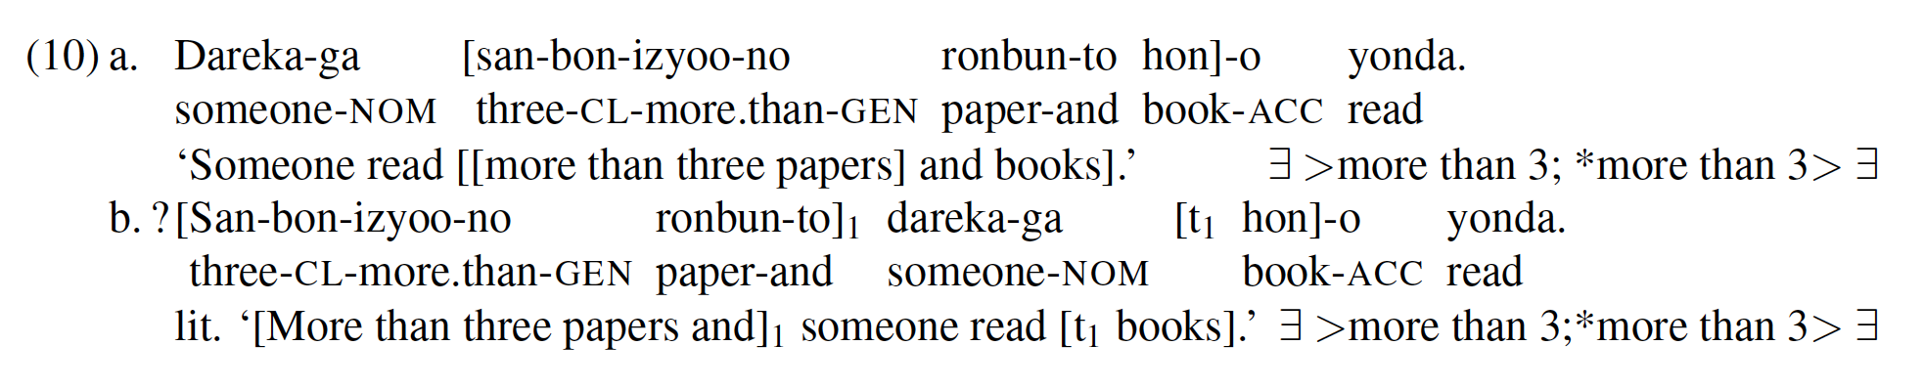
Arano and Oda 2019: Japanese
Arano and Oda 2019 notes CC-violating movement in Japanese does not feed (variable) binding, unlike BCMS.
A&O 2019 thus argues that CC-violating movement is A’ scrambling, potentially challenging the modified Parallelism.

Slide 26
Arano and Oda 2019: Japanese
A&O: that scrambling that crosses a transfer domain (e.g. ConjP) shows A’ properties in Japanese.
CC-violating scrambling does not target optional features, so even that it shows A’ properties, it does not falsify the Parallelism Requirement.
Arano 2025 offers a different analysis and explicitly argues that CC-violating movement in Japanese is not feature driven.

Slide 27
Summary
CC-violating movement provides support to the Parallelism Requirement analysis.
The Parallelism Requirement restricts A’/optional features (instead of categorial features).
Evidence from BCMS, Chinese, and other languages is compatible with the proposal.

Slide 28
What about wh-in-situ?

Slide 29
What about wh-in-situ: predictions
The Parallelism Requirement:
If wh-element is [+wh], wh-in-situ of either conjunct is ruled out:
*[-wh and +wh] or *[+wh and -wh]
If wh-element is not [+wh], wh-in-situ should be OK: [-wh and –wh]
Zhang 2010:
If wh-in-situ is covert movement:
wh-in-situ of the first conjunct should be bad (Category Transfer) wh-in-situ of the second conjunct should be OK
If wh-in-situ is not movement (e.g. unselective binding):
wh-in-situ of the both conjuncts should be OK

Slide 30
What about wh-in-situ: intuitions
Mandarin:
Zai Riben [shui gen Baoyu] liang-ge-ren jian-le mian? 在日本誰跟寶玉兩個人見了面？ in Japan [who and Baoyu] two-CL-people meet-LE face ‘Who and Baoyu two of them met up in Japan.’
Zai Riben [Baoyu gen shui] liang-ge-ren jian-le mian? 在日本寶玉跟誰兩個人見了面？ in Japan [who and Baoyu] two-CL-people meet-LE face ‘Who and Baoyu two of them met up in Japan.’
They sound OK to me, which is still compatible with the Parallelism Requirement:
Given wh-elements can be used as indefinite (Li 1992), wh-elements might not be [+wh]
Ruguo ni tou-le shenme, jiu chengren ba 如果你偷了什麼，就承認吧。 If you stole what, just admit SFP If you stole something, just admit it. (wh-indefinite)

Slide 31
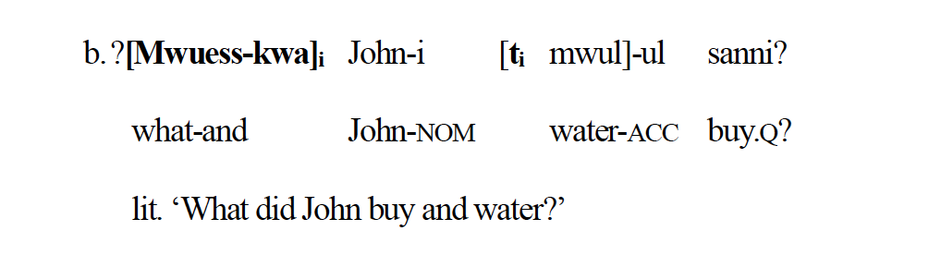
What about wh-in-situ: intuitions
One Korean example from Oda 2021 involves movement of a wh-element:
Given that Korean is a wh-in-situ language, the sentence could be scrambling of the wh-element.
Wh-elements can also be wh-indefinite in Korean (Yun 2013), thus it is not necessary a problem for the Parallelism Requirement.

Slide 32
What about wh-in-situ: experiments in Singlish
Colloquial Singapore English (Singlish): a contact language with English lexifier and Chinese dialects, Malay and Tamil as substrate languages.
It allows both wh-movement and wh-in-situ (Sato and Ngui 2017, Tan and Shen 2025)
Where John can buy the durians?
John can buy the durians where?
Wh-elements in Singlish can also be used as indefinite in the wh-also construction (Lincoln 2024)
What also Mary like to eat. ‘Mary likes to eat everything/anything.’
We conducted two acceptability judgment experiments, one on the first conjunct, one on the second conjunct.

Slide 33
Experiment 1: movement and in-situ of the first conjunct
acceptability judgment on a 100 point scale
Who t fry indomie with oil last night ah? (short | non-island)
What Sarah fry t with oil last night ah? (move | non-island)
Sarah fry what with oil last night ah? (situ | non-island)
Who t fry indomie and chicken last night ah? (short | island)
What Sarah fry t and chicken last night ah? (move | island)
Sarah fry what and chicken last night ah? (situ | island)
18 test items (3 per condition), 36 filler items, 4 check items, n = 29,

Slide 34
Experiment 1: movement and in-situ of the first conjunct
Who t fry indomie with oil last night ah? (short | non-island)
What Sarah fry t with oil last night ah? (move | non-island)
Sarah fry what with oil last night ah? (situ | non-island)
Who t fry indomie and chicken last night ah? (short | island)
What Sarah fry t and chicken last night ah? (move | island)
Sarah fry what and chicken last night ah? (situ | island)
Four conditions were analyzed to test CSC effect on wh-movement

Slide 35
Experiment 1: movement and in-situ of the first conjunct
Who t fry indomie with oil last night ah? (short | non-island)
What Sarah fry t with oil last night ah? (move | non-island)
Sarah fry what with oil last night ah? (situ | non-island)
Who t fry indomie and chicken last night ah? (short | island)
What Sarah fry t and chicken last night ah? (move | island)
Sarah fry what and chicken last night ah? (situ | island)
Four conditions were analyzed to test CSC effect on wh-in-situ

Slide 36
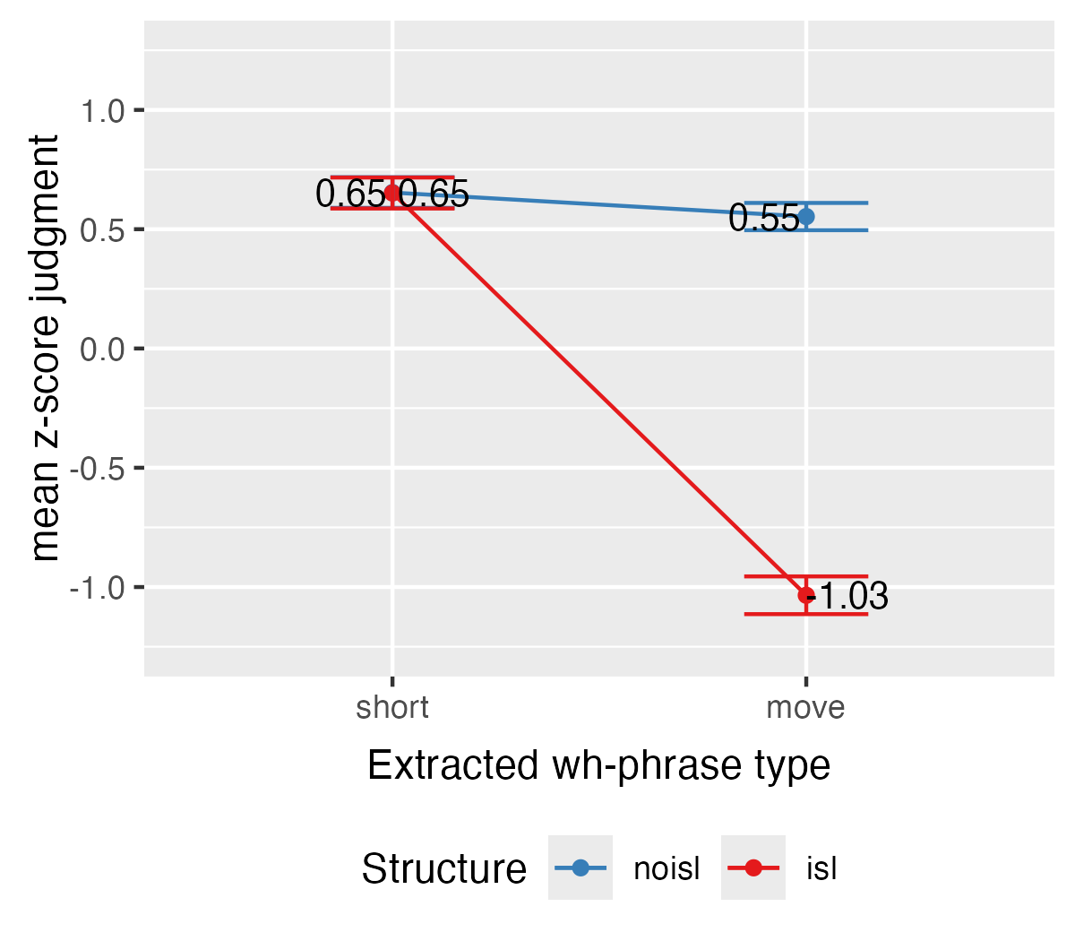
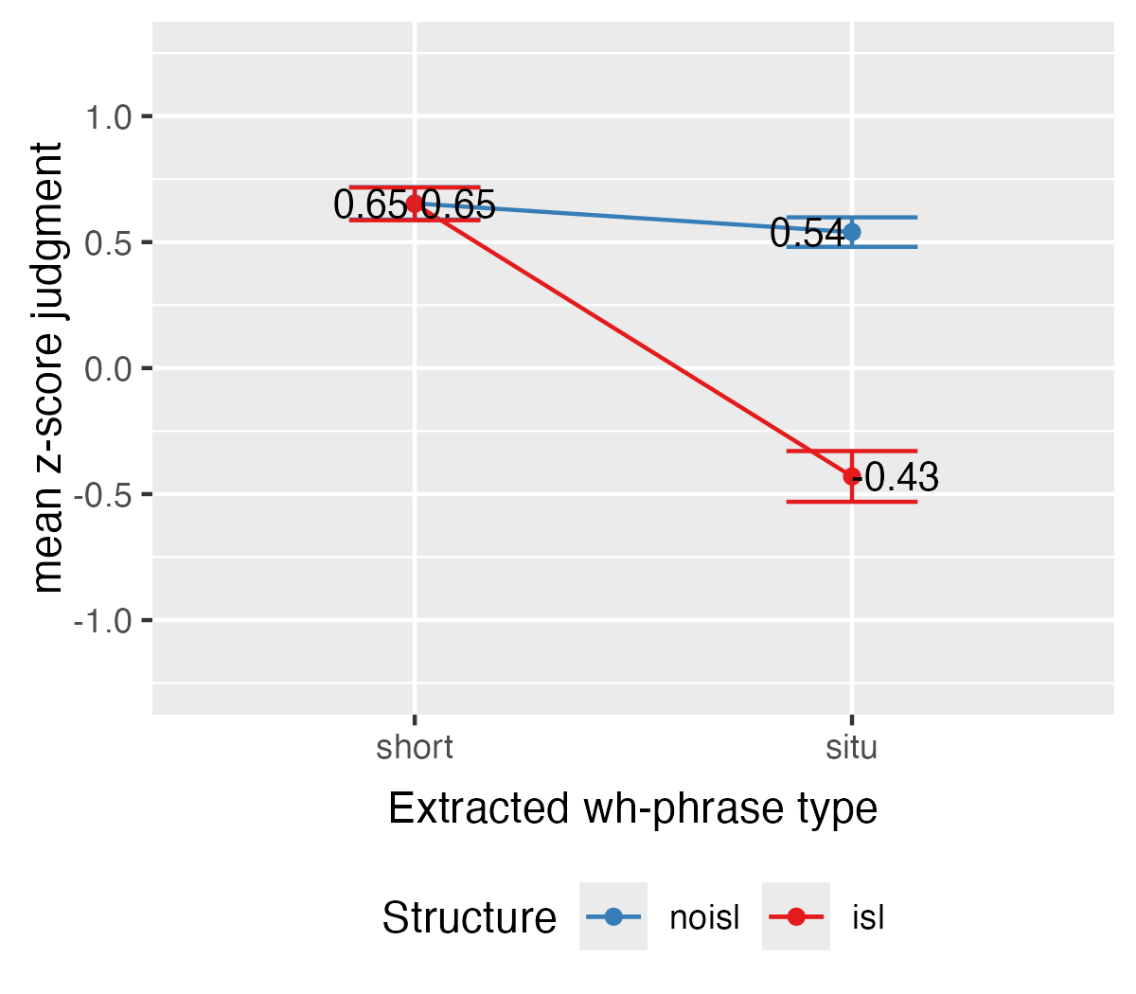
Experiment 1: movement and in-situ of the first conjunct
What Sarah fry t and chicken ah?
Sarah fry what and chicken ah?
short vs. move (p < .0001)
short vs. situ (p < .0001)
Evidence for CSC in both wh-movement and wh-in-situ.

Slide 37
Experiment 2: movement and in-situ of the second conjunct
same procedure, n = 29
Who t fry indomie with oil last night ah? (short | no-island)
What Sarah fry indomie with t last night ah? (move | no-island)
Sarah fry indomie with what last night ah? (situ | no-island)
Who t fry indomie and chicken last night ah? (short | island)
What Sarah fry indomie and t last night ah? (move | island)
Sarah fry indomie and what last night ah? (situ | island)

Slide 38
Experiment 2: movement and in-situ of the second conjunct
same procedure, n = 29
Who t fry indomie with oil last night ah? (short | no-island)
What Sarah fry indomie with t last night ah? (move | no-island)
Sarah fry indomie with what last night ah? (situ | no-island)
Who t fry indomie and chicken last night ah? (short | island)
What Sarah fry indomie and t last night ah? (move | island)
Sarah fry indomie and what last night ah? (situ | island)
Four conditions were analyzed to test CSC effect on wh-movement

Slide 39
Experiment 2: movement and in-situ of the second conjunct
same procedure, n = 29
Who t fry indomie with oil last night ah? (short | no-island)
What Sarah fry indomie with t last night ah? (move | no-island)
Sarah fry indomie with what last night ah? (situ | no-island)
Who t fry indomie and chicken last night ah? (short | island)
What Sarah fry indomie and t last night ah? (move | island)
Sarah fry indomie and what last night ah? (situ | island)
Four conditions were analyzed to test CSC effect on wh-in-situ

Slide 40
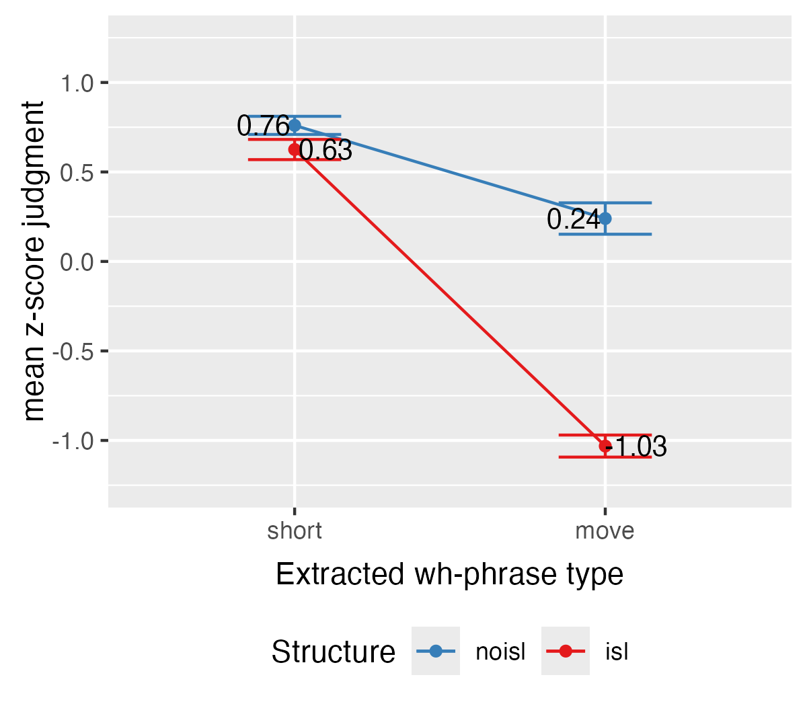
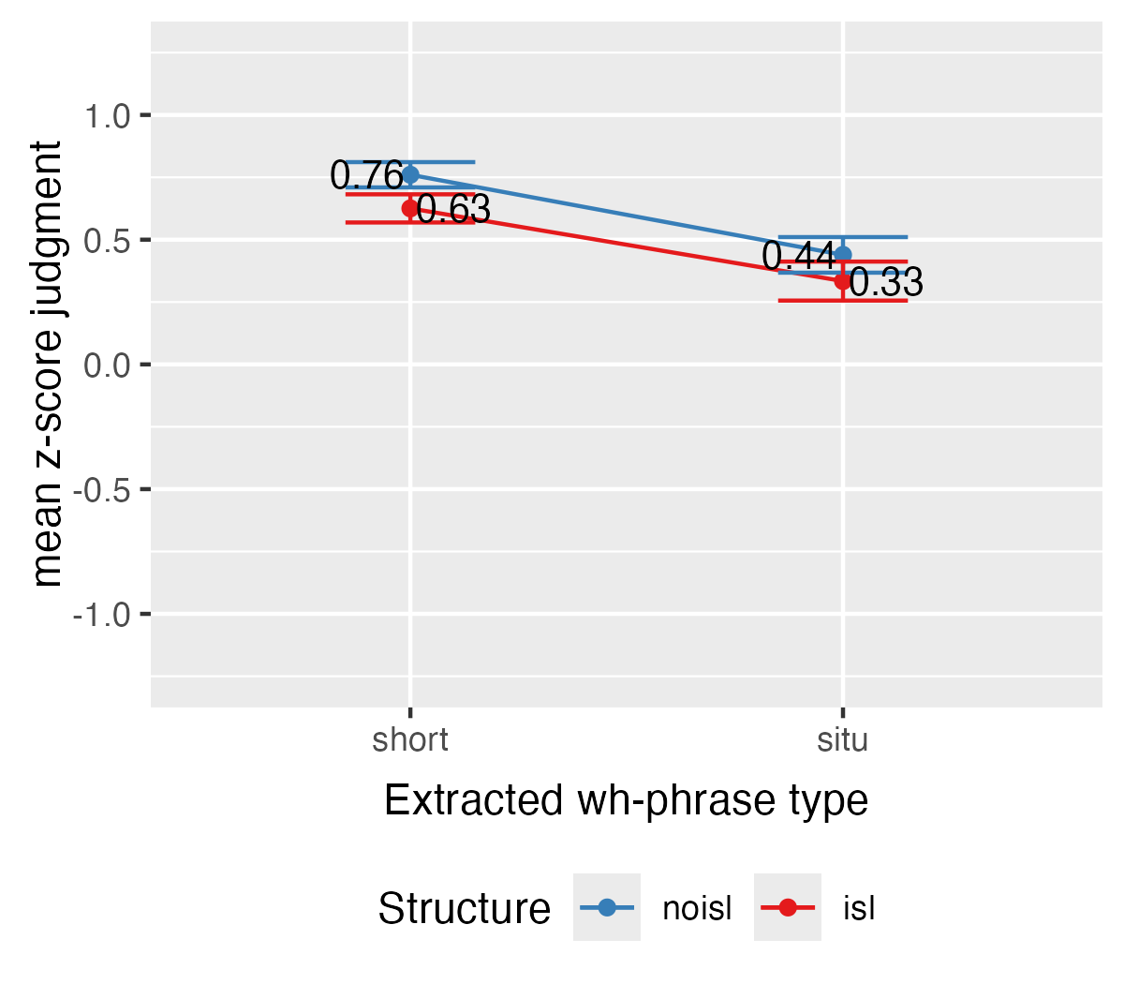
Experiment 2: movement and in-situ of the second conjunct
What Sarah fry indomie and t ah?
Sarah fry indomie and what ah?
short vs. move (p < .0001)
short vs. situ (p = 1)
Evidence for CSC in wh-movement but not wh-in-situ.

Slide 41
What about wh-in-situ: experiments
Results:
Wh-movement of both the first and the second conjunct show CSC effect.
Wh-in-situ of the first conjunct shows CSC effect while wh-in-situ of the second conjunct does not.
*What Sarah fry and chicken ah? (*wh-movement of C1)
*What Sarah fry indomie and ah? (*wh-movement of C2)
*Sarah fry what and chicken ah? (*wh-in-situ of C1)
Sarah fry indomie and what ah? (wh-in-situ of C2)

Slide 42
What about wh-in-situ: predictions (repeated)
The Parallelism Requirement:
If wh-element is [+wh], wh-in-situ of either conjunct is ruled out:
[-wh and +wh] or [+wh and -wh]
If wh-element is not [+wh], wh-in-situ should be OK: [-wh and –wh]
Zhang 2010:
If wh-in-situ is covert movement:
wh-in-situ of the first conjunct should be bad (Category Transfer) wh-in-situ of the second conjunct should be OK
If wh-in-situ is not movement (e.g. unselective binding):
wh-in-situ of the both conjuncts should be OK

Slide 43
What about wh-in-situ: predictions (repeated)
The Parallelism Requirement:
If wh-element is [+wh], wh-in-situ of either conjunct is ruled out: (not supported)
[-wh and +wh] or [+wh and -wh]
If wh-element is not [+wh], wh-in-situ should be OK: [-wh and –wh] (not supported)
Zhang 2010:
If wh-in-situ is covert movement:
wh-in-situ of the first conjunct should be bad (Category Transfer) (supported) wh-in-situ of the second conjunct should be OK (supported)
If wh-in-situ is not movement (e.g. unselective binding):
wh-in-situ of the both conjuncts should be OK (not supported)

Slide 44
What about wh-in-situ: predictions (repeated)
Zhang 2010:
If wh-in-situ is covert movement:
wh-in-situ of the first conjunct should be bad (supported) wh-in-situ of the second conjunct should be OK (supported)
But I just spent the first part of the talk arguing against the category transfer approach.
And I argued against covert movement approach to wh-in-situ based on the absence of (other) island effects (Shen and Huang 2026, Shen and Chan 2025)…

Slide 45
What about wh-in-situ: very tentative suggestion
Is there a way to account for the results in a theory where wh-in-situ is unselective binding and CSC is due to the Parallelism Requirement? Maybe.
CSC effects on wh-movement of both conjuncts are predicted by the Parallelism Requirement.
Absence of CSC effects on wh-in-situ of the second conjunct is predicted if one assumes that wh-elements in Singlish is not [+wh] (given the indefinite use).
Puzzle: CSC effects on wh-in-situ of the first conjunct.

Slide 46
What about wh-in-situ: very tentative suggestion
Puzzle: CSC effects on wh-in-situ of the first conjunct.
Could this effect reflect a restriction on unselective binding in general?
*OP_{i} … [C1_{i} and C2]
OP_{i} … [C1 and C2_{i}]
It’s unclear why this would be the case.
It would predict that wh-indefinite shows the same pattern:
我還以為你買了一部小說和哪本傳記呢。 I thought you bought a novel and which biography.
我還以為你買了哪本傳記和一部小說呢。 I thought you bought which biography and a novel. Intended: I thought you bought some biography and a novel.

Slide 47
Summary (again)
Experiments in Singlish show wh-in-situ of the first conjunct is bad while wh-in-situ of the second conjunct is OK.
This is not expected from the Parallelism Requirement analysis
The unacceptability of wh-in-situ of C1 could result from a general pattern with predictions for wh-indefinite.

Slide 48
Selected references
Arano, Akihiko. 2025. Expanding the Scope of Scrambling. UConn dissertation.
Arano, Akihiko, & Hiromune Oda. 2019. The A-/A′-distinction in scrambling revisited. WCCFL 36.
Bošković, Željko. 2009. Unifying first and last conjunct agreement. Natural Language & Linguistic Theory 27 (3): 455–496.
Fortuny, Jordi. 2024. Deducing the coordinand constraint. Linguistic Inquiry 55 (2): 219–253.
Grosu, Alexander. 1973. On the nonunitary nature of the Coordinate Structure Constraint. Linguistic Inquiry 4 (1): 88–92.
Oda, Hiromune. 2021. Decomposing and deducing the coordinate structure constraint. The Linguistic Review.
Shen, Zheng. 2023. Conjunction agreement and the coordinate structure constraint. Glossa: A journal of general linguistics 46 (1).
Zhang, Niina Ning. 2008. Relativized parallelism in mandarin chinese natural coordination. Language Research 44 (1): 121–163.
Zhang, Niina Ning. 2010. Explaining the immobility of conjuncts. Studia Linguistica 64 (2): 190–238.

Slide 49
Thank you!

