Slide 1
The syntactic and semantic effects on extraction out of DPs Evidence from Definiteness Spreading
Zheng Shen
National University of Singapore
2026.7.16 Singapore Summer Meeting

Slide 2
Definite DP island
Extraction out of definite DPs (the, that, possessive) is degraded.
What did Charlotte see a photo of?
?What did Charlotte see the photo of?
*What did Charlotte see Mary’s photo of?
*What did Charlotte see that photo of?

Slide 3
Previous studies
The Phase Impenetrability Condition analysis: Movement out of DPs must go through Spec-DP, definite DPs have their Spec filled:
*What … [_{DP} indexP [ that [_{NP} [ picture of t ]
*What … [_{DP} Mary’s [ poss [_{NP} [ picture of t ]
What … [_{DP} t [ a [_{NP} [ picture of t ]
The Specificity Condition: Operator cannot bind a variable inside a specific DP.
*QOP₁ [_{specificDP} variable₁ ]
QOP₁ [_{non-specificDP} variable₁]
SpecFilled DPs are usually also specific DPs: do we really need two constraints?

Slide 4
Previous studies: Shen and Huang 2026
In English, the use of creation verbs (tell a joke) partially amerliorates the definiteness effect in wh-movement
In Chinese, no such amelioration is observed in wh-in-situ questions.
Proposal: The PIC restricts wh-movement, the Specificity Condition restricts both wh-movement and wh-in-situ
*What did you hear that joke about? (violates both the PIC and the Specificity Condition)
*What did you tell that joke about? (violates the Specificity Condition only)
*You heard that joke about what? (violates the Specificity Condition)
*You told that joke about what?(violates the Specificity Condition)

Slide 5
Previous studies: Shen 2026
The same conclusion as Shen and Huang 2026 but evidence from Singlish
Gil 2003: possessive DPs in Singlish can be indefinite
Geraint eat Jamil apples.
Gerant eat Jamil’s apples. Possible interpretation: ‘Gerant ate some of Jamil’s apples.’
Empirical evidence (based on 58 speakers): there-existential
photos: There are photos on the table leh. (85.3/100, z-score: 0.76)
your photos: There are your photos on the table leh. (67.7/100, 0.19)
your that photo: There is your that photo on the table leh. (41.4/100, -0.53)

Slide 6
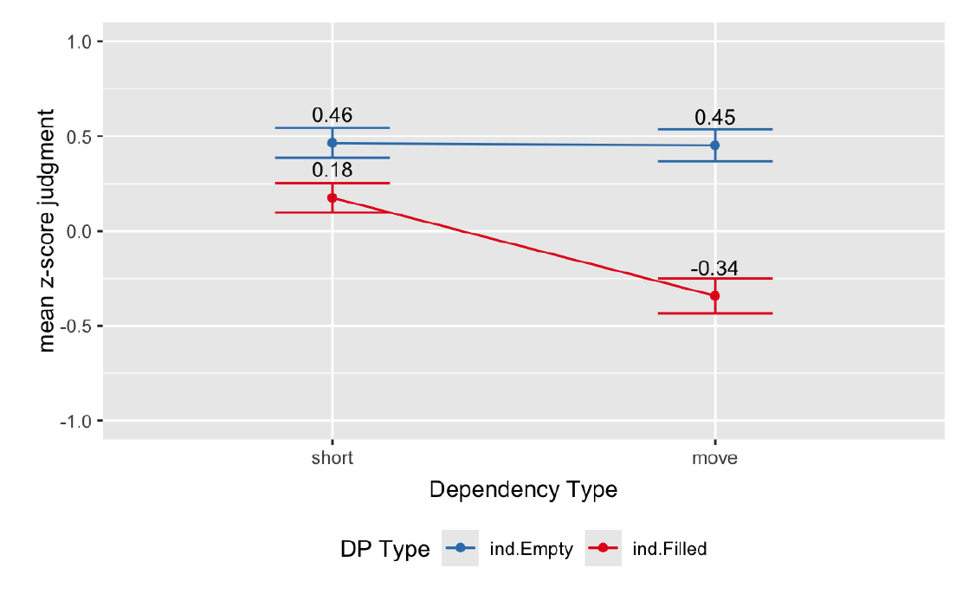
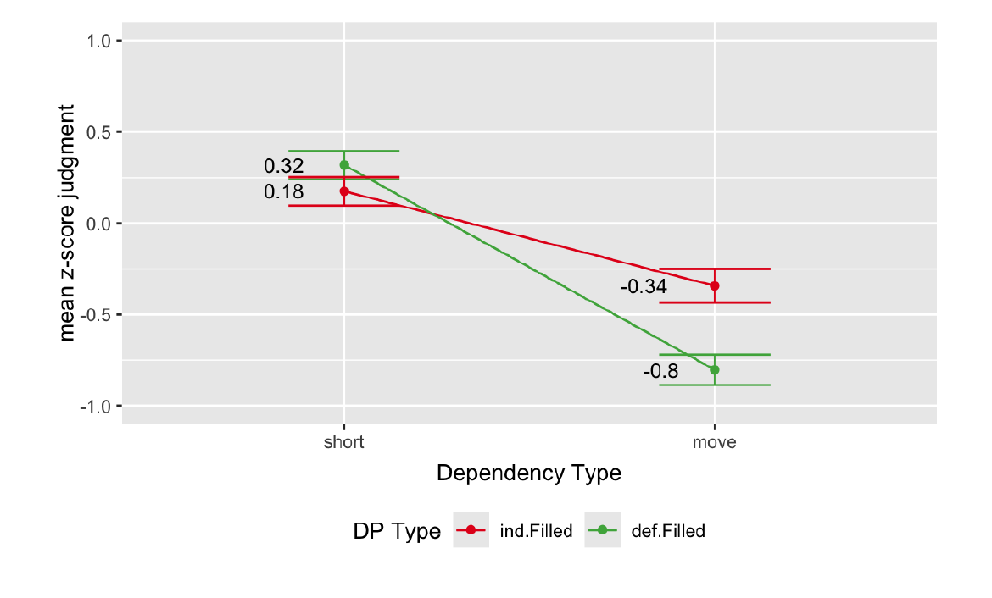
Previous studies: Shen 2026
Possessive DPs in Singlish are indefinite but have their Spec-DP filled.
a. Which president Kavita always collect anecdotes of? (Indefinite.EmptySpec)
b. Which president Kavita always collect your anecdotes of? (Indefinite.FilledSpec)
c. Which president Kavita today read your that anecdote of? (Definite.FilledSpec)
Indefinite.EmptySpec vs. Indefinite.Filled Spec: the effect of the PIC (confirmed in wh-movement)
Indefinite.filledSpec vs. definite.filledSpec: the effect of the Specificity Condition (confirmed in wh-movement)

Slide 7
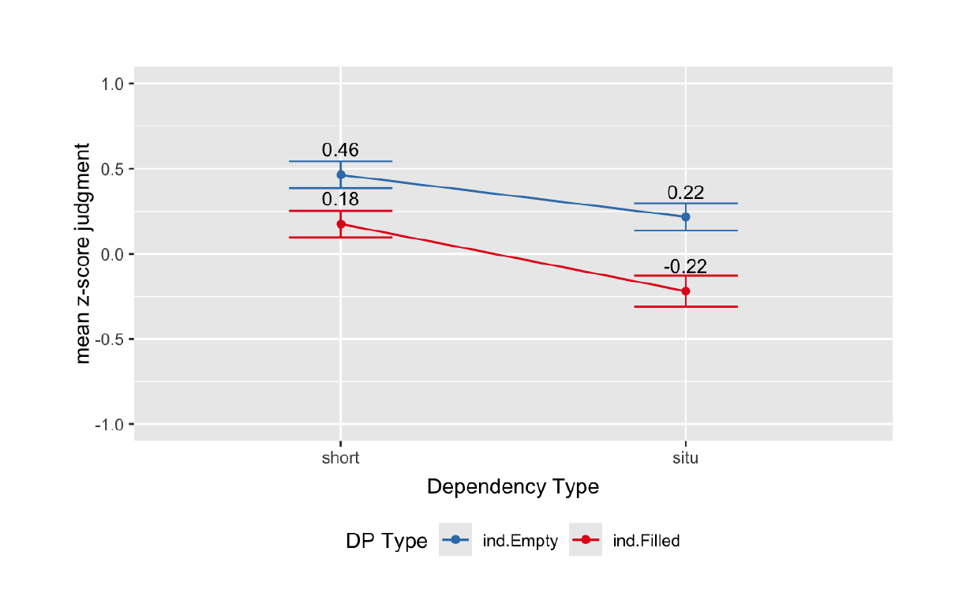
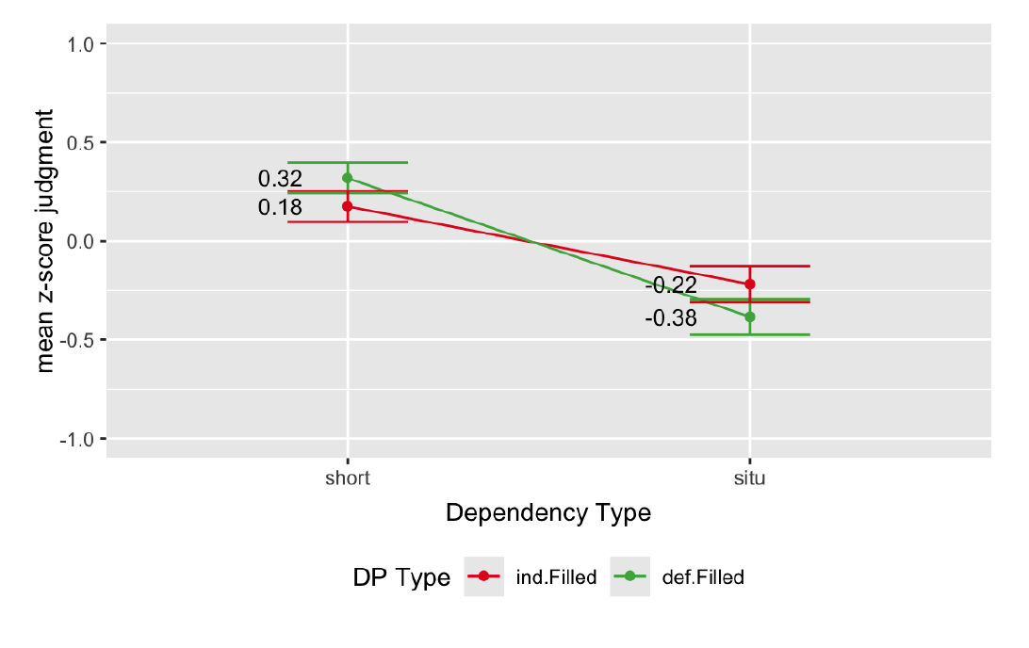
Previous studies: Shen 2026
Possessive DPs in Singlish are indefinite but have their Spec-DP filled.
a. Kavita always collect anecdotes of which president ? (Indefinite.EmptySpec)
b. Kavita always collect your anecdotes of which president ? (Indefinite.FilledSpec)
c. Kavita today read your that anecdote of which president ? (Definite.FilledSpec)
Indefinite.EmptySpec vs. indefinite.FilledSpec: the effect of the PIC (not confirmed in wh-in-situ)
Indefinite.filledSpec vs. definite.filledSpec: the effect of the Specificity Condition (confirmed in wh-in-situ)

Slide 8
Current study: another piece of evidence
Definiteness spreading:
The definiteness of a possessive DP depends on the definiteness of the possessor:
a teacher’s photo of the worksheet vs. the teacher’s photo of the worksheet
If this is the case, three types of DPs in American English
a photo of the worksheet (indefinite.emptySpec)
a teacher’s photo of the worksheet (indefinite.filledSpec)
the teacher’s photo of the worksheet (definite.filledSpec)
indefinite.emptySpec vs. indefinite.filledSpec: effect of the PIC
indefinite.filledSpec vs. definite.filledSpec: effect of the Specificity Condition

Slide 9
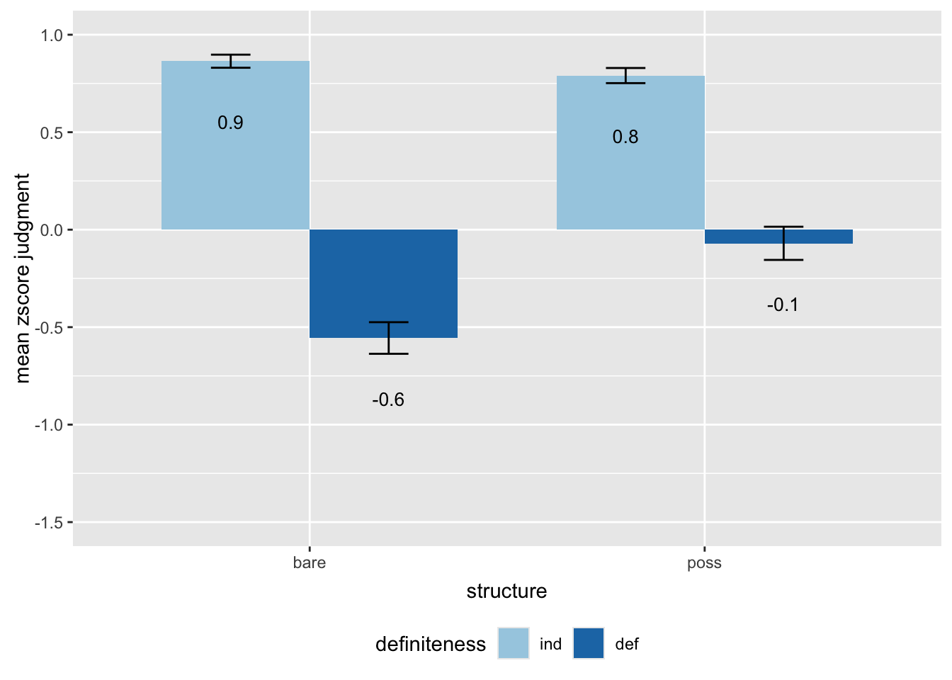
Experiment 1: definiteness spreading
There seems to be a statement on the desk. (plain.ind)
There seems to be the statement on the desk. (plain.def)
There seems to be an officer’s statement on the desk. (poss.ind)
There seems to be the officer’s statement on the desk. (poss.def)
Prediction: 1 is better than 2, 3 is better than 4.
100 point scale, 16 lexically matched set each participant judged 4 items per condition results from 40 participants
For both types of DPs, there is a significant effect of definiteness.
Poss.ind in the there-existential construction is close in acceptability to Plain.ind.

Slide 10
Experiment 2: definite DP island effect with three DPs
Who saw a photo of the worksheet? (ind.short)
Who saw a teacher's photo of the worksheet? (indPoss.short)
Who saw the teacher‘s photo of the worksheet? (defPoss.short)
What did Charlotte see a photo of? (ind.long)
What did Charlotte see a teacher's photo of? (indPoss.long)
What did Charlotte see the teacher‘s photo of? (defPoss.long)
Predictions:
ind vs. indPoss: effect of the PIC
indPoss vs. defPoss : effect of the Specificity Condition
115 participants, 18 lexically matched sets,
Each participant judged 3 items per condition

Slide 11
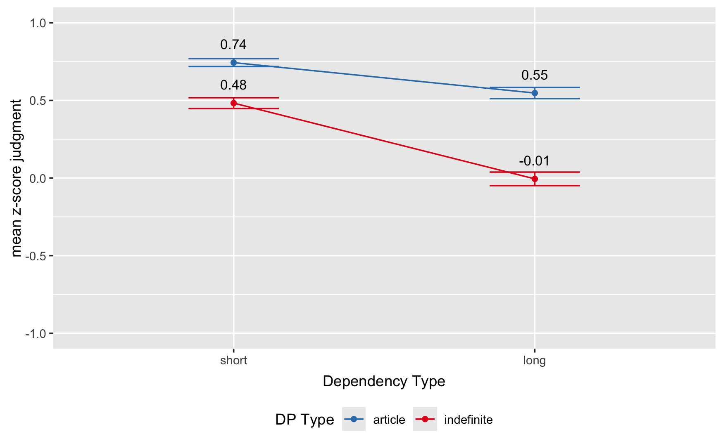
Experiment 2: definite DP island effect with three DPs
Who saw a photo of the worksheet? (ind.short)
Who saw a teacher's photo of the worksheet? (indPoss.short)
Who saw the teacher‘s photo of the worksheet? (defPoss.short)
What did Charlotte see a photo of? (ind.long)
What did Charlotte see a teacher's photo of? (indPoss.long)
What did Charlotte see the teacher‘s photo of? (defPoss.long)
ind vs. indPoss: effect of the PIC confirmed:

Slide 12
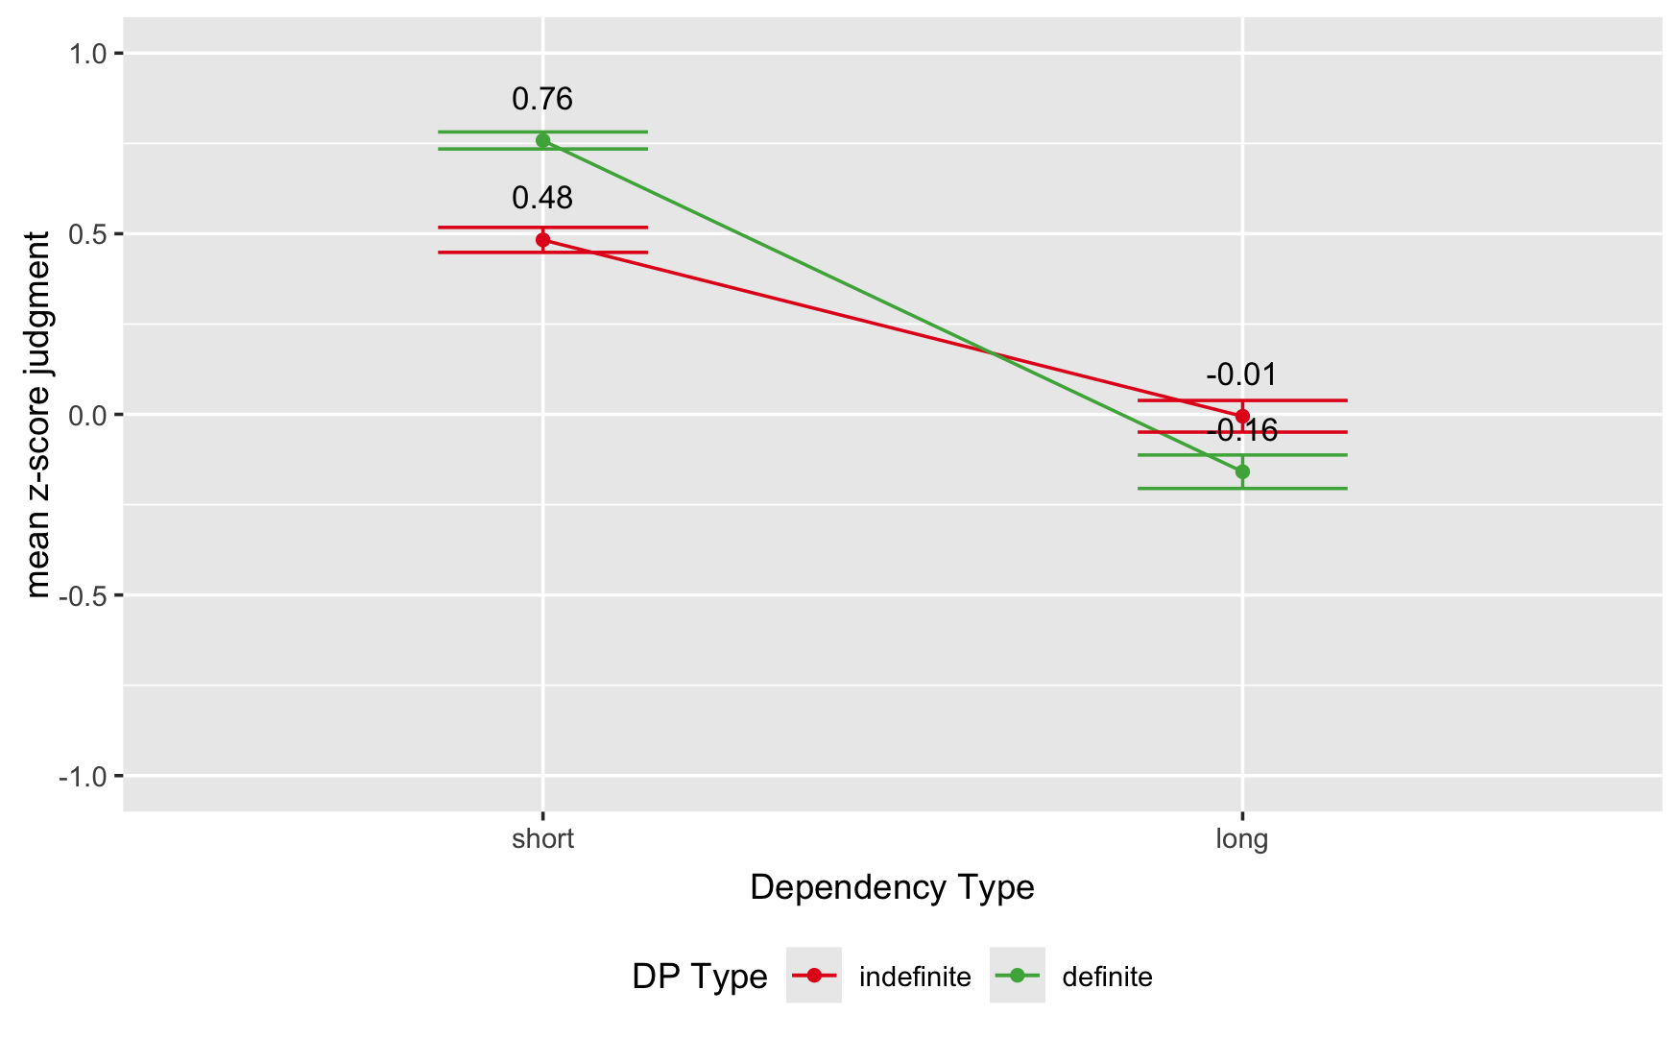
Experiment 2: definite DP island effect with three DPs
Who saw a photo of the worksheet? (ind.short)
Who saw a teacher's photo of the worksheet? (indPoss.short)
Who saw the teacher‘s photo of the worksheet? (defPoss.short)
What did Charlotte see a photo of? (ind.long)
What did Charlotte see a teacher's photo of? (indPoss.long)
What did Charlotte see the teacher‘s photo of? (defPoss.long)
indPoss vs. defPoss : effect of the Specificity Condition confirmed:

Slide 13
Experiment 3: same experiment in Relative Clause
I confronted the student that saw a photo of the worksheet. (ind.short)
I confronted the student that saw a teacher's photo of the worksheet. (indPoss.short)
I confronted the student that saw the teacher's photo of the worksheet.(defPoss.short)
I edited the worksheet that Charlotte saw a photo of. (ind.long)
I edited the worksheet that Charlotte saw a teacher's photo of. (indPoss.long)
I edited the worksheet that Charlotte saw the teacher's photo of. (defPoss.long)
Predictions:
ind vs. indPoss: effect of the PIC
indPoss vs. defPoss : effect of the Specificity Condition
60 participants, 18 lexically matched sets,
Each participant judged 3 items per condition

Slide 14
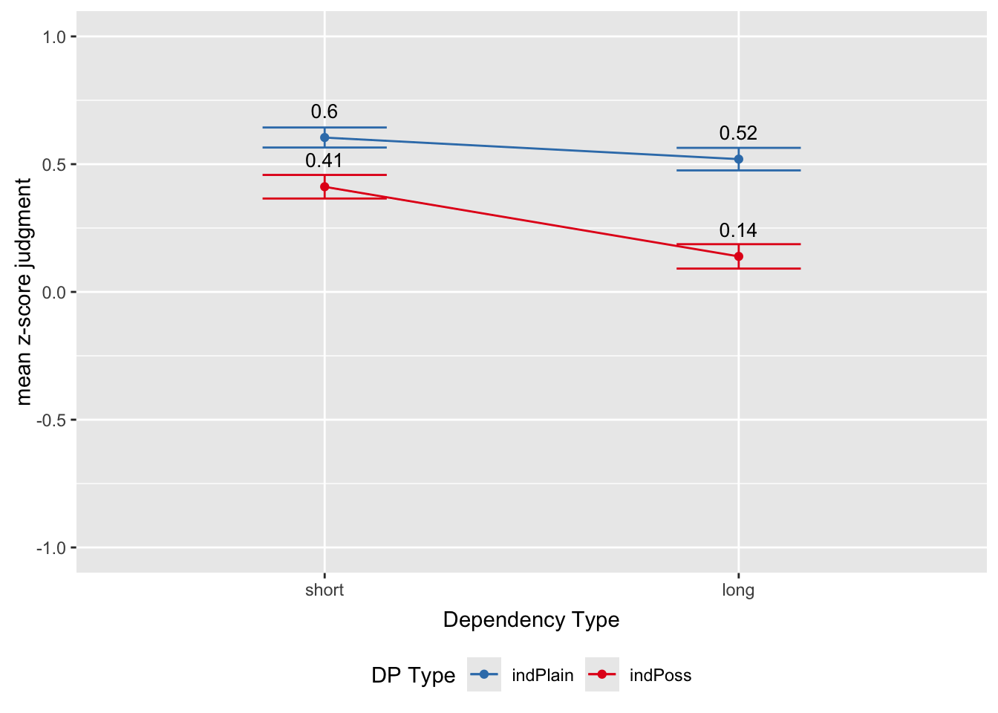
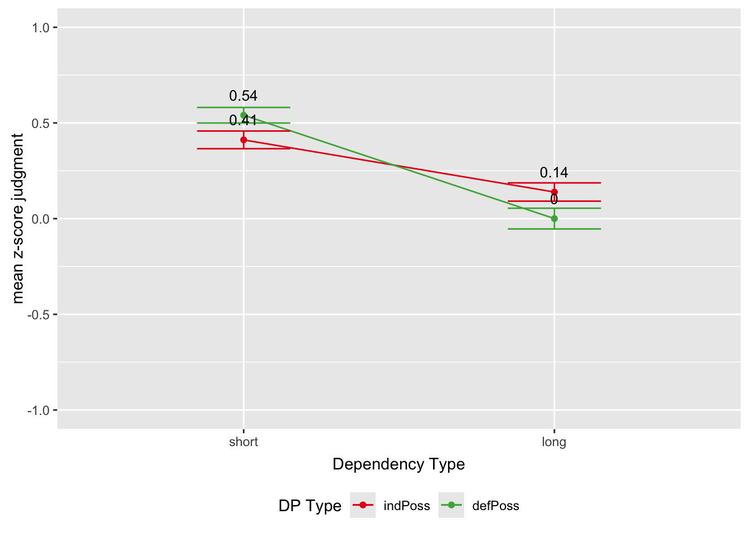
Experiment 3: same experiment in Relative Clause
I confronted the student that saw a photo of the worksheet. (ind.short)
I confronted the student that saw a teacher's photo of the worksheet. (indPoss.short)
I confronted the student that saw the teacher's photo of the worksheet. (defPoss.short)
I edited the worksheet that Charlotte saw a photo of. (ind.long)
I edited the worksheet that Charlotte saw a teacher's photo of. (indPoss.long)
I edited the worksheet that Charlotte saw the teacher's photo of. (defPoss.long)
Predictions:
ind vs. indPoss: effect of the PIC (significant interaction)
indPoss vs. defPoss : effect of the Specificity Condition (marginal interaction)
RC
WH

Slide 15
Thank you!

