Slide 1
Effect of creation verbs in Chinese and English
Zheng Shen Nick Huang
申正 黄志鹏
National University of Singapore
IACL 29
2023.5

Slide 2
Warning: basically the same as in GLOW46 and TEAL13!
N214: Evidence that children use to acquire Mandarin restitutive you - Ting XU and William SNYDER
N212: An investigation of SEE/LOOK verbs as a source of conative modality markers in Sinitic languages - Boyang LIU
N316: 上古漢語否定詞「莫」研究的幾個問題 - 谷峰
N317: 古代韓語借字表記「內」、「屍」的上古漢語音對應 - 安英姬
N221: 寧武話陰平調和上聲調的產出與感知實驗研究 - 趙建軍
N213: 鄭州方言的形容詞短語兒化——兼論北方方言形容詞短語兒化的差異 - 呂曉玲、於雅哲
N101: 吳語臨海方言的主觀量標記——兼與吳語仙居方言比較 - 盧笑予、潘雪雨晴

Slide 3
The definiteness effect
Subextraction from a definite DP is degraded:
1. Who did Mary see a picture of? Indefinite DP
2.*Who did Mary see that picture of? Definite DP with that
(We are restricting the scope to depiction nouns.)
Chomsky 1973; Tollan and Heller 2015; Shen & Lim 2022; and many others
Notes:
By this we refer to the fact that … this is a well known fact

Slide 4
Structural approaches to the definiteness effect
Definite DPs are locality domains for movement (PIC/subjacency; freezing). (Diesing 1992; Citko 2014; Huang 2022; cf. Davies & Dubinsky 2003, Chomsky 1973)
The Specificity Condition: no binding of variables in specific/definite DPs. (Fiengo & Higginbotham 1981; cf. Simonenko 2015)
Leaving an information structure-based approach (Erteschik-Shir 1981, Abeillé et al 2020) aside for now.
Notes:
Two structural approaches:
…
You can see that they overlap in empirical coverage.
Logically, it could be that only one of them is true and we don’t need both. But this is not necesary the case

Slide 5
The amelioration effect of VOC
The definiteness effect is said to disappear when the main verb is a verb of creation (among other conditions; see Erteschik-Shir 1981, Davies & Dubinsky 2003, Huang 2022; Lim 2022):
3. Who did Mary take a picture of? Indefinite DP
4. Who did Mary take that picture of? Definite DP with that
Notes:
So why are we interested in VOCs? That’s because it’s been reported that … Importantly, (4) sounds pretty good, on par with (3)

Slide 6
Today: definiteness and VOC effects across languages
The aforementioned theories make different predictions about when definiteness and VOC effects appears.
We run experiments in English and Chinese to shed light on the different theories.

Slide 7
Background: Wh-in situ in Mandarin Chinese
5. 你吃了什么？ Ni chi-le shenme ? you eat-ASP what “What did you eat?”
Conventionally analyzed as unselective binding by question operator.
QOP_{i} Ni chi-le shenme_{i}
In situ wh-arguments not sensitive to islands (no subjacency).
6. 你讨厌捕杀什么的猎人？ Ni taoyan [ busha shenme de lieren ]? you dislike [ hunt what DE hunter ] Lit: “What do you dislike hunters who hunt __?” Aoun & Li 1993, Tian et al 2022; cf. C.-T. J. Huang 1982, Lu et al. 2020
Notes:
Two facts are important here:

Slide 8
Mandarin Chinese also said to have a definiteness effect
7. 黄老师读了一本关于什么的书？ Huanglaoshi du-le yi-ben guanyu shenme de shu? Prof.Huang read-ASP one-CL about what DE book “What did Prof. Huang read a book about?” Indefinite DP
8. *申老师读了那本关于什么的书？ *Shenlaoshi du-le na-ben guanyu shenme de shu? Prof.Shen read-ASP that-CL about what DE book “What did Prof. Shen read that book about?” Definite DP
Can be understood in terms of Specificity; question operator cannot bind the wh-phrase. (Aoun & Li 1993; cf. C.-T. J. Huang 1982)
The amelioration effect of VOC: no previous claim.
Note that neither effect has been experimentally verified. (Re: data reliability in Chinese, see Chen et al. 2018; Lu et al. 2020 (wh-in situ); N. Huang accepted)
Notes:
What’s particularly interesting for us is that Chinese has been said to have a def effect. In (7) and (8)...
So we want to try to establish some initial generalizations about the VOC and def effect. And we want to do so rigorously, using experimental syntax techniques.

Slide 9
Upshot
Novel experimental demonstration of:
VOC effect in English
Definiteness effect despite VOC in English
Definiteness effect + no VOC effect in Chinese
Theoretical implications:
Existing accounts predict cross-linguistic uniformity or offer no clear predictions; our results pose a challenge to these accounts.
We suggest that a combination of Specificity and PIC can account for the pattern.
Notes:
As a preview,

Slide 10
A closer look at accounts of the definiteness effect
Proposal #1: a locality constraint like PIC + noun incorporation (following Davies & Dubinsky 2003)
Definite DPs are locality domains (also Bowers 1987, N. Huang 2022)
Noun of a definite DP object can incorporate onto a VOC, neutralizing the locality domain (Davies & Dubinsky 2003; N. Huang 2022, cf. Lim 2022a,b - NUS MA!)
Predicts:
Definiteness and VOC effects in English
No definiteness effect in Chinese (wh-in situ is not sensitive to subjacency)
No VOC effects for Chinese, nothing to ameliorate
Notes:
Let me say more

Slide 11
A closer look at accounts of the definiteness effect
Proposal #2: Specificity Condition
Anaphors and variables must be bound inside a specific NP. (Fiengo 1987; Fiengo & Higginbotham 1981)
Predicts:
Definiteness effects in English and Chinese
9. *What_{i} did Mary see [ that picture of t_{i} ]?
10. *QOP_{i} Shenlaoshi du-le [na-ben guanyu shenme_{i} de shu ]? Prof.Shen read-ASP that-CL about what DE book “What did Prof. Shen read that book about?”
No VOC effects for English or Chinese

Slide 12
Predictions
 | PIC+NI | Specificity Condition
Definiteness effect in English | Yes | Yes
VOC effect (amelioration) in English | Yes | No
Definiteness effect in Chinese | No | Yes
VOC effect in Chinese | No | No
Yes
Yes
No
No
No
No
Notes:
The PIC+incorporation account is constructed around English, and so has no problem predicting the def effect or the VOC effect.
However, since wh-in situ is not sensitive to the subjacency or PIC, its descendant, this account predicts that there should be no definiteness effect.
And so we don’t expect a VOC effect: there shouldn’t be any difference between a creation main verb and a non-creation main verb.
In contrast, the specificity condition predicts that both languages show definiteness effects. At the same time, this condition makes no allowance for the choice of main verb, which predicts that both English and MC do not show VOC effects.

Slide 13
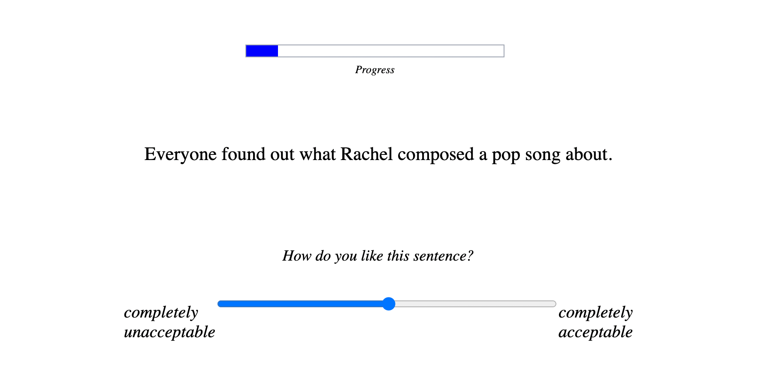
Experiments
Acceptability judgment task on a slider

Slide 14
Experiment 1: English (52 Prolific participants)
2x2x2 (= 8 conditions) x 3 items/conditions (+ 48 fillers)
NP type: indefinite vs. definite demonstrative VOCs said to neutralize definiteness effect of demonstratives (Davies & Dubinsky 2003)
Dependency length: short vs. long
Verb type: nVOC vs. VOC
1.Everyone wants to know who _ saw/shot a film about the war. (nVOC/VOC | ind | short)
2.Everyone wants to know what Tom saw/shot a film about _. (nVOC/VOC | ind | long)
3.Everyone wants to know who _ saw/shot that film about the war. (nVOC/VOC | def | short)
4.Everyone wants to know what Tom saw/shot that film about _. (nVOC/VOC | def | long)

Slide 15
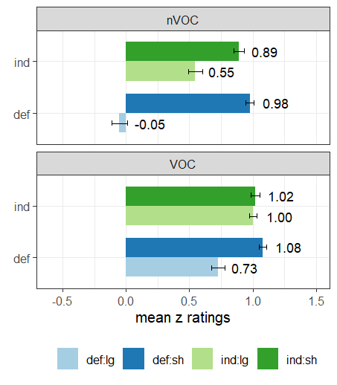
Experiment 1: English
VOCs make subextraction more acceptable (VOC effect).
But there is still a definiteness effect.
How bad is subextraction from nVOCs + definite DP? What did Mary read that book about?
Difference-in-difference score (“Badness”) = 0.69
Difference in badness = 0.36
How bad is subextraction from VOCs + definite DP? What did Mary write that book about?
Badness = 0.33
3-way interaction effects between verb type, definiteness, and dependency; 2-way interaction effects between definiteness and dependency (all p<.01)
Notes:
Note: nVOC worsens subextraction from nVOC, for indefinites. (but the impact is much larger with demonstratives.)

Slide 16
Experiment 2: Chinese (47 Prolific participants)
Parallel to English, same 8 conditions (NP type x Dependency Length x Verb type) + 48 fillers
1. 我想知道谁经常读/写关于历史的书。 wo xiangzhidao shui jingchang du/xie [ guanyu lishi de shu ] I wonder who often read/write [ about history DE book ] “I wonder who often reads/writes books about history. (nVOC/VOC | ind | short)
2. 我想知道黄老师经常读/写关于什么的书。 wo xiangzhidao huanglaoshi jingchang du/xie [guanyu shenme de shu] I wonder Prof. Huang often read/write [about what DE book] “I wonder what Huang often write books about.' (nVOC/VOC | ind | long)
3. 我想知道谁读/写了那本关历史的书。 wo xiangzhidao shui du/xie-le [ na-ben guanyu lishi de shu ] I wonder who read/write-LE [ that-CL about history DE book ] “I wonder who read/wrote that book about history.’ (nVOC/VOC | def | short)
4. 我想知道黄老师读/写了那本关于什么的书。 wo xiangzhidao Huanglaoshi du/xie-le [ na-ben guanyu shenme de shu ] I wonder Prof. Huang read/wrote-LE [ that-CL about what DE book ] “I wonder Huang read/wrote that book about what.' (nVOC/VOC | def | long)

Slide 17
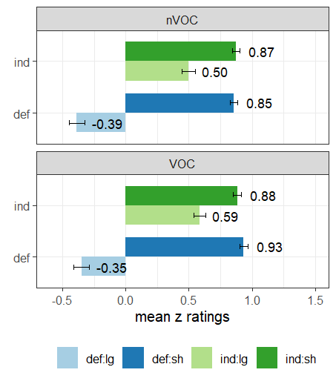
Experiment 2: Chinese
VOCs don’t make wh-in situ in definite DPs more acceptable (no VOC effect).
Definiteness effect for both verb types.
How bad is wh-in situ inside nVOCs + definite DP? “The teacher read that book about what?”
Badness = 0.87
Difference in badness = n.s.
How bad is wh-in situ inside VOCs + definite DP? “The teacher wrote that book about what?”
Badness = 0.99
No 3-way interaction effect between verb type, definiteness, and dependency (p=.35); 2-way interaction effect between definiteness and dependency (p<.01)

Slide 18
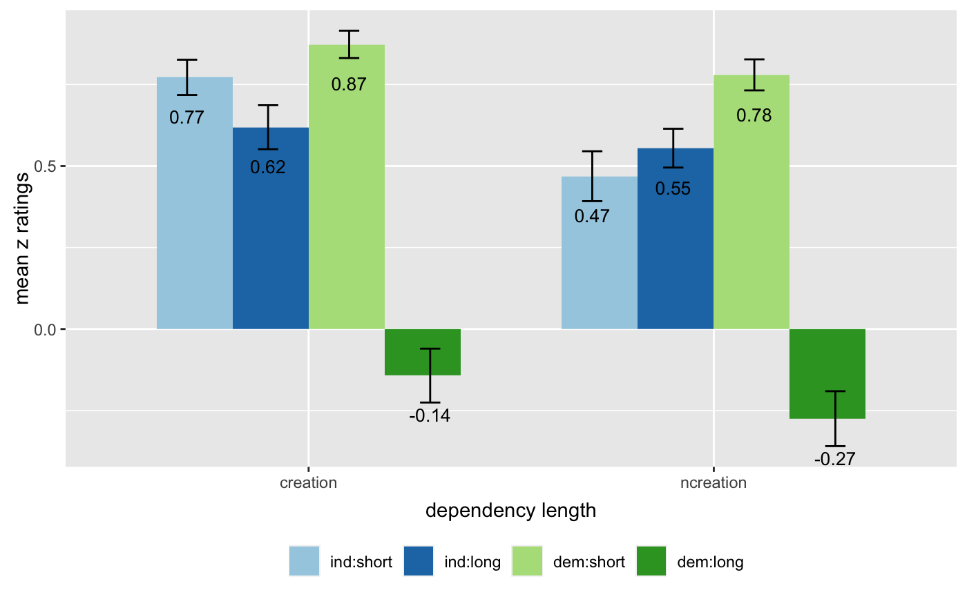
Based on feedback we got from TEAL13
We are doing a follow up experiment in Chinese which is more parallel to the English experiment (so far, n = 32)
Indefinite: 一 + classifier; aspect: 了; more parallel lexicalizations
Ind.short: 我想知道谁看了一部关于超级英雄的电视剧。 Def.short: 我想知道谁看了那部关于超级英雄的电视剧。 Ind.long: 我想知道黄老师看了一部关于什么的电视剧。 Def.long: 我想知道黄老师看了那部关于什么的电视剧。
Same results no VOC effect; Definiteness effect for both VOC and nVOC

Slide 19
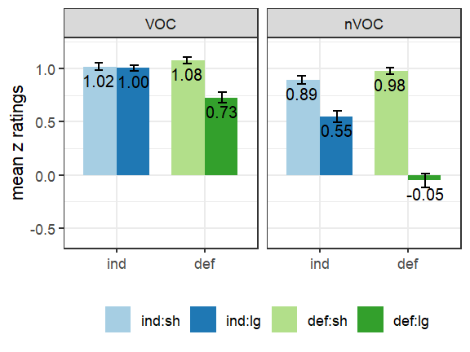
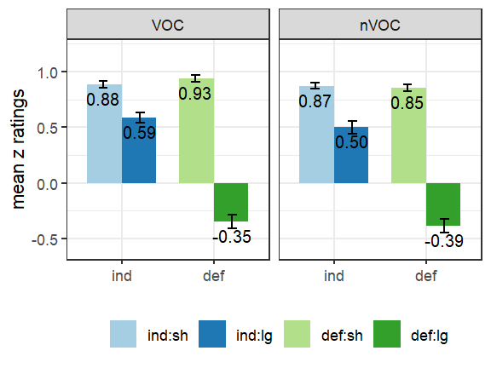
Predictions
English
Chinese
 | Results | PIC+NI | Specificity Condition
Definiteness effect in English nVOC | Yes | Yes | Yes
Definiteness effect in English VOC | Yes | No | Yes
VOC effect in English | Yes | Yes | No
Definiteness effect in Chinese nVOC | Yes | No | Yes
Definiteness effect in Chinese VOC | Yes | No | Yes
VOC effect in Chinese | No | No | No

Slide 20
Proposal: Specificity and PIC+NI
Both the Specificity condition and PIC+NI are at work.
English wh-questions: What_{i} did you read that book about t_{i}?
Subextraction of the wh-phrase ← PIC (can be ameliorated by VOC)
Binding of the wh-phrase’s lower copy (trace) ← Specificity Condition
Chinese wh-questions: QOP_{i} 你读了那本关于谁_{i}的书？
No subextraction
Binding of the wh-phrase by a question operator ← Specificity Condition

Slide 21
Proposal: accounting for the results
 |  | PIC+NI | Specificity Condition
nVOC in English | … what Tom read that book about ___. | Violated | Violated
VOC in English | … what Tom wrote that book about ___. | Satisfied | Violated
nVOC in Chinese | … Tom read that book about what. | n/a | Violated
VOC in Chinese | … Tom wrote that book about what. | n/a | Violated
VOC less bad
Both equally bad

Slide 22
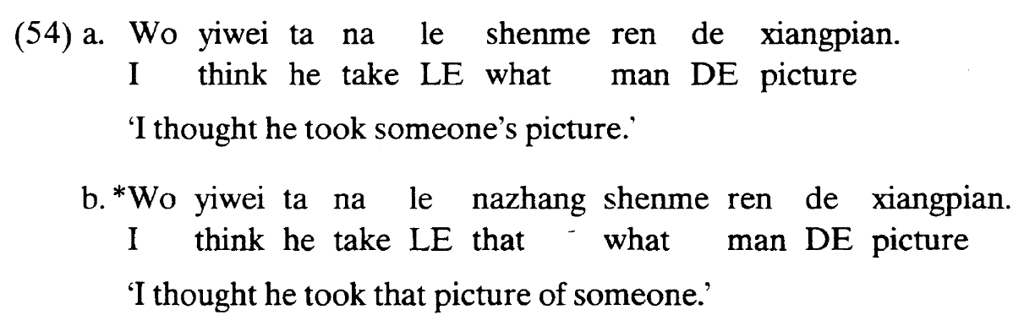
Independent evidence for Specificity in Chinese
Wh-element can have different readings in Chinese when bound by a different kind of operator. E.g. existential operator => indefinite reading. 你吃了什么。∃OP_{i} you ate what_{i} => you ate something
The wh-indefinite reading is blocked when the wh-element is inside a specific DP (Li 1992):
Li 1992, N.B.: took a picture in (54) = “to get hold of a photo”, not “to photograph”

Slide 23
Theoretical consequence:
It’s been commonly assumed that there needs to be only one constraint to account for the definiteness effect. (Davies & Dubinsky 2003; N. Huang 2022, Matushansky 2005)
Matushansky 2005: the definiteness effect cannot be used as an argument for the phasehood of DP, because the effect is already accounted for by the Specificity Condition. “Why have two explanations for one effect?”
Today: whether cross-linguistically or within a language, definiteness effects cannot be reduced to only PIC+NI or only Specificity.

Slide 24
Summary and conclusion
Empirical findings:
Definiteness effect in nVOC and VOC in English and Chinese
No VOC effect in Chinese
Theoretical implications:
Both the Specificity condition and PIC+NI are required and their effects can be teased apart when we compare multiple languages.
Informational structure approach is challenged.

Slide 25
Alternative 1: NI in English but not Chinese
Account:
wh-in-situ involves LF movement which is subject to PIC
the lack of VOC effect results from the absence of the NI strategy in Chinese
Puzzles:
The definiteness effect would be the only island effect observed in argument wh-in-situ. One would have to propose a island theory accordingly.
It’s not clear how this parametric variation would be learned considering that NI is covert.
Maybe it can be learned through semantics (Lim 2022), but why do Chinese children not learn it?

Slide 26
Alternative 2: Information structure approach
Information structure approaches (for discussion of English, see Erteschik-Shir 1981; Goldberg 2006; Abeillé et al. 2020), e.g. Dominance hypothesis:
Only foregrounded / dominant NPs can be extracted.
Definite objects are themselves dominant, so the NPs inside cannot be.
Objects of VOCs are not dominant, NPs inside can be dominant.
No clear predictions about Chinese. But if what matters is communicative intent and information structure status, then we predict cross-linguistic uniformity (cf. Goldberg 2006).
dominant
not dominant
saw… the picture of what
took… the picture of what
not dominant
can be dominant

Slide 27
Alternative 2: Information structure approach
If the same information structure requirements apply to wh-in situ languages (cf. Goldberg 2006):
The NP inside a definite object is not dominant and cannot be asked about.
Predicts definiteness effect in both English and Chinese
VOCs change the dominance status of this NP, so it can be asked about. (Erteschik-Shir and Lappin 1979, Erteschik-Shir 1981)
Predicts no definiteness effect in VOC in English and Chinese → contrary to the results

Slide 28
Why not dominance + Specificity?
Logically possible, but arguably inconsistent with the spirit of information structure-based proposals: If what matters is information structure, then we predict uniformity between wh-movement and wh-in situ(cf. Goldberg 2006): a wh-element within the definite object of a VOC should be better than nVOC in Chinese, just like English. The lack of VOC effect in Chinese is thus surprising even for Specificity + Dominance.
The dominance status of definite NPs and Specificity result in a redundancy in the theory and we have independent evidence from wh-indefinite for Specificity.

Slide 29
Thank you!

Slide 30
写/读 书 | {write/read} book | 制作/观看 纪录片 | {produce/watch} documentary | wrote/read book | produced/watched documentary
写/最关注 报道 | {write/follow the closest} report | 制作/最喜欢 短片 | {produce/like the best} short film | drafted/reviewed essay | produced/reviewed short film
写/听 歌 | {write/listen to} song | 指导/观看 电视剧 | {direct/watch} TV show | composed/listened to song | directed/watched TV show
写/最喜欢 诗 | {write/like the best} poem | 指导/最讨厌 舞台剧 | {direct/dislike the most} play | composed/edited poem | directed/saw play
撰写/读 文章 | {compose/read} article | 编写/收集 故事 | {draft/collect} story | wrote/edited article | wrote/read story
撰写/最关注 论文 | {compose/follow the closest} thesis | 编写/最讨厌 童话 | {draft/dislike the most} fairy tale | drafted/criticized thesis | wrote/heard fairy tale
发表/评论 理论 | {propose/comment on} theory | 讲/收集 传说 | {tell/collect} legend | proposed/evaluated theory | told/heard anecdote
发表/最关注 建议 | {propose/follow the closest} suggestion | 讲/最反感 笑话 | {tell/dislike the most} joke | proposed/praised suggestion | told/heard joke
提出/评论 主张 | {propose/comment on} proposal | 拍/看 短视频 | {shoot/watch} short video | developed/evaluated proposal | made/saw short video
提出/最关注 政策 | {propose/follow the closest} policy | 拍/最反感 视频 | {shoot/dislike the most} video | developed/criticized policy | made/praised video
拍摄/看 电影 | {shoot/see} film | 创作/听 流行歌 | {create/listen to} pop song | shot/saw film | composed/listened to pop song
拍摄/最喜欢 影片 | {shoot/like the best} movie | 创作/最喜欢 歌曲 | {create/like the best} song | shot/saw movie | composed/heard song

Slide 31
References I
Abeillé, Anna, Barbara Hemforth, Elodie Winckel, and Edward Gibson. 2020. Extraction from subjects: Differences in acceptability depend on the discourse function of the construction. Cognition 204.
Aoun, Joseph, and Audrey Yen-hui Li. 1993. Wh-elements in situ: Syntax or LF? Linguistic Inquiry 24 (2): 199–238.
Chomsky, Noam. 1973. Conditions on transformations. In A festschrift for Morris Halle, eds. Stephen R. Anderson and Paul Kiparsky, 232–286. New York: Holt, Rinehart & Winston.
Citko, Barbara. 2014. Phase theory. Cambridge: Cambridge University Press.
Davies, William D., and Stanley Dubinsky. 2003. On extraction from NPs. Natural Language and Linguistic Theory 21 (1): 1–37.
Diesing, Molly. 1992. Indefinites. Cambridge, Massachusetts: MIT Press.
Erteschik-Shir, Nomi. 1981. On extraction from noun phrases (picture noun phrases). In Theory of Markedness in Generative Grammar: Proceedings of the 1979 GLOW Conference, eds. Adriana Belletti, Luciana Brandi, and Luigi Rizzi, 147–169.
Erteschik-Shir, Nomi, and Shalom Lappin. 1979. Dominance and the functional explanation of island phenomena. Theoretical Linguistics 6: 41–86.
Fiengo, Robert. 1987. Definiteness, specificity, and familiarity. Linguistic Inquiry 18 (1): 163– 166.

Slide 32
References II
Fiengo, Robert, and James Higginbotham. 1981. Opacity in NP. Linguistic Analysis 7 (4): 395– 421.
Huang, C. T. James. 1982. Move wh in a language without wh-movement. The Linguistic Review 1: 369–416.
Huang, Nick. 2022. How subjects and possessors can obviate phasehood. Linguistic Inquiry 53 (3): 427–458.
Lim, Meghan. 2022. The bridging effects of verbs of creation: An experimental look. Master’s thesis, National University of Singapore.
Lu, Jiayi, Cynthia K. Thompson, and Masaya Yoshida. 2020. Chinese wh-in-situ and islands: a formal judgment study. Linguistic Inquiry 51 (3): 611–623.
Matushansky, Ora. 2005. Going through a phase. In Mit working papers in linguistics 49: Perspectives on phases, 157–181. Cambridge, Mass.: Department of Linguistics, MITWPL.
Neal, Anissa, and Brian Dillon. 2021. Definitely Islands? An investigation into the offline and online status of definite islands. Poster presented at the annual meeting of Linguistic Society of America 2021.
Shen, Zheng, and Meghan Lim. 2022. The definite DP island in wh-questions and relative clauses. the 40th West Coast Conference on Formal Linguistics.
Shen, Zheng, and Meghan Lim. 2022b. Extraction from definite, indefinite, and superlative DPs: An experimental approach. In NELS 52: Proceedings of the 52nd Annual Meeting of the North East Linguistic Society, eds. Özge Bakay, Breanna Pratley, Eva Neu, and Peyton Deal, Vol. 3, 99–109. GLSA, University of Massachusetts.

Slide 33
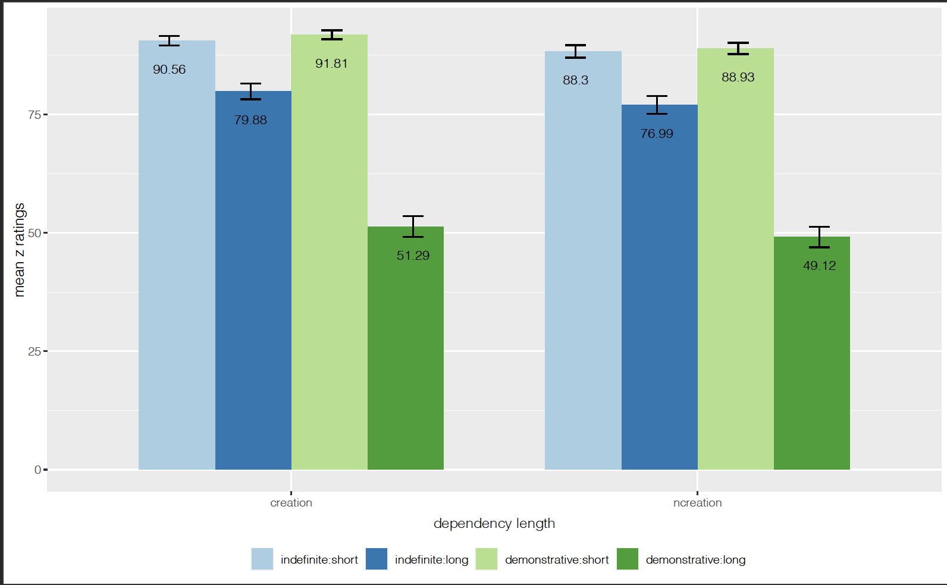
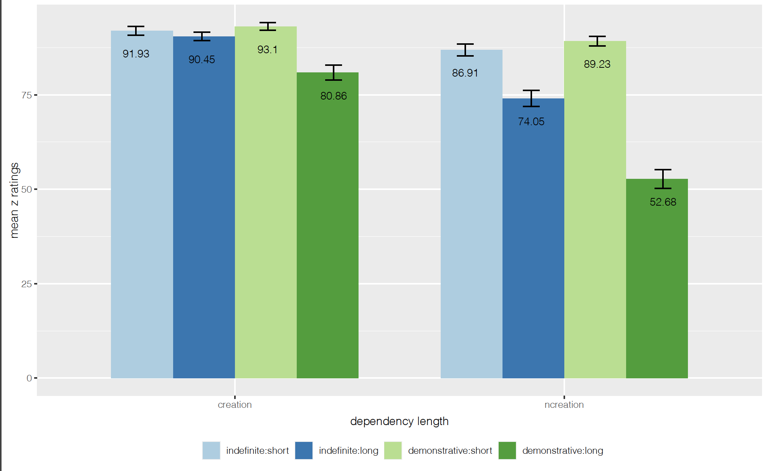
Raw judgments from Chinese and English experiments

Slide 34
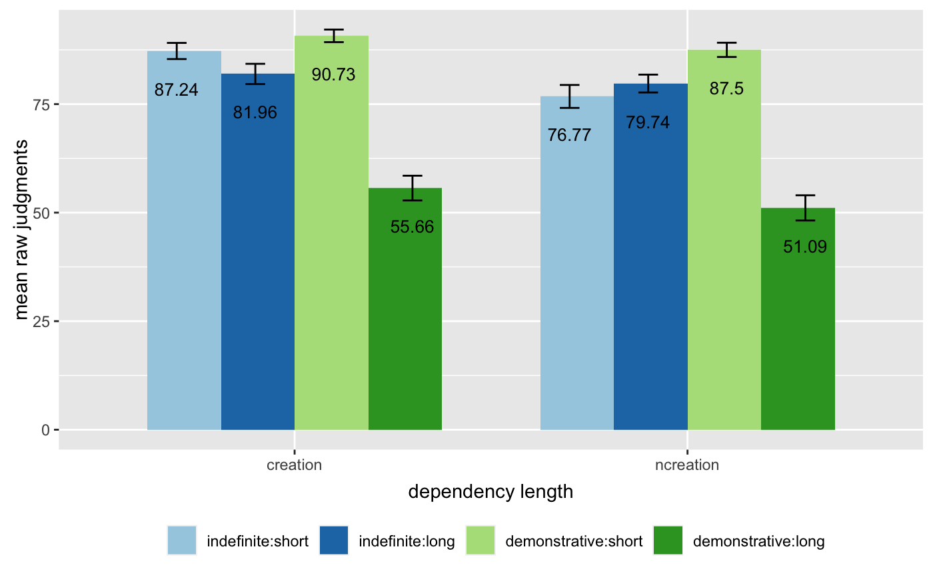
Raw judgments of the follow-up experiment

Slide 35
Predictions: information structure approach
 | Results | Information structure approach
Definiteness effect in English | Yes | Yes
VOC effect in English | Yes | Yes
Definiteness effect in Chinese | Yes | Yes
VOC effect in Chinese | No | Yes

Slide 37
Proposal: Specificity + Locality
Specificity restricts binding:
Wh-phrase binding its trace → English definiteness effect
Question operator binding a wh-phrase → Chinese definiteness effect
VOCs enable subextraction but not binding
Explains the effect size difference between English nVOC and VOC
Since wh-in situ does not involve movement, no effect size difference between Chinese nVOC and VOC.

Slide 38
Why not dominance and Specificity?
Logically possible, but arguably inconsistent with the spirit of information structure-based proposals: If what matters is communicative intent and information structure, then we predict cross-linguistic uniformity (cf. Goldberg 2006): a wh-element within the object of a VOC should be OK in Chinese. The lack of VOC effect in Chinese is thus surprising even for Specificity + Dominance
The dominance status of definite NPs and Specificity result in a redundancy in the theory and we have independent evident from wh-indefinite for Specificity.

Slide 39
Why not dominance and PIC+NI?
They make the same predictions so they will not be helping each other.
English nVOC: violates both
English VOC: violates neither → incorrectly predicted to be OK
Chinese nVOC: violates dominance
Chinese VOC: violates neither → incorrectly predicted to be OK
Also, they were designed to cover the same ground.

Slide 40
What kind of constraint is Specificity?
Specific NPs are referential.
The binding dependency however means that the specific NP is anaphoric.
C.-T. J. Huang (1982:404): an NP cannot be both referential and anaphoric.
“[Specificity]... spells out a special case of the law of contradiction and need not even be stated as a principle of grammar.”

Slide 41
 | Results | information structure- based | Specificity Condition | PIC/Subjacency
Defintieness effect with nVOC in English | Yes | Yes | Yes | Yes
Definiteness effect with VOCs in English | Yes | No | Yes | No
VOC effect in English | Yes | Yes | No | Yes
Definiteness effect in nVOC in Mandarin | Yes | Yes | Yes | No
Definiteness effect in VOC in Chinese | Yes | No | Yes | No
VOC effect in Chinese | No | Yes | No | No

Slide 42
Freezing (Diesing 1992, Sichel 2018)
Definite/presuppositional objects are covertly raised in English, blocking subextraction
Objects of VOCs are not presuppositional, thus not an island
Cannot explain the definiteness effect in English VOC
Since Chinese wh-questions do not involve movement, no definiteness effect is predicted for Chinese.
Specificity Condition + Freezing (same as Specificity + PIC)
English VOC: Specificity
English nVOC: Specificity + Freezing
Chinese VOC: Specificity
Chinese nVOC: Specificity

Slide 43
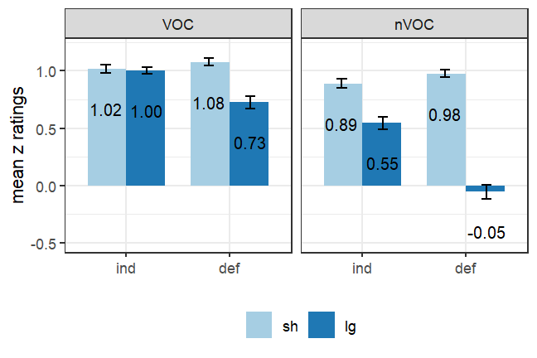
Appendix 1: Is the VOC effect specific to demonstrative DPs?
Maybe VOCs also increase the acceptability of subextraction from indefinite NPs.
Except that we cannot detect it reliably due to a ceiling effect.
VOC increases subextraction by 0.75 z-units
It’s just the indefinite.long nVOC is at 0.56 and 0.56+0.75 is at ceiling.

Slide 44
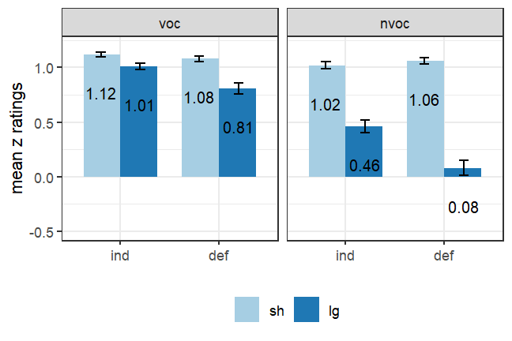
Experiment 3 in English: near replication of Exp 1
Changes made to short movement conditions: subject ‘who’ questions → ‘why’ questions subjects of all conditions → you
Three way interaction: p = .02
Two-way interaction of NP type and dependency length: significant when analyzed separately
definiteness effect in both VOC and nVOC
Two-way interaction of dependency length and verb type: significant when analyzed separately
penalty of long movement is larger in Def than in Indef
DD score nVOC: 0.42 DD score VOC: 0.16 DDD score: 0.26

Slide 45
Experiment 4: making sentences longer to “lift the ceiling”
Changes:
Proper nouns as the matrix subject, with a non-restrictive relative clause with a neg-licensed NPI inside
Coordinated embedded subjects
PP temporal modifier at the end
Non-changes:
why questions as short conditions
you is part of the embedded subject
If the VOC effect is a ceiling effect: we should see no three way interaction
If the VOC effect is real: we should still see it.
Emma, who never watches any TV, wonders why you and Liam promoted a TV show about superheroes last month.
Emma, who never watches any TV, wonders why you and Liam promoted that TV show about superheroes last month.
Emma, who never watches any TV, wonders what you and Liam promoted a TV show about last month.
Emma, who never watches any TV, wonders what you and Liam promoted that TV show about last month.

Slide 46
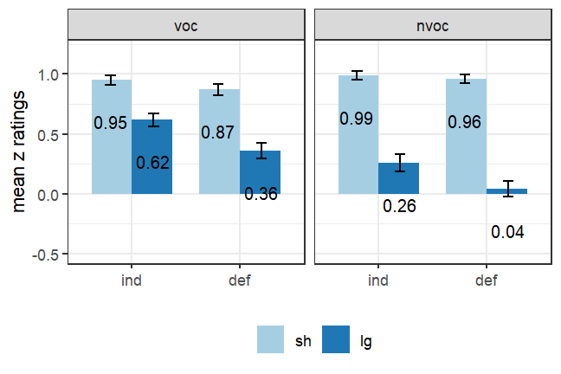
Experiment 4: making sentences longer to “lift the ceiling”
No three way interaction: p = .92
Marginal/No interaction between NP type and dependency length: p = .09
No interaction between NP type and verb type
Significant interaction between dependency length and verb type: extraction out of NPs is harder in nVOC
DD score nVOC: 0.19 DD score VOC: 0.18 DDD score: 0.01 (n.s)

Slide 47
What’s VOC effect and what’s the locality constraint
The results here are preliminary.
We did not find evidence that VOC ameliorate the definiteness effect
Contra Davies and Dubinsky, Erteschik-Shir, Diesing, etc
Instead, it made extraction from both definite and indefinite NPs better
What is ameliorated seems to be a general locality penalty of extraction out of NPs
This penalty has several potential sources:
NPs are islands (Bach and Horn 1976)
Subjacency (vP and NP are phases/barriers)
Distance effect (comparing moving out of one vP to moving across two)
VOC makes two domains one, ameliorating the penalty
Single event approach Lim 2022
N-V incorporation Davies and Dubinsky 2003

Slide 48
information structure based approach
Definite NPs are backgrounded. (Erteschik-Shir and Lappin 1979, Erteschik-Shir 1981, Goldberg 2006)
Dominance Hypothesis: An NP can only be extracted … out of phrases in which the NP may itself be regarded as dominant. (Erteschik-Shir and Lappin 1979, Erteschik-Shir 1981, Goldberg 2006)
Definite NPs are dominant, so the NPs within the definite NPs cannot be dominant thus cannot move.
ES equates movement and question-forming because she only considers wh-movement languages. But assuming that definite NPs are dominant and DH holds across languages.
Prediction: definiteness effect in both English and Mandarin
“The most natural verb object combinations are the creation verb sentences. Therefore the PP can always be interpreted as dominant.”
VOC effect: in both English and Mandarin

Slide 49
Three approaches to the definiteness effect
Definite DPs are locality domains (freezing, subjacency/PIC). (Diesing 1992; Citko 2014; Huang 2022; cf. Davies & Dubinsky 2003, Chomsky 1973)
The Specificity Condition: no binding of variables in specific/definite DPs. (Fiengo & Higginbotham 1981; cf. Simonenko 2015)
Dominance/Backgroundness: Definite NPs are backgrounded (Erteschik-Shir and Lappin 1979, Erteschik-Shir 1981, Goldberg 2006)

Slide 50
Predictions
 | Information structure- based | Specificity Condition | PIC+NI
Definiteness effect with non-VOCs in English | Yes | Yes | Yes
D effect with VOCs in English | No | Yes | No
VOC effect in English | Yes | No | Yes
English-Chinese uniformity | Yes | Yes | N/A

Slide 51
Theoretical consequence 2: Information structure approach
Information structure approaches (for discussion of English, see Erteschik-Shir 1981; Goldberg 2006; Abeillé et al. 2020)
Only foregrounded / dominant NPs can be extracted.
Definite objects are themselves dominant, so the NPs inside cannot be. (saw…) the picture of what → dominant, what → can not be dominant (saw…) a picture of what → not dominant, what → can be dominant
Objects of VOCs are not dominant, NPs inside can be dominant. (took…) the picture of what → not dominant, what → can be dominant
No clear predictions about Chinese.
But if what matters is communicative intent and information structure status, then we predict cross-linguistic uniformity (cf. Goldberg 2006).

