Slide 1

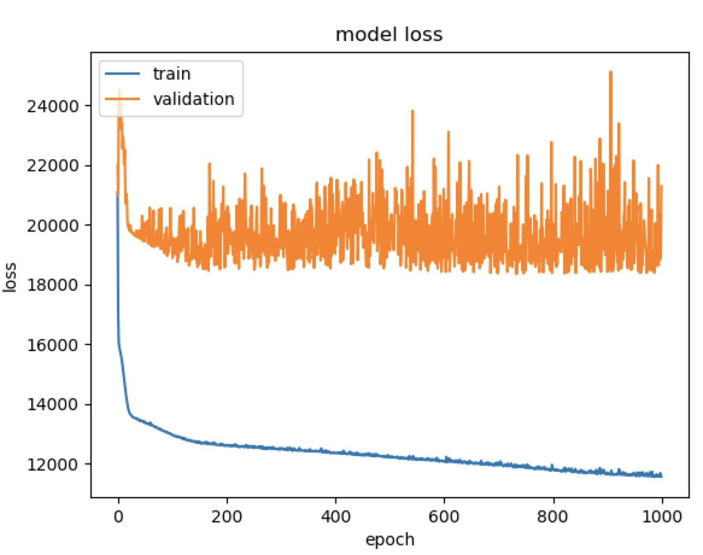
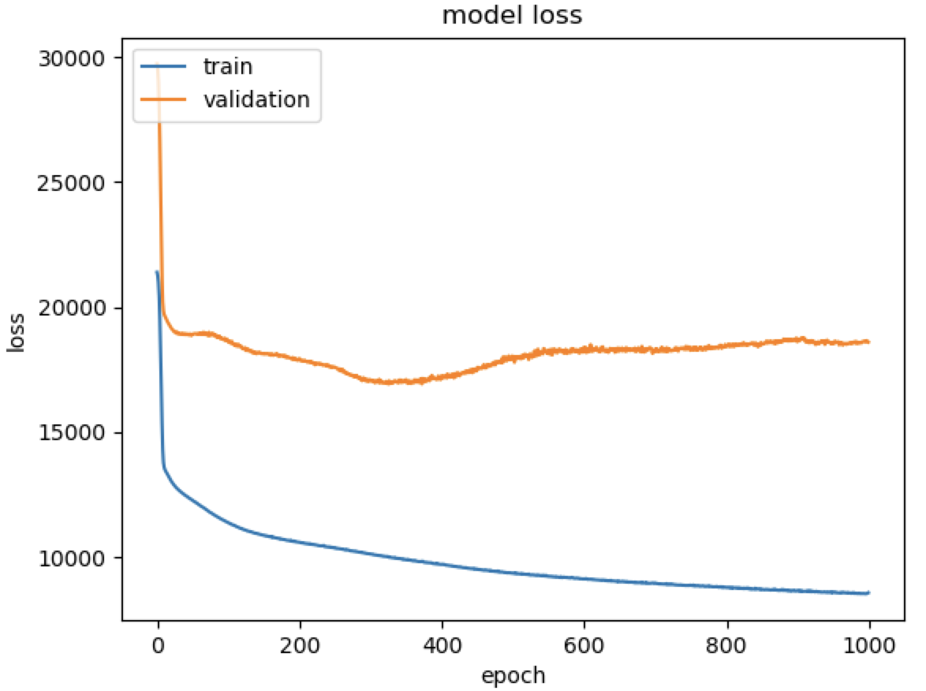
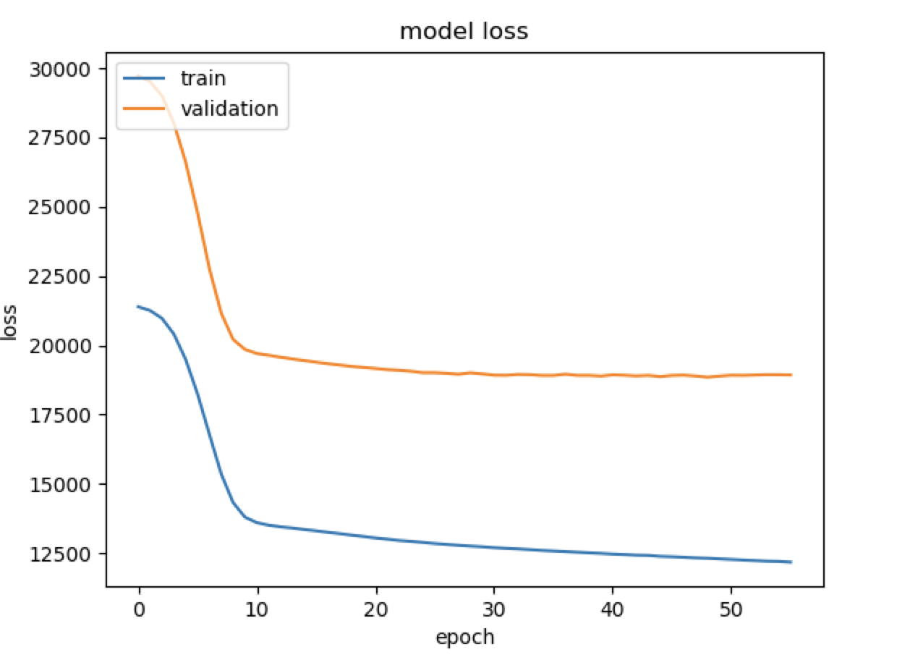
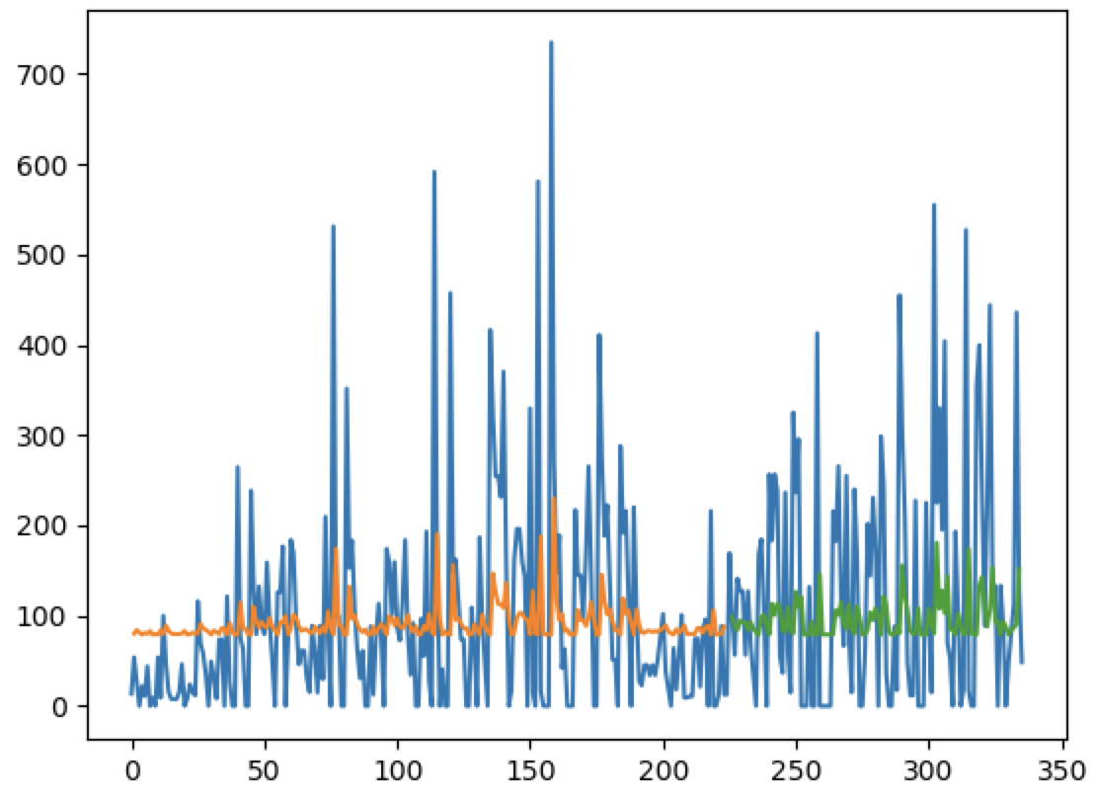
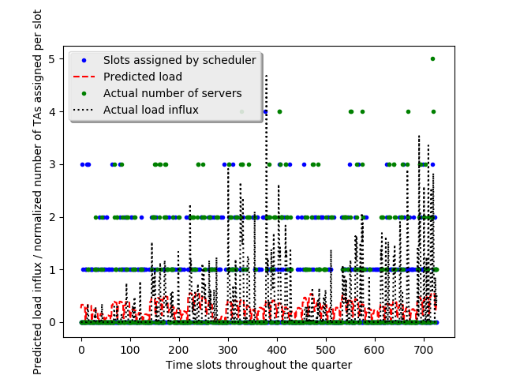
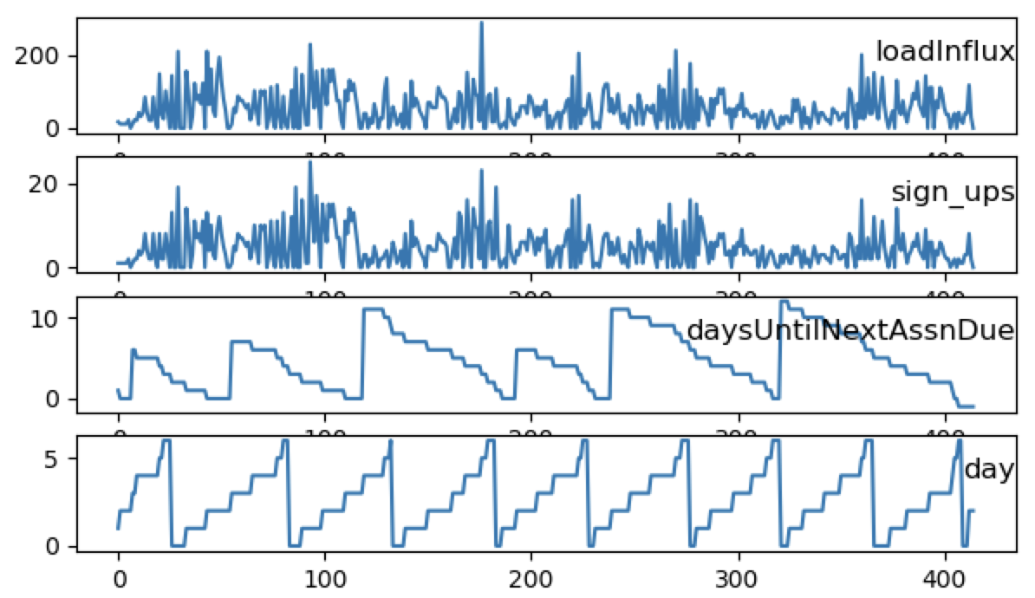

Deep Queue-Learning: A Quest to Optimize Office Hours
CS 221
Avoy Datta, Dian Ang Yap, Zheng Yan
Note: This project is shared between CS221 and CS229. For CS221, we focus on TA scheduling.
CS 229
Introduction
Methodology
Results
OHs often suffer from overcrowding and long wait times, stressing both students and instructors.
If we could accurately predict the expected workload at a given OH, TAs can be better allocated.
QueueStatus, Carta, and course syllabi provide a wealth of information that can be used.
We trained a neural network model that predicts student load influx (expected serve time * # sign-ups) at OH on an hourly basis, for any course.
With these predictions, we now optimize TA scheduling given realistic constraints.
Used normalization and early stopping to prevent overfitting.
Collect
Queue Data
Predict
Load Influx
Optimize
TA Scheduling
Training Datasets: CS107 (Spr/Aut 2017, Aut/Win 2018), CS161 (Spr/Aut 2017), CS110 (Spr/Aut 2018), CS229 (Aut 2018)
Test Dataset: CS107 (Spr 2018)
Without norm With normalization Norm + Early stopping
Predicting Student Load Influx
Trained and compared different models with deep fully-connected NN, univariate LSTMs and multivariate LSTMs.
Model for regression | RMSE (Load Influx)
FCN (hinge/MSE) | 161 / 119
Univariate LSTM | 137
Autoregressive LSTM | 128
Class Statistics
Cosine similarity, actual schedule | Cosine similarity, optimized schedule
0.237 | 0.722
Univariate LSTM predicts load influx spikes.
Table 1: Statistics for sample of classes (4/8 shown)
CS107 Spring 2018, (Test set)
Class | Quarter & Year | #OH-Active TAs | Total # Students | Total OH Hours | Total Served | Total Load Influx
CS107 | Spring 2017 | 13 | 184 | 415 | 1722 | 21873.09
CS161 | Spring 2017 | 6 | 93 | 204 | 875 | 15380.68
CS110 | Spring 2018 | 20 | 187 | 223 | 1749 | 35459.1
CS229 | Autumn 2018 | 17 | 634 | 369 | 1390 | 31733.7
Optimizing TA Scheduling Using Predicted
Load Influx
Features and Preliminary Statistics
Having predicted the expected load influx for each individual office hour in the quarter, we use Bayesian inference with Gibbs Sampling to assign TAs to each individual time slot.
Treating each TA as a variable, the Gibbs sampler assigns a fixed-length list of time slots to each TA through the quarter. Each time slot assignment is weighted according to:
$$P\left({X_{i}}_{j}=x\right)= T_{assigned}⋅T_{predicted} | X_{ij}=x$$
${ T}_{assigned} ⋅T_{predicted}$ measures the cosine similarity between the number of Tas assigned each office hour and the predicted loads
We also factor in constraints such as a maximum TA workload per day and continuity of office hours for a TA within any given day.
We use the cosine similarity between the number of servers and the actual load influx to measure how satisfactory a schedule is in meeting demand.
Load influx is significantly and positively correlated with:
Week number (r = 0.07) and Number of servers (r = 0.32)
Negatively correlated with: Days until assignment due (r= -0.08), Hour of day (r = -0.10), Weekday (r=-0.09), Days until next exam (r = -0.06)
Summary
Using data scraped off of Stanford course resources, a fully connected NN, and Gibbs sampling, we have come up with a system that schedules TA hours (within realistic constraints) that greatly improves over current TA assignment policies.
Major challenges included computational constraints, overfitting, applying real-life TA constraints, and deciding criterion of “optimality” for assignments.
In the future, we hope to extend this to more general testing data, including course numbers we have not seen before.
.
References
[1]
[2]
[3]

