Slide 1
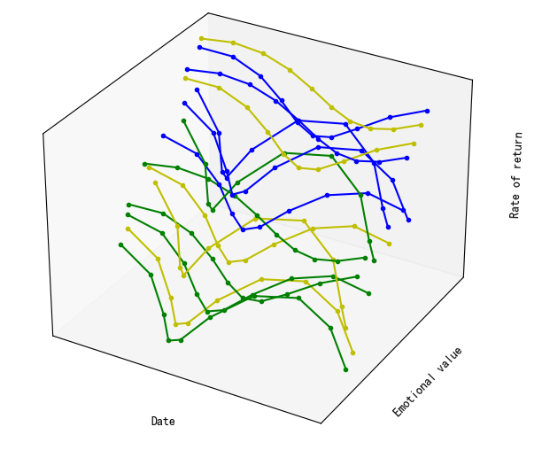



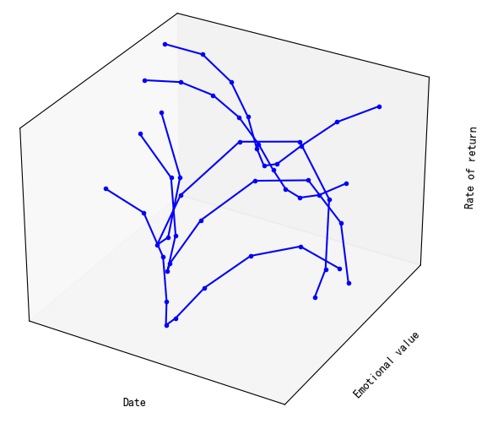









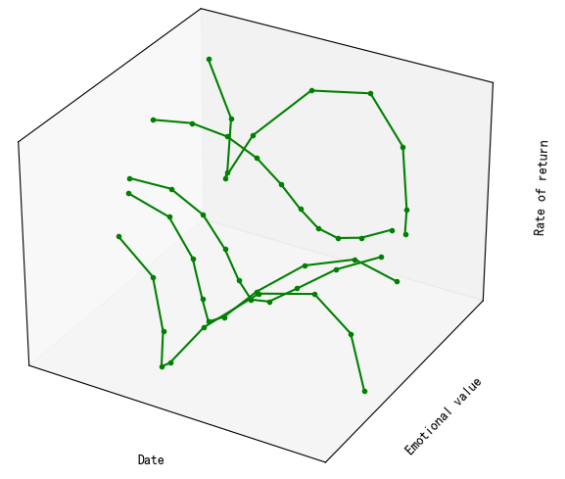
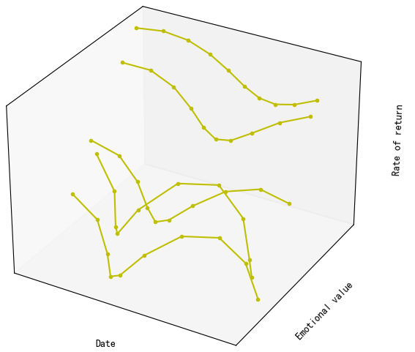




Return:7.21bp
SE:12.64
……
Asset group 1
Asset group 2
Asset group 3
(a) Data-acquisition
(b) Time-series-clustering
(c) Investment-portfolio
Portfolio investor sentiment
Financial data
Time series - Emotion - rate of return
Investment portfolio
Asset analysis data

Slide 3
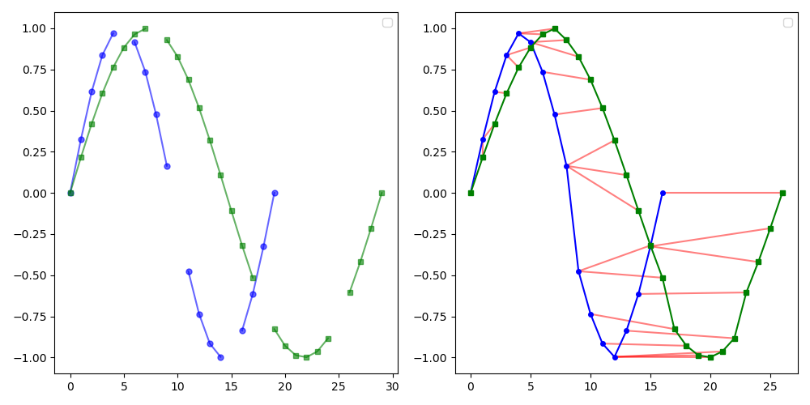



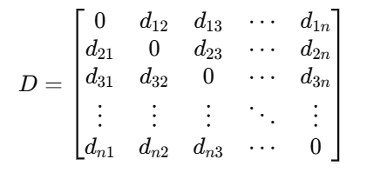
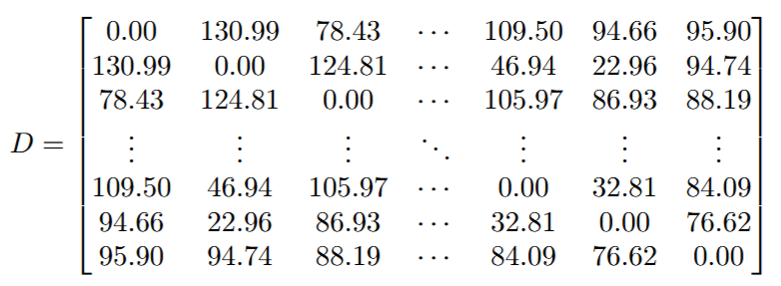
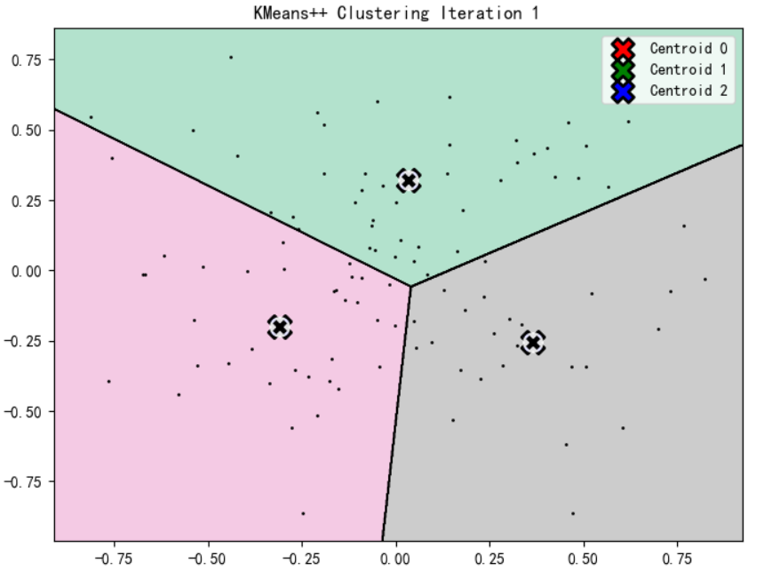
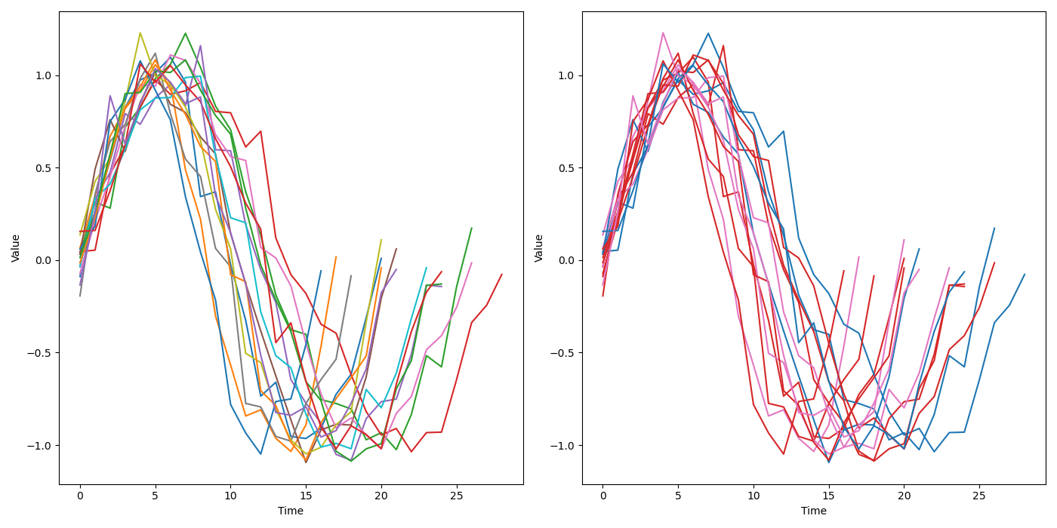
Output layer
Market rate of return
Task specific output layer
Transformer Encoder layer
Data splicing
20% of the test data
Unequal length, uneven time series regularity
Embedding layer
80% of the training data
Input layer
Model fine-tuning
Three market sentiments
Similarity matrix
Real similarity matrix
(b) Dynamic time warping
Output layer
MLM
NSP
Transformer Encoder layer
Embedding layer
Clustering process
Input layer
Stock correlation model
Association pattern clustering
Model pre-training
A large set of securities-linked text data
…
(a) Text emotion measurement based on BERT
(b) Kmeans++ cluster

