Slide 1
MSP Problem:
Its NP-Completeness and Its Algorithm
Xinwen Jiang
College of Computer,XTU xinwenjiang@sina.com （often use）; xinwenjiang@xtu.edu.cn
1. MSP problem
2. The algorithm for MSP problem
3. The Proof of the algorithm
4. Proving the NP-completeness of MSP

Slide 2
MSP problem
What is a multistage graph?
What is a simple path of G?
What is MSP problem?

Slide 3
G = < V, E, S, D, L >

Slide 4
G = < V, E, S, D, L >

Slide 5
G = < V, E, S, D, L >

Slide 6
G = < V, E, S, D, L >

Slide 7

G = < V, E, S, D, L >
Stage L
Stage L-1
for each
v∈V-{S}, it is labeled with E(v) E
Stage L-2
Stage L-3
Stage L-4
Stage 3
Stage 2
Stage 1
Stage 0

Slide 8
A Simple Path of G
A simple path is a path from S to D in G such that…

Slide 9
A Simple Path of G
for all v on the path
A simple path is a path from S to D in G such that…
E(v) contains
v

Slide 10
MSP Problem:
For any multistage graph G,does G have a simple path?
MSP problem

Slide 11
MSP Problem:
Its NP-Completeness and Its Algorithm
Xinwen Jiang
College of Computer,NUDT xinwenjiang@yahoo.com (often use); xwjiang@nudt.edu.cn
1. MSP problem
2. The algorithm for MSP problem
3. The Proof of the algorithm
4. Proving the NP-completeness of MSP

Slide 12
The algorithm for MSP problem
MAIN IDEA ：
for all edge e=<a, b, k>, under the control of E(v)(the level of v is higher than k). It floats to the top step by step.
e
e
b
a

Slide 13
The algorithm for MSP problem
MAIN IDEA ：
for all edge e=<a, b, k>, under the control of E(v)(the level of v is higher than k). It floats to the top step by step.
e
e
e
b
a

Slide 14
The algorithm for MSP problem
MAIN IDEA ：
for all edge e=<a, b, k>, under the control of E(v)(the level of v is higher than k). It floats to the top step by step.

Slide 15

The algorithm for MSP problem
Operator 1：
Operator 2：Init(R(u,v,l))
Operator 3：Comp(ES,v,R(E))
Operator 4：Change(R(u,v,l))
Z-H algorithm

Slide 16

算子1
Suppose ES E and u,v∈V. We define ES ={e | e∈ES, e is on a path u－…－v, and all the edges on u－…－v are contained in ES}

Slide 17


Operator 1:
Let ES be a subset of E, u and v are two vertices of V, we define ES =
{e | e∈ES, e is an edge on a path u－…－v, and all edges on u－…－v are contained in ES}.
How to compute ES ?

Slide 18
Operator 1:
v
ES
u

Slide 19
Operator 1:
Use edges of ES(red ones) to pave the way from u to the level of v
Collect edges(blue ones) to ES_{temp}
v
ES_{temp}
u

Slide 20


Operator 1:
Use edges of ES_{temp}(blue ones) to pave the way from v to u
Collect edges (green ones) to
v
u

Slide 21

算子2
Init (R (u, v, l)) is to compute the initial value of R( u, v, l ).
ES ← {<a, b, k> | <a, b, k> ∈E, l <k≤L, <u, v, l>∈E(a)∩E(b)}.
R(u, v, l) ← ES .

Slide 22
Operator 2: Init(R(u,v,l))
Stage L
D
<u,v,l> is an edge in E, the level of v is l
Stage l
v
u

Slide 23
step 1
Stage L
D
For all <a,b,k>, l <k≤L
b
a
E( )
R(u,v,l)
If E(a) contains <u,v,l> and E(b) also contains <u,v,l>,then <a,b,k>∈R(u,v,l)
Stage l
v
u

Slide 24
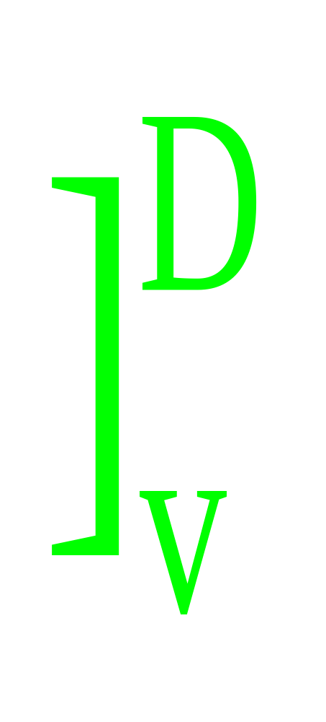

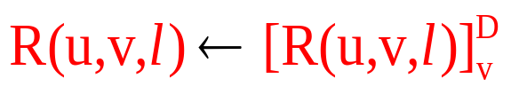
step 2
D
R(u,v,l)
v
u

Slide 25

算子3
Comp(ES, v, R(E)) equals the final result of ES_temp after the following iterations:
（1）ES_temp←ES
（2）For all e= <a, b, k>∈ES_temp:
if （R(a, b, k)∩ES_temp ） contains no path from b to v, ES_temp ←ES_temp-{e}.
（3）ES_temp← ES_temp , where, S is the unique vertex of V₀.
（4）Repeat step 2 and step 3 until ES_temp will not change any more.

Slide 26


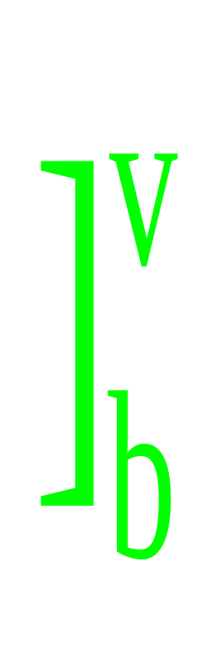



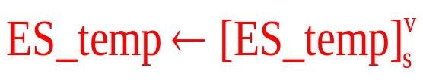
Operator 3: Comp(ES,v,R(E))
1.ES_temp←ES (red edges)
2.For all <a,b,k> in ES_temp
v
R(a, b, k)∩ ES_temp
R(a, b, k)
if R(a, b, k)∩
ES_temp is empty,then delete <a,b,k> from ES_temp, else remain it
3.
b
R( )
a
4.Repeat step 2 and step 3 until no change to ES_temp
ES_temp
S

Slide 27
算子4
（1）For all <a, b, k>∈R(u, v, l), l <k≤ L
if Comp( {e | e=<c, d, kk>∈E, kk < l, R(e)∩Comp(E(b), b, R(E)) contains <u, v, l> and <a, b, k>} , u, R(E))≠Ø
then <a, b, k> is kept in R(u, v, l);
else <a, b, k> is deleted from R(u, v, l).
（2）R(u, v, l)← R(u, v, l) .
（3）Repeat step 1 and step 2 until R(u, v, l) will not change any more

Slide 28

Operator 4: Change(R(u,v,l))
1.For all
<a,b,k>∈R(u,v,l), l <k≤L
b
Comp(E( ),b)
b
a
Find e=<c, d, kk>∈E, kk < l,
contains <u,v,l> and <a,b,k>
R( )
level l
v
u
d
e
R( )
c

Slide 29

Operator 4: Change(R(u,v,l))
Comp(E(b),b)
b
a
Find e=<c, d, kk>∈E, kk < l,
contains <u,v,l> and <a,b,k>
v
u
d
R(e)
c

Slide 30
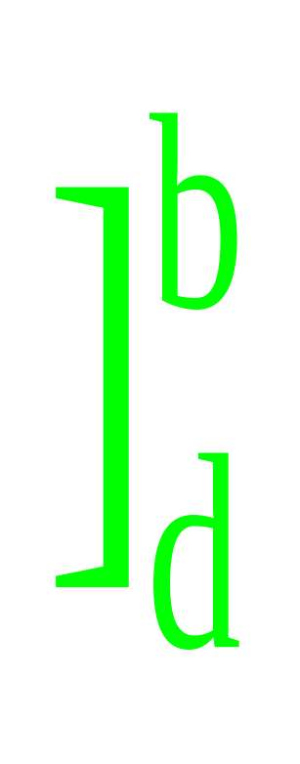

Operator 4: Change(R(u,v,l))
R(e)
Comp(E(b),b)
b
a
Find e=<c, d, kk>∈E, kk < l,
contains <u,v,l> and <a,b,k>
v
u
d
c

Slide 31
Operator 4: Change(R(u,v,l))
collect all <c,d,kk>
b
a
v
u
d
c

Slide 32
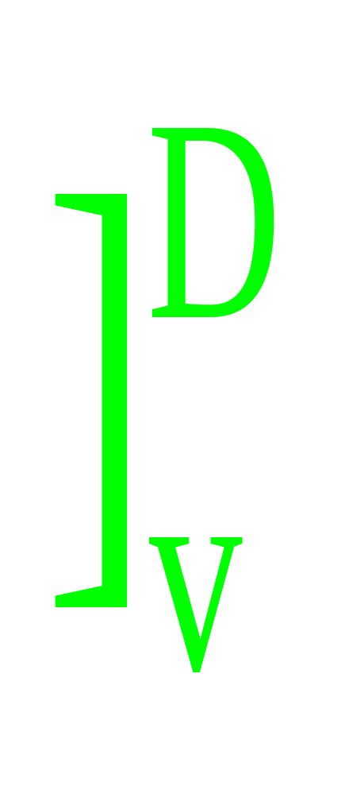


Operator 4: Change(R(u,v,l))
Call operator 3
b
the result is not empty, then <a,b,k> is kept in R(u,v,l), else delete it
a
v
2.
u
Comp( ,u,R(E))

Slide 33
Operator 4: Change(R(u,v,l))
R(u, v, l)
v
3.Repeat step 1 and step 2 until R(u, v, l) will not change any more
u

Slide 34



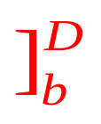
Z-H algorithm to solve MSP
1. For all e∈E, we use operator 2 to generate R(e) directly
2. For l=1 to L-1
2.1 For all <u, v, l> of stage l, call Change(R(u, v, l)) to modify R(u, v, l)
2.2 For all v of stage l, E(v) ← Comp(E(v), v, R(E))
2.3 For all <a, b, k>∈E，k≤l, execute the following two steps:
R(a, b, k)[k+1:l] ← R(a, b, k)∩Comp(E(v), v, R(E))
R(a, b, k) ← R(a, b, k)
3. Repeat step 2 until no R(u, v, l) in R(E)= { R(e) | e∈E} will aachange any more
4. If Comp(E(D), D, R(E))≠Ø, we claim the existence of a aasimple path in G. Otherwise, we claim that there is no aasimple path in G

Slide 35
MSP Problem:
Its NP-Completeness and Its Algorithm
Xinwen Jiang
College of Computer,NUDT xinwenjiang@sina.com (often use); xwjiang@nudt.edu.cn
1. MSP problem
2. The algorithm for MSP problem
3. The Proof of the algorithm
4. Proving the NP-completeness of MSP

Slide 36
The Proof of the algorithm
Lamma 2
Lamma 3
Lamma 4
Lamma 5

Slide 37
Lemma 2
G₁
G
in G, vertex v of stage L-1 is a multi in-degree vertex
D
D
v
v
stage L-1
u
we separate all edges ending at v into two non-empty parts,called group 1 and group 2
u
g
g
f
f
and split v into two vertices called v₁, v₂
S
S

Slide 38
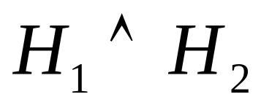
The Proof of the algorithm
G₁<G;
If we have when G is the input of the Proving Algorithm, we must have when G₁ is the input of the Proving Algorithm.
If P is a simple path in G₁, P must be a simple path in G

Slide 39
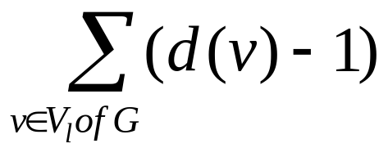
The Proof of the algorithm
Vec (G) = (x₁, x₂,…, x_{L-1}, x_{L}), where,
x_{l} = , 1≤l≤L-1，
x_{L} =0,
Where, d(v) is the in-degree of v, V_{l} is the set of all the vertices of stage l.

Slide 40
Lemma 2
G
G₁
D
D
D
D
v
v1
v
v
v2
v2
u
u
u
u
g
g
g
g
f
f
f
f
S
S
S
S

Slide 41
Lemma 2
G
G₁
the edge set of each vertex in G₁ comes from G
E( )
E( )
D
D
D
D
E( )
E( )
E( )
v
v1
v
v2
E( )
E( )
E( )
E( )
u
u
u
u
E( )
E( )
g
g
g
g
E( )
E( )
f
f
f
f
S
S
S
S

Slide 42
Lemma 3
G
G₁
in G, vertex v of stage L-2 is a multi in-degree vertex, and no multi in-degree vertex can be found at stage L-1
D
D
w
w
v
v
stage L-2
b
b
first, we split v into v₁,v₂
a
a
S
S
S
S

Slide 43
Lemma 3
G
G₁
D
D
w
w
v2
v
v1
v
b
b
a
a
S
S
S
S

Slide 44
Lemma 3
G₁
after that, we split vertex at stage L-1
D
D
D
D
w2
w
w2
w1
w
w1
w
stage L-1
v2
v2
v2
v1
v2
v1
v1
v1
b
b
b
b
a
a
a
a
S
S
S
S

Slide 45
Lemma 3
G
the edge set of each vertex in G₁ comes from G
G₁
E( )
E( )
D
D
E( )
E( )
E( )
E( )
E( )
w
E( )
w2
w1
E( )
E( )
E( )
v
v1
v2
E( )
E( )
E( )
E( )
E( )
E( )
b
b
E( )
E( )
a
a
S
S
S

Slide 46
Conclusion 2 in Lemma 3
G
the edge set of each vertex in G₁
G₁
E( )
D
D
E( )
E( )
E( )
E( )
w
E
w1
w2
E( )
E( )
E( )
v
v1
v2
E( )
E( )
E( )
E( )
E( )
E( )
b
b
E( )
E( )
a
a
S
S
S

Slide 47
Lemma 4
G
in G, vertex v of stage L-3 is a multi in-degree vertex, and no multi in-degree vertex can be found at stage L-1 and stage L-2
D
c
v
stage L-3
we delete all vertices at stage L-3
a
b
S
S

Slide 48
Lemma 4
G
G₁
D
D
c
c
v
v
b
a
b
a
S
S
S
S

Slide 49
Lemma 4
G
G₁
D
D
c
c
v
stage l=L-3
v
a
b
a
b
S
S
S
S

Slide 50
Lemma 4
G
for any <a,v,l> and <v,c,l+1> in G, we generate <a,c,l> in G₁
G₁
D
D
c
c
v
stage l=L-3
a
b
a
b
S
S
pp
S
pp
add edge pp from S to a and b

Slide 51
Lemma 4
G
the edge set of each vertex in G₁ comes from G
G₁
E( )
D
E( )
D
E( )
E( )
E( )
E( )
Comp( )
Comp( )
c
E( )
E( )
c
v
E( )
E( )
E( )
E( )
a
b
a
b
S
S
pp
S
S
pp

Slide 52
Lemma 5
G
G₁
vertex v of stage l is a multi in-degree vertex, l<L-3, and no multi in-degree vertex can be found at stage L-1, stage L-2,...,stage l+1
D
D
b
b
c
c
stage L-3
a
a
v
stage l
v
we delete all vertices at stage L-3
S
S

Slide 53
Lemma 5
G
G₁
D
D
D
b
b
b
c
c
c
a
a
a
v
v
v
S
S
S

Slide 54
Lemma 5
G
for any <a,c,L-3> and <c,b,L-2>, we generate <a,b,(L-1)-2> in G₁
D
G₁
D
D
b
b
c
b
c
a
a
a
v
v
v
S
S
S

Slide 55
Lemma 5
G
the edge set of each vertex in G₁ comes from G
E( )
G₁
D
E( )
E( )
E( )
D
Comp( )
Comp( )
E( )
E( )
b
E( )
E( )
c
b
E( )
E( )
E( )
E( )
a
a
E( )
E( )
v
v
E( )
E( )
E( )
E( )
S
S

Slide 56
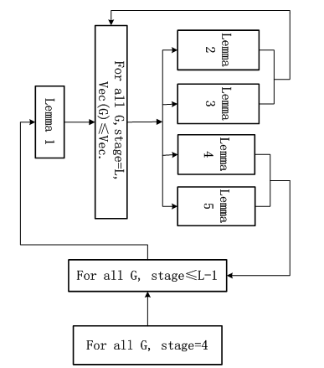
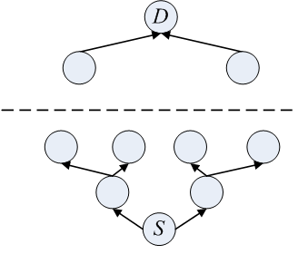
The Proof of the algorithm

Slide 57
MSP Problem:
Its NP-Completeness and Its Algorithm
Xinwen Jiang
College of Computer,NUDT xinwenjiang@sina.com (often use); xwjiang@nudt.edu.cn
1. MSP problem
2. The algorithm for MSP problem
3. The Proof of the algorithm
4. Proving the NP-completeness of MSP

Slide 58
Proving NP-completeness
1
1
1
(1,4)
2
3
4
(1,0)

Slide 59
Proving NP-completeness
1
(1,4)
2
2
3
(2,3)
4
(2,2)
(2,1)
(1,0)

Slide 60
Proving NP-completeness
1
(1,4)
2
3
3
(2,3)
(3,3)
(4,3)
4
(2,2)
(3,2)
(4,2)
(2,1)
(3,1)
(4,1)
(1,0)

Slide 61
Proving NP-completeness
1
(1,4)
2
3
(2,3)
(3,3)
(4,3)
4
4
(2,2)
(3,2)
(4,2)
(2,1)
(3,1)
(4,1)
(1,0)

Slide 62
Proving NP-completeness
1
(1,4)
2
3
(2,3)
(3,3)
(4,3)
4
(2,2)
(3,2)
(4,2)
(2,1)
(3,1)
(4,1)
(1,0)

Slide 63
Proving NP-completeness
1
(1,4)
2
3
(2,3)
(3,3)
(4,3)
4
(2,2)
(3,2)
(4,2)
(2,1)
(3,1)
(4,1)
(1,0)

Slide 64
Proving NP-completeness
1
(1,4)
2
3
(2,3)
(3,3)
(4,3)
4
(2,2)
(3,2)
(4,2)
(2,1)
(3,1)
(4,1)
(1,0)

Slide 65
Proving NP-completeness
1
(1,4)
2
3
(2,3)
(3,3)
(4,3)
4
(2,2)
(3,2)
(4,2)
E([vertex,level])=
E - {e|e is an edge which ends at [vertex,k],k≠level}
(2,1)
(3,1)
(4,1)
(1,0)

Slide 66
Proving NP-completeness
1
(1,4)
2
3
(2,3)
(3,3)
(4,3)
4
(2,2)
(3,2)
(4,2)
For example,
E([3,2])=
E - {e|e is an edge which ends at [3,1] and [3,3] }
(2,1)
(3,1)
(4,1)
(1,0)

Slide 67

MSP Problem: Its NP-Completeness and Its Algorithm
Thank you！

