Slide 1
New techniques for cost sharing in combinatorial optimization games
Reporter：Xiangbin Liao
Date: 2023.11.08

Slide 2
Paper Information
Title: New techniques for cost sharing in combinatorial optimization games
Published on Mathematical Programming
Received: June 3 2008
Accepted: August 10 2009
Published online: May 11 2010
Keywords: Cooperative games; Optimal cost shares; Combinatorial optimization games; Valid inequalities; Traveling salesman game; Vehicle routing game
Authors: Alberto Caprara · Adam N. Letchford

Slide 3

Author Information
Alberto Caprara (Professor, University of Bologna, QS 154)
Education
Bachelor degree, The University of Pennsylvania
PhD, Universities of Bologna
Publication
Mathematical Programming (17)
INFORMS Journal on Computing (9)
Operations Research (6)
Research Area
Combinatorial Optimization

Slide 4
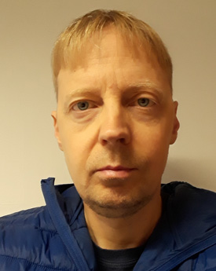
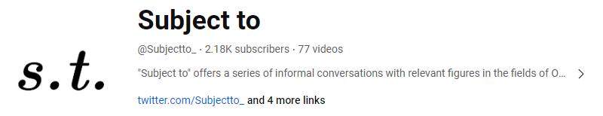
Author Information
Adam N. Letchford (Professor, Lancaster University, QS 122)
Education
Bachelor degree, Nottingham University
PhD, Lancaster University
Publication
Mathematical Programming (19)
INFORMS Journal on Computing (2)
Mathematics of Operations Research(2)
Research Area
Combinatorial Optimization
Integer Programming

Slide 5

1. Introduction
Cooperative Game Fundamental:
Cost sharing games with Transferable Utilities
Objective: share costs among the players in a ‘fair’ way
Represent: $G=\left(V, c\right)$, where $V=\left\{1,⋯,n\right\}$, $c\left(S\right)$ denotes the minimal cost of serving the players in $S$.
Cost allocation for cooperative game ($w$)
Core property: $\sum_{i∈S}{w_{i}}≤c\left(S\right), S∈𝒮$
Budget balanced property: $\sum_{i∈V}{w_{i}}=c\left(V\right)$
Core: the set of cost allocations that satisfies core property and budget balanced property

Slide 6
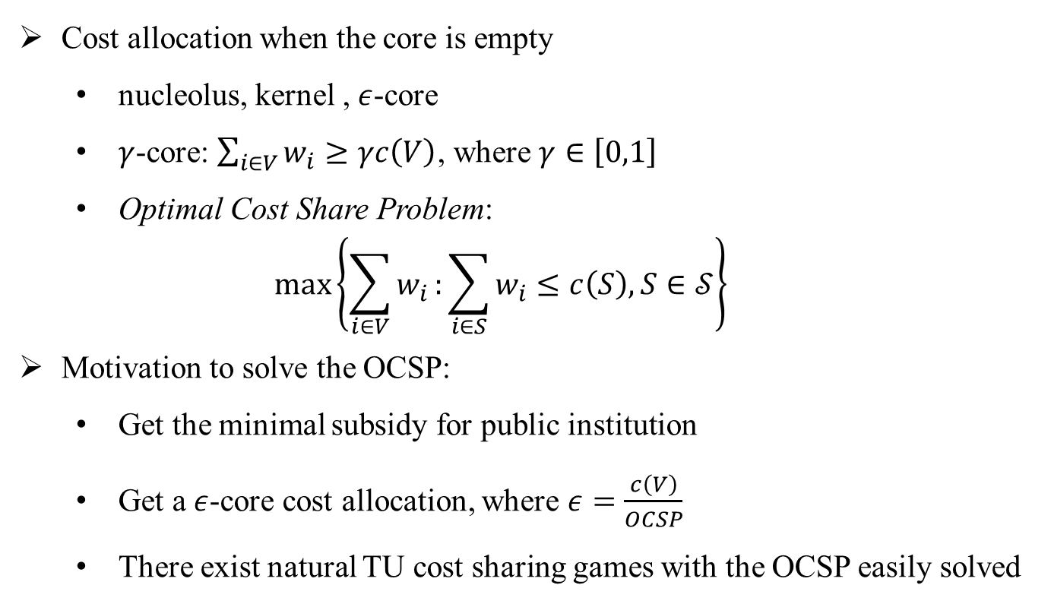
1. Introduction
Cooperative Game Fundamental:
Cost allocation when the core is empty
nucleolus, kernel , $ε$-core
$γ$-core: $\sum_{i∈V}{w_{i}}≥γc\left(V\right)$, where $γ∈\left[0,1\right]$
Optimal Cost Share Problem:
$$\max\left\{\sum_{i∈V}{w_{i}}:\sum_{i∈S}{w_{i}}≤c\left(S\right), S∈𝒮\right\}$$
Motivation to solve the OCSP:
Get the minimal subsidy for public institution
Get a $ε$-core cost allocation, where $ε=\frac{c\left(V\right)}{OCSP}$
There exist natural TU cost sharing games with the OCSP easily solved

Slide 7
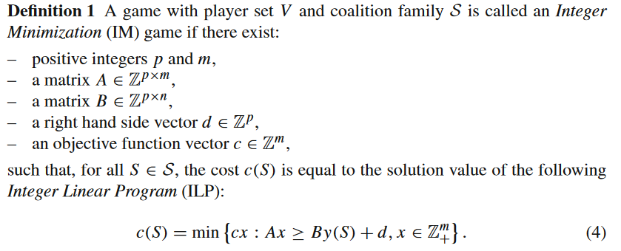
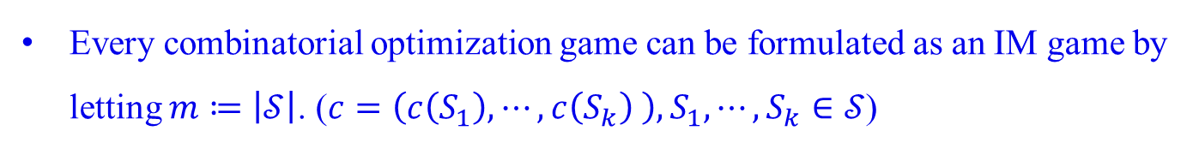
2. Integer minimization games
Definition and basic properties:
Every combinatorial optimization game can be formulated as an IM game by letting $m≔\left|𝒮\right|$. ($c=\left(c\left(S_{1}\right),⋯,c\left(S_{k}\right) \right), S_{1},⋯,S_{k}∈𝒮$)

Slide 8
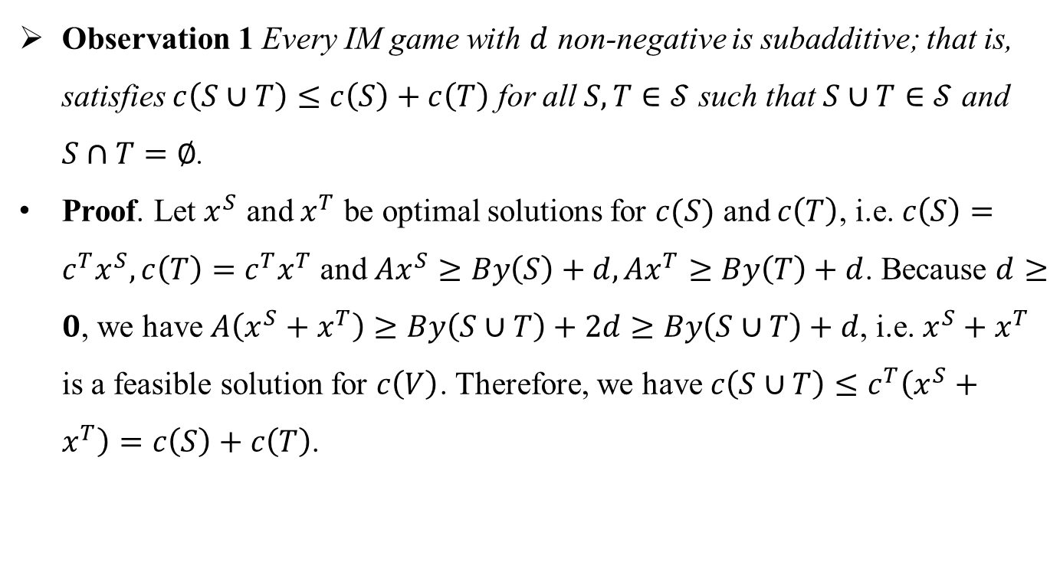
2. Integer minimization games
Definition and basic properties:
Observation 1 Every IM game with $d$ non-negative is subadditive; that is, satisfies $c\left(S∪T\right)≤c\left(S\right)+c\left(T\right)$ for all $S,T∈𝒮$ such that $S∪T∈𝒮$ and $S∩T=∅$.
Proof. Let $x^{S}$ and $x^{T}$ be optimal solutions for $c(S)$ and $c\left(T\right)$, i.e. $c\left(S\right)=c^{T}x^{S}, c\left(T\right)=c^{T}x^{T}$ and $Ax^{S}≥By\left(S\right)+d, Ax^{T}≥By\left(T\right)+d$. Because $d≥0$, we have $A\left(x^{S}+x^{T}\right)≥By\left(S∪T\right)+2d≥By\left(S∪T\right)+d$, i.e. $x^{S}+x^{T}$ is a feasible solution for $c\left(V\right)$. Therefore, we have $c\left(S∪T\right)≤c^{T}\left(x^{S}+x^{T}\right)=c\left(S\right)+c\left(T\right)$.

Slide 9
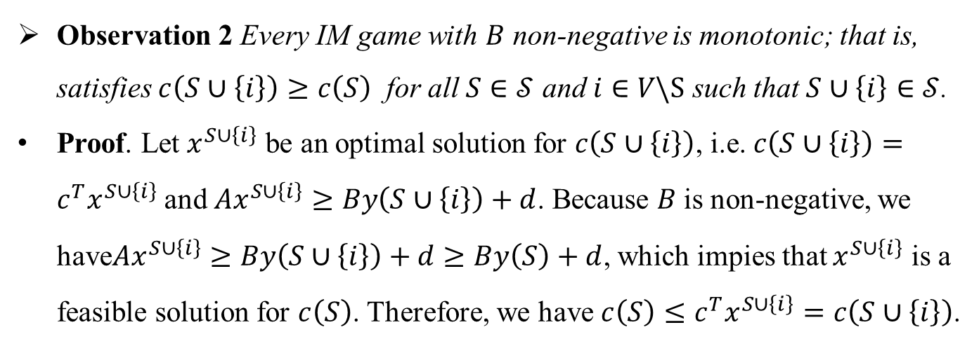
2. Integer minimization games
Definition and basic properties:
Observation 2 Every IM game with $B$ non-negative is monotonic; that is, satisfies $c\left(S∪\left\{i\right\}\right)≥c\left(S\right)$ for all $S∈𝒮$ and $i∈V\backslash S$ such that $S∪\left\{i\right\}∈𝒮$.
Proof. Let $x^{S∪\left\{i\right\}}$ be an optimal solution for $c\left(S∪\left\{i\right\}\right)$, i.e. $c\left(S∪\left\{i\right\}\right)=c^{T}x^{S∪\left\{i\right\}}$ and $Ax^{S∪\left\{i\right\}}≥By\left(S∪\left\{i\right\}\right)+d$. Because $B$ is non-negative, we have$Ax^{S∪\left\{i\right\}}≥By\left(S∪\left\{i\right\}\right)+d≥By\left(S\right)+d$, which impies that $x^{S∪\left\{i\right\}}$ is a feasible solution for $c\left(S\right)$. Therefore, we have $c\left(S\right)≤c^{T}x^{S∪\left\{i\right\}}=c\left(S∪\left\{i\right\}\right)$.
When $d=0$, we call such IM game homogeneous.

Slide 10
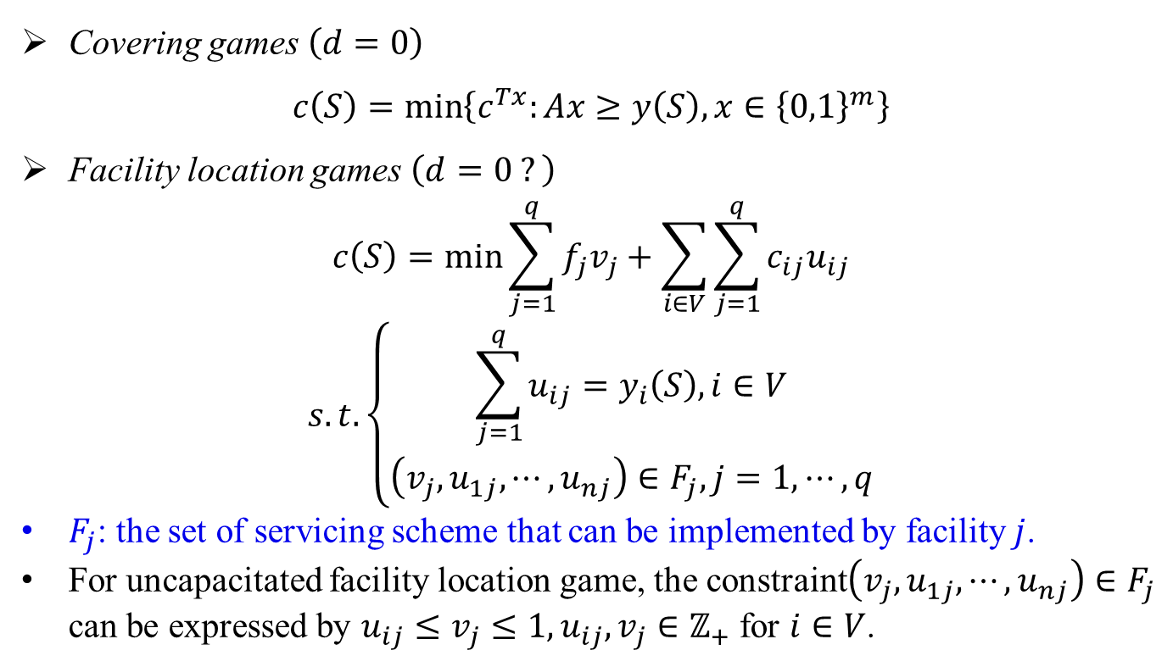
2. Integer minimization games
Some specific IM games:
Covering games $\left(d=0\right)$
$$c\left(S\right)=\min\left\{c^{Tx}:Ax≥y\left(S\right),x∈{\left\{0,1\right\}}^{m}\right\}$$
Facility location games $\left(d=0 ?\right)$
$$c\left(S\right)=\min{\sum_{j=1}^{q}{f_{j}v_{j}}+\sum_{i∈V}{\sum_{j=1}^{q}{c_{ij}u_{ij}}}}$$
$$s.t. \left\{\begin{aligned}\sum_{j=1}^{q}{u_{ij}}=y_{i}\left(S\right), i∈V \\ \left(v_{j},u_{1j},⋯,u_{nj}\right)∈F_{j}, j=1,⋯,q\end{aligned}\right.$$
$F_{j}$: the set of servicing scheme that can be implemented by facility $j$.
For uncapacitated facility location game, the constraint$\left(v_{j},u_{1j},⋯,u_{nj}\right)∈F_{j}$ can be expressed by $u_{ij}≤v_{j}≤1, u_{ij},v_{j}∈ℤ_{+}$ for $i∈V$.

Slide 11

2. Integer minimization games
Some specific IM games:
Traveling salesman game
$$c\left(S\right)=\min{\sum_{e∈E}{c_{e}x_{e}}}$$
$$s.t. \left\{\begin{aligned}\sum_{e∈δ\left(0\right)}{x_{e}}=2, \\ \sum_{e∈δ\left(i\right)}{x_{e}}=2y_{i}\left(S\right), i∈V, \\ \sum_{e∈δ\left(R\right)}{x_{e}}≥2y_{i}\left(S\right), R⊆V,i∈R, \\ x∈ℤ_{+}^{\left|E\right|}\end{aligned}\right.$$

Slide 12

2. Integer minimization games
Some specific IM games:
Vehicle routing game $(d=0)$
$$c\left(S\right)=\min{\sum_{e∈E}{c_{e}x_{e}}}$$
$$s.t. \left\{\begin{aligned}\sum_{e∈δ\left(i\right)}{x_{e}}=2y_{i}\left(S\right), i∈V, \\ \sum_{e∈δ\left(R\right)}{x_{e}}≥2\frac{\sum_{i∈R}{q_{i}y_{i}\left(S\right)}}{Q}, R⊆V, \\ x∈ℤ_{+}^{\left|E\right|}.\end{aligned}\right.$$

Slide 13
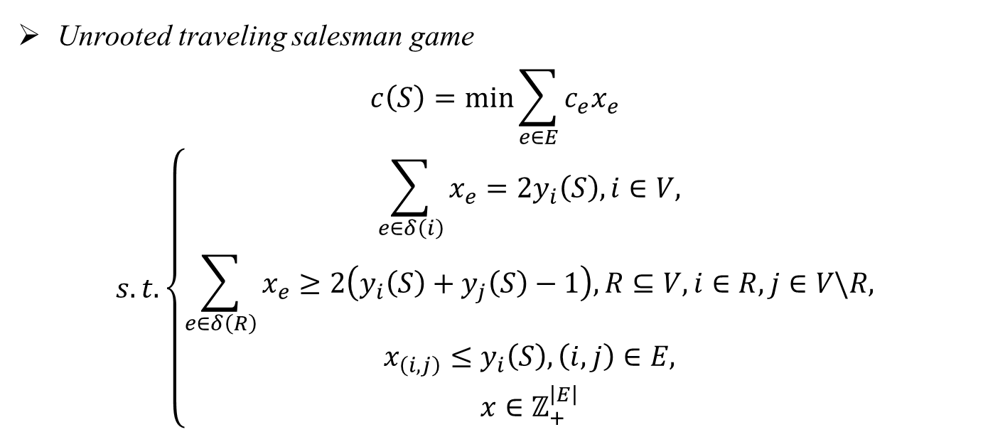
2. Integer minimization games
Some specific IM games:
Unrooted traveling salesman game
$$c\left(S\right)=\min{\sum_{e∈E}{c_{e}x_{e}}}$$
$$s.t. \left\{\begin{aligned}\sum_{e∈δ\left(i\right)}{x_{e}}=2y_{i}\left(S\right), i∈V, \\ \sum_{e∈δ\left(R\right)}{x_{e}}≥2\left(y_{i}\left(S\right)+y_{j}\left(S\right)−1\right), R⊆V, i∈R, j∈V\backslash R, \\ x_{\left(i,j\right)}≤y_{i}\left(S\right), \left(i,j\right)∈E, \\ x∈ℤ_{+}^{\left|E\right|}\end{aligned}\right.$$

Slide 14

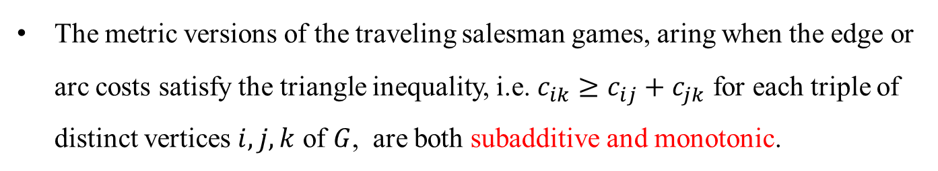
2. Integer minimization games
Some specific IM games:
Two-matching game $\left(d=0\right)$
$$c\left(S\right)=\min{\sum_{e∈E}{c_{e}x_{e}}}$$
$$s.t. \left\{\begin{aligned}\sum_{e∈δ\left(i\right)}{x_{e}}=2y_{i}\left(S\right), i∈V, \\ x_{\left(i,j\right)}≤y_{i}\left(S\right), \left(i,j\right)∈E, \\ x∈ℤ_{+}^{\left|E\right|}\end{aligned}\right.$$
The metric versions of the traveling salesman games, aring when the edge or arc costs satisfy the triangle inequality, i.e. $c_{ik}≥c_{ij}+c_{jk}$ for each triple of distinct vertices $i,j,k$ of $G$, are both subadditive and monotonic.

Slide 15
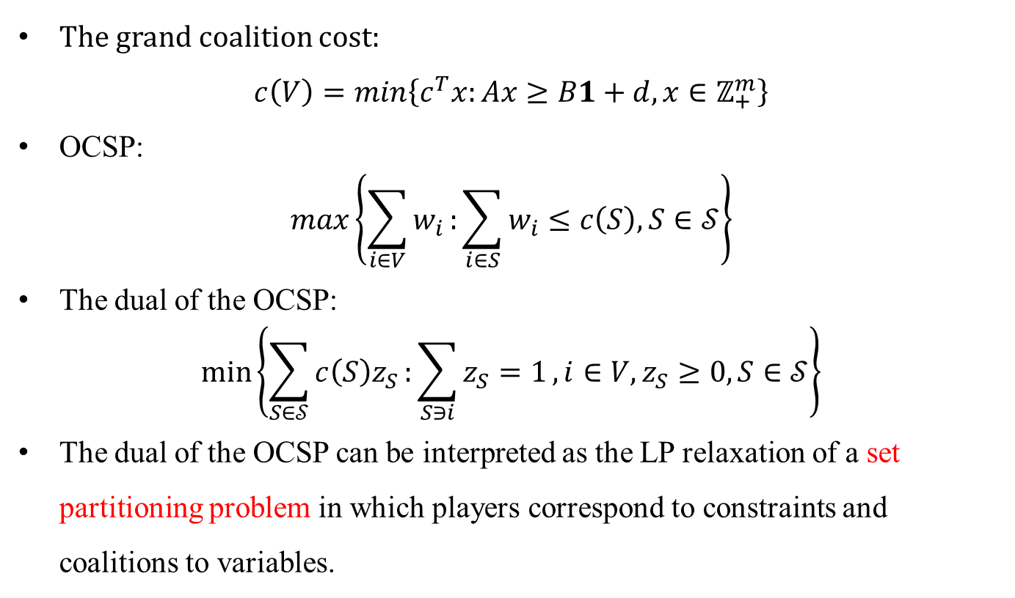
3. Three methods
Preliminaries:
The grand coalition cost:
$$c\left(V\right)=\min\left\{c^{T}x:Ax≥B1+d, x∈ℤ_{+}^{m}\right\}$$
OCSP:
$$\max\left\{\sum_{i∈V}{w_{i}}:\sum_{i∈S}{w_{i}}≤c\left(S\right), S∈𝒮\right\}$$
The dual of the OCSP:
$$\min\left\{\sum_{S∈𝒮}{c\left(S\right)z_{S}}:\sum_{S∋i}{z_{S}=1}, i∈V, z_{S}≥0, S∈𝒮\right\}$$
The dual of the OCSP can be interpreted as the LP relaxation of a set partitioning problem in which players correspond to constraints and coalitions to variables.

Slide 16
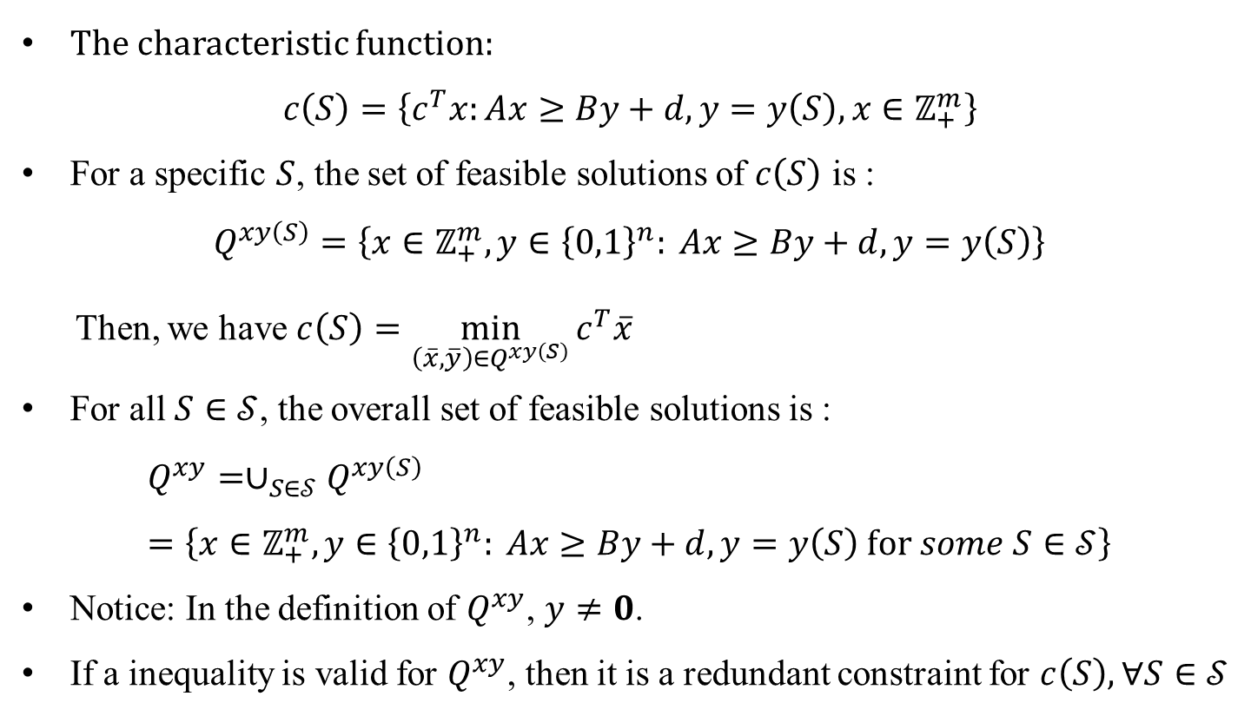
3. Three methods
Column generation:
The characteristic function:
$$c\left(S\right)=\left\{c^{T}x:Ax≥By+d, y=y\left(S\right), x∈ℤ_{+}^{m}\right\}$$
For a specific $S$, the set of feasible solutions of $c\left(S\right)$ is :
$$Q^{xy\left(S\right)}=\left\{x∈ℤ_{+}^{m},y∈{\left\{0,1\right\}}^{n}: Ax≥By+d, y=y\left(S\right)\right\}$$
Then, we have $c\left(S\right)=\min_{\left(\overline{x},\overline{y}\right)∈Q^{xy\left(S\right)}}{c^{T}\overline{x}}$
For all $S∈𝒮$, the overall set of feasible solutions is :
$$Q^{xy}=∪_{S∈𝒮}Q^{xy\left(S\right)}=\left\{x∈ℤ_{+}^{m},y∈{\left\{0,1\right\}}^{n}: Ax≥By+d, y=y\left(S\right) for some S∈𝒮\right\}$$
Notice: In the definition of $Q^{xy}$, $y≠0$.
If a inequality is valid for $Q^{xy}$, then it is a redundant constraint for $c\left(S\right), ∀S∈𝒮$

Slide 17
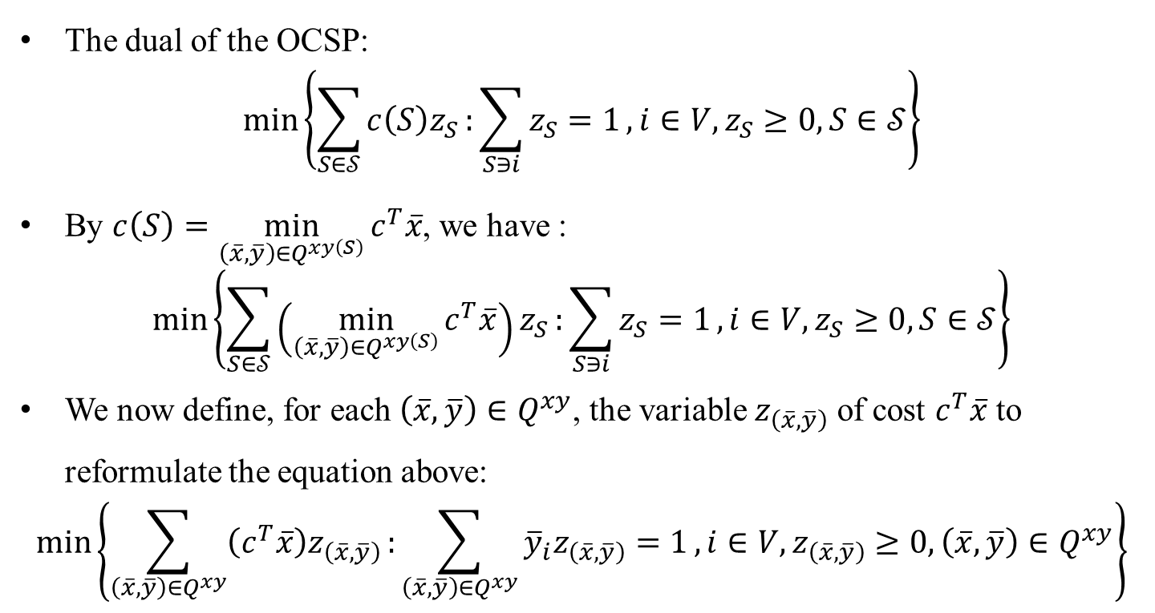
3. Three methods
Column generation:
The dual of the OCSP:
$$\min\left\{\sum_{S∈𝒮}{c\left(S\right)z_{S}}:\sum_{S∋i}{z_{S}=1}, i∈V, z_{S}≥0, S∈𝒮\right\}$$
By $c\left(S\right)=\min_{\left(\overline{x},\overline{y}\right)∈Q^{xy\left(S\right)}}{c^{T}\overline{x}}$, we have :
$$\min\left\{\sum_{S∈𝒮}{\left(\min_{\left(\overline{x},\overline{y}\right)∈Q^{xy\left(S\right)}}{c^{T}\overline{x}}\right)z_{S}}:\sum_{S∋i}{z_{S}=1}, i∈V, z_{S}≥0, S∈𝒮\right\}$$
We now define, for each $\left(\overline{x},\overline{y}\right)∈Q^{xy}$, the variable $z_{\left(\overline{x},\overline{y}\right)}$ of cost $c^{T}\overline{x}$ to reformulate the equation above:
$$\min\left\{\sum_{\left(\overline{x},\overline{y}\right)∈Q^{xy}}{\left(c^{T}\overline{x}\right)z_{\left(\overline{x},\overline{y}\right)}}:\sum_{\left(\overline{x},\overline{y}\right)∈Q^{xy}}{{\overline{y}}_{i}z_{\left(\overline{x},\overline{y}\right)}=1}, i∈V,z_{\left(\overline{x},\overline{y}\right)}≥0,\left(\overline{x},\overline{y}\right)∈Q^{xy}\right\}$$

Slide 18
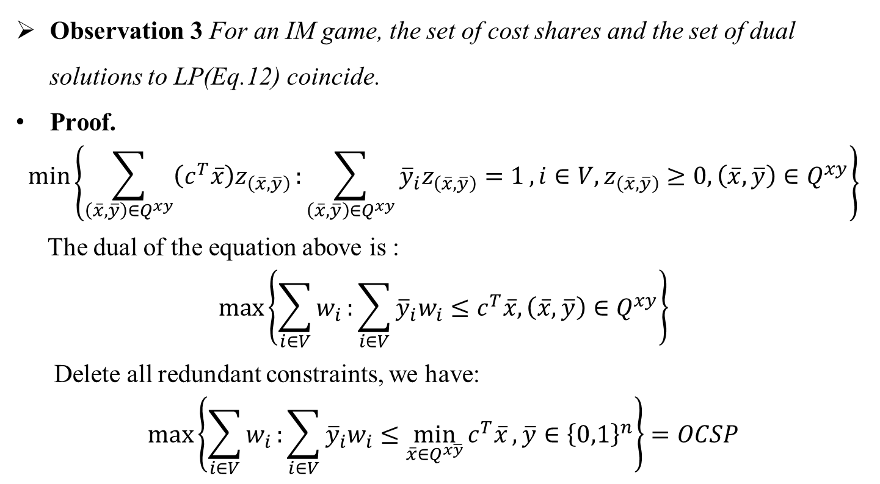
3. Three methods
Column generation:
Observation 3 For an IM game, the set of cost shares and the set of dual solutions to LP(Eq.12) coincide.
Proof.
$$\min\left\{\sum_{\left(\overline{x},\overline{y}\right)∈Q^{xy}}{\left(c^{T}\overline{x}\right)z_{\left(\overline{x},\overline{y}\right)}}:\sum_{\left(\overline{x},\overline{y}\right)∈Q^{xy}}{{\overline{y}}_{i}z_{\left(\overline{x},\overline{y}\right)}=1}, i∈V,z_{\left(\overline{x},\overline{y}\right)}≥0,\left(\overline{x},\overline{y}\right)∈Q^{xy}\right\}$$
The dual of the equation above is :
$$\max\left\{\sum_{i∈V}{w_{i}}:\sum_{i∈V}{{\overline{y}}_{i}w_{i}}≤c^{T}\overline{x},\left(\overline{x},\overline{y}\right)∈Q^{xy}\right\}$$
Delete all redundant constraints, we have:
$$\max\left\{\sum_{i∈V}{w_{i}}:\sum_{i∈V}{{\overline{y}}_{i}w_{i}}≤\min_{\overline{x}∈Q^{x\overline{y}}}{c^{T}\overline{x}}, \overline{y}∈{\left\{0,1\right\}}^{n}\right\}=OCSP$$

Slide 19
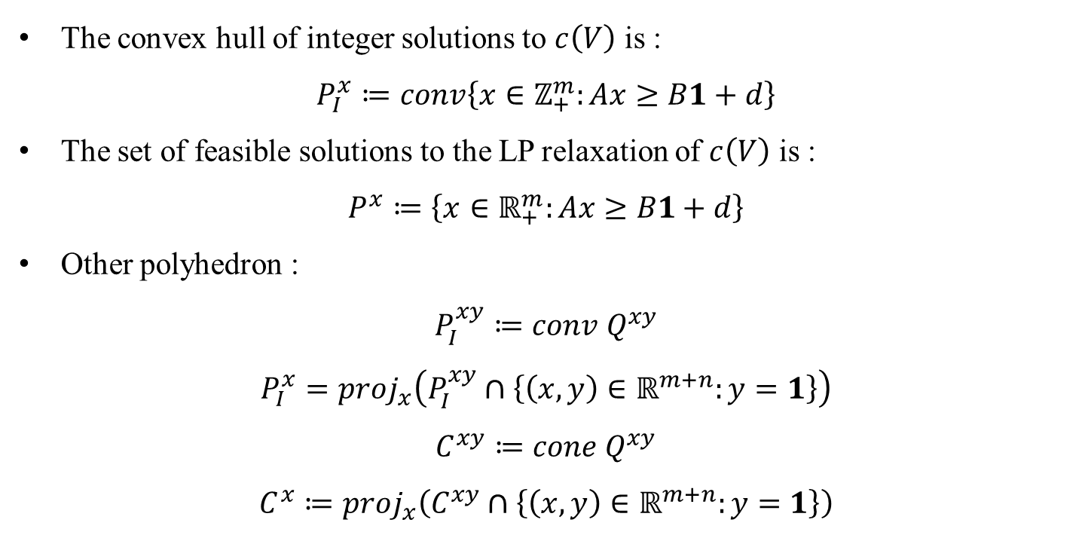
3. Three methods
Row generation:
The convex hull of integer solutions to $c\left(V\right)$ is :
$$P_{I}^{x}≔conv\left\{x∈ℤ_{+}^{m}:Ax≥B1+d\right\}$$
The set of feasible solutions to the LP relaxation of $c\left(V\right)$ is :
$$P^{x}≔\left\{x∈ℝ_{+}^{m}:Ax≥B1+d\right\}$$
Other polyhedron :
$$P_{I}^{xy}≔conv Q^{xy}$$
$$P_{I}^{x}=proj_{x}\left(P_{I}^{xy}∩\left\{\left(x,y\right)∈ℝ^{m+n}:y=1\right\}\right)$$
$$C^{xy}≔cone Q^{xy}$$
$$C^{x}≔proj_{x}\left(C^{xy}∩\left\{\left(x,y\right)∈ℝ^{m+n}:y=1\right\}\right)$$

Slide 20
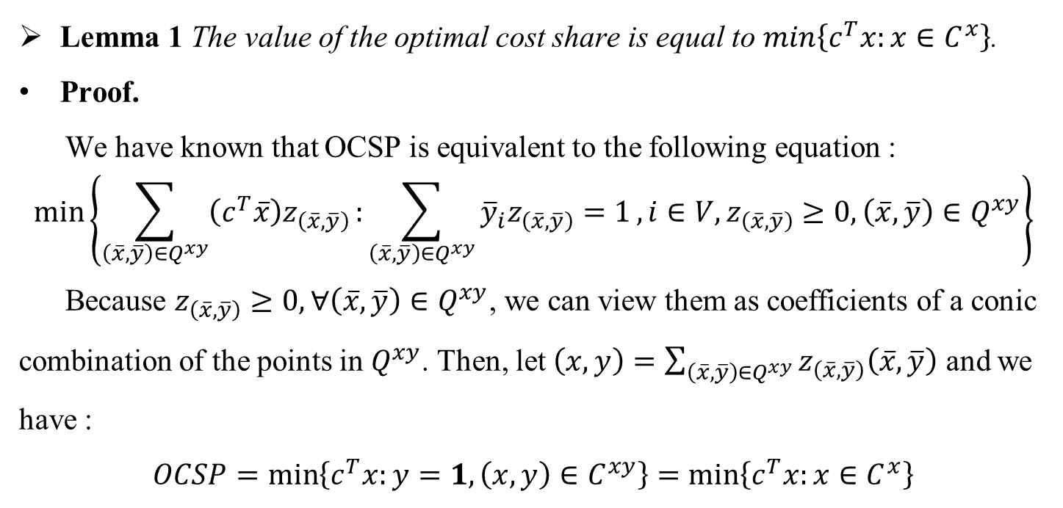
3. Three methods
Row generation:
Lemma 1 The value of the optimal cost share is equal to $\min\left\{c^{T}x:x∈C^{x}\right\}$.
Proof.
We have known that OCSP is equivalent to the following equation :
$$\min\left\{\sum_{\left(\overline{x},\overline{y}\right)∈Q^{xy}}{\left(c^{T}\overline{x}\right)z_{\left(\overline{x},\overline{y}\right)}}:\sum_{\left(\overline{x},\overline{y}\right)∈Q^{xy}}{{\overline{y}}_{i}z_{\left(\overline{x},\overline{y}\right)}=1}, i∈V,z_{\left(\overline{x},\overline{y}\right)}≥0,\left(\overline{x},\overline{y}\right)∈Q^{xy}\right\}$$
Because $z_{\left(\overline{x},\overline{y}\right)}≥0, ∀\left(\overline{x},\overline{y}\right)∈Q^{xy}$, we can view them as coefficients of a conic combination of the points in $Q^{xy}$. Then, let $\left(x,y\right)=\sum_{\left(\overline{x},\overline{y}\right)∈Q^{xy}}{z_{\left(\overline{x},\overline{y}\right)}\left(\overline{x},\overline{y}\right)}$ and we have :
$$OCSP=\min\left\{c^{T}x:y=1, \left(x,y\right)∈C^{xy}\right\}=\min\left\{c^{T}x:x∈C^{x}\right\}$$

Slide 21
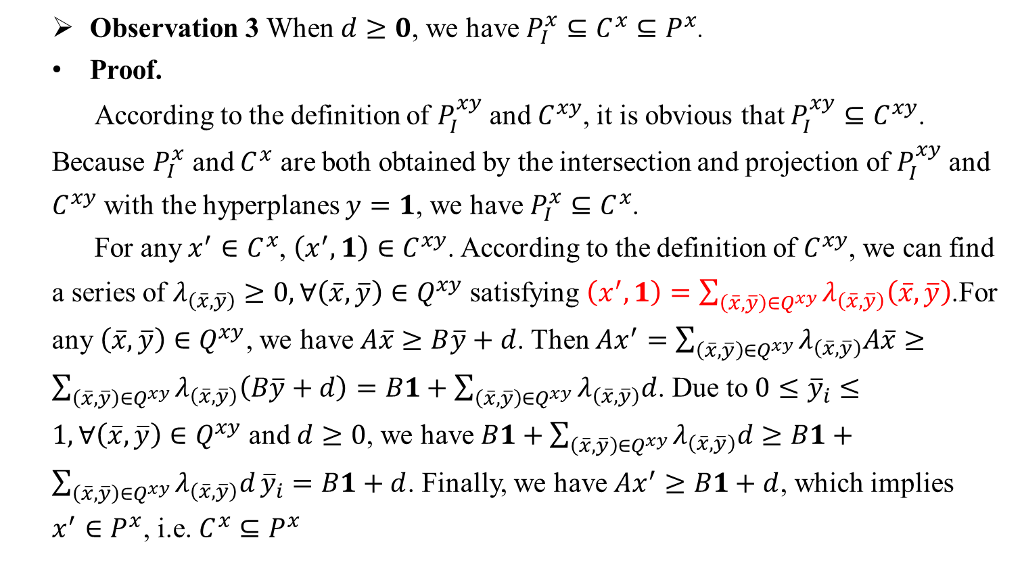
3. Three methods
Row generation:
Observation 3 When $d≥0$, we have $P_{I}^{x}⊆C^{x}⊆P^{x}$.
Proof.
According to the definition of $P_{I}^{xy}$ and $C^{xy}$, it is obvious that $P_{I}^{xy}⊆C^{xy}$. Because $P_{I}^{x}$ and $C^{x}$ are both obtained by the intersection and projection of $P_{I}^{xy}$ and $C^{xy}$ with the hyperplanes $y=1$, we have $P_{I}^{x}⊆C^{x}$.
For any $x^{′}∈C^{x}$, $\left(x^{′},1\right)∈C^{xy}$. According to the definition of $C^{xy}$, we can find a series of $λ_{\left(\overline{x},\overline{y}\right)}≥0, ∀\left(\overline{x},\overline{y}\right)∈Q^{xy}$ satisfying $\left(x^{′},1\right)=\sum_{\left(\overline{x},\overline{y}\right)∈Q^{xy}}{λ_{\left(\overline{x},\overline{y}\right)}\left(\overline{x},\overline{y}\right)}$.For any $\left(\overline{x},\overline{y}\right)∈Q^{xy}$, we have $A\overline{x}≥B\overline{y}+d$. Then $Ax^{′}=\sum_{\left(\overline{x},\overline{y}\right)∈Q^{xy}}{λ_{\left(\overline{x},\overline{y}\right)}A\overline{x}}≥\sum_{\left(\overline{x},\overline{y}\right)∈Q^{xy}}{λ_{\left(\overline{x},\overline{y}\right)}\left(B\overline{y}+d\right)}=B1+\sum_{\left(\overline{x},\overline{y}\right)∈Q^{xy}}{λ_{\left(\overline{x},\overline{y}\right)}d}$. Due to $0≤{\overline{y}}_{i}≤1, ∀\left(\overline{x},\overline{y}\right)∈Q^{xy}$ and $d≥0$, we have $B1+\sum_{\left(\overline{x},\overline{y}\right)∈Q^{xy}}{λ_{\left(\overline{x},\overline{y}\right)}d}≥B1+\sum_{\left(\overline{x},\overline{y}\right)∈Q^{xy}}{λ_{\left(\overline{x},\overline{y}\right)}d}{\overline{y}}_{i}=B1+d$. Finally, we have $Ax^{′}≥B1+d$, which implies $x^{′}∈P^{x}$, i.e. $C^{x}⊆P^{x}$

Slide 22
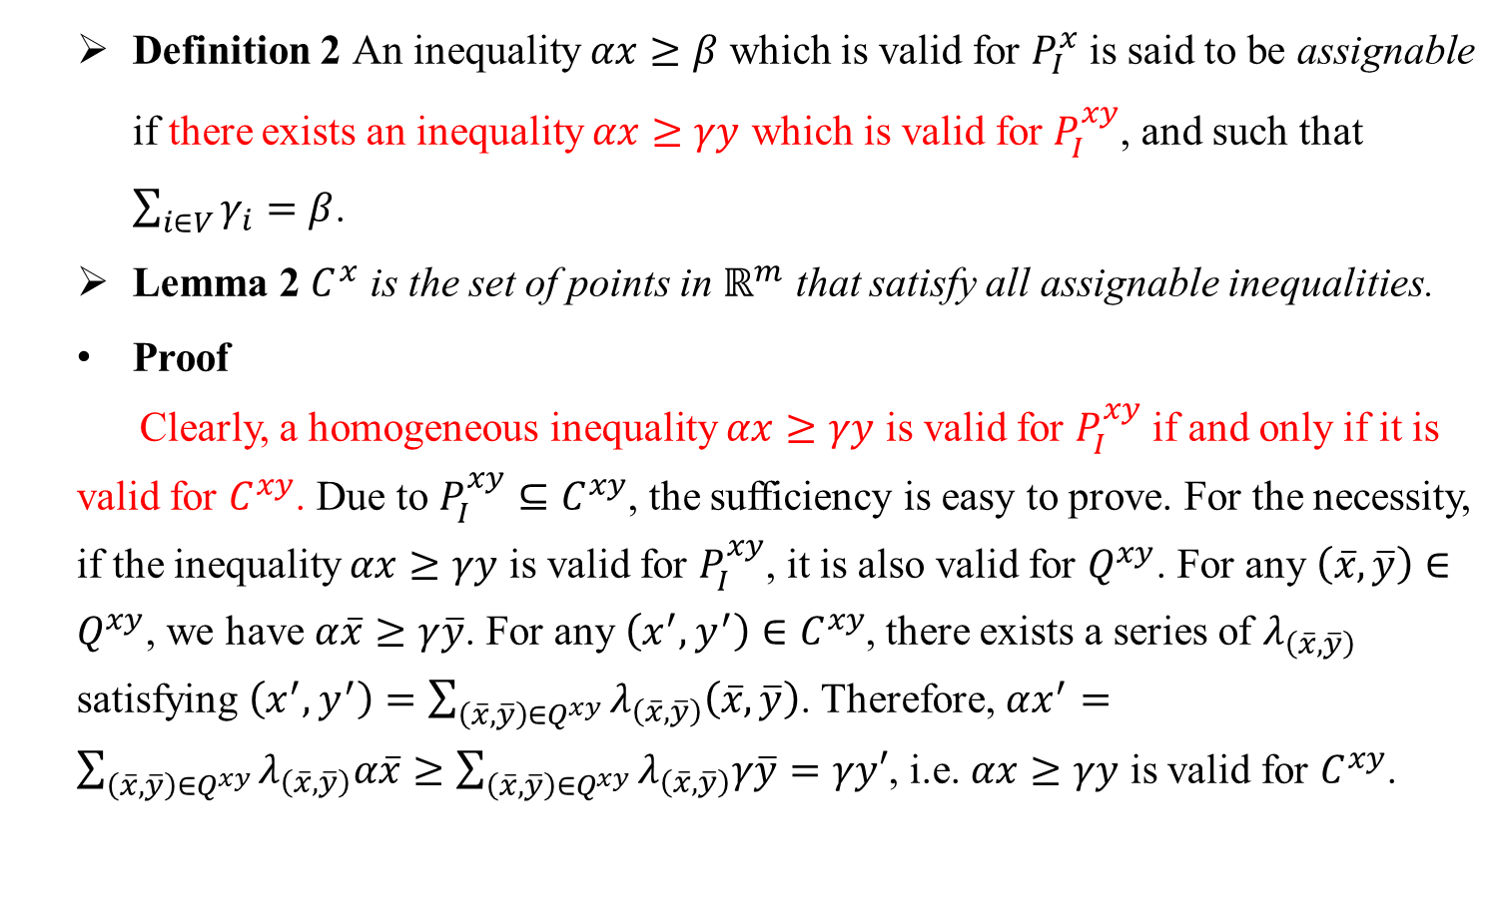
3. Three methods
Row generation:
Definition 2 An inequality $αx≥β$ which is valid for $P_{I}^{x}$ is said to be assignable if there exists an inequality $αx≥γy$ which is valid for $P_{I}^{xy}$, and such that $\sum_{i∈V}{γ_{i}}=β$.
Lemma 2 $C^{x}$ is the set of points in $ℝ^{m}$ that satisfy all assignable inequalities.
Proof
Clearly, a homogeneous inequality $αx≥γy$ is valid for $P_{I}^{xy}$ if and only if it is valid for $C^{xy}$. Due to $P_{I}^{xy}⊆C^{xy}$, the sufficiency is easy to prove. For the necessity, if the inequality $αx≥γy$ is valid for $P_{I}^{xy}$, it is also valid for $Q^{xy}$. For any $\left(\overline{x},\overline{y}\right)∈Q^{xy}$, we have $α\overline{x}≥γ\overline{y}$. For any $\left(x^{′},y^{′}\right)∈C^{xy}$, there exists a series of $λ_{\left(\overline{x},\overline{y}\right)}$ satisfying $\left(x^{′},y^{′}\right)=\sum_{\left(\overline{x},\overline{y}\right)∈Q^{xy}}{λ_{\left(\overline{x},\overline{y}\right)}\left(\overline{x},\overline{y}\right)}$. Therefore, $αx^{′}=\sum_{\left(\overline{x},\overline{y}\right)∈Q^{xy}}{λ_{\left(\overline{x},\overline{y}\right)}α\overline{x}}≥\sum_{\left(\overline{x},\overline{y}\right)∈Q^{xy}}{λ_{\left(\overline{x},\overline{y}\right)}γ\overline{y}}=γy′$, i.e. $αx≥γy$ is valid for $C^{xy}$.

Slide 23
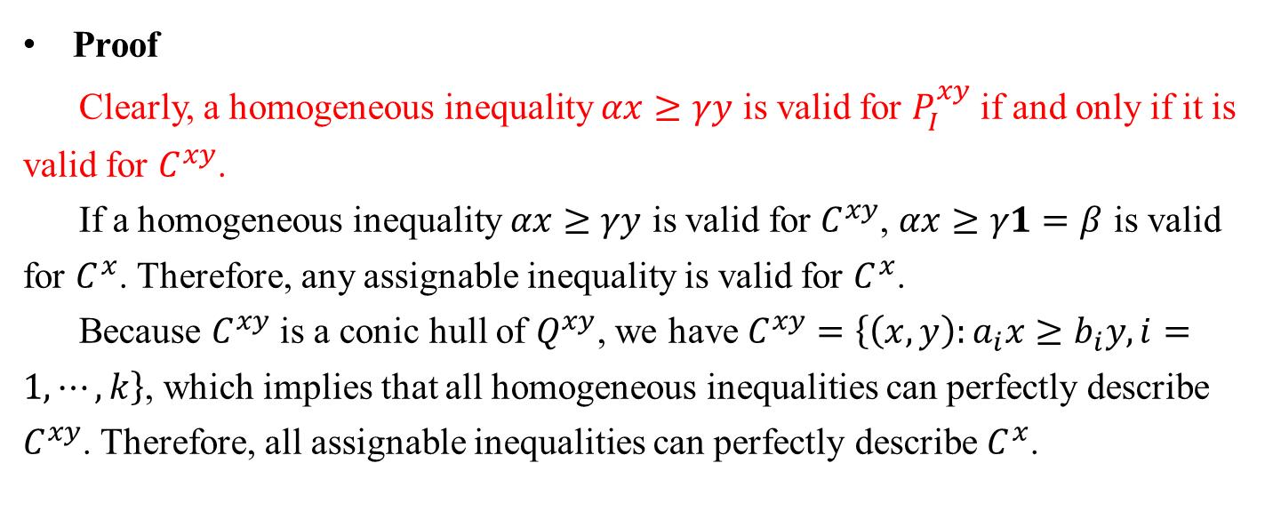
3. Three methods
Row generation:
Proof
Clearly, a homogeneous inequality $αx≥γy$ is valid for $P_{I}^{xy}$ if and only if it is valid for $C^{xy}$.
If a homogeneous inequality $αx≥γy$ is valid for $C^{xy}$, $αx≥γ1=β$ is valid for $C^{x}$. Therefore, any assignable inequality is valid for $C^{x}$.
Because $C^{xy}$ is a conic hull of $Q^{xy}$, we have $C^{xy}=\left\{\left(x,y\right):a_{i}x≥b_{i}y, i=1,⋯,k\right\}$, which implies that all homogeneous inequalities can perfectly describe $C^{xy}$. Therefore, all assignable inequalities can perfectly describe $C^{x}$.

Slide 24
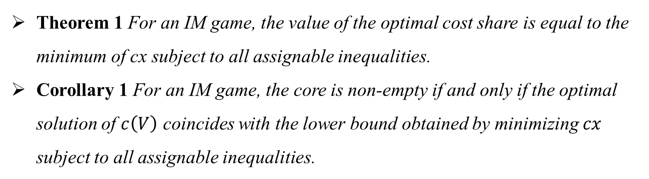
3. Three methods
Row generation:
Theorem 1 For an IM game, the value of the optimal cost share is equal to the minimum of cx subject to all assignable inequalities.
Corollary 1 For an IM game, the core is non-empty if and only if the optimal solution of $c\left(V\right)$ coincides with the lower bound obtained by minimizing $cx$ subject to all assignable inequalities.

Slide 25
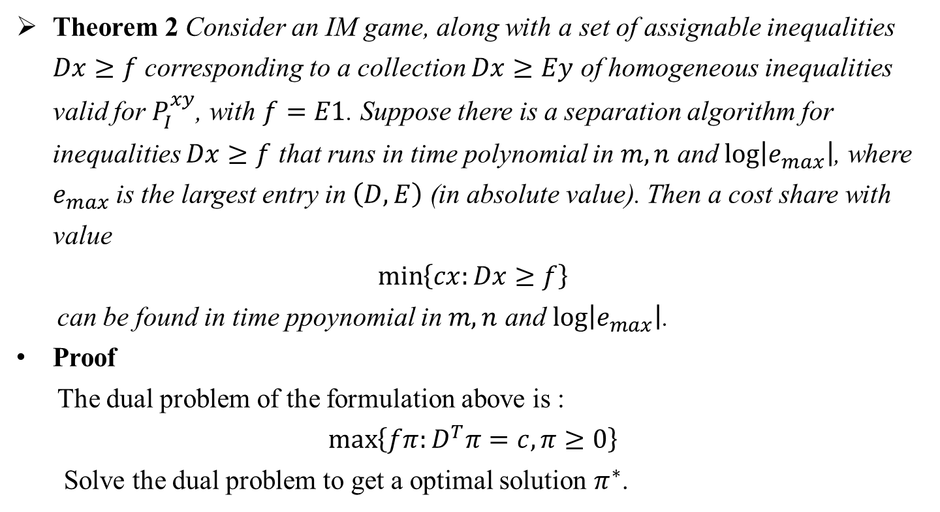
3. Three methods
Row generation:
Theorem 2 Consider an IM game, along with a set of assignable inequalities $Dx≥f$ corresponding to a collection $Dx≥Ey$ of homogeneous inequalities valid for $P_{I}^{xy}$, with $f=E1$. Suppose there is a separation algorithm for inequalities $Dx≥f$ that runs in time polynomial in $m, n$ and $\log\left|e_{max}\right|$, where $e_{max}$ is the largest entry in $\left(D, E\right)$ (in absolute value). Then a cost share with value
$$\min\left\{cx:Dx≥f\right\}$$
can be found in time ppoynomial in $m, n$ and $\log\left|e_{max}\right|$.
Proof
The dual problem of the formulation above is :
$$\max\left\{fπ:D^{T}π=c, π≥0\right\}$$
Solve the dual problem to get a optimal solution $π^{∗}$.

Slide 26
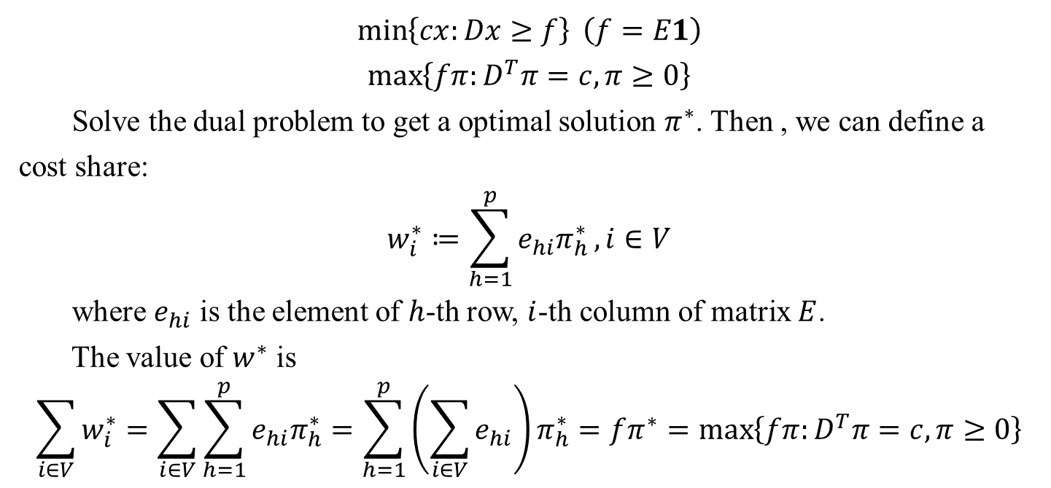
3. Three methods
Row generation:
$$\min\left\{cx:Dx≥f\right\} \left(f=E1\right)$$
$$\max\left\{fπ:D^{T}π=c, π≥0\right\}$$
Solve the dual problem to get a optimal solution $π^{∗}$. Then , we can define a cost share:
$$w_{i}^{∗}≔\sum_{h=1}^{p}{e_{hi}π_{h}^{∗}}, i∈V$$
where $e_{hi}$ is the element of $h$-th row, $i$-th column of matrix $E$.
The value of $w^{∗}$ is
$$\sum_{i∈V}{w_{i}^{∗}}=\sum_{i∈V}{\sum_{h=1}^{p}{e_{hi}π_{h}^{∗}}}=\sum_{h=1}^{p}{\left(\sum_{i∈V}{e_{hi}}\right)π_{h}^{∗}}=fπ^{∗}=\max\left\{fπ:D^{T}π=c, π≥0\right\}$$

Slide 27
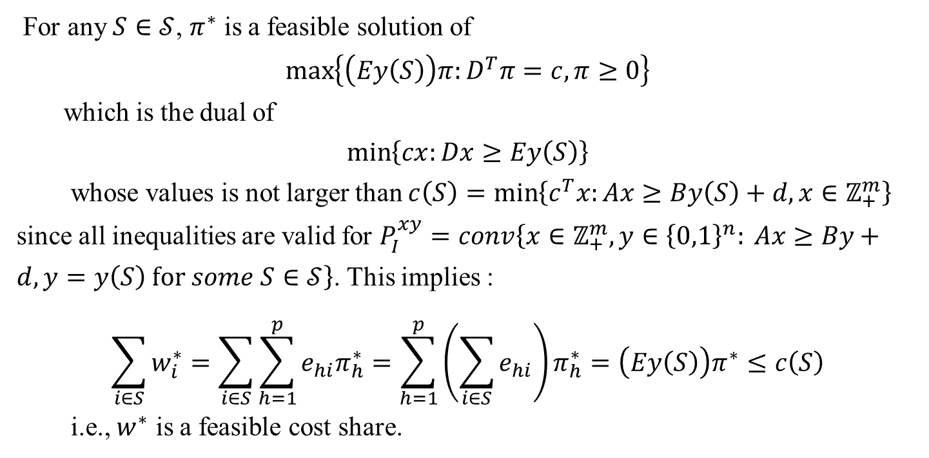
3. Three methods
Row generation:
For any $S∈𝒮$, $π^{∗}$ is a feasible solution of
$$\max\left\{\left(Ey\left(S\right)\right)π:D^{T}π=c, π≥0\right\}$$
which is the dual of
$$\min\left\{cx:Dx≥Ey\left(S\right)\right\}$$
whose values is not larger than $c\left(S\right)=\min\left\{c^{T}x:Ax≥By\left(S\right)+d,x∈ℤ_{+}^{m}\right\}$ since all inequalities are valid for $P_{I}^{xy}=conv\left\{x∈ℤ_{+}^{m},y∈{\left\{0,1\right\}}^{n}: Ax≥By+d, y=y\left(S\right) for some S∈𝒮\right\}$. This implies :
$$\sum_{i∈S}{w_{i}^{∗}}=\sum_{i∈S}{\sum_{h=1}^{p}{e_{hi}π_{h}^{∗}}}=\sum_{h=1}^{p}{\left(\sum_{i∈S}{e_{hi}}\right)π_{h}^{∗}}=\left(Ey\left(S\right)\right)π^{∗}≤c\left(S\right)$$
i.e., $w^{∗}$ is a feasible cost share.

Slide 28
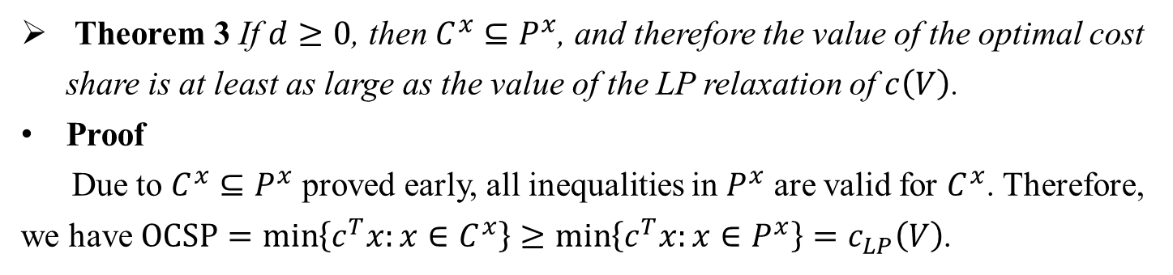
3. Three methods
Row generation:
Theorem 3 If $d≥0$, then $C^{x}⊆P^{x}$, and therefore the value of the optimal cost share is at least as large as the value of the LP relaxation of $c\left(V\right)$.
Proof
Due to $C^{x}⊆P^{x}$ proved early, all inequalities in $P^{x}$ are valid for $C^{x}$. Therefore, we have $OCSP=\min\left\{c^{T}x:x∈C^{x}\right\}≥\min\left\{c^{T}x:x∈P^{x}\right\}=c_{LP}\left(V\right)$.

Slide 29
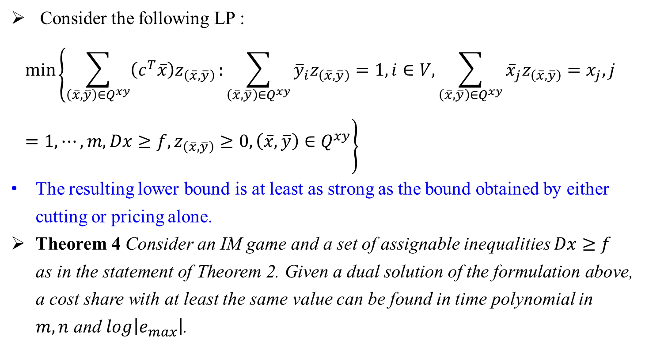
3. Three methods
Combined column and row generation (B&C&P):
Consider the following LP :
$$\min\left\{\sum_{\left(\overline{x},\overline{y}\right)∈Q^{xy}}{\left(c^{T}\overline{x}\right)z_{\left(\overline{x},\overline{y}\right)}}:\sum_{\left(\overline{x},\overline{y}\right)∈Q^{xy}}{{\overline{y}}_{i}z_{\left(\overline{x},\overline{y}\right)}}=1, i∈V,\sum_{\left(\overline{x},\overline{y}\right)∈Q^{xy}}{{\overline{x}}_{j}z_{\left(\overline{x},\overline{y}\right)}}=x_{j}, j=1,⋯,m, Dx≥f, z_{\left(\overline{x},\overline{y}\right)}≥0,\left(\overline{x},\overline{y}\right)∈Q^{xy}\right\}$$
The resulting lower bound is at least as strong as the bound obtained by either cutting or pricing alone.
Theorem 4 Consider an IM game and a set of assignable inequalities $Dx≥f$ as in the statement of Theorem 2. Given a dual solution of the formulation above, a cost share with at least the same value can be found in time polynomial in $m, n$ and $\log\left|e_{max}\right|$.

Slide 30
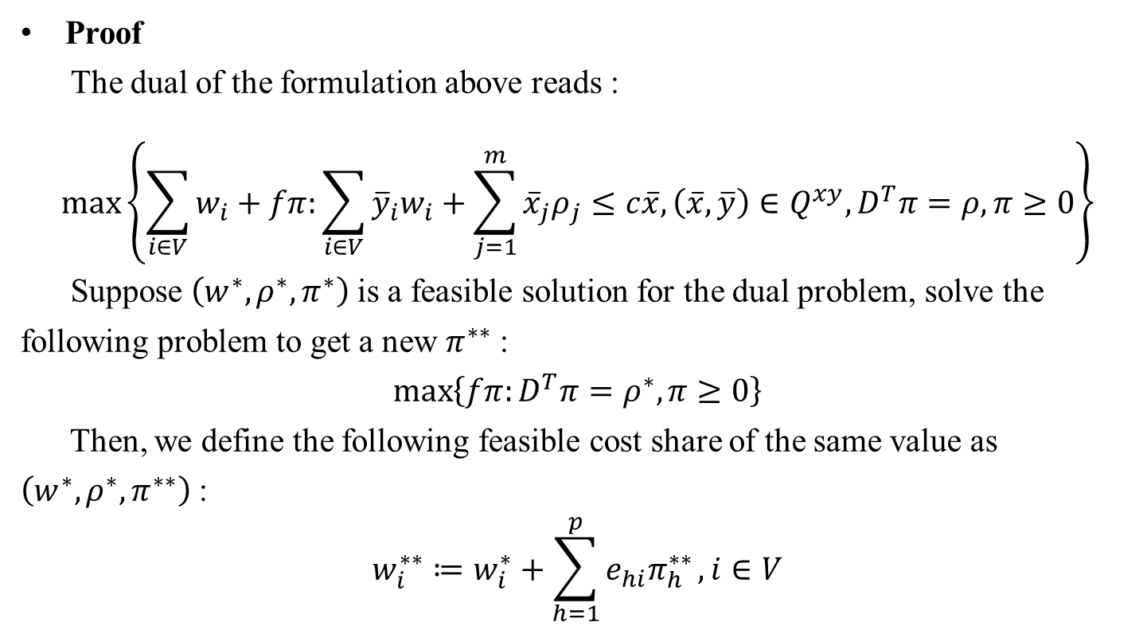
3. Three methods
Combined column and row generation:
Proof
The dual of the formulation above reads :
$$\max\left\{\sum_{i∈V}{w_{i}}+fπ:\sum_{i∈V}{{\overline{y}}_{i}w_{i}}+\sum_{j=1}^{m}{{\overline{x}}_{j}ρ_{j}}≤c\overline{x}, \left(\overline{x},\overline{y}\right)∈Q^{xy}, D^{T}π=ρ, π≥0\right\}$$
Suppose $\left(w^{∗}, ρ^{∗}, π^{∗}\right)$ is a feasible solution for the dual problem, solve the following problem to get a new $π^{∗∗}$ :
$$\max\left\{fπ:D^{T}π=ρ^{∗},π≥0\right\}$$
Then, we define the following feasible cost share of the same value as $\left(w^{∗},ρ^{∗}, π^{∗∗}\right)$ :
$$w_{i}^{∗∗}≔w_{i}^{∗}+\sum_{h=1}^{p}{e_{hi}π_{h}^{∗∗}}, i∈V$$

Slide 31
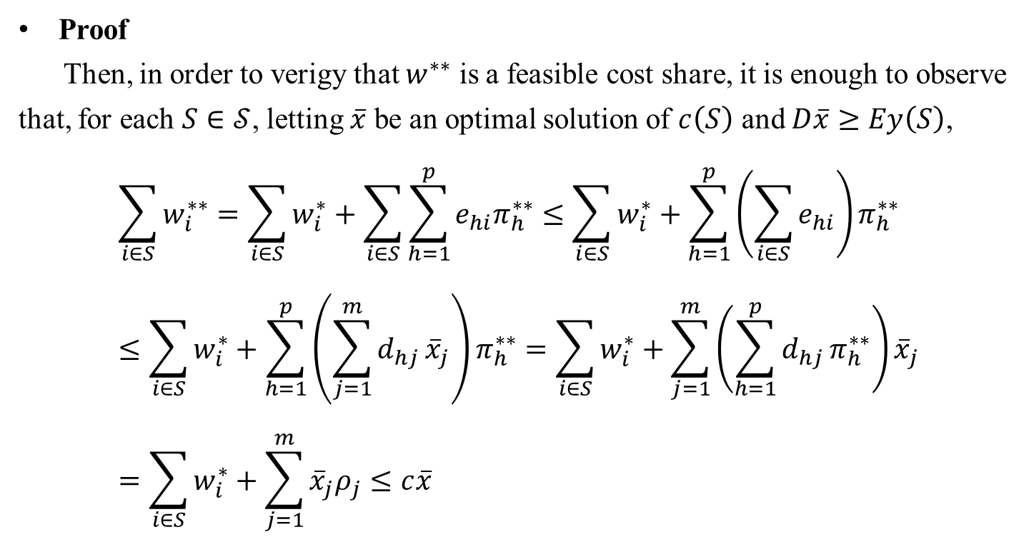
3. Three methods
Combined column and row generation:
Proof
Then, in order to verigy that $w^{∗∗}$ is a feasible cost share, it is enough to observe that, for each $S∈𝒮$, letting $\overline{x}$ be an optimal solution of $c\left(S\right)$ and $D\overline{x}≥Ey\left(S\right)$,
$$\sum_{i∈S}{w_{i}^{∗∗}}=\sum_{i∈S}{w_{i}^{∗}}+\sum_{i∈S}{\sum_{h=1}^{p}{e_{hi}π_{h}^{∗∗}}}≤\sum_{i∈S}{w_{i}^{∗}}+\sum_{h=1}^{p}{\left(\sum_{i∈S}{e_{hi}}\right)π_{h}^{∗∗}}≤\sum_{i∈S}{w_{i}^{∗}}+\sum_{h=1}^{p}{\left(\sum_{j=1}^{m}{d_{hj}}{\overline{x}}_{j}\right)π_{h}^{∗∗}}=\sum_{i∈S}{w_{i}^{∗}}+\sum_{j=1}^{m}{\left(\sum_{h=1}^{p}{d_{hj}}π_{h}^{∗∗}\right){\overline{x}}_{j}}=\sum_{i∈S}{w_{i}^{∗}}+\sum_{j=1}^{m}{{\overline{x}}_{j}ρ_{j}}≤c\overline{x}$$

Slide 32
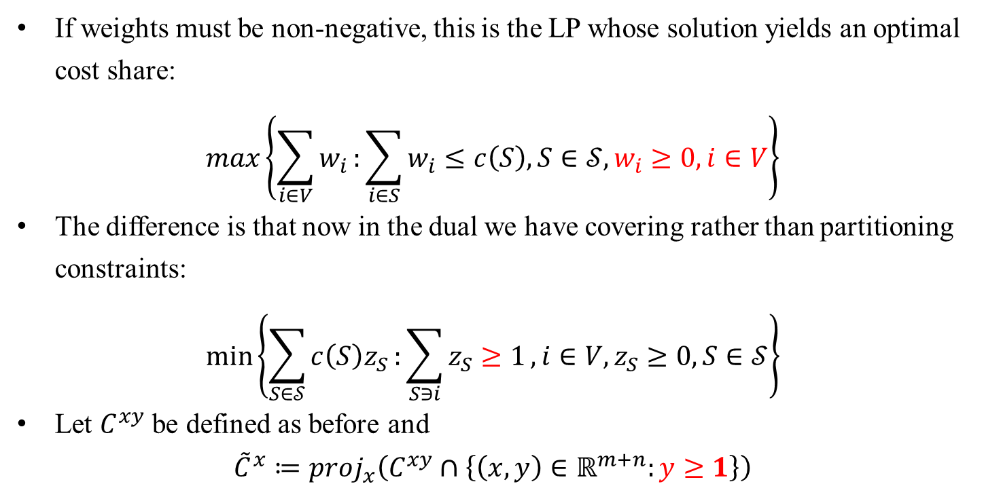
3. Three methods
Handing non-negative weights:
If weights must be non-negative, this is the LP whose solution yields an optimal cost share:
$$\max\left\{\sum_{i∈V}{w_{i}}:\sum_{i∈S}{w_{i}}≤c\left(S\right), S∈𝒮, w_{i}≥0, i∈V\right\}$$
The difference is that now in the dual we have covering rather than partitioning constraints:
$$\min\left\{\sum_{S∈𝒮}{c\left(S\right)z_{S}}:\sum_{S∋i}{z_{S}≥1}, i∈V, z_{S}≥0, S∈𝒮\right\}$$
Let $C^{xy}$ be defined as before and
$${\tilde{C}}^{x}≔proj_{x}\left(C^{xy}∩\left\{\left(x,y\right)∈ℝ^{m+n}:y≥1\right\}\right)$$

Slide 33
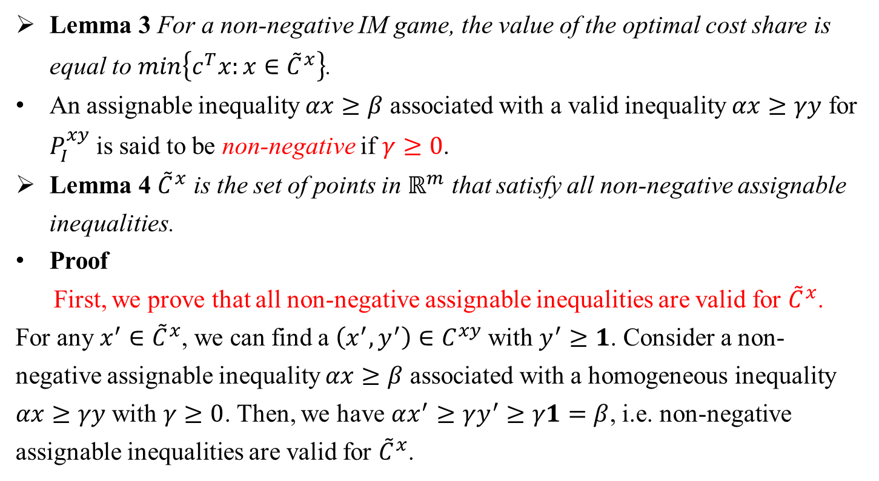
3. Three methods
Handing non-negative weights:
Lemma 3 For a non-negative IM game, the value of the optimal cost share is equal to $\min\left\{c^{T}x:x∈{\tilde{C}}^{x}\right\}$.
An assignable inequality $αx≥β$ associated with a valid inequality $αx≥γy$ for $P_{I}^{xy}$ is said to be non-negative if $γ≥0$.
Lemma 4 ${\tilde{C}}^{x}$ is the set of points in $ℝ^{m}$ that satisfy all non-negative assignable inequalities.
Proof
First, we prove that all non-negative assignable inequalities are valid for ${\tilde{C}}^{x}$. For any $x^{′}∈{\tilde{C}}^{x}$, we can find a $\left(x^{′},y^{′}\right)∈C^{xy}$ with $y^{′}≥1$. Consider a non-negative assignable inequality $αx≥β$ associated with a homogeneous inequality $αx≥γy$ with $γ≥0$. Then, we have $αx^{′}≥γy^{′}≥γ1=β$, i.e. non-negative assignable inequalities are valid for ${\tilde{C}}^{x}$.

Slide 34
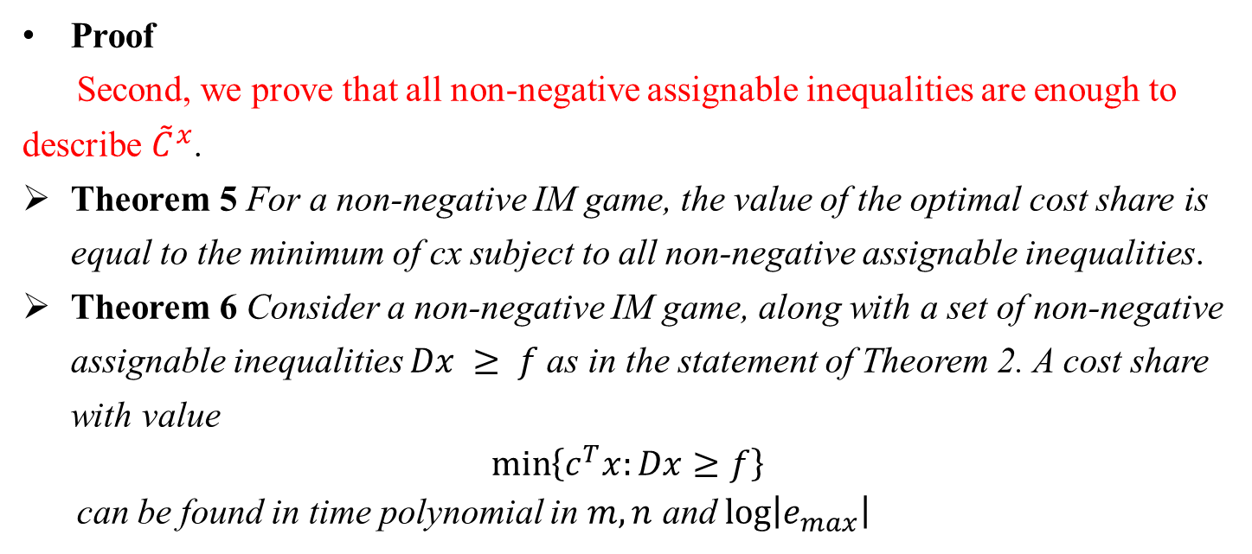
3. Three methods
Handing non-negative weights:
Proof
Second, we prove that all non-negative assignable inequalities are enough to describe ${\tilde{C}}^{x}$.
Theorem 5 For a non-negative IM game, the value of the optimal cost share is equal to the minimum of cx subject to all non-negative assignable inequalities.
Theorem 6 Consider a non-negative IM game, along with a set of non-negative assignable inequalities $Dx ≥ f$as in the statement of Theorem 2. A cost share with value
$$\min\left\{c^{T}x:Dx≥f\right\}$$
can be found in time polynomial in $m,n$ and $\log\left|e_{max}\right|$

Slide 35
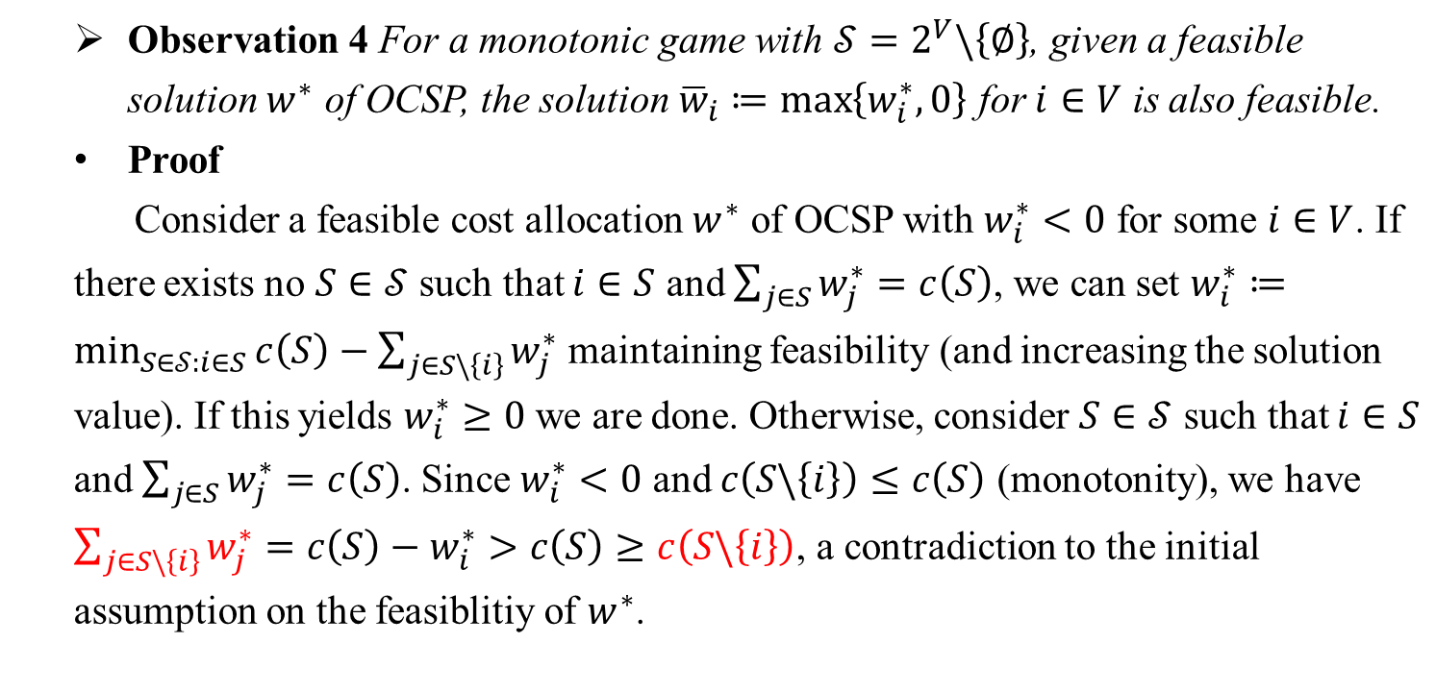
3. Three methods
Handing non-negative weights:
Observation 4 For a monotonic game with $𝒮=2^{V}\backslash \left\{∅\right\}$, given a feasible solution $w^{∗}$ of OCSP, the solution ${\overline{w}}_{i}≔\max\left\{w_{i}^{∗},0\right\}$ for $i∈V$ is also feasible.
Proof
Consider a feasible cost allocation $w^{∗}$ of OCSP with $w_{i}^{∗}<0$ for some $i∈V$. If there exists no $S∈𝒮$ such that $i∈S$ and $\sum_{j∈S}{w_{j}^{∗}}=c\left(S\right)$, we can set $w_{i}^{∗}≔\min_{S∈𝒮:i∈S}{c\left(S\right)−\sum_{j∈S\backslash \left\{i\right\}}{w_{j}^{∗}}}$ maintaining feasibility (and increasing the solution value). If this yields $w_{i}^{∗}≥0$ we are done. Otherwise, consider $S∈𝒮$ such that $i∈S$ and $\sum_{j∈S}{w_{j}^{∗}}=c\left(S\right)$. Since $w_{i}^{∗}<0$ and $c\left(S\backslash \left\{i\right\}\right)≤c\left(S\right)$ (monotonity), we have $\sum_{j∈S\backslash \left\{i\right\}}{w_{j}^{∗}}=c\left(S\right)−w_{i}^{∗}>c\left(S\right)≥c\left(S\backslash \left\{i\right\}\right)$, a contradiction to the initial assumption on the feasiblitiy of $w^{∗}$.

Slide 36
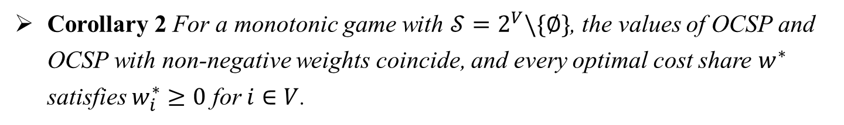
3. Three methods
Handing non-negative weights:
Corollary 2 For a monotonic game with $𝒮=2^{V}\backslash \{∅\}$, the values of OCSP and OCSP with non-negative weights coincide, and every optimal cost share $w^{∗}$ satisfies $w_{i}^{∗}≥0$ for $i∈V$.

Slide 37
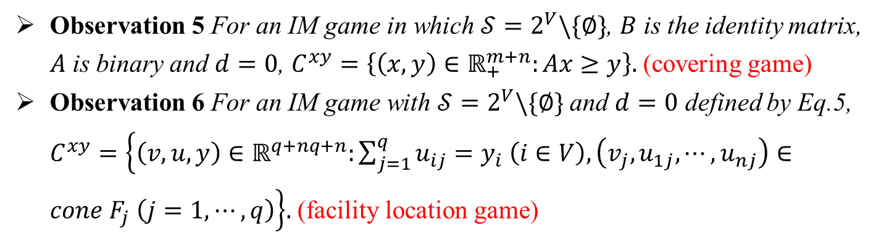
4. Application
Application to covering and facility location games:
Observation 5 For an IM game in which $𝒮=2^{V}\backslash \{∅\}$, $B$ is the identity matrix, $A$ is binary and $d=0$, $C^{xy}=\left\{\left(x,y\right)∈ℝ_{+}^{m+n}:Ax≥y\right\}.$ (covering game)
Observation 6 For an IM game with $𝒮=2^{V}\backslash \{∅\}$ and $d=0$ defined by Eq.5, $C^{xy}=\left\{\left(v,u,y\right)∈ℝ^{q+nq+n}:\sum_{j=1}^{q}{u_{ij}}=y_{i} \left(i∈V\right), \left(v_{j},u_{1j},⋯,u_{nj}\right)∈cone F_{j} \left(j=1,⋯,q\right)\right\}.$ (facility location game)

Slide 38
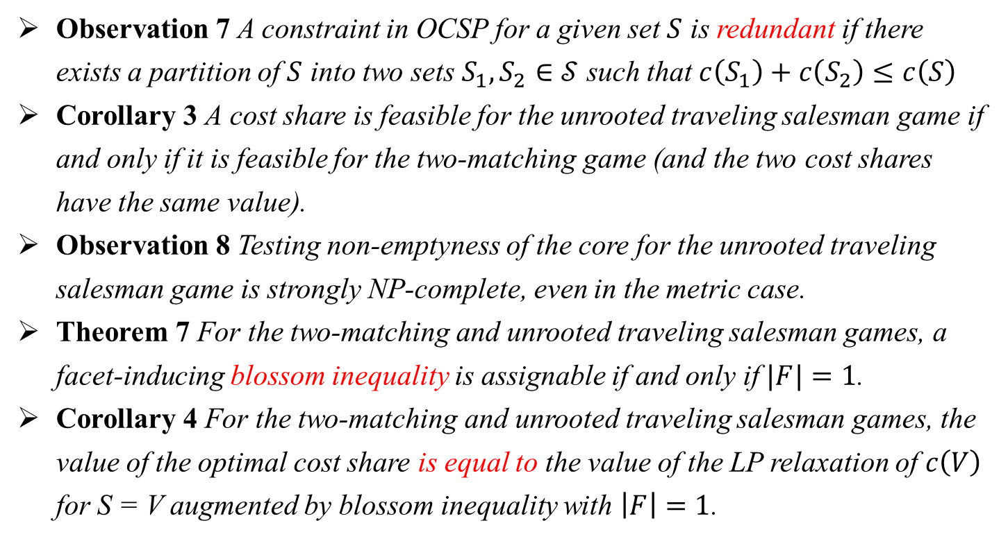
4. Application
Application to the unrooted traveling salesman game:
Observation 7 A constraint in OCSP for a given set $S$ is redundant if there exists a partition of $S$ into two sets $S_{1}, S_{2}∈𝒮$ such that $c\left(S_{1}\right)+c\left(S_{2}\right)≤c\left(S\right)$
Corollary 3 A cost share is feasible for the unrooted traveling salesman game if and only if it is feasible for the two-matching game (and the two cost shares have the same value).
Observation 8 Testing non-emptyness of the core for the unrooted traveling salesman game is strongly NP-complete, even in the metric case.
Theorem 7 For the two-matching and unrooted traveling salesman games, a facet-inducing blossom inequality is assignable if and only if $|F|=1$.
Corollary 4 For the two-matching and unrooted traveling salesman games, the value of the optimal cost share is equal to the value of the LP relaxation of $c\left(V\right)$ for S = V augmented by blossom inequality with $\left|F\right|=1$.

Slide 39
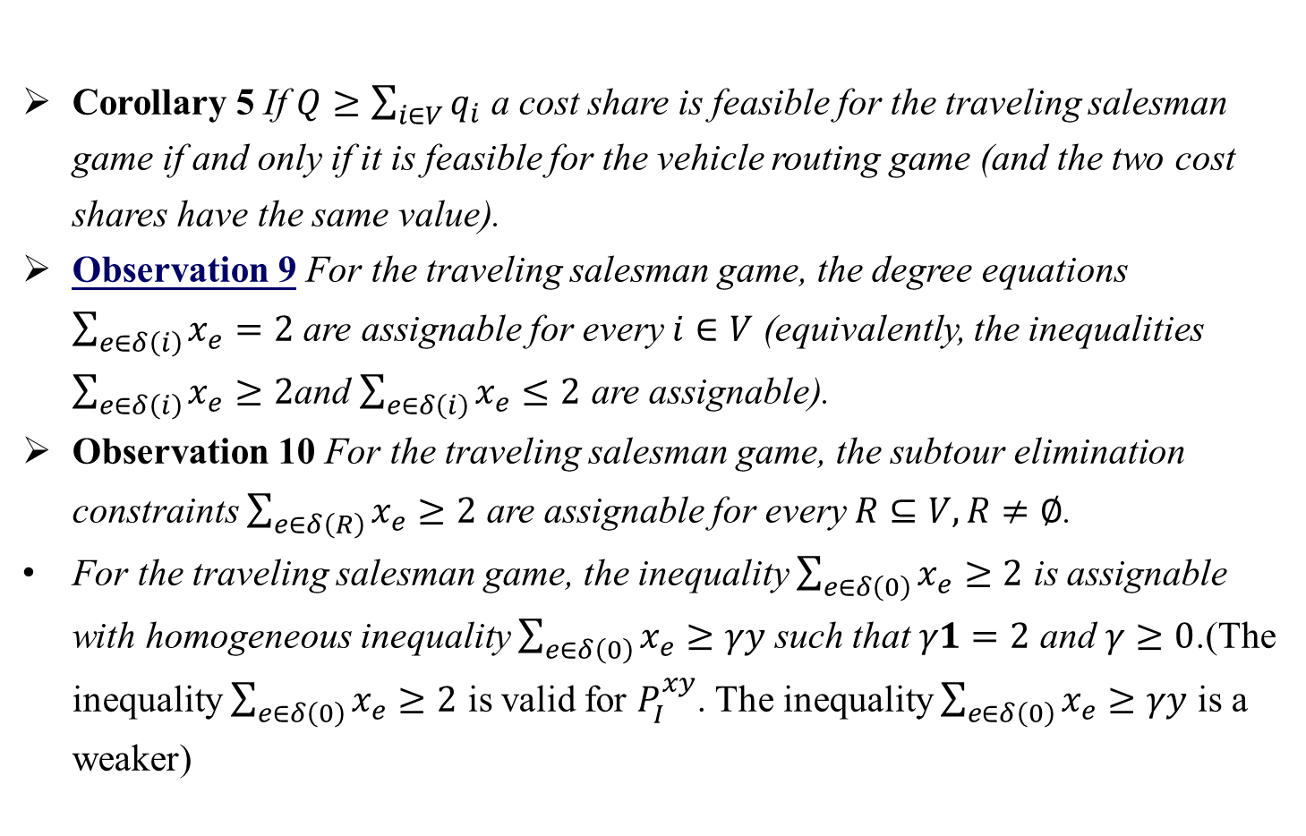
4. Application
Application to traveling salesman and vehicle routing games:
Corollary 5 If $Q≥\sum_{i∈V}{q_{i}}$ a cost share is feasible for the traveling salesman game if and only if it is feasible for the vehicle routing game (and the two cost shares have the same value).
Observation 9 For the traveling salesman game, the degree equations $\sum_{e∈δ\left(i\right)}{x_{e}}=2$ are assignable for every $i∈V$ (equivalently, the inequalities $\sum_{e∈δ\left(i\right)}{x_{e}}≥2$and $\sum_{e∈δ\left(i\right)}{x_{e}}≤2$ are assignable).
Observation 10 For the traveling salesman game, the subtour elimination constraints $\sum_{e∈δ\left(R\right)}{x_{e}}≥2$ are assignable for every $R⊆V, R≠∅$.
For the traveling salesman game, the inequality $\sum_{e∈δ\left(0\right)}{x_{e}}≥2$ is assignable with homogeneous inequality $\sum_{e∈δ\left(0\right)}{x_{e}}≥γy$ such that $γ1=2$ and $γ≥0$.(The inequality $\sum_{e∈δ\left(0\right)}{x_{e}}≥2$ is valid for $P_{I}^{xy}$. The inequality $\sum_{e∈δ\left(0\right)}{x_{e}}≥γy$ is a weaker)

Slide 40
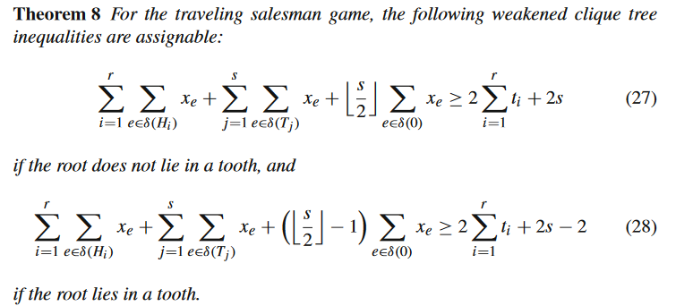
4. Application
Application to traveling salesman and vehicle routing games:

Slide 41
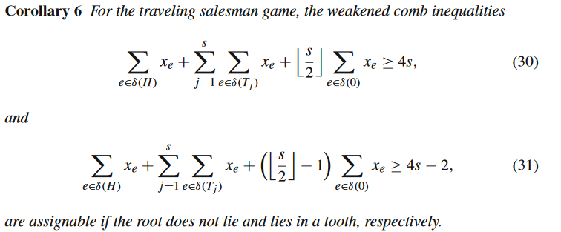
4. Application
Application to traveling salesman and vehicle routing games:

Slide 42
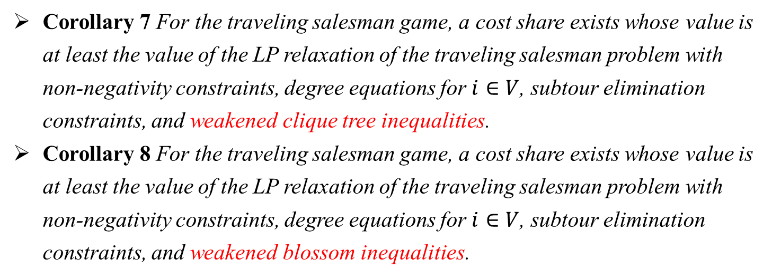
4. Application
Application to traveling salesman and vehicle routing games:
Corollary 7 For the traveling salesman game, a cost share exists whose value is at least the value of the LP relaxation of the traveling salesman problem with non-negativity constraints, degree equations for $i∈V$, subtour elimination constraints, and weakened clique tree inequalities.
Corollary 8 For the traveling salesman game, a cost share exists whose value is at least the value of the LP relaxation of the traveling salesman problem with non-negativity constraints, degree equations for $i∈V$, subtour elimination constraints, and weakened blossom inequalities.

Slide 43
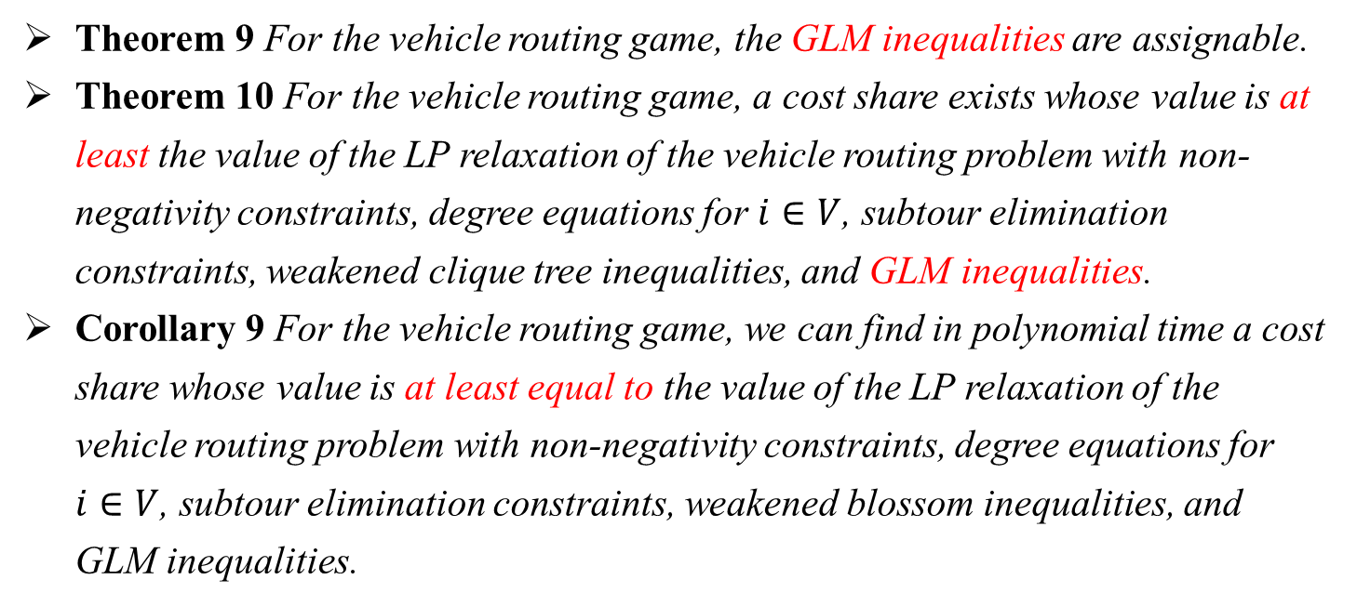
4. Application
Application to traveling salesman and vehicle routing games:
Theorem 9 For the vehicle routing game, the GLM inequalities are assignable.
Theorem 10 For the vehicle routing game, a cost share exists whose value is at least the value of the LP relaxation of the vehicle routing problem with non-negativity constraints, degree equations for $i∈V$, subtour elimination constraints, weakened clique tree inequalities, and GLM inequalities.
Corollary 9 For the vehicle routing game, we can find in polynomial time a cost share whose value is at least equal to the value of the LP relaxation of the vehicle routing problem with non-negativity constraints, degree equations for $i∈V$, subtour elimination constraints, weakened blossom inequalities, and GLM inequalities.

Slide 44
Thank You!
$$\text{Reporter}\text{：}\text{Xiangbin} \text{Liao}$$

