Slide 1
Product Redesign and Innovation Based on Online Reviews
Author：Jindong Qin, Pan Zheng, Pan Zheng
李泽西
2024.03.17

Slide 2
Introduction
Related work
Methodology
Conclusions,limitations,and future research

Slide 3


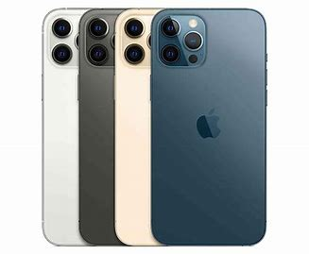
1.Introduction
In today’s market, new products are often developed through redesigning and innovating existing products (Kagan et al. 2018).
Product redesign refers to optimizations and improvements based on previous generations of products (Zhang et al. 2019, Lai et al. 2019). For example, leading automotive manufacturers (e.g., Toyota and BMW) typically launch new products in the same series regularly, in which key features are redesigned based on customer feedback and technological development.
Product innovation is the process of turning an idea or invention into a valuable product or service (Zhang et al. 2021c).
On the one hand, with the continuous release of new generations with product redesign and innovation, iPhone has transformed from a niche product to a dominant economic force in the mobile communication and technology sector.
On the other hand, Apple’s latest edition, iPhone 14, is criticized for its lack of innovation by consumers, leading to the poor take-up of the device post-release.
Innovation
Redesign

Slide 4
1.Introduction
New product development (NPD):
They aim to increase customer satisfaction and help create new space in a crowded market by improving the identified product features and developing a corresponding improvement strategy.
Maintain or increase market share
NPD
Changing customer needs
Determining the differences between customer needs and
the feature performance of existing products
挑战
In previous studies (Timoshenko and Hauser 2019, Anderson et al. 2018), customer preferences and requirements were typically obtained from a focus group or customer survey containing specific customer information.

Slide 5
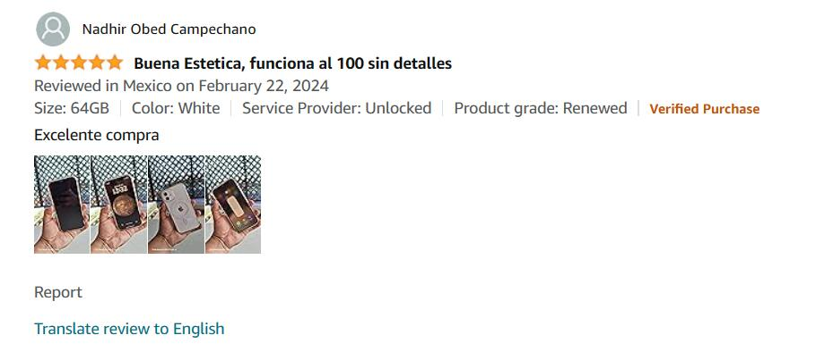
1.Introduction
Traditional method
Shortcoming :
Methods based on online reviews
Free and varied
Direct demand driven
Easy to access
Market insight
alternative and complementary
aesthetic and market trends
products
passive
costly
Under the guidance of prepared questions, customers often passively express their views and opinions on the product.
In addition, because traditional customer survey methods need to collect enough data for analysis, this makes them costly.
High professional requirements
The quality of this research method is closely related to the questionnaire itself, the professionalism of the organization personnel, and the participation of the interviewee group

Slide 6
1.Introduction
Innovation points and key contributions
This research contributes to the existing literature on NPD (Zhang et al. 2021a, Lai et al. 2019,Zhang et al. 2019) by proposing a methodology for constructing an IPCA plot and developing a product improvement strategy based on online reviews. Compared to existing approaches, the product improvement strategies developed by our framework are more fine-grained and specific.
This research complements the existing literature (Bi et al. 2019, Zhang et al. 2021a, Archak et al. 2011) on review feature extraction by introducing competitiveness into NPD. We employ a PUBG algorithm to calculate the competitiveness and construct the competitiveness network for product features, introducing competitive factors into product strategy development. 个性化单向二部图
Online reviews posted by customers can be first classified into redesign and innovation using a multiple embedding model(MEM).

Slide 7
2. Literature Review
Identifying reviews related to product redesign and innovation
Zhang et al. (2022b) developed a framework for opinion extraction and effect estimation, which obtains textual opinions based on multiple Siamese BERT networks and then uses selective inference methods to reveal the average and interaction effects of customer opinions to support product redesign.
Integrated text analysis
Abrahams et al. (2015) identified product defects from online usergenerated content (UGC).
Kokkodis and Lappas (2020) modeled the popularity difference bias as a function of two opposing forces to improve the recommendation service of top restaurants.
Integrated embedding
Zhang et al. (2021c) developed a new integrated embedding (GloVe, XLNet, and BERT) method to generate semantic and contextual representations of words in review sentences for innovative idea recognition and demonstrated small performance differences between integration- and GPT-2-based embedding methods.
Goldberg and Abrahams (2022) used text mining tools as an effective way to quickly identify innovation opportunities through online reviews.

Slide 8
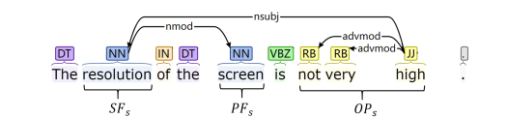
2. Literature Review
Product feature extraction
Lexicon-based 基于词典
A lexicon-based approach extracts product features through a manually predefined or high-frequency
vocabulary related to product features.
Syntax and dependency relation–based 基于语法和依赖关系的
A syntax and dependency relation–based approach extracts product features based on phrasing and connections relations among terms that appear in online reviews. Multiple studies (Archak et al. 2011, Yan et al. 2015, Yang et al. 2022) found that relationships often exist between product features and emotional words, which may help to extract critical product features.
Machine learning–based approaches 基于机器学习的 Tag forms of speech
The product features mentioned in online reviews typically comprise nouns or noun phrases.

Slide 9
2. Literature Review
Product feature extraction
These methods can effectively extract product features, but few can extract features with fine granularity or the subordinate relationship between each feature.
Potential Information subordinate relationship
Product improvement strategy
Some studies (Zhang et al. 2021a, Lai et al. 2019, Zhang et al. 2019) focused on identifying product features to be improved and summarizing product improvement strategies from online reviews.
However, research has rarely focused on developing specific improvement strategies (e.g., the improvement direction of product features), which is vital for manufacturers.
“Life is long” “battery life is long,”
“appearance” and “color” or “appearance_color,”

Slide 10
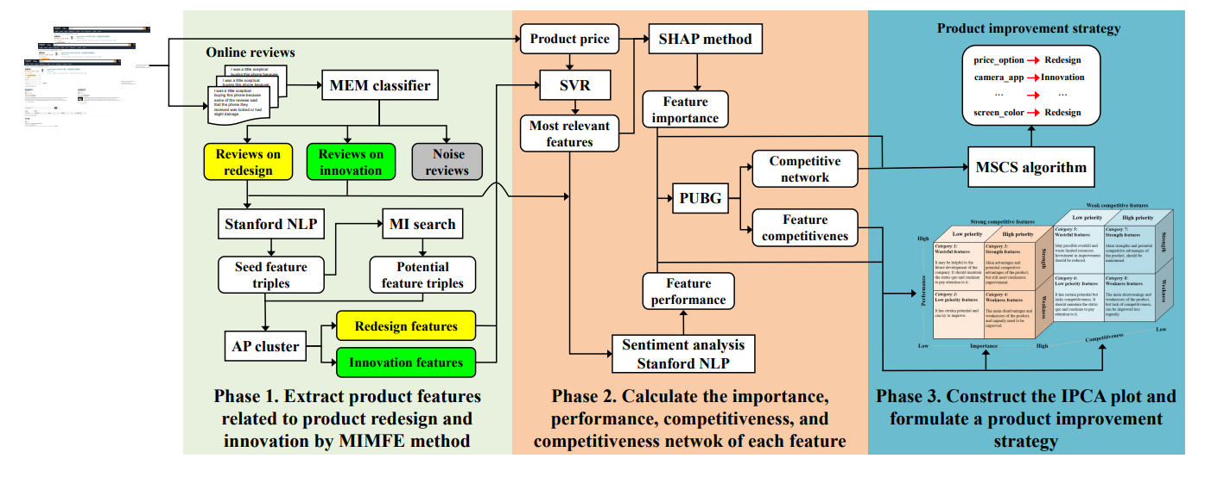
3. Methodology
1. Extract product features related to product redesign and innovation.
2. Calculate each feature’s importance, performance, and competitiveness, and build a competitiveness network.
3. Construct the IPCA plot and develop a product improvement strategy.

Slide 11
3. Methodology
Identifying reviews related to product redesign and innovation
Studies in the literature have proposed various text embedding methods, which are mainly divided into two categories: traditional embedding (e.g., Word2Vec and GloVe) and contextual embedding (e.g., XLNet and GPT-2) (Zhang et al. 2021c).
Traditional word embedding methods learn global word embedding without considering the meaning of words in different contexts.
Contextual embedding techniques can learn different representations of multisense words.
Text → vector
CBOW
Traditional word embedding
Word2Vec
GloVe
Skip-gram
Text embedding
Contextual embedding
BERT
XLNet
GPT

Slide 12
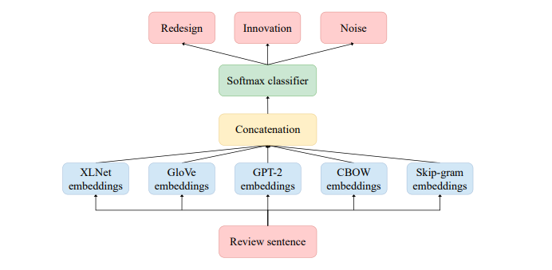
3. Methodology
Identifying reviews related to product redesign and innovation
Multiple embeddings with Neural Network Architecture

Slide 13
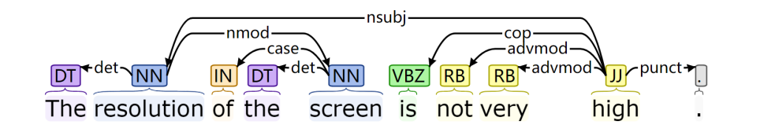
3. Methodology
Extract product features
Part-of-speech tagging and dependency relations analysis tool: Stanford CoreNLP
Preprocess
Removing non-English reviews 删除非英语评论
Excessively short reviews 删除太短的评论
Special characters 删除特殊字符
Generating POS tags and identifying parts of speech：
Product features are usually nouns or noun phrases and opinions are usually adjectives with adverbs or negatives
Analyze the dependency relations of reviews
Describe the sentence structure

Slide 14
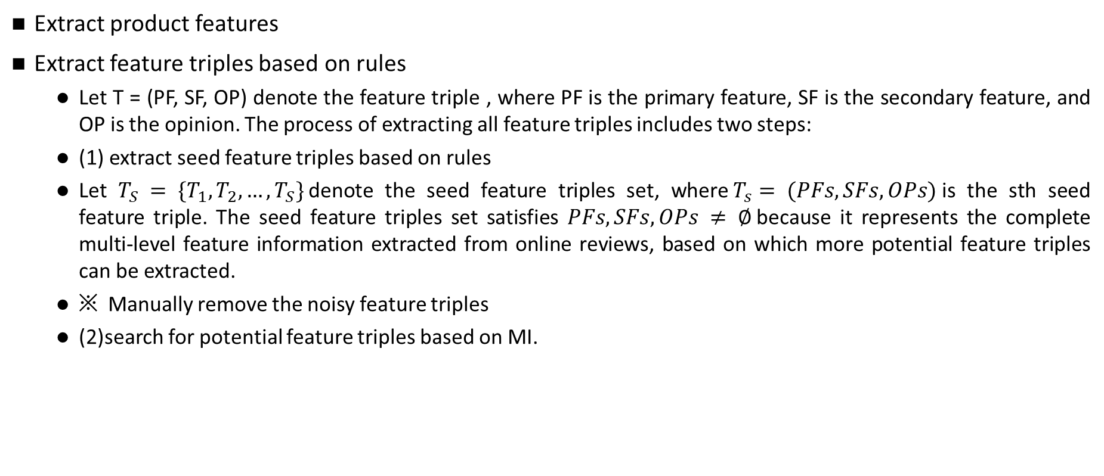
3. Methodology
Extract product features
Extract feature triples based on rules
Let T = (PF, SF, OP) denote the feature triple , where PF is the primary feature, SF is the secondary feature, and OP is the opinion. The process of extracting all feature triples includes two steps:
(1) extract seed feature triples based on rules
Let $T_{S} = \{T_{1},T_{2}, …,T_{S}\}$denote the seed feature triples set, where$T_{s}= (PFs, SFs, OPs)$is the sth seed feature triple. The seed feature triples set satisfies $PFs, SFs, OPs ≠ ∅$because it represents the complete multi-level feature information extracted from online reviews, based on which more potential feature triples can be extracted.
※ Manually remove the noisy feature triples
(2)search for potential feature triples based on MI.

Slide 15
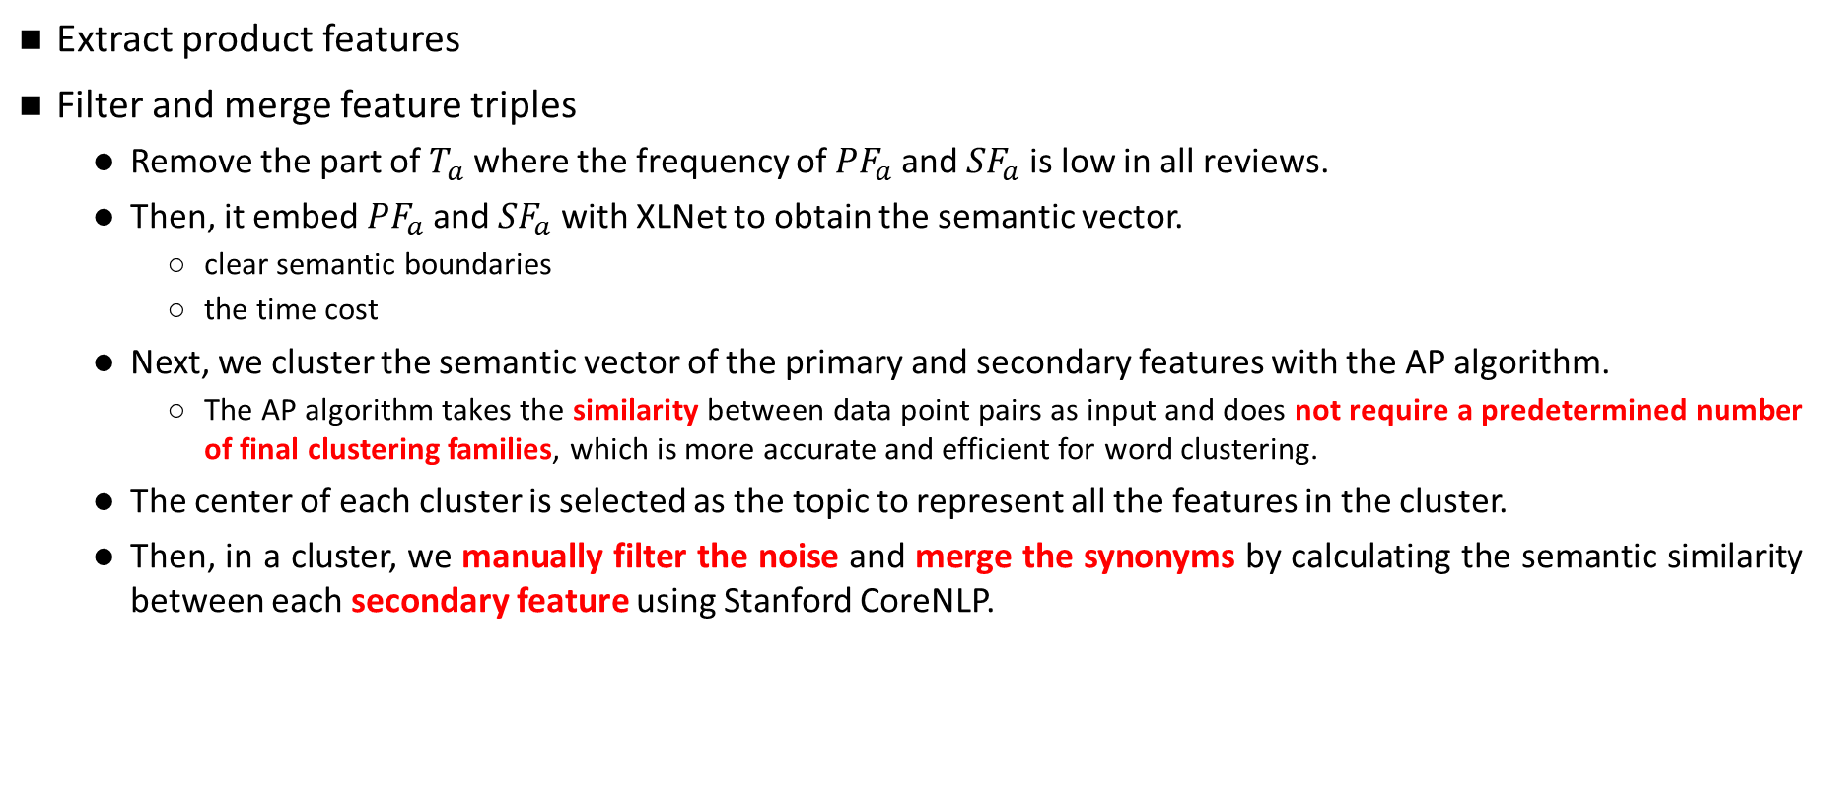
3. Methodology
Extract product features
Filter and merge feature triples
Remove the part of $T_{a}$where the frequency of ${PF}_{a}$and ${SF}_{a}$ is low in all reviews.
Then, it embed ${PF}_{a}$and ${SF}_{a}$ with XLNet to obtain the semantic vector.
clear semantic boundaries
the time cost
Next, we cluster the semantic vector of the primary and secondary features with the AP algorithm.
The AP algorithm takes the similarity between data point pairs as input and does not require a predetermined number of final clustering families, which is more accurate and efficient for word clustering.
The center of each cluster is selected as the topic to represent all the features in the cluster.
Then, in a cluster, we manually filter the noise and merge the synonyms by calculating the semantic similarity between each secondary feature using Stanford CoreNLP.

Slide 16
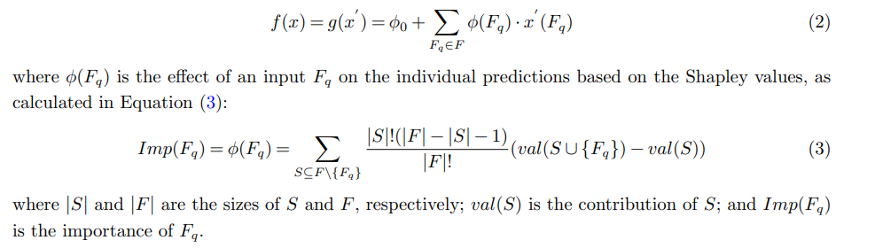
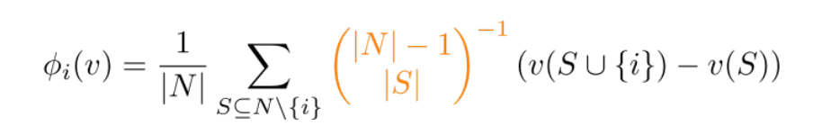
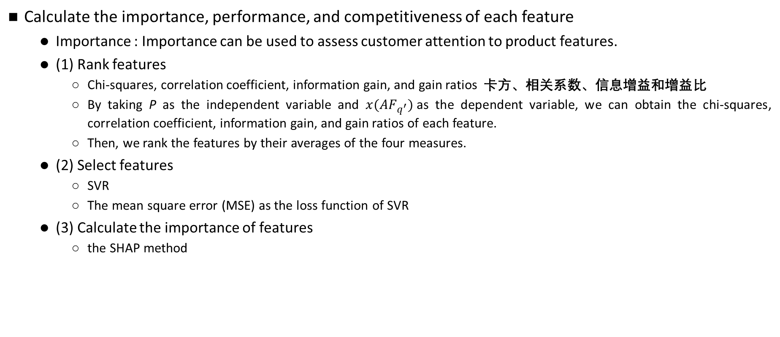
3. Methodology
Calculate the importance, performance, and competitiveness of each feature
Importance : Importance can be used to assess customer attention to product features.
(1) Rank features
Chi-squares, correlation coefficient, information gain, and gain ratios 卡方、相关系数、信息增益和增益比
By taking P as the independent variable and $x({AF}_{q^{′}})$as the dependent variable, we can obtain the chi-squares, correlation coefficient, information gain, and gain ratios of each feature.
Then, we rank the features by their averages of the four measures.
(2) Select features
SVR
The mean square error (MSE) as the loss function of SVR
(3) Calculate the importance of features
the SHAP method

Slide 17
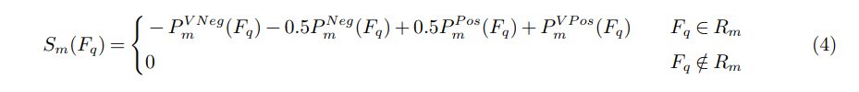


3. Methodology
Calculate the importance, performance, and competitiveness of each feature
Performance : Feature performance can inform designers on customer satisfaction with different aspects of a product.
They use the sentiment analysis module of Stanford CoreNLP to obtain the sentiment score, and its output is the sentiment probability distribution of $D= \left\{VNeg, Neg, Neu, Pos, VPos\right\}$, the score value of each sentiment strength can be expressed as $(−1,−0.5, 0, 0.5, 1 )$.

Slide 18
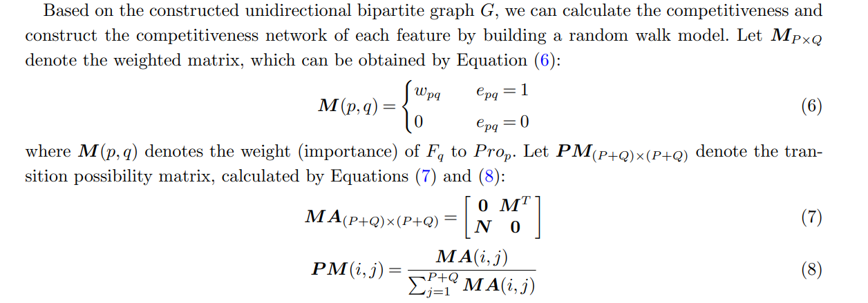
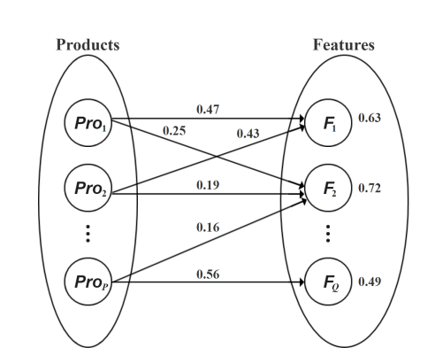
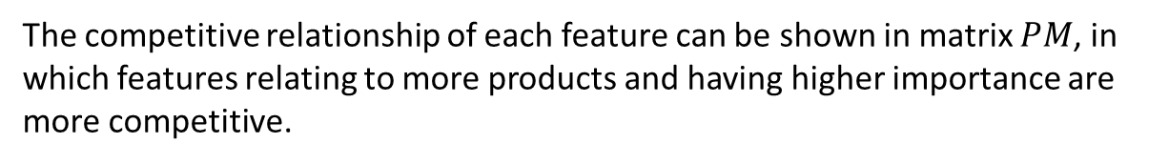
3. Methodology
Calculate the importance, performance, and competitiveness of each feature
Competitiveness: The competitiveness of features represents the influence of features on all products.
The competitive relationship of each feature can be shown in matrix $PM$, in which features relating to more products and having higher importance are more competitive.

Slide 19

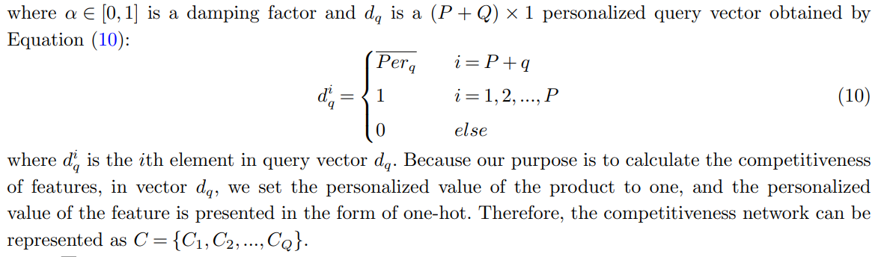
3. Methodology
Calculate the importance, performance, and competitiveness of each feature
In addition, a previous study (Liu et al. 2020b) showed that the popularity (performance) of a product feature impacts competitiveness.
TrustRank algorithm, a variant of the well-known PageRank algorithm

Slide 20
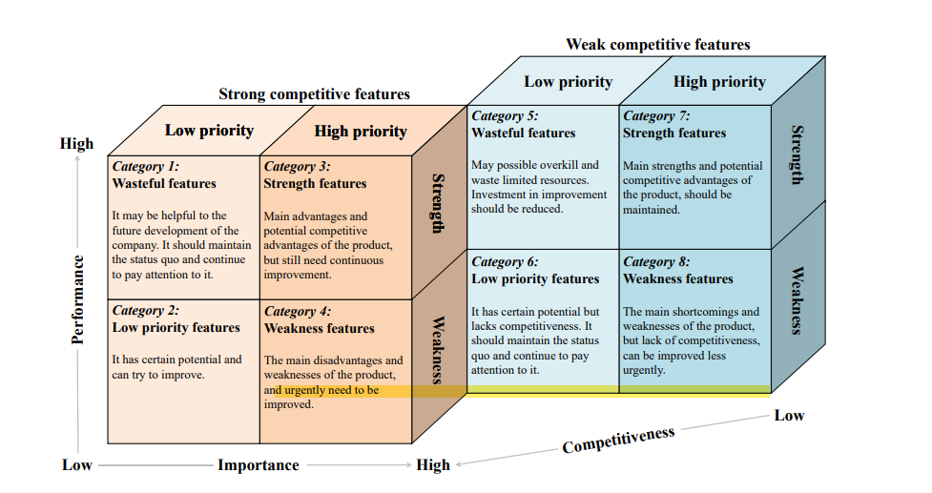
3. Methodology

Slide 21
4. Conclusions, limitations, and future research
Significance
This methods can be applied to many industries, including automobiles, restaurants, hotels, tourism, scientific and technological products, hedonism and experience products, retail supermarkets, and professional business-to-business and business-to-consumer services.
Limitations
First, we considered the customer review data with the highest correlation to the previous generation of products. In practice, product designers also need to consider data from other sources such as competitors’ substitutes and complements, brand development and market trends. In the future, more sources of data can be integrated to further improve the NPD process, especially for those market-sensitive products, such as apparel and cosmetics.
Second, time series and asymmetric relationships.
Lastly, Need- and technology-driven approaches.

