Slide 1

Stabilizing Grand Cooperation via Cost Adjustment:
An Inverse Optimization Approach
INFORMS Journal on Computing
By: Liu Lindong, Qi Xiangtong, Xu Zhou
Reporter: Zhao Junzhe

Slide 2
Contents
1. Motivation
2. Model Building
3. Model Solving
4. Applications
5. Conclusion

Slide 3
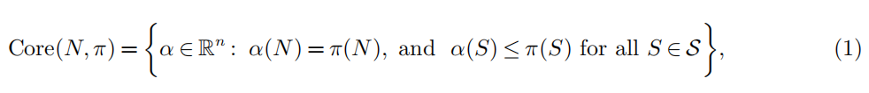
1. Motivation
Cooperative Game Theory
There are n players, each of whom needs to complete a specific task at minimum cost using a certain resource she owns. Some, or all of the players, may form a coalition by pooling their resources together to jointly work on all their tasks, with the goal being to reduce their total cost. The set of all players is called the grand coalition. The major concern is how to share the total cost of the grand coalition in a “fair” way among all players such that no player has any incentive to quit. (Liu et al. 2016)
One of the most important concepts for fair cost allocations is the core.
budget balance constraint
coalition stability constraints

Slide 4
1. Motivation
Instruments: Cost Impositions
Subsidization, through which an outside authority injects certain outside resources to reduce the grand coalition cost so that the players only need to share a portion of the incurred cost. For example, γ-core.
Penalization, through which an outside authority can stabilize the grand coalition by enforcing a penalty to any sub-coalition that deviates from the grand coalition. For example, least core value.
Liu et al. (2018) reveal the complementary roles of subsidization and penalization and apply them simultaneously to develop a new instrument for stabilizing the grand coalition.
Problem: imposing new cost terms

Slide 5
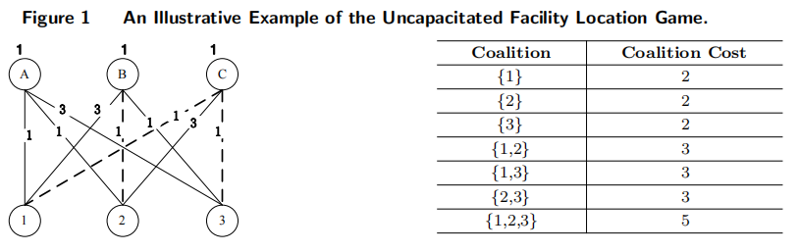
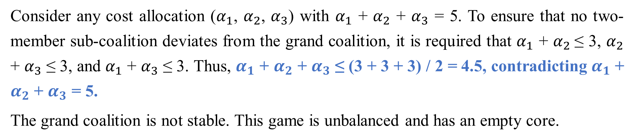
1. Motivation
1.1 A Motivation Example and Some Practical Incentives
sub-coalition
grand coalition
Consider any cost allocation ($α_{1}$, $α_{2}$, $α_{3}$) with $α_{1}$ + $α_{2}$ + $α_{3}$ = 5. To ensure that no two-member sub-coalition deviates from the grand coalition, it is required that $α_{1}$ + $α_{2}$≤ 3, $α_{2}$ + $α_{3}$ ≤ 3, and $α_{1}$ + $α_{3}$ ≤ 3. Thus, $α_{1}$ + $α_{2}$ + $α_{3}$ ≤ (3 + 3 + 3) / 2 = 4.5, contradicting $α_{1}$ + $α_{2}$ + $α_{3}$ = 5.
The grand coalition is not stable. This game is unbalanced and has an empty core.

Slide 6
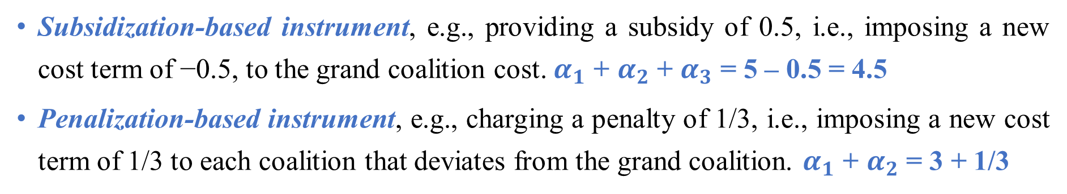
1. Motivation
1.1 A Motivation Example and Some Practical Incentives
sub-coalition
grand coalition
Subsidization-based instrument, e.g., providing a subsidy of 0.5, i.e., imposing a new cost term of −0.5, to the grand coalition cost. $α_{1}$ + $α_{2}$ + $α_{3}$ = 5 – 0.5 = 4.5
Penalization-based instrument, e.g., charging a penalty of 1/3, i.e., imposing a new cost term of 1/3 to each coalition that deviates from the grand coalition. $α_{1}$ + $α_{2}$ = 3 + 1/3

Slide 7
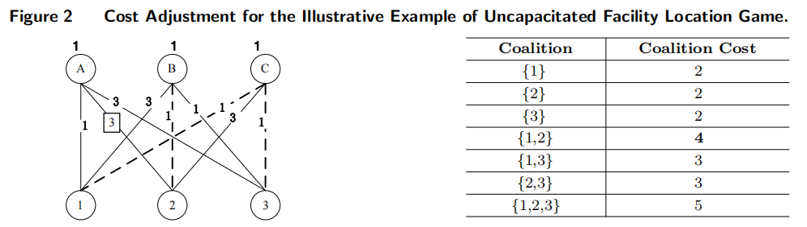

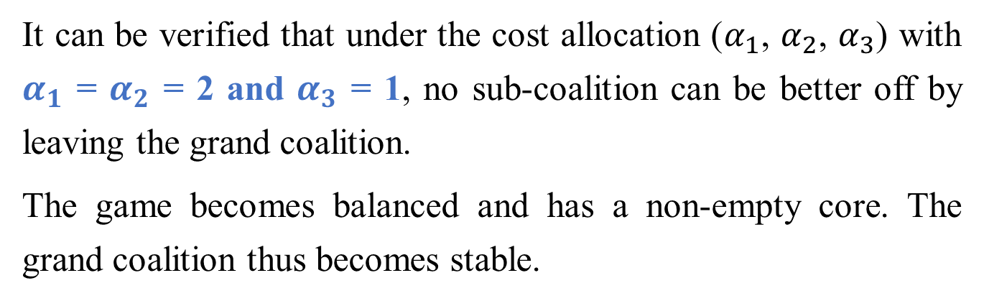
1. Motivation
1.1 A Motivation Example and Some Practical Incentives
It can be verified that under the cost allocation ($α_{1}$, $α_{2}$, $α_{3}$) with $α_{1}$ = $α_{2}$ = 2 and $α_{3}$ = 1, no sub-coalition can be better off by leaving the grand coalition.
The game becomes balanced and has a non-empty core. The grand coalition thus becomes stable.
Practical applications:

Slide 8
1. Motivation
1.2 Cost Adjustment and Inverse Optimization
The cost adjustment for stabilizing the grand coalition needs to be optimized in such a way that the total adjustment of existing cost terms is minimized.
A desirable way of cooperation.
A desirable amount of total cost to be shared.
The inverse optimization problems involve having a solution or objective function value of a forward optimization problem provided beforehand. The task is then to determine the parameters of the forward optimization problem that yield the given solution or objective function value as optimal.
Chan, T. C., Mahmood, R., & Zhu, I. Y. (2021). Inverse optimization: Theory and applications. arXiv preprint arXiv:2109.03920. https://www.youtube.com/watch?v=ux2ClmtlOmE

Slide 9
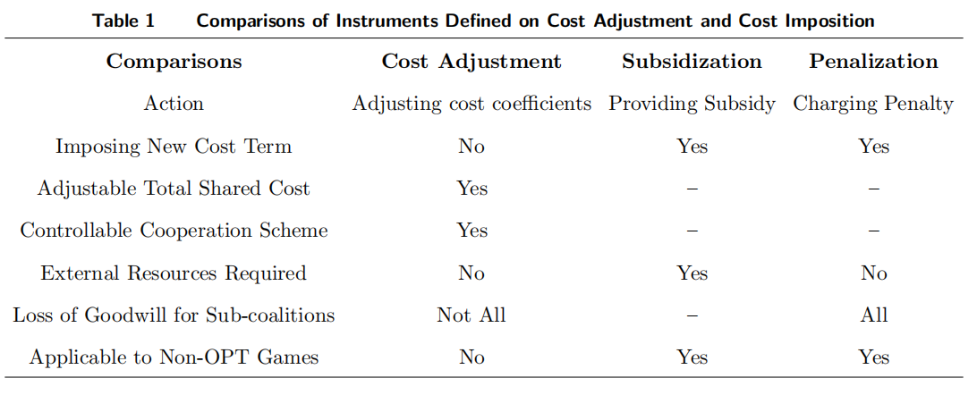
1. Motivation
1.3 Cost Adjustment versus Cost Imposition
Cost adjustment is applicable to games that have explicit optimization formulations.
Cost adjustment does not impose costs on players that form specific coalitions.
Cost adjustment can impose a desirable cooperation scheme and a desirable range of sharing cost among the players.

Slide 10
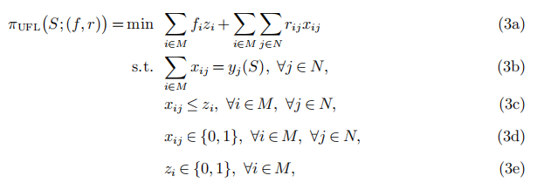


2. Model Building
2.1 Cooperative Game and Integer Minimization (IM) Game
Definition 1. Integer Linear Program (ILP):
the value of the characteristic function
the cost vector
$y_{j}\left(S\right)$ = 1 if$j ∈ S$
UFL game ($N$, $π(S;\left(f, r\right))$):
Only players in S need to be served.
Only an opened facility can serve players.

Slide 11
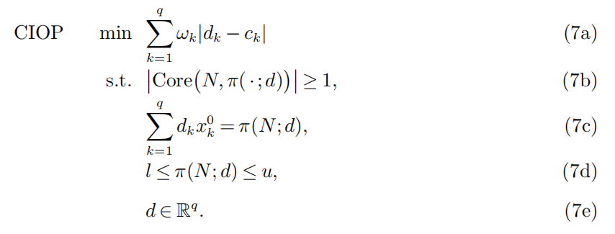




2. Model Building
2.2 Formulation: A Constrained Inverse Optimization Problem (CIOP)
$L_{1}$ norm
balancedness constraint
desirable cooperation constraint
a desirable cooperation scheme
desirable cost sharing constraint

Slide 12
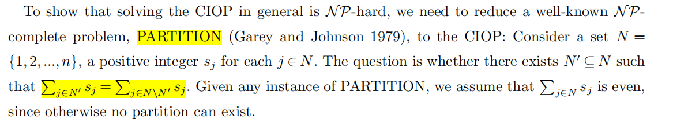

3. Model Solving
3.1 Complexity Result
There are three bins for packing the items, with each bin having a capacity of $W$, where

Slide 13
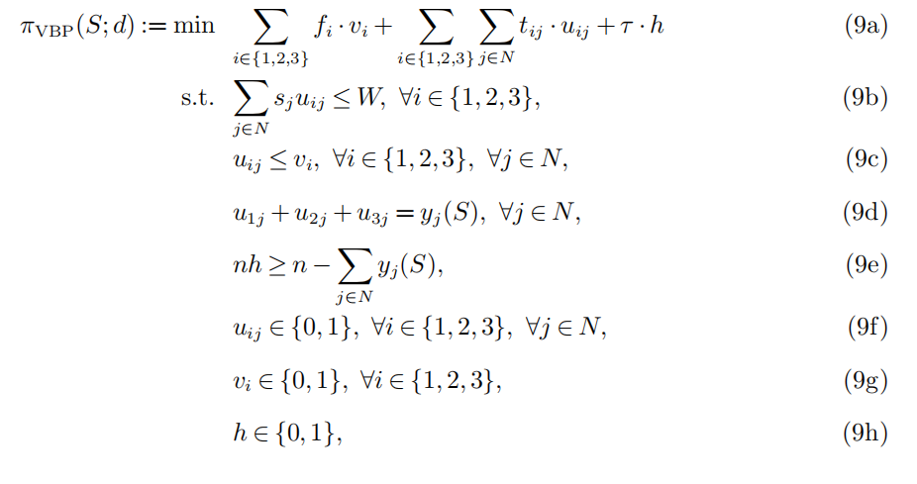
3. Model Solving
3.1 Complexity Result
Bin cost
Item cost
Fixed cost
The binary variable $h$ must equal 1 if $S ⊂ N$.

Slide 14
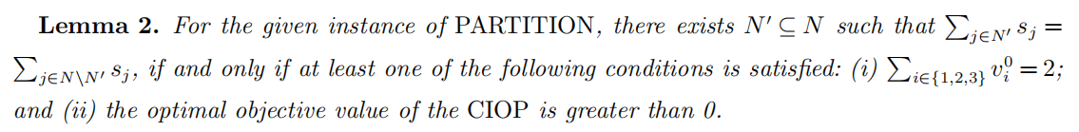
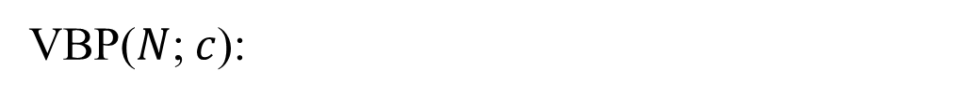
3. Model Solving
3.1 Complexity Result
VBP($N$;$c$):
first-fit approach

Slide 15
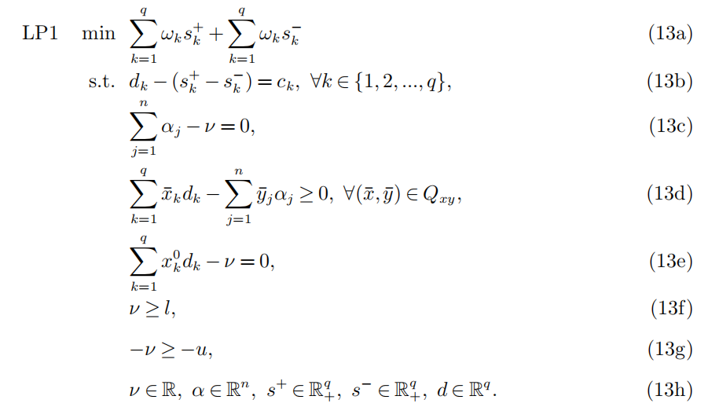



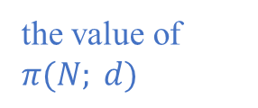
3. Model Solving
3.2.1 Reformulation LP1
budget balance constraint
the value of $π(N; d)$
coalition stability constraints

Slide 16
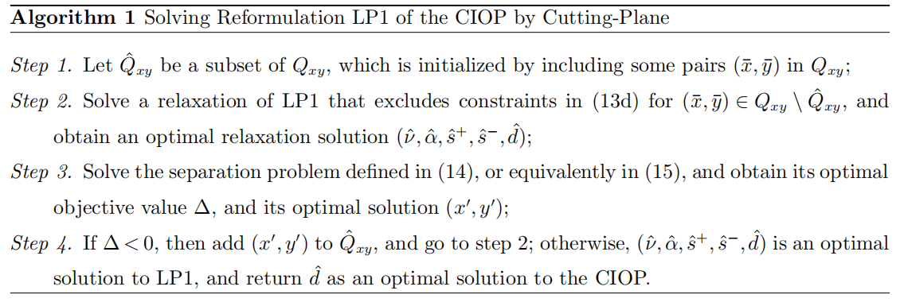


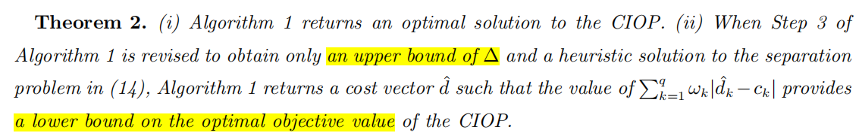
3. Model Solving
3.2.1 Reformulation LP1

Slide 17

3. Model Solving
3.2.2 Reformulation LP2
Assignable inequalities:
Caprara and Letchford (2010) have shown that:
the set of points that satisfy all assignable inequalities

Slide 18

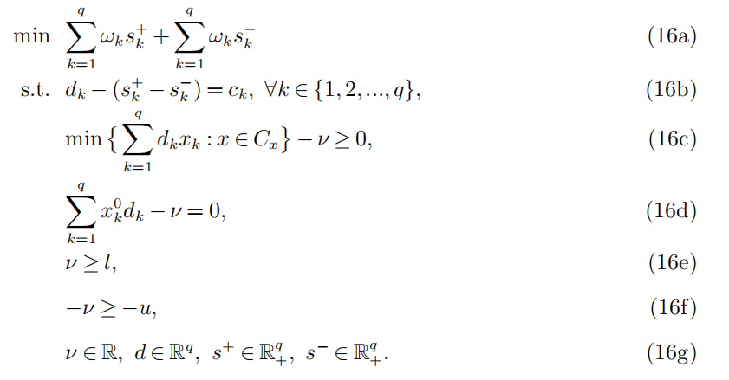


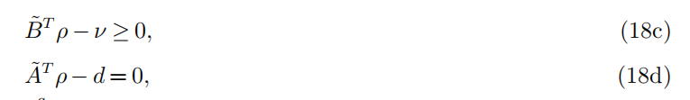
3. Model Solving
3.2.2 Reformulation LP2
dual
Replace (16c) with constraints (18c) and (18d):

Slide 19
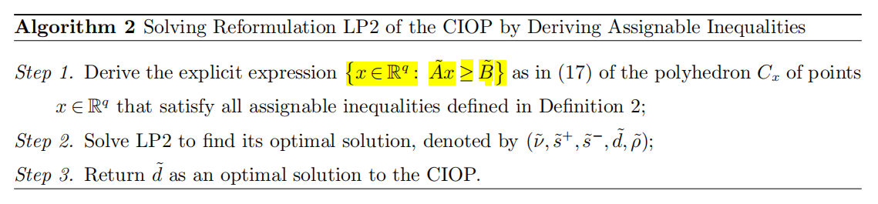
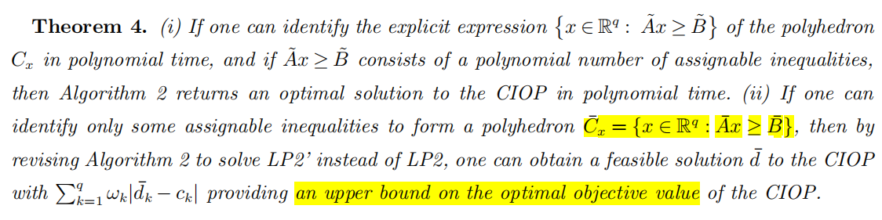
3. Model Solving
3.2.2 Reformulation LP2

Slide 20
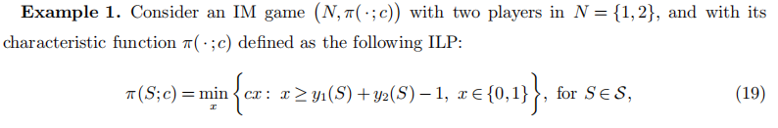
3. Model Solving
3.3 Feasibility Conditions
$c=1$, $x^{∗}=1, π\left(N;c\right)=1. \left[l,u\right]=\left[0.5,1.5\right], x^{0}=x^{∗}=1.$
If $d≥0: π\left(\{1\};d\right)=π\left(\{2\};d\right),=0,$ and $π\left(\{1, 2\};d\right)=d∗1=d;$If $d<0: π\left(\{1\};d\right)=π\left(\{2\};d\right)=π\left(\{1, 2\};d\right)=d∗1=d.$ This implies that$π\left(\{1\};d\right)+π\left(\{2\};d\right)<π\left(\{1, 2\};d\right)$

Slide 21
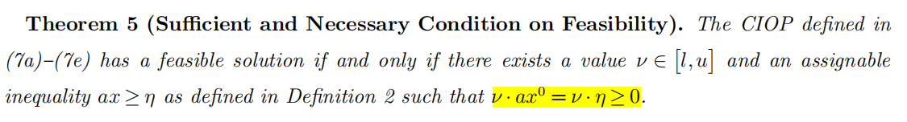
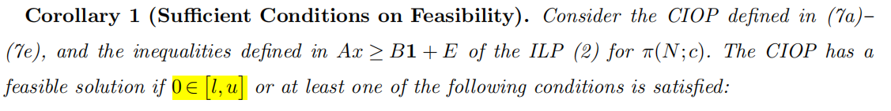
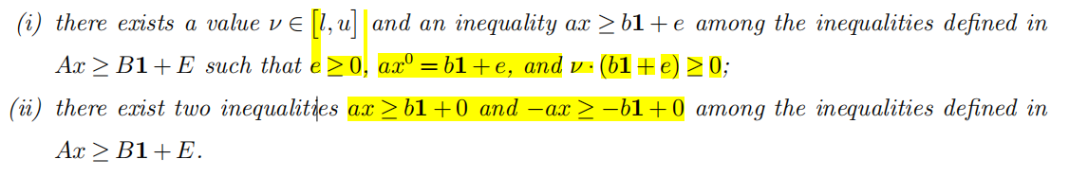
3. Model Solving
3.3 Feasibility Conditions

Slide 22
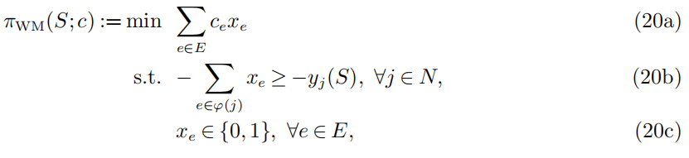


4. Applications
4.1 Cost Adjustment for WM Game using LP1
The weighted matching (WM) game denoted by $(N, π_{WM} (·; c))$
Only a vertex in the coalition can be matched
Separation problem:
(Deng et al. 1999)

Slide 23
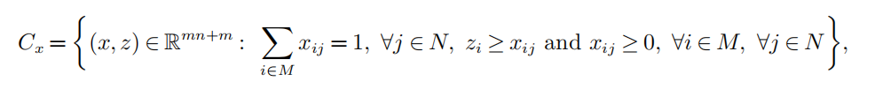
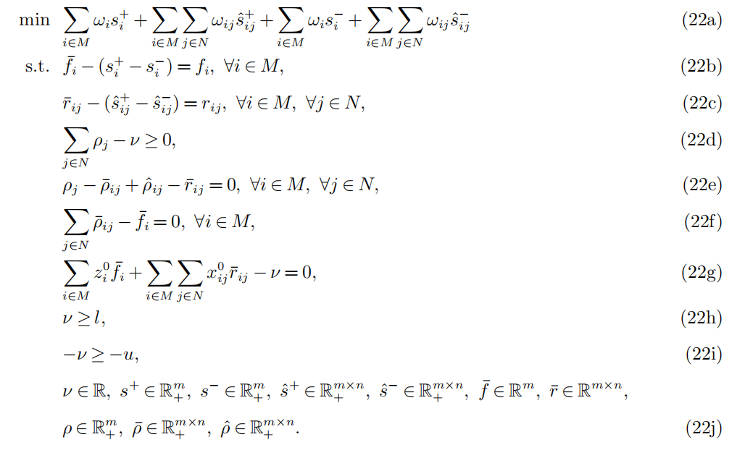
4. Applications
4.2 Cost Adjustment for UFL Game using LP2
Caprara and Letchford (2010)

Slide 24
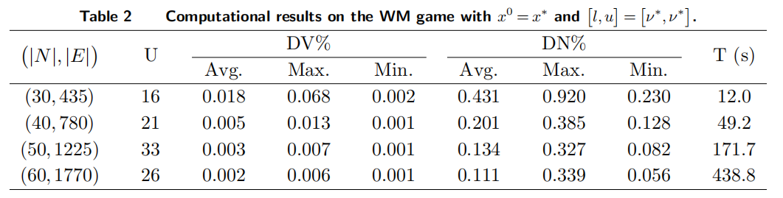
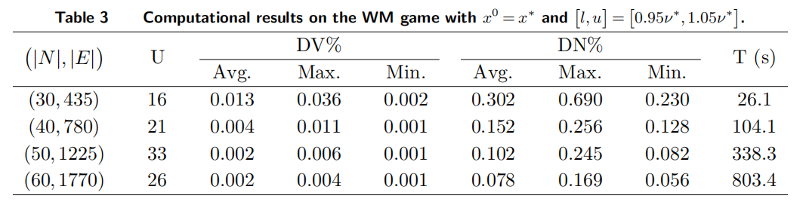
4. Applications
4.3.1 Computational Experiments on the WM Game

Slide 25
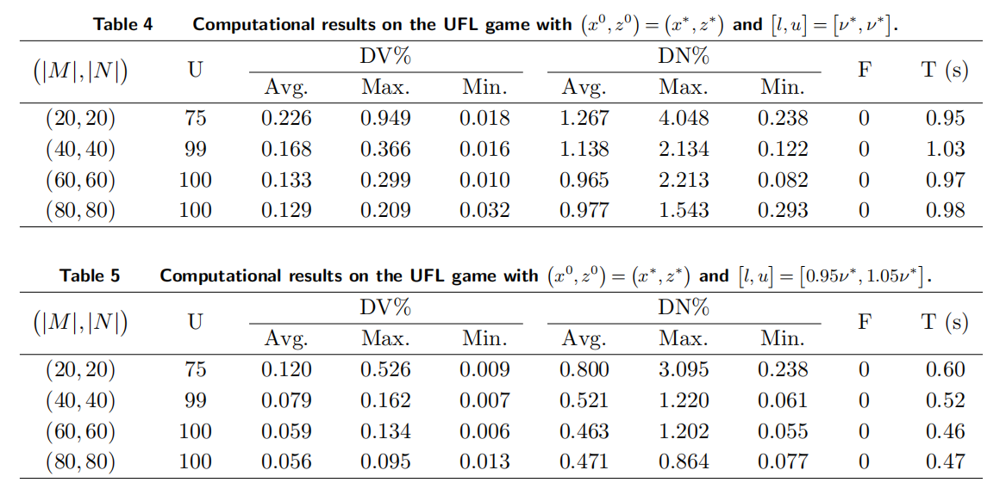
4. Applications
4.3.2 Computational Experiments on the UFL Game

Slide 26
5. Conclusion
Conclusion
Our study proposes a new cost adjustment-based instrument for stabilizing the grand coalition of general IM games.
We formulate the problem on how to make such cost adjustments for stabilizing the grand coalition as a constrained inverse optimization problem, and prove it to be NP-hard.
we develop solution algorithms based on two linear programming reformulations, and derive some feasibility conditions that are easy to check.
We demonstrate the applicability and effectiveness of our alternative instrument by applying our models and solution algorithms to two typical unbalanced games.

Slide 27
5. Conclusion
Future research
When applying the instrument of cost adjustments to other games.
It can also be utilized alongside other existing instruments designed around cost imposition, such as subsidization-based and penalization-based one.
Only a subset of cost coefficients can be adjusted.

Slide 28
Thanks for your listening!
汇报人： 赵俊喆
2023.10.01

