Slide 1
Integrating decisions with advance supply information in an assemble-to-order system
Author: Jie Chu; Kai Huang
Naval Res Logistics(NRL)
Received: 29 September 2018 Revised: 11 September 2019 Accepted: 30 October 2019
reporter：许璟钊
2023.10

Slide 2

Authors
Education background
Ph.D. in Management Science, McMaster University, Canada
M.Eng. in Electrical and Computer Engineering, University of Toronto, Canada
M.S. in Industrial Engineering, Arizona State University, United States
B.Eng. in Automation, Huazhong University of Science and Technology, China
Work experience
Assistant Professor, IBSS, Xi'an Jiaotong-Liverpool University, 2020-Present
Deputy Program Director (MSc. Operations and Supply Chains), IBSS, XJTLU, 2020- Present
Assistant Professor, College of Economics and Management, Huazhong Agricultural University, 2019-2020
Jie Chu
Interest
Production and Inventory Management
Stochastic Programming/Robust Optimization
Closed-loop Supply Chain

Slide 3

Authors
Kai Huang
Education background
PhD, Georgia Institute of Technology
MSc, Tsinghua University
BSc, Huazhong University of Science and Technology
Work experience
Professor, DeGroote School of Business, McMaster University, Canada
Recent journal articles
Deep learning-based model predictive control for real-time supply chain optimization. Journal of Process Control. 129:103049-103049. 2023
Data-driven supply chain monitoring using canonical variate analysis. Computers and Chemical Engineering. 174:108228-108228. 2023
Research interest
data-driven inventory management
humanitarian logistics
closed-loop supply chain

Slide 4
Background
periodic-review
含义：每个周期期初检查库存，当库存水平低于base stock level，发出订货请求
assemble-to-order (ATO)
含义：按订单装配，制造商最小库存单位维持在零件层面
目的：降低产成品的存货积压成本
难点：joint optimization
(1)库存补充(inventory replenishment):订货提前期不确定
(2)零件分配(component allocation)：零件之间的库存水平相互关联

Slide 5
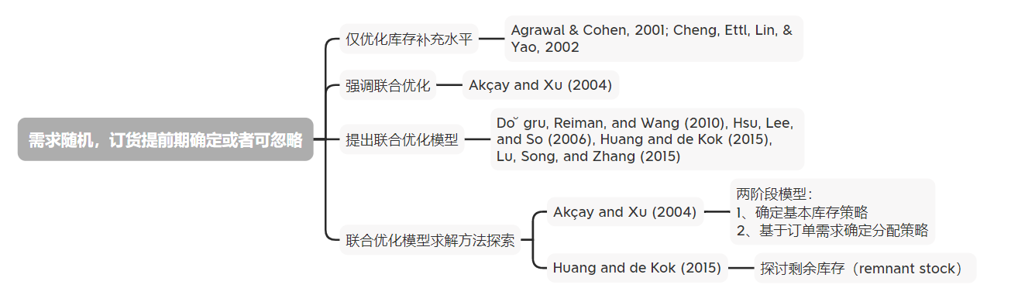
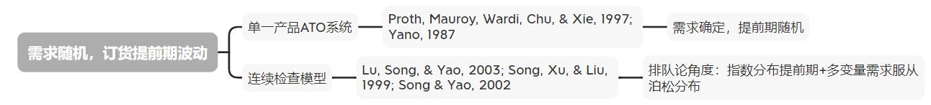
Literature review

Slide 6
Model
Some assumptions
缺货订单按照FCFS原则满足
零件持有成本和产品缺货惩罚成本与数量线性相关
产成品需求允许在响应时间窗口内的多个时期内被满足
假设装配提前期为0
假设产成品需求是离散的
本文考虑的ATO系统为：多产品多零件，且对不同零件的需求存在交叉关系

Slide 7
Model
Sequence of Events
t时期：
1、检查库存位置(inventory position)=现有库存+在途库存-缺货
2、根据base-stock level下达零件补货订单
3、replenishment lead time变为已知
4、收到之前的补货订单并更新库存位置
5、产品需求到达，分配可用零件
6、计算在响应时间窗口内满足需求获得的奖励

Slide 8








Model
Condition 1
每个零件已经实现的订货提前期必须满足：
例如：
当已实现的订货提前期 =2，lead time support 会更新为：
Theorem 1
零件需求 会在 时期内被完全满足
产品需求 会在 时期内被完全满足

Slide 9


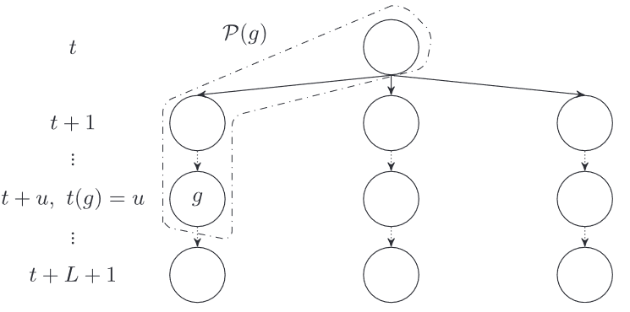


Model
场景树(Scenario tree)
目的：枚举所有提前期的可能情况
根节点：产品需求 和补货提前期 已知，所以概率为1
含义：
:节点g到根节点的路径，
代表一个场景
t(g):节点g所处时期
p(g):节点g提前期的可能性
两阶段：t和t+1
t+1之后的节点概率等于同场景下t+1节点的概率

Slide 10
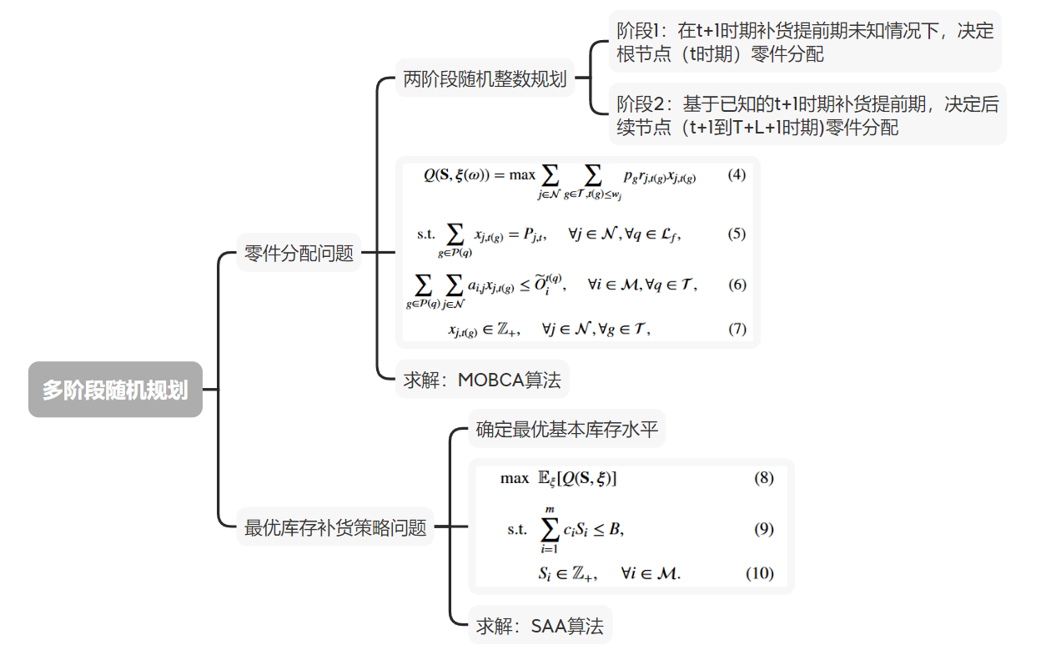
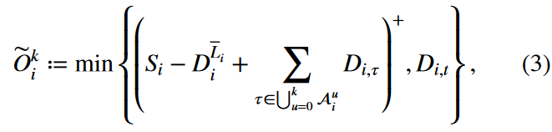
Model

Slide 11
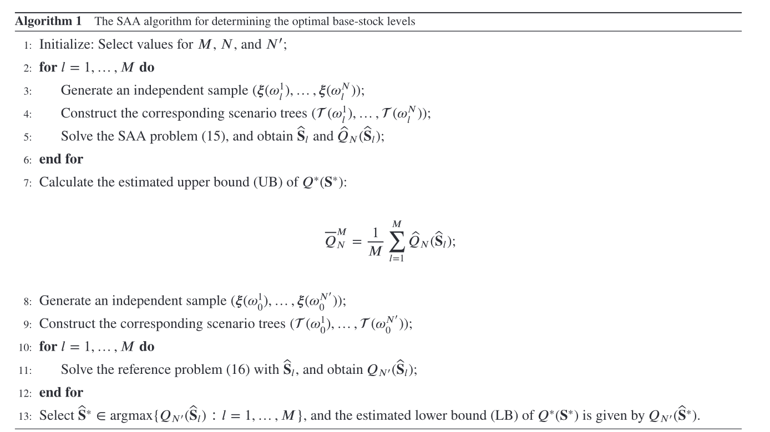
模型求解
样本均值近似算法(SAA)
抽样并计算每个样本的目标函数值
计算上界
重新抽样取下界

Slide 12
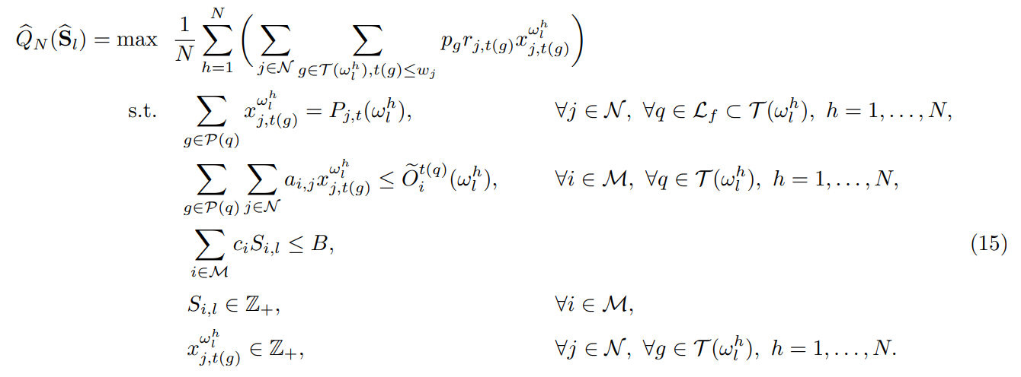
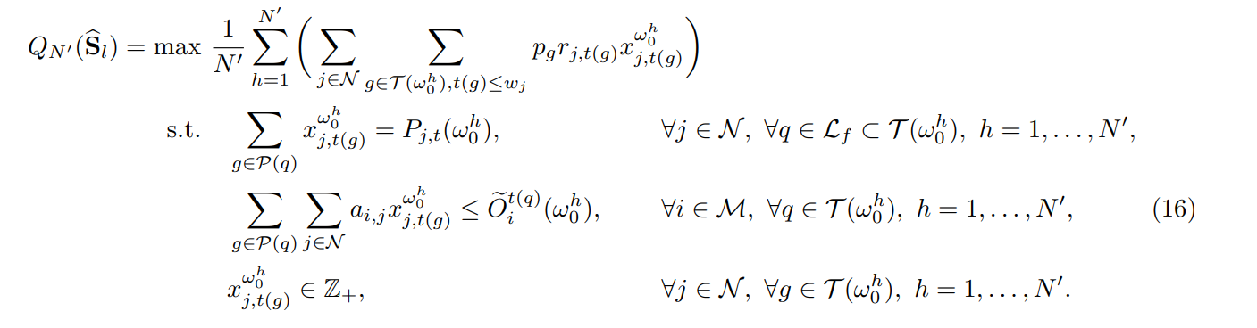
模型求解
样本均值近似算法(SAA)

Slide 13


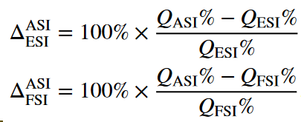
数值实验
average service level
模型：SAAESI:the SAA solutions of the two-stage model of Akçay and Xu (2004)
SAAFSI:the FSI model
SAAASI:the ASI model
指标：the base-stock levels
LB%
UB%
optimality gap (GAP% = UB% − LB%)
：relative performance of ASI in comparison to ESI and FSI

Slide 14
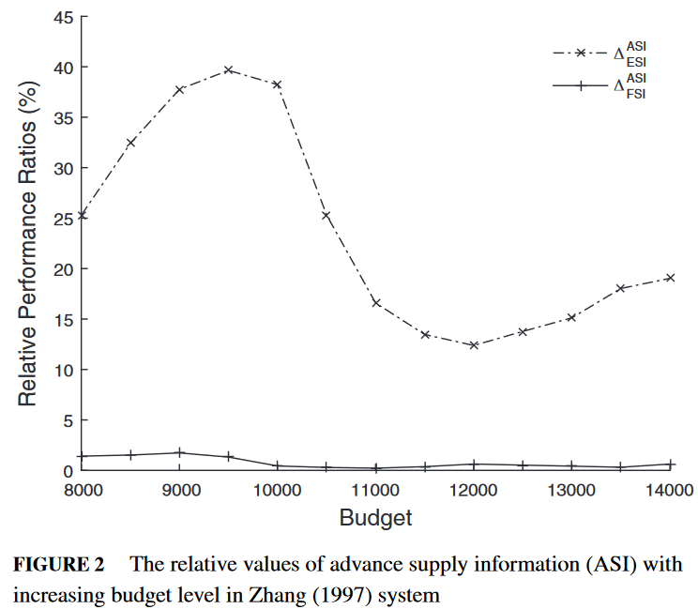
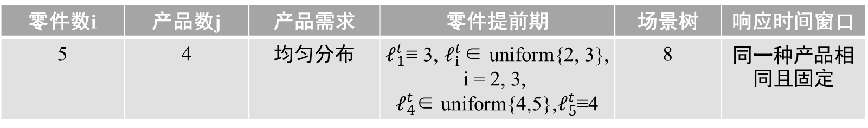
数值实验
算例
Zhang (1997) system
零件数i | 产品数j | 产品需求 | 零件提前期 | 场景树 | 响应时间窗口
5 | 4 | 均匀分布 | $𝓁_{1}^{t}$≡ 3, $𝓁_{i}^{t}$∈ uniform{2, 3}, i = 2, 3, $𝓁_{4}^{t}$∈ uniform{4,5},$𝓁_{5}^{t}$≡4 | 8 | 同一种产品相同且固定
M | 1000
N | 20
N′ | 500

