Slide 1
A fuzzy cooperative game theoretic approach for multinational water
resource spatiotemporal allocation
European Journal of Operational Research, 2019
Dehai Liu, Xiaoxian Ji, Jiafu Tang, Hongyi Li
汇报人：李昊洋

Slide 2
Contents
1
Background
2
Literature Review
三
Model
3
4
Case Study
5
Conclusion

Slide 3
Background
Due to climate warming, environmental pollution, population increases, and accelerated industrialization and urbanization, the shortage in global water resources has severely impacted the maintenance of the Earth’s ecological system and the sustainable development of human society.
There are 276 multinational rivers that are shared by more than 2 counties in the world at present, which provide 60% of the total fresh water resources (UN Water, 2013). The development and allocation of shared water resources have been the focus of competition and conflicts between riparian countries.
Problem:
Challenge: How riparian countries to utilize the water resources of multinational rivers efficiently and equally, which should be based on the mutual benefit principle, specifically, water demands, water utility, seasonality effects, and the priority of water use due to the geographic locations of each riparian country?
unstable volume and uneven distribution of seasonal water resources
water scarcity
sharp growth in water demand
lack of a globally agreed upon water resource allocation mechanism
Notes:
随着信息技术的发展，定制化在电子商务中变得越来越重要。许多网上商店根据顾客的个人喜好量身定做商品，这叫做商品分类。例如，在在线零售中
每当客户点击进入一个网站时，都会向客户显示一组根据该客户的历史点击/购买记录生成的产品;
根据客户的观看历史，在客户的主页上向每位客户推荐精选视频
在社交媒体网站，广告是根据用户的浏览记录发布的
为每位读者提供个性化的文章推荐
使用个人数据根据客户的偏好向客户推荐商品分类的问题被称为个性化分类优化

Slide 4
Background
Problem features
The natural and social attributes of multinational rivers determine the cooperative development pattern between basin countries.
Geographical location: the upstream countries are always in favorable positions that can affect the flow of rivers in downstream countries
Seasonal demand: the efficient allocation of water resources of relative countries in different seasons such as rainy and dry seasons will help to alleviate droughts and floods for downstream ones.
Despite the establishment of regional cooperative organizations, there is still a lack of water resource allocation schemes that take into account the spatial and temporal characteristics of the water demands in upstream and downstream countries.
the demands for agricultural water the differences in the net utility
the priority of water uses the seasonality of the water demand
Notes:
随着信息技术的发展，定制化在电子商务中变得越来越重要。许多网上商店根据顾客的个人喜好量身定做商品，这叫做商品分类。例如，在在线零售中
每当客户点击进入一个网站时，都会向客户显示一组根据该客户的历史点击/购买记录生成的产品;
根据客户的观看历史，在客户的主页上向每位客户推荐精选视频
在社交媒体网站，广告是根据用户的浏览记录发布的
为每位读者提供个性化的文章推荐
使用个人数据根据客户的偏好向客户推荐商品分类的问题被称为个性化分类优化

Slide 5
Literature Review
The priority of water resource utilization
The literature now mainly focuses on the optimization algorithms and simulation analysis of the linear planning and network planning of water rights allocations.
Kucukmehmetoglu and Geymen (2014): Based on linear programming, they proposed a transboundary water resource allocation model for the Tigris-Euphrates Basin considering the geographic location of the upstream and downstream countries together with the industrial water
The seasonal adjustment effect on the flow of downstream countries
The existing literature mainly focuses on the analysis of the seasonal variation of the stream flow based on water conservancy and hydrology.
Masaki et al. (2017) simulated the seasonal flow variation with dam regulation using five global hydrological models and compared their simulation results with the differences of the models under different meteorological conditions.
Notes:
观察展示的产品K，客户根据多项logit (MNL)选择模型做出购买决策
在MNL模型下，拥有个人数据xt的客户概率选择产品i，其中0表示不购买任何东西的选项
其中参数θi对于i∈N为d维列向量，该列向量对公司先验未知，需要通过销售数据来学习。给定分类S，来自拥有信息xt的客户的期望收益是
由于不知道选择模型的先验参数，公司希望通过响应性决策在时间范围内最大化预期总回报(例如，点击率，收入
周期t的分类决策St与未来的个性化信息xs (s > t)之间没有依赖关系

Slide 6
Literature Review
The cooperative game method
The cooperative game method provides a suitable analytical framework for watershed stakeholders to achieve the fair, reasonable and sustainable use of water resources.
At present, scholars have used Shapley values, Cores, Nucleolus and other methods to study the rational distribution of water resources in the Nile, Canada, Iran and other regions.
Sadegh et al. (2010) built a regional water resource allocation model based on both crisp and fuzzy cooperative game methods, thereby revealing the significant impact of regional cooperation on the results of the deployment.
Wu and Whittington (2006) considered the differences in the incentives between cooperative and non-cooperative countries in the basin; and used the Core, the Nucleolus and the Shapley value of the cooperative game to analyze the water allocation conflicts of the Nile River.
The Shapley value, is adopted in this paper in order to motivate more “powerful” countries to get involved in the cooperation and at the same time minimize the free-riding problem.
Notes:
观察展示的产品K，客户根据多项logit (MNL)选择模型做出购买决策
在MNL模型下，拥有个人数据xt的客户概率选择产品i，其中0表示不购买任何东西的选项
其中参数θi对于i∈N为d维列向量，该列向量对公司先验未知，需要通过销售数据来学习。给定分类S，来自拥有信息xt的客户的期望收益是
由于不知道选择模型的先验参数，公司希望通过响应性决策在时间范围内最大化预期总回报(例如，点击率，收入
周期t的分类决策St与未来的个性化信息xs (s > t)之间没有依赖关系

Slide 7
Literature Review
The innovation
Based on the fuzzy cooperative game method, this paper proposes the best solution among the following three models: the initial water resource allocation model, crisp coalition allocation model and fuzzy coalition reallocation model.
Under the framework of regional cooperation, this paper adopts the cooperative game method to consider the water demands and the differences in the net utility of the water resource utilization between countries in the basin to maximize the overall benefits.
In the formulation of a fair and reasonable allocation of water resources in the basin, the different water priorities due to the geographical locations of upstream and downstream countries are considered.
In the framework of river basin cooperation, upstream countries conduct seasonal water resource scheduling according to the seasonality of the water demands of different countries.
Notes:
观察展示的产品K，客户根据多项logit (MNL)选择模型做出购买决策
在MNL模型下，拥有个人数据xt的客户概率选择产品i，其中0表示不购买任何东西的选项
其中参数θi对于i∈N为d维列向量，该列向量对公司先验未知，需要通过销售数据来学习。给定分类S，来自拥有信息xt的客户的期望收益是
由于不知道选择模型的先验参数，公司希望通过响应性决策在时间范围内最大化预期总回报(例如，点击率，收入
周期t的分类决策St与未来的个性化信息xs (s > t)之间没有依赖关系

Slide 8
Model
Basic assumptions
Assumption 1. The discharge flow of the hydropower stations in upstream countries is used to meet the ecological needs of the domestic rivers and the water demands of the downstream countries.
The discharged water from this station is mainly used for the river ecological needs of the upstream country from this station to the border, and the water demands of each country. To reflect the role of the seasonal adjustment schedule of upstream hydropower dams, they assume that the ecological river water demands in downstream regions can be satisfied by the in-flows of tributaries and water discharges from the existing reservoirs at downstream locations.
Assumption 2. 10% of the average annual flow measured by the hydrological station that is closest to the border is considered the minimum ecological demand of the upstream country.
According to the Tennant method (Guo, Xia, Lin & Wang, 2009), this paper assumes that 10% of the average annual flow that is obtained from the upstream hydrological station that is closest to the border is the minimum ecological flow of the river from this station to the border.
Notes:
观察展示的产品K，客户根据多项logit (MNL)选择模型做出购买决策
在MNL模型下，拥有个人数据xt的客户概率选择产品i，其中0表示不购买任何东西的选项
其中参数θi对于i∈N为d维列向量，该列向量对公司先验未知，需要通过销售数据来学习。给定分类S，来自拥有信息xt的客户的期望收益是
由于不知道选择模型的先验参数，公司希望通过响应性决策在时间范围内最大化预期总回报(例如，点击率，收入
周期t的分类决策St与未来的个性化信息xs (s > t)之间没有依赖关系

Slide 9
Model
Basic assumptions
Assumption 3. For countries in the downstream basin, agricultural irrigation water use is the basic water demand.
Generally, the upstream mountainous countries focus on hydropower development while the downstream plain countries focus on irrigation. So far, by sectors, the agriculture water withdrawal in the world accounts for 69% of the total withdrawal. In particular, in most of the multinational river basins, irrigation is the largest water use. Therefore, in this paper, the agricultural water use in downstream countries will be considered as the basic demand.
Assumption 4. The geographical locations of upstream and downstream countries and the net utility coefficients of the agricultural water usage among downstream countries determine the water resource allocation priorities in basin countries.
First, the upstream countries have the priority when meeting their domestic water demands because their hydropower stations play decisive roles in water discharges. Second, with respect to the distribution of water resources for outbound flows, priority is given to meeting the water demands of countries with the largest net utility coefficients, which will result in the maximum marginal utility for the overall cooperative group. In addition, countries with lower water demands and lower water production can be considered separately.
Notes:
观察展示的产品K，客户根据多项logit (MNL)选择模型做出购买决策
在MNL模型下，拥有个人数据xt的客户概率选择产品i，其中0表示不购买任何东西的选项
其中参数θi对于i∈N为d维列向量，该列向量对公司先验未知，需要通过销售数据来学习。给定分类S，来自拥有信息xt的客户的期望收益是
由于不知道选择模型的先验参数，公司希望通过响应性决策在时间范围内最大化预期总回报(例如，点击率，收入
周期t的分类决策St与未来的个性化信息xs (s > t)之间没有依赖关系

Slide 10
Model
Steps of water resource allocation along multinational rivers
1. Initial water resource allocation model
Considering the demand for agricultural water in various countries, the initial water resource allocation model is constructed based on the equity criterion to ensure the fairness of the initial water distribution results.
2. Crisp coalition allocation model
Considering the geographical locations and the net utility differences, the utility of water resource utilization in the entire basin will be maximized under the framework of regional cooperation. Then, the Shapley value is used to distribute the total utility to the countries in the basin and to compensate for the reduction of the benefits of sharing the water in some countries
3. Fuzzy coalition allocation model
Considering the seasonality of the water demands in upstream and downstream countries, the water use utility of the entire basin is maximized through the seasonal reallocation of water resources in the basin countries. To achieve this, a fuzzy coalition allocation model is constructed.
Notes:
观察展示的产品K，客户根据多项logit (MNL)选择模型做出购买决策
在MNL模型下，拥有个人数据xt的客户概率选择产品i，其中0表示不购买任何东西的选项
其中参数θi对于i∈N为d维列向量，该列向量对公司先验未知，需要通过销售数据来学习。给定分类S，来自拥有信息xt的客户的期望收益是
由于不知道选择模型的先验参数，公司希望通过响应性决策在时间范围内最大化预期总回报(例如，点击率，收入
周期t的分类决策St与未来的个性化信息xs (s > t)之间没有依赖关系

Slide 11
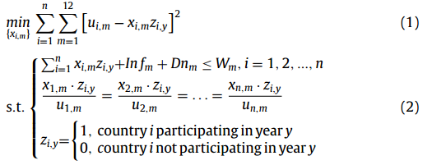
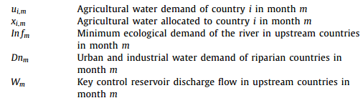
Model
Initial water resource allocation model based on agricultural water demand
The initial water resource allocation model for multinational rivers is set as follows:
Objective function: minimize the difference between the actual agricultural water demands and the amount of water allocated (maximize the matching)
First constraint：the water discharges per
month of the upstream power station must meet the ecological needs of the river and the municipal and industrial water consumption of each country, while surplus water is distributed to downstream countries according to their agricultural water demands.
Second constraint: the agricultural water needs are given
equal weight (priority) in each downstream country
Notes:
观察展示的产品K，客户根据多项logit (MNL)选择模型做出购买决策
在MNL模型下，拥有个人数据xt的客户概率选择产品i，其中0表示不购买任何东西的选项
其中参数θi对于i∈N为d维列向量，该列向量对公司先验未知，需要通过销售数据来学习。给定分类S，来自拥有信息xt的客户的期望收益是
由于不知道选择模型的先验参数，公司希望通过响应性决策在时间范围内最大化预期总回报(例如，点击率，收入
周期t的分类决策St与未来的个性化信息xs (s > t)之间没有依赖关系

Slide 12
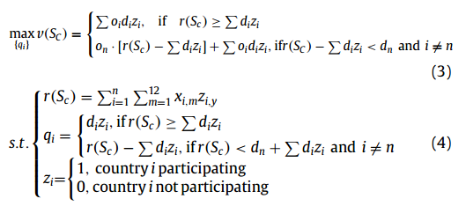
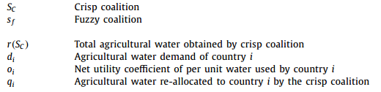
Model
Crisp coalition allocation model considering spatial geographical locations
According to Assumption 4, the geographical locations of the upstream and downstream countries and the net utility coefficient of water resource in each country needs to be considered.
Objective function: maximize the total revenue function
Condition 1: the water resources are no less than the total water demand
Condition 2: the water resources are less than the total water demand, after the upstream’s demand is met, the remaining water allocated to the last country will be less than the country’s demand.
First constraint：the amount of water available for distribution in the coalition
Second constraint: the amount of water re-allocated to the countries in the crisp coalition, and the country where the estuary is located may not be able to meet all of its demand
Notes:
观察展示的产品K，客户根据多项logit (MNL)选择模型做出购买决策
在MNL模型下，拥有个人数据xt的客户概率选择产品i，其中0表示不购买任何东西的选项
其中参数θi对于i∈N为d维列向量，该列向量对公司先验未知，需要通过销售数据来学习。给定分类S，来自拥有信息xt的客户的期望收益是
由于不知道选择模型的先验参数，公司希望通过响应性决策在时间范围内最大化预期总回报(例如，点击率，收入
周期t的分类决策St与未来的个性化信息xs (s > t)之间没有依赖关系

Slide 13



Model
Crisp coalition allocation model considering spatial geographical locations
Secondly, according to the marginal contribution of the water resource utilization in each country, the Shapley value is used to distribute the total utility to each participating country i in the coalition:
Shapley value:
It is a weighted average value of the marginal contribution of player i alone in all combinations. (Lloyd Shapley 1951)
Consider all possible coalitions: Shapley Value considers all possible coalitions.
Calculate the marginal contribution: for each member i, Shapley Value calculates the marginal contribution of member i in the coalition.
Weighted summation: weighted summation of each member's marginal contribution using weighting factors
Validity：
When the total utility of water resource utilization in the basin is maximized, corresponding utility is allocated to each member in the coalition according to their own marginal contribution under the framework of regional cooperation.
Notes:
观察展示的产品K，客户根据多项logit (MNL)选择模型做出购买决策
在MNL模型下，拥有个人数据xt的客户概率选择产品i，其中0表示不购买任何东西的选项
其中参数θi对于i∈N为d维列向量，该列向量对公司先验未知，需要通过销售数据来学习。给定分类S，来自拥有信息xt的客户的期望收益是
由于不知道选择模型的先验参数，公司希望通过响应性决策在时间范围内最大化预期总回报(例如，点击率，收入
周期t的分类决策St与未来的个性化信息xs (s > t)之间没有依赖关系

Slide 14


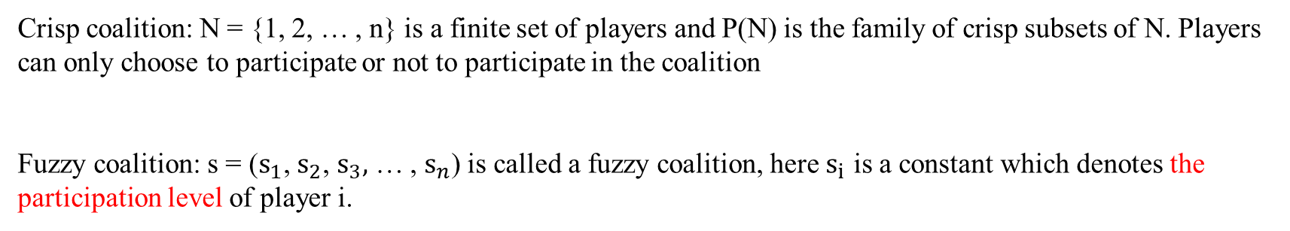
Model
Fuzzy coalition reallocation model considering seasonal allocation of water resources
Li, S., & Zhang, Q. (2009). A simplified expression of the shapley function for fuzzy game. European Journal of Operational Research, 196, 234–245:
Crisp coalition: N = {1, 2, … , n} is a finite set of players and P(N) is the family of crisp subsets of N. Players can only choose to participate or not to participate in the coalition
Fuzzy coalition: s = ($s_{1}$, $s_{2}$, $s_{3},$ … , $s_{n}$) is called a fuzzy coalition, here $s_{i}$ is a constant which denotes the participation level of player i.
Shapley value:
Notes:
观察展示的产品K，客户根据多项logit (MNL)选择模型做出购买决策
在MNL模型下，拥有个人数据xt的客户概率选择产品i，其中0表示不购买任何东西的选项
其中参数θi对于i∈N为d维列向量，该列向量对公司先验未知，需要通过销售数据来学习。给定分类S，来自拥有信息xt的客户的期望收益是
由于不知道选择模型的先验参数，公司希望通过响应性决策在时间范围内最大化预期总回报(例如，点击率，收入
周期t的分类决策St与未来的个性化信息xs (s > t)之间没有依赖关系

Slide 15

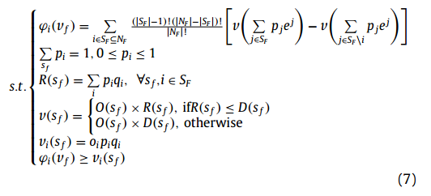
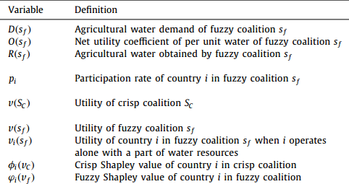
Model
Fuzzy coalition reallocation model considering seasonal allocation of water resources
According to the definition of fuzzy coalition (Li & Zhang, 2009), the sharing proportion of water resources of each country is defined as the participation rate in the fuzzy coalition.
Considering the seasonal re-allocation of water resources, the utility of water resources utilization in the whole basin are maximized:
Objective function: maximize the sum of the net utility of water resources allocated to countries for each fuzzy coalition
Notes:
观察展示的产品K，客户根据多项logit (MNL)选择模型做出购买决策
在MNL模型下，拥有个人数据xt的客户概率选择产品i，其中0表示不购买任何东西的选项
其中参数θi对于i∈N为d维列向量，该列向量对公司先验未知，需要通过销售数据来学习。给定分类S，来自拥有信息xt的客户的期望收益是
由于不知道选择模型的先验参数，公司希望通过响应性决策在时间范围内最大化预期总回报(例如，点击率，收入
周期t的分类决策St与未来的个性化信息xs (s > t)之间没有依赖关系

Slide 16


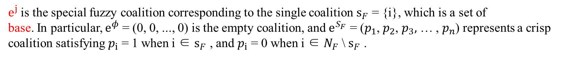
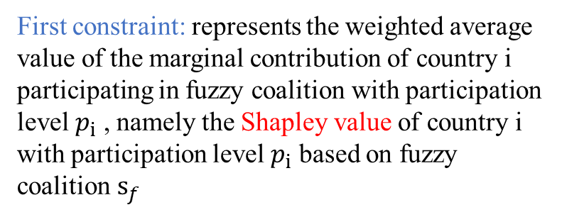
Model
Fuzzy coalition reallocation model considering seasonal allocation of water resources
First constraint: represents the weighted average value of the marginal contribution of country i participating in fuzzy coalition with participation level $p_{i}$ , namely the Shapley value of country i with participation level $p_{i}$ based on fuzzy coalition $s_{f}$
Denote the equivalent utility function w of the crisp game corresponding to fuzzy game v as
$e^{j}$ is the special fuzzy coalition corresponding to the single coalition $s_{F}$ = {i}, which is a set of
base. In particular, $e^{φ}$ = (0, 0, ..., 0) is the empty coalition, and $e^{S_{F}}$ = ($p_{1}$, $p_{2}$, $p_{3},$ … , $p_{n}$) represents a crisp coalition satisfying $p_{i}$ = 1 when i ∈ $s_{F}$ , and $p_{i}$ = 0 when i ∈ $N_{F}$ \ $s_{F}$ .
The fuzzy coalition variable $p_{S_{F}}$corresponding to $S_{F}$ is denoted by
Notes:
观察展示的产品K，客户根据多项logit (MNL)选择模型做出购买决策
在MNL模型下，拥有个人数据xt的客户概率选择产品i，其中0表示不购买任何东西的选项
其中参数θi对于i∈N为d维列向量，该列向量对公司先验未知，需要通过销售数据来学习。给定分类S，来自拥有信息xt的客户的期望收益是
由于不知道选择模型的先验参数，公司希望通过响应性决策在时间范围内最大化预期总回报(例如，点击率，收入
周期t的分类决策St与未来的个性化信息xs (s > t)之间没有依赖关系

Slide 17

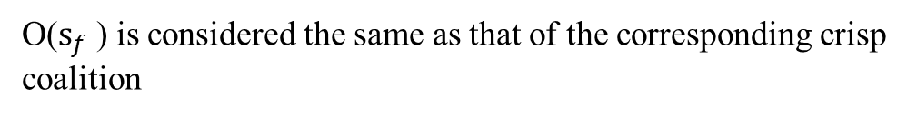
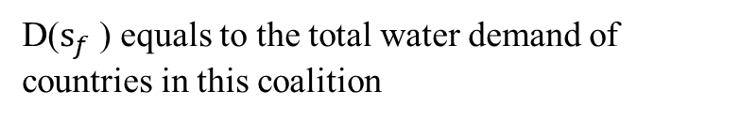
Model
Fuzzy coalition reallocation model considering seasonal allocation of water resources
Second constraint: the completeness of the participation rates of countries in all fuzzy coalitions.
Third constraint: the amount of available water resources of the fuzzy coalition, which is determined by the volume of water resources that each country contributes to the coalition.
Fourth constraint: implies the fuzzy coalition utility determined by the net water utility coefficient of the fuzzy coalition and the amount of partial water resource reallocated.
D($s_{f}$ ) equals to the total water demand of countries in this coalition
O($s_{f}$ ) is considered the same as that of the corresponding crisp coalition
Notes:
观察展示的产品K，客户根据多项logit (MNL)选择模型做出购买决策
在MNL模型下，拥有个人数据xt的客户概率选择产品i，其中0表示不购买任何东西的选项
其中参数θi对于i∈N为d维列向量，该列向量对公司先验未知，需要通过销售数据来学习。给定分类S，来自拥有信息xt的客户的期望收益是
由于不知道选择模型的先验参数，公司希望通过响应性决策在时间范围内最大化预期总回报(例如，点击率，收入
周期t的分类决策St与未来的个性化信息xs (s > t)之间没有依赖关系

Slide 18
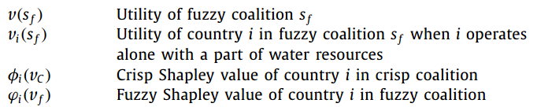
Model
Fuzzy coalition reallocation model considering seasonal allocation of water resources
Fifth constraint: the utility of country i when it chooses to independently utilize all the corresponding part of water resources instead of transferring it to the other participants in any of the coalitions.
Sixth constraint: the individual rationality, which implies that the allocated utility of country i should be no less than that when operating alone.
Notes:
观察展示的产品K，客户根据多项logit (MNL)选择模型做出购买决策
在MNL模型下，拥有个人数据xt的客户概率选择产品i，其中0表示不购买任何东西的选项
其中参数θi对于i∈N为d维列向量，该列向量对公司先验未知，需要通过销售数据来学习。给定分类S，来自拥有信息xt的客户的期望收益是
由于不知道选择模型的先验参数，公司希望通过响应性决策在时间范围内最大化预期总回报(例如，点击率，收入
周期t的分类决策St与未来的个性化信息xs (s > t)之间没有依赖关系

Slide 19


Model
Fuzzy coalition reallocation model considering seasonal allocation of water resources
The total water resources utility of the basin countries under the framework of regional seasonal cooperation:
total additional utility of the fuzzy coalition gained through seasonal water resources re-allocation
net utility of self-utilized water resources through participating in regional cooperation by the crisp coalition
When the water is re-allocated to fuzzy coalitions to meet the different seasonal demands, the inherent worth of re-allocated water must be decreased from the crisp Shapley Value of the players who give water to the fuzzy coalitions.
Notes:
观察展示的产品K，客户根据多项logit (MNL)选择模型做出购买决策
在MNL模型下，拥有个人数据xt的客户概率选择产品i，其中0表示不购买任何东西的选项
其中参数θi对于i∈N为d维列向量，该列向量对公司先验未知，需要通过销售数据来学习。给定分类S，来自拥有信息xt的客户的期望收益是
由于不知道选择模型的先验参数，公司希望通过响应性决策在时间范围内最大化预期总回报(例如，点击率，收入
周期t的分类决策St与未来的个性化信息xs (s > t)之间没有依赖关系

Slide 20
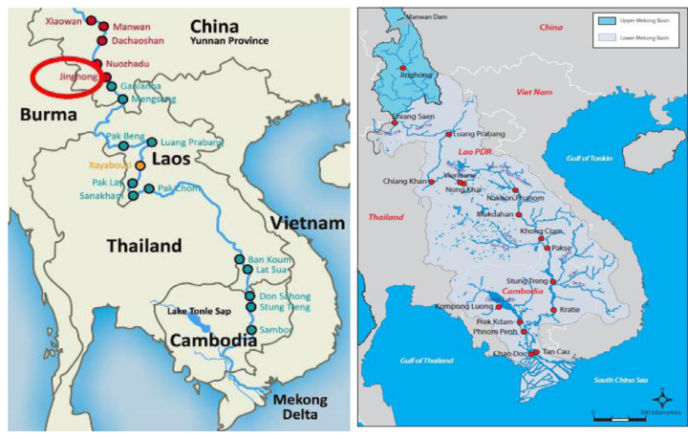
Case Study
International water resource in Lancang-Mekong River
The Lancang River originates from the southern part of Qinghai Province, China. It flows through Qinghai, Tibet and Yunnan provinces. After leaving China, it enters Southeast Asia and is called the Mekong River. It flows through Laos, Myanmar, Thailand, Cambodia and Vietnam, and finally flows into the South China Sea. The population along the Mekong River Basin exceeds 60 million, and more than 70% live on agricultural land.
Notes:
观察展示的产品K，客户根据多项logit (MNL)选择模型做出购买决策
在MNL模型下，拥有个人数据xt的客户概率选择产品i，其中0表示不购买任何东西的选项
其中参数θi对于i∈N为d维列向量，该列向量对公司先验未知，需要通过销售数据来学习。给定分类S，来自拥有信息xt的客户的期望收益是
由于不知道选择模型的先验参数，公司希望通过响应性决策在时间范围内最大化预期总回报(例如，点击率，收入
周期t的分类决策St与未来的个性化信息xs (s > t)之间没有依赖关系

Slide 21
Case Study
Assumptions in Lancang-Mekong River
According to the basic assumptions of the above model, firstly, there are three pivotal hydropower stations in China that have an important impact on the water resources of the Lancang-Mekong River Basin, among which the Jinghong Power Station is close to the exit section, and its discharge directly determines the downstream flow.
Assumption 1: Jinghong Power Station’s discharge flow will preferentially meet the minimum ecological flow requirements of the Lancang River in China, and then in turn meet the water demand of Xishuangbanna Prefecture and downstream countries.
Assumption 2: 10% of the annual average flow rate of the Qingsheng hydrological station near the border as the minimum ecological flow that should be preferentially satisfied.
Assumption 3: The Southeast Asian countries in downstream of the Lancang-Mekong River Basin, which are all developing countries with the lower level of socio-economic development, are mainly dominated by agricultural sector.
Assumption 4: When China and downstream countries form a strategic coalition under the regional cooperation framework, Yunnan Province has the priority in obtaining water resources as an upstream area.
Notes:
观察展示的产品K，客户根据多项logit (MNL)选择模型做出购买决策
在MNL模型下，拥有个人数据xt的客户概率选择产品i，其中0表示不购买任何东西的选项
其中参数θi对于i∈N为d维列向量，该列向量对公司先验未知，需要通过销售数据来学习。给定分类S，来自拥有信息xt的客户的期望收益是
由于不知道选择模型的先验参数，公司希望通过响应性决策在时间范围内最大化预期总回报(例如，点击率，收入
周期t的分类决策St与未来的个性化信息xs (s > t)之间没有依赖关系

Slide 22
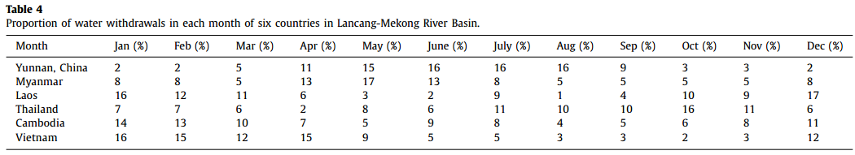
Case Study
Initial water resource allocation method
For the case of Xishuangbanna Prefecture in Yunnan province, they choose the sum of monthly water requirement of the representative staple crops as the monthly agricultural water requirements. For the other five downstream countries, the data come the monthly demand ratio of agriculture.
solve the initial water resources allocation model (1) and (2) through the nonlinear constrained optimization,
Notes:
观察展示的产品K，客户根据多项logit (MNL)选择模型做出购买决策
在MNL模型下，拥有个人数据xt的客户概率选择产品i，其中0表示不购买任何东西的选项
其中参数θi对于i∈N为d维列向量，该列向量对公司先验未知，需要通过销售数据来学习。给定分类S，来自拥有信息xt的客户的期望收益是
由于不知道选择模型的先验参数，公司希望通过响应性决策在时间范围内最大化预期总回报(例如，点击率，收入
周期t的分类决策St与未来的个性化信息xs (s > t)之间没有依赖关系

Slide 23
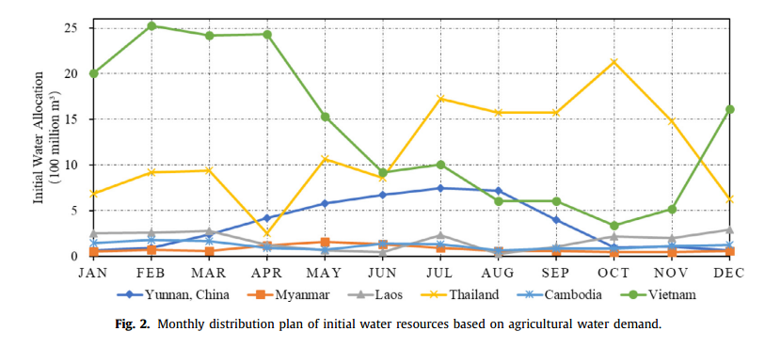
Case Study
Initial water resource allocation method
monthly distribution plan of the initial water resources based on the agricultural water demand in the six countries of the Lancang-Mekong River Basin:
Notes:
观察展示的产品K，客户根据多项logit (MNL)选择模型做出购买决策
在MNL模型下，拥有个人数据xt的客户概率选择产品i，其中0表示不购买任何东西的选项
其中参数θi对于i∈N为d维列向量，该列向量对公司先验未知，需要通过销售数据来学习。给定分类S，来自拥有信息xt的客户的期望收益是
由于不知道选择模型的先验参数，公司希望通过响应性决策在时间范围内最大化预期总回报(例如，点击率，收入
周期t的分类决策St与未来的个性化信息xs (s > t)之间没有依赖关系

Slide 24
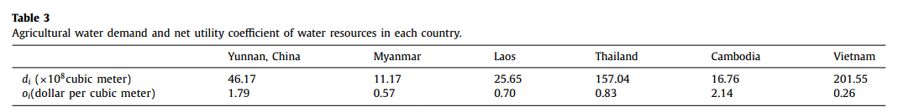
Case Study
Crisp coalition allocation method
Under the Lancang-Mekong cooperation framework, the initial water resources can be allocated to other
countries in the basin in order to achieve the higher water use utility of the total drainage basin.
For the water resource allocation of the outbound flow of the Lancang River, the water demand of countries with the largest net utility coefficient will be prioritized to meet.
Considering the geographic location and the net water utility of basin countries, the Shapley value is obtained based on the marginal contribution rate of each country.
Notes:
观察展示的产品K，客户根据多项logit (MNL)选择模型做出购买决策
在MNL模型下，拥有个人数据xt的客户概率选择产品i，其中0表示不购买任何东西的选项
其中参数θi对于i∈N为d维列向量，该列向量对公司先验未知，需要通过销售数据来学习。给定分类S，来自拥有信息xt的客户的期望收益是
由于不知道选择模型的先验参数，公司希望通过响应性决策在时间范围内最大化预期总回报(例如，点击率，收入
周期t的分类决策St与未来的个性化信息xs (s > t)之间没有依赖关系

Slide 25
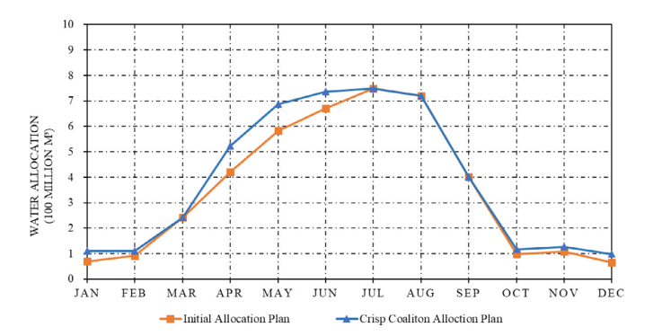
Case Study
Crisp coalition allocation method
Under the Lancang-Mekong Cooperation Framework, the monthly water resources allocated are equal to or higher than the initial allocation plan in Xishuangbanna Prefecture, especially in the peak season for rice planting from April to June each year.
Notes:
观察展示的产品K，客户根据多项logit (MNL)选择模型做出购买决策
在MNL模型下，拥有个人数据xt的客户概率选择产品i，其中0表示不购买任何东西的选项
其中参数θi对于i∈N为d维列向量，该列向量对公司先验未知，需要通过销售数据来学习。给定分类S，来自拥有信息xt的客户的期望收益是
由于不知道选择模型的先验参数，公司希望通过响应性决策在时间范围内最大化预期总回报(例如，点击率，收入
周期t的分类决策St与未来的个性化信息xs (s > t)之间没有依赖关系

Slide 26
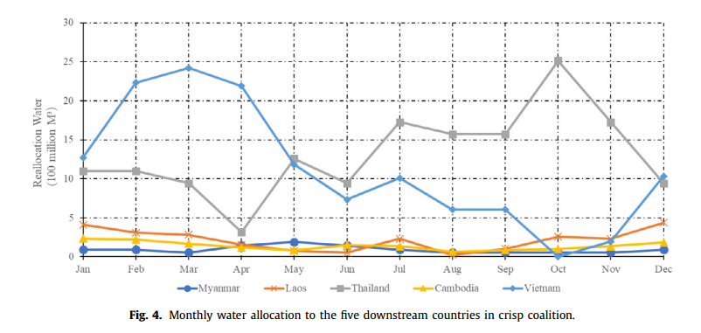
Case Study
Crisp coalition allocation method
Observation 1. Considering the differences in the geographical distribution and water usage utility under the Lancang-Mekong Cooperation Framework, compared with the initial allocation based on agricultural water demand, the crisp coalition can improve the overall utilization efficiency of water resources in the basin, and increase the water distribution in other countries with higher utility, except the water allocated to the estuary countries has decreased.
Notes:
观察展示的产品K，客户根据多项logit (MNL)选择模型做出购买决策
在MNL模型下，拥有个人数据xt的客户概率选择产品i，其中0表示不购买任何东西的选项
其中参数θi对于i∈N为d维列向量，该列向量对公司先验未知，需要通过销售数据来学习。给定分类S，来自拥有信息xt的客户的期望收益是
由于不知道选择模型的先验参数，公司希望通过响应性决策在时间范围内最大化预期总回报(例如，点击率，收入
周期t的分类决策St与未来的个性化信息xs (s > t)之间没有依赖关系

Slide 27
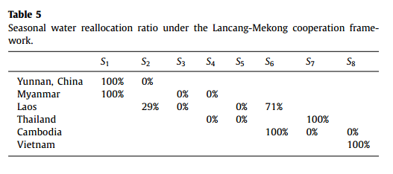
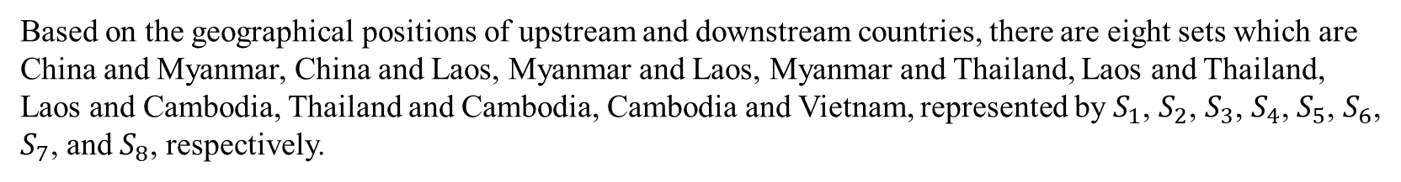
Case Study
Fuzzy coalition allocation method
Fuzzy coalition allocation method considered the seasonal allocation of water resources will help to further improve the water use utility of the entire basin.
Based on the geographical positions of upstream and downstream countries, there are eight sets which are China and Myanmar, China and Laos, Myanmar and Laos, Myanmar and Thailand, Laos and Thailand, Laos and Cambodia, Thailand and Cambodia, Cambodia and Vietnam, represented by $S_{1}$, $S_{2}$, $S_{3}$, $S_{4}$, $S_{5}$, $S_{6}$, $S_{7}$, and $S_{8}$, respectively.
In addition, the cooperation of three countries, with two of whom sharing the same river as their boundary river can be regarded as a whole, is still considered as the cooperation of two members.
Thailand, Cambodia and Vietnam have large agricultural water demand. Therefore, other upstream countries need to distribute the water resources in the dry season to improve the water use.
Notes:
观察展示的产品K，客户根据多项logit (MNL)选择模型做出购买决策
在MNL模型下，拥有个人数据xt的客户概率选择产品i，其中0表示不购买任何东西的选项
其中参数θi对于i∈N为d维列向量，该列向量对公司先验未知，需要通过销售数据来学习。给定分类S，来自拥有信息xt的客户的期望收益是
由于不知道选择模型的先验参数，公司希望通过响应性决策在时间范围内最大化预期总回报(例如，点击率，收入
周期t的分类决策St与未来的个性化信息xs (s > t)之间没有依赖关系

Slide 28
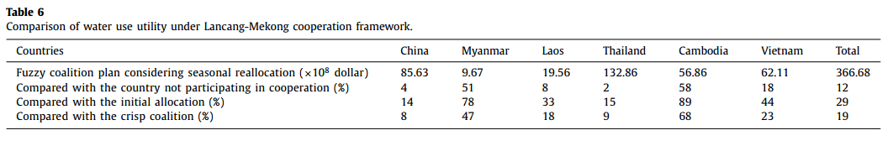
Case Study
Fuzzy coalition allocation method
We can obtain the optimal allocation scheme of water resource utilization in the basin according to the calculation results from Eq. (8)
Observation 2. The basin countries form a fuzzy coalition to achieve seasonal regulation of water resources under the Lancang-Mekong Cooperation Framework, which will improve the net utility of water resource utilization in the whole basin and each country. It is the optimal allocation of water resources among three alternative allocation models.
Observation 3. In the Lancang-Mekong Cooperation Framework, the upstream countries need to transfer some water rights and interests to the downstream countries in certain seasons.
Notes:
观察展示的产品K，客户根据多项logit (MNL)选择模型做出购买决策
在MNL模型下，拥有个人数据xt的客户概率选择产品i，其中0表示不购买任何东西的选项
其中参数θi对于i∈N为d维列向量，该列向量对公司先验未知，需要通过销售数据来学习。给定分类S，来自拥有信息xt的客户的期望收益是
由于不知道选择模型的先验参数，公司希望通过响应性决策在时间范围内最大化预期总回报(例如，点击率，收入
周期t的分类决策St与未来的个性化信息xs (s > t)之间没有依赖关系

Slide 29
Conclusion
Main work
This paper considers the spatial and temporal characteristics of the water resource allocation based on the framework of multinational basin cooperation, and then proposes the optimal allocation of water resources in transnational basins using a fuzzy coalition game. This method realizes the maximum utility of the water resource utilization in the basin.
Initial water resource allocation model
Crisp coalition allocation model
Fuzzy coalition reallocation model
Future research
The limitation of the Shapley value
This paper only considers agricultural water and neglects other utilizations of water resources, such as shipping and electricity generation.
The mechanism design about compensation and the specific regional cooperative process are not taken into account in this paper
Notes:
对这一结果的直觉是，当公司的平均质量（相对于外部选项）较低时，客户已经不太可能购买公司的服务；因此，有偏见的信念对公司收入的边际影响很低。然而，当公司的平均质量（相对于外部选项）较高时，公司的质量可变性带来的潜在收入损失也很高

Slide 30
Recent work and Future plan
Recent work
Learning the background of water resources management research
Read relevant literature and summarize methods and shortcomings
Graduation design openings based on the water resources management
Future plan
Based on the graduation design, read the literature related to water value measurement
Learning the common underlying methods of water value measurement studies
Thinking about a more pluralistic and stable value evaluation system from a statistical point of view
Collect basic ecological and economic data on Chaohu
Notes:
对这一结果的直觉是，当公司的平均质量（相对于外部选项）较低时，客户已经不太可能购买公司的服务；因此，有偏见的信念对公司收入的边际影响很低。然而，当公司的平均质量（相对于外部选项）较高时，公司的质量可变性带来的潜在收入损失也很高

Slide 31
Thanks for your listening!
汇报人：李昊洋
2023.11.02

