Slide 1


On the Importance of Delexicalization for Fact Verification
Sandeep Suntwal, Mithun Paul, Rebecca Sharp, Mihai Surdeanu
EMNLP, November 6, 2018

Slide 2
Background
Fake news detection/fact verification has emerged as a critical task with important societal implications
Formalized in several datasets in our community
Fever (Thorne et al., 2018)
Fake news challenge (FNC) (Pomerleau and Rao, 2017)

Slide 3
Example
Claim | Evidence | Label
Ben Stiller is a member of the Frat Pack | Stiller is a member of a group of comedic actors colloquially known as the Frat Pack . | Agree? Disagree? Not Enough Info?

Slide 4
Example
Claim | Evidence | Label
Ben Stiller is a member of the Frat Pack | Stiller is a member of a group of comedic actors colloquially known as the Frat Pack . | Agree! Disagree? Not Enough Info?

Slide 5
Motivation
Fact verification has been modeled as textual entailment + deep learning with excellent performance
However…

Slide 6
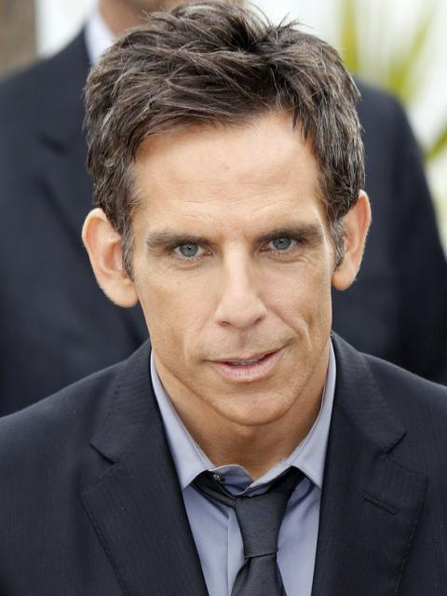
The “Ben Stiller Effect”
The occurrence of the name Ben Stiller is associated with the Agree label in more than 70% of its training instances in the FEVER training dataset!

Slide 7
More examples of the “Ben Stiller Effect”
Phrase | Supports Label | Refutes Label
Ben Stiller | 74% | 26%
Israeli-American | 100% | 0%
American Author | 91% | 3%
Examples from the Fever training dataset

Slide 8
More examples of the “Ben Stiller Effect”
Phrase | Supports Label | Refutes Label
Ben Stiller | 74% | 26%
Israeli-American | 100% | 0%
American Author | 91% | 3%
Examples from the Fever training dataset
What this means is that a fact verification method may overfit simply by looking at the claim!

Slide 9
Key question
How do we mitigate this overfitting?

Slide 10
Key intuition
We want to semantically lift the text away from lexicalized information
To reduce overfitting
To preserve as much of the text semantics as possible

Slide 11
Knowledge distillation
Our approach can be seen as a form of knowledge distillation (Hinton et al., 2015) applied a priori on the data, rather than post hoc on the model

Slide 12
Setup
We aligned the labels between the two datasets (see paper)
Used Decomposable Attention to train our textual entailment models (Parikh et al., 2016)
Trained and tested in both directions (next slide)
Official FNC and FEVER scripts were used for evaluations in each domain

Slide 13
Setup
FNC
Train
FNC
Test
FNC Model
(DA)
Train
Evaluate
Evaluate
Evaluate
Fever
Train
Fever
Test
Fever Model
(DA)
Train
Evaluate

Slide 14
Setup
FNC
Train
FNC
Test
FNC Model
(DA)
Train
Evaluate
Evaluate
Evaluate
Fever
Train
Fever
Test
Fever Model
(DA)
Train
Evaluate

Slide 15
Lexicalized baseline
Method: no change!
 | Claim | Evidence
Original | With Singapore Airlines, the Airbus A380 entered commercial service | The A380 made its first flight on 27 April 2005 and entered commercial service on 25 October 2007 with Singapore Airlines.
Transformed | With Singapore Airlines, the Airbus A380 entered commercial service | The A380 made its first flight on 27 April 2005 and entered commercial service on 25 October 2007 with Singapore Airlines.

Slide 16
Deletion baseline
Method: remove named entities
 | Claim | Evidence
Original | With Singapore Airlines, the Airbus A380 entered commercial service | The A380 made its first flight on 27 April 2005 and entered commercial service on 25 October 2007 with Singapore Airlines.
Transformed | With, the entered commercial service | The A380 made its flight on and entered commercial service on with.

Slide 17
Masking method: basic NER
Method: replace named entities with their class
 | Claim | Evidence
Original | With Singapore Airlines, the Airbus A380 entered commercial service | The A380 made its first flight on 27 April 2005 and entered commercial service on 25 October 2007 with Singapore Airlines.
Transformed | With organization, the miscellaneous entered commercial service | The A380 made its ordinal flight on date and entered commercial service on date with organization.

Slide 18
Masking method: overlap-aware NER
Method: replace named entities with their class, but use ids to track overlap between entities in claim and evidence
 | Claim | Evidence
Original | With Singapore Airlines, the Airbus A380 entered commercial service | The A380 made its first flight on 27 April 2005 and entered commercial service on 25 October 2007 with Singapore Airlines.
Transformed | With organization-c1, the misc-c1 entered commercial service | The A380 made its ordinal-e1 flight on date-e1 and entered commercial service on date-e2 with organization-c1.
Initial embeddings for new tokens (i.e., organization-c1) were created by perturbing pre-trained embeddings for the base entity (organization)

Slide 19
Masking method: overlap-aware NER + super sense tags
Method: replace named entities with their super sense class (Ciaramita and Johnson, 2003); use ids to track overlap between entities in claim and evidence; replace words with super sense tags when available
 | Claim | Evidence
Original | With Singapore Airlines, the Airbus A380 entered commercial service | The A380 made its first flight on 27 April 2005 and entered commercial service on 25 October 2007 with Singapore Airlines.
Transformed | With organization-c1, the artificat-c1 motion-c1 commercial act-c1 | The A380 stative its ordinal-e1 cognition-e1 on date-e1 and motion-c1 commercial act-c1 on date-e2 with organization-c1.

Slide 20
Results

Slide 21
In-domain and cross-domain results
In-domain
Cross-domain

Slide 22
In-domain and cross-domain results
In-domain
Cross-domain
Lexicalized models do not transfer well

Slide 23
In-domain and cross-domain results
In-domain
Cross-domain

Slide 24
In-domain and cross-domain results
In-domain
Cross-domain
Overlap aware methods outperform

Slide 25
In-domain and cross-domain results
In-domain
Cross-domain

Slide 26
Discussion: Delexicalization learns and preserves
Claim | Evidence | Actual Label | Predicted Label | Key Evidence Words
DodgeBall : A True Underdog Story has Vince Vaughn and Ben Stiller in starring roles . | DodgeBall : A True Underdog Story is a 2004 American sports comedy film written and directed by Rawson Marshall Thurber and starring Vince Vaughn and Ben Stiller . | Agree | Agree | "True", "Stiller", "DodgeBall"
 |  | Agree | Agree | "True", "Underdog", "PERSONc1"

Slide 27
Discussion: Delexicalization learns and improves
Claim | Evidence | Actual Label | Predicted Label | Key Evidence Words
DodgeBall : A True Underdog Story was unable to feature scenes with Vince Vaughn and Ben Stiller . | DodgeBall : A True Underdog Story is a 2004 American sports comedy film written and directed by Rawson Marshall Thurber and starring Vince Vaughn and Ben Stiller . | Disagree | Agree | "True", ".", "Stiller"
 |  | Disagree | Disagree | "True", "is", "Underdog“ (Stiller does not receive a high attention score)

Slide 28
Conclusions
Investigated the importance NNs place on lexical items in textual entailment task
Proposed several strategies for semantically masking word classes
Replaced named entities with their class
Generalized nouns and verbs to more abstract WordNet concepts
Kept track of repeated concepts in claim and evidence
Outperformed fully-lexicalized models by over 10% accuracy when evaluated out of domain

Slide 29
Thank you!
Data and code
https://github.com/clulab/releases/tree/master/emnlp2019-masking
Emails
{sandeepsuntwal, mithunpaul, bsharp, msurdeanu} @email.arizona.edu
This work was supported by DARPA and the Bill and Melinda Gates Foundation

Slide 30
Acknowledgements
This work was supported by the Defense Advanced Research Projects Agency (DARPA) under the World Modelers program, grant number W911NF1810014, and by the Bill and Melinda Gates Foundation HBGDki Initiative.
Mihai Surdeanu declares a financial interest in lum.ai. This interest has been properly disclosed to the University of Arizona Institutional Review Committee and is managed in accordance with its conflict of interest policies.

Slide 31
Appendix

Slide 32
Intuition
The model will overfit on “Ben Stiller effect” phrases
To find them:
Train on domain 1; test on domain 2 (cross domain)
Train on domain 2; test on domain 2 (in domain)
Overfitted words: receive high attention scores when the cross-domain model makes an incorrect prediction, and low attention scores when the in-domain model yields the correct prediction

Slide 33
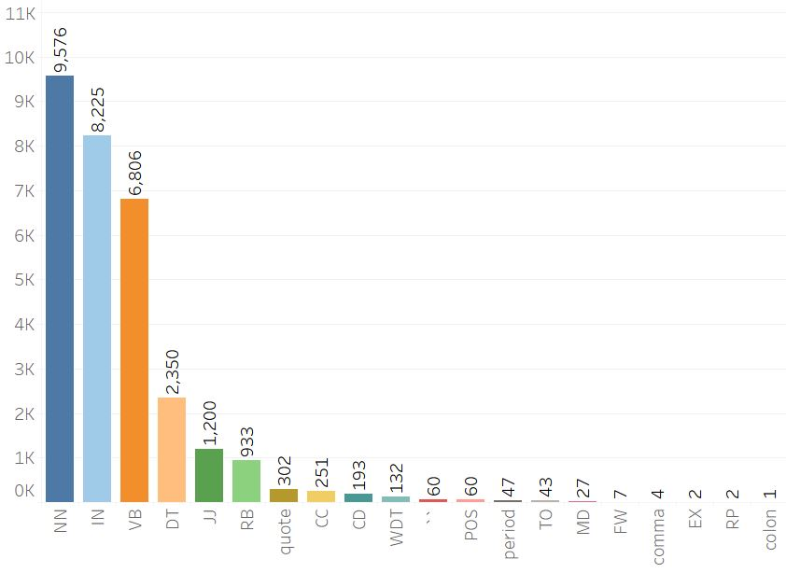
Error analysis

Slide 34
Setup
We used two domains: Fever and FNC
Labels between the two domains were aligned as shown:
Label | Datasets
 | FEVER | FNC
Entailment label | Supports | Agree
Contradiction Label | Refutes | Disagree
Neutral Label | Not Enough Info (KNN) | Discuss
 | Not Enough Info (Random) | Unrelated

Slide 35
Discussion: Cross-domain improvement example
Transformation Type | Claim | Evidence | Actual Label | Predicted Label | Key Evidence Words
Lex | Bieber ringtone scares bear , saves man 's life | A man was saved from a vicious bear attack thanks to his Justin Bieber ringtone … | Agree | Disagree | ["Bieber", "MAN", "man"]
OA | PERSONc1 ringtone scares bear , saves man 's life | A man was saved from a vicious bear attack thanks to his PERSONc1 ringtone … | Agree | Agree | ["but", "PERSONc1", "MAN"]

Slide 36
References
Ankur P Parikh, Oscar Tackstrom, Dipanjan Das, and Jakob Uszkoreit. 2016. A decomposable attention model for natural language inference. arXiv preprint arXiv:1606.01933.
Ciaramita, M., & Johnson, M. (2003, July). Supersense tagging of unknown nouns in WordNet. In Proceedings of the 2003 conference on Empirical methods in natural language processing (pp. 168-175). Association for Computational Linguistics.
Hinton, G., Vinyals, O., & Dean, J. (2015). Distilling the knowledge in a neural network. arXiv preprint arXiv:1503.02531.
James Thorne, Andreas Vlachos, Christos Christodoulopoulos, and Arpit Mittal. 2018. Fever: a large-scale dataset for fact extraction and verification. arXiv preprint arXiv:1803.05355.
Pomerleau, D., & Rao, D. (2016). Fake news challenge stage 1 (FNC-I): Stance detection.

