Slide 1
Event Extraction Using Distant Supervision
Kevin Reschke, Martin Jankowiak, Mihai Surdeanu, Christopher D. Manning, Daniel Jurafsky
30 May 2014
Language Resources and Evaluation Conference
Reykjavik, Iceland

Slide 2
Overview
Problem: Information extraction systems require lots of training data. Human annotation is expensive and does not scale.
Distant supervision: Generate training data automatically by aligning existing knowledge bases with text.
Approach shown for relation extraction: Minz et al. 2009 (ACL); Surdeanu et al. 2012 (EMNLP).
Goal: Adapt distant supervision to event extraction.

Slide 3
Outline
Present new dataset and extraction task.
Describe distant supervision framework.
Evaluate several models within this framework.

Slide 4
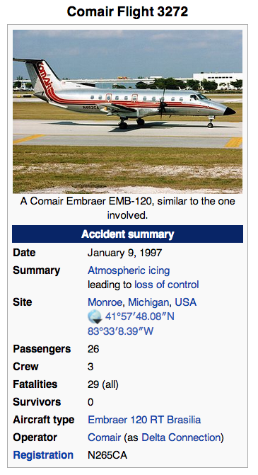
Plane Crash Dataset
80 plane crash events from Wikipedia infoboxes (40 train / 40 test).
Newswire corpus from 1988 to present (Tipster/Gigaword).
Download: http://nlp.stanford.edu/projects/dist-sup-event-extraction.shtml

Slide 5
Template-Based Event Extraction
…
<Plane Crash>
<Flight Number = Flight 14>
<Operator = Delta>
<Fatalities = 40>
<Crash Site = Mississippi>
…
“… Delta Flight 14
crashed in Mississippi
killing 40 …”
News Corpus
Knowledge Base

Slide 6
Distant Supervision (Relation Extraction)
Noisy Labeling Rule: If slot value and entity name appear together in a sentence, then assume that sentence encodes the relation.
Apple co-founder Steve Jobs passed away in 2011.
founder
Training Fact:
Entity: Apple
founder = Steve Jobs
Noise!!!
Steve Jobs was fired from Apple in 1985.
founder

Slide 7
Distant Supervision (Event Extraction)
Sentence level labeling rule won’t work.
Many events lack proper names.
“The crash of USAir Flight 11”
Slots values occur separate from names.
The plane went down in central Texas.
10 died and 30 were injured in yesterday’s tragic incident.
Heuristic solution:
Document-level labeling rule.
Use Flight Number as proxy for event name.
Training Fact:
{<Flight Number = Flight 11>,
<CrashSite= Toronto>}
…Flight 11 crash Sunday…
…The plane went down in [Toronto]_{CrashSite}…

Slide 8
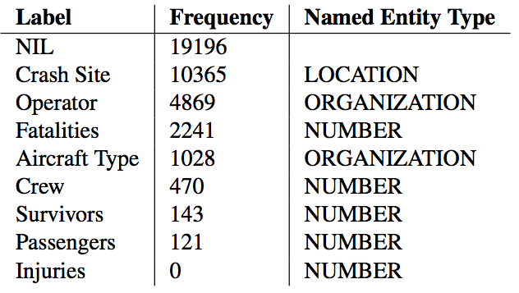
Automatic Labeling Results
38,000 Training Instances.
39% Noise:
Good: At least 52 people survived the crash of the Boeing 737.
Bad: First envisioned in 1964, the Boeing 737 entered service in 1968.

Slide 9
Model 1: Simple Local Classifier
Multiclass Logistic Regression
Features: unigrams, POS, NETypes, part of doc, dependencies
US Airways Flight 133 crashed in Toronto
LexIncEdge-prep_in-crash-VBD
UnLexIncEdge-prep_in-VBD
PREV_WORD-in
2ndPREV_WORD-crash
NEType-LOCATION
Sent-NEType-ORGANIZATION
etc.

Slide 10
Model 2: Sequence Model with Local Inference (SMLI)
Intuition: There are dependencies between labels.
Crew and Passenger go together:
4 crew and 200 passengers were on board.
Site often follows Site:
The plane crash landed in Beijing, China.
Fatalities never follows Fatalities
* 20 died and 30 were killed in last Wednesday’s crash.
Solution: A sequence model where previous non-NIL label is a feature.
At train time: use noisy “gold” labels.
At test time: use classifier output.

Slide 11
Motivating Joint Inference
Problem: Local sequence models propagate error.
20 dead, 15 injured in a USAirways Boeing 747 crash.
Gold: Fat. Inj. Oper. A.Type.
Pred: Fat. Surv. ?? ??

Slide 12
Motivating Joint Inference
Problem: Local sequence models propagate error.
20 dead, 15 injured in a USAirways Boeing 747 crash.
Gold: Fat. Inj. Oper. A.Type.
Pred: Fat. Surv. ?? ??
Gold: Fat. Fat. Oper. A.Type.
Pred: Fat. Inj. ?? ??

Slide 13
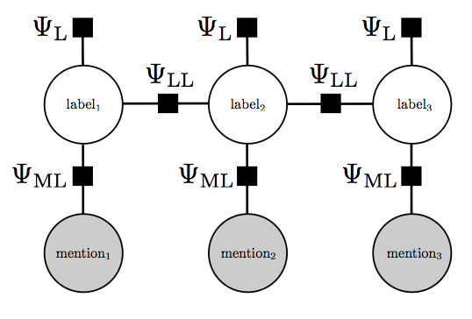
Model 3: Condition Random Fields (CRF)
Linear-chain CRF.
Algorithm: Laferty et al. (2001).
Software: Factorie. McCallum et al. (2009)
Jointly model all entity mentions in a sentence.

Slide 14
Model 4: Search-based structured prediction (Searn)
General framework for infusing global decisions into a structured prediction task (Daumé III, 2009).
We use Searn to implement a sequence tagger over a sentence’s entity mentions.
Searn’s “chicken and egg” problem:
Want to train an optimal classifier based on a set of global costs.
Want global costs to be computed from the decisions made by an optimal classifier.
Solution: Iterate!

Slide 15
A Searn iteration
Start with classifier H_{i}.
For each training mention:
Try all possible labels.
Based on label choice, predict remaining labels using H_{i}.
Compute global cost for each choice.
Use computed costs to train classifier H_{i+1}.
20 dead, 15 injured in a USAirways Boeing 747 crash.
Gold: Fat. Fat. Oper. A.Type
H_{i}: Fat.

Slide 16
A Searn iteration
Start with classifier H_{i}.
For each training mention:
Try all possible labels.
Based on label choice, predict remaining labels using H_{i}.
Compute global cost for each choice.
Use computed costs to train classifier H_{i+1}.
20 dead, 15 injured in a USAirways Boeing 747 crash.
Gold: Fat. Fat. Oper. A.Type
H_{i}: Fat. Fat.
Inj.
etc…

Slide 17
A Searn iteration
Start with classifier H_{i}.
For each training mention:
Try all possible labels.
Based on label choice, predict remaining labels using H_{i}.
Compute global cost for each choice.
Use computed costs to train classifier H_{i+1}.
20 dead, 15 injured in a USAirways Boeing 747 crash.
Gold: Fat. Fat. Oper. A.Type
H_{i}: Fat. Fat. NIL NIL
Inj. Oper. A. Type
etc…

Slide 18
A Searn iteration
Start with classifier H_{i}.
For each training mention:
Try all possible labels.
Based on label choice, predict remaining labels using H_{i}.
Compute global cost for each choice.
Use computed costs to train classifier H_{i+1}.
20 dead, 15 injured in a USAirways Boeing 747 crash.
Gold: Fat. Fat. Oper. A.Type
H_{i}: Fat. Fat. NIL NIL Cost: 2
Inj. Oper. A. Type Cost: 1
etc…

Slide 19
Evaluation
Task: Reconstruct knowledge base given just flight numbers.
Metric: Multiclass Precision and Recall
Precision: # correct (non-NIL) guesses / total (non-NIL) guesses
Recall: # slots correctly filled / # slots possibly filled
 | Precision | Recall | F-score
Maj. Class | 0.026 | 0.237 | 0.047
Local Model | 0.187 | 0.370 | 0.248
SMLI | 0.185 | 0.386 | 0.250
CRF Model | 0.159 | 0.425 | 0.232
Searn Model | 0.240 | 0.370 | 0.291

Slide 20
Feature Ablation
 | Precision | Recall | F-score
All features | 0.240 | 0.370 | 0.291
- location in document | 0.245 | 0.386 | 0.300
- syntactic dependencies | 0.240 | 0.330 | 0.278
- sentence context | 0.263 | 0.228 | 0.244
- local context | 0.066 | 0.063 | 0.064

Slide 21
Feature Ablation
 | Precision | Recall | F-score
All features | 0.240 | 0.370 | 0.291
- location in document | 0.245 | 0.386 | 0.300
- syntactic dependencies | 0.240 | 0.330 | 0.278
- sentence context | 0.263 | 0.228 | 0.244
- local context | 0.066 | 0.063 | 0.064

Slide 22
Feature Ablation
 | Precision | Recall | F-score
All features | 0.240 | 0.370 | 0.291
- location in document | 0.245 | 0.386 | 0.300
- syntactic dependencies | 0.240 | 0.330 | 0.278
- sentence context | 0.263 | 0.228 | 0.244
- local context | 0.066 | 0.063 | 0.064

Slide 23
Feature Ablation
 | Precision | Recall | F-score
All features | 0.240 | 0.370 | 0.291
- location in document | 0.245 | 0.386 | 0.300
- syntactic dependencies | 0.240 | 0.330 | 0.278
- sentence context | 0.263 | 0.228 | 0.244
- local context | 0.066 | 0.063 | 0.064

Slide 24
Summary
New plane crash dataset and evaluation task.
Distant supervision framework for event extraction.
Evaluate several models in this framework.

Slide 25
Thanks!

