Slide 1
On the Importance of Text Analysis for Stock Price Prediction
Heeyoung Lee (Stanford),
Mihai Surdeanu (University of Arizona),
Bill MacCartney (Google),
Dan Jurafsky (Stanford)

Slide 2
Motivation
Many people are interested in the financial market
A vast amount of text information online
Hard to monitor in real time for individual investors

Slide 3
Financial reports list events that impact company performance
“8-K” financial reports for companies
US companies required to file an 8-K upon events like layoffs, mergers, officer changes
On November 15, 2011, the Board of Directors (the “Board”) of Apple Inc. (the “Company”) appointed Robert A. Iger to the Board. Mr. Iger will serve on the Audit and Finance Committee of the Board.

Slide 4
The problem
Can we predict stock price movement after the 8-K report is released?
Since 8-K generally released after market close, can we predict what happens when market opens?
Modeled as a three-class classification problem:
UP: Δ > +1%,
DOWN: Δ < -1%,
STAY: -1% < Δ < +1%
Various controls and normalizations (normalize by change in S&P 500 index)

Slide 5
Our question: How is the text of 8-K reports linked with stock movements?
Does language in 8-K reports offer additional information?
What kind of information?
How long does the effect persist in the marketplace?

Slide 6
Related Work
Xie et al. (2013): Tree representations of information in news
Bollen et al. (2010): Twitter mood for market movement
Bar-Haim et al. (2011): Identifying better expert investors
Leinweber and Sisk (2011): Effect of news and the time needed to process the news in event-driven trading
Kogan et al. (2009): A method that predicts risk based on financial reports
Engelberg (2008): Linguistic information has more long-term predictability
Only few previous results show improvements from textual information on predicting the impact of financial events on top of quantitative features

Slide 7
Corpus
8-K financial reports for S&P 500 companies
Between 2002-2012 (2009-2010 dev, 2011-2012 test)
13,671 documents, 28M words
8-K reports are mostly released before the market open or after the market closed
Financial Annotations:
Daily history of stock prices
The (normalized) difference in the company’s stock price before and after the report is released
Earnings Per Share (EPS)
Reported EPS (from 8-K reports)
Consensus EPS (the estimation of analysts)

Slide 8
Baseline Financial Features
Earnings surprise | The gap between the actual and expected earnings per share
Recent stock price changes | 1 week, 1 month, 1 quarter, 1 year
Volatility S&P 500 index | roughly represents the expected movement of S&P 500 index over the following 30 days
Event category features | Event types in 8-K reports (merger, bankruptcy, …)

Slide 9
Linguistic Features
Unigram features
. . . On a GAAP basis, the Company reported a net loss of $356 million . . . We remain intensely focused on helping …
{loss:1, basis:1, remain:2 … }

Slide 10
Linguistic Features
Unigrams are too sparse!
Projected textual features into a smaller-dimension latent space by non-negative matrix factorization
Unigrams are projected into 50, 100, 200 dimension vectors
Benefits: captures latent meaning, faster training
{loss:1, basis:1, remain:2, dimension:0, clandestine:0, … }

Slide 11

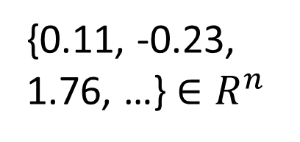
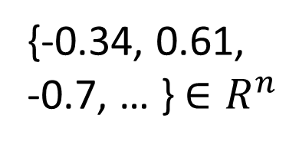

Linguistic Features
{loss:1, basis:1,
remain:2 … }
loss
basis
{1, 0, 0, …}
{0, 1, 0, …}
{1, 1, 2, …}
{0.11, -0.23,
1.76, …} $∈R^{n}$
{-0.34, 0.61,
-0.7, … } $∈R^{n}$
{0.2391, 0.7293,
-1.2301, … } $∈R^{n}$
$$n=50, 100, 200$$

Slide 12
Example
Visa inc 8-K report released after Oct 29 market close
Label: DOWN
Visa inc Δ
-0.2%
-1.2%
Normalized Δ
+1%
S&P 500 Δ
Oct 29 Close
Oct 30 Open
Oct 29 Close
Oct 30 Open

Slide 13
Example
Earnings surprise = (0.58-0.56)/0.56*100 = 3.57%
Event type: Results of Operations and Financial Condition
From 8-K report
. . . On a GAAP basis, the Company reported a net loss of $356 million . . . We remain intensely focused on helping …
Unigrams: {loss: 1, basis: 1, …}
NMF vectorized: {0.2391, 0.7293, -1.2301, … }

Slide 14
Classifier
Random forest with 2000 trees
Tuned on the development set (The size of random subset of features when training)
PMI based feature selection
Among top 5000 features, keep features occurred at least 10 times throughout the training data -> 2319 unigram features

Slide 15
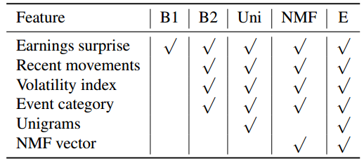
Five Models
Text projected
into latent space
Financial baseline 2
Explicit text
Everything (ensemble)
Financial baseline 1

Slide 16
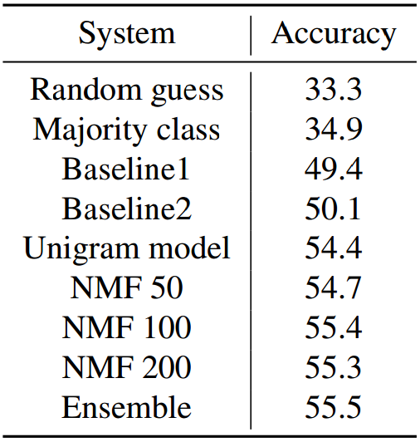
Results
Financial baseline 1: using only earnings surprise
Financial baseline 2: using numeric & event category features to see financial baseline
Ensemble: combined unigram and 3 NMF models

Slide 17
Temporal Aspect Model
Report release
After event
1-d open
2-d open
…
n-d open
Before event
(Close Price)
Investigates the predictive power of text as we move farther away from the event
Same as before, it predicts UP/DOWN/STAY

Slide 18
Results: Temporal Aspect Model
The effect of linguistic features diminishes quickly

Slide 19
Results: Temporal Aspect Model
Engelberg’s (2008):
Soft information (textual information) requires a higher processing cost and takes longer to affect the market

Slide 20
Results: Temporal Aspect Model
Why the opposite result?
Our data: company report (short term)
Their data: news article (longer term)
News articles reflect not only new information, but also the perspectives and opinions of third parties
Hypothesis: the market is highly sensitive to company reports in the short term, but more sensitive to third party perspectives in the longer term

Slide 21
Positive & Negative words from Unigrams
Positive: Increase, growth, new, strong, forward, well, grow, product, future, we
Negative: charge, loss, lower, decline, reduce, down, adjust, regulation, offset, reduction, while

Slide 22
Error Analysis
Correct label: DOWN
Unigram: DOWN, baseline2: UP
... despite lower than expected growth, the more rapid decline in demand for FedEx Express services, particularly from Asia, outpaced our ability to reduce operating costs. …
lower, decline, and reduce are in our top features

Slide 23
Error Analysis (2)
Correct label: DOWN
Unigram: STAY, baseline2: DOWN
"We are very pleased with our fourth quarter and full year results, as well as …
Unigram model incorrectly predicts STAY even though the company has unsatisfactory earnings per share

Slide 24
Example Decision Path
Earning surprise
Abbott Laboratories
Apr 15, 2009 report
True label: DOWN
Decision: DOWN
… This resulted in a $230 million decline in Depakote sales in the first quarter …
…
increase
decline
…
1 Quarter Δ
…
DOWN

Slide 25
Negative Results
Sentiment features
SentiWordNet: domain difference. e.g., growth is objective (or slightly negative)
Sentiment lexicons from Jegadeesh and Wu (2013): The list is small and 77% of lexicons are already in our feature set.
Bigrams and Word clustering features
Other classifiers (logistic regression or multilayer perceptron)

Slide 26
Limitations
Do not trade using this yet ☺
Predicts movement but not magnitude (how big the change will be)
It ignores several important real-world factors:
Transaction costs: bid-ask spreads
Slippage: the tendency of large trading programs to move the market
Borrowing costs for short positions
Does not parse numbers and their meaning

Slide 27
Conclusions
New corpus of 8-K financial reports, annotated with financial metrics
http://nlp.stanford.edu/pubs/stock-event.html
Text helps to predict stock price movement,
short-term movement is sensitive to events in company reports
longer-term movement may be sensitive to third-party perspectives in news
Domain is important when using sentiment lexicons
Using all unigrams was better than using published lexicons
Methodology
Dimensionality reduction of word vectors helps
Random forests worked well to combine lexical and numeric features

