Slide 1


It Takes Two Flints to Make a Fire: Multitask Learning of Neural Relation and Explanation Classifiers
Zheng Tang and Mihai Surdeanu
Computational Linguistics 1–40
EMNLP 2022

Slide 2

Most credit goes to Zheng
Zheng Tang

Slide 3
Accuracy

Slide 4
Neural networks
Accuracy
Rules, decision trees
Explainability

Slide 5
Explainability Is Important!
“Advances in machine learning (ML) techniques promise to produce AI systems that perceive, learn, decide, and act on their own. However, they will be unable to explain their decisions and actions to human users. This lack is especially important for the Department of Defense, whose challenges require developing more intelligent, autonomous, and symbiotic systems. Explainable AI will be essential if users are to understand, appropriately trust, and effectively manage these artificially intelligent partners.”
Dave Gunning, program manager for DARPA XAI
This of course applies to other domains: medical, legal, etc.

Slide 6
What directions are there for explainable AI?

Slide 7
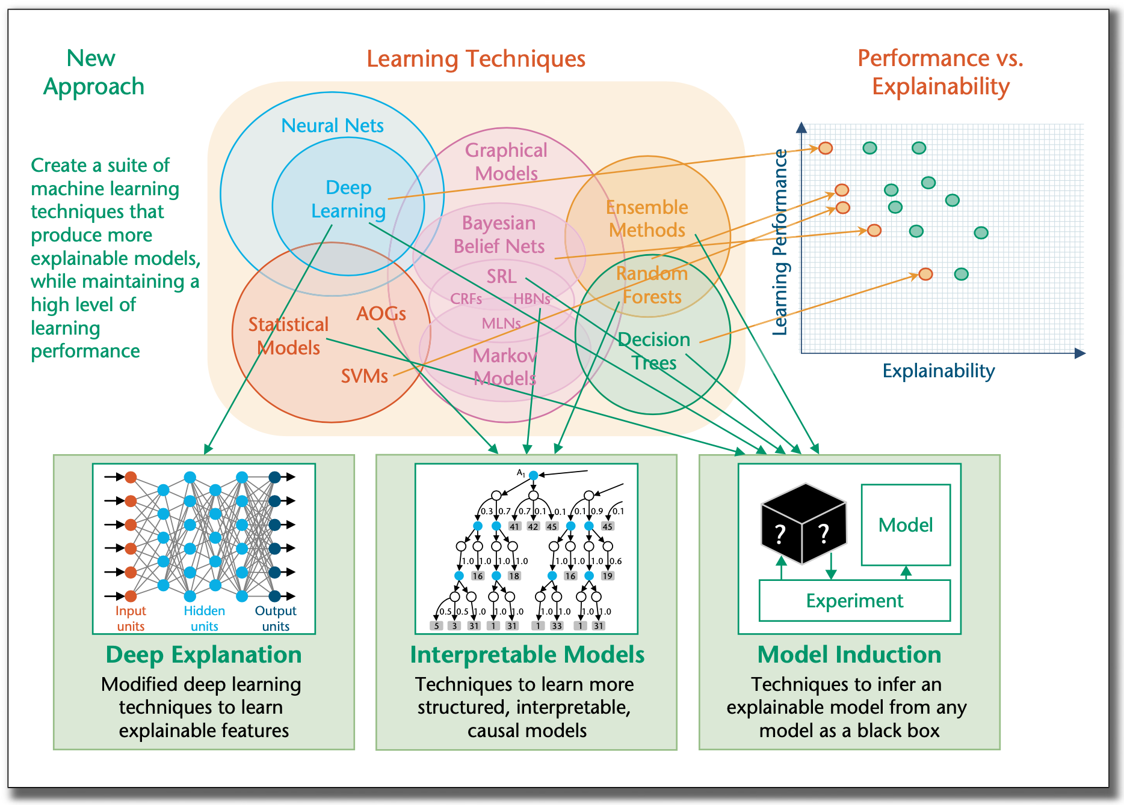
From (Gunning and Aha, 2019)

Slide 8
Learn how to classify and explain
From (Gunning and Aha, 2019)

Slide 9
Learn an explainable model directly
From (Gunning and Aha, 2019)

Slide 10
”Distill” a NN into an explainable model post hoc
From (Gunning and Aha, 2019)

Slide 11
This paper
Learn how to classify and explain
”Distill” a NN into an explainable model post hoc
From (Gunning and Aha, 2019)

Slide 12
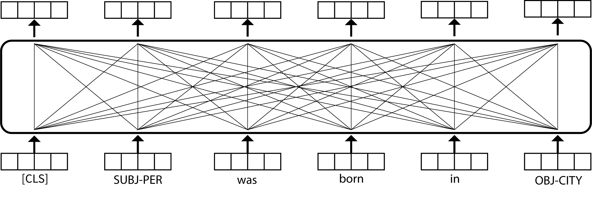
Intuition
These words explain the relation!

Slide 13
Intuition
per:city_of_birth
Aggregate just the important words!

Slide 14
Intuition
Two tasks trained jointly:
Find explanatory words
Classify the relation
per:city_of_birth

Slide 15
Problem 1: Supervision for Explainability
We have (some) annotations from rules
Surface rules (from the TACRED dataset creators)
SUBJ-PER * born in * OBJ-CITY

Slide 16
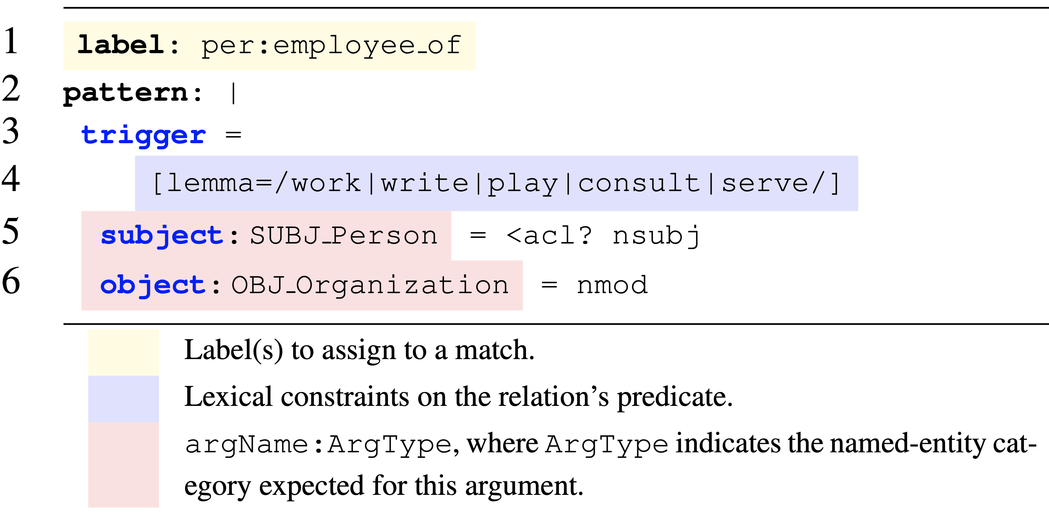
Problem 1: Supervision for Explainability
We have (some) annotations from rules
Syntactic rules (from us)

Slide 17
Problem 1: Supervision for Explainability
The rules cover 16% of the training examples in the TACRED dataset, and 23% of the development and test examples
Not that many: an average of 5 rules per relation type
This is a semi-supervised task!

Slide 18
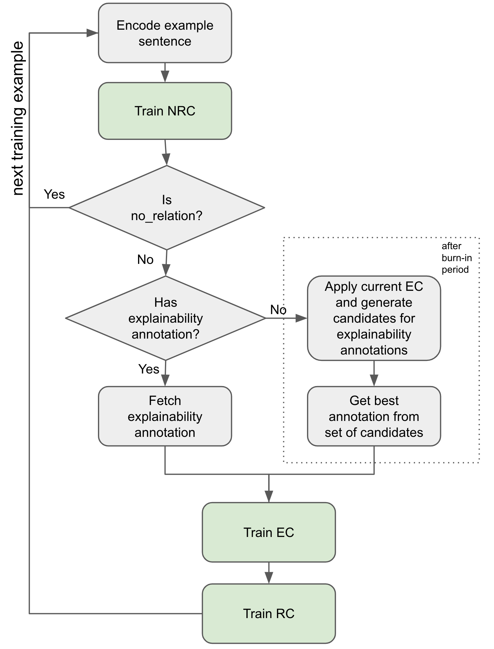
Problem 2: Semi-supervised Training
NRC: no-relation classifier
EC: explainability classifier
RC: relation classifier

Slide 19
Problem 2: Semi-supervised Training
NRC: no-relation classifier
EC: explainability classifier
RC: relation classifier
Burn-in period:
Train only on examples with supervision for explainability
Joint loss for EC + RC

Slide 20
Problem 2: Semi-supervised Training
NRC: no-relation classifier
EC: explainability classifier
RC: relation classifier
Semi-supervised training:
Generate a large number of possible explanations using the current model
Choose as pseudo-gold the explanation that maximizes the probability of the correct relation
Then use the same joint loss for EC + RC

Slide 21
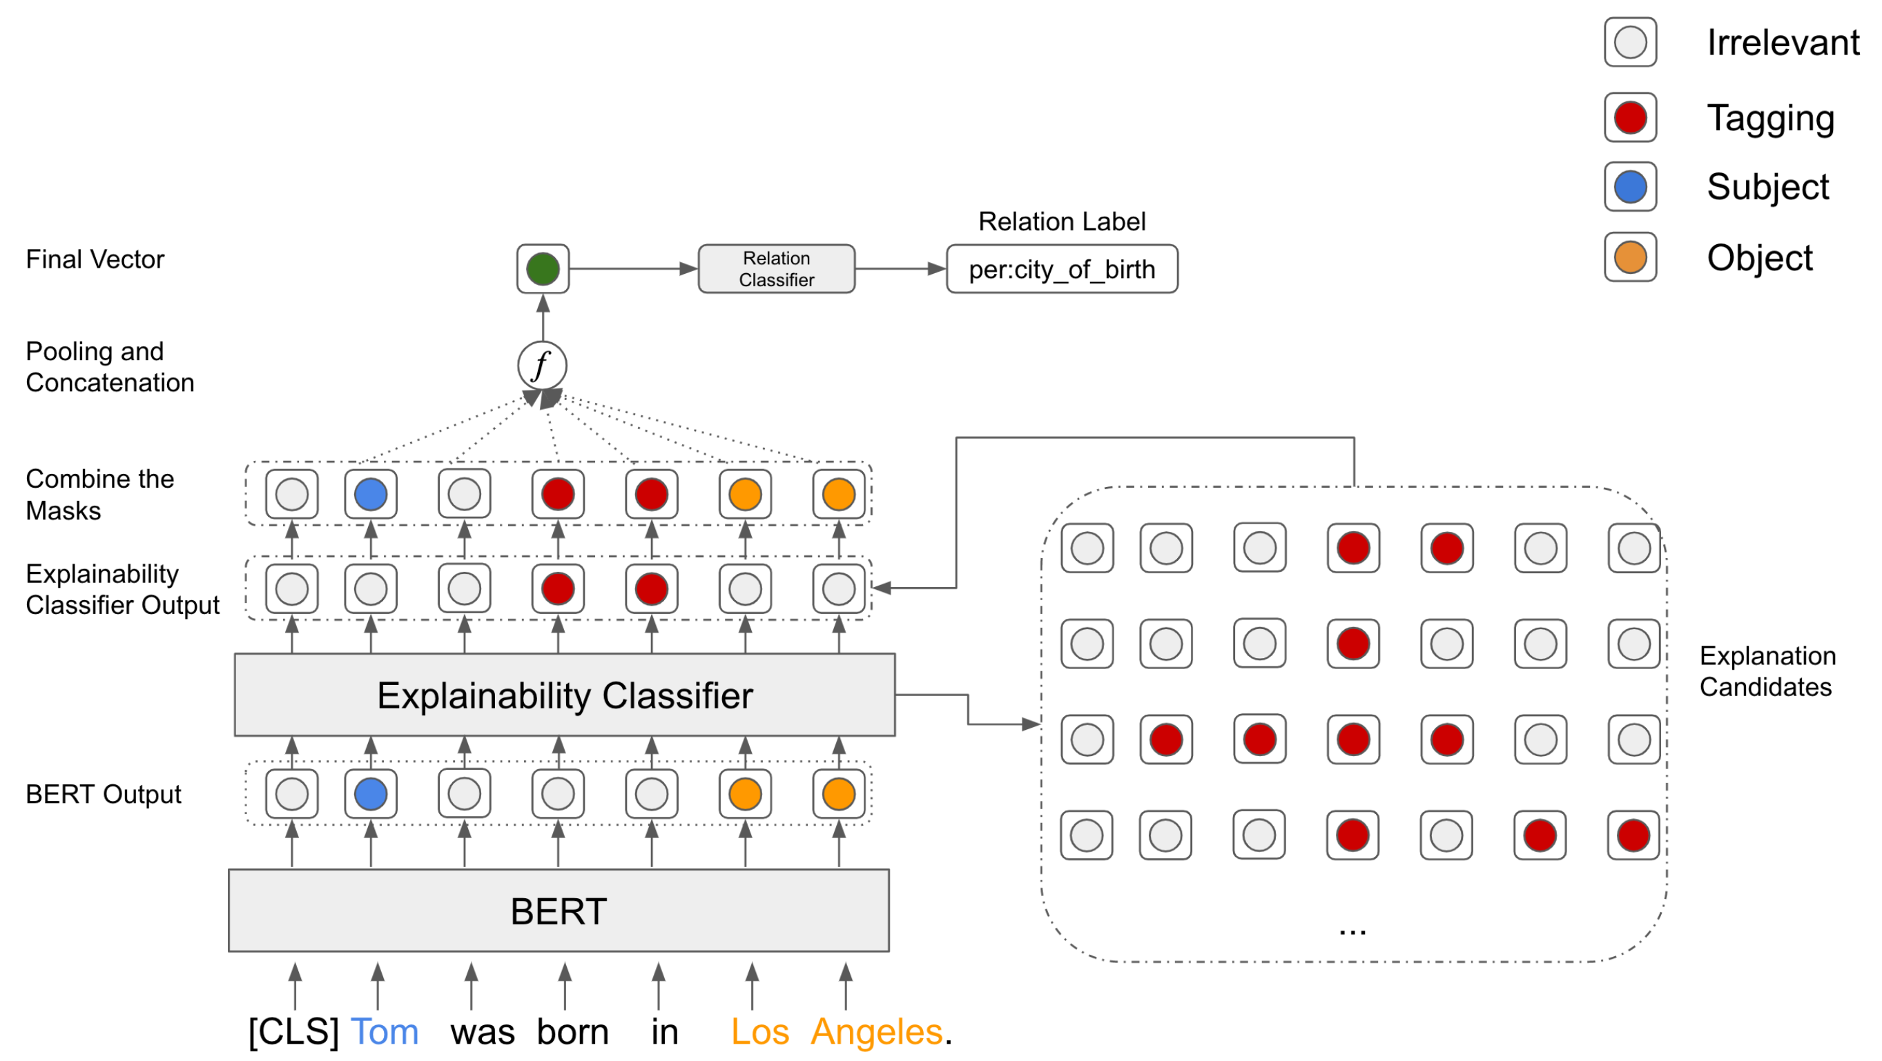
Architecture
SpanBERT
Some heuristics to reduce search space here!

Slide 22
Architecture
SpanBERT
Some heuristics to reduce search space here!

Slide 23
Architecture
SpanBERT
Some heuristics to reduce search space here!

Slide 24
Architecture
SpanBERT
Some heuristics to reduce search space here!

Slide 25
Architecture
SpanBERT
Some heuristics to reduce search space here!

Slide 26
How well does this work?

Slide 27
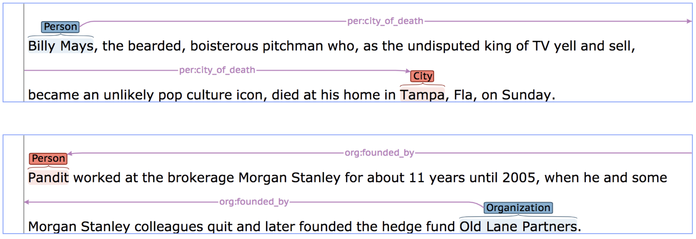
Task: Relation Extraction
Two datasets: TACRED and CoNLL04
From https://nlp.stanford.edu/projects/tacred/

Slide 28
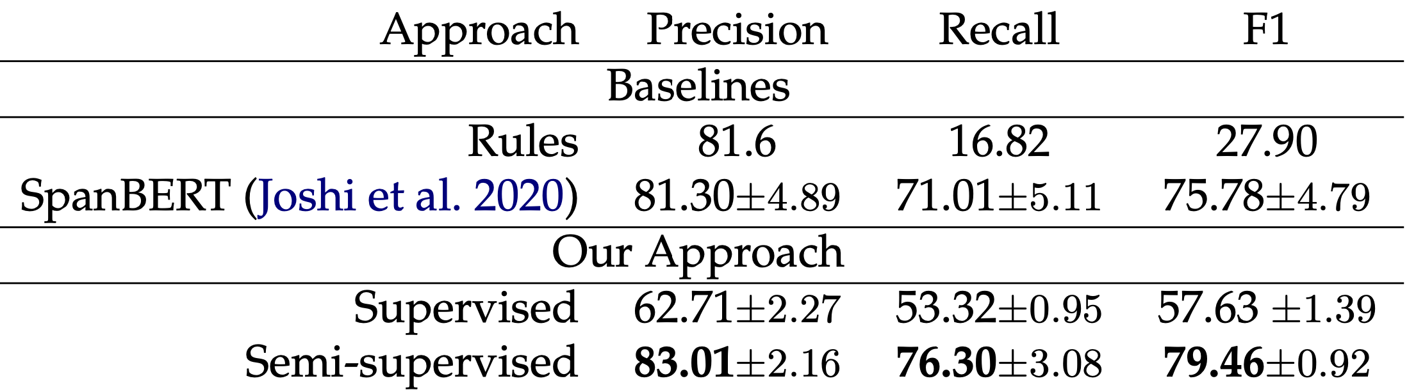
Relation Classification Performance (CoNLL04)

Slide 29
Relation Classification Performance (CoNLL04)
Our approach produces a significant improvement on the CoNLL04 dataset, where multiple relations tend to co-occur in the same sentence

Slide 30
But are our explanations better?

Slide 31
Explanation Classification Performance on TACRED (plausibility)
Two human domain experts annotated the minimal set of words necessary to explain the relation
Substitution heuristic
The annotators worked
Independently of each other, and
Without seeing the machine output
Kappa agreement = 70%

Slide 32
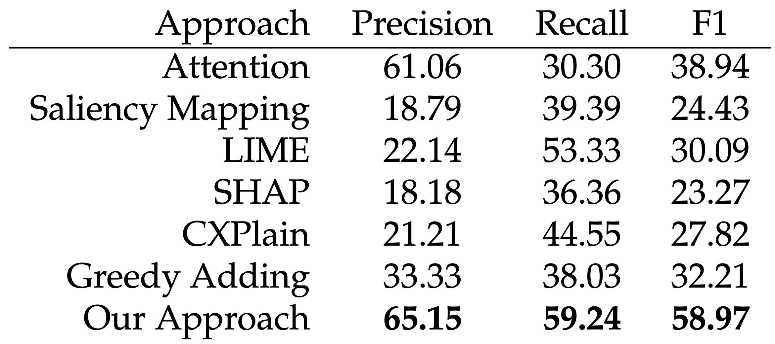
Explanation Classification Performance on TACRED (plausibility)
Much better plausibility according to two human annotators

Slide 33
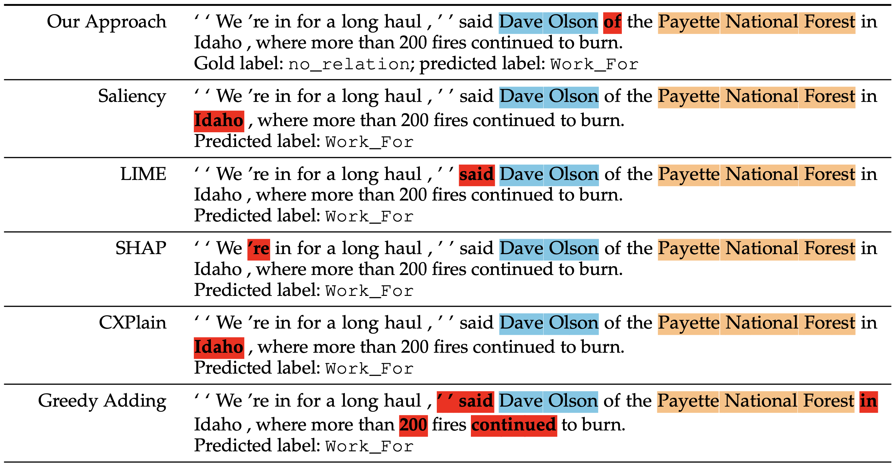
Example

Slide 34
Conclusions
Modeling explainability explicitly
Improves (or at least does not hurt) the performance of the downstream NLP task
And improves explainability considerably!
Linguistics (surface and syntactic rules) complements deep learning nicely!

Slide 35
Please Read The Paper for
Many more experiments
More analyses
Distilling the trained network back into rules

Slide 36
Takeaway
We can and should have both performance and explainability!
Accuracy
Explainability

Slide 37
Thank you!
Paper: https://direct.mit.edu/coli/article/doi/10.1162/coli_a_00463/113094/It-Takes-Two-Flints-to-Make-a-Fire-Multitask
Emails: msurdeanu@arizona.edu, zhengtang@arizona.edu
clulab.org

