Slide 1
TraCS: Trajectory Collection in Continuous Space under
Local Differential Privacy
Authors: Ye Zheng, Yidan Hu
Rochester Institute of Technology (RIT)

Slide 2





Trajectory Collection
Private trajectories
Mac Donald
Hospital
Starbucks
Park
w/ labels
w/o labels
Ye Zheng
TraCS: Trajectory Collection in Continuous Space under LDP
2

Slide 3

Trajectory Collection
Collecting private trajectories
Mac Donald
Third-party
trajectory/location
service provider
Hospital
Starbucks
Park
w/ labels
w/o labels
Ye Zheng
TraCS: Trajectory Collection in Continuous Space under LDP
3

Slide 4
Trajectory Collection
Collecting private trajectories
Mac Donald
Third-party
trajectory/location
service provider
Hospital
Untrusted
Even an adversary
Starbucks
I care about privacy
Park
w/ labels
w/o labels
Ye Zheng
TraCS: Trajectory Collection in Continuous Space under LDP
4

Slide 5



LDP-fy a Trajectory
LDP-fy: perturb a trajectory with LDP guarantee (provable privacy)
- cannot distinguish location $τ_{1}$ from $τ_{2}$ with confidence level $e^{ε}$
$$\frac{\operatorname{Pr}\left[ℳ\left(τ_{1}\right)=τ_{∗}\right]}{\operatorname{Pr}\left[ℳ\left(τ_{2}\right)=τ_{∗}\right]}≤e^{ε}$$
distinguish level
$$∀τ_{1},τ_{2},τ_{∗}∈𝒮:$$
location space
probability difference of outputting $τ_{∗}$
Ye Zheng
TraCS: Trajectory Collection in Continuous Space under LDP
5

Slide 6
LDP-fy a Trajectory
LDP-fy: perturb a trajectory with LDP guarantee (provable privacy)
- cannot distinguish location $τ_{1}$ from $τ_{2}$ with confidence level $e^{ε}$
$$\frac{\operatorname{Pr}\left[ℳ\left(τ_{1}\right)=τ_{∗}\right]}{\operatorname{Pr}\left[ℳ\left(τ_{2}\right)=τ_{∗}\right]}≤e^{ε}$$
distinguish level
$$∀τ_{1},τ_{2},τ_{∗}∈𝒮:$$
location space
probability difference of outputting $τ_{∗}$
We want: $ℳ$ for continuous location space
- existing methods are all for discrete location space $→$ not always available
- continuous space $⊃$ discrete space $→$ can apply to discrete space
Ye Zheng
TraCS: Trajectory Collection in Continuous Space under LDP
6

Slide 7


Existing Methods
Location space $𝒮$ is a set of cells or points
$$𝒮=\{c_{1},…,c_{n}\}$$
$$𝒮=\{p_{1},…,p_{n}\}$$
Ye Zheng
TraCS: Trajectory Collection in Continuous Space under LDP
7

Slide 8


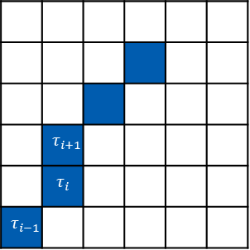
Existing Methods
Location space $𝒮$ is a set of cells or points
 | $$τ_{i+1}$$
 | $$τ_{i}$$
$$τ_{i−1}$$
$τ_{i}$
$τ_{i−1}$
$$𝒮=\{c_{1},…,c_{n}\}$$
$$𝒮=\{p_{1},…,p_{n}\}$$
Ye Zheng
TraCS: Trajectory Collection in Continuous Space under LDP
8

Slide 9
Existing Methods
Location space $𝒮$ is a set of cells or points
 | $$τ_{i+1}$$
 | $$τ_{i}$$
$$τ_{i−1}$$
$τ_{i}$
$τ_{i−1}$
$$𝒮=\{c_{1},…,c_{n}\}$$
$$𝒮=\{p_{1},…,p_{n}\}$$
Perturb each location $τ$ using the Exponential Mechanism
distance
$$\operatorname{Pr}{[ℳ_{exp}\left(τ\right)=τ^{∗}]}= \frac{\exp\left(kd\left(τ,τ^{∗}\right)\right)}{\sum_{τ^{′}∈S}{\exp\left(kd\left(τ,τ′ \right)\right)}}$$
sum of distance
Ye Zheng
TraCS: Trajectory Collection in Continuous Space under LDP
9

Slide 10


Existing Methods
Location space $𝒮$ is a set of cells or points
 | $$τ_{i+1}$$
 | $$τ_{i}$$
$$τ_{i−1}$$
Perturbed trajectory
(ensuring LDP)
$τ_{i}^{∗}$
$τ_{i−1}^{∗}$
$$𝒮=\{c_{1},…,c_{n}\}$$
$$𝒮=\{p_{1},…,p_{n}\}$$
Perturb each location $τ$ using the Exponential Mechanism
distance
$$\operatorname{Pr}{[ℳ_{exp}\left(τ\right)=τ^{∗}]}= \frac{\exp\left(kd\left(τ,τ^{∗}\right)\right)}{\sum_{τ^{′}∈S}{\exp\left(kd\left(τ,τ′ \right)\right)}}$$
sum of distance
Ye Zheng
TraCS: Trajectory Collection in Continuous Space under LDP
10

Slide 11



Existing Methods
NGram [2021]: reachability constraint from public knowledge
- e.g. distance reachability
- the next location cannot be too far
- $ℳ_{exp}\left(τ\right)$ on reduced $𝒮$
$τ_{i}$
$d\left(τ_{i+1},τ_{i}\right)≤θ$
Ye Zheng
TraCS: Trajectory Collection in Continuous Space under LDP
11

Slide 12



Existing Methods
NGram [2021]: reachability constraint from public knowledge
- e.g. distance reachability
- the next location cannot be too far
- $ℳ_{exp}\left(τ\right)$ on reduced $𝒮$
ATP [2023]: direction perturbation
$τ_{i+2}$
$τ_{i+1}$
$τ_{i}$
private directions
Ye Zheng
TraCS: Trajectory Collection in Continuous Space under LDP
12

Slide 13

Existing Methods
NGram [2021]: reachability constraint from public knowledge
- e.g. distance reachability
- the next location cannot be too far
- $ℳ_{exp}\left(τ\right)$ on reduced $𝒮$
ATP [2023]: direction perturbation
- i. divide direction sectors, e.g. $k=4$
$τ_{i+2}$
$τ_{i}$
private sector
Ye Zheng
TraCS: Trajectory Collection in Continuous Space under LDP
13

Slide 14


Existing Methods
NGram [2021]: reachability constraint from public knowledge
- e.g. distance reachability
- the next location cannot be too far
- $ℳ_{exp}\left(τ\right)$ on reduced $𝒮$
ATP [2023]: direction perturbation
- i. divide direction sectors, e.g. $k=4$
$τ_{i+2}$
- ii. perturb sector
- iii. $ℳ_{exp}\left(τ\right)$ on reduced $𝒮$
$τ_{i}$
reduced $𝒮$
Ye Zheng
TraCS: Trajectory Collection in Continuous Space under LDP
14

Slide 15
Existing Methods: Weaknesses
Privacy: only for discrete space
NGram [2021]: reachability constraint from public knowledge
- indistinguishability for finite # locations/cells/sectors (weak privacy)
- e.g. distance reachability
- the next location cannot be too far
Utility: relies on the Exponential Mechanism
- $ℳ_{exp}\left(τ\right)$ on reduced $𝒮$
- efficacy depends on # locations/cells/sectors
- high time complexity (in computing and sampling)
ATP [2023]: direction perturbation
- discrete locations not always available
- i. divide direction sectors, e.g. $k=4$
$τ_{i+2}$
- ii. perturb sector
- iii. $ℳ_{exp}\left(τ\right)$ on reduced $𝒮$
$τ_{i}$
reduced $𝒮$
Ye Zheng
TraCS: Trajectory Collection in Continuous Space under LDP
15

Slide 16
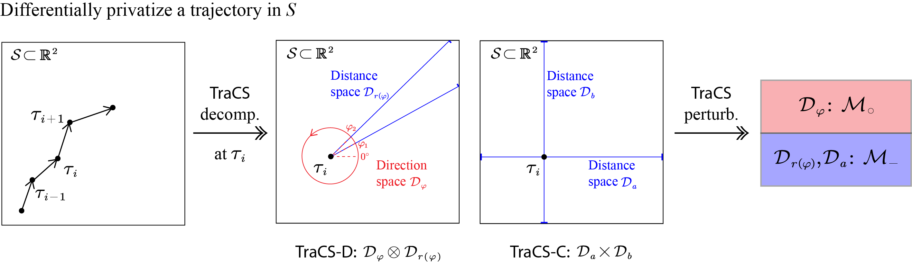
This Paper: Continuous Space
TraCS-D: direction-distance perturbation
TraCS-C: coordinates perturbation
Key idea: decomposes $𝒮$ into two subspaces
Ye Zheng
TraCS: Trajectory Collection in Continuous Space under LDP
16

Slide 17
This Paper: Continuous Space
TraCS-D: direction-distance perturbation
TraCS-C: coordinates perturbation
Key idea: decomposes $𝒮$ into two subspaces $→$ design $ℳ$ for each subspace
Ye Zheng
TraCS: Trajectory Collection in Continuous Space under LDP
17

Slide 18
Decomposition of Continuous Space
$𝒮=𝒟_{φ}⊗𝒟_{r(φ)}$
2D space
1D subspaces
Each location $τ_{i+1}∈𝒮$ has a unique representation $(φ, r(φ))$
Perturb $φ$ and $r(φ)$ using 1D mechanisms
Ye Zheng
TraCS: Trajectory Collection in Continuous Space under LDP
18

Slide 19
Decomposition of Continuous Space
$𝒮=𝒟_{φ}⊗𝒟_{r(φ)}$
2D space
1D subspaces
Each location $τ_{i+1}∈𝒮$ has a unique representation $(φ, r(φ))$
Perturb $φ$ and $r(φ)$ using 1D mechanisms
$𝒮=𝒟_{a}×𝒟_{b}$
Each location $τ_{i+1}∈𝒮$ has a unique representation $(a, b)$
Perturb $a$ and $b$ using 1D mechanisms
Ye Zheng
TraCS: Trajectory Collection in Continuous Space under LDP
19

Slide 20

$ℳ$ for Continuous Space
Q: How to design LDP mechanisms for:
- circular space $\left[0,2π\right)→\left[0,2π\right)$? linear space $\left[a_{sta},a_{end}\right)→\left[a_{sta},a_{end}\right)$?
Ye Zheng
TraCS: Trajectory Collection in Continuous Space under LDP
20

Slide 21
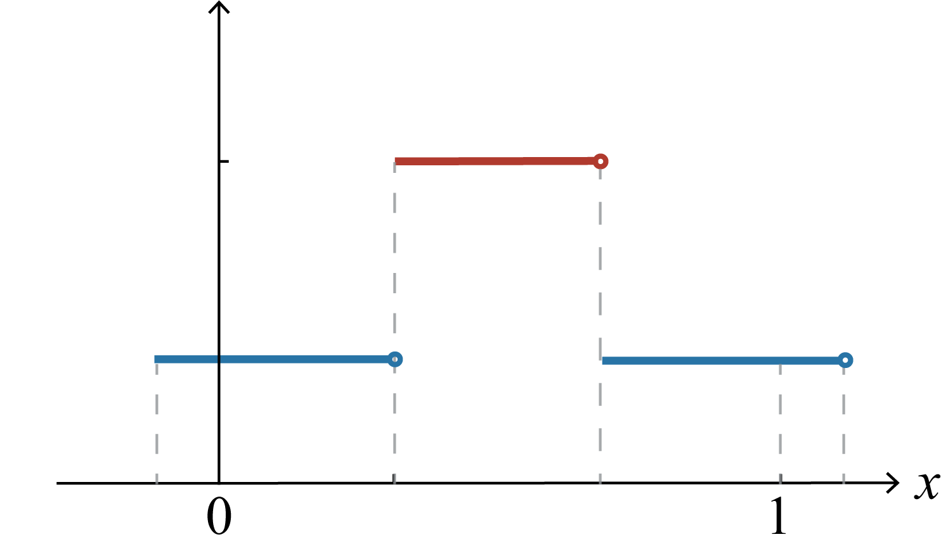
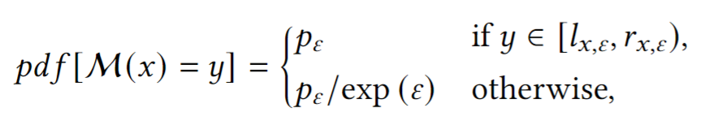


$ℳ$ for Continuous Space
Q: How to design LDP mechanisms for:
- circular space $\left[0,2π\right)→\left[0,2π\right)$? linear space $\left[a_{sta},a_{end}\right)→\left[a_{sta},a_{end}\right)$?
S: Piecewise-based mechanism
- originally designed for mean * /distribution estimation**
$$pdf[ℳ(x)]$$
- ensure LDP for $\left[0,1\right)→[−C, C)$
Private $x=0.5$
* Collecting and Analyzing Multidimensional Data with Local Differential Privacy, ICDE 2019
** Estimating Numerical Distributions under Local Differential Privacy, SIGMOD 2020
Ye Zheng
TraCS: Trajectory Collection in Continuous Space under LDP
21

Slide 22
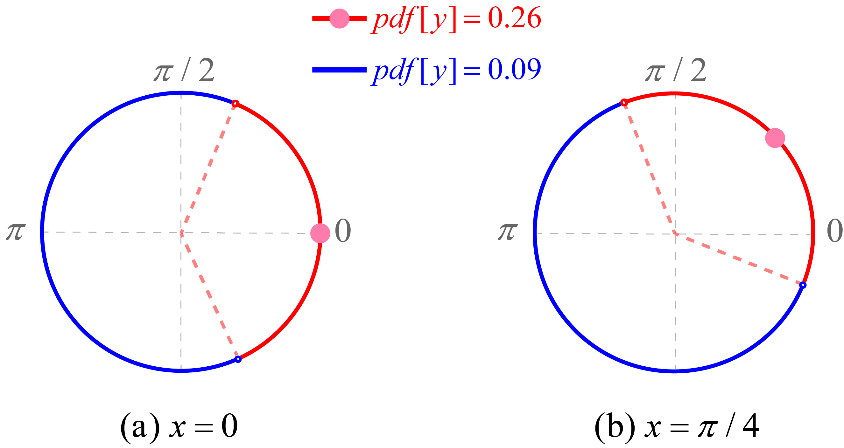
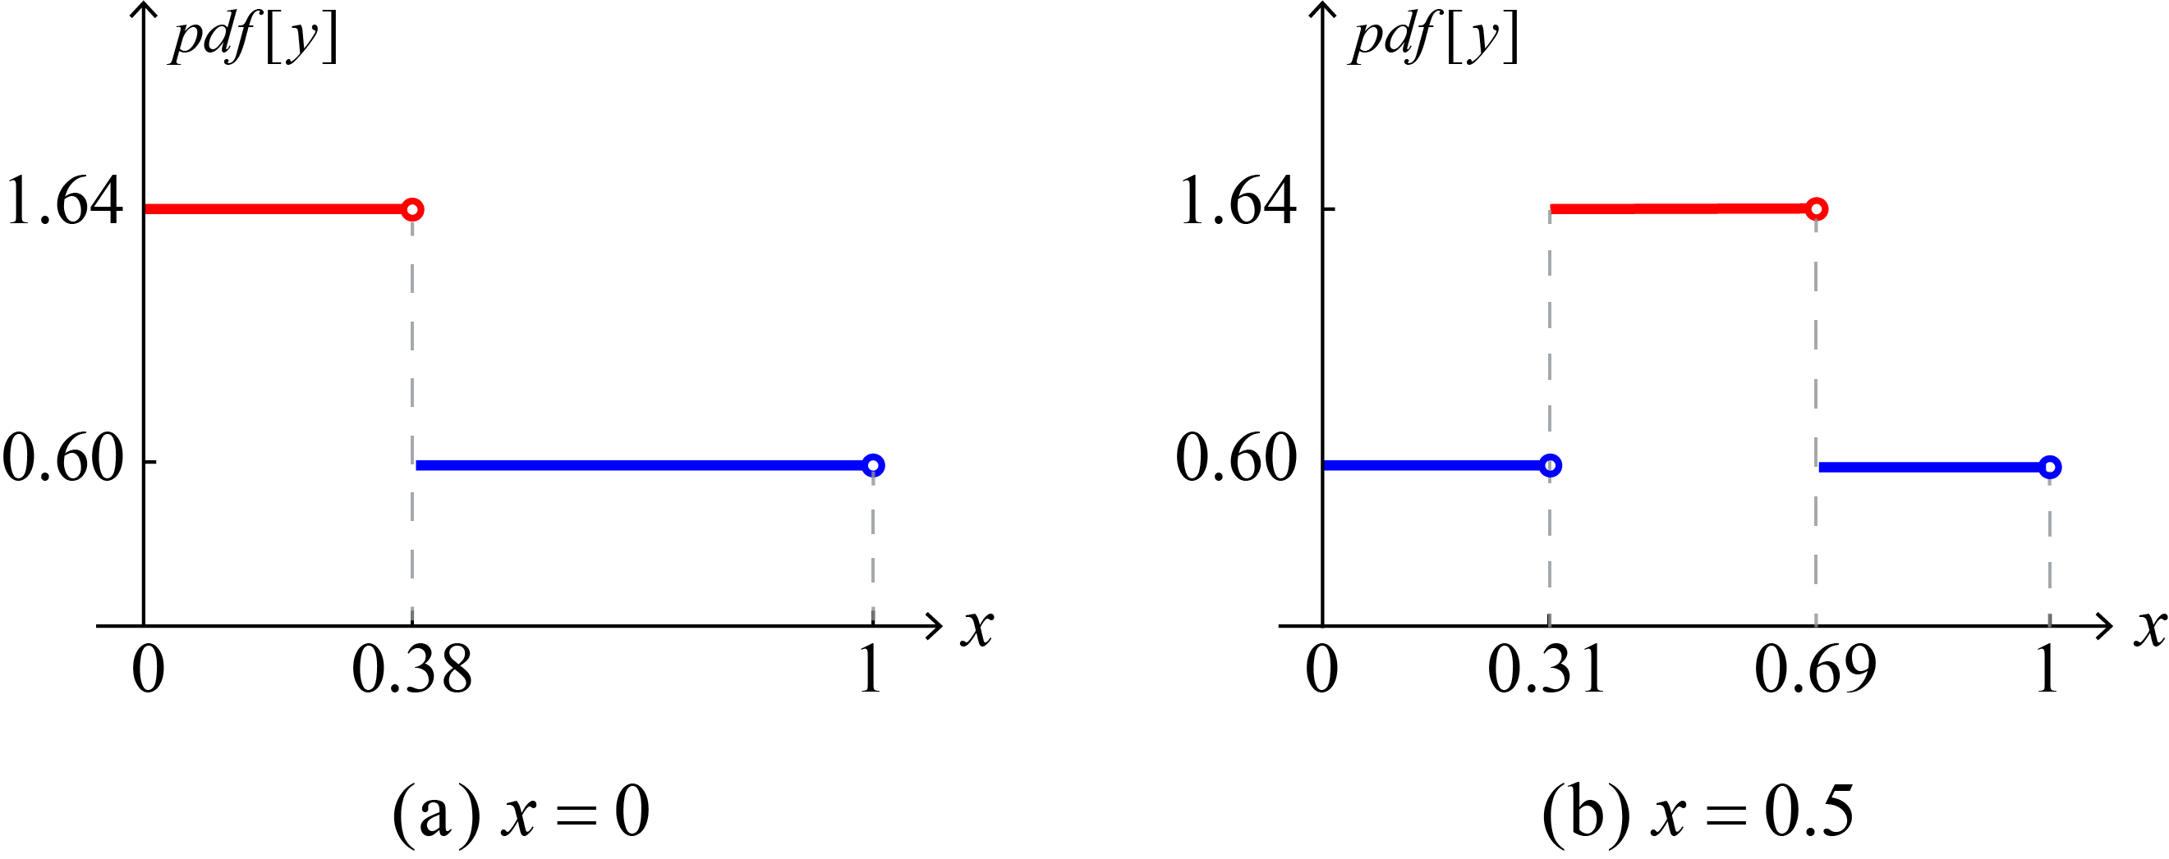





$ℳ_{∘}$ and $ℳ_{−}$
Design piecewise-based mechanisms $ℳ_{∘}$ and $ℳ_{−}$
$$\left[0,2π\right)→\left[0,2π\right)$$
$$\left[0,1\right)→\left[0,1\right)$$
Examples of $ℳ_{∘}$ and $ℳ_{−}$
$$ℳ_{∘}(x;ε=1)$$
$$ℳ_{−}(x;ε=1)$$
Ye Zheng
TraCS: Trajectory Collection in Continuous Space under LDP
22

Slide 23





Rounding to Discrete Spaces
$𝒮=\left[a_{sta},a_{end}\right]×[b_{sta},b_{end}]$
longitude
latitude
$$b_{end}$$
$τ_{i}$
$$b_{sta}$$
$$a_{sta}$$
$$a_{end}$$
Ye Zheng
TraCS: Trajectory Collection in Continuous Space under LDP
23

Slide 24

Rounding to Discrete Spaces
$𝒮=\left[a_{sta},a_{end}\right]×[b_{sta},b_{end}] →$ apply TraCS to $𝒮$
longitude
latitude
$τ_{i}$
$τ_{i}^{∗}$
Ye Zheng
TraCS: Trajectory Collection in Continuous Space under LDP
24

Slide 25
Rounding to Discrete Spaces
$𝒮=\left[a_{sta},a_{end}\right]×\left[b_{sta},b_{end}\right] →$ apply TraCS to $𝒮$ $→$ round to discrete locations
longitude
latitude
$τ_{i}$
$τ_{i}^{∗}$
Ye Zheng
TraCS: Trajectory Collection in Continuous Space under LDP
25

Slide 26
Rounding to Discrete Spaces
$𝒮=\left[a_{sta},a_{end}\right]×\left[b_{sta},b_{end}\right] →$ apply TraCS to $𝒮$ $→$ round to discrete locations
longitude
latitude
$τ_{i}$
$τ_{i}^{∗}$
Advantages:
- not affected by # locations/cells
- efficient sampling ($Θ\left(1\right)$ time complexity; EM: $Θ\left(m\right)$)
- stronger privacy (for continuous space)
Ye Zheng
TraCS: Trajectory Collection in Continuous Space under LDP
26

Slide 27
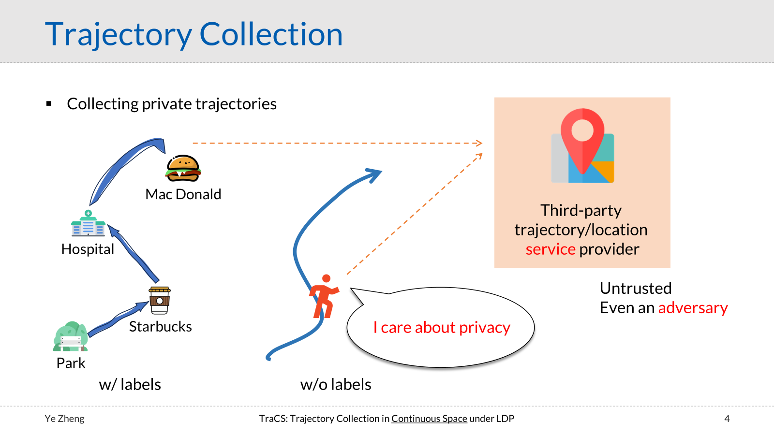
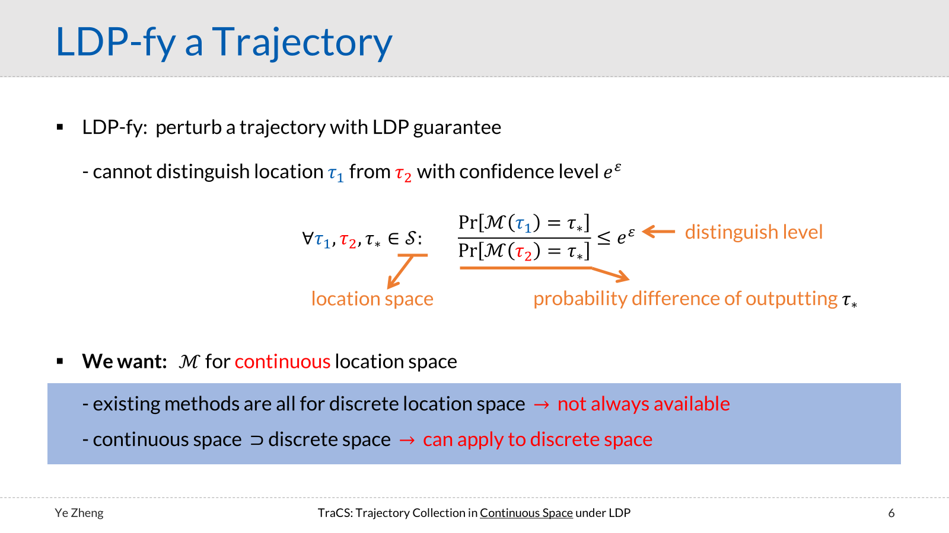
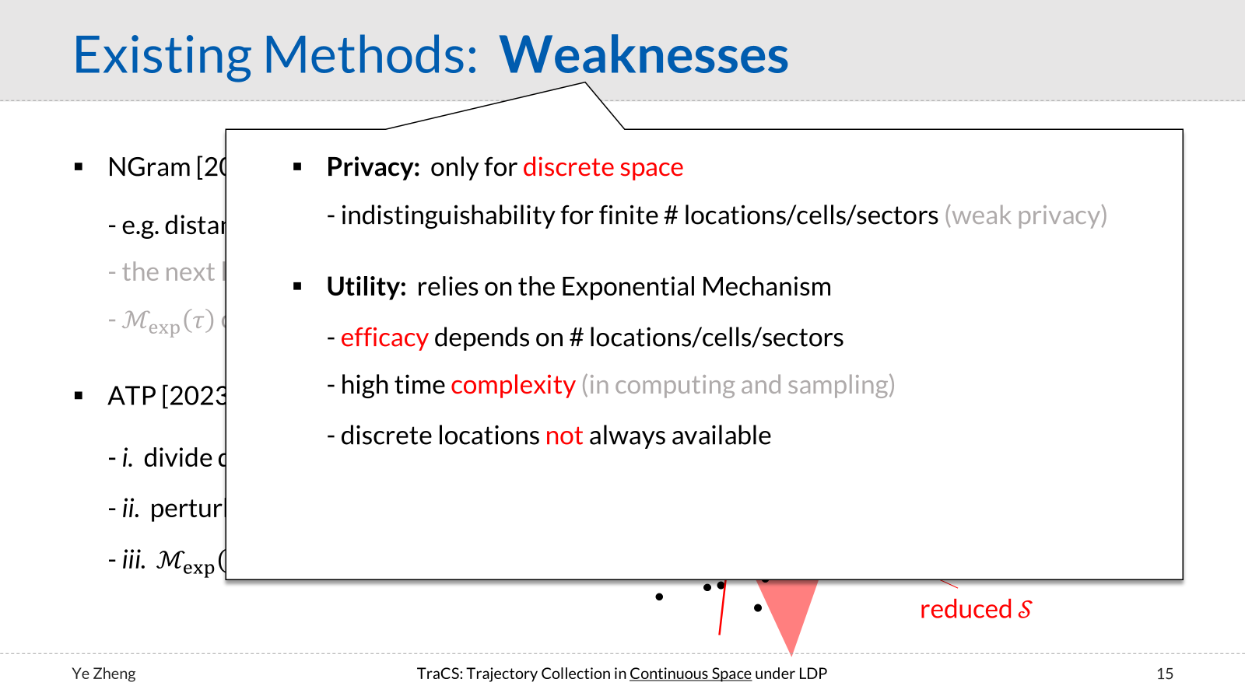
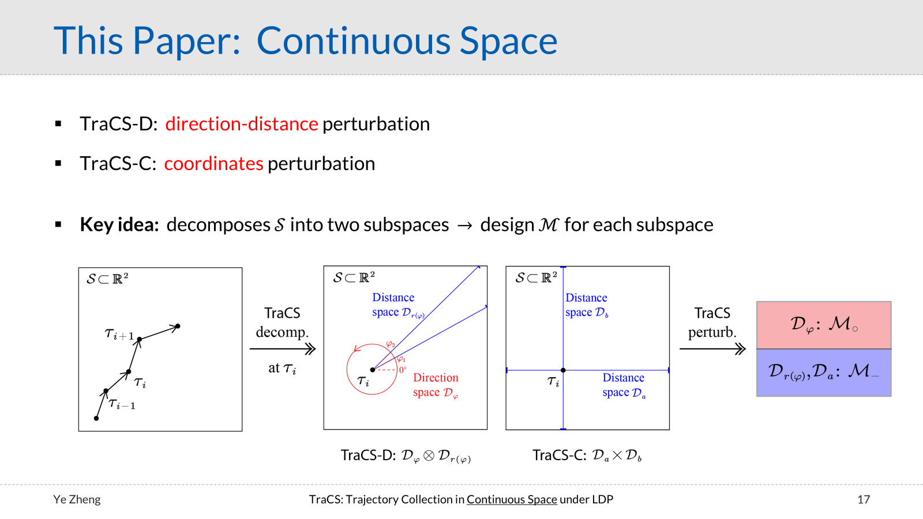
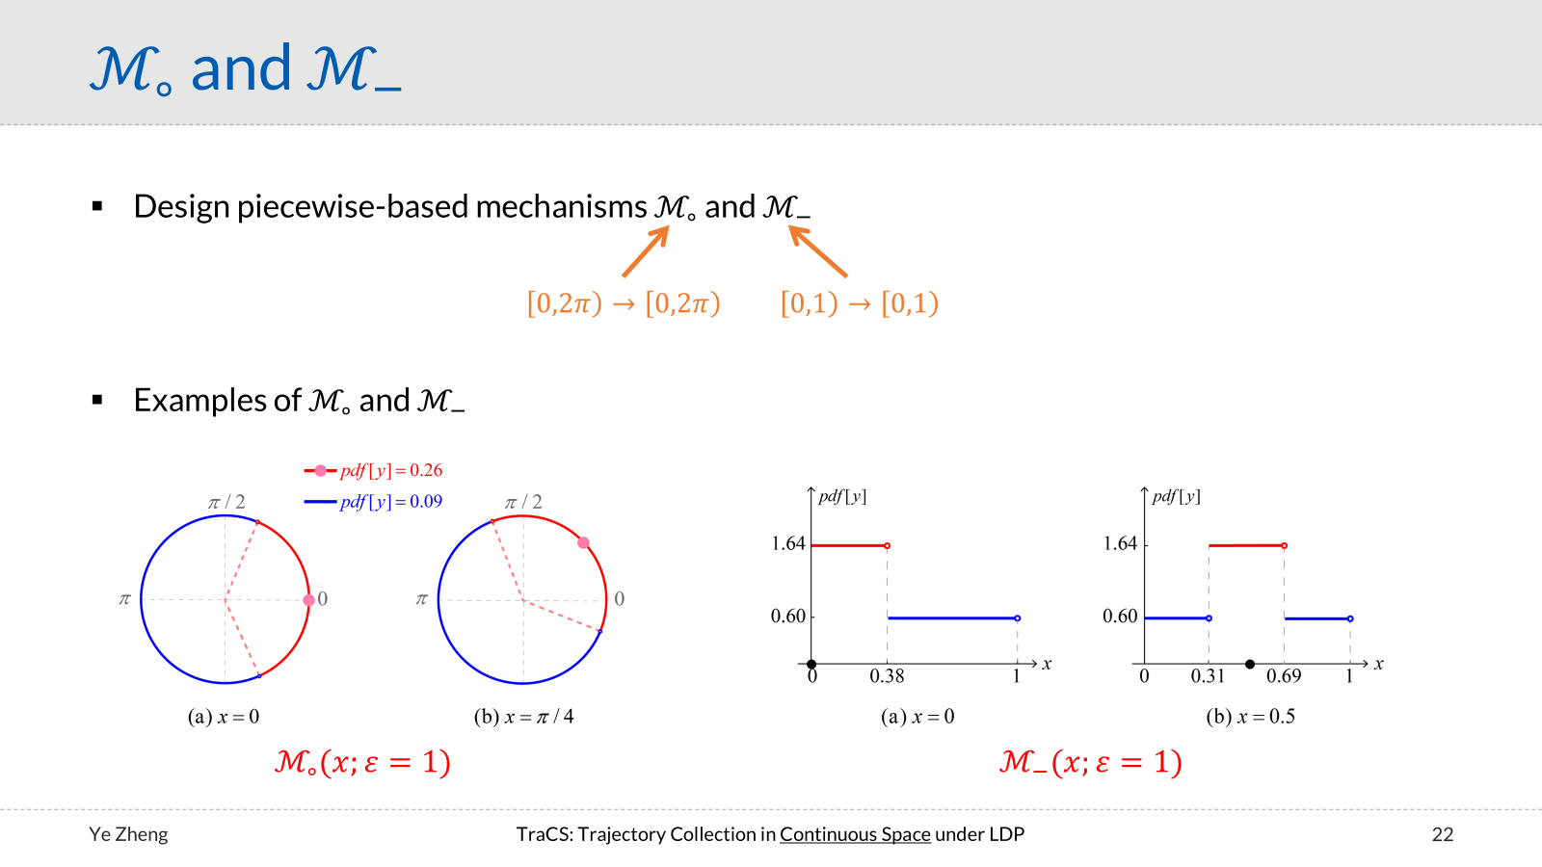
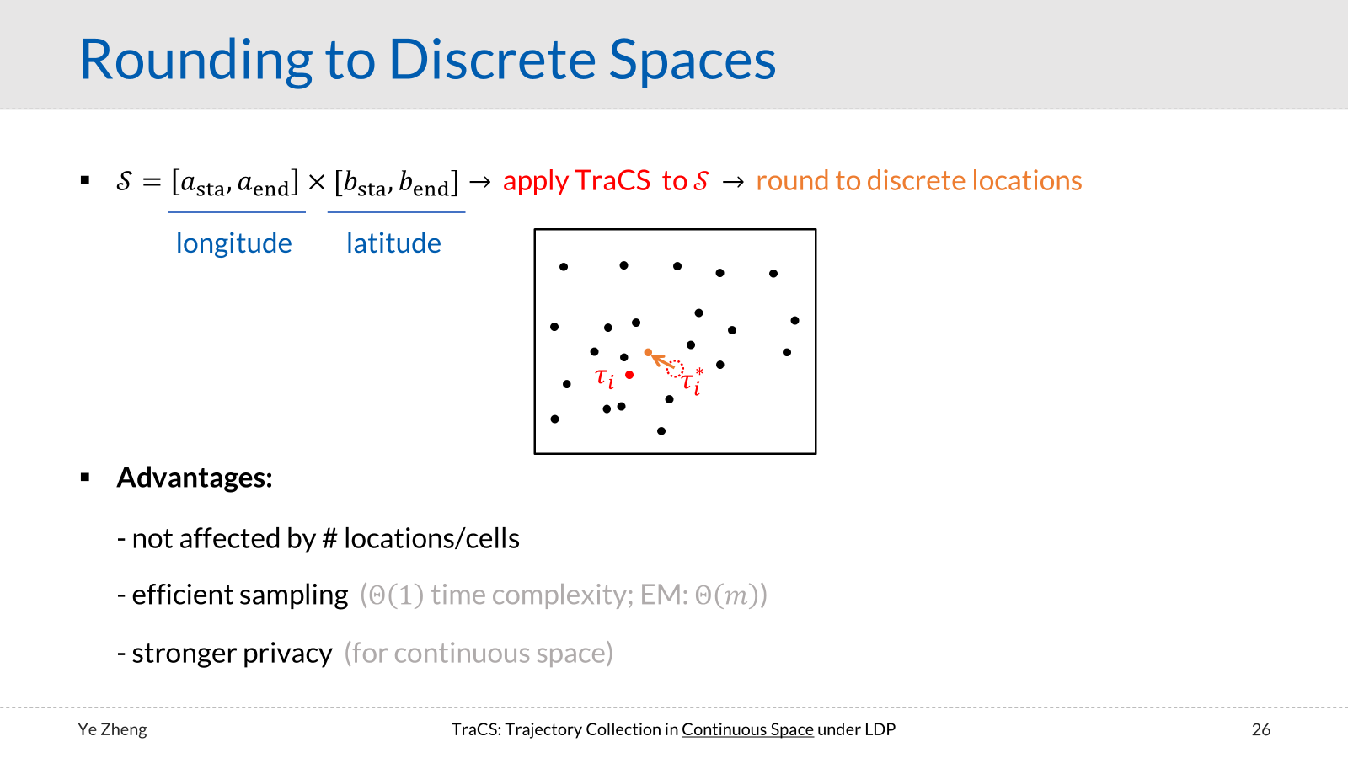

TraCS: Trajectory Collection in Continuous Space under
Local Differential Privacy
Thank you!

