Slide 1

Computer Network Fault Diagnosis
Based on Neural Network
Wenfen Lin
Yuting Zheng
Linfang Chen
2022/12/22
Collage of Computer Science & Software Engineering

Slide 2
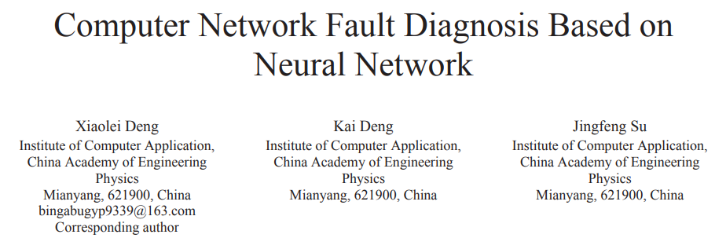
Basic Information
This presentation is based on the academic paper Computer Network Fault Diagnosis Based on Neural Network on IEEE Xplore.

Slide 3
Main content
The basic principles of it
Computer network fault diagnosis based on NN
The related algorithms of it
How to apply it
3

Slide 4


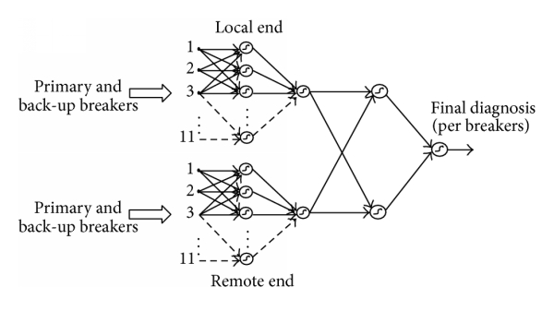
Background
Network fault
Network fault detection based on traditional technologies
Network Fault Diagnosis Based on Neural Network
Considering the advantages of NN in network fault diagnosis and detection, the computer network fault detection technology based on NN has always been an important research topic.

Slide 5
Introduction
Network fault
the network coverage is wide
network failures occur frequently
the maintenance of network failures is urgent

Slide 6
Introduction
Network fault detection
check and repair the errors that occur in the computer network
diagnose the problems in the computer network according to the target and analyze the failures
find out the causes of the failures, and discover preventive measures in time

Slide 7
Introduction
Network Fault Diagnosis Based on Neural Network
NN has a unique nonlinear adaptive information processing ability
NN overcomes the intuition of traditional artificial intelligence methods
NN is suitable for neural expert system, pattern recognition, intelligent control and coupling.
Prediction and other fields have been successfully applied.
Through the study of computer network faults, the characteristics of NN are taken as the basis of computer network diagnosis and the purpose of computer network optimization.

Slide 8

Neural network computer network failure
A. The application of computer network in practice
B. Introduction to NN
C. Application of NN in fault diagnosis

Slide 9

A. What is computer network ？
Computer network is also called communication network.
Computer network is a diversified network that integrates effective resources and realizes the purpose of resource sharing in this way .

Slide 10
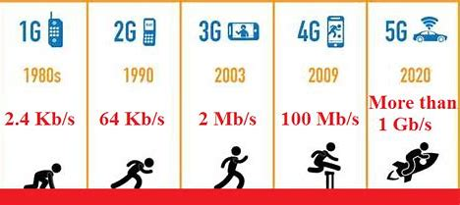
A. Computer network’s problems
Due to the low security of the computer network, it is easy to be invaded, resulting in a large amount of information disclosure.
The network is updated from the original 2G, 3G and 4G networks to the current 5G networks, and the speed is obviously much faster than before. When the transmission rate of computer network increases, maintenance is an arduous task in case of failure.

Slide 11
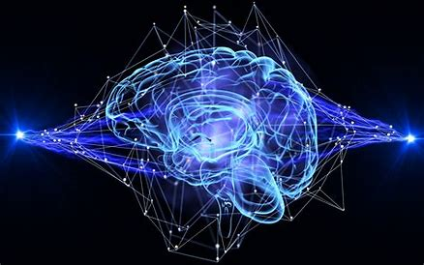
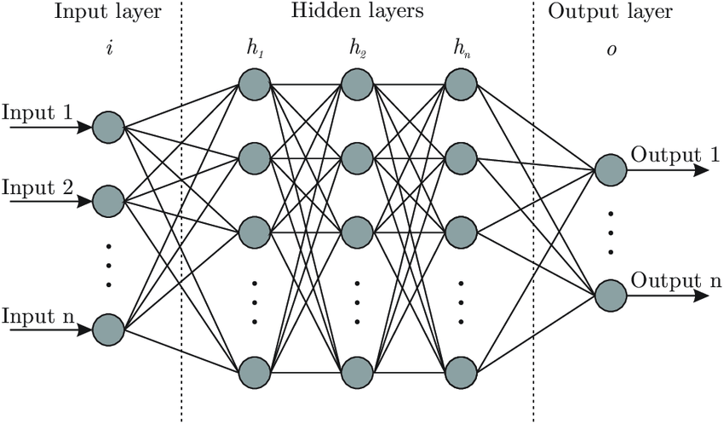
B. Neural Network
Biology Neural Network
Artificial Neural Network

Slide 12
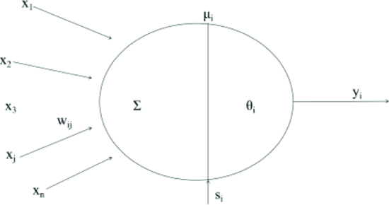
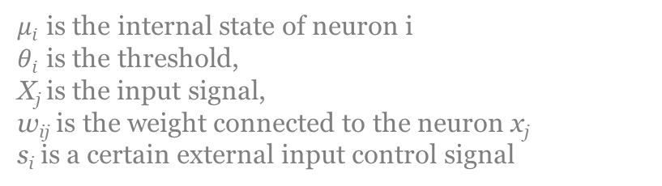
B. "training"
NNs have their own functions.
And the basic rules between them can be analyzed and found out by using the input and output data corresponding to the batch provided in advance. Finally, according to these rules, the new input data can be used to calculate the output results.
This learning and analysis process is called "training" .
$μ_{i}$ is the internal state of neuron i
$θ_{i}$ is the threshold,
X_{j} is the input signal,
w_{ij} is the weight connected to the neuron x_{j}
s_{i} is a certain external input control signal

Slide 13
C. Single NN structure
The common diagnosis structure is to establish a single NN for diagnosis. The input of the system is all possible fault symptom sets, and each output node corresponds to a fault mode.

Slide 14
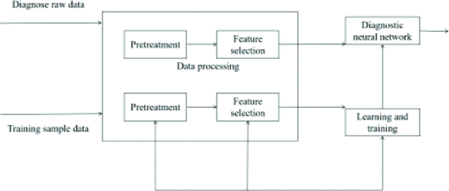
C. Schematic diagram of fault diagnosis based on NN
For fault diagnosis based on NN, the input node of the network corresponds to the fault symptom, and the output node corresponds to the cause of the fault.

Slide 15
C. The Applications
It can be used for fault pattern recognition of unknown or complex system model and non-linear system.
It has the functions of mode transformation and feature extraction of fault signal.
It is not sensitive to uncertain factors, noise and incomplete input mode in the system.
It can be used for complex multi-mode fault diagnosis.
It can be used for offline diagnosis and real-time monitoring.

Slide 16
C. Two Steps
Step 1： properly process the diagnostic raw data and training sample data.
Step 2: According to the current diagnosis input, the diagnosis process is the process of forward calculation using NN.
training sample data
Diagnose

Slide 17
Algorithm
Computer network has been in a state of continuous learning, and it has certain self-adaptive ability.
Even if the environment changes, the mapping relationship can be adjusted to achieve self-adaptive.
Therefore, it has a strong adaptive function.

Slide 18



Algorithm
The algorithm formula of BPNN is as follows:
Enter the algorithm formula:
Output algorithm formula:
The output derivative is:
X_{j} is the input signal,
w_{ij} is the weight connected to the neuron x_{j}

Slide 19
Computer network fault diagnosis and simulation
A. Computer network fault diagnosis and simulation
B. Computer Network Fault Diagnosis and Simulation

Slide 20
A. Computer network fault diagnosis and simulation
The main faults of computer and solutions
network equipment damage: integrate, inspect and maintain regularly
network transmission : transmission medium
network structure : control within the network coverage(cellular structure division)

Slide 21
B. Computer Network Fault Diagnosis and Simulation
① Get the clustered data by using the self-organizing feature mapping (SOM) NN
② Set weights and add to the sample and continuous train to adjust
③ Establish BP network by the new sample
④ Train and simulate BPNN using LM algorithm improved by parallel algorithm
OTA: Over-the-Air Technology

Slide 22
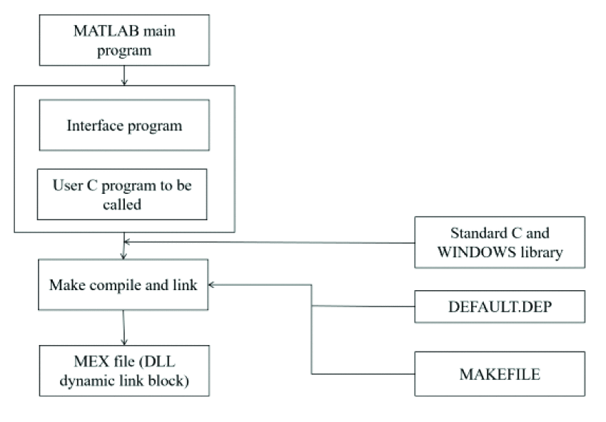
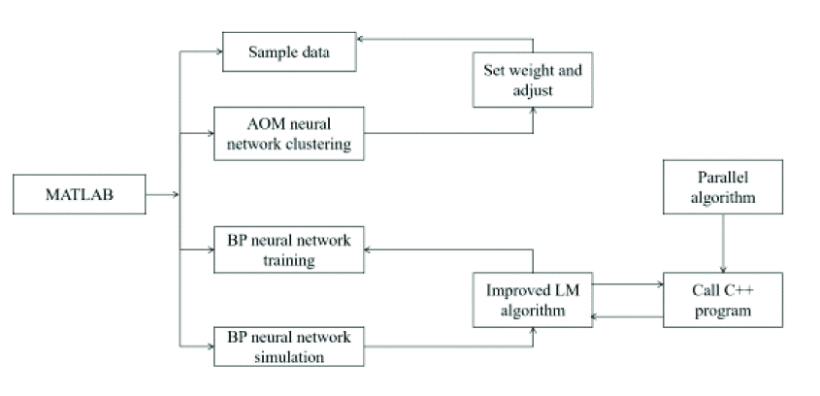
B. Computer Network Fault Diagnosis and Simulation
use MATLAB to design the program, and use C++ language to write the program when improving LM algorithm and use method to call.

Slide 23
B. Computer Network Fault Diagnosis and Simulation
Step 1：NN make preliminary diagnosis
Step 2: according to the current diagnostic system, reasonable processing
preliminary diagnosis
current diagnostic system

Slide 24
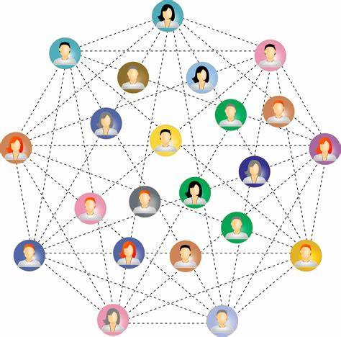
Conclusion
The faults in NN and computer network support each other in the diagnosis measures, which makes NN attached to the computing network and become an inseparable part.
Based on NN ,the computer network fault diagnosis technology network has broad development prospects.
The structure and training times of NN should be properly designed, so that NN research in the field of fault diagnosis can achieve good results.
Smooth network

Slide 25
Thanks for listening!
Email:
Wenfen Lin 2071198926@qq.com Yuting Zheng 1132306320@qq.com
Linfang Chen 3350452212@qq.com
2022/12/22
Collage of Computer Science & Software Engineering

