Slide 1
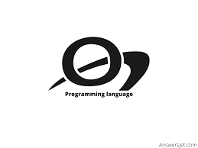
Oberon
by Haonan Jia, Matthew Wrizar, Zheng Zhou

Slide 2

Oberon's History and Evolution
Oberon is a programming language developed by Swiss computer scientist Niklaus Wirth in 1986. which was designed with Einstein’s motto in mind: Make it as simple as possible, Initially created for educational purposes and system programming. Known for its simplicity and modular design, it remains a niche language. Although it hasn't evolved extensively like popular languages such as Python or Java, Oberon still finds utility in education and system programming.

Slide 3
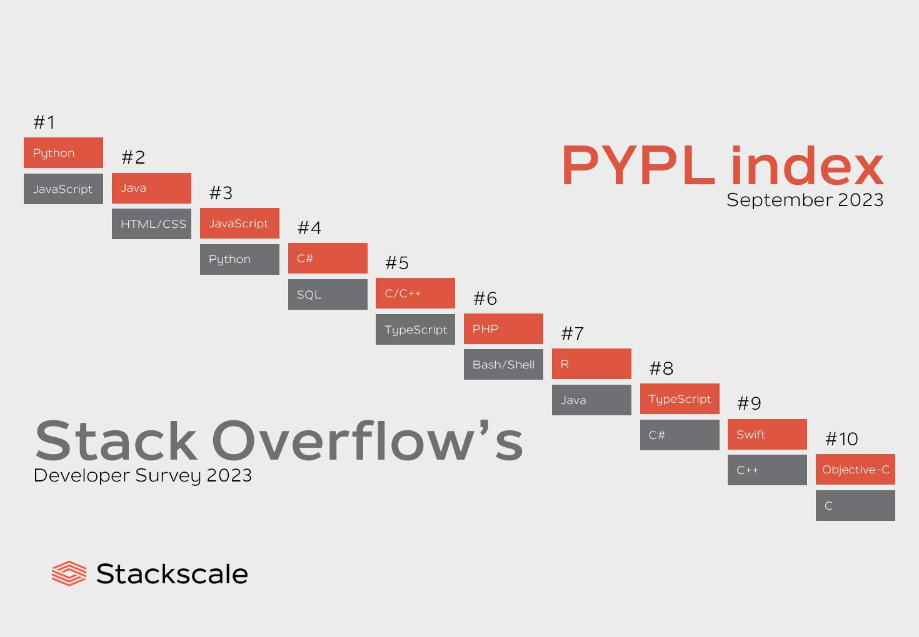
Is Oberon Still Popular?
The Oberon programming language has consistently remained a specialized language and continues to be utilized in specific areas, particularly in education and research. However, on a global scale, it has not supplanted more popular programming languages.
Specialized Nature: Oberon has always been a specialized programming language and has never achieved widespread usage like programming languages such as Python, Java, or C++. It has not formed a large user base within the developer community.
Market Demand: Many industrial and commercial applications tend to prefer more widely supported programming languages because these languages typically have the advantage of a more active community. This presents a competitive challenge for Oberon.
Technological Progress: Over time, programming languages and technologies continuously advance. New programming languages and frameworks frequently emerge, often offering more robust capabilities, enhanced performance, and more extensive ecosystems. These innovations generally attract the interest of developers.
Education and Academia: While Oberon still holds value in education and academia, some other programming languages, such as Python, are extensively employed in these fields. As a result, the education sector may lean towards more widely embraced languages to offer students broader employment opportunities.

Slide 4
Features
1. Paradigm: supports different programming paradigms that are imperative, structured, modular, and object oriented programming.
2. Platform: Programmers can use Oberon on different platforms,such as StrongARM, SPARC, ARM, IA-32 and Ceres (NS32032).
3. General purpose: the usage of programmers in developing numerous sorts of applications, programs, operating systems, softwares, etc.
4. Object oriented: supports all features and functions of Object oriented programming and it follows the concepts of object oriented programming comstructions, such as class, inheritance, abstraction, polymorphism, encapsulation, etc.
5. Operating systems: Oberon programming language can run on different operating systems, such as Windows, Linux, macOS, Solaris, AmigaOS, Atari TOS, etc.
6. Typing disciplines: uses strong, static and dynamic typing disciplines.
7. Simplicity: It makes program simple

Slide 5
Other Features
Syntax: Case sensitivity with uppercase keywords. To form a syntex, an extended Backus-Naur Formalism (EBNF) is used, where brackets [] are denoted optionality for an enclosed sentential form, and braces {} for its repetition, usually 0 times. Symbols such as strings are used to enclose in quote marks or words written in capital letters, so-called reserved words. Non-terminal symbols start with upper-case letters, while terminal symbols start with either lower-case letters or are written all in upper-case letters or are denoted by strings (":=").
Type-Extension: It permits the construction of new data types on the basis of existing and relate ones. It is intentionally kept concise, as it is to serve as a reference for users such as programmers.
Type Declaration: It determines the set of values which variables of that type may be assumed, in which operators are applicable. A type declaration is used to associate an identifier with that type. Types can be either structured or unstructured, in which case they define the structure of their variables, and by implication, the operators that are applicable to the components. Examples can be arrays, pointers, etc.
Modularity and Separation Compilation: code can be organized into separate units called modules that import and export numerous sorts of data such as types, variables, constants, procedures.
String operations: when declaring or working with strings
Isolating unsafe code: to isolate unsafe coding errors or bugs.
Garbage collection: where it helps programmers iin deallocating data structures correctly and avoid errors.

Slide 6
Two specific Features: For loop (1/2)
· Oberon's FOR loop requires that the start, end, and step values of the loop be explicitly specified, which increases the controllability of the loop.
· Counter automatically increasing or decreasing.
· Oberon's for loop syntax is relatively concise and clear, making the loop's purpose and range easy to understand.

Slide 7
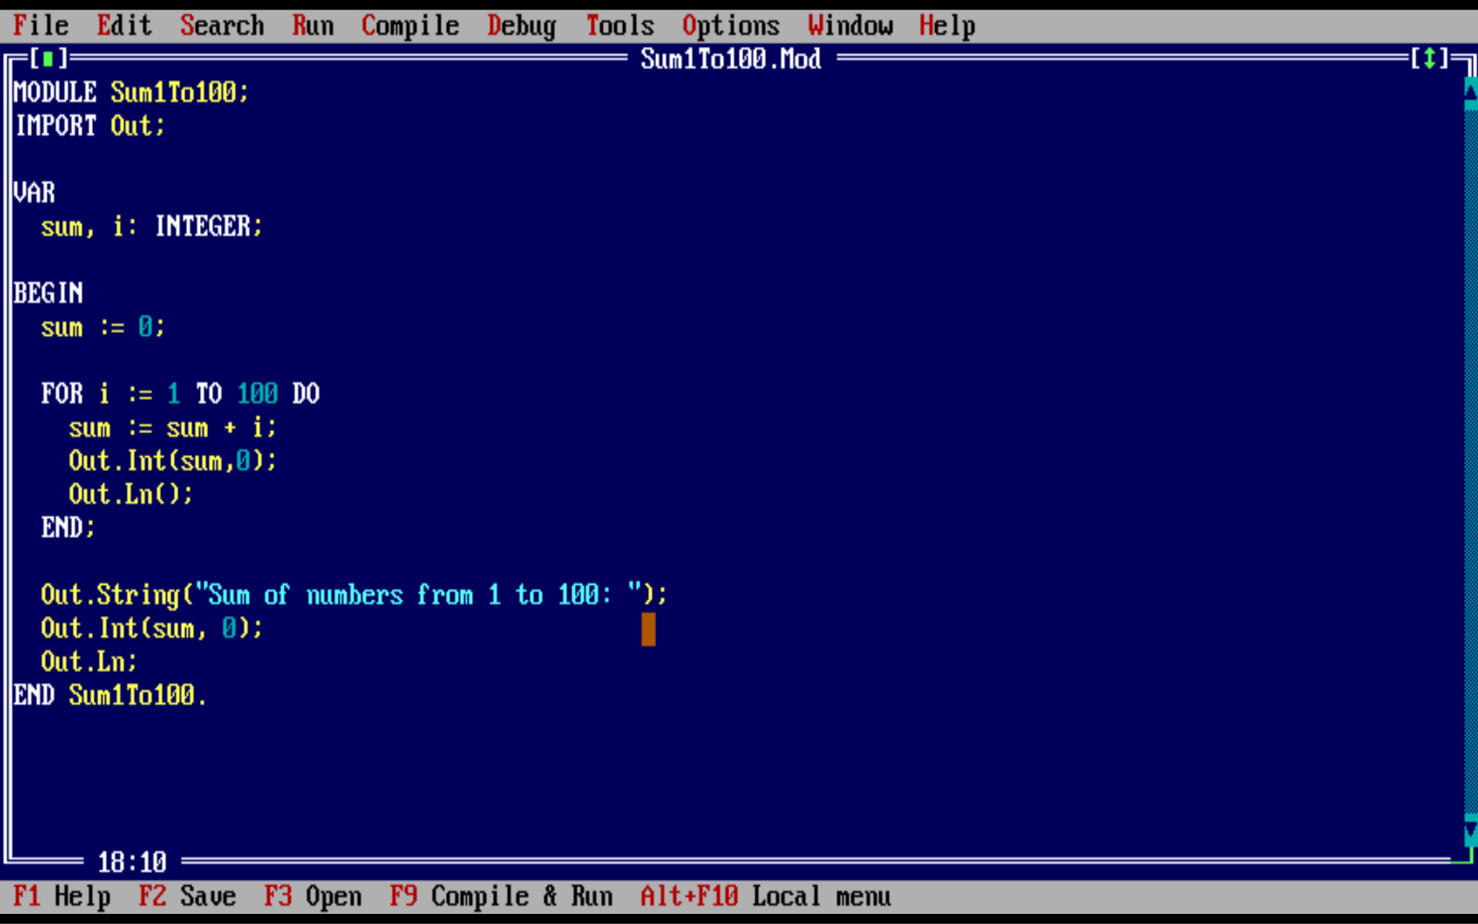

Slide 8
Two specific Features: Modularity (2/2)
· Oberon encourages modular programming through the use of modules.
· Modules are self-contained units of code and data, making it easier to organize and maintain large projects.
· What's unique is that Oberon supports separate compiling, which means you can compile and link modules independently.
· This promotes code reuse and reduces compilation times for large codebases.

Slide 9
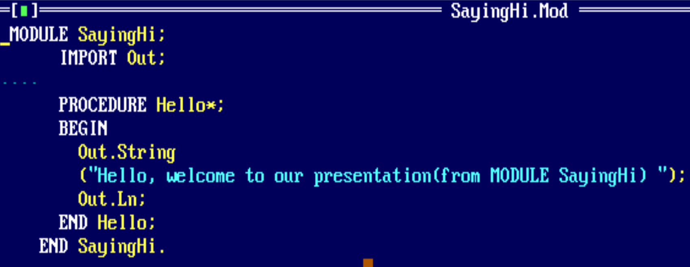
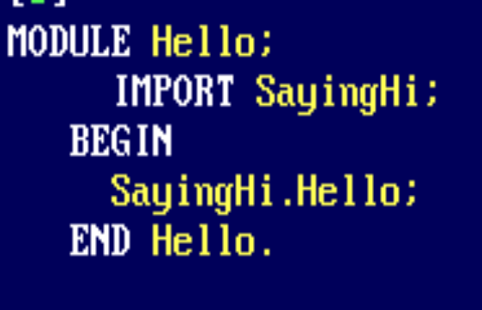

Slide 10
The Future of Oberon
Oberon is used by developers in developingand running in different types of applications, softwares, platforms, and programs, such as Windows, Linux, classic macOS, Solaris, AmigaOS, Atari TOS, etc. As years pass by, it becomes upgraded with new features. For instance, during its upgradation in 2013, and later in 2014, it contained new networking library that provides support for socket programming, such as TCP/IP, UDP, and HTTP. Another instance can be having a new graphics library that provides support for creating 2D and 3D graphics, such as drawing primitives, images, and fonts.
Oberon is an amazing language that continues to have a great amount compactness and efficiency, as it offers a rich, diverse set of features for making systems programming much safer be used for numerous daily purposes.

Slide 11
References
https://www.answersjet.com/2021/08/oberon-programming-language-history-features-applications-why-should-learn-oberon-lang.html
https://www.stackscale.com/blog/most-popular-programming-languages/#Top_10_programming_languages_in_2023
https://codedocs.org/what-is/oberon-programming-language
https://cseweb.ucsd.edu/~wgg/CSE131B/oberon2.htm#:~:text=Its%20most%20important%20features%20are,2%20an%20object%2Doriented%20language.
https://dbpedia.org/page/Oberon_(programming_language)
https://medium.com/@alexandragrosu03/oberon-a-compact-and-efficient-language-for-systems-programming-96f60ae10eff
https://people.inf.ethz.ch/wirth/Oberon/Oberon.Report.pdf
https://www.techopedia.com/definition/8630/oberon

