Slide 1
Final Project Group 4
Group member:
Yu Du
Anurag Gher
Sajiri Gokak
Jiajian You
Zheng Zhang

Slide 2
Project Topic - Restaurant Management System
Our project aims to provide a comprehensive solution for restaurant owners and managers to efficiently manage their operations.
Key Features
Order Management: Easily take, modify, and track orders, status query ensuring accurate and timely service.
Menu Customization: Effortlessly update menus, add new items, and adjust prices to meet changing demands.
Table Reservation: Enable customers to book tables online, improving convenience and reducing wait times.

Slide 3
Technology Stack
1. Programming Language:
Java: Primary programming language for implementing the backend logic, business logic, and user interface components.
2. User Interface Development:
Swing UI Framework: Chosen for its simplicity and ease of use in creating graphical user interfaces (GUIs) for Java applications.
3. Integrated Development Environment (IDE):
IntelliJ IDEA: Selected as the development environment for its powerful features, excellent Java support, and seamless integration with Java projects.
4. Version Control:
Git: Employed for version control to manage codebase changes, track revisions, collaborate with team members, and ensure code integrity.

Slide 4
UML

Slide 5
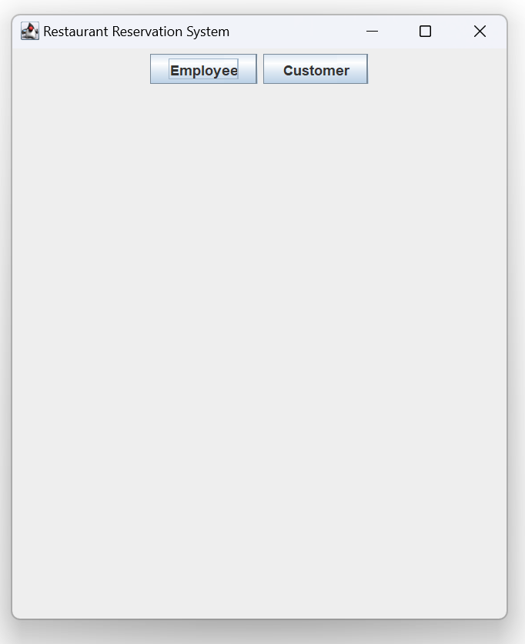
Functionalities implemented

Slide 6
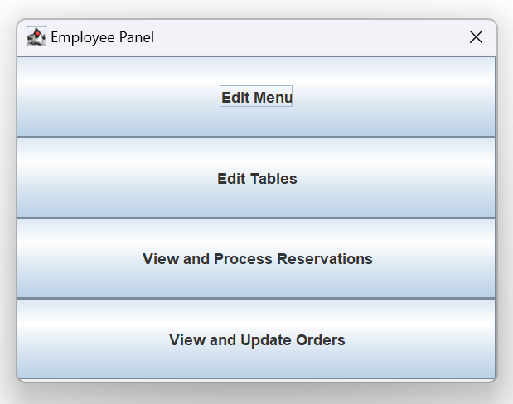
Functionalities implemented

Slide 7
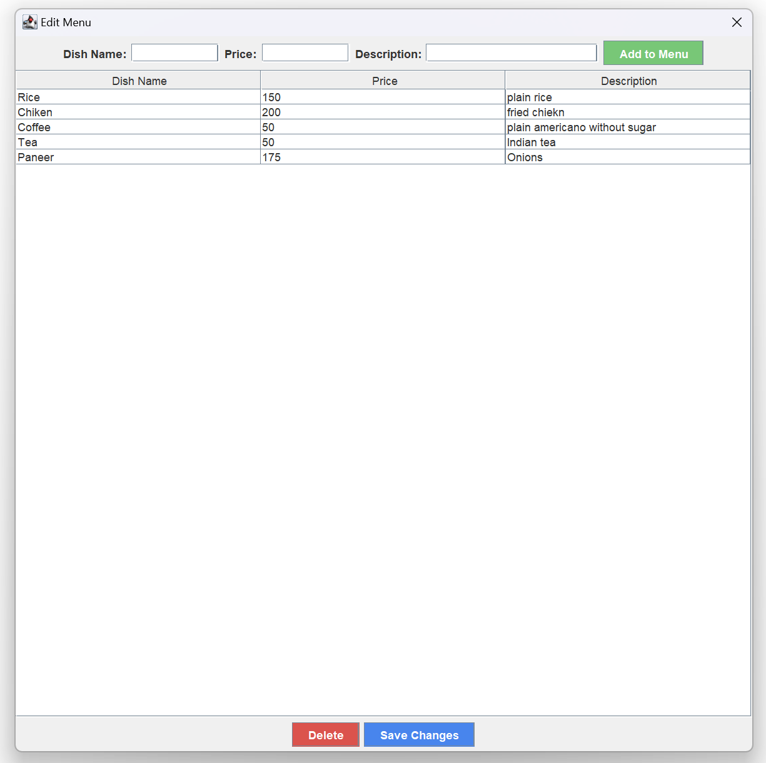

Slide 8
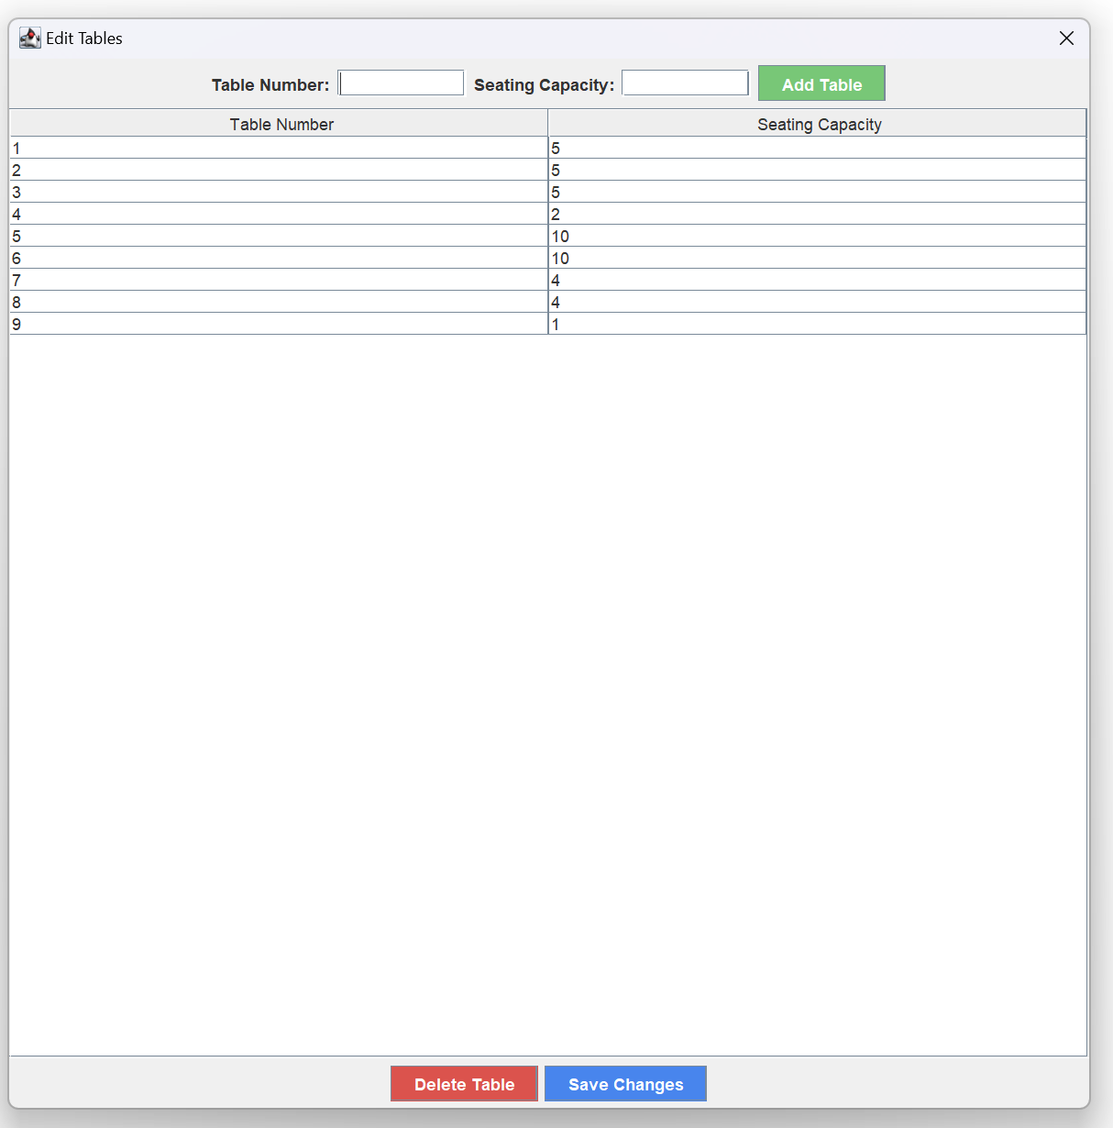

Slide 9
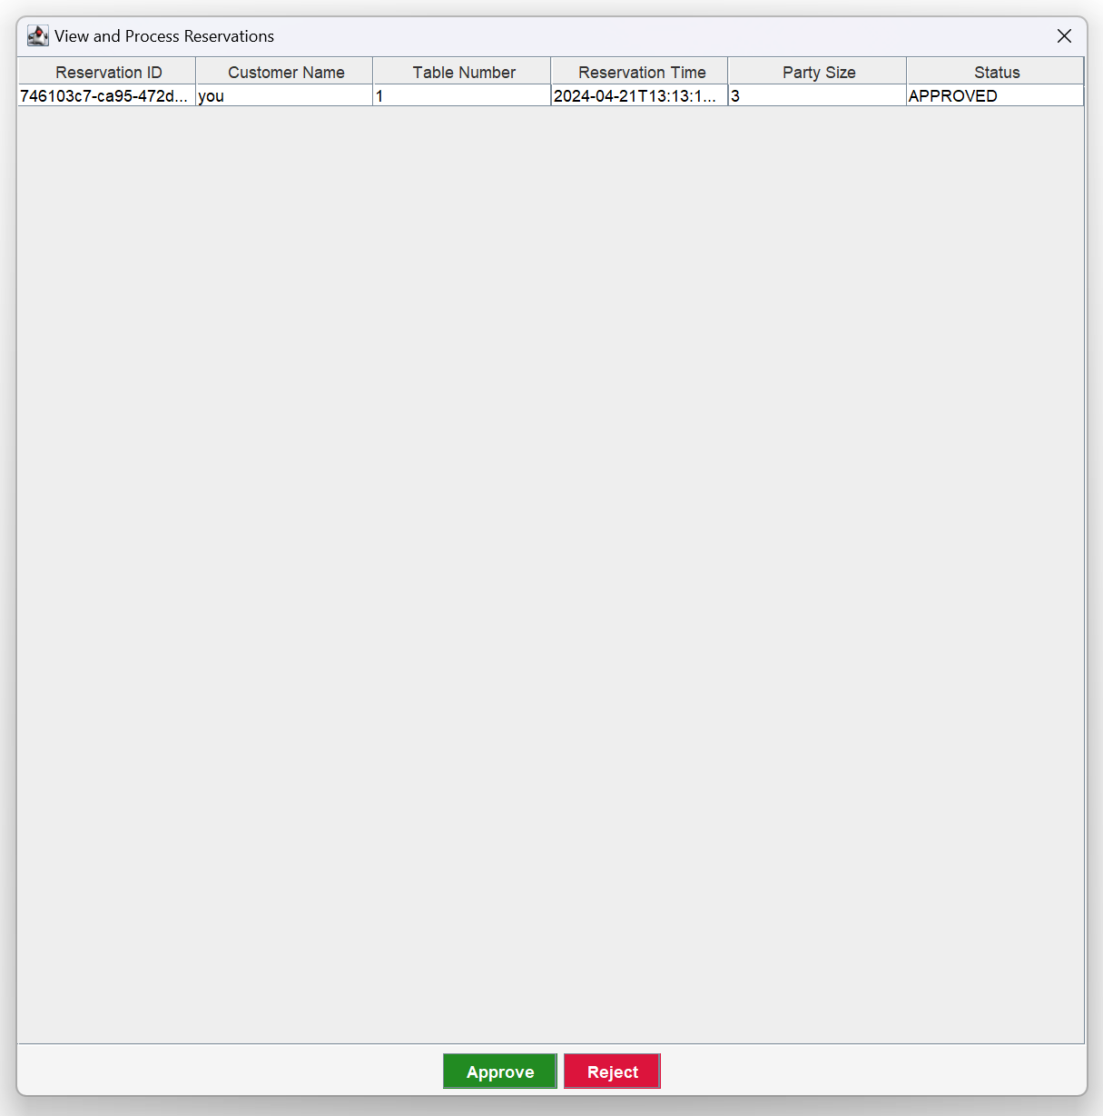

Slide 10
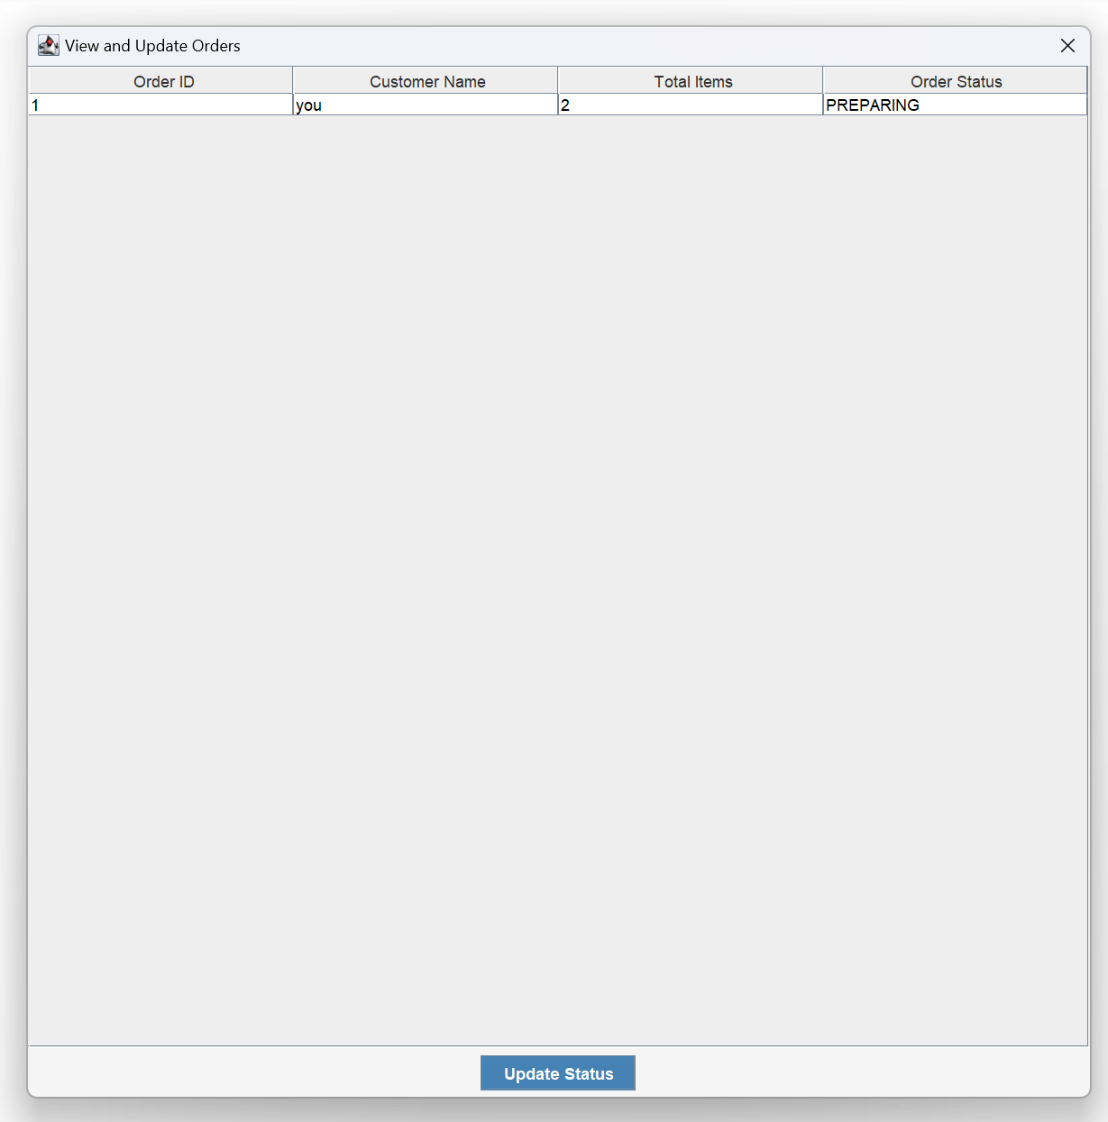

Slide 11
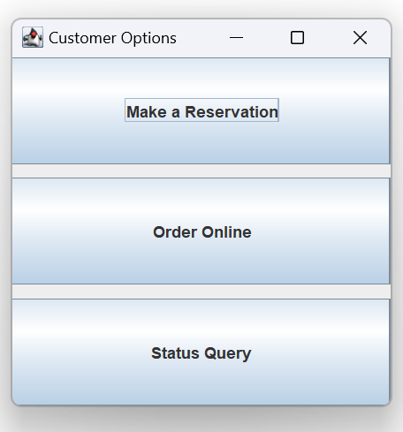
Functionalities implemented

Slide 12
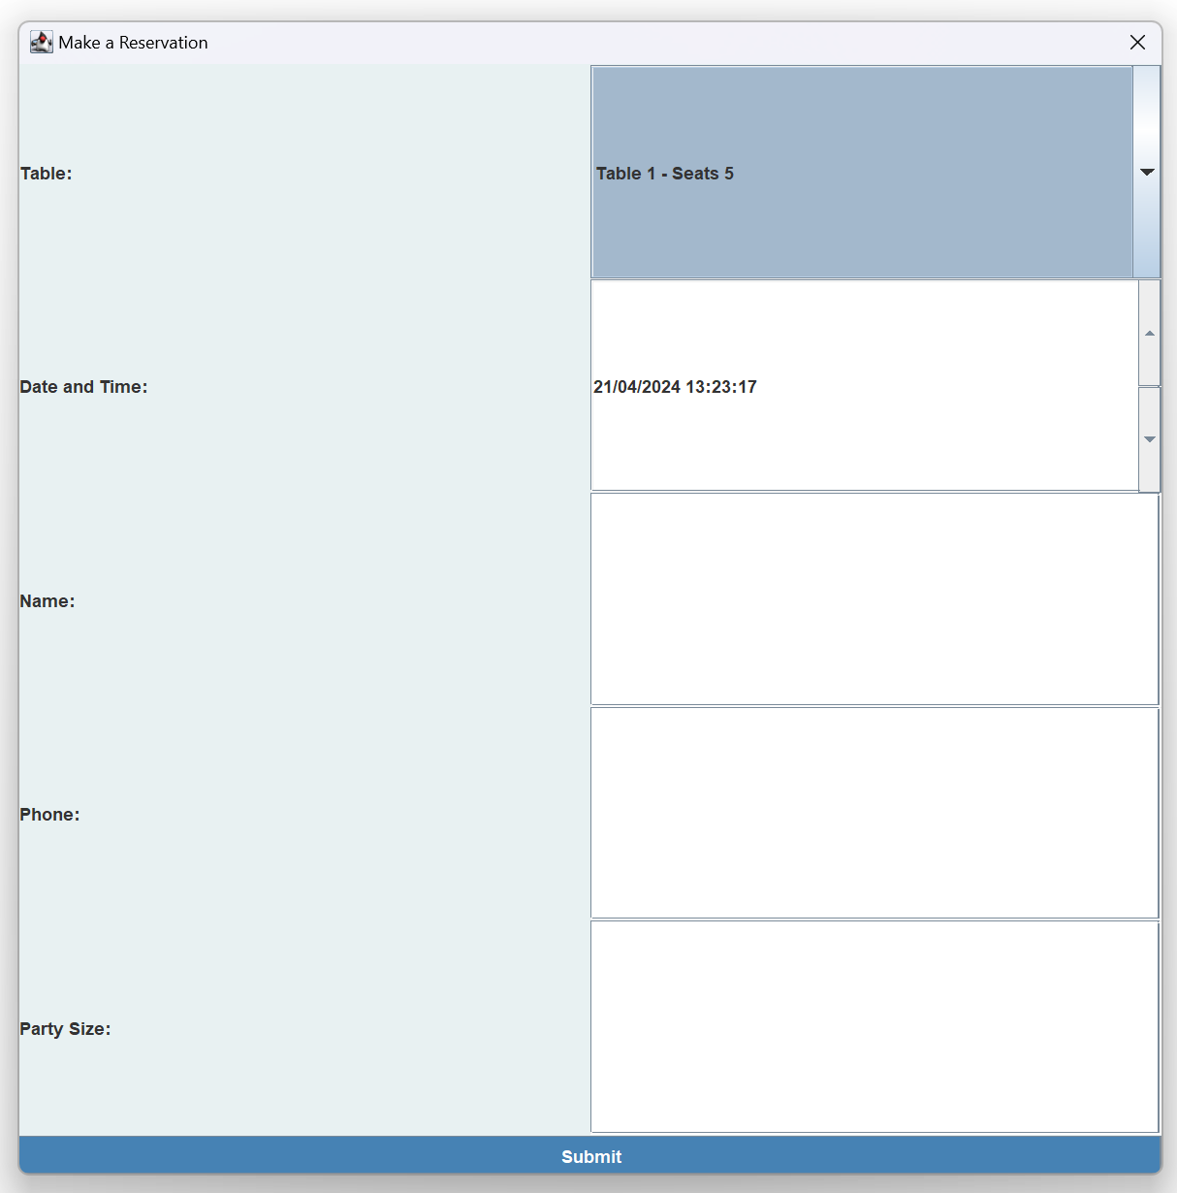

Slide 13
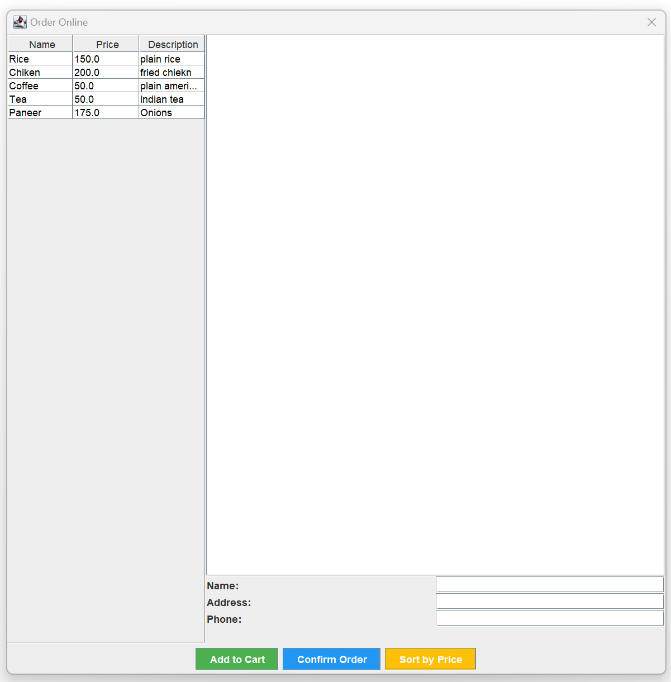

Slide 14
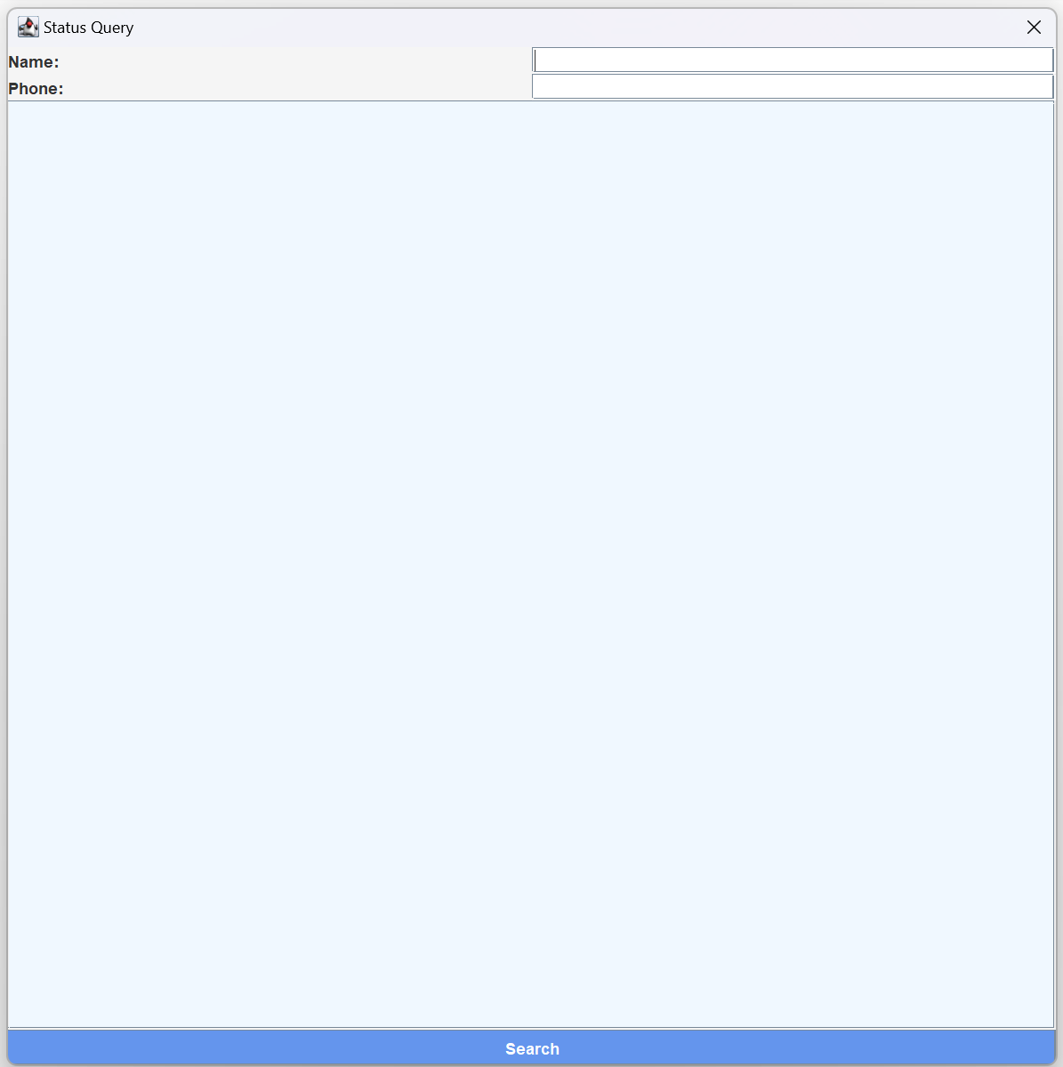

Slide 15
Object Oriented concepts code
public class CSVUtils {
public static List<String[]> readCSV(String filePath) {
List<String[]> data = new ArrayList<>();
File file = new File(filePath);
if (!file.exists()) {
System.out.println("File does not exist: " + filePath);
return data;
}
try (BufferedReader br = new BufferedReader(new FileReader(file))) {
String line;
while ((line = br.readLine()) != null) {
String[] dataValues = line.split(",");
data.add(dataValues);
}
} catch (IOException e) {
System.out.println("Error reading CSV file: " + e.getMessage());
}
return data;
}
public static void writeCSV(List<String[]> data, String filePath) {
try (PrintWriter pw = new PrintWriter(new FileWriter(filePath))) {
for (String[] dataValues : data) {
pw.println(String.join(",", dataValues));
}
} catch (IOException e) {
System.out.println("Error writing CSV file: " + e.getMessage());
}
}
}

Slide 16
Functionalities that was implemented
read/write csv

Slide 17
Object Oriented concepts code
public static List<Order> findOrdersByNameAndPhone(String name, String phone) {
return orders.stream()
.filter(order -> order.getCustomer().getName().equalsIgnoreCase(name) && order.getCustomer().getPhoneNumber().equals(phone))
.collect(Collectors.toList());
}
public static List<Reservation> findReservationsByNameAndPhone(String name, String phone) {
return reservations.stream()
.filter(reservation -> reservation.getCustomer().getName().equalsIgnoreCase(name) && reservation.getCustomer().getPhoneNumber().equals(phone))
.collect(Collectors.toList());
}

Slide 18
Functionalities that was implemented
Stream
lambda

Slide 19
Object Oriented concepts code
public class PersonFactory {
public static Person createPerson(String type, String name, String phoneNumber, String id) {
switch (type.toLowerCase()) {
case "customer":
return new Customer(name, phoneNumber, id);
case "employee":
return new Employee(name, phoneNumber, id);
default:
throw new IllegalArgumentException("Invalid person type.");
}
}
}

Slide 20
Functionalities that was implemented
Simple Factory Pattern

Slide 21
Contributions
Yu Du
Anurag Gher
Sajiri Gokak
Jiajian You
Zheng Zhang

