Slide 1
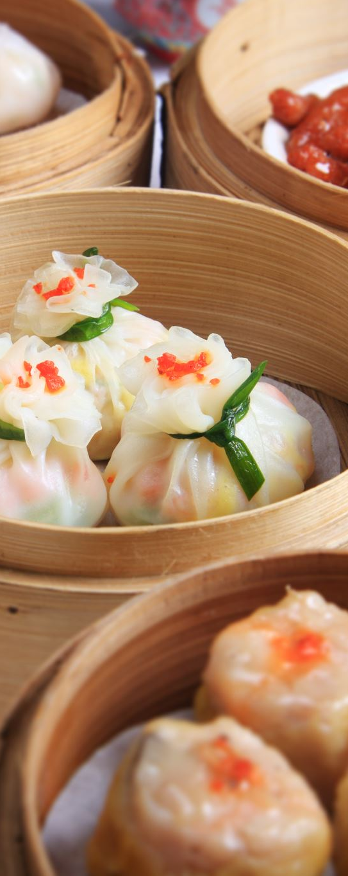
Final Project Group 4 Restaurant Management System
Group members:
Anurag Gher
Jiajian You
Sajiri Gokak
Yu Du
Zheng Zhang

Slide 2

Project Topic - Restaurant Management System
Our project aims to provide a comprehensive solution for restaurant owners and managers to efficiently manage their operations.
Key Features
Order Management: Easily take, modify, and track orders, status query ensuring accurate and timely service.
Menu Customization: Effortlessly update menus, add new items, and adjust prices to meet changing demands.
Table Reservation: Enable customers to book tables online, improving convenience and reducing wait times.

Slide 3

Technology Stack
User Interface Development:
Swing UI Framework: Chosen for its simplicity and ease of use in creating graphical user interfaces (GUIs) for Java applications.
Integrated Development Environment (IDE):
IntelliJ IDEA: Selected as the development environment for its powerful features, excellent Java support, and seamless integration with Java projects.
Programming Language:
Java: Primary programming language for implementing the backend logic, business logic, and user interface components.
Version Control:
Git: Employed for version control to manage codebase changes, track revisions, collaborate with team members, and ensure code integrity.

Slide 4
Object-Oriented Programming (OOP)
CSV File Handling and Exception Handling
Exception Handling
Comparators for Sorting
Java Collections Framework (ArrayList, List)
Java Date and Time API
Lambda Expressions
Java Swing for GUI Development

Slide 5
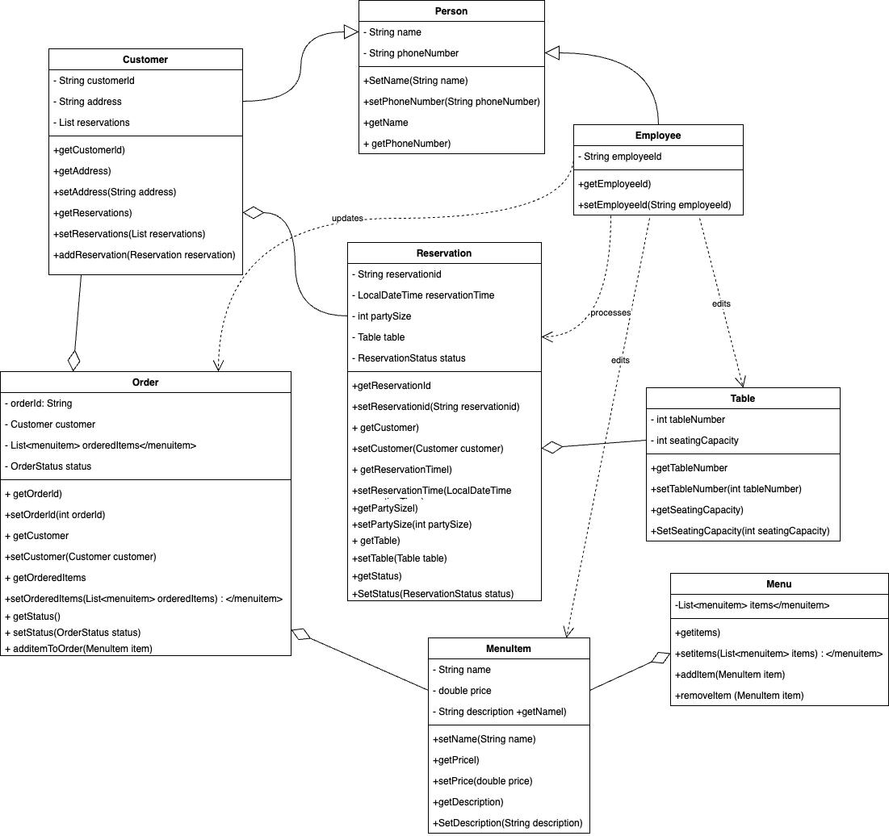
U
M
L
D
I
A
G
R
A
M
There are two distinct roles: customers and employees, each with specialized functionalities designed to streamline their interactions with the platform

Slide 6
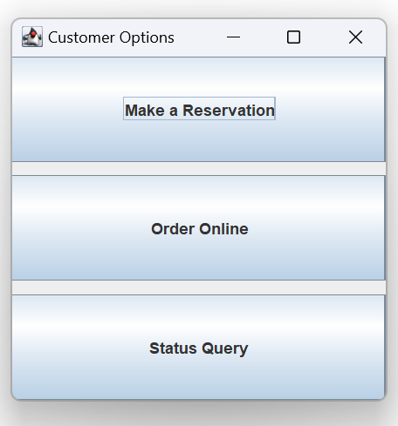
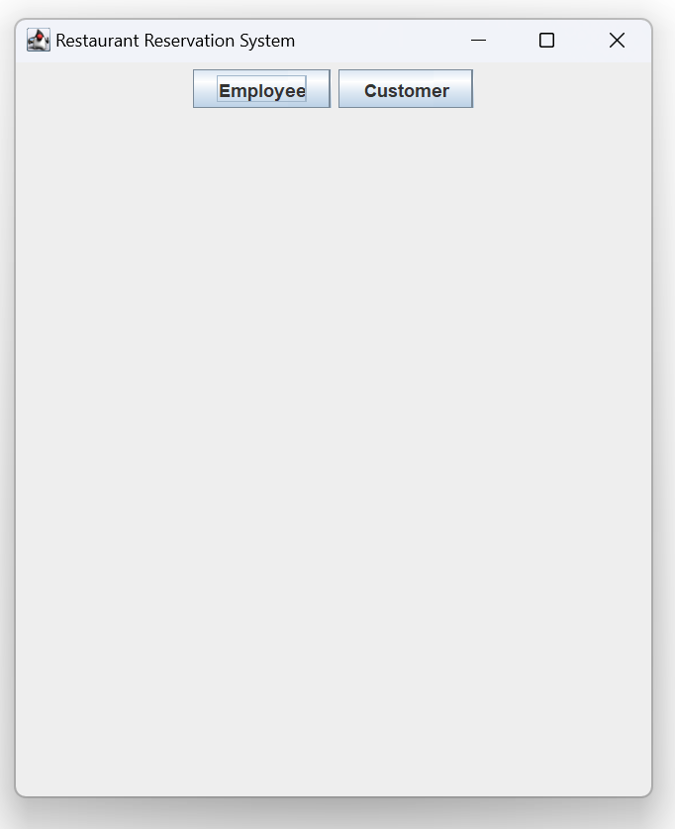
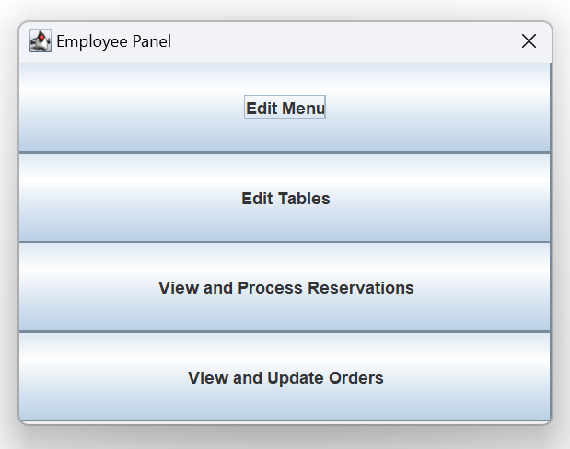
Functionalities Implemented
There are two distinct roles: customers and employees, each with specialized functionalities designed to streamline their interactions with the platform

Slide 7
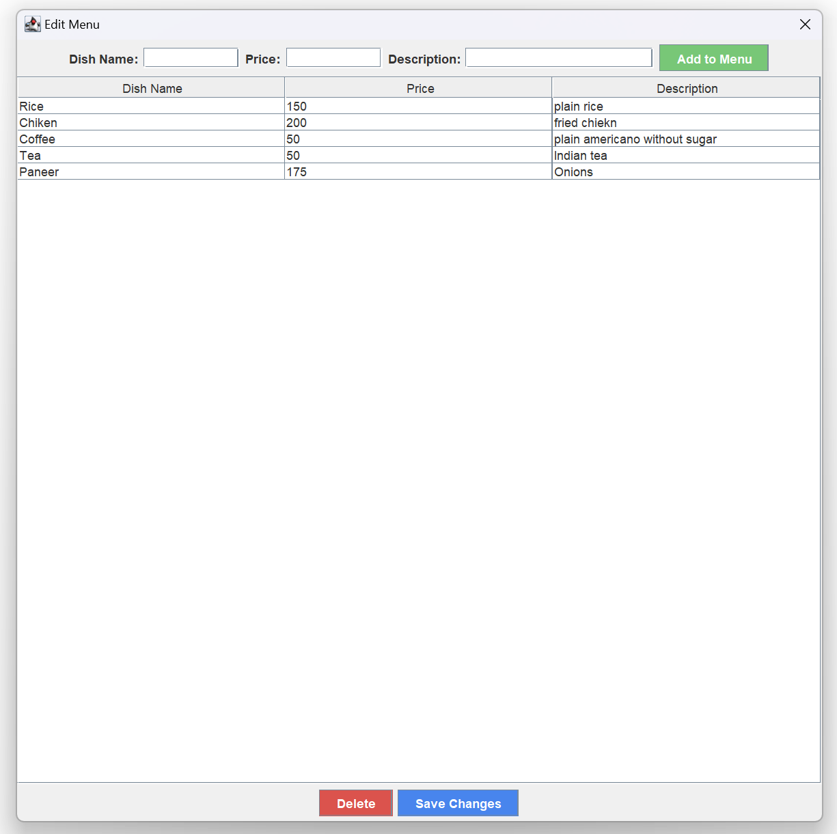
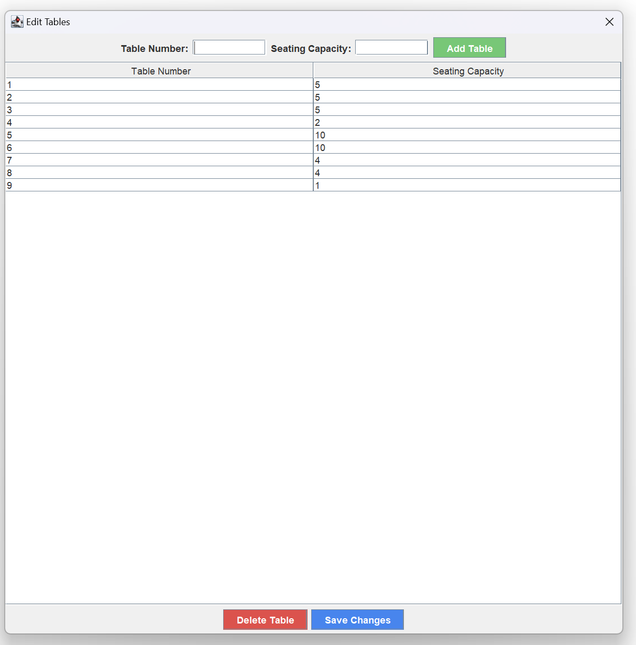
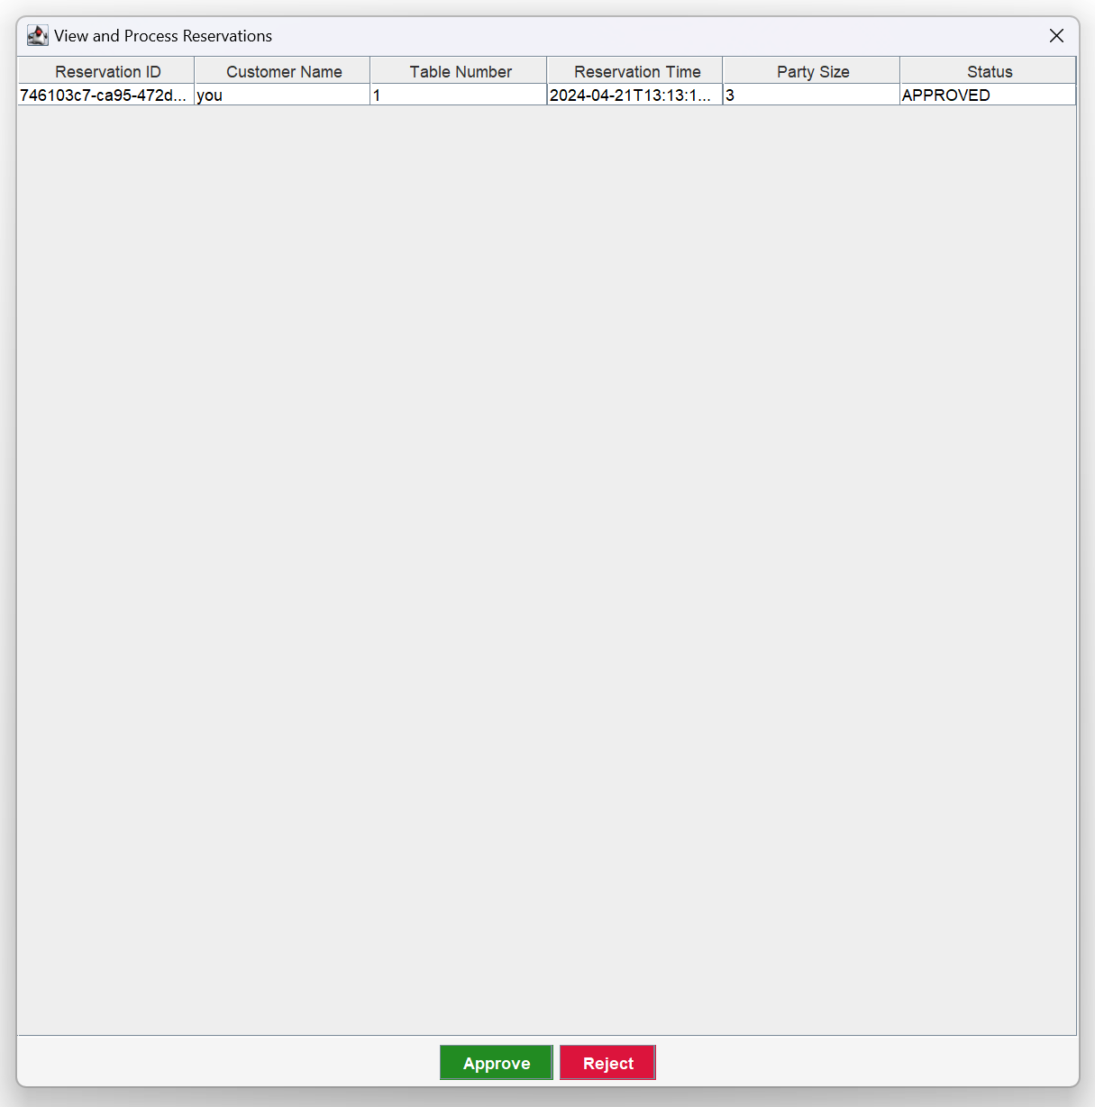
Functionalities Implemented
There are two distinct roles: customers and employees, each with specialized functionalities designed to streamline their interactions with the platform
Edit Menu
Edit Table
View Reservation

Slide 8
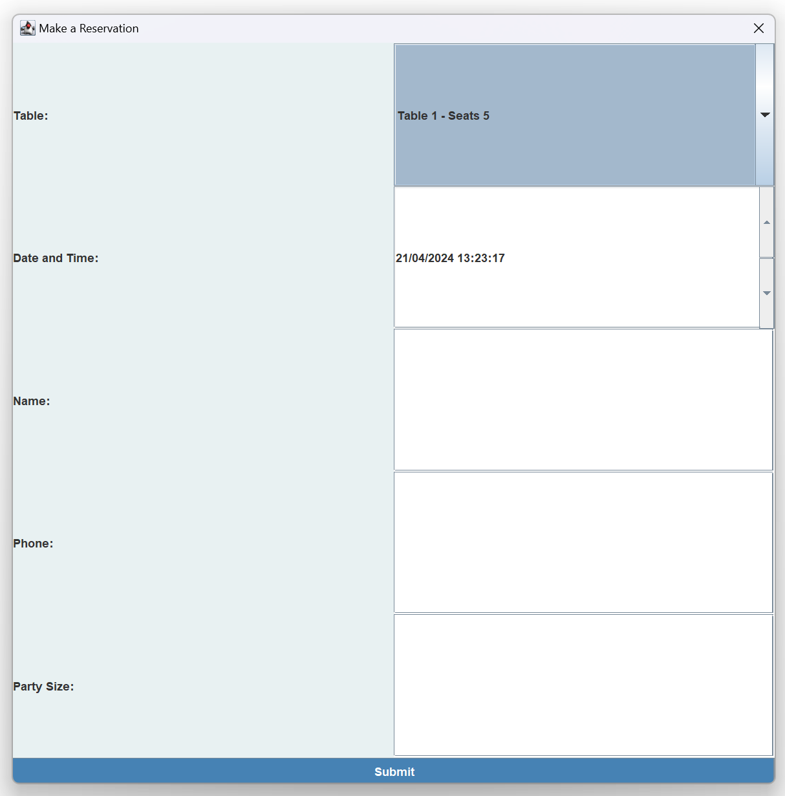
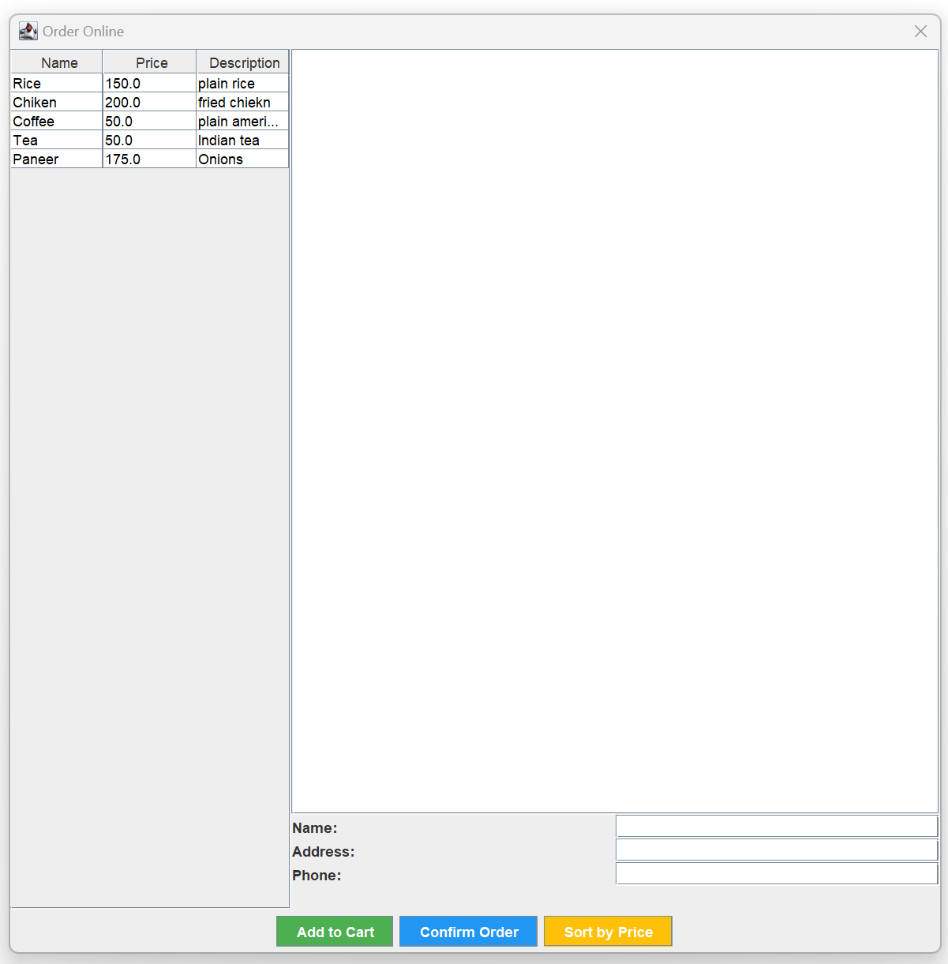
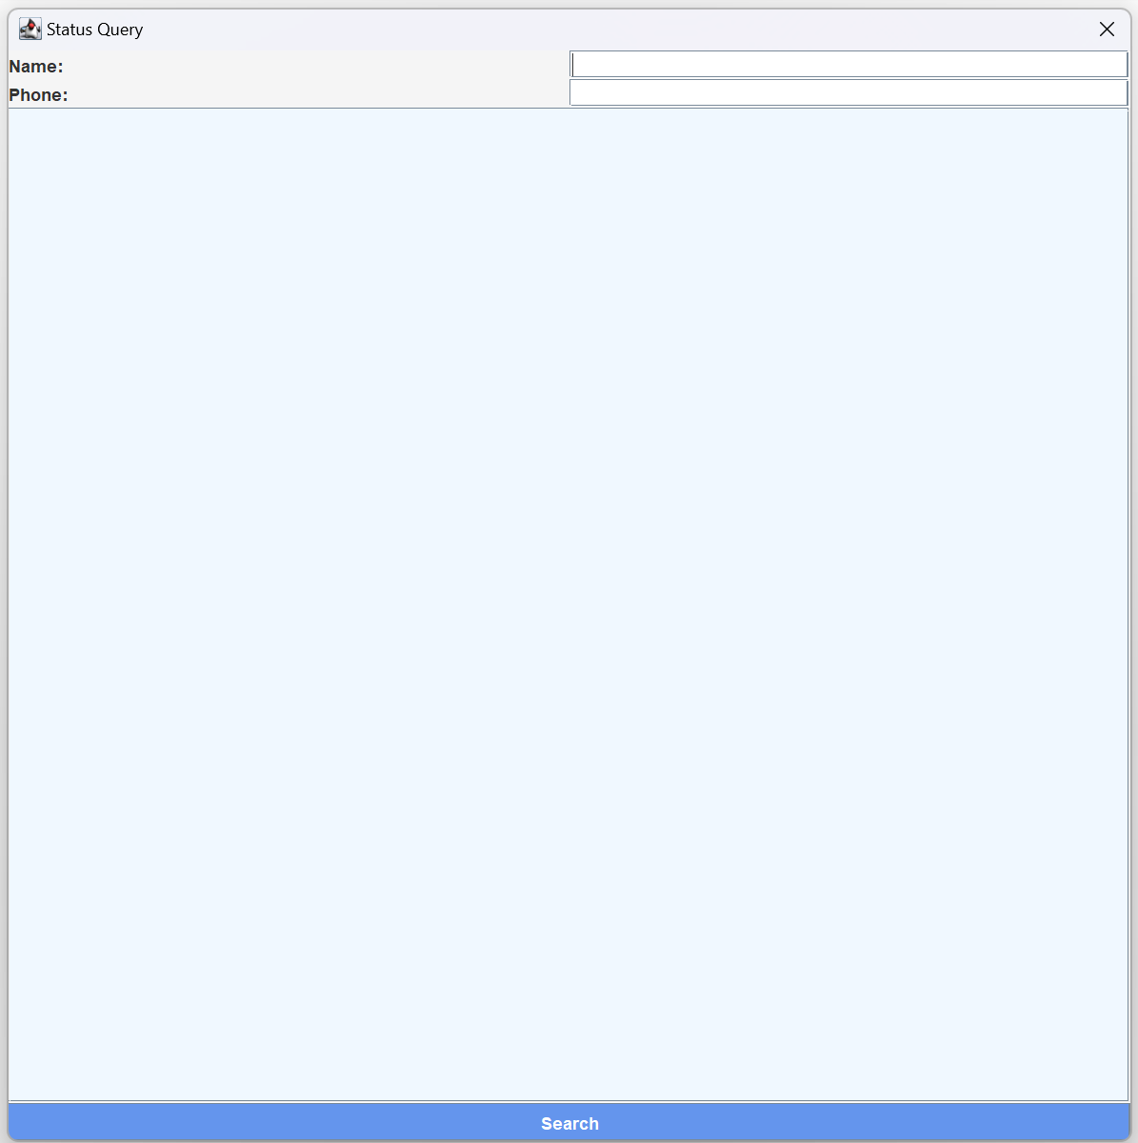
Functionalities Implemented
There are two distinct roles: customers and employees, each with specialized functionalities designed to streamline their interactions with the platform
Make a Reservation
Order Online
Order Status

Slide 9
Functionalities Implemented
Object Oriented Concepts Code
public class CSVUtils {
public static List<String[]> readCSV(String filePath) {
List<String[]> data = new ArrayList<>();
File file = new File(filePath);
if (!file.exists()) {
System.out.println("File does not exist: " + filePath);
return data;
}
try (BufferedReader br = new BufferedReader(new FileReader(file))) {
String line;
while ((line = br.readLine()) != null) {
String[] dataValues = line.split(",");
data.add(dataValues);
}
} catch (IOException e) {
System.out.println("Error reading CSV file: " + e.getMessage());
}
return data;
}
public static void writeCSV(List<String[]> data, String filePath) {
try (PrintWriter pw = new PrintWriter(new FileWriter(filePath))) {
for (String[] dataValues : data) {
pw.println(String.join(",", dataValues));
}
} catch (IOException e) {
System.out.println("Error writing CSV file: " + e.getMessage());
}
}
}
CSV Utils class handles operations for reading from and writing to CSV files, used for storing table, customer, and reservation data.

Slide 10
Functionalities Implemented
Object Oriented Concepts Code
public static List<String[]> readCSV(String filePath) {
List<String[]> data = new ArrayList<>();
File file = new File(filePath);
if (!file.exists()) {
System.out.println("File does not exist: " + filePath);
return data;
}
try (BufferedReader br = new BufferedReader(new FileReader(file))) {
String line;
while ((line = br.readLine()) != null) {
String[] dataValues = line.split(",");
data.add(dataValues);
}
} catch (IOException e) {
System.out.println("Error reading CSV file: " + e.getMessage());
}
return data;
}
Exception Handling :
Try-catch blocks in CSVUtils to handle I/O errors during file reading and writing processes.

Slide 11
Functionalities Implemented
Object Oriented Concepts Code
public static List<Order> findOrdersByNameAndPhone(String name, String phone) {
return orders.stream()
.filter(order -> order.getCustomer().getName().equalsIgnoreCase(name) && order.getCustomer().getPhoneNumber().equals(phone))
.collect(Collectors.toList());
}
public static List<Reservation> findReservationsByNameAndPhone(String name, String phone) {
return reservations.stream()
.filter(reservation -> reservation.getCustomer().getName().equalsIgnoreCase(name) && reservation.getCustomer().getPhoneNumber().equals(phone))
.collect(Collectors.toList());
}
Lambda expressions and Stream API : to filter collections of orders and reservations based on specific criteria.

Slide 12
Functionalities Implemented
Object Oriented Concepts Code
private void sortMenuByPrice() {
menuItems.sort(Comparator.comparingDouble(MenuItem::getPrice));
refreshTable();
}
JSpinner.DateEditor timeEditor = new JSpinner.DateEditor(dateSpinner, "dd/MM/yyyy HH:mm:ss");
dateSpinner.setEditor(timeEditor);
Comparators for Sorting: Sorting menu items by price in the menu management feature using a lambda expression.
LocalDateTime and ZoneId: in Reservation to handle reservation date and time details.

Slide 13
Contributions
Anurag Gher : UI, PPT and Video
Jiajian You : UI and backend
Sajiri Gokak : UI, PPT and Video
Yu Du : UML and UI
Zheng Zhang : UI and backend

Slide 14

Thank you

