Slide 1

Welcome to Burger Haven
Team Member:
Jaeson Ryu
Zhengdong Peng
Lan Zhang

Slide 2
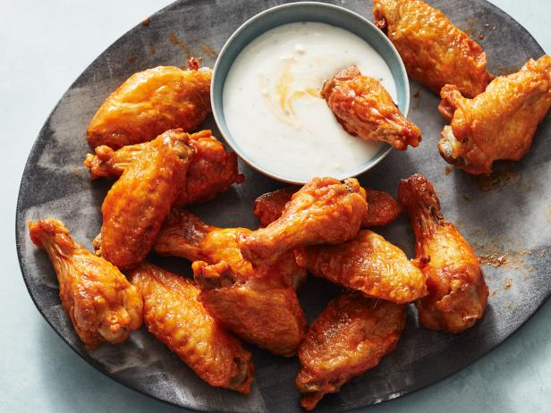
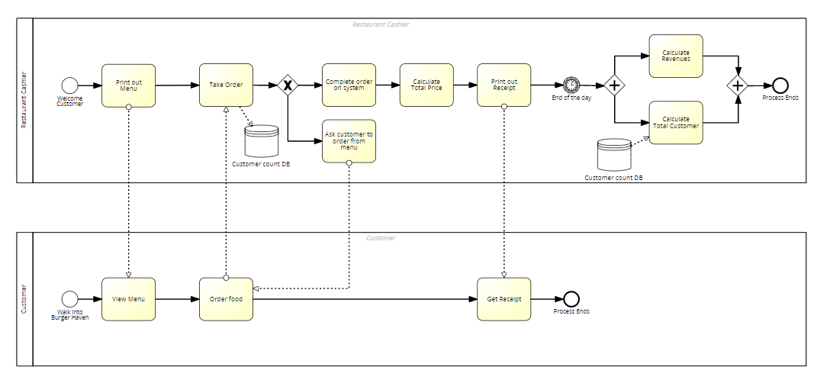
BPMN Flow Chart

Slide 3
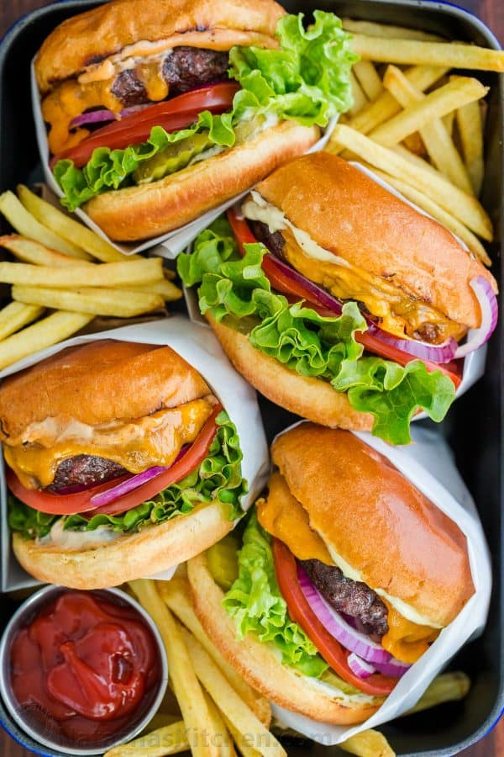
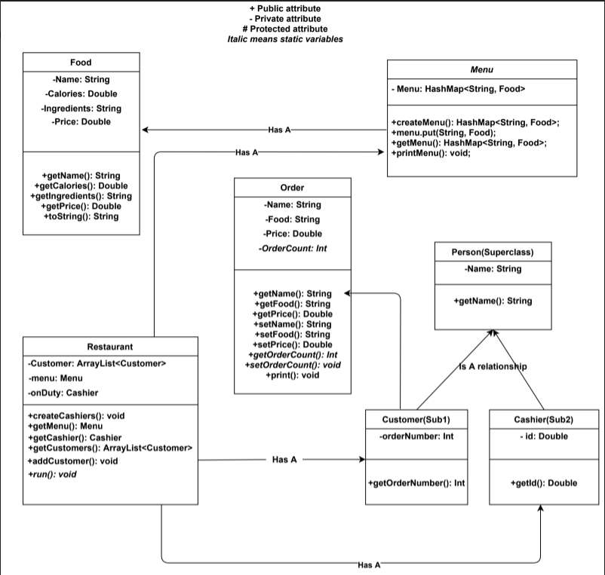
UML

Slide 4
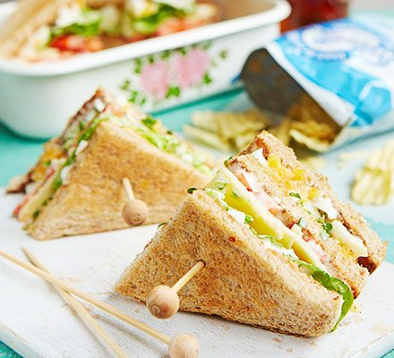
OOP & Classes
Food
Menu
Restaurant
Restaurant
Cashier
Customer
Order process
Person
Cashier
Customer

Slide 5
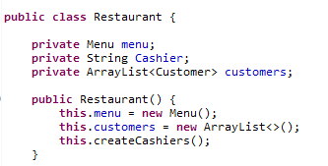
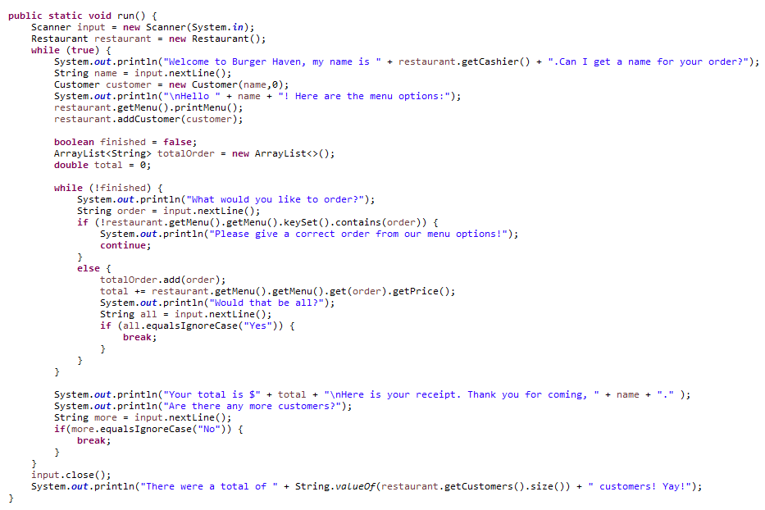
Restaurant Class

Slide 6
Cashier List: private String[] Cashier
Ingredients: String[] ingredients
Array
Customer List:ArrayList<Customer> customers;
TotalOrder: ArrayList<String> totalOrder
ArrayList
Menu:
private HashSet<String> menu = new HashSet<String>();
HashSet
Food:
private HashMap<String, Food> menu;
HashMap

Slide 7
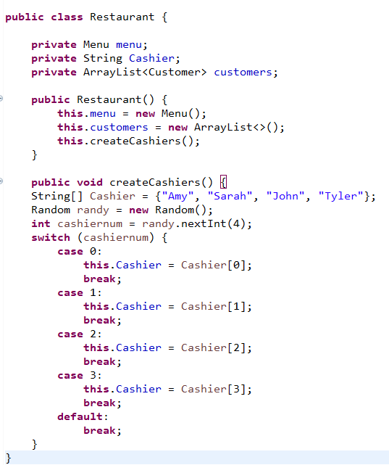
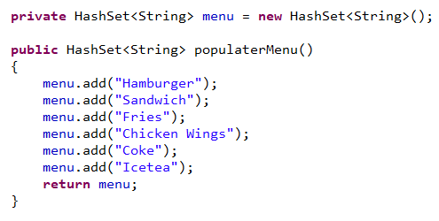
Array & HashSet

Slide 8
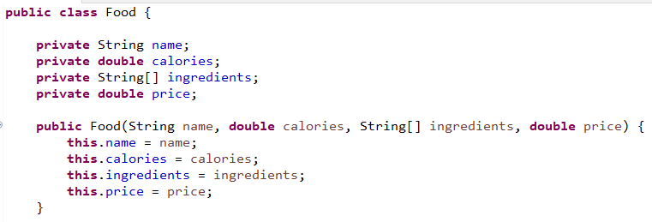
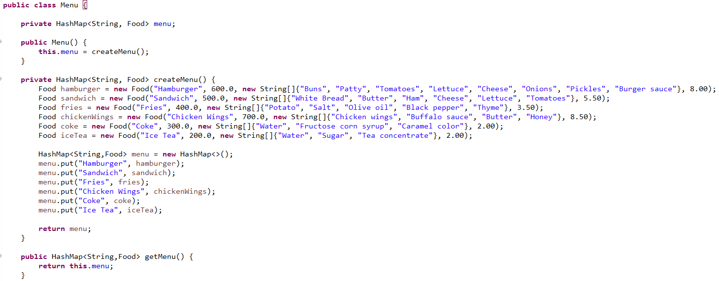
HashMap

Slide 9
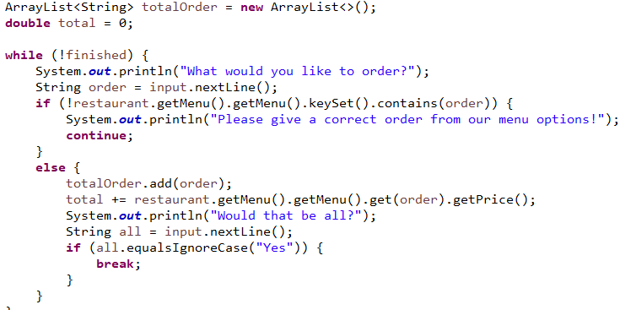
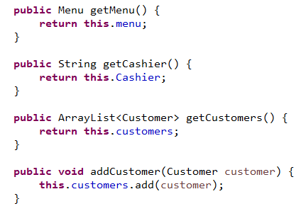
ArrayList

Slide 10
OOP Principles
Has-A (Composition):
Food to Menu
Static data:
private static int orderCount;
IS – A (Inheritance):
Cashier to Person
Customer to Person

Slide 11
Has-A

Slide 12
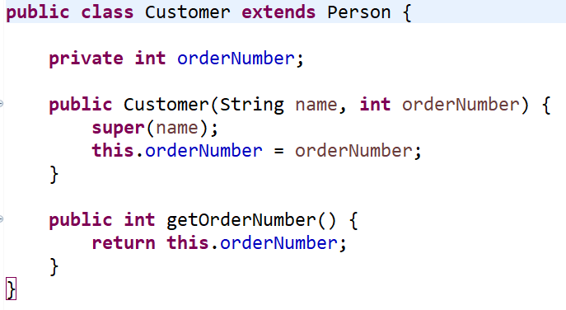
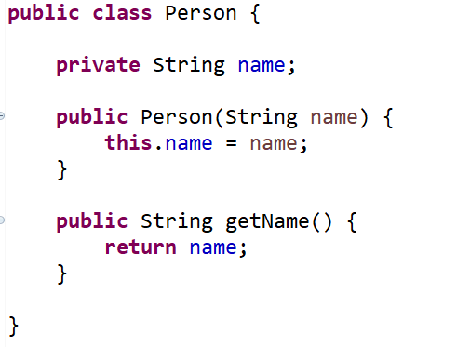
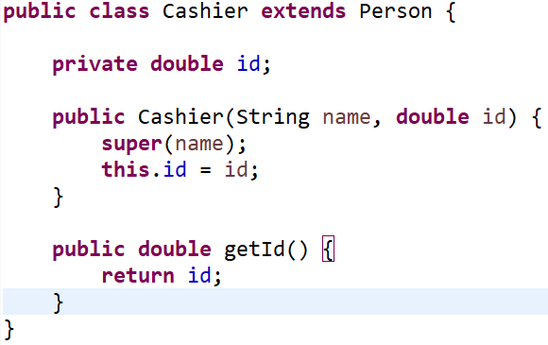
Is-A

Slide 13
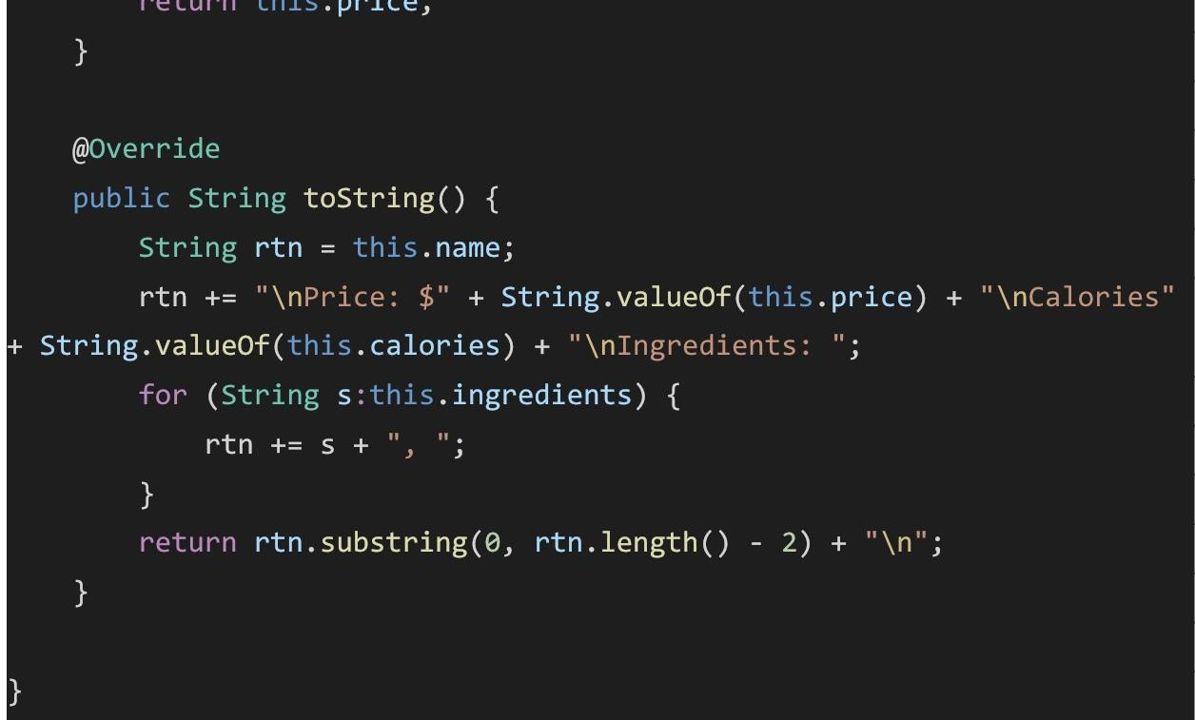
Polymorphism

Slide 14
Scenarios
Katie wants to order some food from Burger Haven to eat for lunch. She wants to order either a hamburger or a sandwich and then something for a drink. However, she is allergic to pickles and corn-related products (fructose corn syrup). We want to know what she may order from the menu options and what the total will be.
2. A following set of customers came and ordered food at Burger Haven on a single day. We want to know what the total revenue will be for the restaurant for that day.
Order #1: John ordered a hamburger, a sandwich, and a coke
Order #2: Luke ordered Chicken WIngs
Order #3: Karen ordered a sandwich, chicken wings, and an ice tea

Slide 16
Thank
You

Slide 17
Inheritance:
Ex: Cashier and customer class both extends upon the person class,
and we can see how objects of both classes have adopted getName() method
Composition:
HashMap attribute for objects of Menu class require Food class object values.
This demonstrates how the two classes are connected and one can't exist without another
Menu can't exist without food options
Encapsulation:
Ex: attributes such as name and menu for the objects of Restaurant class
cannot be accessed directly but only by utilizing the public getter and setter methods
Polymorphism:
Override is a form of polymorphism.
toString() method originally returns the String representation of the object
Overriding it as we did in Food class makes the method return a desired form of
output instead of a random hashcode representation

Slide 18
1. Give brief description (Joyce)
2. Explain our flowchart(Joyce)
c. explaining collections (Jaeson)
d. explaining OOP principles (Joey)
(inheritance, polymorphism, encapsulation, composition)
3. Walk-through of the scenario (Jaeson)

