Slide 1



Identifying Key Indicators of Spam Emails: A GLM Approach
Group22
Jingyue Hu; Xinyi Hu; Zhengfu LI; Ruijin LUO; Ziyue Tang; Mingjing ZHANG

Slide 2

Background
Which text characteristics influence whether an email will be classified as spam or not?
Objective: Optimize Spam Filters

Slide 3
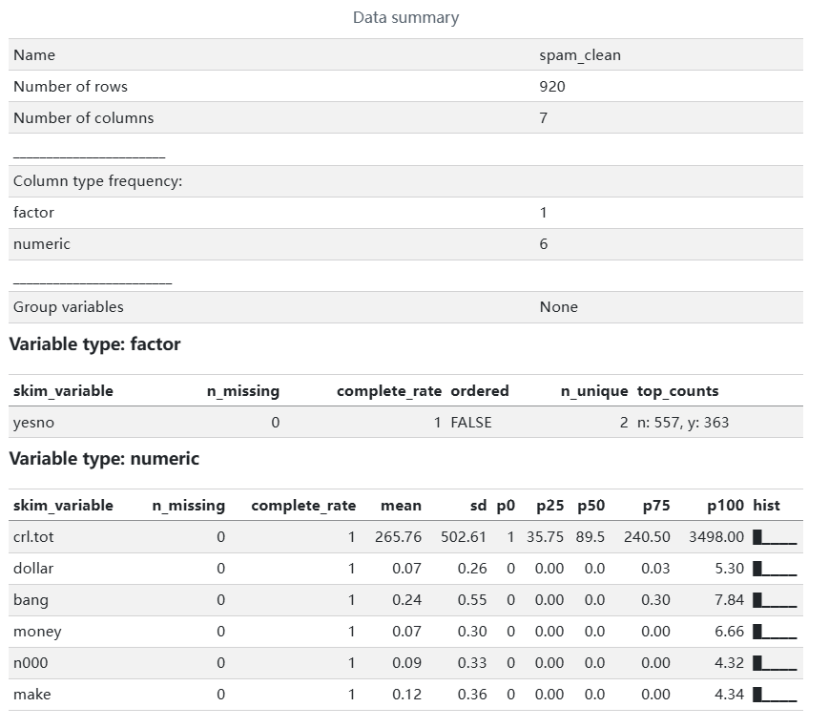
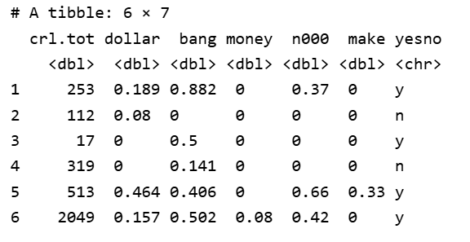
Data Cleaning
Response (Y): yes/no (Spam vs. Non-spam)
Predictors (X): 6 text-based features

Slide 4
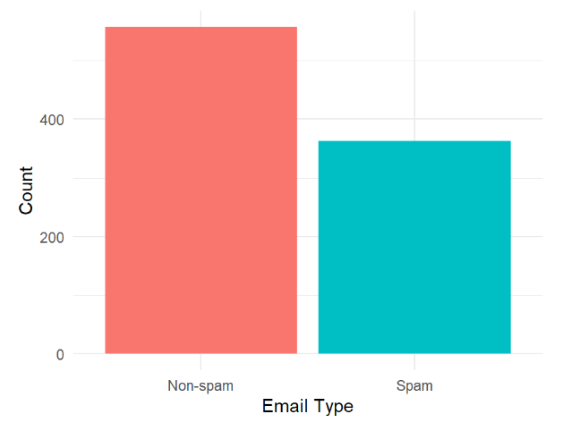
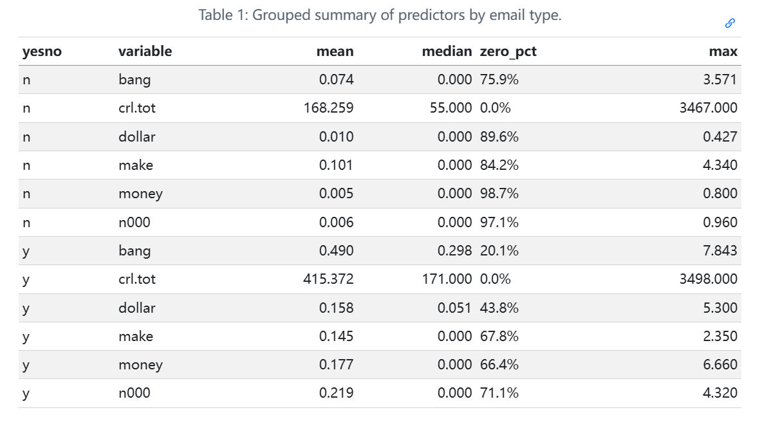
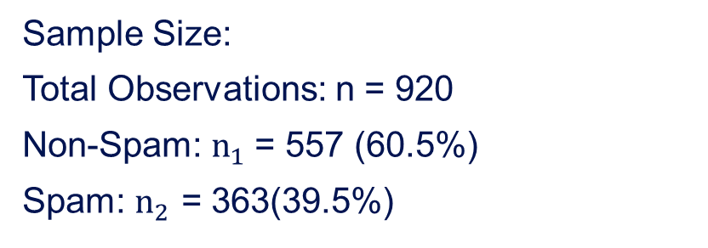
Exploratory Data Analysis (EDA)
Sample Size:
Total Observations: n = 920
Non-Spam: $n_{1}$= 557 (60.5%)
Spam: $n_{2}$ = 363(39.5%)

Slide 5
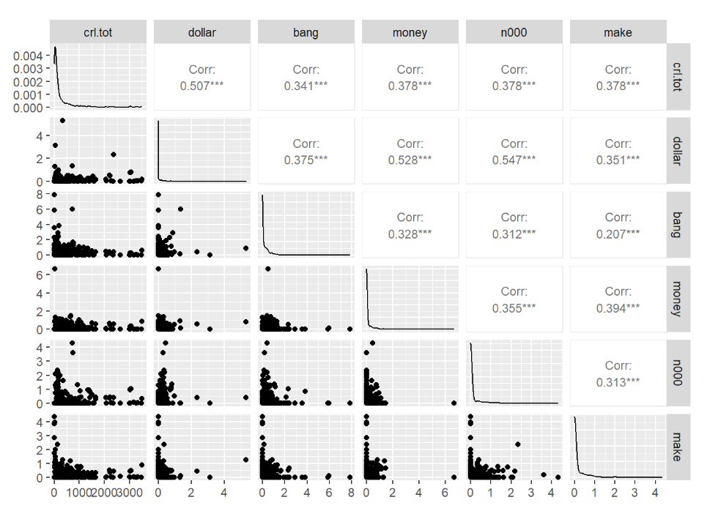
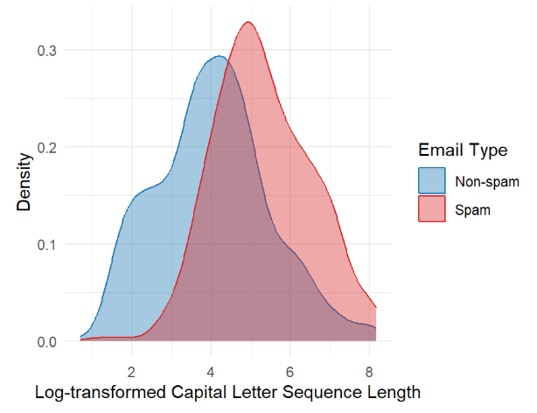
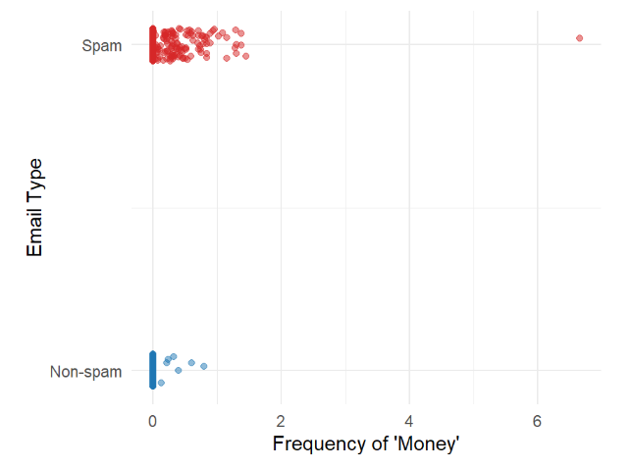
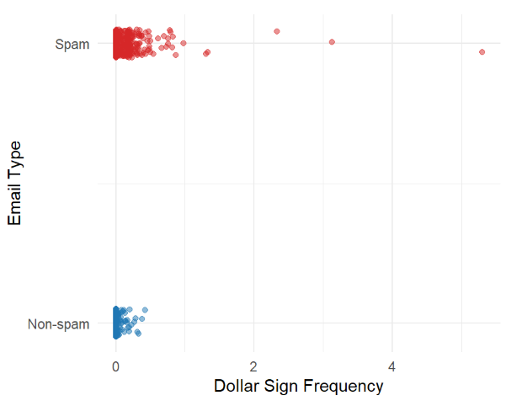
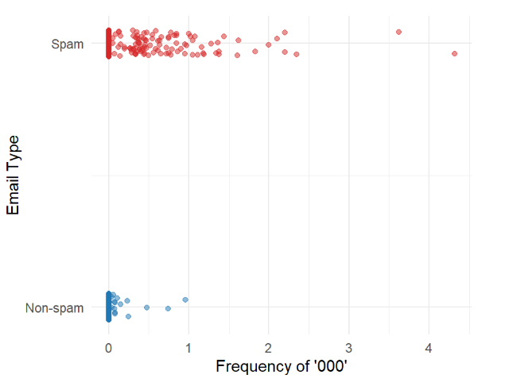
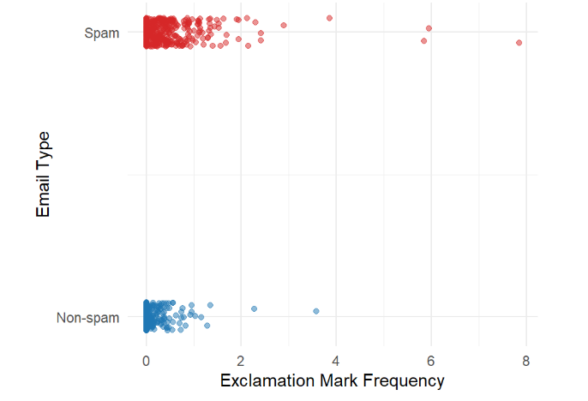
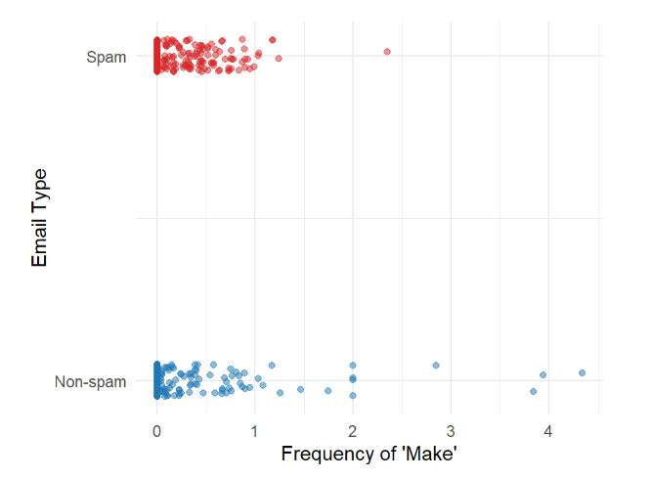
Exploratory Data Analysis (EDA) - Key Findings
Spam Indicators: Strong patterns observed in dollar, bang, and money.
Key Feature: String n000 shows a distinct frequency spike in spam.
Weak Pattern: Variable make appears less discriminative.
Model Suitability: Low multicollinearity; variables ready for Logistic Regression.

Slide 6
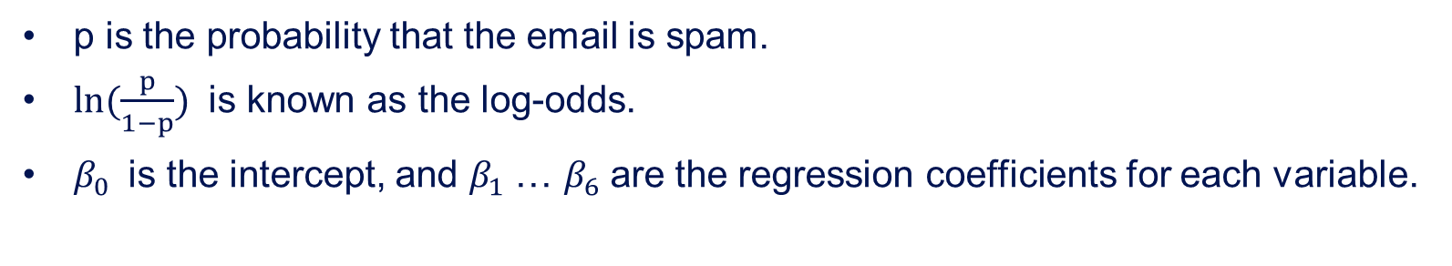
Statistical Analysis: Logistic Regression
$$ln(\frac{p}{1−p})=β_{0}+β_{1}（crl.tot)+β_{2}(dollar)+β_{3}(bang)+β_{4}(money)+β_{5}(n000)+β_{6}(make)$$
p is the probability that the email is spam.
$ln(\frac{p}{1−p})$ is known as the log-odds.
$β_{0}$is the intercept, and $β_{1}$… $β_{6}$are the regression coefficients for each variable.

Slide 7
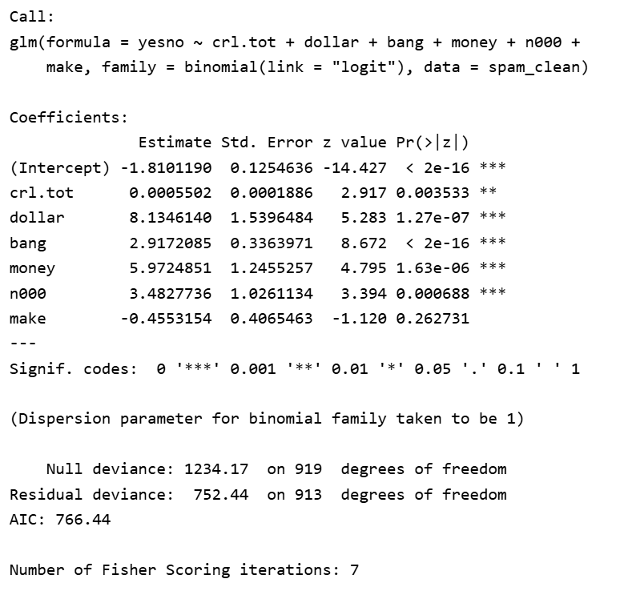
Model Fitting

Slide 8
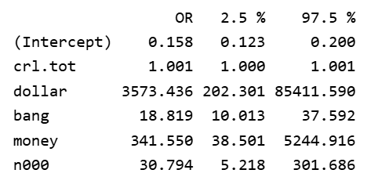
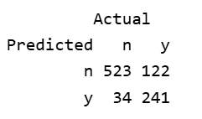
Model Selection & Results
Full : yesno ~ crl.tot + dollar + bang + money + n000 + make
Reduced : yesno ~ crl.tot + dollar + bang + money + n000
Selection: Reduced model via backward elimination.
Full Model AIC: 766.44
Reduced Model AIC: 766.04
Improved parsimony without sacrificing predictive power.
Overall Accuracy: 83.04 %
False Positive Rate: 6.1 %
Sensitivity: 67.4%
dollar, money are highly significant.
n000, bang are significant.
Capital letters have a negligible effect on predictions, or possibly no effect at all.

Slide 9
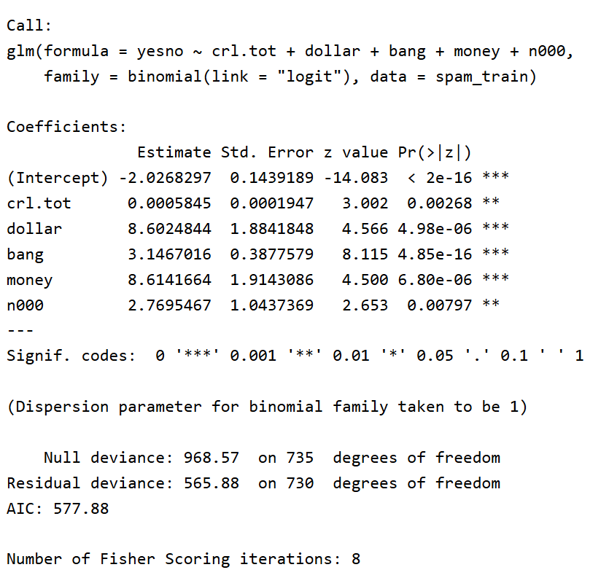
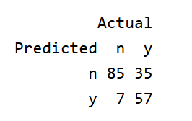
Model Validation & Performance
80/20 Train-Test
Final Test Accuracy: 77.17 %
False Positive Rate (Unseen Data): 7.61 %

Slide 10
Conclusion, Future Work & Limitations
Spam and non-spam emails showed clear differences in financial, promotional, and emphatic text features.
Strongest predictors:
dollar (P < 0.001, OR ≈ 3573), money (P < 0.001, OR ≈ 341)
Moderate predictors:
n000 (P < 0.01, OR ≈ 30.8), bang (P < 0.001, OR ≈ 18.8)
Weak practical effect:
crl.tot was statistically significant, but OR ≈ 1.001, so its practical effect was very small.
make was removed from the reduced model, which gave a simpler model while keeping the main useful predictors.
83% Accuracy confirms text-based features are effective for real-world baseline filtering.

Slide 11
Conclusion, Future Work & Limitations
Limitations:
The model used only a limited number of text-based predictors. And some predictors（e.g., crl.tot）were statistically significant but had weak practical effects, so The model should be seen as a useful baseline rather than a final solution.
Future Work:
Use a larger and more diverse dataset.
Add more text-based features.
Try other classification methods.

Slide 12
Q & A
Thanks for your listening!

