Slide 2

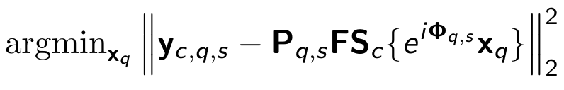
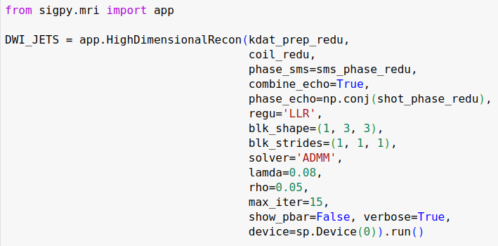
Overlapping Locally Low-Rank (LLR) Regularization
https://github.com/ZhengguoTan/demo_jets_diffusion_mri_7t
Efficient reconstruction framework
Easy-to-implement proximal functions
Extendable to neural networks
Proximal operator:
Singular value
thresholding
Patch pixels
Contrast
Z Tan, PA Liebig, RM Heidemann, FB Laun, F Knoll

Slide 3
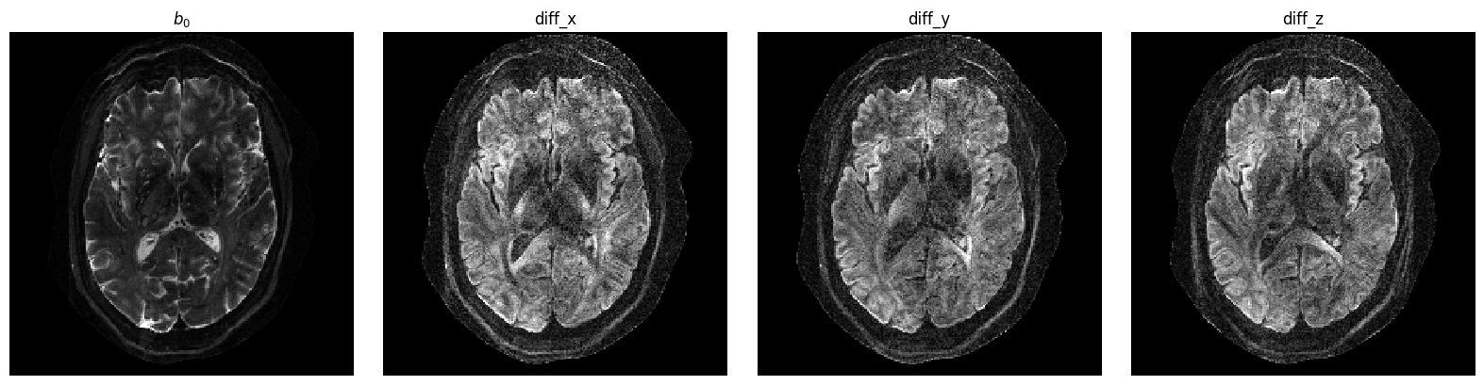
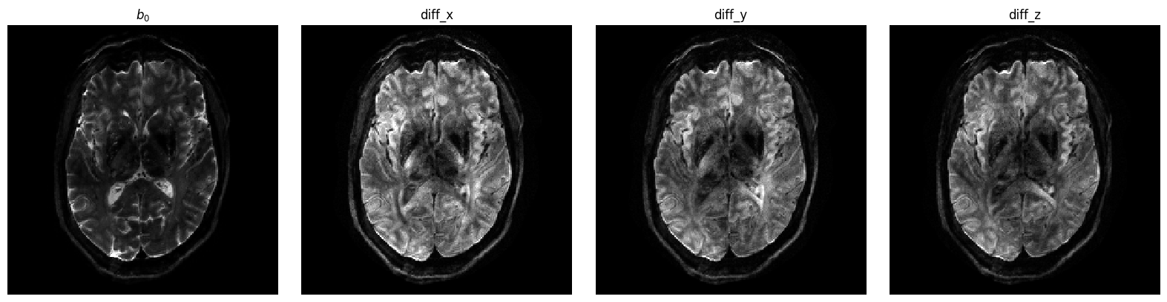
Result: Diffusion Weighted Images @ 0.5 x 0.5 x 2.0 mm
Parallel Imaging
JETS
Z Tan, PA Liebig, RM Heidemann, FB Laun, F Knoll

