Slide 1
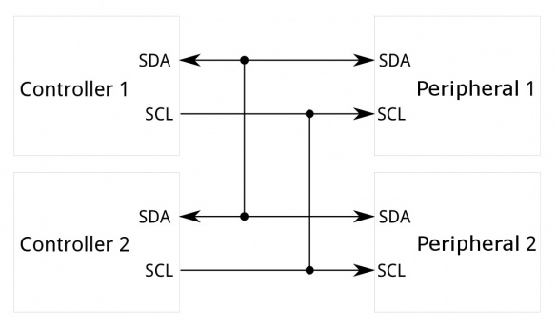
Inter-Integrated Circuit
Synchronous, multi-controller/multi-target (controller/target), packet switched, single-ended, serial communication bus.
Widely used for attaching lower-speed peripheral ICs to processors and microcontrollers in short-distance, intra-board communication.
https://learn.sparkfun.com/tutorials/i2c/all

Slide 2
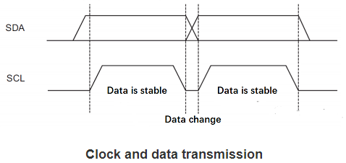
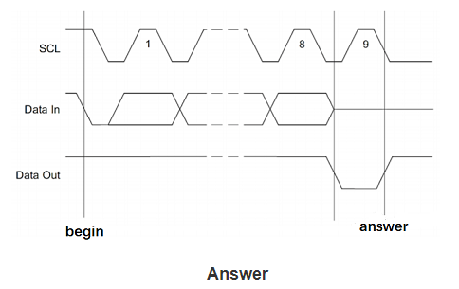
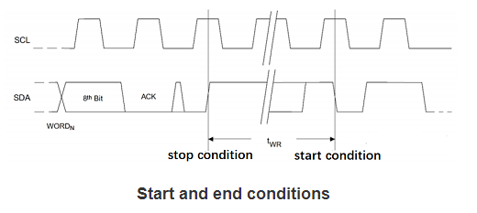
i2c signal
https://www.utmel.com/blog/categories/integrated%20circuit/what-is-inter-integrated-circuit-i2c

Slide 3
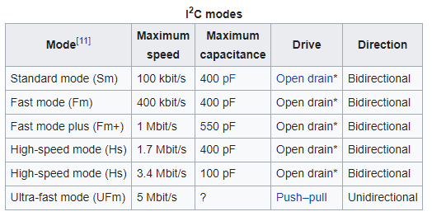
Modes
https://en.wikipedia.org/wiki/I%C2%B2C

Slide 4
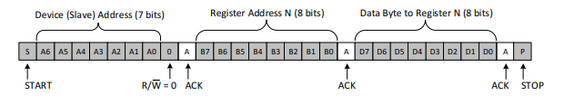

Read and Write
Understanding the I2C Bus (ti.com)

Slide 5
Logic Design
Mater
Slave
Mater
Slave
Slave Address (7Bit) + W
Slave Address (7Bit) + W
ACK (1Bit)
ACK (1Bit)
Slave Register Address (8Bit)
Slave Register Address (8Bit)
ACK (1Bit)
ACK (1Bit)
Slave Address (7Bit) + R
Data1 (8Bit)
ACK (1Bit)
ACK (1Bit)
Data1 (8Bit)
Data2 (8Bit)
ACK (1Bit)
ACK (1Bit)
Data2 (8Bit)
ACK (1Bit)
Write
Read

Slide 6
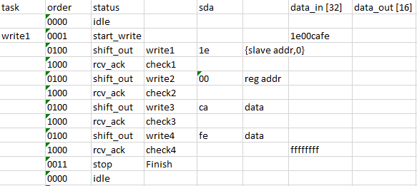
Master Flow Chart
Master Write Process
write enable signal (From controller)
idle
Start write
Shift out (Send bits by shift register)
Receive acknowledge (From slave)
Stop

Slide 7
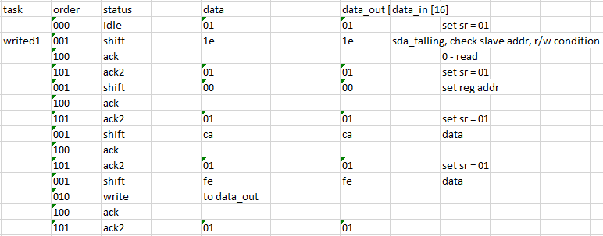
Slave Flow Chart
Write Slave Process
idle
sda_falling
Shift (Receive)
Send acknowledge
Write (Register File)
idle

Slide 8
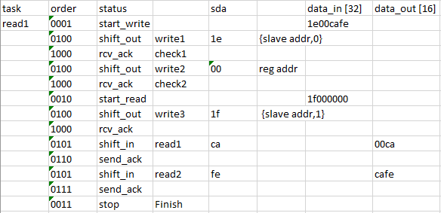
Master Flow Chart
Master Read Process
read enable signal (From controller)
idle
Start read
Shift out (Send slave address, R/W signal and slave register address)
Receive acknowledge (From slave)
Shift in (Receive data from slave)
Send acknowledge
Stop

Slide 9
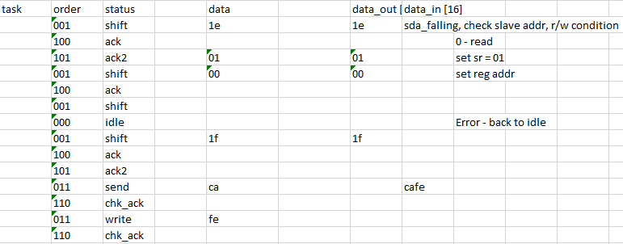
Slave Flow Chart
Read Slave Process
idle
sda_falling
Shift (Receive)
Send acknowledge
Send
Receive acknowledge
idle

Slide 10
INPUT
OUTPUT
clk
reset
clk_div
open_drain (always 1)
MASTER
status [4]
done
busy
Interal registers
sr [32] (Shift register) writing
sr_count [6] reading
byte_count [3] in_prog
scl_count [2]
clk_count [12]
data_out [16]
chip_addr [7]
reg_addr [8]
write_en
read_en
write_mode
sda_s
sda_reg
oen_reg
scl_s
data_in [16]
SDA
sda_in
sda_out
sda_oen
scl_in
scl_out
scl_oen
SCL

Slide 11
INPUT
OUTPUT
clk
reset
open_drain (always 1)
SLAVE
done
busy
Interal registers
sr [8] (Shift register) rw_bit
sr_send [16] nack
reg_bytes [2] writing
addr_bytes[2] reading
scl_count [2] continuing
clk_count [12]
chip_addr_reg [7]
data_out [16]
reg_addr [8]
chip_addr [7]
sda_s
sda_reg
oen_reg
sda_ss
scl_ss
scl_s
data_in [16]
sda_in
sda_out
sda_oen
scl_in
scl_out (0)
scl_oen (1)
SDA
SCL

Slide 12
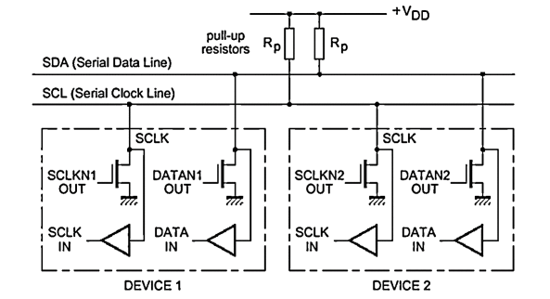
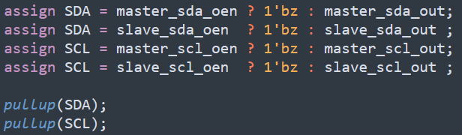
Open Drain
SDA is high when idle.

Slide 13
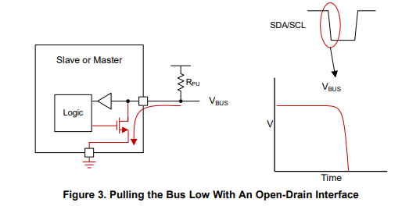
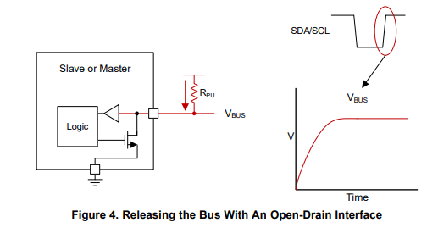
Open-Drain Pulling Low and Releasing
Understanding the I2C Bus (ti.com)

Slide 14
VDD
Chip
Control Logic
I2C
Register for slave address + W/R [8]
sda_in
Pull-up R
SDA
Master
Slave Register address [8]
sda_out_en
Write enable [1]
sda_out (Ground)
Pull-up R
SCL
scl_in
Read enable [1]
sda_out_en
sda_ out (Ground)
sda_in
Slave
sda_out_en
Data Path
sda_out (Groud)
Data Register [16]
scl_in
scl_out_en
Register File [16bit * 256]
scl_out (Ground)
Open drain design

Slide 15
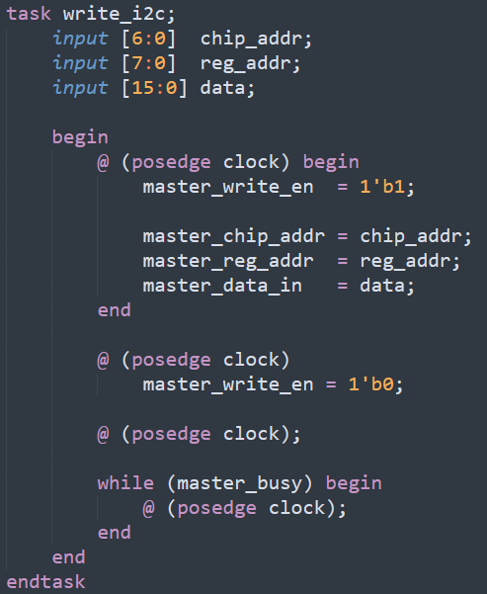
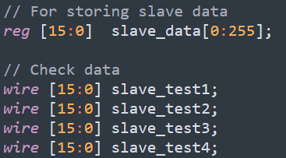
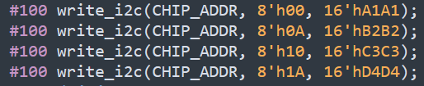
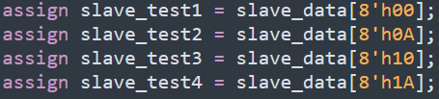
i2c_write_tb

Slide 16
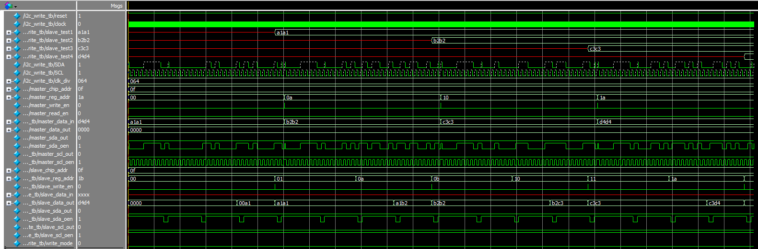
i2c_write_tb

Slide 17
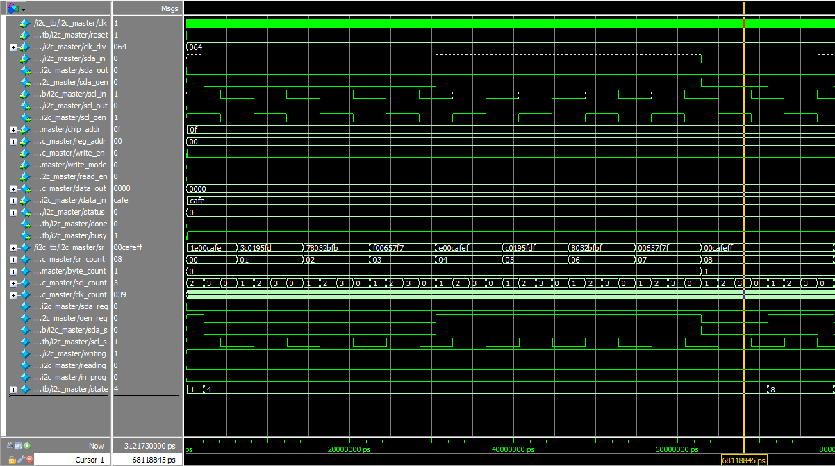
i2c_write_tb Master

Slide 18
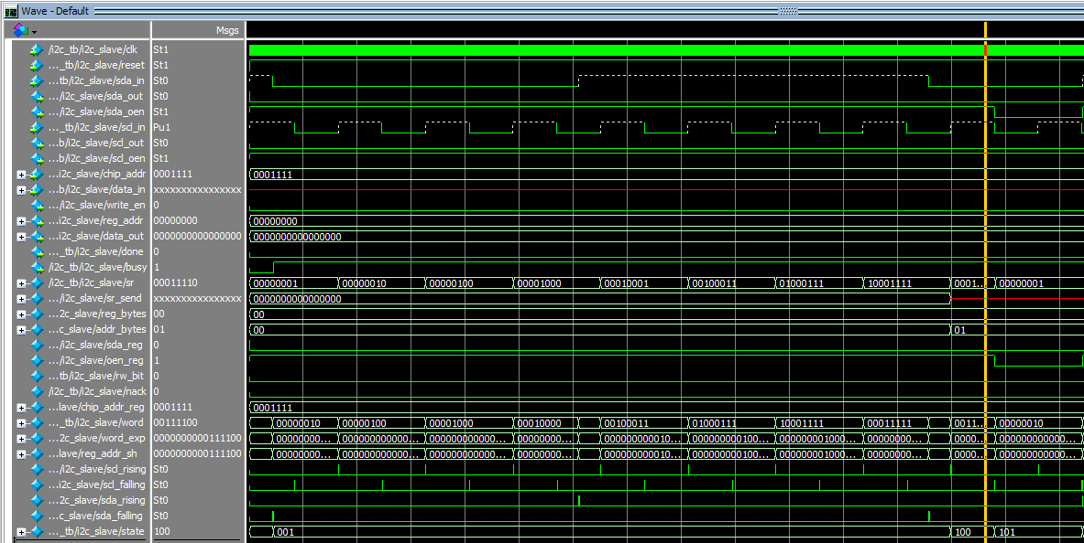
i2c_write_tb Slave

Slide 19
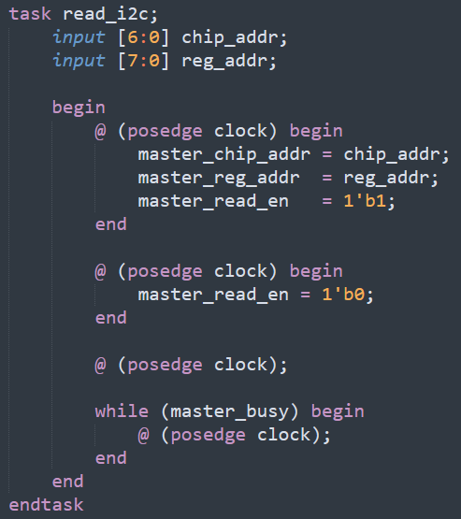

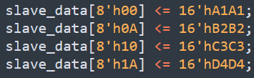
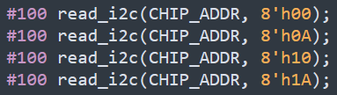
i2c_read_tb

Slide 20
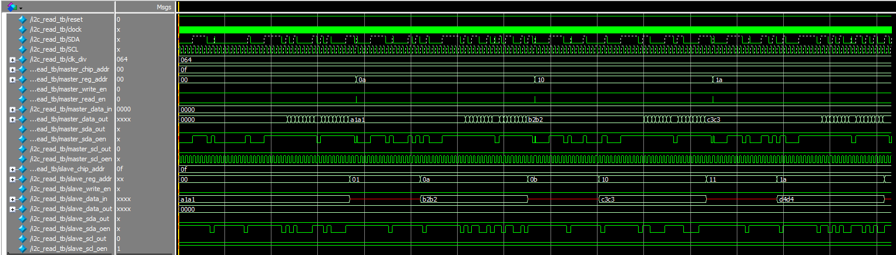
i2c_read_tb

Slide 21
Input clk
Input reset
Input clk_div
Input open_drain
I2C
Input clk
Input reset
Input clk_div
Input open_drain
Input chip_addr
Input reg_addr
Input data_in
Input write_en
Input write_mode
Input read_en
Output status
Output done
Output busy
Output data_out
Input sda_in
Input scl_in
Output sda_out
Output sda_oen
Output scl_out
Output scl_oen
Master
MUX
Output sda_out
Output sda_oen
Output scl_out
Output scl_oen
enable
Input chip_addr
Input reg_addr
Input write_en
Input write_mode
Input read_en
Output status
MUX
MUX
Master Logic
MUX
enable? Master, Slave
MUX
MUX
Input data_in
Output data_out
Output done
Output busy
Data Path
MUX
SDA and SCL
MUX
Input clk
Input reset
Input open_drain
Input chip_addr
Output reg_addr
Input data_in
Output write_en
Output data_out
Output done
Output busy
Input sda_in
Input scl_in
Output sda_out
Output sda_oen
Output scl_out
Output scl_oen
Slave
Slave Logic
Input chip_id
Output slave_reg_addr
Output slave_write_en
Input sda_in
Input scl_in

