Slide 1
Body fat data
Group 7
Ruijing Chen,Tianyu Yao, Kangxin Zheng

Slide 2
Data Cleaning
Notes:
Our first step was data cleaning. Recognizing the connections between features, we used Siri’s equation to calculate body fat from density. We compared these calculated values with the provided data, focusing on errors that exceeded a set threshold. For indices 48 and 76, the calculated body fat appeared normal, so we identified these as transcription or calculation errors and replaced them with calculated body fat. The remaining three rows had abnormal density values, indicating measurement errors, so we set them to NA.

Slide 3
Data cleaning-consistency check
Check the correlation between bodyfat and density
$$Bodyfat=\frac{\frac{495}{Density}−450}{100}$$
By Siri’s equation, we have:
calculated bodyfat
IDNO | BODYFAT | DENSITY | CALCULATED_BODYFAT
48 | 6.4 | 1.0665 | 14.1350
76 | 18.3 | 1.0666 | 14.0915
96 | 17.3 | 1.0991 | 0.3684
182 | 0 | 1.1089 | -3.6116
216 | 45.1 | 0.995 | 47.4874
Index 48,76:Transcription error of bodyfat
Impute them with calculated bodyfat
Index 96,182,216:Measurement error
Set the value to NA
Notes:
Our first step was data cleaning. Recognizing the connections between features, we used Siri’s equation to calculate body fat from density. We compared these calculated values with the provided data, focusing on errors that exceeded a set threshold. For indices 48 and 76, the calculated body fat appeared normal, so we identified these as transcription or calculation errors and replaced them with calculated body fat. The remaining three rows had abnormal density values, indicating measurement errors, so we set them to NA.

Slide 4
Data cleaning-consistency check
Check the correlation between height, weight and adiposity
$$Adiposity= \frac{\frac{Weight(lbs)}{2.2}}{{(Height\left(inches\right)∗0.0254)}^{2}}$$
We have:
calculated BMI
IDNO | WEIGHT | HEIGHT | ADIPOSITY | CALCULATED BMI
42 | 205 | 29.5 | 29.9 | 165.9662
163 | 184.25 | 68.75 | 24.4 | 27.4645
221 | 153.25 | 70.5 | 24.5 | 21.7236
Index 42 : Transcription error of height
Impute it with calculated height.
Index 163 : Transcription error of height
Impute it with calculated height.
Index 221 : Transcription error of weight
Impute it with calculated weight.
Notes:
Similarly, we examined the relationship between height, weight, and BMI. The abnormal height data we’ve mentioned in class is detected by this way. we corrected abnormal height values for indices 42 and 163, and adjusted the weight for index 221.

Slide 5
Data cleaning-consistency check
Check the correlation between height, weight and adiposity
$$Adiposity= \frac{\frac{Weight(lbs)}{2.2}}{{(Height\left(inches\right)∗0.0254)}^{2}}$$
We have:
calculated BMI
IDNO | WEIGHT | HEIGHT | ADIPOSITY | CALCULATED BMI
42 | 205 | 29.5 69.5 | 29.9 | 165.9662
163 | 184.25 | 68.75 72.94 | 24.4 | 27.4645
221 | 153.25 | 70.5 | 24.5 | 21.7236
Index 42 : Transcription error of height
Impute it with calculated height.
69.5
72.94
Index 163 : Transcription error of height
Impute it with calculated height.
172.8
Index 221 : Transcription error of weight
Impute it with calculated weight.

Slide 6
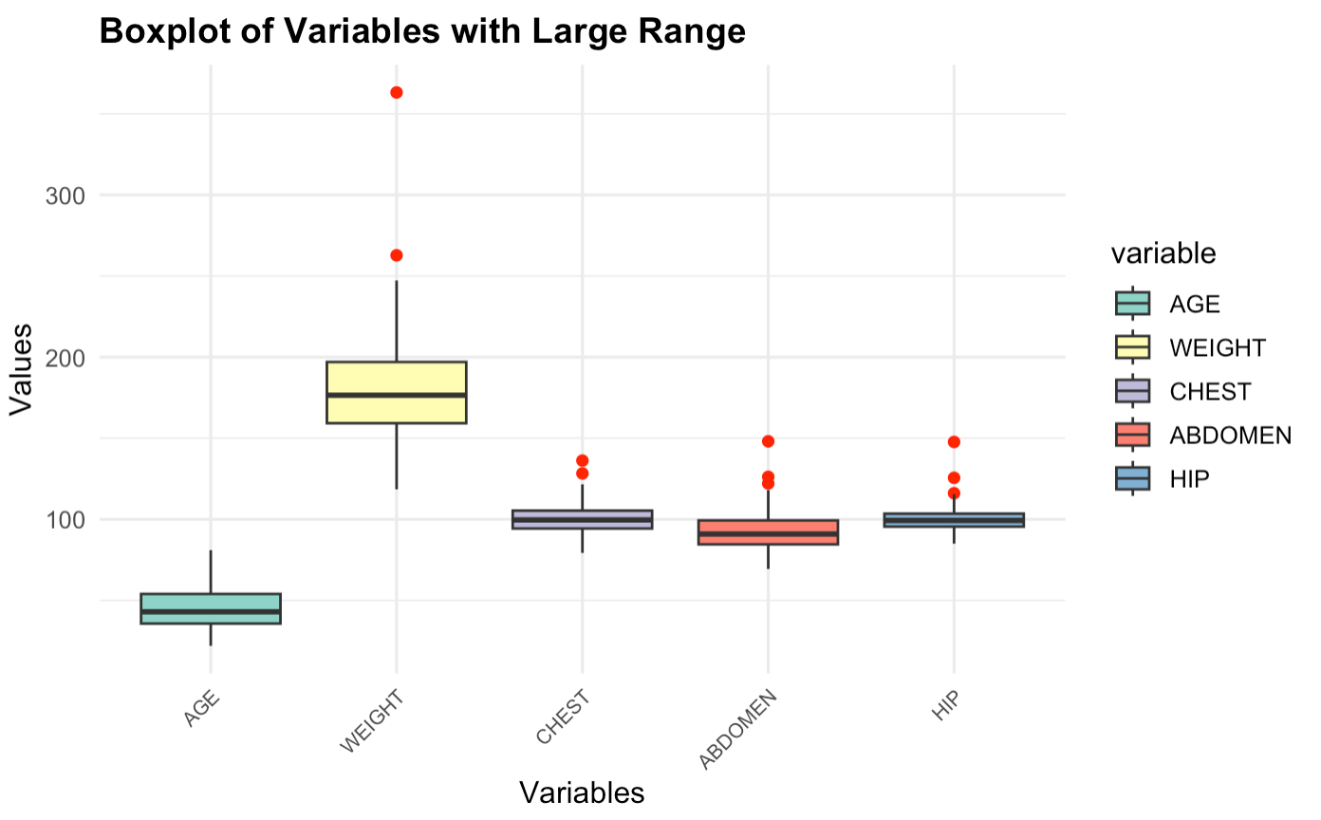
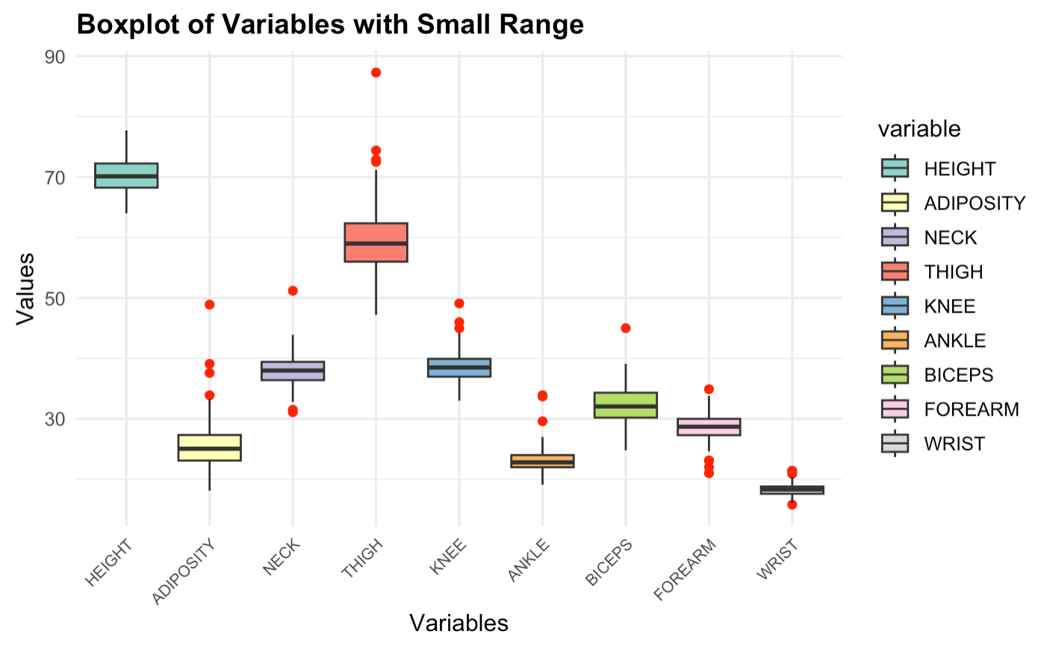
Data cleaning-find outliers
IQR=Q3−Q1
Lower Bound=Q1−1.5×IQR
Draw the boxplot and use IQR method to find outliers.
Upper Bound=Q3+1.5×IQR
Notes:
We then generated box plots and applied the IQR method to detect outliers.

Slide 7
Data cleaning-find outliers
Find the index that only occur once.
Double check the bodyfat outliers
by real-life data
Index | Feature | Value
31 | ANKLE | 33.9
35 | HIP | 116.1
86 | ANKLE | 33.7
106 | NECK | 31.1
152 | THIGH | 72.9
159 | FOREARM | 34.9
169 | THIGH | 74.4
172 | BODYFAT | 1.9
175 | FOREARM | 21
192 | KNEE | 45
206 | FOREARM | 23.1
242 | ADIPOSITY | 33.9
244 | KNEE | 46
252 | WRIST | 20.9
bodyfat < 3
abnormal
NA
bodyfat > 40
Notes:
Any index occurring only once was considered an outlier and set to NA. Additionally, we reviewed body fat values and set those below 3% or above 40% as outliers.

Slide 8
Data cleaning-Imputation
Impute with regression
IDNO | BODYFAT | AGE | WEIGHT | HEIGHT | ADIPOSITY | NECK | CHEST | ABDOMEN | HIP | THIGH | KNEE | ANKLE | BICEPS | FOREARM | WRIST
31 | 12.3 | 32 | 182 | 73.75 | 23.6 | 38.7 | 100.5 | 88.7 | 99.8 | 57.5 | 38.7 | NA | 32.5 | 27.7 | 18.4
23.36
ANKLE = 10.4099 - 0.0015 $×$BODYFAT - 0.0155 $×$AGE + 0.0348 $×$WEIGHT + 0.0340 $×$HEIGHT
+ 0.1526 $×$ADIPOSITY - 0.1102 $×$NECK -0.0202 $×$CHEST -0.0449 $×$ABDOMEN
- 0.0588 $×$HIP + 0.0370 $×$THIGH + 0.1878 $×$KNEE - 0.0703 $×$BICEPS
- 0.0353 $×$FOREARM +0.6001 $×$WRIST
Final cleaned data: n=252(from n=252) with p = 14 predictors
Y : BODYFAT
X: AGE, WEIGHT, HEIGHT, ADIPOSITY, NECK, CHEST, ABDOMEN, HIP, THIGH, KNEE, ANKLE, BICEPS, FOREARM, WRIST
Notes:
Finally, we employed regression method to impute missing values, treating ankle size as a dependent variable based on other variables.
After data cleaning, we’re left with 252 samples and 14 predictors, excluding index and density.

Slide 9
Model Selection
Notes:
Then we need to build our model .

Slide 10
Selection Criterion
Accuracy :
Adjusted r-square
Simplicity:
the number of predictors
Robustness :
using bootstrap resampling method and calculate the standard error for each coefficient
Notes:
We want to find a model that satisfies accuracy simplicity robustness, the measurements of
Basically ,We used multiple linear regression as the model because it’s easy and interpretable. The problem is to find the predictors.
Why adjusted r squared
Penalizes for adding unnecessary predictors:
makes it especially useful when comparing models with different numbers of predictors.

Slide 11
Accuracy vs. Simplicity– all subsets of regression
No. | Model | Accuracy (Adjusted R-Squared) | Simplicity (# of predictors)
1 | Y ~ ABDOMEN | 0.66 | 1
2 | Y ~ WEIGHT+ABDOMEN | 0.72 | 2
3 | Y ~WEIGHT+ABDOMEN+WRIST | 0.73 | 3
4 | Y~WEIGHT+ABDOMEN+WRIST+FOREARM | 0.74 | 4
5 | Y~WEIGHT+ABDOMEN+WRIST+FOREARM+NECK | 0.74 | 5
6 | Y~WEIGHT+ABDOMEN+WRIST+FOREARM+NECK+CHEST | 0.74 | 6
Notes:
To choose the variables, we applied all- subsets regression, which went through all possible combinations of variables, which is 2^p−1 possible models of p predictors, to select the best linear regression model. From this process, we selected the top-performing model within each subset size, The six models we chose are listed in the tables with one to six predictors The accuracy are ranged from 0.66 to 0.74.

Slide 12
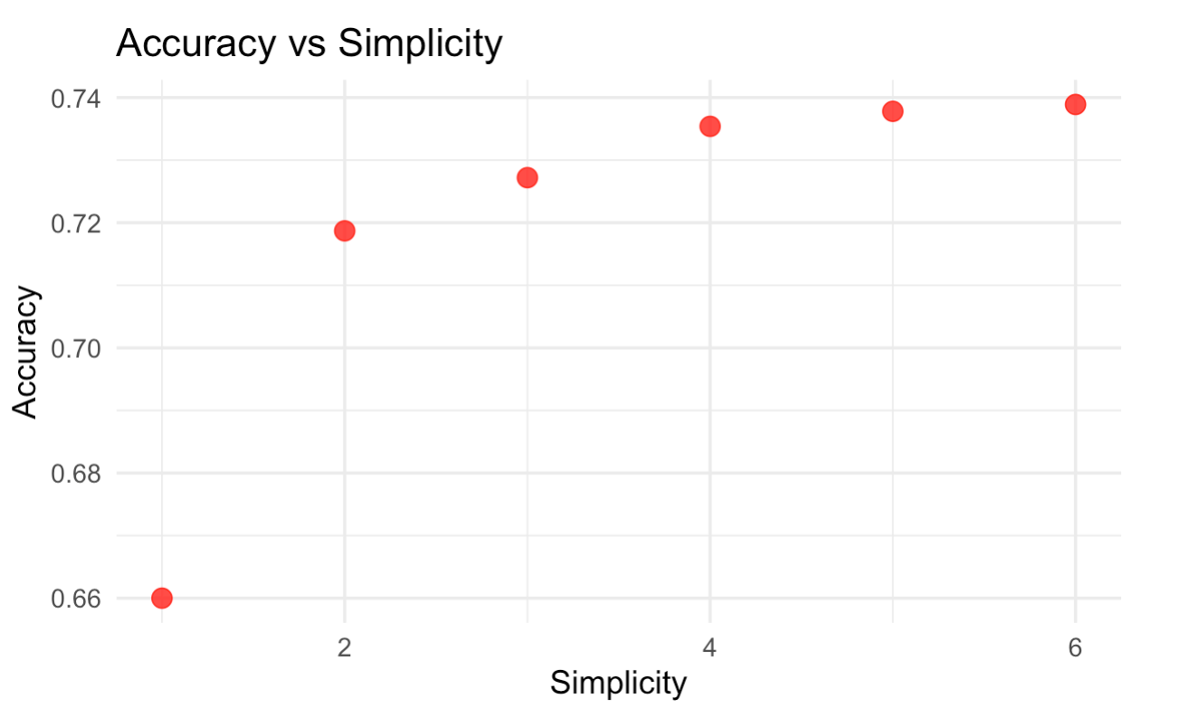
Accuracy vs. Simplicity
Notes:
As we can see from the plot , when we introduce more variables the accuracy increase we only select 6 models here because we found that adding predictors will only make slight advancement in r squared and start to decrease.
Then we evaluated the robustness of these models.

Slide 13
Robustness
Model | INTERCEPT | ABDOMEN | WEIGHT | WRIST | FOREARM | NECK | CHEST
1 | 3.51 | 0.04
2 | 2.55 | 0.05 | 0.02
3 | 6.5 | 0.05 | 0.03 | 0.42
4 | 7.38 | 0.05 | 0.03 | 0.43 | 0.25
5 | 7.21 | 0.05 | 0.03 | 0.46 | 0.26 | 0.23
6 | 7.94 | 0.06 | 0.03 | 0.47 | 0.26 | 0.22 | 0.84
Notes:
we used bootstrap sampling to calculate the standard error of the coefficients. We found that after adding the third variable,the standard error is relatively larger, which means more predictors introduce more variability and show less robustness.
to visualize the performances of these models and make our decision of our final model, we evaluating several candidate models using a bubble plot,we ultimately chose the model which has abdomen and weight as predictors, for it’s the relatively robust and simple model,and maintains good accuracy among the candidates. It strikes the ideal balance across all three dimensions – simplicity, robustness, and accuracy. The overall performance of model 2 is more likely to yield reliable and efficient results compared to other models that either lack robustness or simplicity.
It strikes the ideal balance across all three dimensions – simplicity, robustness, and accuracy.

Slide 14
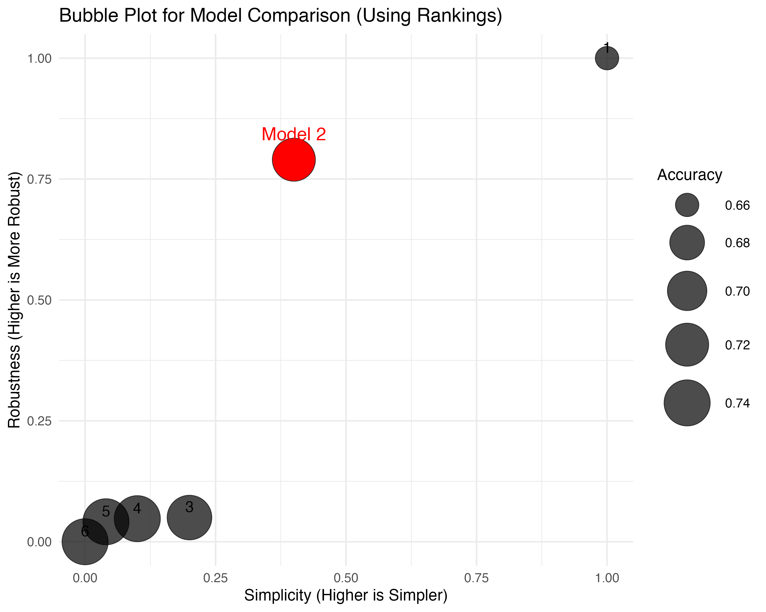
Results
Notes:
to visualize the performances of these models and make our decision of our final model, we evaluated several candidate models using a bubble plot,
X axis is simplicity and y axis is robustness we calculated them both to put them in the same scale with accuracy and use accuracy the size of the circle
we ultimately chose the model which has abdomen and weight as predictors, for it’s the relatively robust and simple model,and maintains good accuracy among the candidates.
Model 1 is simple and robust but the accuracy is less satisfying
It strikes the ideal balance across all three dimensions – simplicity, robustness, and accuracy. The overall performance of model 2 is more likely to yield reliable and efficient results compared to other models that either lack robustness or simplicity.

Slide 15
Final Model

Slide 16
Final model
BodyFat% = -40.42 + 0.92 * Abdomen(cm) – 0.14 * Weight (lbs)
Description
Weight +1 lb (abdomen unchanged): Body fat ↓ 0.14%
Abdomen +1 cm (weight unchanged): Body fat ↑ 0.92%
Example usage
Chinese men average (155 lbs, 90 cm): 20.05% with 95% PI (19.16%, 20.92%)
American men average(200 lbs, 102.1 cm): 24.74% with 95% PI (24.03%, 25.5%)
Notes:
This is our final model. For every 1 pounds increase in weight, body fat percentage decreases by 0.14%, while for every 1 cm increase in abdomen circumference, body fat percentage increases by 0.92%.
For example, the model predicts that an average Chinese man weighing 155 pounds with an abdomen circumference of 90 cm would have a body fat percentage of 20.04%.
For an average American man predicted body fat percentage is 24.74%.

Slide 17
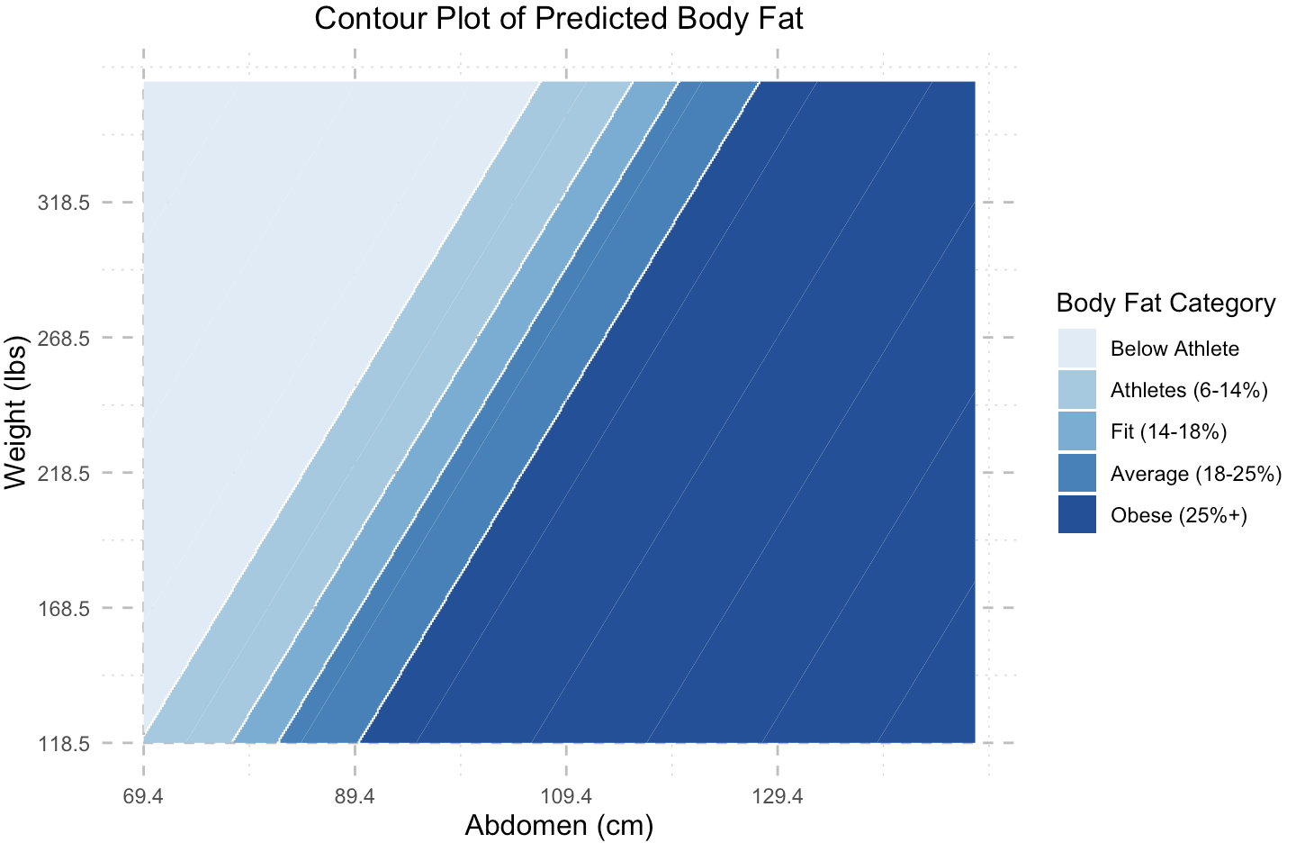
A Visual Description of the Final Model
Notes:
A contour plot illustrates how predicted body fat percentage varies with different values of weight and abdomen circumference. The plot is color-coded to represent different body fat categories, ranging from "Below Athlete" to "Obese," providing an intuitive visual representation of body composition.

Slide 18
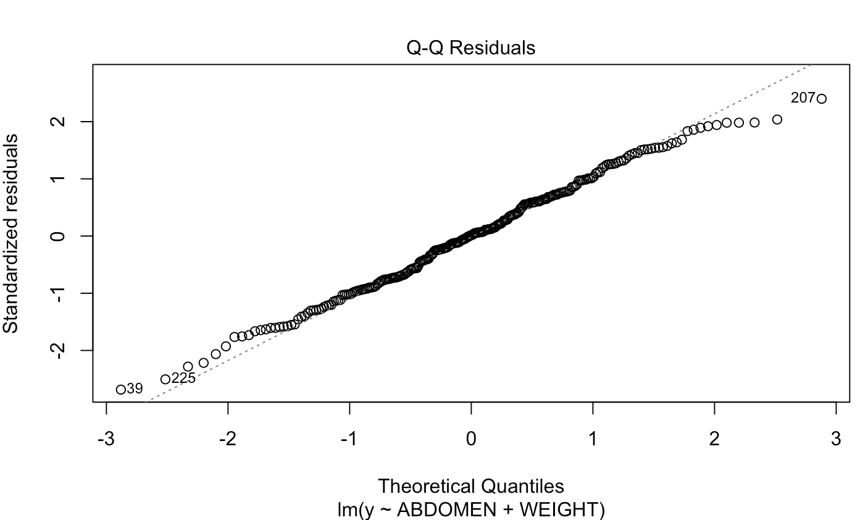
Model Diagnostics and Significance Testing
Normality check of residuals: QQ plot
Significance of coefficient and overall model：T-test, F-test
No multicollinearity between the variables as the VIF value = 4.77 (<5)
 | Abdomen coefficient | Weight coefficient | Overall model
T-test p-value | 3.7962e-46 | 1.1208e-12
F-test p-value |  |  | 9.5175e-70
significance | significant | significant | significant
Notes:
Model diagnostics indicate that the residuals approximately follow a normal distribution (as shown by the Q-Q plot), and the T-test and F-test results confirm that both coefficients and the overall model are statistically significant. Additionally, the model does not suffer from multicollinearity, as the Variance Inflation Factor (VIF) is below 5.

Slide 19
Strengths and Weaknesses of Final Model
Body Fat% = -40.42 + 0.92 * Abdomen(cm) – 0.14 * Weight (lb)
Strengths
Very simple (only 2 variables and easy to get)
Explains 0.721 of variation in body fat
Weaknesses
Prediction is not accurate:
12.70% of predictions within +/- 3% of true value
19.84% of predictions within +/- 5% of true value
32.94% of predictions within +/- 10% of true value
Notes:
Strengths: The model is straightforward, using only two easily obtainable variables, and explains approximately 72% of the variation in body fat.
Weaknesses: Prediction accuracy is limited, with only 32.94% of predictions falling within 10% of the true body fat percentage, highlighting areas for potential improvement.

Slide 20
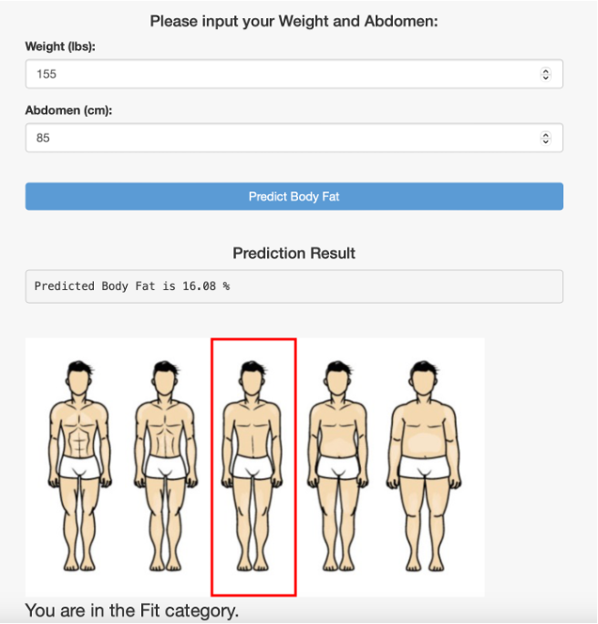
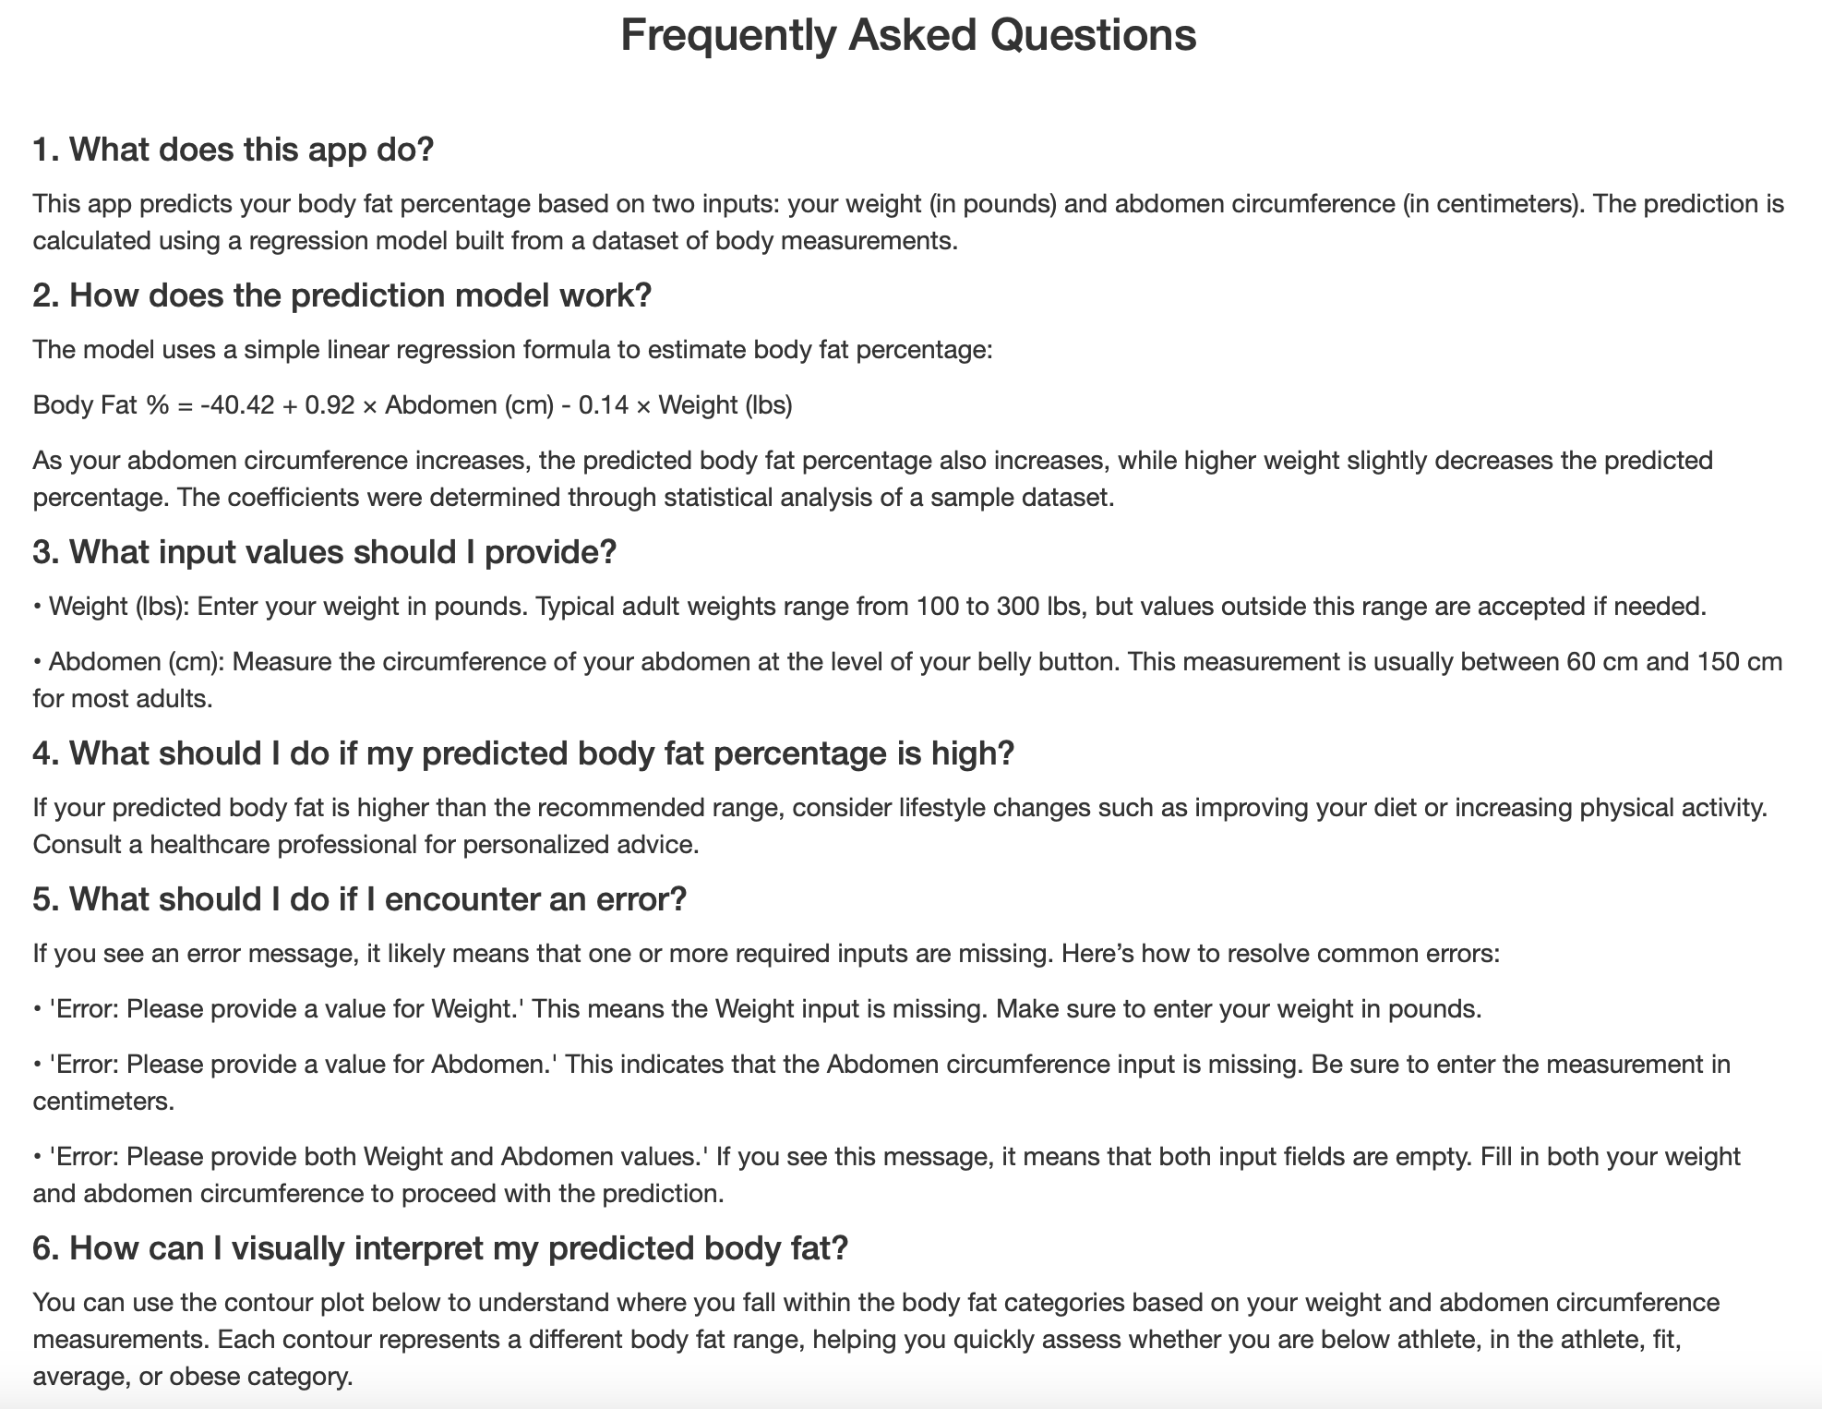
Shiny App
Link: https://crj2002.shinyapps.io/shiny_app/
Notes:
The Shiny app provides a user-friendly interface for predicting body fat percentage based on weight and abdomen measurements. It includes features such as real-time predictions, visual indicators of body fat categories, and a FAQ section to guide users in interpreting results and troubleshooting potential errors.

