Slide 1

Fine-tuning Speechbrain
Speaker Recognition
with Mandarin
zhengkun mei
s5075580
延时符

Slide 2
content
Speaker Recognition
2
Method
4
1
3
Speechbrain
Result
延时符

Slide 3
1
Speaker Recogntion
延时符

Slide 4
History of SR
1997
Gaussian mixture model
2018
X-Vector
2000
GMM-UBM
2006
SVM
2010
I-Vector
Joint factor analysis
2007
延时符

Slide 5
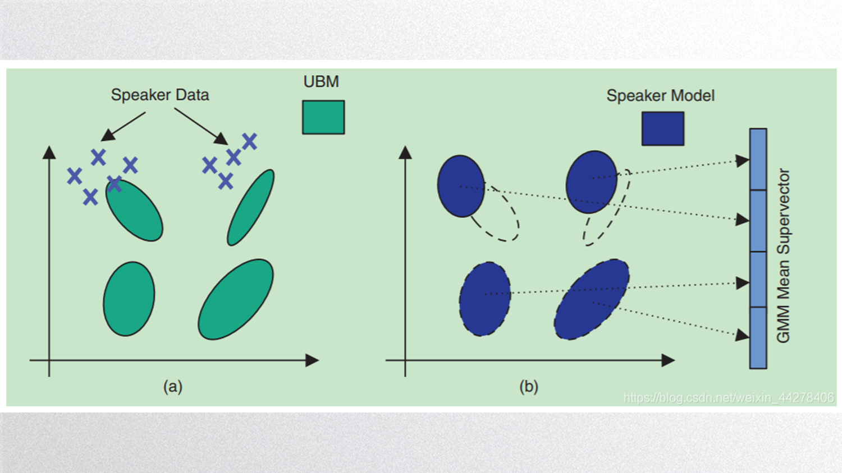
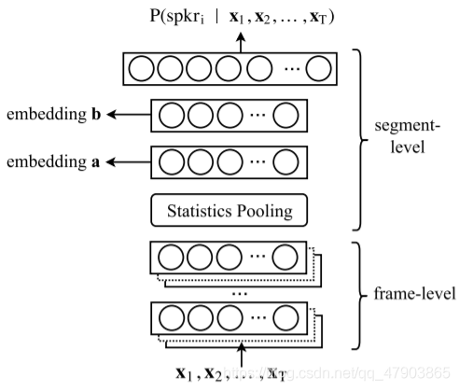
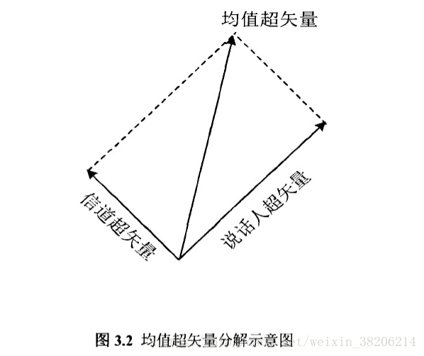


History of SR
GMM-UBM
JFA
X-vector
I-vector
延时符

Slide 6
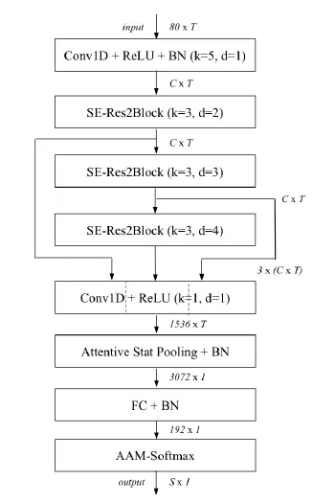
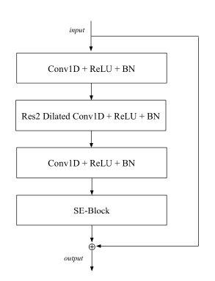
ECAPA-TDNN
延时符

Slide 7
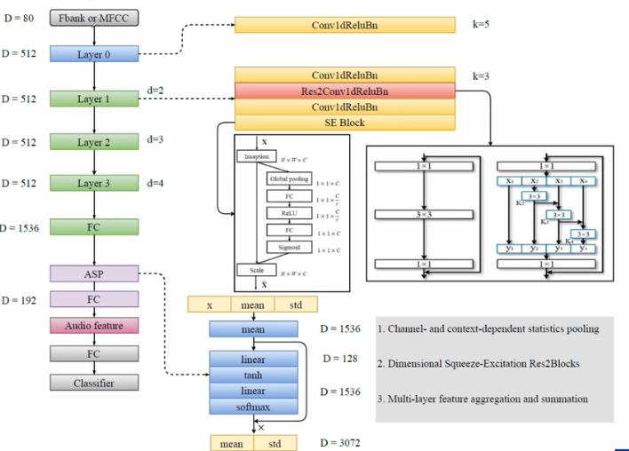
延时符

Slide 8
2
Speechbrain
延时符

Slide 9
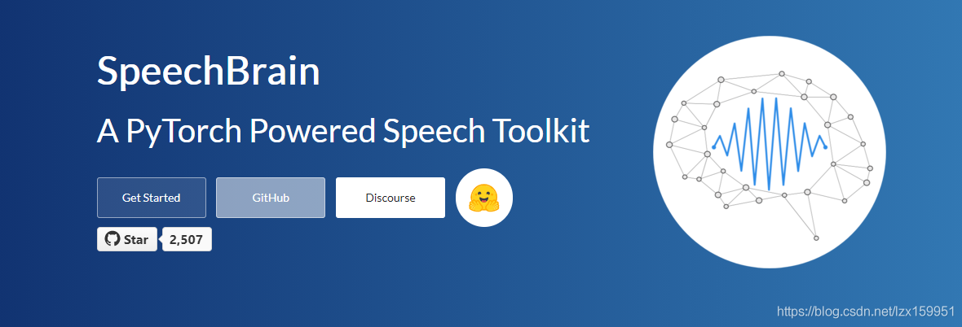
Speechbrain
Speechbrain is a pytorch-based speech toolkit. Its ambitions are also great. It is positioned as a speech toolkit that integrates all functions. It involves various speech technologies, such as speech recognition system, speaker recognition system, speech enhancement system, multi-microphone signal processing system and so on.
延时符

Slide 10
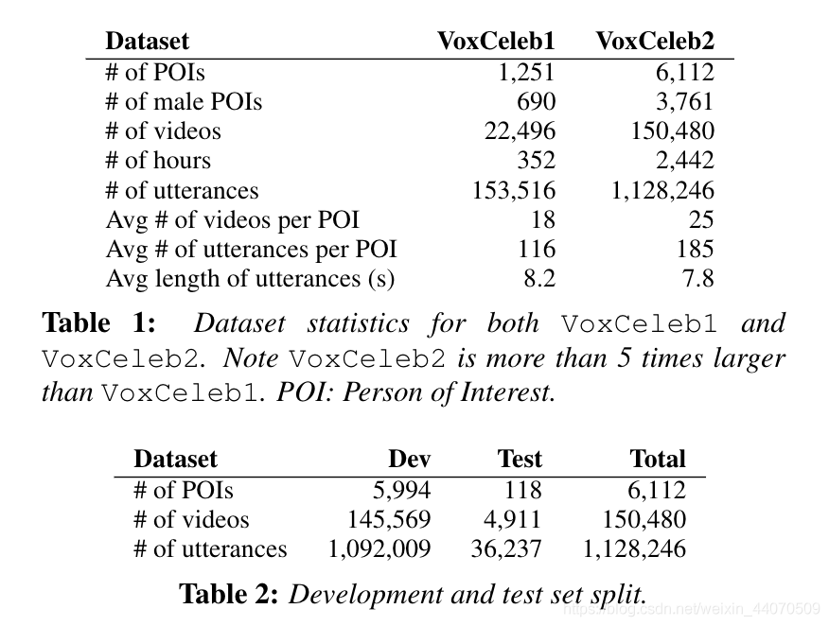
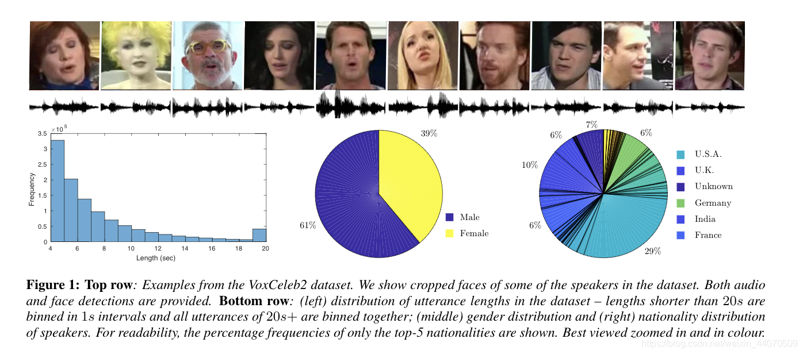
Dataset
VoxCeleb2 provides more than 1 million utterances for more than 6,000 celebrities, uploaded to YouTube. The dataset is gender balanced, with 61% of the speakers being male. Speakers spanned a wide variety of races, accents, professions and languages. The videos included in the dataset were shot in a large number of challenging visual and auditory environments. These include interviews on red carpets, outdoor stadiums and quiet indoor studios, presentations to large audiences, excerpts from professionally shot multimedia, and even sketchy videos shot with handheld devices. Chatter, laughter, overlapping voices and different room acoustics.
延时符

Slide 11
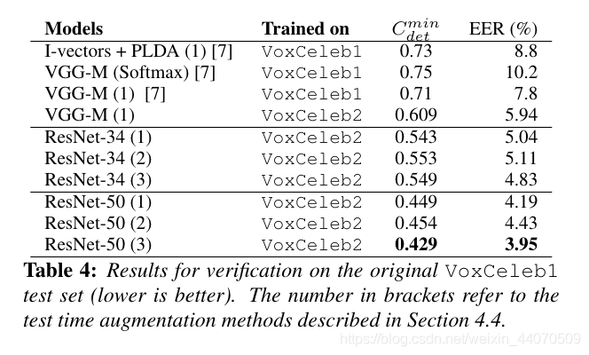
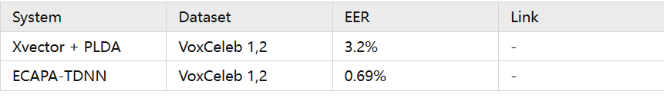
Model
python train_speaker_embeddings.py hparams/train_x_vectors.yaml
python train_speaker_embeddings.py hparams/train_ecapa_tdnn_big.yaml
延时符

Slide 12
3
Method
延时符

Slide 13
Dataset
zhvoice
900 hours
conversion to Pinyin
text, audio, speaker
metadata
noise and mute reduce
text nomarlization
延时符

Slide 14
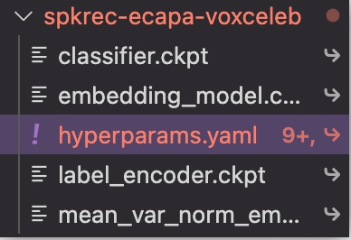

Train
Pre-trained model with voxceleb
延时符

Slide 15
4
Result
延时符

Slide 16

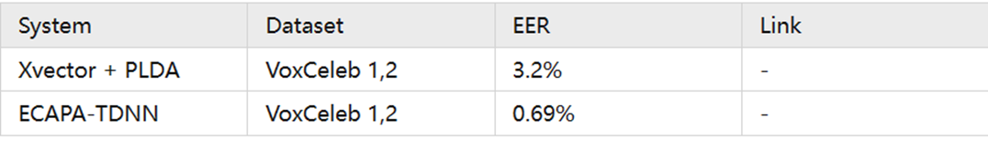

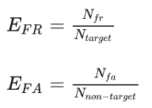
Result
延时符

Slide 17
Reference
Emphasized channel attention, propagation and aggregation in tdnn based speaker verification
VoxCeleb2: Deep Speaker Recognition
X-vectors: Robust DNN Embedding for Speaker Recognition
Speaker verification using adapted gaussian mixture models
Support vector machines for speaker and language recognition
延时符

Slide 18
Thanks and questions
延时符

