Slide 1

Analysis of Happy DB for Happy Moment Prediction
Kedhara Nethra - 011833640
Mohammed Haroon - 011815479
Lavanya Kadukuri - 011833588

Slide 2
Introduction
HAPPY DB:
Happy DB is a collection of 100,000+ happy experiences
Information is gathered from Amazon’s Mechanical Turk over a period of four months.
MOTIVATION:
It is necessary to refocus on the everyday things that make us happy. This is what we are trying to do with Happy DB.
OBJECTIVE:
To find the correlation between demographic information of a person and the category of happiness by using classification algorithms and ultimately build a predictive model based on the correlation determined.

Slide 3
Dataset Description:
Happy DB is a collection of various files of which we are using only cleaned_hm.csv and demographic.csv.
cleaned_hm.csv has dimensions 100535*9 and demographic.csv has dimensions 10844*6. The feature that we are considering for our analysis in cleaned_hm.csv is “predicted_category”. We are considering features age, country, parenthood, marital, gender from demographic.csv.
cleaned_hm.csv contains cleaned happy moments and demographic.csv contains demographic details of a person.

Slide 4
Solutions
Algorithms used:
Gaussian Naïve Bayes,
Decision Trees Classifier,
Random Forest Classifier,
Support Vector Machine,
K-Nearest Neighbor,
Logistic Regression

Slide 5
Data preprocessing
Dropping features that are not required
Imputing missing values
Removing outliers
Converting categorical to dummy variables
Preventing dummy variable trap
Replace NaN with mean for age
Replace NaN with mode for other categorical values

Slide 6
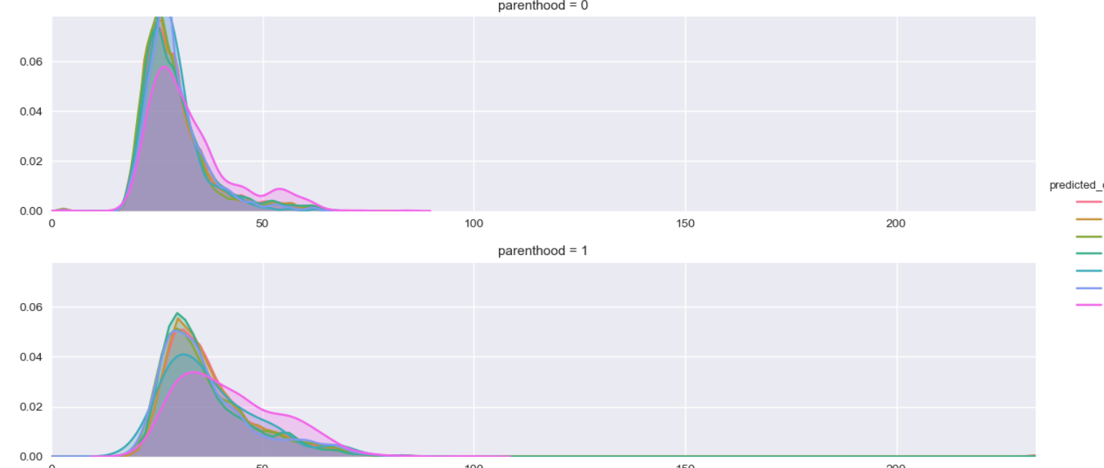
Data Preprocessing

Slide 7
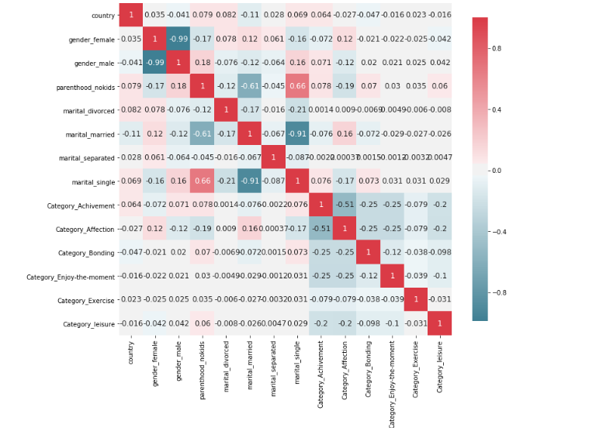
Data Preprocessing

Slide 8
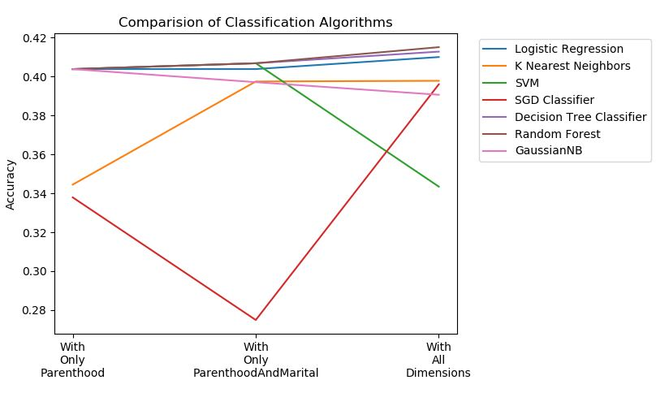
Algorithm Variations:

Slide 9
Evaluation/Demo
Accuracy of Knn with Parenthood = 0.34445
Accuracy of Knn with all features = 0.39775
Accuracy of Linear Regression with Parenthood = 0.40378
Accuracy of Linear Regression with all features = 0.40996
Accuracy of Naïve bayes with Parenthood = 0.40378
Accuracy of Naïve bayes with all features = 0.39085
Accuracy of Random Forest with Parenthood = 0.40378
Accuracy of Random Forest with all features = 0.41504
Accuracy of SGD with Parenthood = 0.33788
Accuracy of SGD with all features = 0.39596
Accuracy of SVM with Parenthood = 0.40378
Accuracy of SVM with all features = 0.34341
Accuracy of Decision Tree with Parenthood = 0.403785Accuracy of Decision Tree with all features = 0.412752

Slide 10
Things that worked:
Data preprocessing gave us much better results than the raw data. All the measures like data cleaning by removing unwanted features, outliers and imputing missing values improved the accuracy.
Our decision to convert categorical to numerical values also helped in giving better results.

Slide 11
Things that didn't work:
Linear algorithms like SGD Classifier and Logistic Regression didn’t work well in giving satisfactory results as anticipated. Logistic Regression only could predict two values out of a total of six values in predicted_category.
Initially we thought the features like age and country will contribute towards target variable “predicted_category” which wasn’t the case. Happy moment category is not dependent on demographic data is what we found out.

Slide 12
Analysis of Results:
With the help of results and the evaluation graphs we can say that Logistic Regression has good accuracy results but the algorithm failed to predict most of the target categories.
Tree based algorithms like Decision Tree and Random Forest performs the best in all three conditions, i.e with only Parenthood variable, Parenthood along with Marital and also with all the variables.
It is also seen that Parenthood variable alone was able to give an accuracy of more than 40% for most of the algorithms except KNN and SGD.
We can see that adding more dimensions does not improve our accuracy score. With 8 more variables as independent variables, we were able to improve the accuracy by only 1%

Slide 13
Conclusion:
Through data exploration and preprocessing of Happy DB, we better understood the data we are dealing with and how features are interdependent. We could apply concepts learnt in the class which was a very good experience.
Even after applying various algorithms, we couldn’t predict the happy moment category with a good accuracy which shows that this category is independent of demographic information and this is counter-intuitive!
Future scope is to perform sentiment analysis to determine happiness by specific types of experiences.

Slide 14
References:
Akari Asai, Sara Evensen, Behzad Golshan, Alon Halevy, Vivian Li, Andrei Lopatenko, Daniela Stepanov, Yoshihiko Suhara, Wang-Chiew Tan, Yinzhan Xu, ``HappyDB: A Corpus of 100,000 Crowdsourced Happy Moments'', LREC '18, May 2018.
https://github.com/rit-public/HappyDB
https://www.kaggle.com/ritresearch/happydb
http://scikit-learn.org/stable/supervised_learning.html
http://scikit-learn.org/stable/auto_examples/model_selection/plot_roc.html#multiclass-settings
https://pandas.pydata.org/pandas-docs/stable/visualization.html

Slide 15
THANK YOU!

