Slide 1
DNN
June 12, 2020

Slide 2
Parameters
(my choices)
batch size: 50, 100, 500
learning rate: 0.1, 0.01, 0.001
steps: 50000, 80000, 100000, 120000
best corr filter: 0.3, 0.5, 0.6
gdelt amount filter: 12000, 8000, 5000, 10
k: -1, 0
n: 1, 2, 3

Slide 3
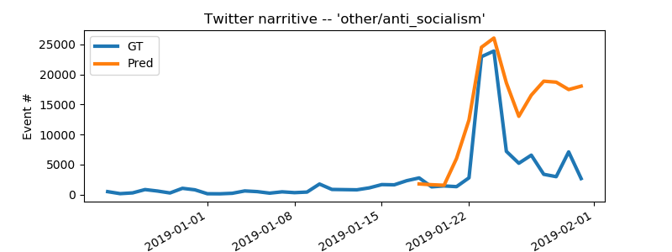
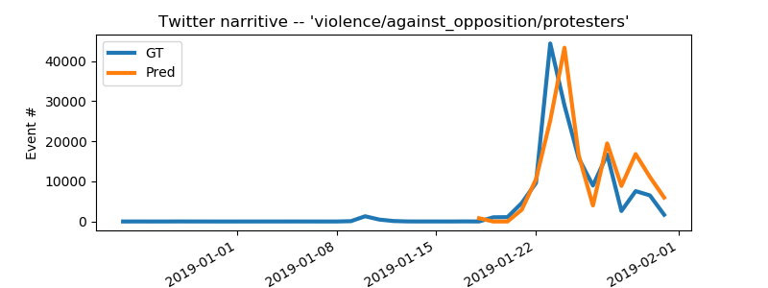
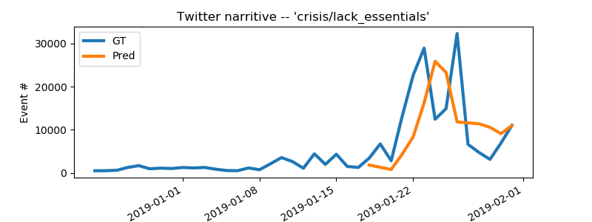
Results
“baseline” error: 1.06 * 10^7
batch: 50
learning rate: 0.01
steps: 80000
corr filter: 0.6
gdelt amount filter: 10
k = -1
n = 2
error: 0.92 * 10^7

Slide 4
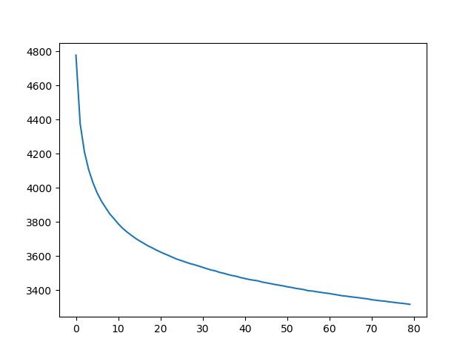
Loss Decay

Slide 5
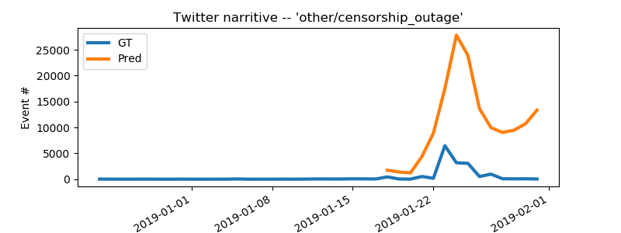
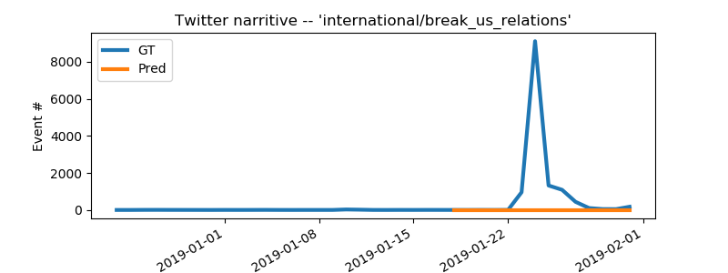
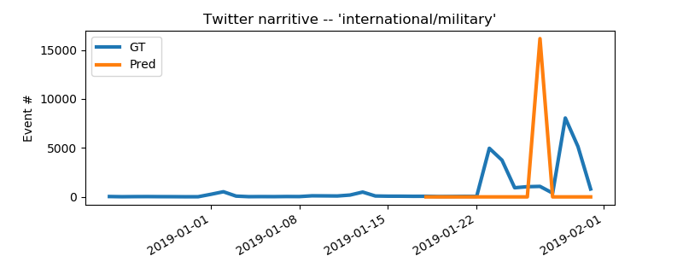
Problems
1. The scale of spike
influence of correlation
2. Timing of spike (+text analysis?)

