Slide 1
Predicting Rating of Yelp Review Text
Zhengzheng Yu

Slide 2


Love or hate?

Slide 3
How to learn?
Model
  Naive Bayes classifier
  Support Vector Machine
Feature
  Bag-of-words
  Part-of-speech

Slide 4
Yelp open dataset
1. 15,585 businesses
2. 335,022 reviews
3. 11,434 check-in sets
4. 70,817 users
… …
We extract 11,355 reviews for all the Chinese restaurant.

Slide 5
Generate feature
If:
  vocabulary = [A, B, C, D]
  Review text = AHBDJBB
Then:
  Feature vector = [1, 3, 0, 1]

Slide 6
Feature reduction
Dimension depend on the size of vocabulary
Use all unique words as vocabulary
Or, we can filter the keywords by PoS
“The best sweet and sour soup ever!”
[(u'The', 'DT'), (u'best', 'JJS'), (u'sweet', 'NN'), (u'and', 'CC'), (u'sour', 'PRP$'), (u'soup', 'NN'), (u'ever', 'RB'), (u'!', '.')]

Slide 7
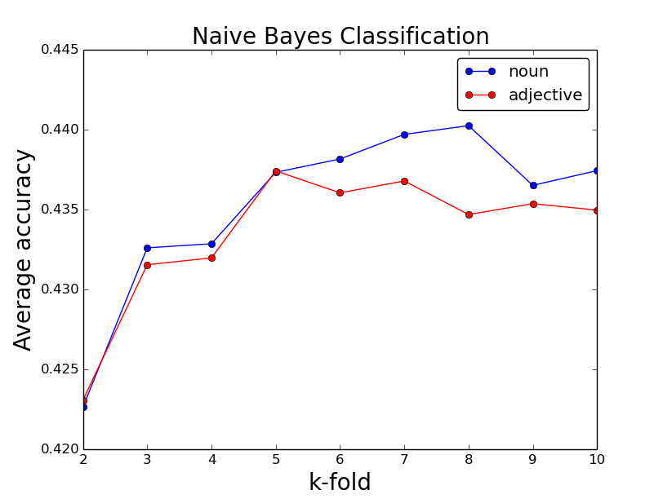
Naive Bayes Classifier

Slide 8
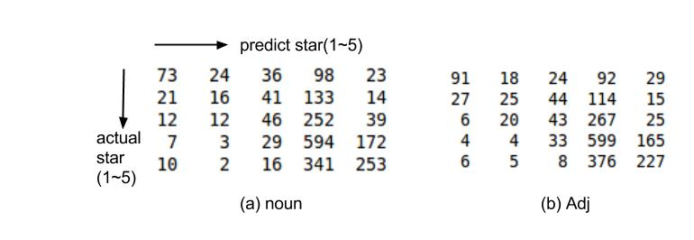
Naive Bayes Classifier
Confusion matrix
9000 training data, 2000 testing data

Slide 9
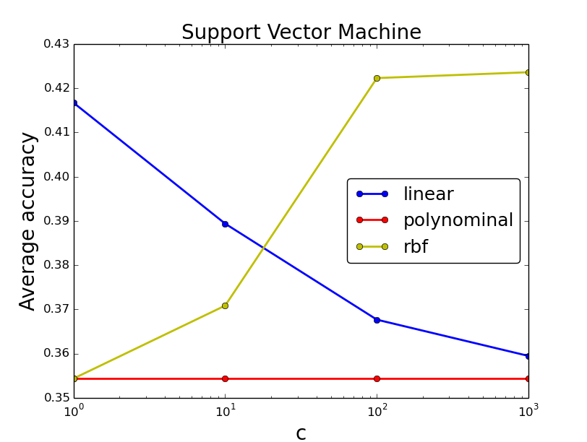
Support Vector Machine

Slide 10
More to do
Keep reduce feature dimension
Adaboost
Different smoothing in NB
…...

Slide 11
Thank you

