Slide 1
Introduction to MLlib
CMPT 733, SPRING 2016
Jiannan Wang

Slide 2
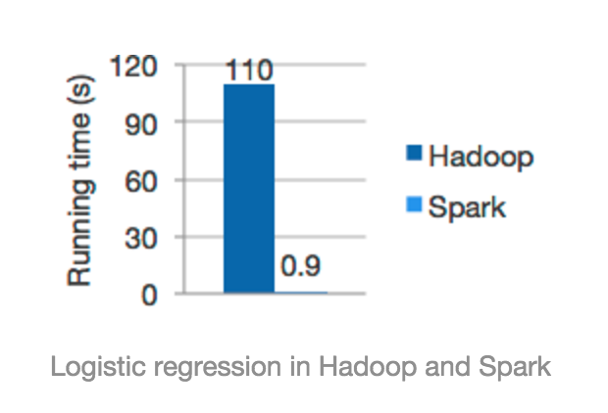
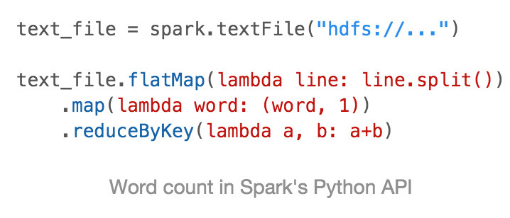
Recap of Spark
Spark is a fast and general engine for large-scale data processing
Improving MapReduce from two aspects
Efficiency: in-memory computing
Usability : high-level operators

Slide 3

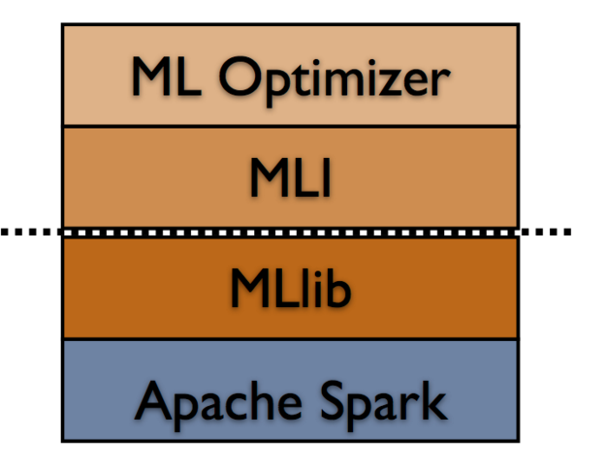
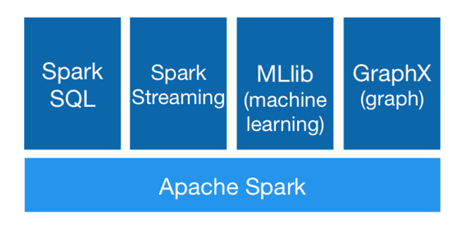
A Brief History of MLlib
Mlbase (2012)
Started in the AMPLab
Goal: making distributed machine learning easy
MLlib enters Spark v0.8 (2013)
One of the four big libraries built on top of Spark
A good coverage of distributed machine learning algorithms
A New High-Level API for MLlib (2015)
spark.ml provides higher-level API built on top of DataFrames for constructing ML pipelines

Slide 4
MLlib’s Mission
Making practical machine learning scalable and easy
Data is messy, and often comes from multiple sources
Feature selection and parameter tuning are quite important
A model should have good performance in productions
How did MLlib achieve the goal of scalability?
Implementing distributed ML algorithms using Spark

Slide 5
Distributed ML Algorithms in MLlib
Week 2
Feature extraction and transformation: TF-IDF, Word2Vec
Classification and regression: SVMs, logistic regression, linear regression
Optimization: limited-memory BFGS (L-BFGS)
Clustering: k-means
Dimensionality reduction: principal component analysis (PCA)
Collaborative filtering: alternating least squares (ALS)
Week 2
Week 3
Week 4
Week 4
Week 5

Slide 6
Some Basic Concepts
What is distributed ML?
How different is it from non-distributed ML?
How to evaluate the performance of distributed ML algorithms?

Slide 7
What is Distributed ML?
A Hot topic! Many Aliases:
Scalable Machine Learning
Large-scale Machine Learning
Machine Learning for Big Data
Take a look at these courses if you want to learn more theories
SML: Scalable Machine Learning (UC Berkeley, 2012)
Large-scale Machine Learning (NYU, 2013)
Scalable Machine Learning (edX, 2015)

Slide 8
An intuitive explanation of distributed ML
Data are often in the form of a table
N: # of training examples (e.g., tweets, images)
F: # of features (e.g., bag of words, color histogram)
An ML algorithm can be thought of as a process that turns the table into a model
We will discuss this process later
Distributed ML studies how to make the process work for the following cases:
Big N, Small F
Small N, Big F
Big N, Big F
F
N

Slide 9
How different from non-distributed ML?
Requiring distributed data storage and access
Thanks to HDFS and Spark!
Network communication is often the bottleneck
Non-distributed ML focuses on reducing CPU time and I/O cost, but distributed ML often seeks to reduce network communication
More design choices
Broadcast (Recall Assignment3B in CMPT 732)
Caching (which intermediate results should be cached in Memory?)
Parallelization (which part in an ML algorithm should be parallelized? )
…

Slide 10
Performance metrics of distributed ML
Consider this scenario:
You develop an ML application using MLlib, and deploy it in your company’s product. It works pretty well. But after some time, …
1. Speedup
Your boss said: “Some customers complained that our product is slow. How much can we improve the speed by buying more machines?”
2. Scaleout
You boss said: “More and more costumers like to use our product. But, at the same time, we will collect/process more customer data. How many new machines do we need to buy in order to keep the same speed? ”
ideal
speedup
# of machines
ideal
scaleout
# of machines and data size

Slide 11
MLlib’s Mission
Making practical machine learning scalable and easy
Data is messy, and often comes from multiple sources
Feature selection and parameter tuning are quite important
A model should have good performance in productions
How did MLlib achieve the goal of scalability?
Implementing distributed machine learning algorithms using Spark
How did MLlib achieve the goal of ease of use?
The new ML Pipeline API

Slide 12
ML Workflow
Our goal
Load
Data
Extract Features
Train
Model
Dataset
Model

Slide 13
ML Workflows are complex
Our goal
Load
Data
Extract Features
Train
Model
Dataset
Model
Data often comes from multiple sources
This requires a lot of data transformation work
There are so many ML algos and parameters to choose from

Slide 14
Pain points
1. There will generate a lot of RDDs through the whole process. Manipulating and managing these RDDs are painful.
In the feature selection stage, we often need to perform selection/ projection/ aggregation/ group-by/ join operations on RDDs.
2. Writing the workflow as a script is hard for workflow reuse.
Data often change over time. We need to iterate on the old workflow, making it work for new datasets.
3. An ML workflow has a lot of parameters. Tuning the parameters is painful.
Almost every stage of the workflow has some parameters to tune (e.g., # of features, # of iterations, step size, gram size, regularization parameter).

Slide 15
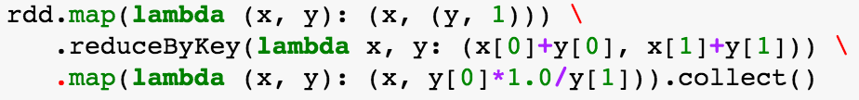

The new ML pipeline API
Pain Point 1: Manipulating and managing a lot of RDDs are painful.
Basic Idea: Using DataFrame (instead of RDD) to represent the ML dataset
DataFrame adds schema and relational operations on RDD.
easy to manipulate
easy to manage
VS.
VS.

Slide 16
The new ML pipeline API (cont’d)
Pain Point 2: Writing as a script is hard for workflow reuse.
Basic Idea: Abstracting ML stages into two components
Transformer:
Estimator:
A pipeline consists of a sequence of Transformers and Estimators
Create a new pipeline:
Apply the pipeline to a dataset:
Use a different estimator:
Apply to a new dataset:
DataFrame → DataFrame
DataFrame → Model
pipeline = Pipeline(stages=[Transformer1, Transformer2, Estimator])
model = pipeline.fit(dataset)
pipeline’ = Pipeline(stages=[Transformer1’, Transformer2, Estimator])
model' = pipeline’.fit(new-dataset)

Slide 17
The new ML pipeline API (cont’d)
Pain Point 3: Parameter tuning is painful.
Basic Idea: grid search and cross validation
Grid search enumerates every possible combination of parameters
numFeatures = 10, 100, 1000
regParam = 0.1, 0.01
Grid Search
(10, 0.1), (10, 0.01), (100, 0.1), (100, 0.01), (1000, 0.1), (1000, 0.01)

Slide 18
The new ML pipeline API (cont’d)
Pain Point 3: Parameter tuning is painful.
Basic Idea: grid search and cross validation
Grid search enumerates every possible combination of parameters
Cross validation evaluates which combination performs the best
Fold 1
Fold 2
Fold 3
dataset
Cross Validation
(3 folds)
training
testing
training
testing
training
testing
evaluation metric
evaluation metric
evaluation metric
Average metric

Slide 19
spark.mllib vs. spark.ml
Advantage of spark.ml
spark.mllib is the old ML API in Spark. It only focuses on making ML scalable.
spark.ml is the new ML API in Spark. It focuses on making ML both scalable and easy of use.
Disadvantage of spark.ml
spark.ml contains fewer ML algorithms than spark.mllib.
How to choose which one to use in your assignments?
Use spark.ml in Assignment 1
Use spark.mllib in other Assignments

Slide 20
Assignment 1 (http://tiny.cc/cmpt733-sp16-a1)
Part 1. Matrix Multiplication
Dense Representation
Sparse Representation
Part 2. A simple ML pipeline
Adding a parameter tuning component
Deadline: 23:59pm, Jan 11

