Slide 1
Lecture 3: Anomaly Detection
CMPT 733, SPRING 2017
Jiannan Wang

Slide 2
Outline
Recap of Anomaly Detection
Application: Network Intrusion Detection

Slide 3
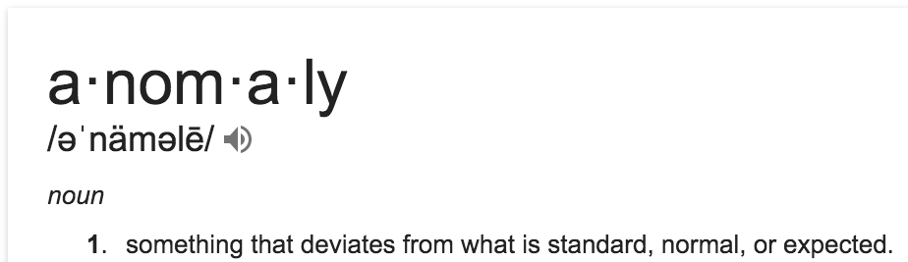
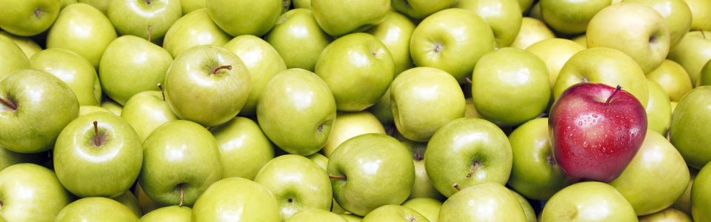
What is Anomaly Detection?
Definition from dictionary
Also known as Outlier Detection
Anomaly!!

Slide 4
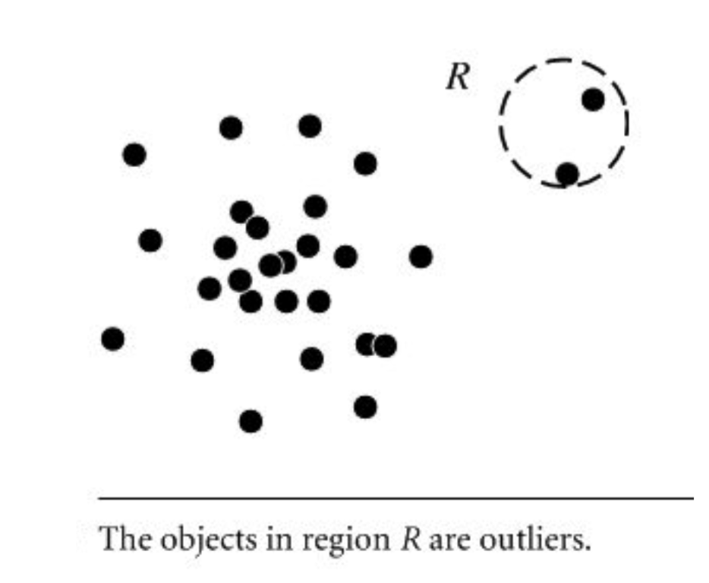
Anomaly Categories (I)
Global Anomaly
A data point is considered anomalous with respect to the rest of data
Example: There is a person whose age is 110

Slide 5
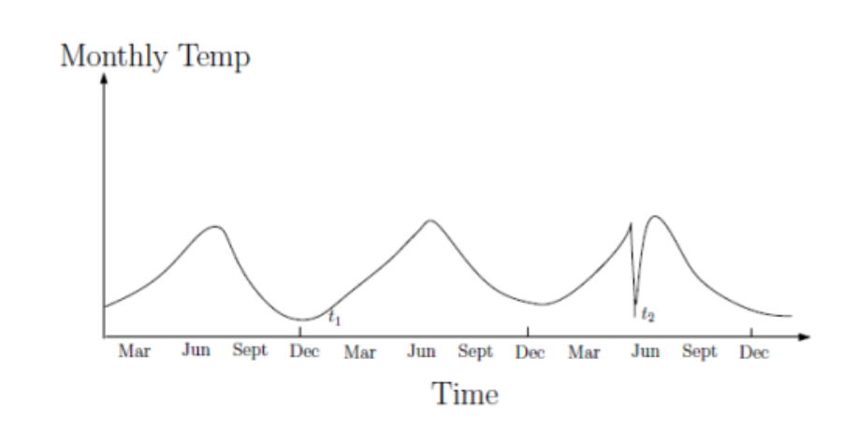
Anomaly Categories (II)
Context Anomaly
A data point is considered anomalous with respect to a specific context
Example: There is a person in our class whose age is 70.

Slide 6
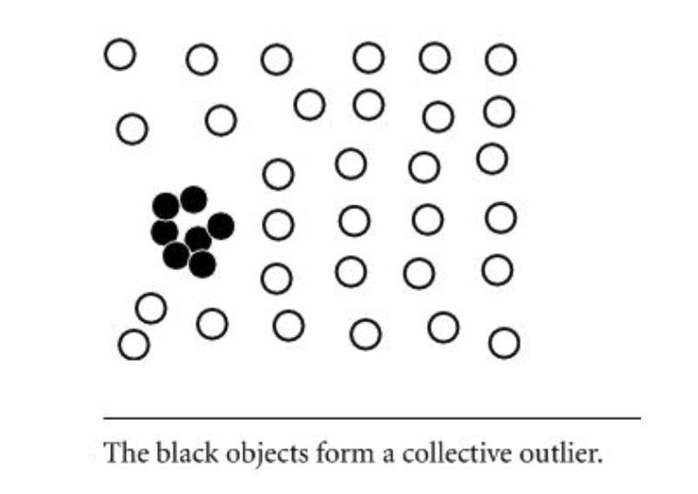
Anomaly Categories (III)
Collective Anomaly
A subset of data points as a whole deviates significantly from the entire dataset
Example: An order may have some delay to be processed. But, what if 1000 orders are processed with delay?

Slide 7
Real-world Applications
Fraud Detection
Medical Care
Public Safety and Security
Network Intrusion

Slide 8
Challenges
Modeling normal objects and anomalies effectively:
Hard to enumerate all possible normal behaviors
The border between normal objects and anomaly can be gray area
Application specific anomaly detection:
Hard to develop general purpose anomaly detection tools
Understandability:
Not only detect the anomalies, but also understand why they are anomalies

Slide 9
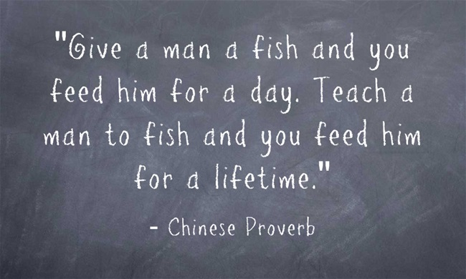
Outline
Recap of Anomaly Detection
Application: Network Intrusion Detection
Teach you a network-intrusion solution
vs.
Teach you how to come up with this solution

Slide 10

Network Intrusion
“Our web servers got attacked yesterday.
I don’t want it happen again.
Please build a system to address it!”
TO DO Lists:
1. Finding related datasets (e.g., /var/log/apache2/access.log)
2. Figuring out how to detect attacks (anomalies)
3. Triggering an alert when an attack is detected (e.g., send an email)
Key Problem

Slide 11
How to come up with a solution?
Doing a survey on related work

Slide 12
Anomaly Detection Methods
Survey Paper
V. Chandola, A. Banerjee, V. Kumar: Anomaly detection: A survey. ACM Computing Surveys (2009)
Supervised Learning (e.g., Assignment 2 – Sentiment Analysis)
Both normal and anomalous instances are given
Classification models can be used
Unsupervised Learning (e.g., Find the top-10 hot topics in twitter)
No labeled instances are given
Clustering models can be used

Slide 13
Why is unsupervised learning more common?
No need to label data
Labeling is a tedious and expensive process
Able to identify “unknown unknowns”
Not only detect a known attack pattern,
but also detect an unknown attack pattern

Slide 14
How to come up with a solution?
Doing a survey on related work
Choosing an unsupervised learning approach

Slide 15
Clustering-based
Basic Idea
Cluster data points into groups.
Decide which points are anomalies:
Points in small clusters
Using distance to the closest cluster
Cluster 1
Cluster 2
Cluster 3

Slide 16
How to come up with a solution?
Doing a survey on related work
Choosing an unsupervised learning approach
Picking up a clustering algorithm

Slide 17
K-Means
Iterative Algorithm
This is the initial motivation for creating Spark
Algorithm Overview
Picking up K random points as cluster centers
Assigning each point to the closest center
Updating cluster centers accordingly
Repeat Steps 2 and 3 until some termination conditions are met
How to optimize?
RDD.cache()
K-Means++ Initialization

Slide 18
How to come up with a solution?
Doing a survey on related work
Choosing an unsupervised learning approach
Picking up a clustering algorithm
Selecting and transforming features

Slide 19
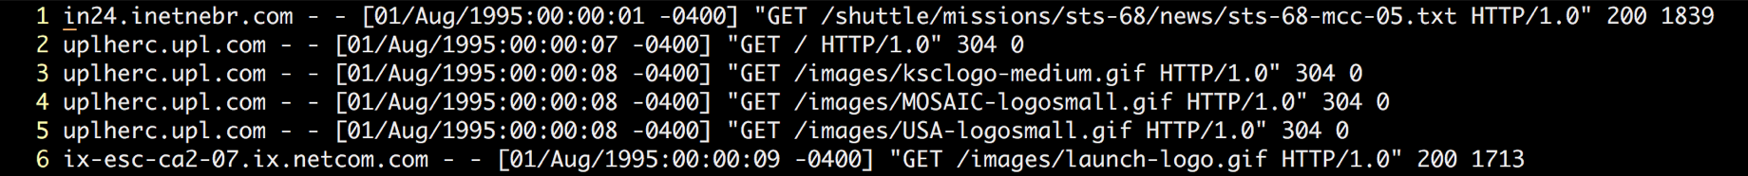
Feature Selection
Raw Data
Turning Raw Data into Connection Data
A connection is a sequence of HTTP requests starting and ending at some well defined times
Turning Connection Data into Feature Vectors
Requiring a fair bit of domain knowledge
Asking yourself how to distinguish attacks from normal connections (e.g., number of failed login attempts, duration of the connection )

Slide 20
Feature Transformation
Feature Vector
e.g., [http, BC, 0, 105, 146, 0, … , 0.00, 0.00]
Will this feature vector work for KMeans?
What’s distance between “http” and “ftp”?
The distance between two feature vectors will be dominated by the features with a broad range of values (e.g., the 4th feature)
Categorical
feature
Numerical
feature

Slide 21
Categorical Features → Numerical Features
Naïve solution
http→ 0
ftp → 1
ssh → 2
One-hot encoding
http → [1,0,0]
ftp → [0,1,0]
ssh → [0,0,1]
What’s the drawback?
Distance(“http”, “ssh”) > Distance(“http”, “ftp”)

Slide 22


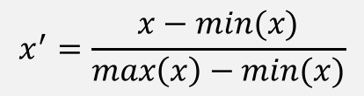
Scaling Numerical Features
1. Rescaling
2. Standardization
3. Scaling to unit length
You have done it in Assignment 2
Which one to use?
$$x^{′}=\frac{x−min(x)}{max\left(x\right)−min(x)}$$
$$x^{′}=\frac{x−\overline{x}}{σ}$$
It depends on data. Some heuristics:
(2) is more popular than (1)
(1) or (2) are often first applied, and then (3) is applied afterward
$$x^{′}=\frac{x}{|\left|x\right||}$$

Slide 23
How to come up with a solution?
Doing a survey on related work
Choosing an unsupervised learning approach
Picking up a clustering algorithm
Selecting and transforming features
Parameter Tuning

Slide 24
Parameter Tuning
You need to describe your solution in Assignment 3
Key Questions
How different is it from supervised learning?
Which parameters do you need to tune?
What are possible values for them?
How can you tell which values are better?

Slide 25
How did we come up the solution?
Doing a survey on related work
Choosing an unsupervised learning approach
Picking up a clustering algorithm
Selecting and transforming features
Tuning Parameters
If not satisfied, go back to previous steps

Slide 26
How did we come up the solution?
Doing a survey on related work
Choosing an unsupervised learning approach
Picking up a clustering algorithm
Selecting and transforming features
Tuning Parameters
If not satisfied, go back to previous steps
Deploying your model in production

Slide 27
Model Serving
New Challenges
Model has to reflect to the latest data updates.
Kmeans → Streaming Kmeans
Predictions have to be made in real-time.
Parallelizing prediction process

Slide 28
Summary
How did we come up the solution?
Doing a survey on related work
Choosing an unsupervised learning approach
Picking up a clustering algorithm
Selecting and transforming features
Tuning Parameters
If not satisfied, go back to previous steps
Deploying your model in production
Theory
Model Development
Practice
Model Serving

Slide 29
Assignment 3: Anomaly Detection
Part 1. Model Development (required)
Part 2. Model Serving (optional)
Deadline: 11:59pm, Jan 29th
http://tiny.cc/cmpt733-a3

