Slide 1
Big Data Programming II Course Introduction
CMPT 733, SPRING 2017
Jiannan Wang

Slide 2
Who am I?
Assistant Professor from Simon Fraser University
Postdoc from UC Berkeley AMPLab
Ph.D. from Tsinghua University
8+ years of research experience in the database field

Slide 3
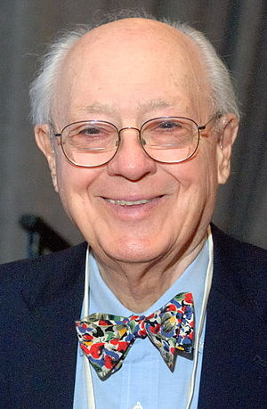
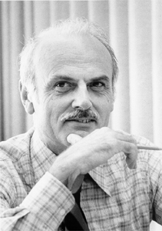
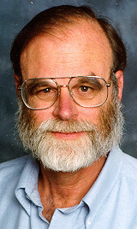
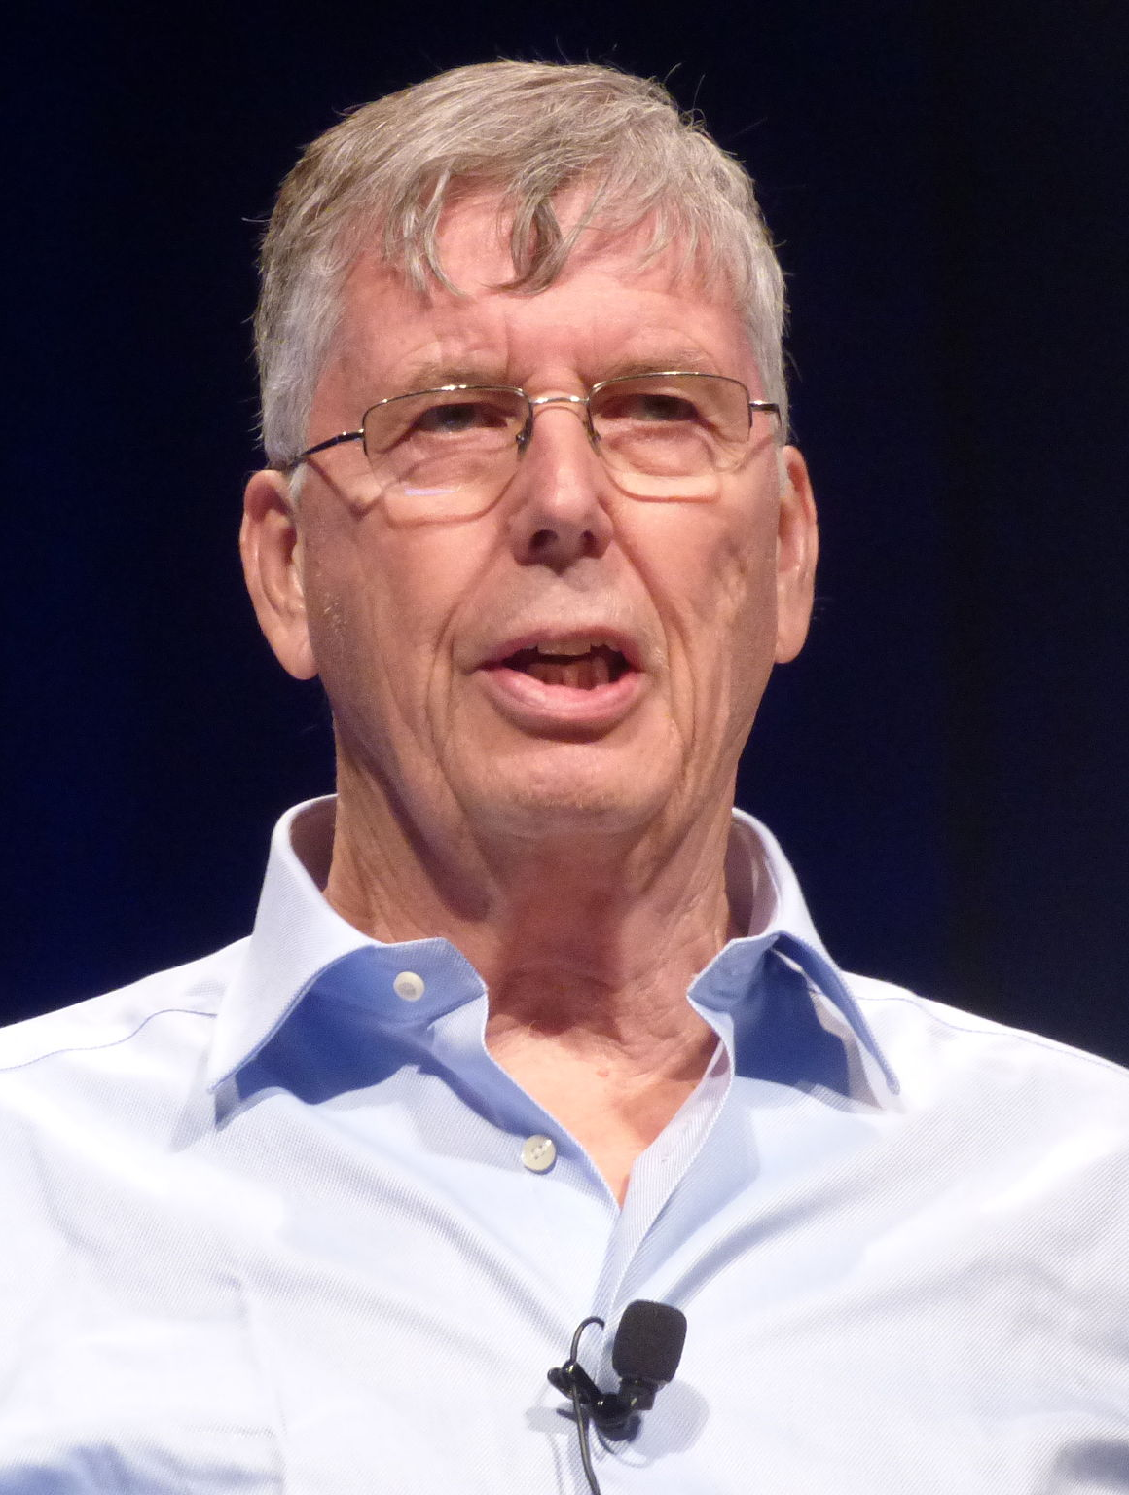
Database: Research Success
4 Turing Award Winners in 50 years
I am so proud of being a database guy!
1973
1981
1998
2014
Network database
Relational database
Transactional database
Modern database systems
Charles W. Bachman
Edgar Codd
Jim Gray
Michael Stonebraker

Slide 4

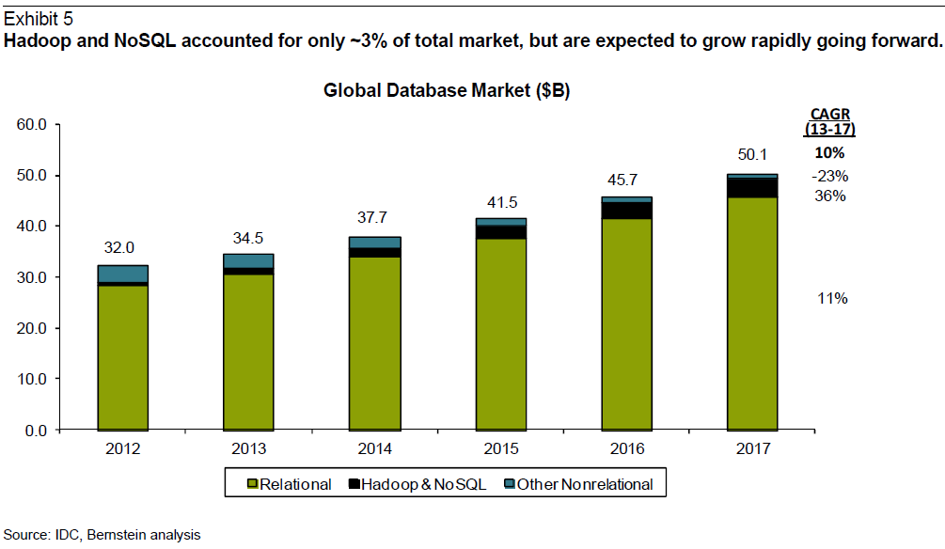

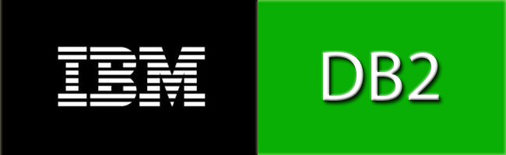
Database: Industry Success
$30~$50 billion market per year
I am so proud of being a database guy!
3x faster growth
. . .

Slide 5
But, what has changed in the “Big Data” world?
People have different opinions on this question.
You should have your own opinion!
I believe there are two major changes: Cloud Computing and Machine Learning

Slide 6
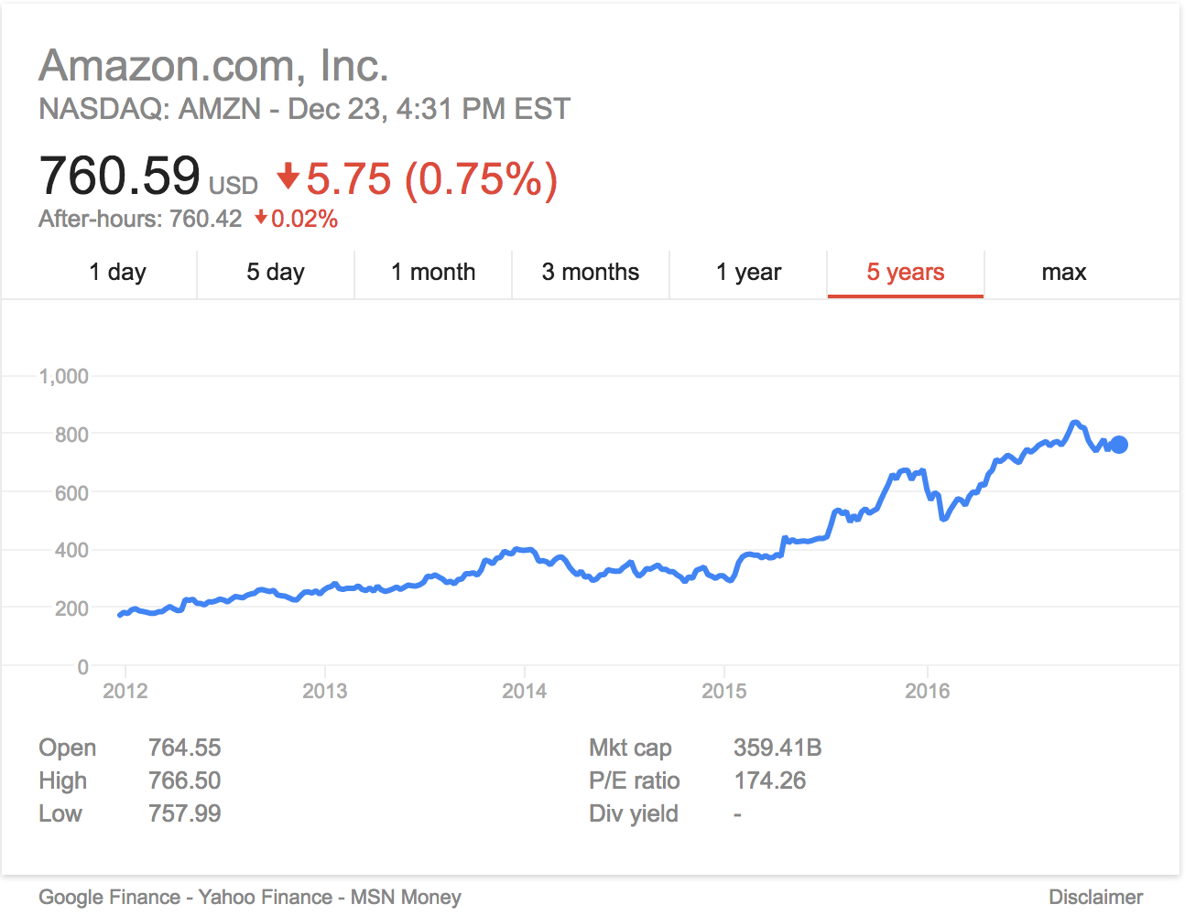
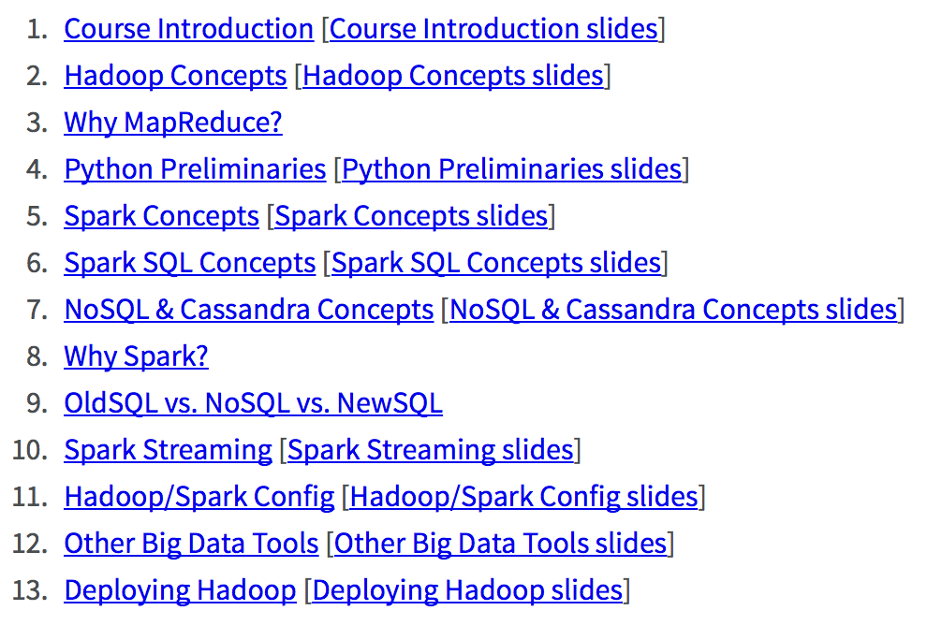
Cloud Computing
Making it tremendously easier and cheaper to run applications on a cluster (e.g., 50 nodes)
Oracle’s Biggest Competitor?
How to Program?
CMPT 732. http://bit.ly/2iaNKuT

Slide 7
Machine Learning (ML)
People are not only interested in understanding the past but also in predicting the future
Imagine your boss asks you the following questions
Understanding the past (SQL Analytics) | Predicating the future (Machine Learning)
How many Apple Watches did we sell
in 2015?
How many Apple Watches will we sell
in 2016?
Which movies did “Bob” watch
before?
Which movies will “Bob” like to watch
in the future?
…
…

Slide 8
ML in Class vs. ML in Practice
ML in Class
Data is clean, and comes from a single source
Developing a new ML model is quite important
A model should have good properties in theory
ML in Practice
Data is messy, and often comes from multiple sources
Feature selection and parameter tuning are quite important
A model should have good performance in production

Slide 9
What’s this course about?
Goals
Advanced analytics (beyond SQL analytics)
Tools
Spark MLlib, Scikit-Learn, Caffee
Lecture style
More “why” less “how”
Assignment style
Problem centric instead of tool centric

Slide 10
Course Plan
Part I: Advanced Analytics with Spark
Introduction & MLlib Basics
Sentiment Analysis (Feature Representation + Linear Regression)
Anomaly Detection (Unsupervised Learning)
Data Integration and Cleaning
Movie Recommendation
Part II: Advanced Analytics with Other Tools
Small Data (Scikit-Learn)
Deep Learning (caffee)
Data Labeling (Crowdsourcing, Active Learning)
Project Proposal Presentation
Visualization (D3) & AWS
Dr. Jiannan Wang
Dr. Apala Guha

Slide 11
Course Setup
Marking
Assignments: 9 x 8 = 72%
Project: (proposal + poster + report): 28%
Lectures (1 hour/week)
Group A, B: Monday 9:30-10:20
Labs (5 hours/week)
Group A: Tues 9:30–11:20, Thurs 9:00–11:50
Group B: Tues 14:30–16:20, Thurs 13:30–16:20
TAs
Venkatesh Palani Prabhu Angalakurichi Ramaraj <vangalak@sfu.ca>
Jaypratap Naidu <jna50@sfu.ca>

