Slide 1
Lecture 3: Anomaly Detection
CMPT 733, SPRING 2016
Jiannan Wang
Including notes from arash vahdat

Slide 2
Revised Course Plan
Part I: Advanced Analytics with Spark
Introduction & MLlib Basics
Sentiment Analysis
Anomaly Detection
Data Integration and Data Cleaning
Movie Recommendation
Part II: Advanced Analytics with Other Tools
Small Data (Scikit-Learn)
Deep Learning (Caffee)
Project Proposal Presentation
Visualization & AWS EC2 (D3)
Dr. Jiannan Wang
Dr. Apala Guha

Slide 3
Feedback from Lecture 1
15 responses
Sampled Positive Points
“Interesting industrial facts and how to gain additional practical knowledge through online courses.”
“I like the fact you emphasized the "why" so that we might be able to retain the correct knowledge for longer term career viability. Good to be reminded once in a while!”
“Slides were good and informative. Though presence of the instructor in the room could have been an additional boon. Hoping to see you soon Professor. ”

Slide 4
Feedback from Lecture 1
15 responses
Sampled Negative Points
“in this cohort Everyone is from different background… So please don’t assume everyone is good at programming and also explain more technical details and programs.”
“Lecture should be more interactive, where we get something to discuss or answer…”

Slide 5
Outline
Recap of Anomaly Detection
Application: Network Intrusion Detection

Slide 6
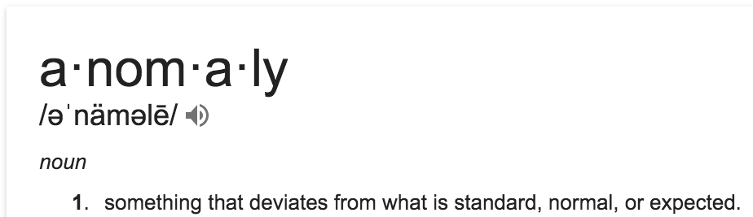
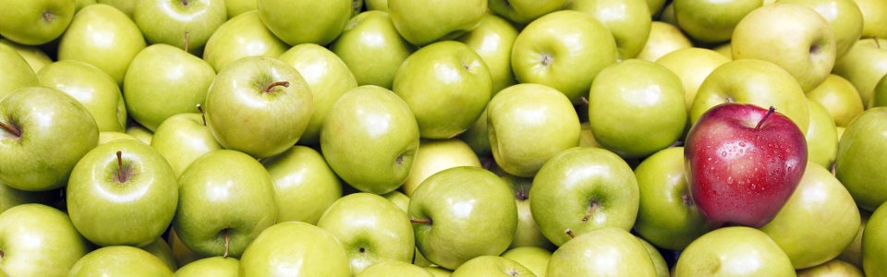
What is Anomaly Detection?
Definition from dictionary
Also known as Outlier Detection
Anomaly!!

Slide 7
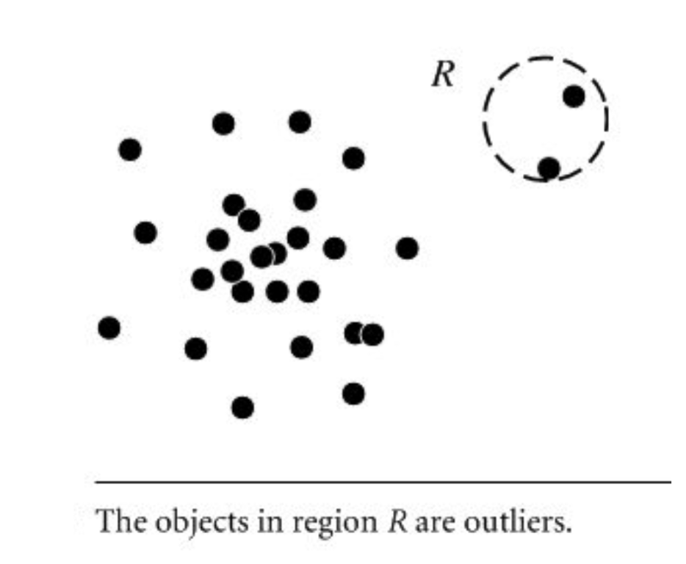
Anomaly Categories (I)
Global Anomaly
A data point is considered anomalous with respect to the rest of data
Example: There is a person whose age is 110

Slide 8
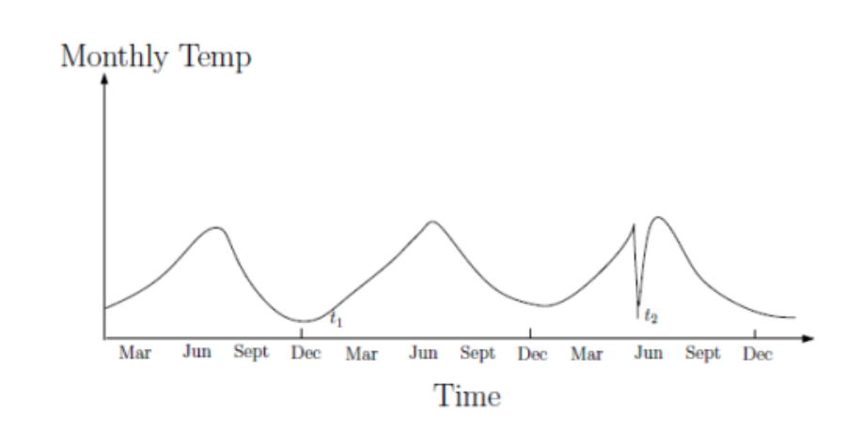
Anomaly Categories (II)
Context Anomaly
A data point is considered anomalous with respect to a specific context
Example: There is a person in our class whose age is 60.

Slide 9
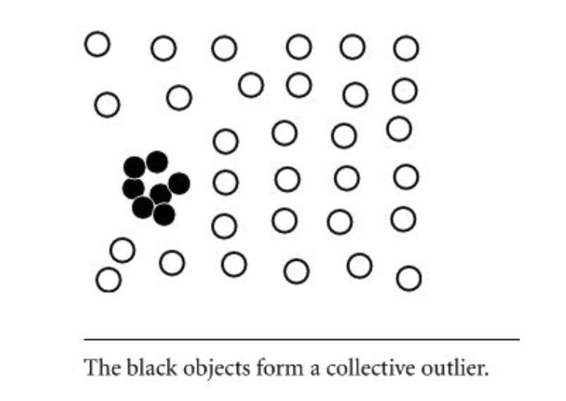
Anomaly Categories (III)
Collective Anomaly
A subset of data points as a whole deviates significantly from the entire dataset
Example: An order may have some delay to be processed. But, what if 1000 orders are processed with delay?

Slide 10
Real-world Applications
Fraud detection
Medical care
Public safety and security
Network Intrusion

Slide 11
Challenges
Modeling normal objects and anomalies effectively:
Hard to enumerate all possible normal behaviors.
The border between normal objects and anomaly can be gray area
Application specific anomaly detection:
Hard to develop general purpose anomaly detection tools
Understandability:
not only detect the anomalies, but also understand why they are anomalies.

Slide 12
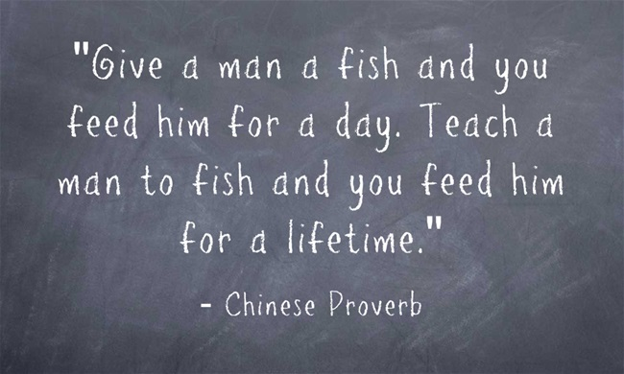
Outline
Recap of Anomaly Detection
Application: Network Intrusion Detection
Teach you a network-intrusion solution
vs.
Teach you how to come up with this solution

Slide 13

Network Intrusion
“Our web servers got attacked yesterday.
I don’t want it happen again.
Please build a system to address it!”
TO DO Lists:
1. Finding related datasets (e.g., /var/log/apache2/access.log)
2. Figuring out how to detect attacks (anomalies)
3. Triggering an alert when an attack is detected (e.g., send an email)
Key Problem

Slide 14
How to come up with a solution?
Doing a survey on related work

Slide 15
Anomaly Detection Methods
Survey Paper
V. Chandola, A. Banerjee, V. Kumar: Anomaly detection: A survey. ACM Computing Surveys (2009)
Supervised Learning (e.g., Assignment 2 – Sentiment Analysis)
Both normal and anomalous instances are given
Classification models can be used
Unsupervised Learning (e.g., Find the top-10 hot topics in twitter)
No labeled instances are given
Clustering models can be used

Slide 16
Why is unsupervised learning more common?
No need to label data
Labeling is a tedious and expensive process
Able to identify “unknown unknowns”
Not only detect a known attack pattern,
but also detect an unknown attack pattern

Slide 17
How to come up with a solution?
Doing a survey on related work
Choosing an unsupervised learning approach

Slide 18
Clustering-based
Basic Idea
Cluster the data points into groups.
Decide which points are anomalies:
Points in small clusters
Using distance to the closest cluster
Cluster 1
Cluster 2
Cluster 3

Slide 19
How to come up with a solution?
Doing a survey on related work
Choosing an unsupervised learning approach
Picking up a clustering algorithm

Slide 20
K-Means
Iterative Algorithm
This is the initial motivation for creating Spark
Algorithm Overview
Picking up K random points as cluster centers
Assigning each point to the closest center
Updating cluster centers accordingly
Repeat Steps 2 and 3 until some termination conditions are met
How to optimize?
RDD.cache()
K-Means++ Initialization

Slide 21
How to come up with a solution?
Doing a survey on related work
Choosing an unsupervised learning approach
Picking up a clustering algorithm
Selecting and transforming features

Slide 22
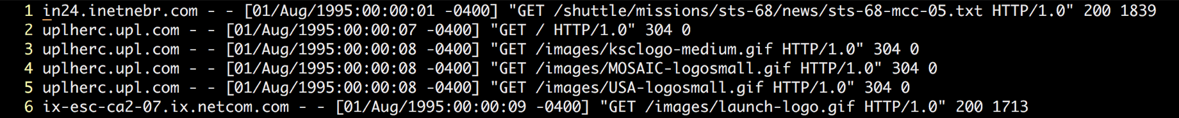
Feature Selection
Raw Data
Turning Raw Data into Connection Data
A connection is a sequence of HTTP requests starting and ending at some well defined times
Turning Connection Data into Feature Vectors
Requiring a fair bit of domain knowledge
Asking yourself how to distinguish attacks from normal connections (e.g., number of failed login attempts, duration of the connection )

Slide 23
Feature Transformation
Feature Vector
e.g., [http, BC, 0, 105, 146, 0, … , 0.00, 0.00]
Will this feature vector work for KMeans?
What’s distance between “http” and “ftp”?
The distance between two feature vectors will be dominated by the features with a broad range of values (e.g., the 4th feature)
Categorical
feature
Numerical
feature

Slide 24
Categorical Features → Numerical Features
Naïve solution
http→ 0
ftp → 1
ssh → 2
One-hot encoding
http → [1,0,0]
ftp → [0,1,0]
ssh → [0,0,1]
What’s the drawback?
Distance(“http”, “ssh”) > Distance(“http”, “ftp”)

Slide 25


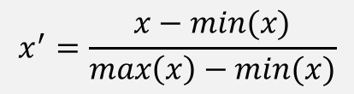
Scaling Numerical Features
Rescaling
Standardization
Scaling to unit length
You have done it in Assignment 2
Which one to use?
$$x^{′}=\frac{x−min(x)}{max\left(x\right)−min(x)}$$
$$x^{′}=\frac{x−\overline{x}}{σ}$$
It depends on your data. In practice, you may need to try all three of them and choose the one that gives you the best result.
$$x^{′}=\frac{x}{|\left|x\right||}$$

Slide 26
How to come up with a solution?
Doing a survey on related work
Choosing an unsupervised learning approach
Picking up a clustering algorithm
Selecting and transforming features
Parameter Tuning

Slide 27
Parameter Tuning
You need to describe your solution in Assignment 3
Key Questions
How different is it from supervised learning?
Which parameters do you need to tune?
What are possible values for them?
How can you tell which values are better?

Slide 28
How did we come up the solution?
Doing a survey on related work
Choosing an unsupervised learning approach
Picking up a clustering algorithm
Selecting and transforming features
Tuning Parameters
If not satisfied, go back to previous steps

Slide 29
How did we come up the solution?
Doing a survey on related work
Choosing an unsupervised learning approach
Picking up a clustering algorithm
Selecting and transforming features
Tuning Parameters
If not satisfied, go back to previous steps
Deploying your model in production

Slide 30
Model Serving
New Challenges
Model has to reflect to the latest data updates.
Kmeans → Streaming Kmeans
Predictions have to be made in real-time.
Parallelizing prediction process

Slide 31
Summary
How did we come up the solution?
Doing a survey on related work
Choosing an unsupervised learning approach
Picking up a clustering algorithm
Selecting and transforming features
Tuning Parameters
If not satisfied, go back to previous steps
Deploying your model in production
Theory
Model Development
Practice
Model Serving

Slide 32
Assignment 3: Anomaly Detection
Part 1. Model Development (required)
Part 2. Model Serving (optional)
Deadline: 11:59pm, Feb 1st
http://tiny.cc/cmpt733-sp16-a3

