Slide 1
Lecture 4: Data Integration and Cleaning
CMPT 733, SPRING 2017
Jiannan Wang

Slide 2
Outline
Motivation
Asking “Why” before you learn something
Data Integration and Cleaning
Getting the big picture
Entity Resolution
Learning how to solve a particular problem

Slide 3
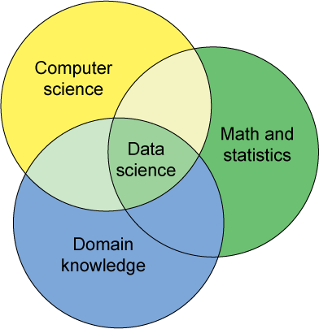
Want to become a data scientist?
One definition

Slide 4
Making it More Specific
Domain Knowledge
Use domain knowledge to ask questions and find related data
E.g., Which customers are likely to leave your company?
Math/Statistics
Use math/statistics knowledge to come up with a solution
E.g., Design an algorithm that can make the prediction based on enterprise data
Computer Science
Use programming skills to build a data-processing pipeline
E.g., The pipeline takes enterprise data as input, and outputs the prediction
No domain knowledge?
Then, you have to have strong teamwork and communication skills
Want to know more statistics?
Read CH 5-7 in “Data Science from Scratch”
What is a data-processing pipeline?

Slide 5
Data-processing Pipeline
What you think you do?
What you really do?
Analysis/
Modeling
Cleaned Data
Predictive
Model
Data Collection
Data Cleaning
Data Integration
Analysis/
Modeling
Visualization

Slide 6
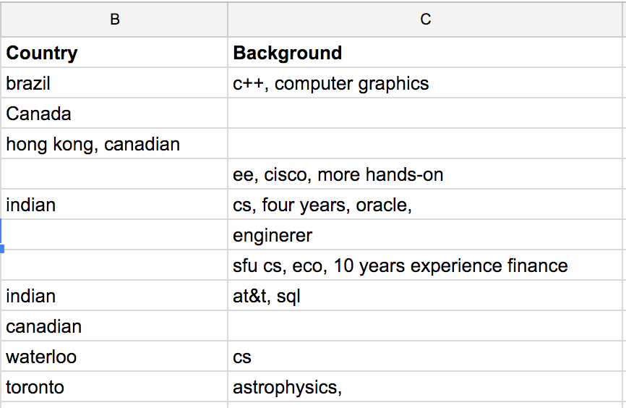
Example: Assignment Mark Prediction
Data Collection
Collect background information
Data Cleaning
Missing values, Inconsistent values
Data integration
Integrate with CourSys to get assignment marks
Modeling
Build a linear regression model
Visualization
Present results to non-technical persons

Slide 7
Outline
Motivation
Asking “Why” before you learn something
Data Cleaning and Integration
Getting the big picture

Slide 8
Dirty Data Problems
From Stanford Course:
Parsing text into fields (separator issues)
Missing required field (e.g. key field)
Different representations (iphone 2 vs iphone 2nd generation)
Fields too long (get truncated)
Formatting issues – especially dates
Licensing issues/Privacy/ keep you from using the data as you would like?

Slide 9
Data Cleaning Tools
Python
Missing Data (Pandas)
Deduplication (Dedup)
OpenRefine
Open-source Software (http://openrefine.org)
OpenRefine as a Service (RefinePro)
Data Wrangler
The Stanford/Berkeley Wrangler research project
Commercialized (Trifacta)

Slide 10
Data Integration Problem
Data Source 1 (from CourSys)
Data Source 2 (from survey)
First Name | Last Name | Mark
Michael | Jordan | 50
Kobe | Bryant | 48
Name | Background
Mike Jordan | C++, CS, 4 years
Kobe Bryant | Business, 2 years
Data Integration???
Name | Mark | Background
Michael Jordan | 50 | C++, CS, 4 years
Kobe Bryant | 48 | Business, 2 years
Integrated Data

Slide 11
Data Integration: Three Steps
Schema Mapping
Creating a global schema
Mapping local schemas to the global schema
Entity Resolution
You will learn this in detail later
Data Fusion
Resolving conflicts based on some confidence scores
Want to know more?
Anhai Doan, Alon Y. Halevy, Zachary Ives. Principles of Data Integration. Morgan Kaufmann Publishers, 2012.

Slide 12
Outline
Motivation
Asking “Why” before you learn something
Data Integration and Cleaning
Getting the big picture
Entity Resolution
Learning how to solve a particular problem

Slide 13
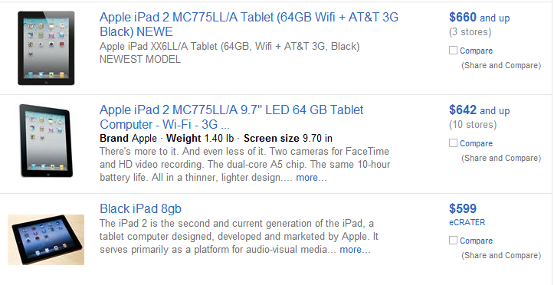
Entity Resolution

Slide 14
Output of Entity Resolution
ID | Product Name | Price
r₁ | iPad Two 16GB WiFi White | $490
r₂ | iPad 2nd generation 16GB WiFi White | $469
r₃ | iPhone 4th generation White 16GB | $545
r₄ | Apple iPhone 3rd generation Black 16GB | $375
r₅ | Apple iPhone 4 16GB White | $520
(r₁, r₂)
, (r₃, r₅)

Slide 15
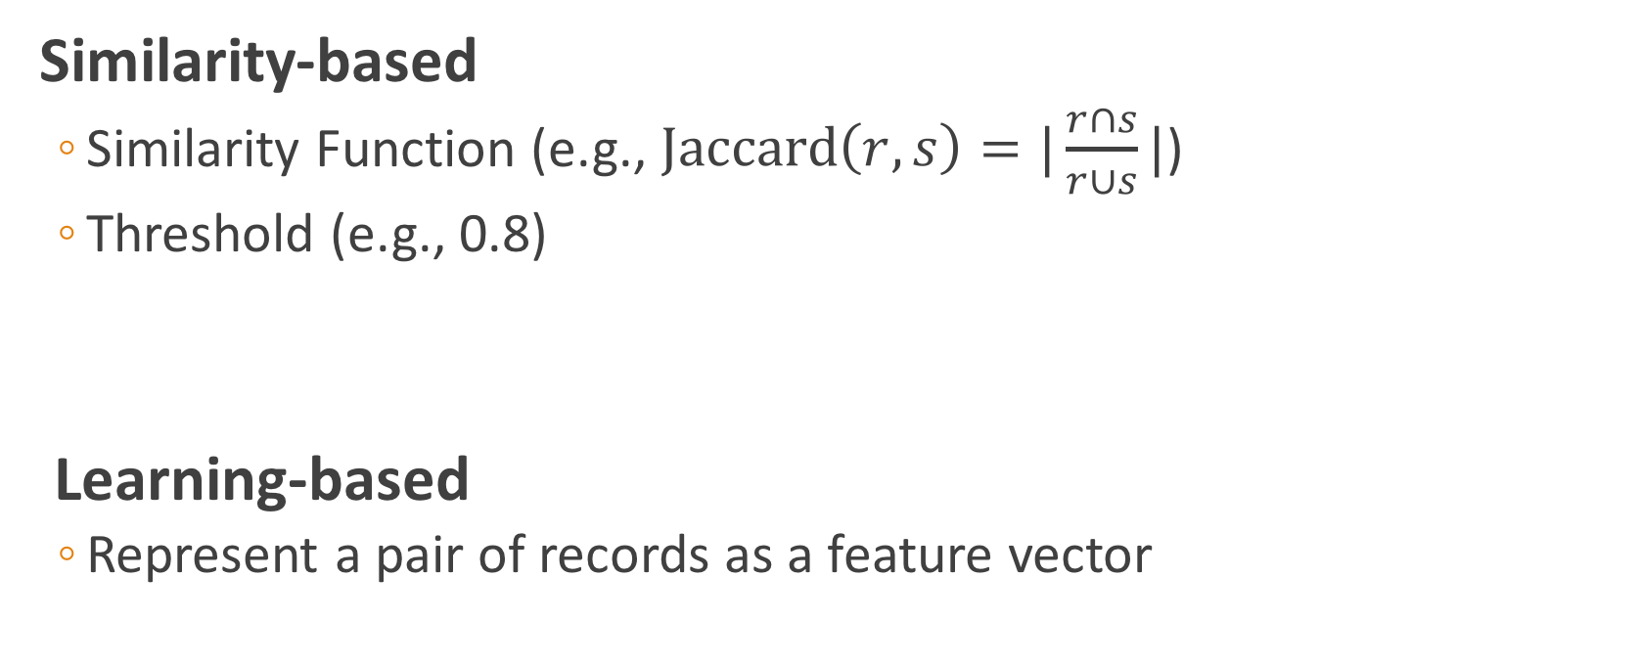
Entity Resolution Techniques
Similarity-based
Similarity Function (e.g., $\text{Jaccard}\left(r, s\right)=|\frac{r∩s}{r∪s}|$)
Threshold (e.g., 0.8)
Learning-based
Represent a pair of records as a feature vector
Jaccard(r1, r2) = 0.9 ≥ 0.8 Matching
Jaccard(r4, r8) = 0.1 < 0.8 Non-matching

Slide 16
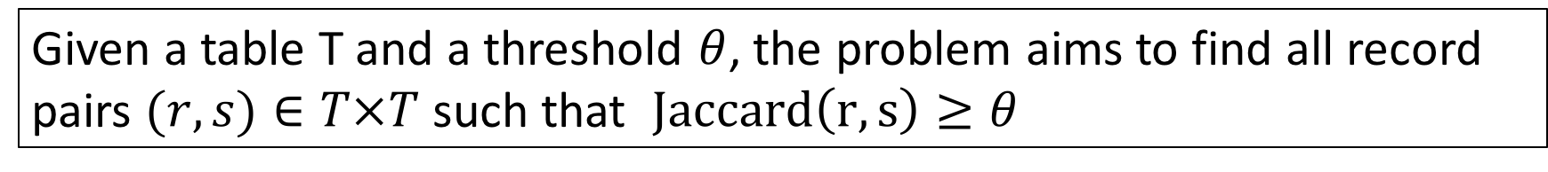

Similarity-based
Suppose the similarity function is Jaccard.
Problem Definition
Given a table T and a threshold $θ$, the problem aims to find all record pairs $(r,s)∈T×T$ such that $Jaccard\left(r, s\right)≥θ$
The naïve solution needs $n^{2}$ comparisons

Slide 17
Filtering-and-Verification
Step 1. Filtering
Removing obviously dissimilar pairs
Step 2. Verification
Computing Jaccard similarity only for the survived pairs

Slide 18
How Does Filtering Work?
What are “obviously dissimilar pairs”?
Two records are obviously dissimilar if they do not share any word.
In this case, their Jaccard similarity is zero, thus they will not be returned as a result and can be safely filtered.
How can we efficiently return the record pairs that share at least one word?
To help you understand the solution, let’s first consider a simplified version of the problem, which assumes that each record only contains one word
Notes:
obviously dissimilar pairs

Slide 19
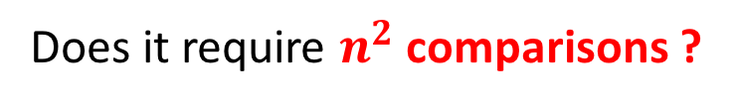
A simplified version
Suppose each record has only one word. Write a SQL query to do the filtering.
r₁
Apple
Apple
Banana
Orange
Banana
SELECT T1.id, T2.id
FROM Table T1, Table T2
WHERE T1.word = T2.word and T1.id < T2.id
r₂
r₃
r₄
r₅
Does it require $n^{2}$ comparisons ?
Output: (r1, r2), (r3, r5)

Slide 20
A general case
Suppose each record can have multiple words.
r₁
Apple
Orange
Apple
Banana
Orange
Apple
Banana
r₁
r₁
Apple, Orange
Apple
Banana
Orange, Apple
Banana
r₂
This new table can be thought of as the inverted index of the old table.
r₂
r₃
Flatten
Run the previous SQL on this new table and remove redundant pairs.
r₃
r₄
r₄
r₄
r₅
r₅

Slide 21
Not satisfied with efficiency?
Exploring stronger filter conditions
Filter the record pairs that share zero token
Filter the record pairs that share one token
….
Filter the record pairs that share k tokens
Challenges
How to develop efficient filter algorithms for these stronger conditions?
Jiannan Wang, Guoliang Li, Jianhua Feng.
Can We Beat The Prefix Filtering? An Adaptive Framework for Similarity Join and Search. SIGMOD 2012:85-96.

Slide 22
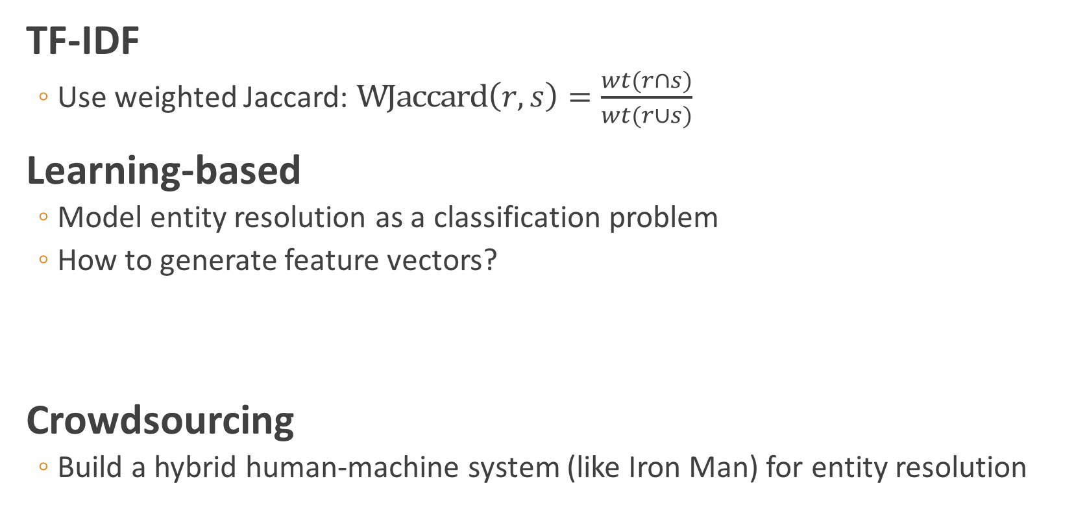
Not satisfied with result quality?
TF-IDF
Use weighted Jaccard: $\text{WJaccard}\left(r, s\right)=\frac{wt(r∩s)}{wt(r∪s)}$
Learning-based
Model entity resolution as a classification problem
How to generate feature vectors?
Crowdsourcing
Build a hybrid human-machine system (like Iron Man) for entity resolution
M. Bilenko and R. J. Mooney. Adaptive duplicate detection using learnable string similarity measures. In KDD, pages 39–48, 2003

Slide 23
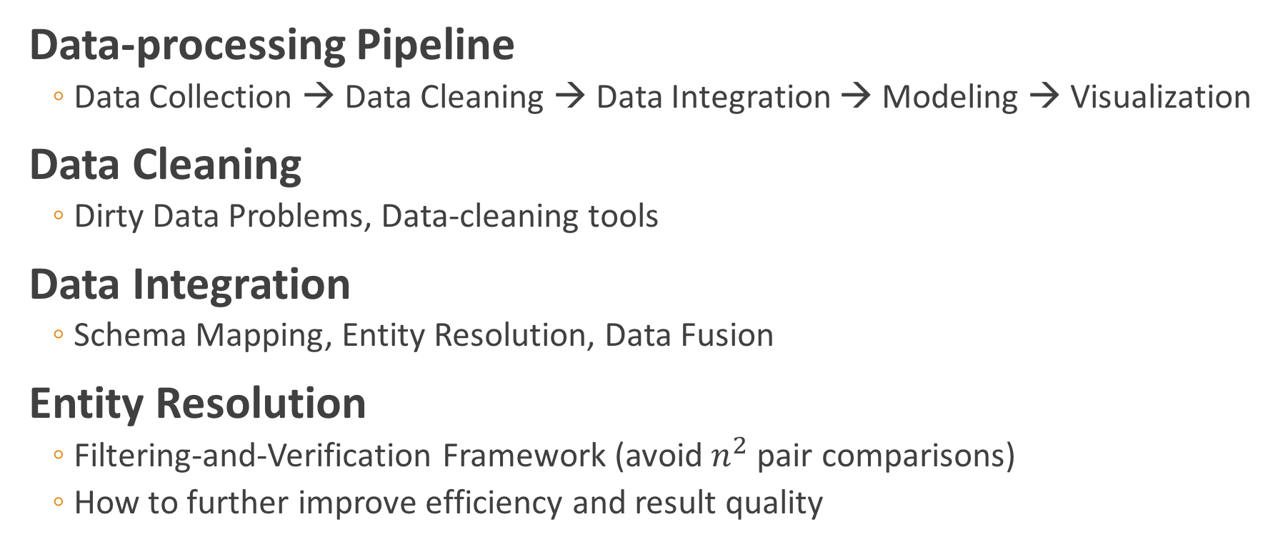
Summary
Data-processing Pipeline
Data Collection → Data Cleaning → Data Integration → Modeling → Visualization
Data Cleaning
Dirty Data Problems, Data-cleaning tools
Data Integration
Schema Mapping, Entity Resolution, Data Fusion
Entity Resolution
Filtering-and-Verification Framework (avoid $n^{2}$ pair comparisons)
How to further improve efficiency and result quality

Slide 24
Assignment 4: Entity Resolution
Part 1. Similarity Joins (required)
Part 2. Where To Go From Here (optional)
Deadline: 11:59pm, Feb 5th
http://tiny.cc/cmpt733-a4

Slide 25
About Final Project
My thoughts
You have to integrate data from at least two data sources
You have to come up with some interesting questions to investigate
You have to give an excellent talk on your project proposal
…
You will get a detailed project instruction in two weeks

