Slide 1
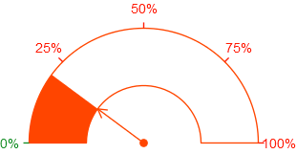
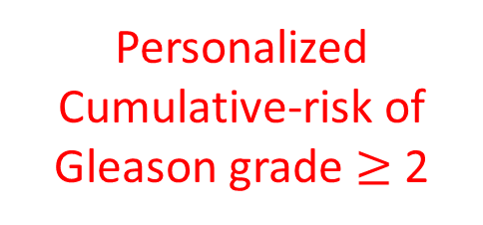
PSA Profile
Previous biopsy results
Prediction Joint Model
Age
Personalized Cumulative-risk of
Gleason grade $≥$ 2

