Slide 1
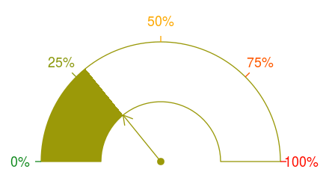
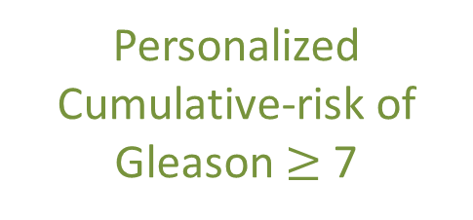
PSA Profile
Time of latest biopsy
Prediction Joint Model
Age
Personalized Cumulative-risk of
Gleason $≥$ 7

