Slide 1
Power of Parallel Computing
in Thoracic Disease Classification
Using NIH ChestX-ray14 Dataset | DenseNet-121 | 112,120 Images | ~45 GB
Team 13: Daxiao Han & Zhenyu Dai
CSYE 7105 — High Performance Parallel Machine Learning & AI

Slide 2
Agenda
01
Introduction & Motivation
05
FP16 Mixed-Precision Training
Background, goals, clinical relevance
Tensor Cores: 1.13× speed + 44.3% memory
02
Dataset & Methodology
06
Multi-GPU DDP & FSDP
NIH ChestX-ray14, DenseNet-121, 4 strategies
P100 cluster: near-linear strong scaling
03
CPU Multiprocessing Results
07
Conclusion & Future Work
16-core preprocessing: 12.90× speedup
Summary of gains and next steps
04
DataLoader Optimization
Pipeline parallelism: 4.33× throughput

Slide 3
Introduction & Motivation
Clinical Context
Chest X-ray is the most widely used medical imaging modality. Automated deep learning classification (CNN) can reach radiologist-level performance.
Computational Bottlenecks
• Preprocessing 112K images → 20–40 min on 1 CPU core
• Training DenseNet-121 → several hours on 1 GPU
CPU Multiprocessing
Distribute preprocessing across 16 cores
DataLoader Tuning
Overlap CPU data prep with GPU compute
Mixed-Precision (FP16)
Halve memory, boost Tensor Core throughput
Multi-GPU DDP/FSDP
Scale training to 2 & 4 P100 GPUs

Slide 4
Dataset & Model Architecture
NIH ChestX-ray14
DenseNet-121
Property | Value
Total Images | 112,120
Unique Patients | 30,805
Resolution | 1024×1024 (PNG)
Disease Labels | 14 (multi-label)
Dataset Size | ~45 GB
Train / Val / Test | 69K / 17K / 26K
Input Size (resized) | 224×224
Parameters
7,485,838 trainable
Pretrained
ImageNet weights
Output Layer
14-output sigmoid
Loss Function
BCEWithLogitsLoss
Optimizer
Adam (lr=1e-4)
Batch Size
32 per GPU
Metric
AUC per disease

Slide 5
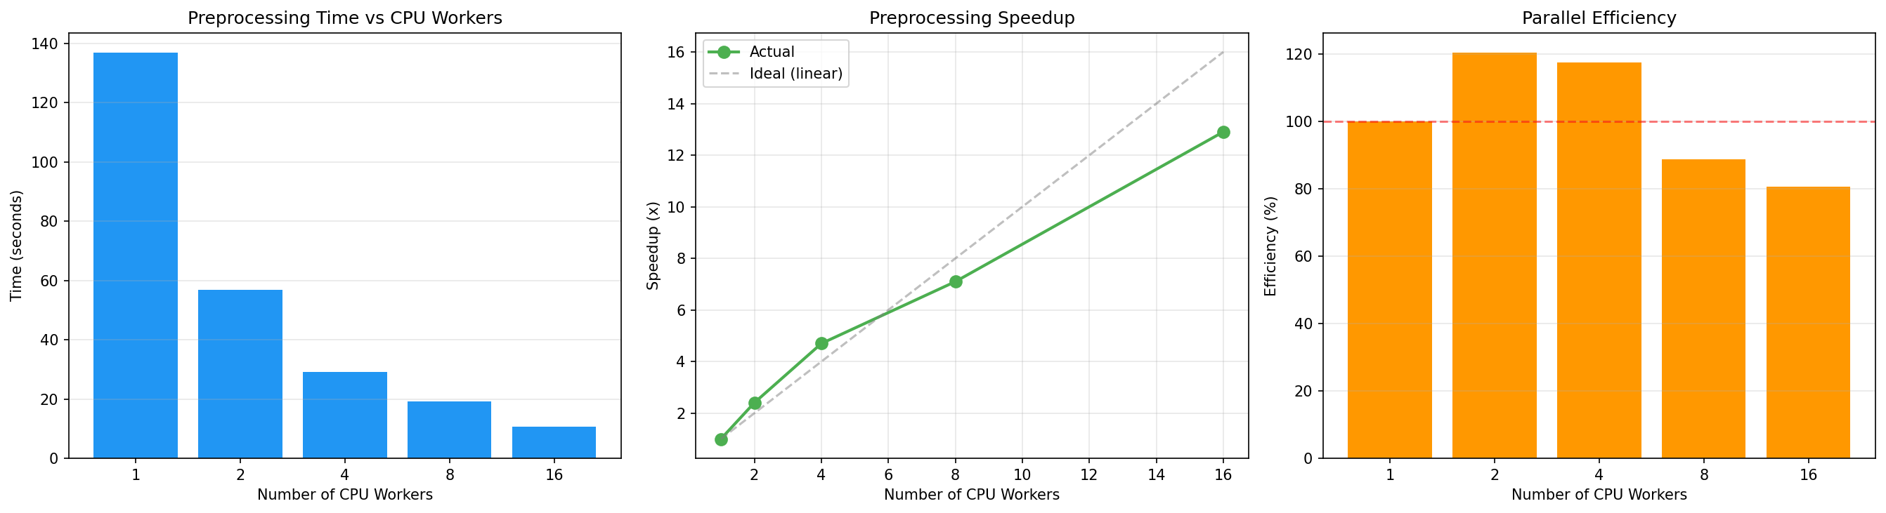
CPU Multiprocessing — Preprocessing
Speedup Results
Cores | Time (s) | Efficiency
1 Core | 136.8s | 100%
2 Cores | 56.9s | 120%
4 Cores | 29.1s | 118%
8 Cores | 19.3s | 89%
16 Cores | 10.6s | 81%
12.90×
Max Speedup at 16 Cores (80.6% efficiency)

Slide 6
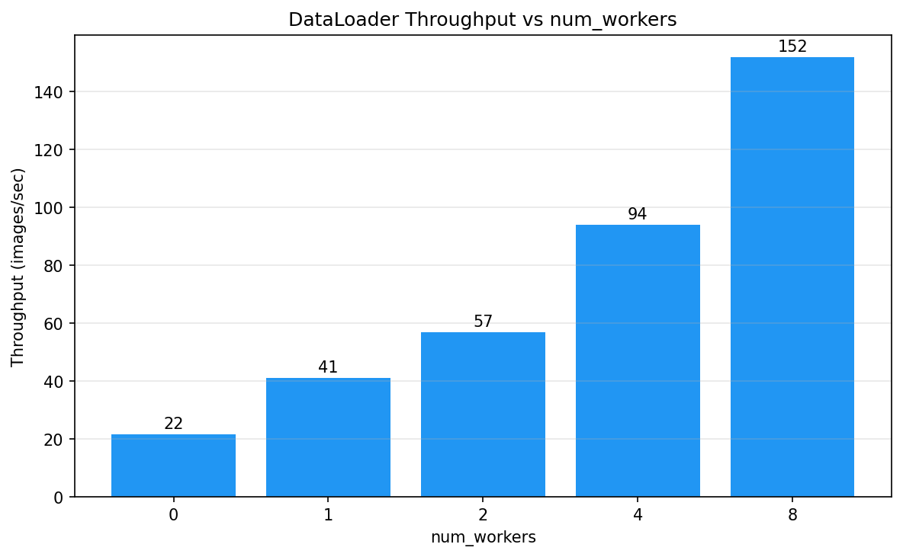
DataLoader Multi-Worker Optimization
Pipeline Parallelism Detail
Workers | Throughput | Speedup
1 worker | 41.0 img/s | 1.89×
2 workers | 56.9 img/s | 2.63×
4 workers | 93.8 img/s | 4.3×
8 workers | 151.9 img/s | 7.02×
4.33×
Best at num_workers=4 (balance); 8 workers=7.02× but diminishing returns

Slide 7
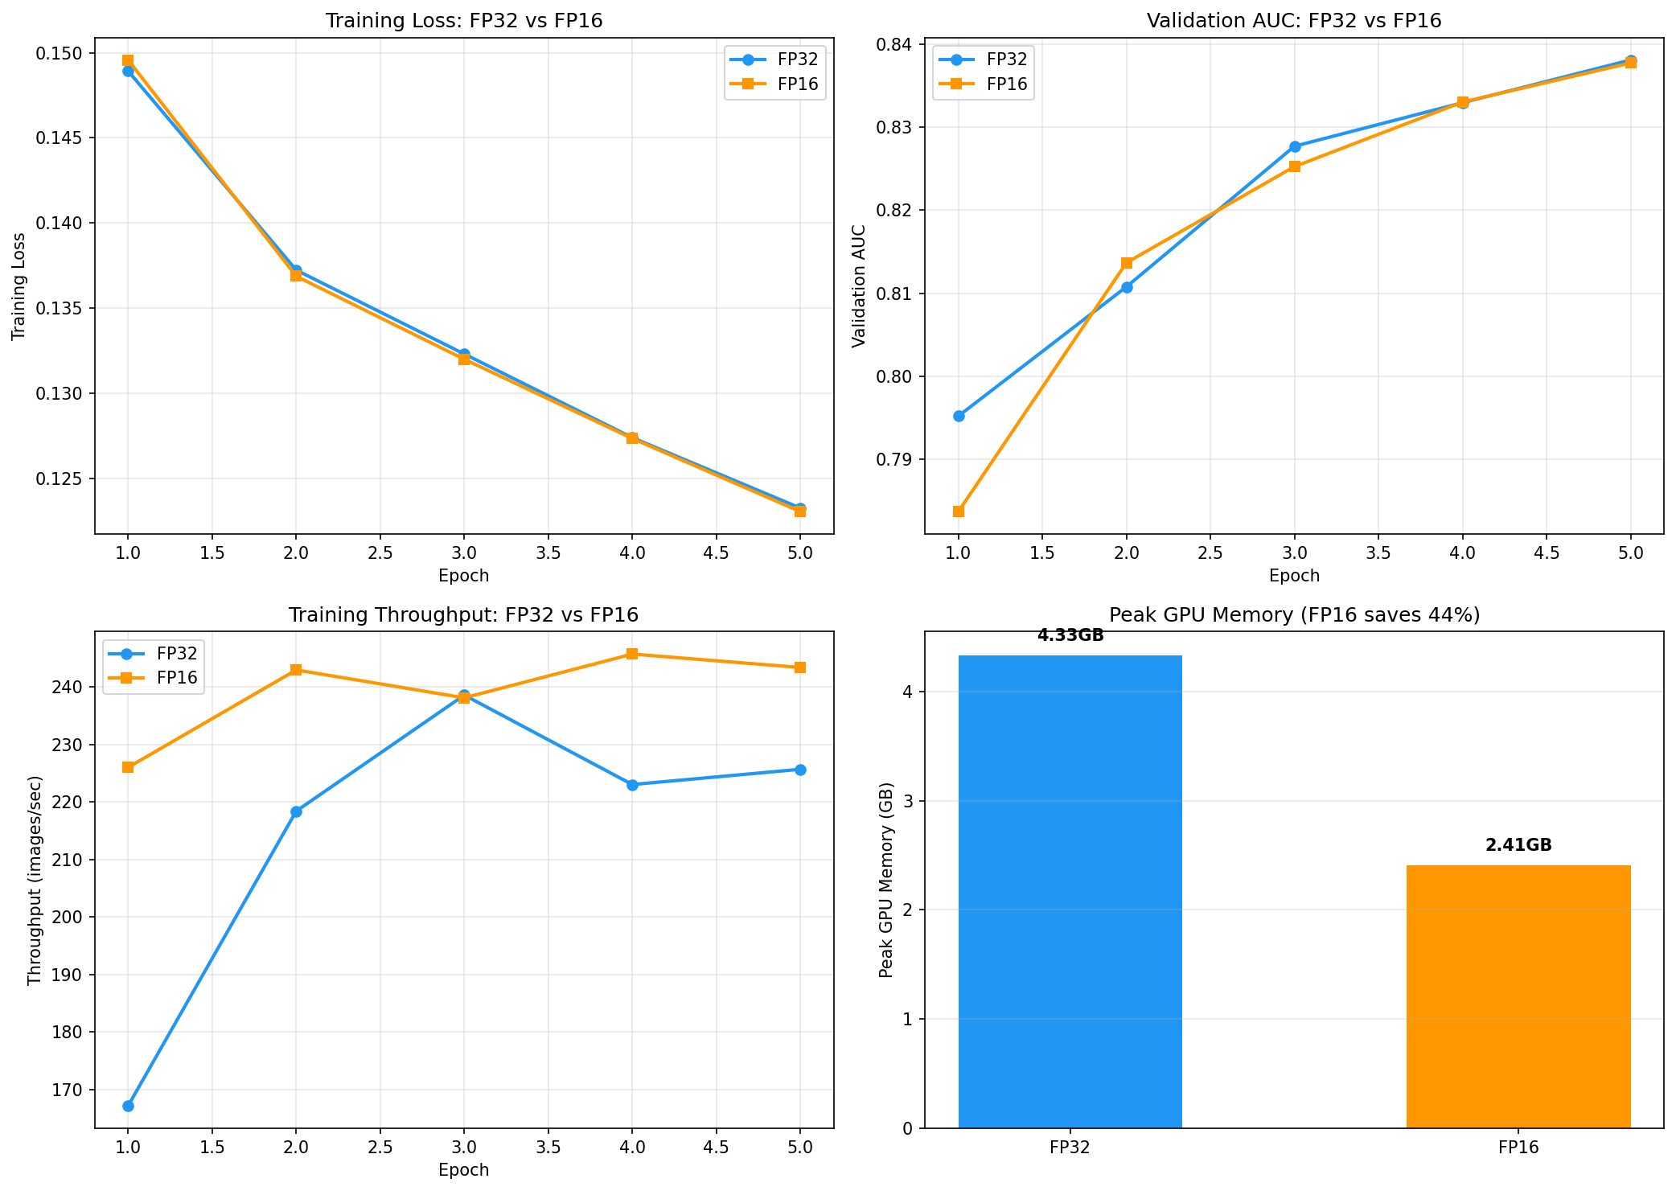
FP32 vs FP16 Mixed-Precision Training
1.13×
Training Speedup
44.3%
GPU Memory Reduction
0.8062
FP16 Test AUC
0.8059
FP32 Test AUC
Accuracy preserved: FP16 AUC ≈ FP32 AUC

Slide 8
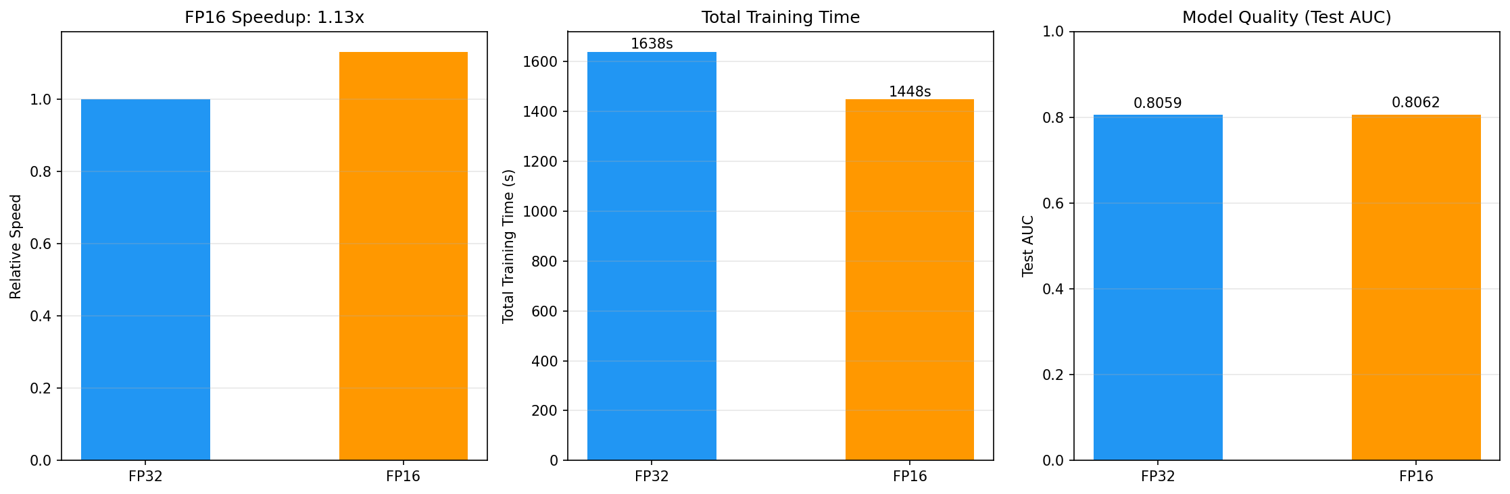
Multi-GPU Training: DDP & FSDP
Config | Epoch Time | Throughput | GPU Mem | AUC
Single GPU (A100) FP32 | 327.6s | 215 img/s | 4.33 GB | 0.8059
Single GPU (A100) FP16 | 289.6s | 239 img/s | 2.41 GB | 0.8062
DDP 2-GPU (P100) FP32 | 1135s | 61 img/s | 4.36 GB | 0.8029
DDP 4-GPU (P100) FP32 | 603.5s | 115 img/s | 4.36 GB | 0.7966
FSDP 2-GPU (P100) FP32 | 601s | 115 img/s | 4.30 GB | 0.8068
FSDP 4-GPU (P100) FP32 | 637s | 109 img/s | 4.27 GB | 0.7969

Slide 9
Overall Parallel Performance Summary
Optimization Strategy | Baseline | Optimized | Improvement
CPU Preprocessing (1→16 cores) | 136.84s | 10.60s | 12.90× speedup
DataLoader (0→4 workers) | 21.65 img/s | 93.83 img/s | 4.33× throughput
Training Precision (FP32→FP16) | 327.6s/epoch | 289.6s/epoch | 1.13× speedup
GPU Memory (FP32→FP16) | 4.33 GB | 2.41 GB | 44.3% reduction
DDP Strong Scaling (2→4 GPUs) | 61 img/s | 115 img/s | 1.89× (94% eff.)
12.9×
4.33×
1.13×
1.89×
Preprocessing
DataLoader
FP16 Speed
DDP 2→4GPU

Slide 10
Conclusion
1
CPU multiprocessing → 12.90× speedup (1.9% serial fraction → near-ideal Amdahl scaling)
2
DataLoader 4 workers → 4.33× throughput via pipeline parallelism
3
FP16 AMP → 1.13× speed + 44.3% GPU memory reduction, accuracy preserved (AUC 0.8062 ≈ 0.8059)
4
DDP 2→4 GPU → 1.89× speedup (94% efficiency), near-linear strong scaling

