Slide 1
Data Transmission and further analysis
Signals
(monitoring)
Monitoring
Storage
Online Control
Signals
(PMT + SiPM)
hDOM Internal Trigger
Digitization
Physics Filter
Fast Reconstruction
High energy charged particles
hDOM arrays
satellite
On-shore Station
TDLI
Main/Sub Junction Box
Large bandwidth
Positioning system
Small bandwidth
Junction box system & Optical Fiber

Slide 2
Discriminator
L1 message
FPGA
Extract signals over the threshold
(0.3 single photon peak)
Process L1 trigger
Store 1000ns signals
Waiting for L1 message
PMT
Analog Signal
SCA
ADC
1000ns L1 signals
digitized L1 signals

Slide 3

hDOM arrays
hDOM Internal Trigger
Signals
(PMT + SiPM)
Signals
(positioning)
Cherenkov Radiation
L1 trigger
Digitization
Positioning system
Data Transmission
High-level Trigger & Analysis
Physics Filter
Fast Reconstruction
On-shore Station
Further Analysis

Slide 4
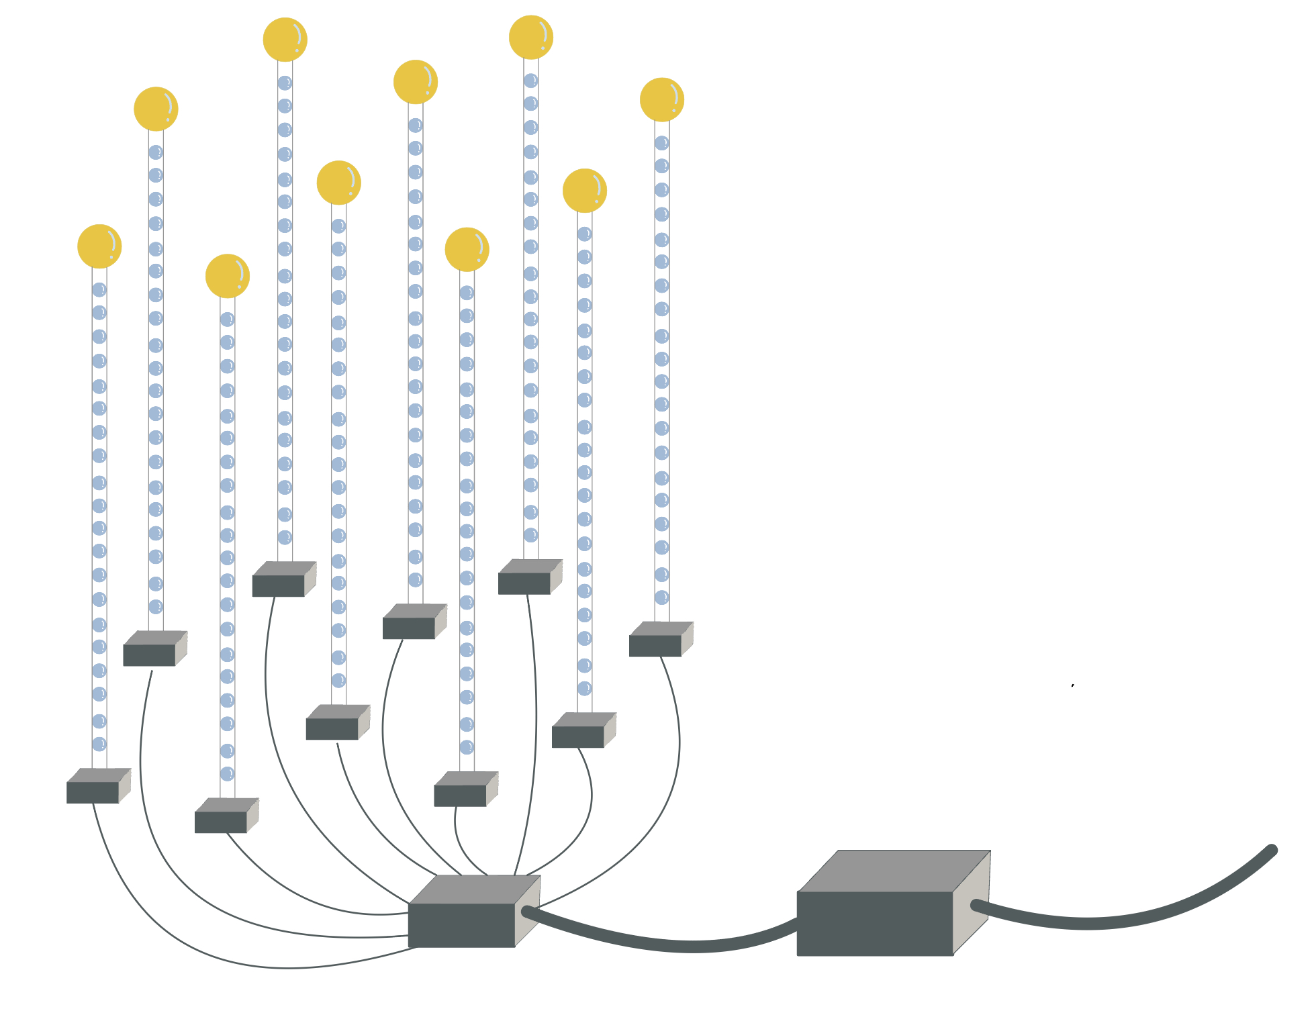

L1 Trigger
Signals
(PMT + SiPM)
L1 trigger
Digitization
Data Transmission
L2 Trigger
Physics Filter
Fast Reconstruction
Further Analysis

Slide 5
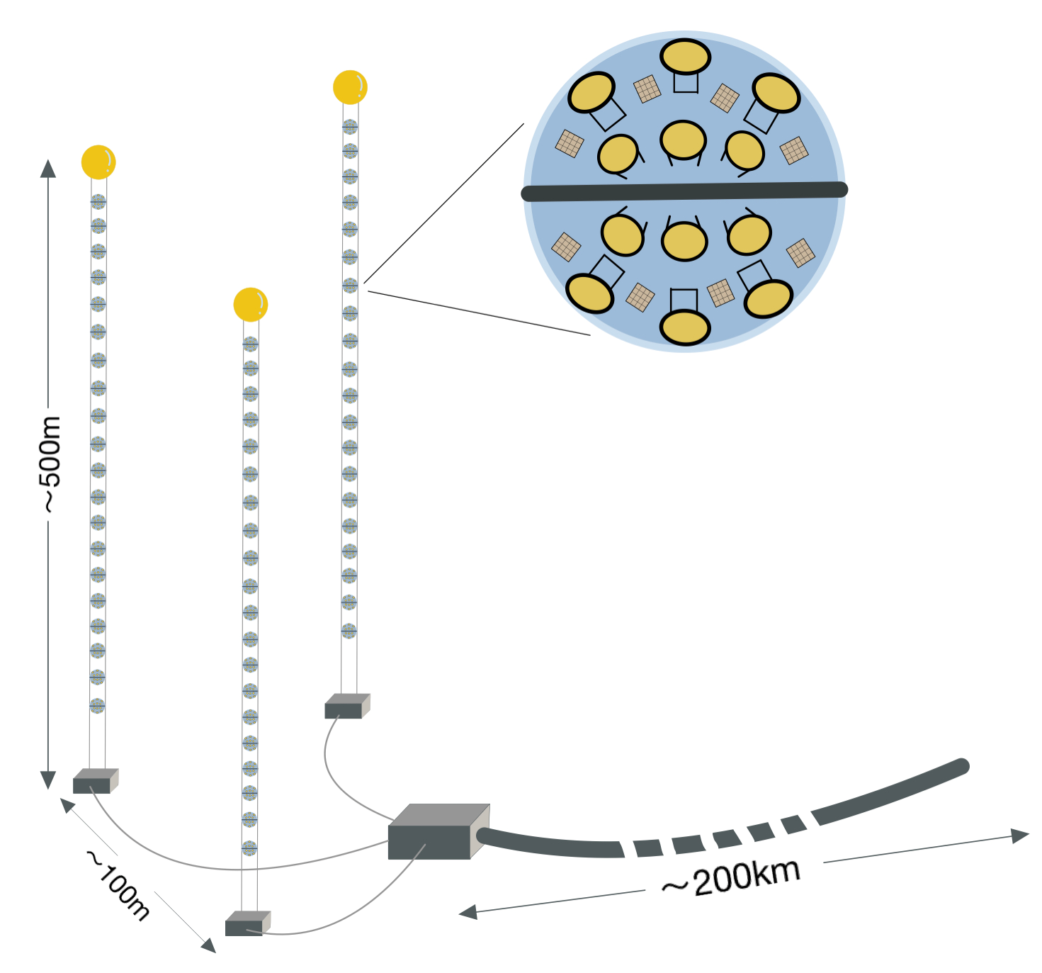
Signals
(PMT + SiPM)
L1 trigger
Digitization
Physics Filter
Fast Reconstruction
Further Analysis

Slide 6
Shell file: batch processing in remote server
Root file
Python
(L1 trigger)
CSV file
Python
(statistics)
Geant4
YAML Configuration files:
Water Optical Property
Geometry of hDOM
Energy of muon

Slide 7
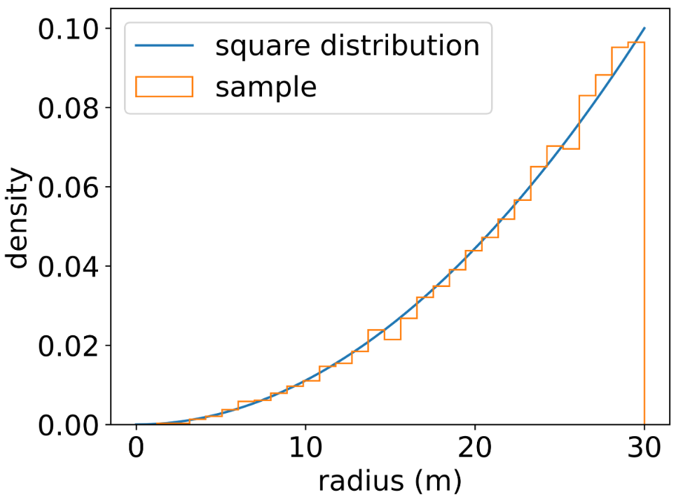

R

Slide 8
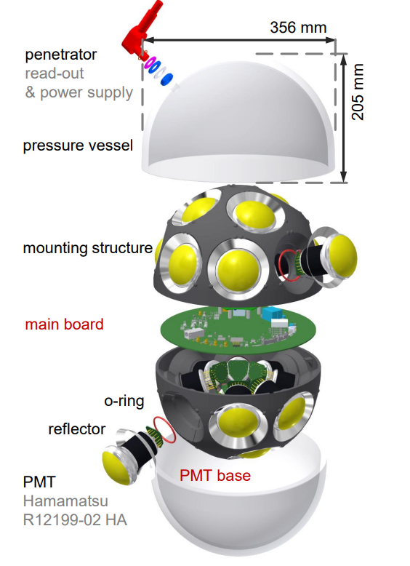
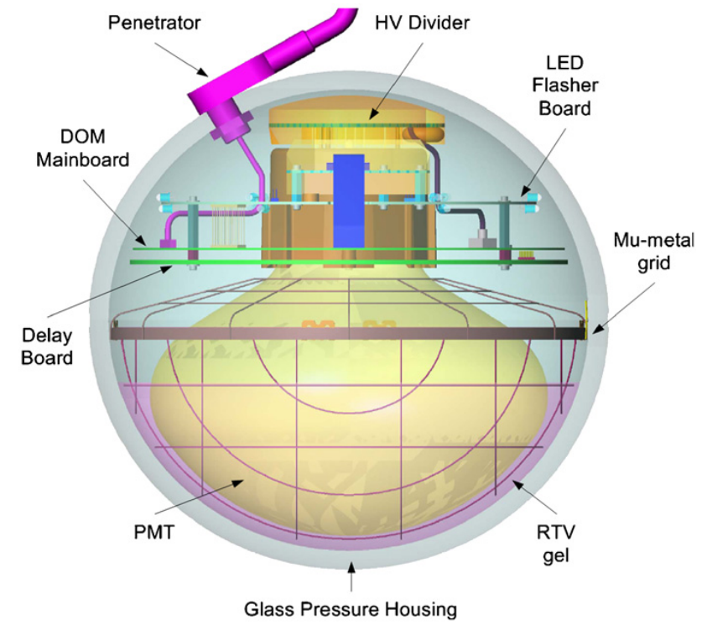

Slide 9
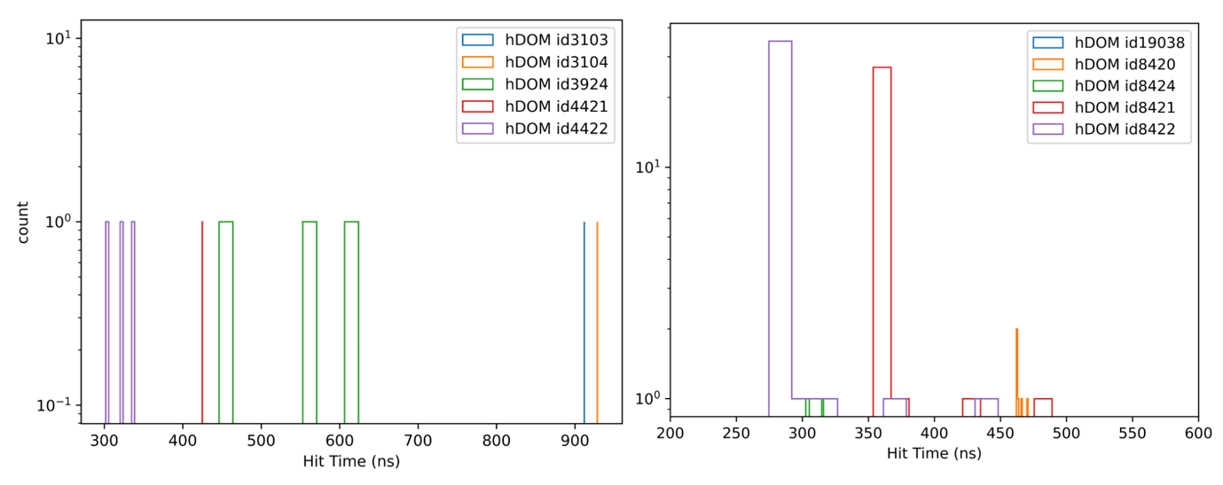
Hit Time (ns)

Slide 10
