Slide 1





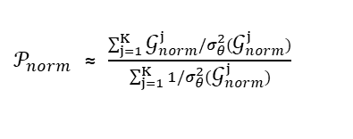











Graph Dataset
Uncertainty
Ranking $σ_{θ}^{2}$
Top-K graphs with lowest uncertainty
$$σ_{θ}^{2}({\text{𝒢}}_{1})$$
${\text{𝒢}}_{1}$:Normal Graph
$${\text{𝒢}}_{norm}^{1}$$
$${\text{𝒢}}_{norm}^{K}$$
Input
...
Neural Network
$$σ_{θ}^{2}({\text{𝒢}}_{2})$$
...
...
$$σ_{θ}^{2}({\text{𝒢}}_{N})$$
$𝒫_{norm}$ ≈ $\frac{\sum_{j=1}^{K}{{\text{𝒢}}_{norm}^{j}/σ_{θ}^{2}({\text{𝒢}}_{norm}^{j})}}{\sum_{j=1}^{K}{1/σ_{θ}^{2}({\text{𝒢}}_{norm}^{j})}}$
${\text{𝒢}}_{2}$:Normal Graph
$$σ_{θ}^{2}({\text{𝒢}}_{N})$$
$$σ_{θ}^{2}({\text{𝒢}}_{1})$$
E-step
M-step
Neural Network(GNN+MLP)
...
$$𝒫_{norm}\sim \text{𝒩}\left({\text{𝒢}}_{2},σ_{θ}^{2}\left({\text{𝒢}}_{2}\right)\right)$$
$${\text{𝓛}}_{n}=−\log{p (𝒫_{norm}|{\text{𝒢}}_{2},θ)}$$
$$σ_{θ}^{2}({\text{𝒢}}_{2})$$
Back Propagation
${\text{𝒢}}_{N}$:Anomaly Graph
$${\text{𝒢}}_{2}$$
$$σ_{θ}^{2}({\text{𝒢}}_{2})$$
$${\text{𝒢}}_{2}$$
Higher$σ_{θ}^{2}\left({\text{𝒢}}_{2}\right)$→ Higher abnormality degree

