Slide 1
Automatic Topology Discovery
An approach to discover IS-IS implemented network topology
Presenter: Zhenyuan Bo, Xiao Wang
December 19, 2016

Slide 2
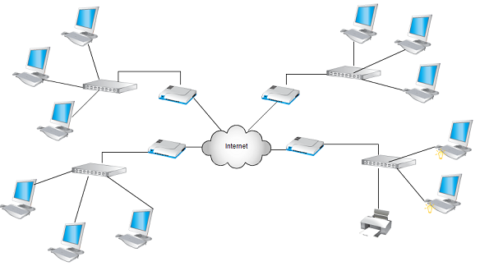
Topology Discovery
Project objective: Discover network topology based on routing information extracted from one router node.
Motivation:
-Network scale grows exponentially
-Network topology not accurate
-Labor costly upon contingency

Slide 3
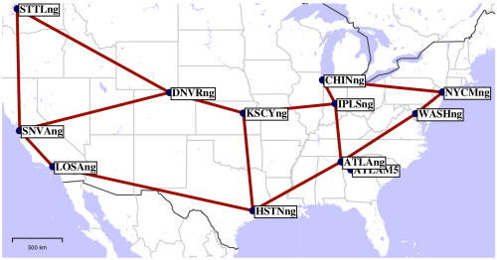
Test Model: Abilene network
Abilene network was a high-performance backbone network created by Interenet2 in the late 1990s.

Slide 4
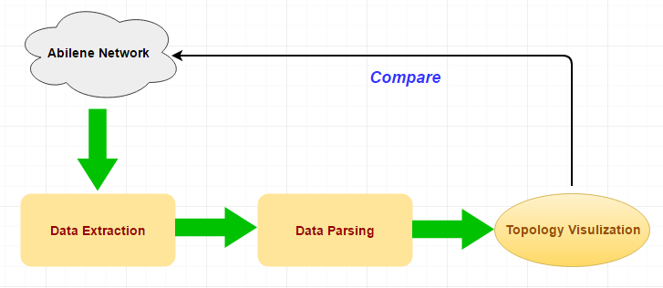
Approach
By extracting and parsing the data of interest, we recover the network topology.

Slide 5
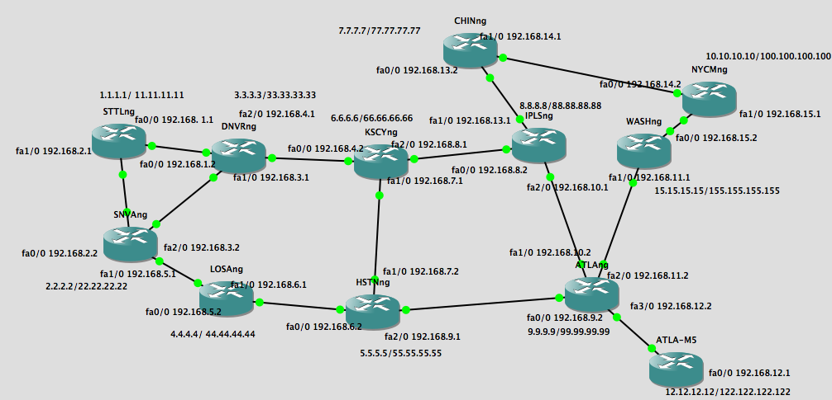
Network Set-up Using GNS3

Slide 6
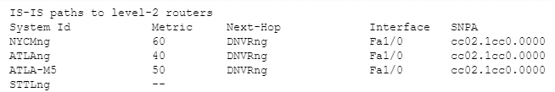
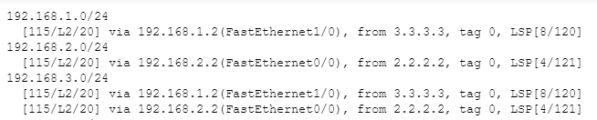
Data Extraction
-”show isis topology”
-”show isis rib”

Slide 7
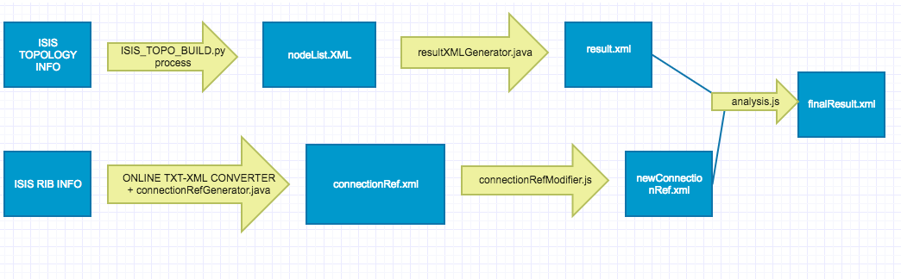
Data Parsing
Parsing Workflow

Slide 8
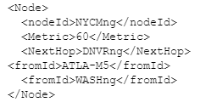
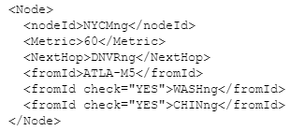
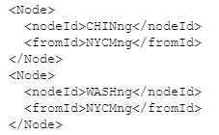

Data Parsing(Output)
1.1. nodeList.xml
2. newResult.xml
Combine
1.2. connectionRef.xml
3. finalResult.xml

Slide 9
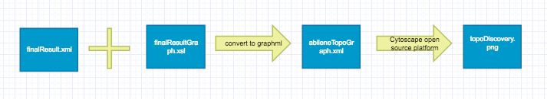

Topology Visualization
Cytospace is an open source software platform for visualizing complex networks.
-Input: .graphml file
-Output: Topology diagram

Slide 10
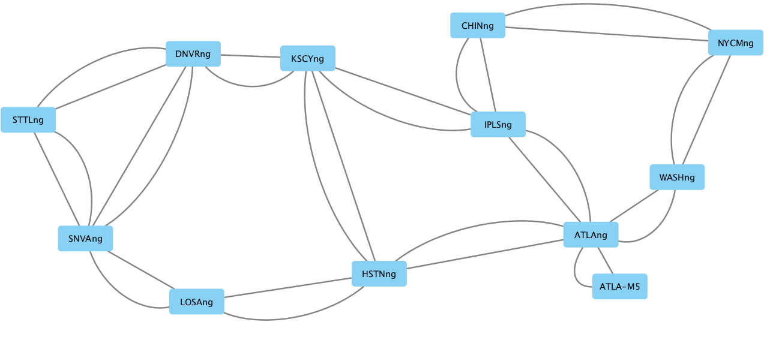
Result
They match?!

Slide 11
Why Topology Discovery?
Key Benefits
Gain insight about the network connectivity
Save bandwidth and budget
Reduce down time

Slide 12
Future Improvement
Use one command to discover
Improve parsing efficiency
Combine with Traffic Analytics
Thank you! Question?

