Slide 1



Slide 2

BALATON Setup a React-Native project from scratch
Workshop

Slide 3
AGENDA
Dev environment setup
Code Quality tools
Navigation
Storage Caching
State Management
Localization and Internationalization

Slide 4
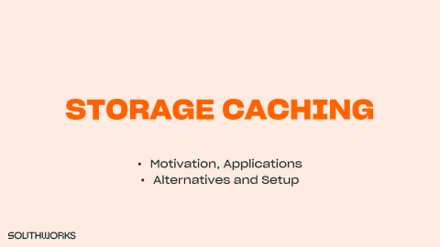

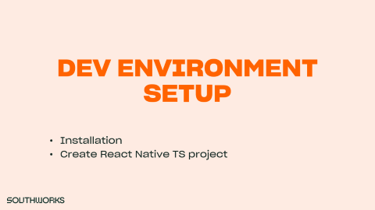
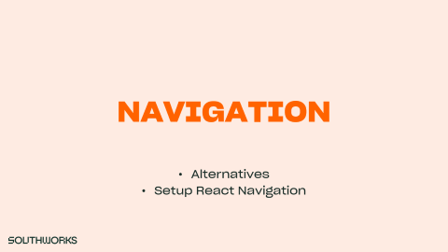
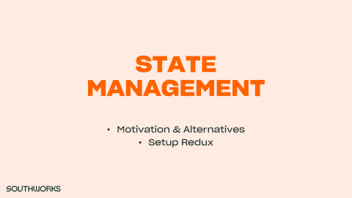
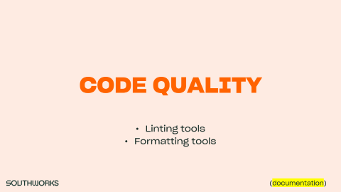
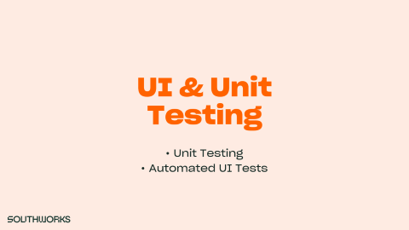
AGENDA

Slide 5
DEV ENVIRONMENT SETUP
Installation
Create React Native TS project

Slide 6






WHAT WE NEED
(more information)

Slide 7
WHAT WE NEED
NodeJS
Yarn
Java JDK 8
Device specific software
Android Studio
On Mac:
Xcode
Cocoapods
(more information)

Slide 8
CHECK SETUP
Create React Native TS app
Open Android Studio
Create and open emulator
Run app
[optional] Run on physical device
[optional] Run with XCode
(more information)

Slide 9
CODE QUALITY
Linting tools
Formatting tools
(documentation)

Slide 10


LINTING TOOLS
VS

Slide 11


FORMATTING TOOLS
VS

Slide 12

FORMATTING TOOLS
VS

Slide 13
NAVIGATION
Alternatives
Setup React Navigation

Slide 14


ALTERNATIVES

Slide 15
ALTERNATIVES
React Navigation
Intuitive with React Native
React Router
React Router Native → React Navigation’s equivalent
React Router DOM → Important for WEB
(more information)

Slide 16
SETUP REACT NAVIGATION
Considerations
App component = <AppContainer />
A Navigator is just a component
this.props.navigation.navigate()
Callback function for navigation
Receives routes and params
Define routes on a separate file!
(more information)

Slide 17
STATE MANAGEMENT
Motivation & Alternatives
Setup Redux

Slide 18
STATE MANAGEMENT
Motivation & Alternatives
Redux
Asynchronous Calls w/ Thunks

Slide 19

MOTIVATION
Extract State’s logic from components
Avoid prop drill down
Easy access to global state

Slide 20
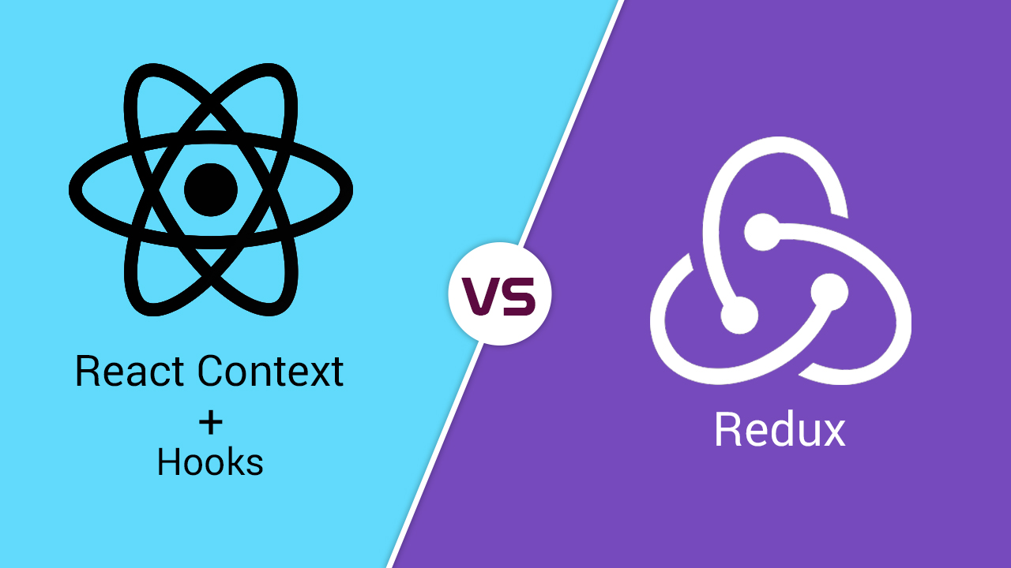
ALTERNATIVES

Slide 21
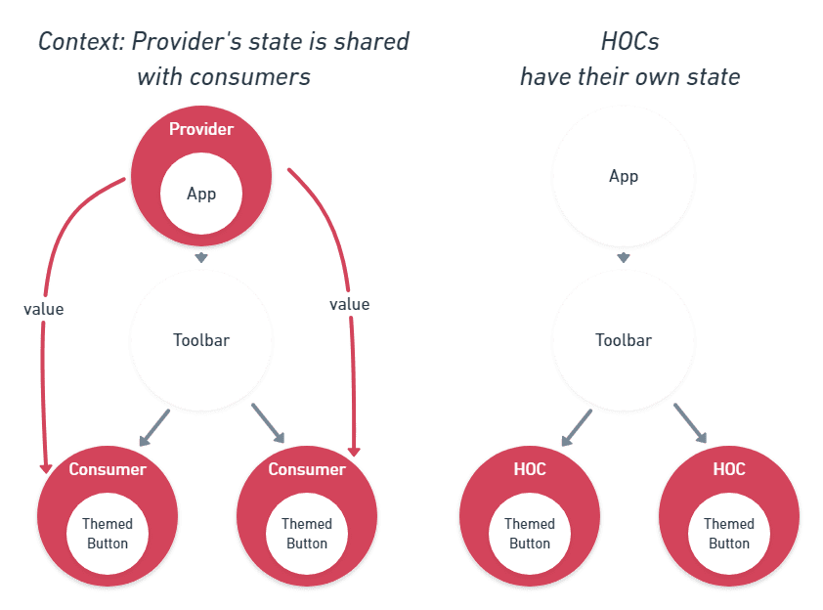
REACT CONTEXT

Slide 22
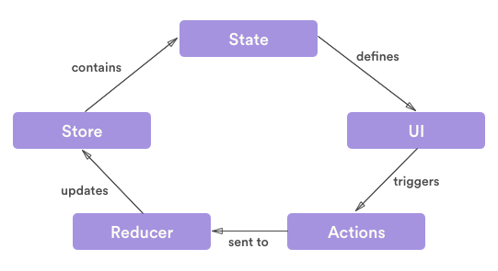
REDUX
(more information)

Slide 23


BONUS TRACK: ASYNC CALLS

Slide 24
STORAGE CACHING
Motivation, Applications
Alternatives and Setup

Slide 25
MOTIVATION & APPLICATIONS
Replace repetitive API Calls with Cache queries
Applications
Database
Locale configuration
User settings
Login tokens

Slide 26
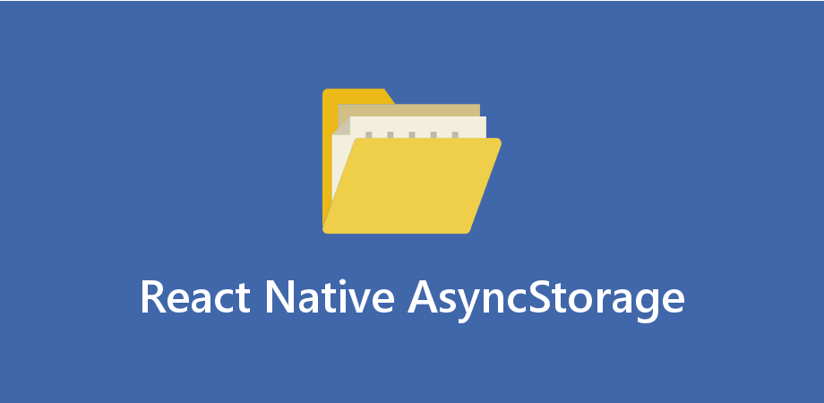

ALTERNATIVES
(more information)

Slide 27
i18n & L10n
Internationalization
Localization
Alternatives

Slide 28

INTERNATIONALIZATION

Slide 29

LOCALIZATION
Language
Date, time, calendar formatting
Region based custom UX
Different pricings
Access permits
Many more!

Slide 30
ALTERNATIVES
Internationalization
i18next
i18n-js
react-intl
Localization
React localize
React localization
(more information)

Slide 31
TEMPLATE SLIDE
Item 1
Item 2
Item 3
Subitem 1
Subitem 2
Subitem 3
(links)

Slide 32
UI & Unit Testing
Unit Testing
Automated UI Tests

Slide 33

Unit Testing
Notes:
Using jest and naming enzyme would be a good idea

Slide 34
Unit Testing
Mocking components and services
Structure of tests
Run tests
Enzyme utility
Shallow
Mount
Render
Notes:
Using jest and naming enzyme would be a good idea

Slide 35


Automated UI Testing
Notes:
Using jest and naming enzyme would be a good idea

Slide 36

Automated UI Testing
Write automated tests against multiple platforms using the same API
Write tests in plain English
Implement the steps
Assert using chai
Notes:
Using jest and naming enzyme would be a good idea

Slide 37

DEMO TIME!

Slide 38
QUESTIONS?

Slide 39
THANK YOU!

