Slide 1
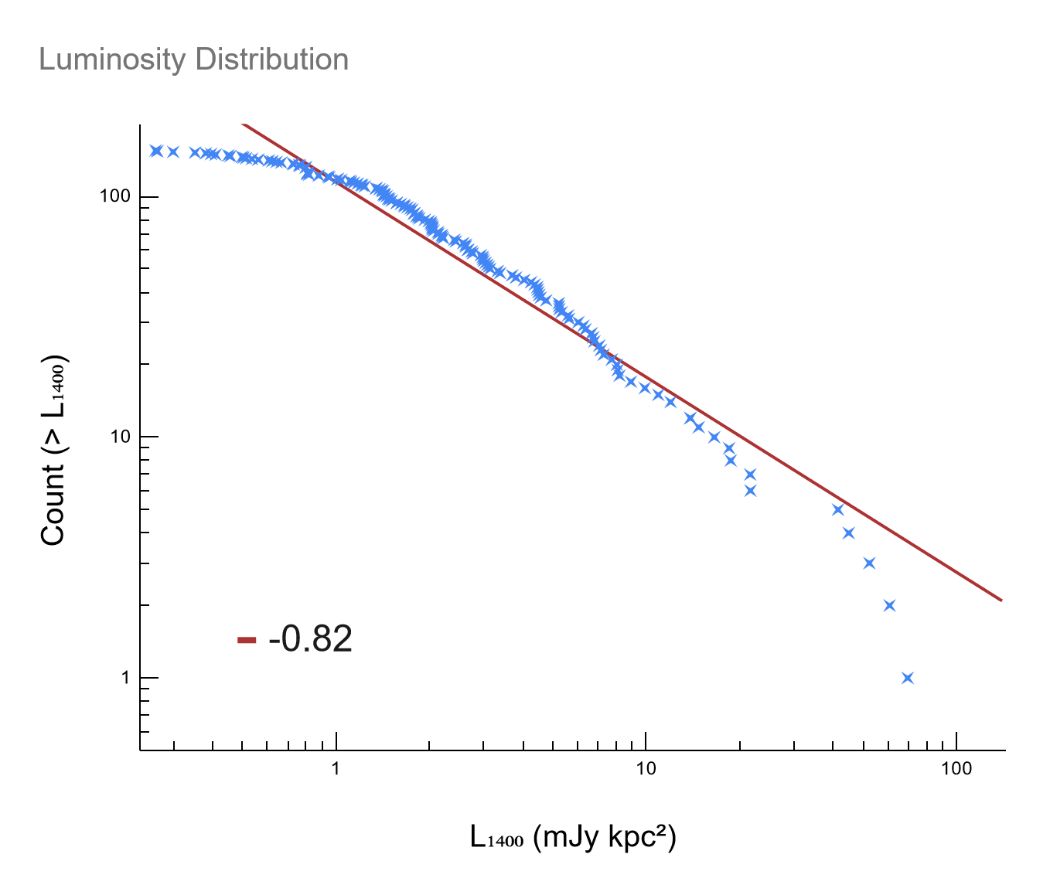
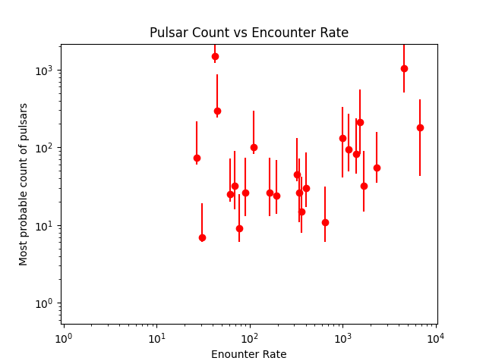
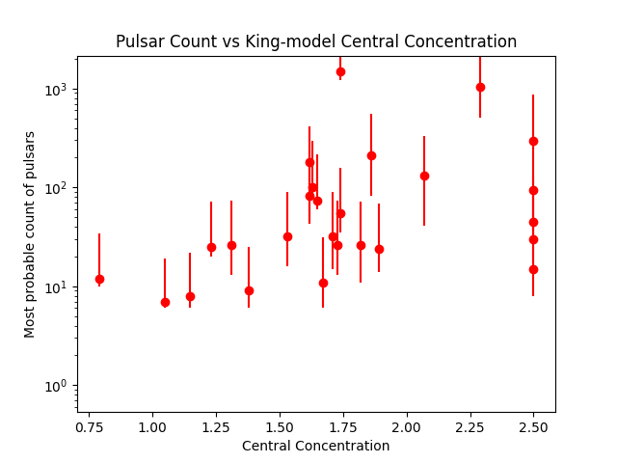
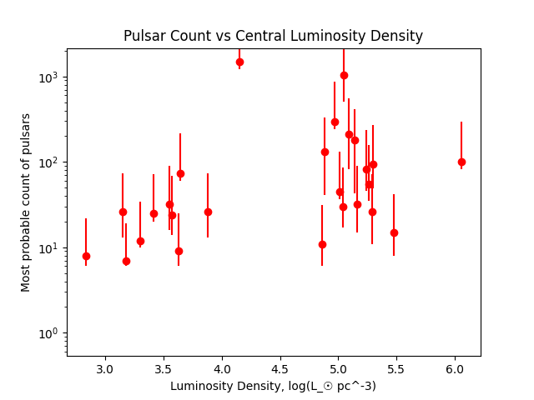
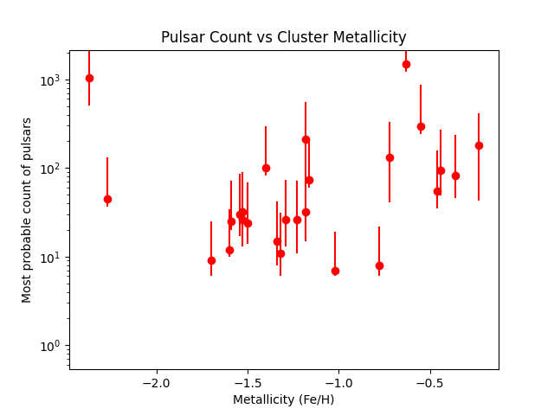
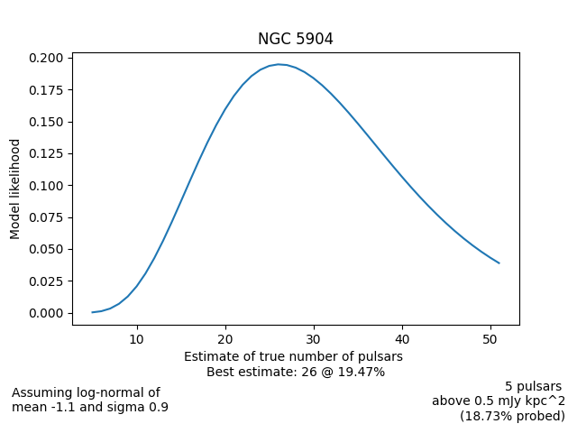
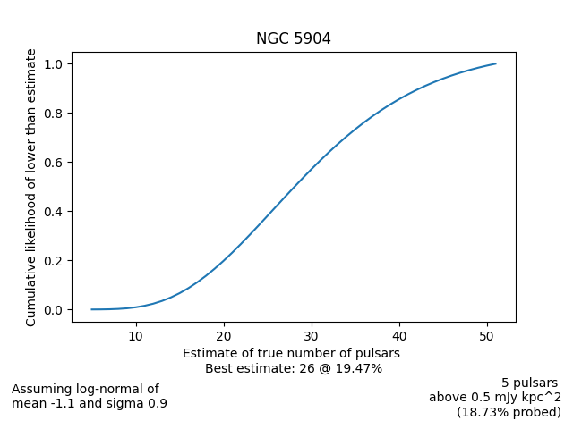
Luminosities of Globular Cluster Pulsars
Kriisa Halley, Duncan Lorimer
We have conducted an analysis of 152 known radio pulsar fluxes located within 27 globular clusters. We calculate pseudoluminosities of these pulsars (defined to be flux time distance squared) using the host cluster’s distance and show that the cumulative luminosity function of this total population follows a power law with index α = -0.82. By assuming that all pulsars brighter than the dimmest observed pulsar in any given cluster are detectable, and the luminosity distribution of pulsars in globular clusters follows the same log-normal distribution found in Galactic pulsars, we estimate the true number of pulsars in each cluster to within a 95% confidence interval, with a total count of ~4000.
Globular clusters (GCs) are dense groups of gravitationally-bound stars. They appear as stars to the naked eye, but are actually clusters of tens of thousands to millions of individual stars. The density of globular clusters results in a much higher rate of stellar interactions.
Pulsars are rapidly rotating neutron stars with strong magnetic fields. The rotating magnetic field creates two bright “beams” of radiation that sweep across the sky. When these beams happen to cross over Earth, we detect a “pulse”, much like a lighthouse appears to pulse as it sweeps across a given vantage point.
The high rate of stellar interactions in GCs results in a population of pulsars with much faster rotation rates than those in the galactic disc. The vast majority of pulsars included in this study have periods on the order of milliseconds, lending them the name Millisecond Pulsars (MSPs).
Histogram Here
Flow Diag Here
Bahramian, A., Heinke, C. O., Sivakoff, G. R., & Gladstone, J. C. (2013). Stellar Encounter Rate in Galactic Globular Clusters. The Astrophysical Journal, 766(2), 136.
Friere, P. C. (n.d.). Pulsars in Globular Clusters. https://www3.mpifr-bonn.mpg.de/staff/pfreire/GCpsr.html
Harris, W. E. (1996). A Catalog of Parameters for Globular Clusters in the Milky Way. The Astronomical Journal, 112, 1487
Manchester, R. N., Hobbs, G. B., Teoh, A., & Hobbs, M. (2005). The Australia Telescope National Facility Pulsar Catalogue. The Astronomical Journal, 129(4), 1993–2006. https://www.atnf.csiro.au/research/pulsar/psrcat/

