Slide 1
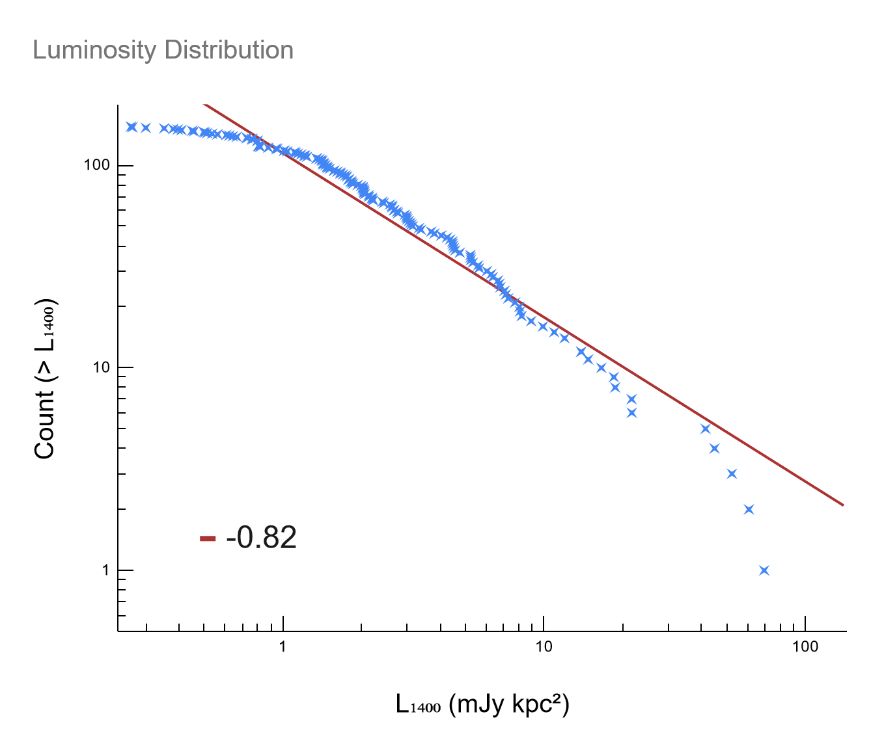
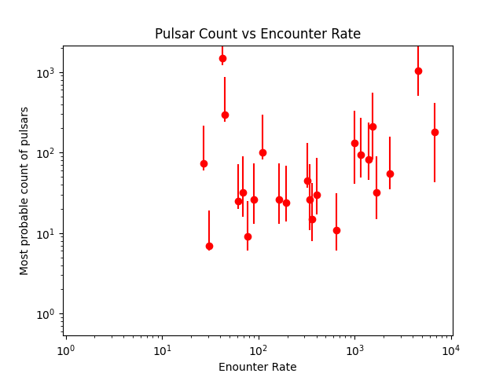
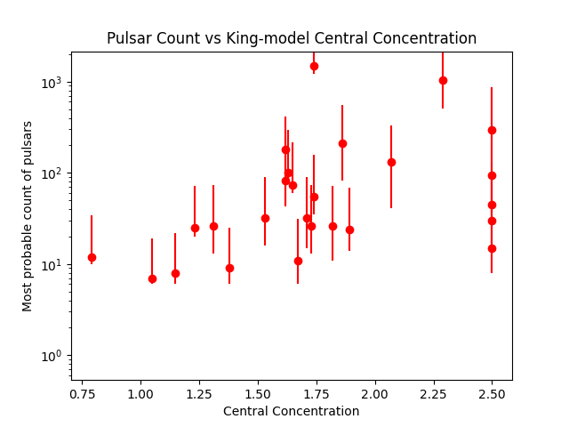
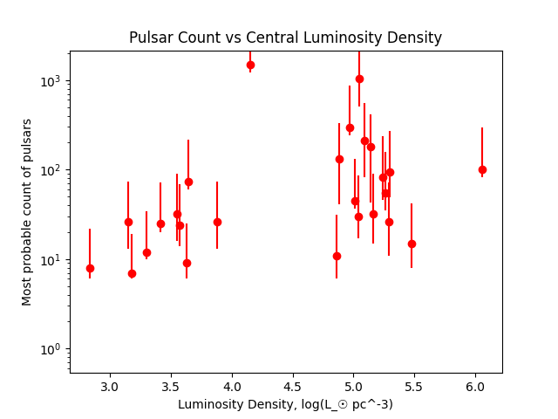
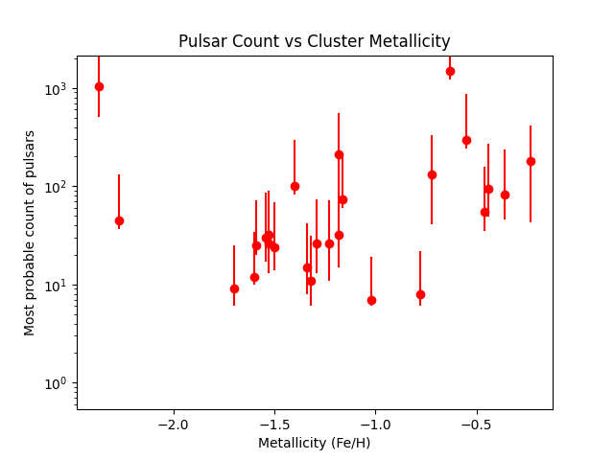
Luminosities of Globular Cluster Pulsars
We have conducted an analysis of 152 known radio pulsar fluxes located within 27 globular clusters. We calculate pseudoluminosities of these pulsars (defined to be flux time distance squared) using the host cluster’s distance and show that the cumulative luminosity function of this total population follows a power law with index α = -0.82. By assuming that all pulsars brighter than the dimmest observed pulsar in any given cluster are detectable, and the luminosity distribution of pulsars in globular clusters follows the same log-normal distribution found in Galactic pulsars, we estimate the true number of pulsars in each cluster to within a 95% confidence interval, with a total count of ~4000.

