Slide 1





TrioXpert: An Automated Incident Management Framework for Microservice System
Yongqian Sun¹, Yu Luo¹, Xidao Wen², Yuan Yuan³,
Xiaohui Nei⁴, Shenglin Zhang¹, Tong Liu⁵, Xi Luo⁵
¹Nankai University, ²BizSeer,
³National University of Defense Technology,
⁴Computer Network Information Center, Chinese Academy of Sciences, ⁵Lenovo
Notes:
单击此处添加文本

Slide 2
Outline
Background & Motivation
Framework Design
Evaluation

Slide 3




Microservices Systems
Microservice architectures have become the standard
for modern enterprise systems

Slide 4



Impact of Incidents
Incidents
Poor UX
Financial Loss

Slide 5
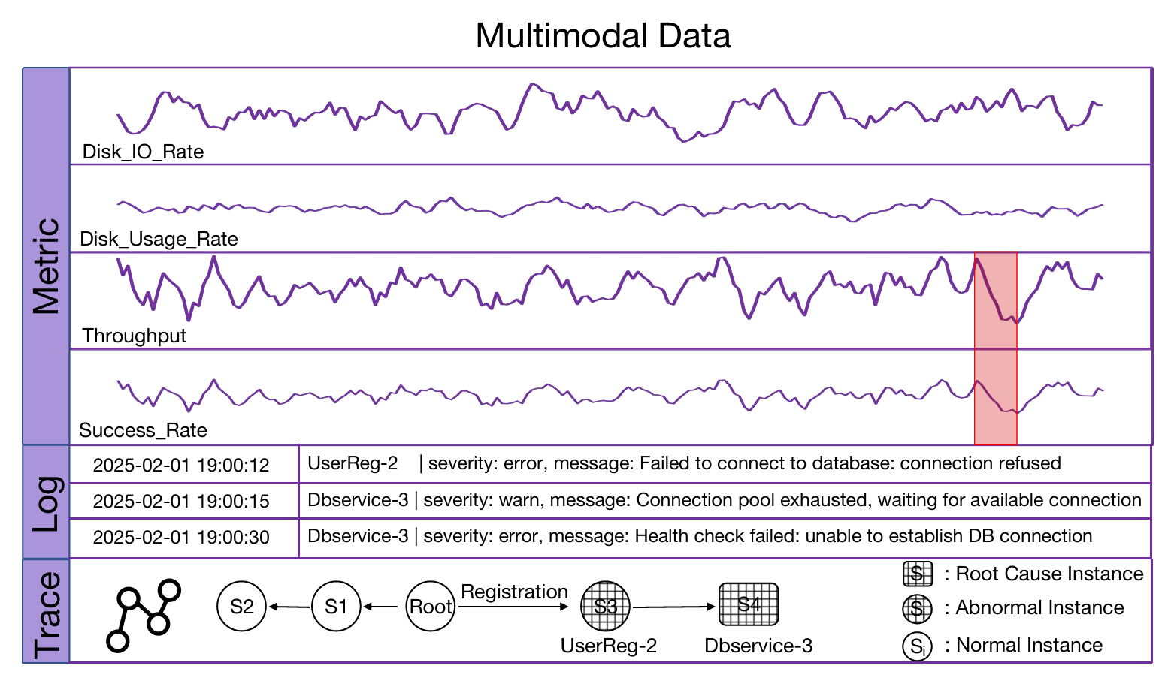
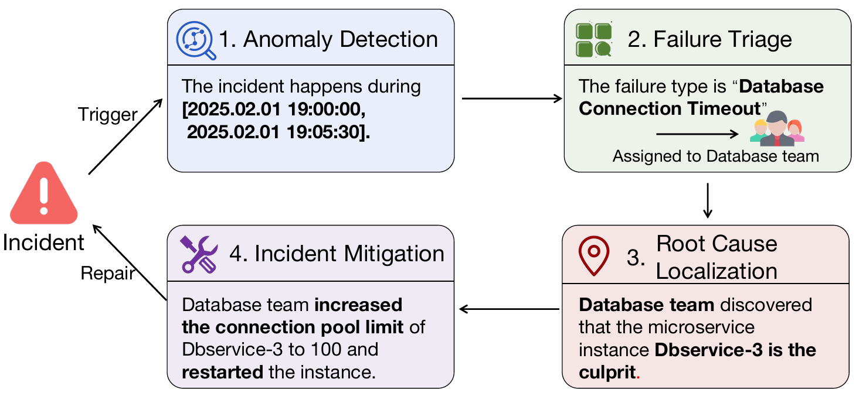
Typical Lifecycle of Incident Management
OCEs require automated management

Slide 6










Why We Need an End-to-End Framework?
Metrics
Model
Logs
Model
Traces
Model
Inconsistent or partial conclusions

Slide 7








Why We Need an End-to-End Framework?
Incident
Anomaly Detection
Failure Triage
Root Cause Localization
Mitigation
End-to-End Framework
Increased Deployment Costs & Integration Overhead

Slide 8
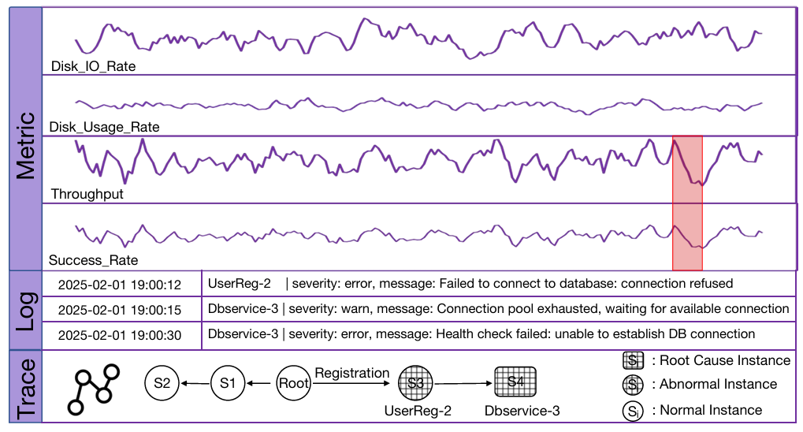




Can We Trust a Black-Box in Critical Operations?
"Good,
But Why?"
Model
Prediction
OCEs
Risk in Real-world Systems
No Explanation, No Trust

Slide 9
Challenges when integrating LLMs
Semantic impoverishment in multimodal fusion
Textual data overload in real-time incident management
LLM limitations in complex and trust critical incident management

Slide 10
Outline
Background & Motivation
Framework Design
Evaluation

Slide 11
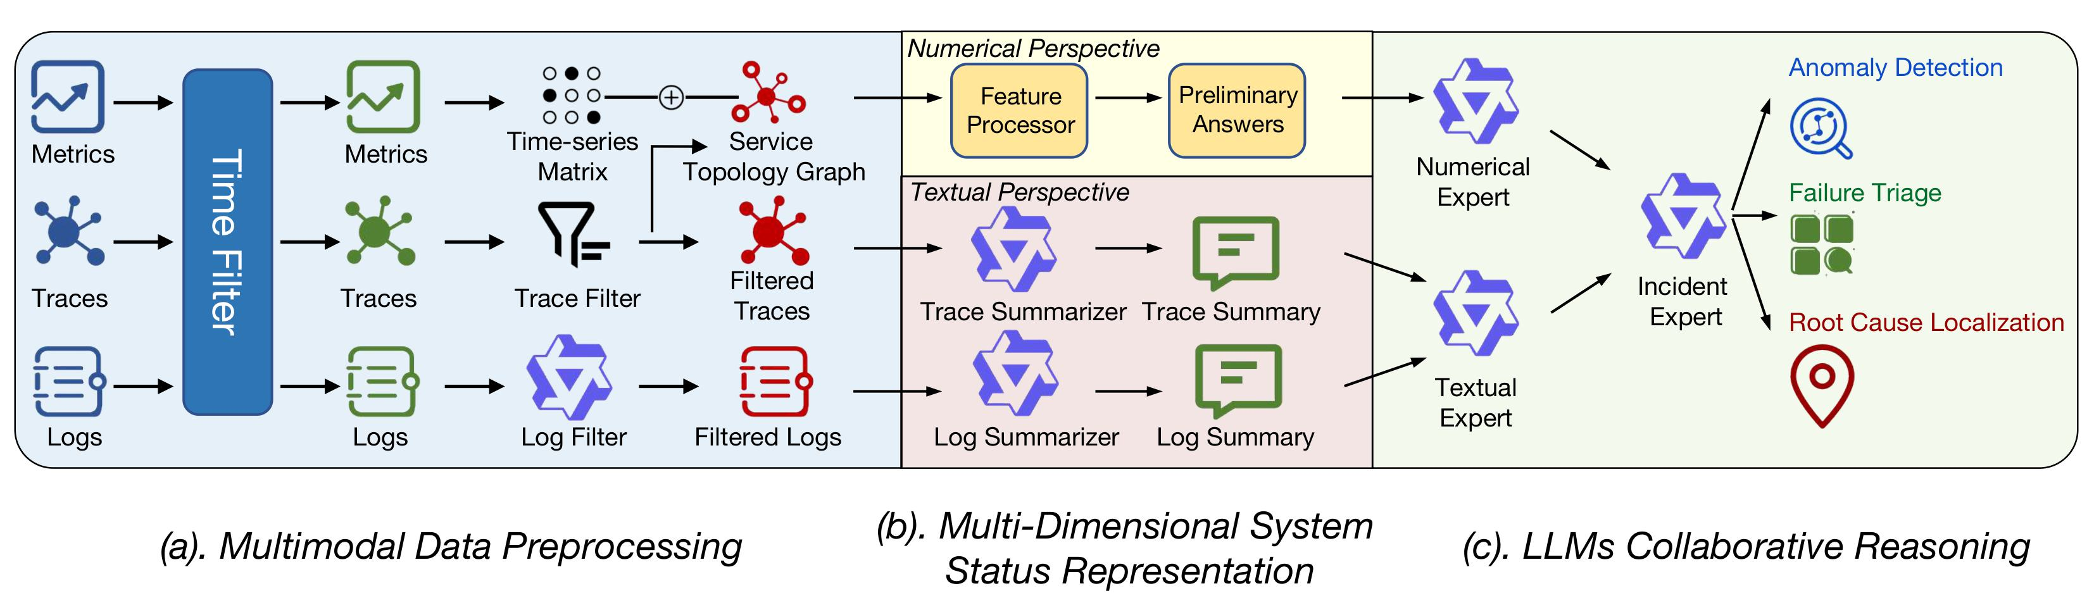
TrioXpert Overview
An End-to-End Incident Management Framework
for Microservice System

Slide 12
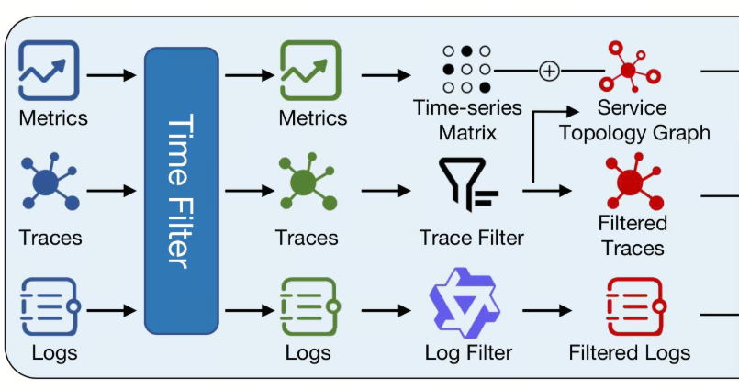
TrioXpert - Module #1
Module #1 Multimodal Data Preprocessing

Slide 13
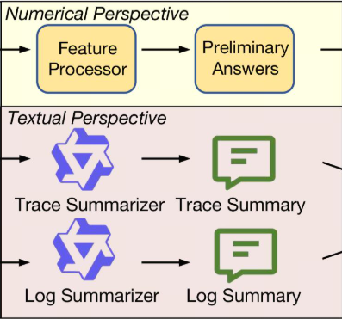
TrioXpert - Module #2
Module #2 Multi-Dimensional System Status Representation

Slide 14
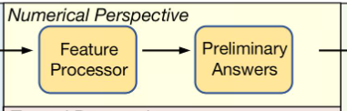
TrioXpert - Module #2
Module #2 Numerical Perspective

Slide 15
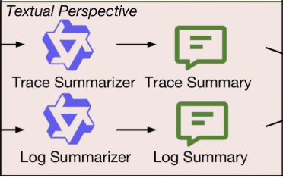
TrioXpert - Module #2
Module #2 Textual Perspective

Slide 16
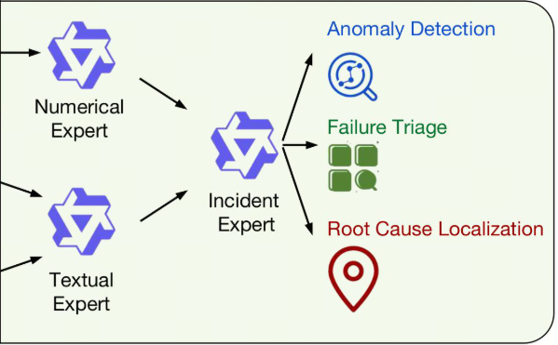
TrioXpert - Module #3
Module #3 LLMs Collaborative Reasoning

Slide 17
Outline
Background & Motivation
Framework Design
Evaluation

Slide 18
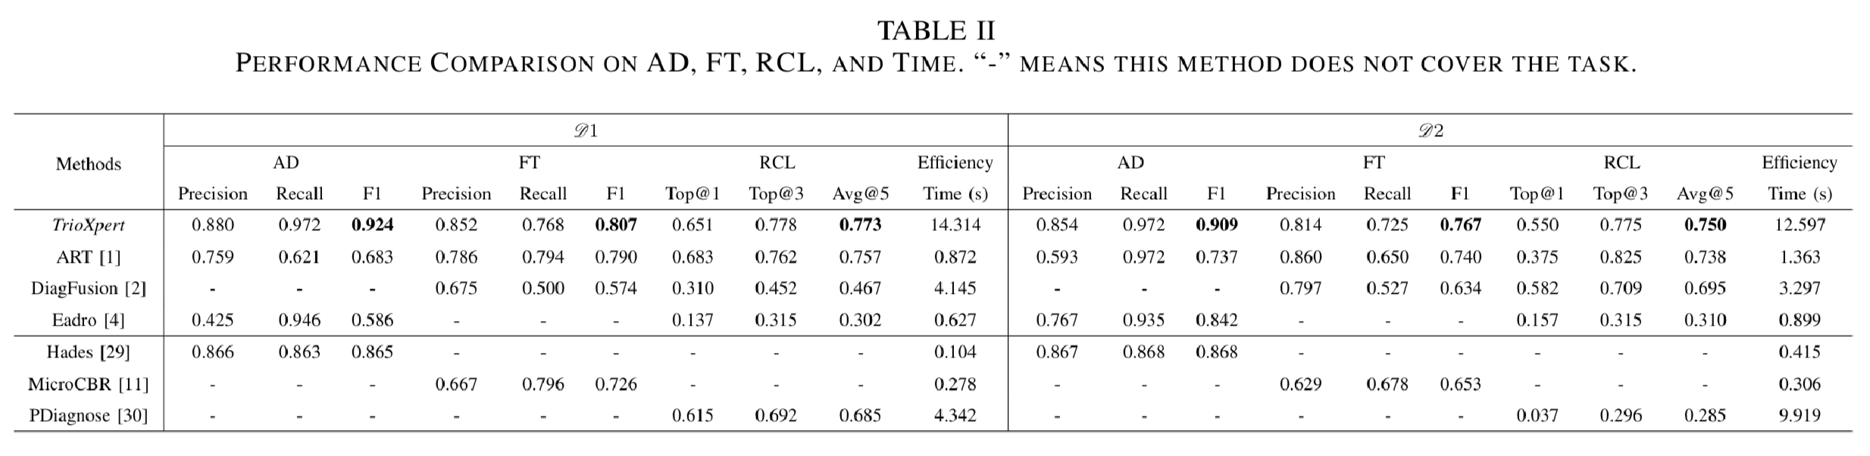
Evaluation: Performance

Slide 19
Evaluation: Ablation Study
A1 | Remove the textual pipelines
A2 | Remove the numerical pipeline
A3 | Replace the multi-expert reasoning with a single LLM
A4 | Disable conflict resolution and aggregation
A5 | Disable hallucination mitigation

Slide 20
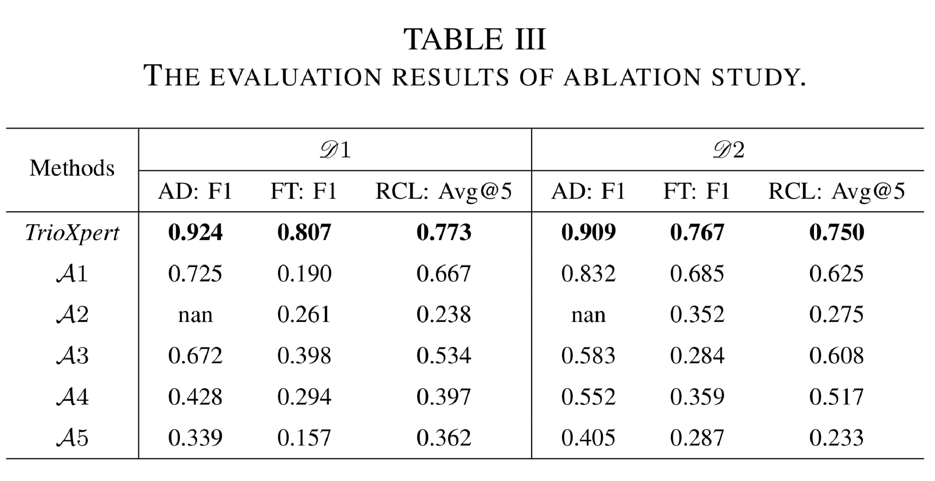
Evaluation: Ablation Study

Slide 21
Case Study: Real-World Incidents from Lenovo Production
Traditional Method | TrioXpert
3 OCEs | Automated
2.5 h | 26 s
5+ attempts | 2 attempts
Manual reasoning | Interpretable reasoning chain

Slide 22




Case Study: Real-World Incidents from Lenovo Production
Detected 100% disk usage
Disk Space Exhaustion!
Numerical Expert
User report 500 errors
Identified critical logs "No space left on device"
Incident Expert
Textual Expert
Lenovo OCEs Validation: Root cause was transparent and traceable

Slide 23
Thank you!

