Slide 1
Developing a Medicare Data Analysis System
CS8647
{team names}

Slide 2
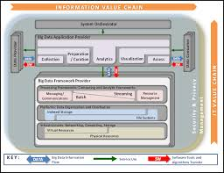
Basic Aims
National Institute of Standards and Technology (NIST) Big Data Reference Architecture
Develop a use case on public data set to test/validate NIST Reference Architecture
Chose Medicare Part B Data Analysis
Public data sets
Considerable scope for creative analysis
Sufficient data size to explore ‘big data’ technologies and cloud-based distributed systems

Slide 3
Medicare Data Sets
Raw data on medicare providers and procedures performed
Locations, costs (median, std), number and type of procedures
Spreadsheet (csv) format for raw data
Size
Rows ???
MBs ???

Slide 4
Analysis of Medicare Data
To do – list a few you will demo? Make them easy to explain (maybe example query?)

Slide 5

Collection/Preparation
Visualization/Access/Analytics
Medicare Summary Data
(.xls/csv)
Annual Data Ingest
Cleaning
Web
Browser
Interactive
Processing Layer
Batch
Data Consumers
Web
Container
Web
Container
External Reference data sets, eg zip codes, population, etc
Cassandra/Solr Client
Spark Client
Cassandra
Solr
S3
Data Providers
Data Layer
Infrastructure: AWS

